Slide 1
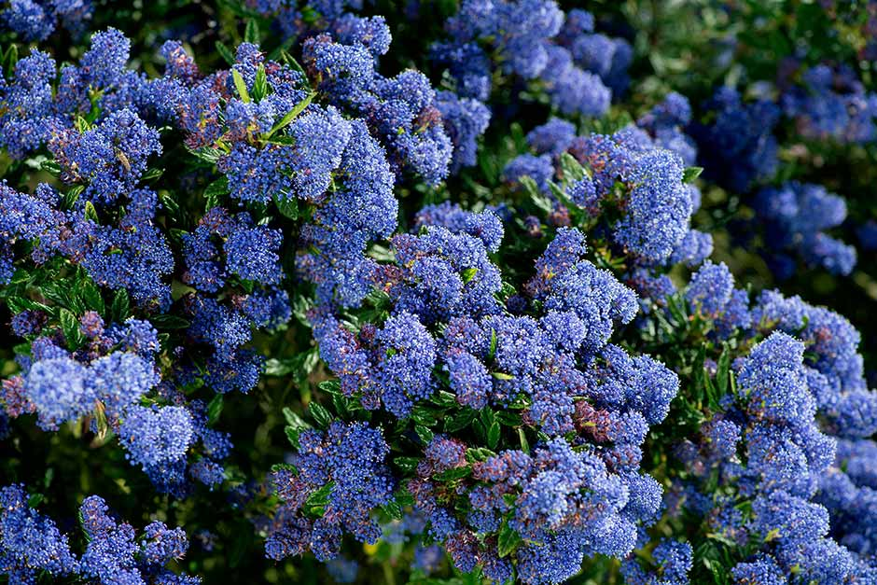
GARDENING WITH NATIVE PLANTS
Notes:
Created: 8/24/2020
Created by: Loren Fefer
Audience: general public – home gardeners
Publicity: Come learn about how to incorporate native California plants into your garden and the many advantages of doing so.
Update History: for each update to the presentation include date, name of updater, explanation of update
(were additional slides added, were web links updated, etc.)
1

Slide 2
Who Are Master Gardeners?
Master Gardeners of Placer County
Extend research-based, sustainable gardening and composting information
Present accurate, impartial information to home gardeners
Encourage public to make informed gardening decisions
2

Slide 3
Who Are Master Gardeners?
Where to find us…
Online, in the Media, and Special Publications
Hotline: Call (530) 889-7388 or submit your questions online
Website: pcmg.ucanr.org
Facebook, Twitter, Instagram
Gold Country Media monthly column
Curious Gardener quarterly newsletter on our website
Gardening Guide and Calendar
3

Slide 4
Who Are Master Gardeners?
Where to find us…
Workshops, Fairs and Festivals and Special Events
Speakers by Request
Workshops (various venues, check website)
Farmers’ Markets (seasonal: Auburn, Roseville)
Fairs and Festivals Booths (varies)
Garden Faire (April)
Mother’s Day Garden Tour (May)
4

Slide 5
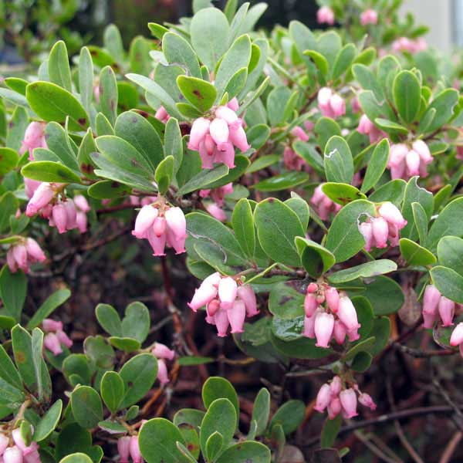
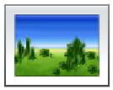
AGENDA
What are “native” plants
Why they are important
What you can do as home gardeners
5

Slide 6
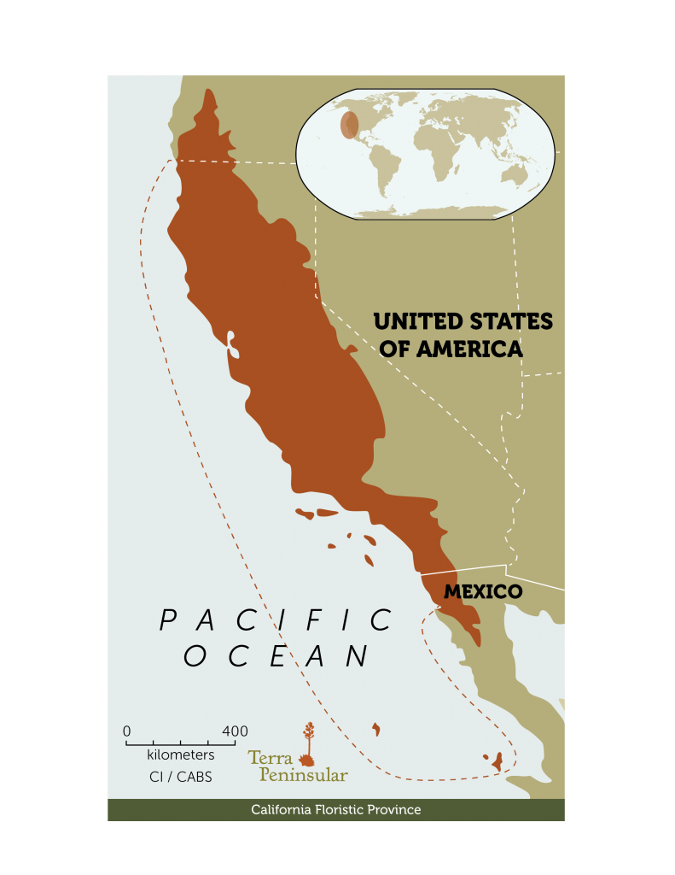
What are native plants?
Here before European exploration (1500s)
Part of the local foodweb
6

Slide 7
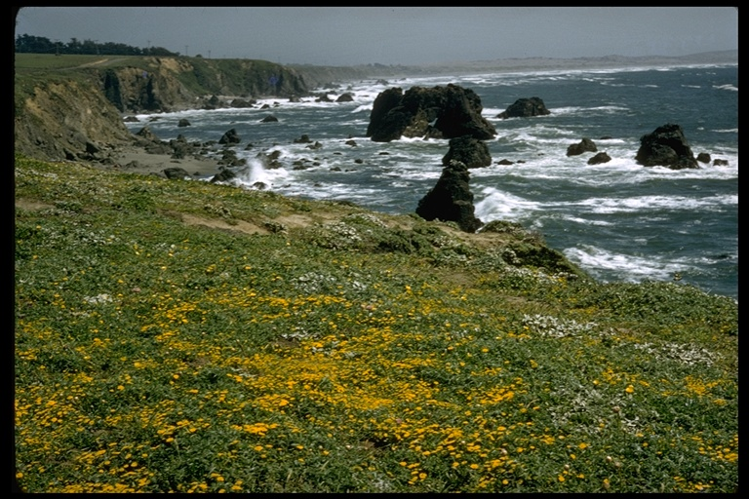
COASTAL SCRUB
Charles Webber © California Academy of Sciences
7

Slide 8
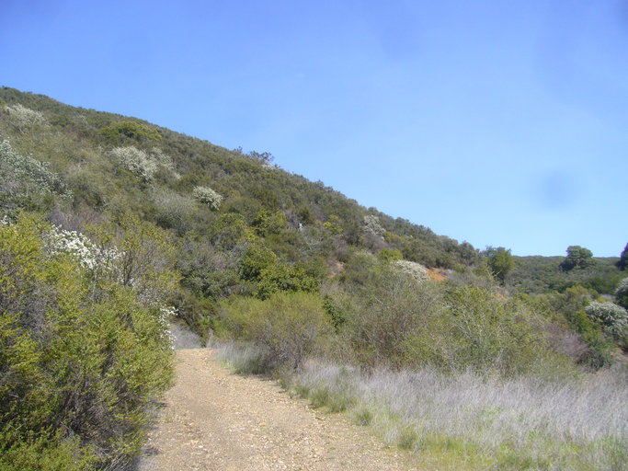
CHAPARRAL
© 2012 Zoya Akulova
8

Slide 9
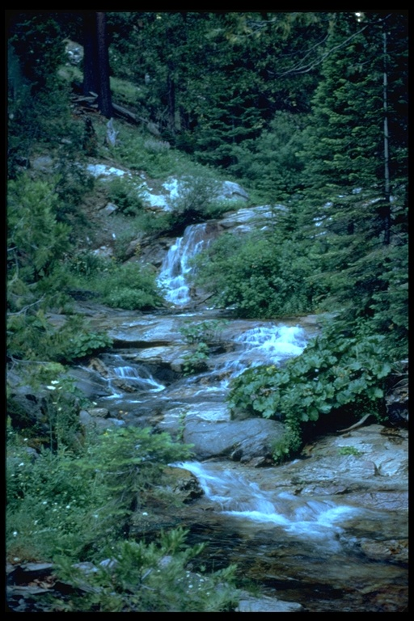
RIPARIAN
Mona Burell © California Academy of Sciences
9

Slide 10
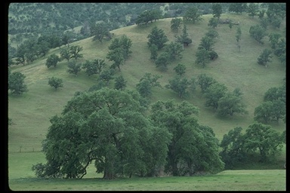
OAK WOODLAND
Ann Ordano © 2000 California Academy of Sciences
10

Slide 11
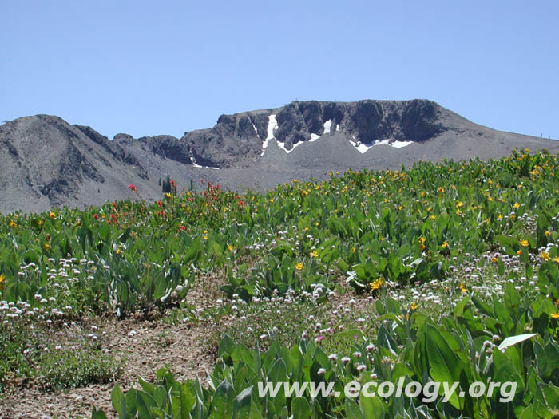
ALPINE
© Joseph Dougherty, M.D./ecology.org
11

Slide 12
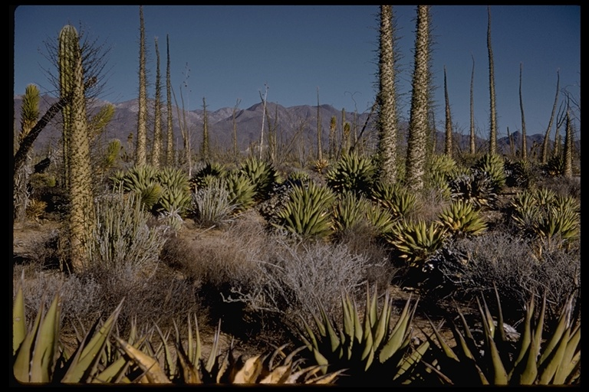
DESERT SCRUB
Steven Kaune © California Academy of Sciences
12

Slide 13
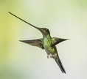
BENEFITS OF NATIVES
Save water
Reduce maintenance
Use less pesticide and fertilizer
Attract wildlife
Support local ecology
Gerald and Buff Corsi © California Academy of Sciences
13

Slide 14
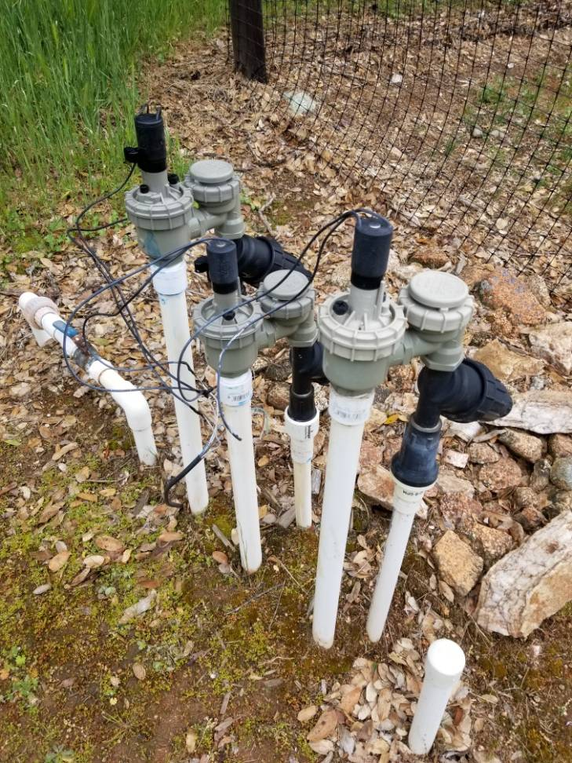
WATER CONSERVATION
Natives have evolved in our Mediterranean climate
Many need little supplemental irrigation once established
14

Slide 15
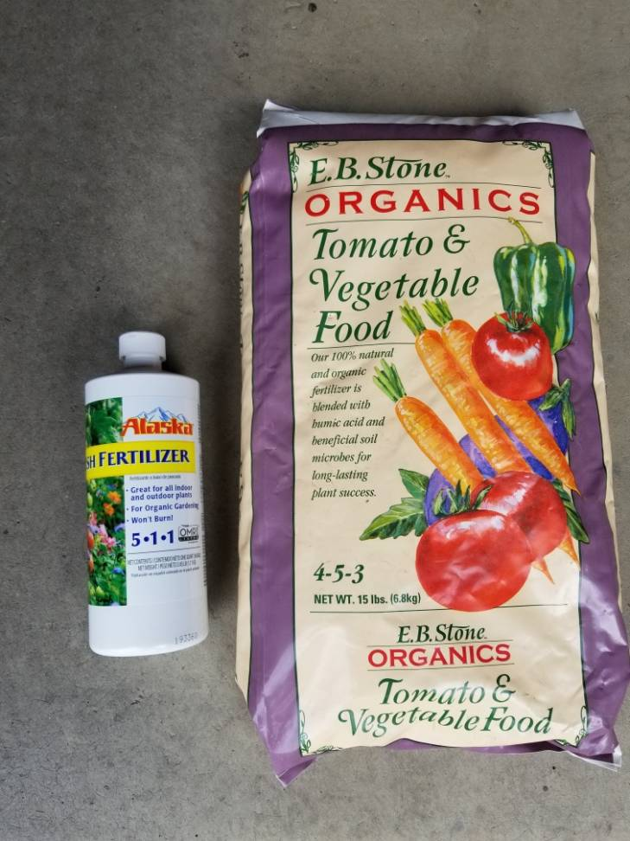
LESS MAINTENANCE
fertilizer
pesticides
pruning
irrigation
15

Slide 16
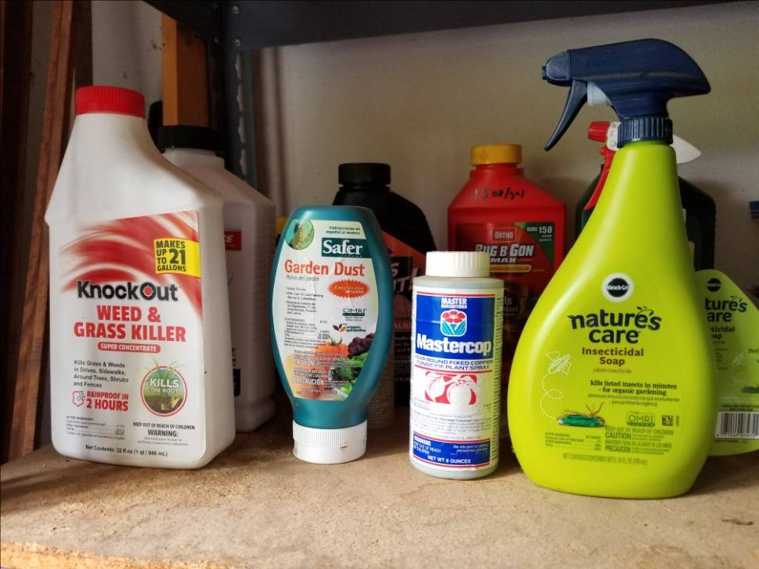
REDUCE PESTICIDE USE
Native plants have developed defenses to native pests
Avoid killing beneficials
Keep toxins out of watershed
16

Slide 17
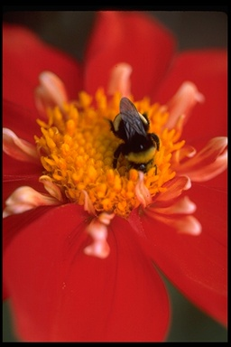
ATTRACT WILDLIFE
Native wildlife evolved with and may prefer native plants
Native plants can bring pollinators into your garden
Jo-Ann Ordano © California Academy of Sciences
17

Slide 18
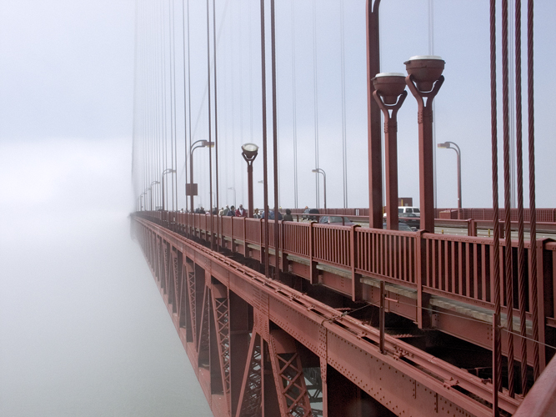
SUPPORT LOCAL ECOLOGY
Your garden natives can be a bridge to nearby remaining wildlands
©2006 George Rembert
18

Slide 19
GARDEN DESIGN PRINCIPLES
19

Slide 20
Consider bloom cycles for year-round nectar, pollen, fruit, seeds and cover/nesting sites
JAN/FEB - manzanita, willow
FEB/MARCH - ceanothus
APR/MAY - coffeeberry, hollyleaf cherry
MAY/JUNE - toyon, elderberry
OCT/DEC - coyote bush
20

Slide 21
Match plants to soil type and sun/shade exposure – “right plant, right place”
Group plants by water requirements – “hydrozoning”
Layer the garden – trees, shrubs, herbaceous plants, grasses
Consider size of mature plant to avoid crowding / need for constant pruning
21

Slide 22
GARDEN INSTALLATION PRINCIPLES
22

Slide 23
Best time to plant – FALL (when rains return)
Prefer 1 gallon plants (within 2-3 yrs are usually bigger than 5 gallon plants)
Avoid rootbound plants
Consider washing roots of media (plant in native soil without amendments)
23

Slide 24
PLANTING
Make hole 2X wide - ½ again as deep
Fill hole with water
Rough up sides/bottom to promote root penetration
Keep crown about 1 inch above grade
Gently tamp soil and water in to settle to avoid compaction
24

Slide 25
MULCHING
Benefits include:
moderating soil temperature
preventing formation of soil crust
reducing dust
curbing erosion
suppressing weeds
25

Slide 26
MULCHING
chaparral, woodland and forest plants prefer organic mulch - wood chips, bark, leaves
seashore and desert plants prefer inorganic mulch - rocks, gravel
(consider leaving a few bare spots for native bee nesting)
26

Slide 27
MAINTENANCE
Main issue is irrigation (#1 reason native plants fail)
Little pruning needed if properly placed – “the 3D’s”
Fertilizer usually unnecessary – prefer mulching, occasional compost
Leave leaves, some deadwood/snags for nesting
27

Slide 28
IRRIGATION OF NEW PLANTS
First 3 months - keep rootball moist
3 to 12 months – deep watering every 2-3 weeks if needed (check soil manually)
After 12 months – deep watering once a month to none
28

Slide 29
IRRIGATION OF ESTABLISHED PLANTS
Realize that most can survive on natural rainfall alone
Expect summer dormancy
Be careful providing supplemental summer irrigation – warm/wet conditions promote fungal disease
Use drip irrigation – move emitters away from plant as it grows and extends its roots
29

Slide 30
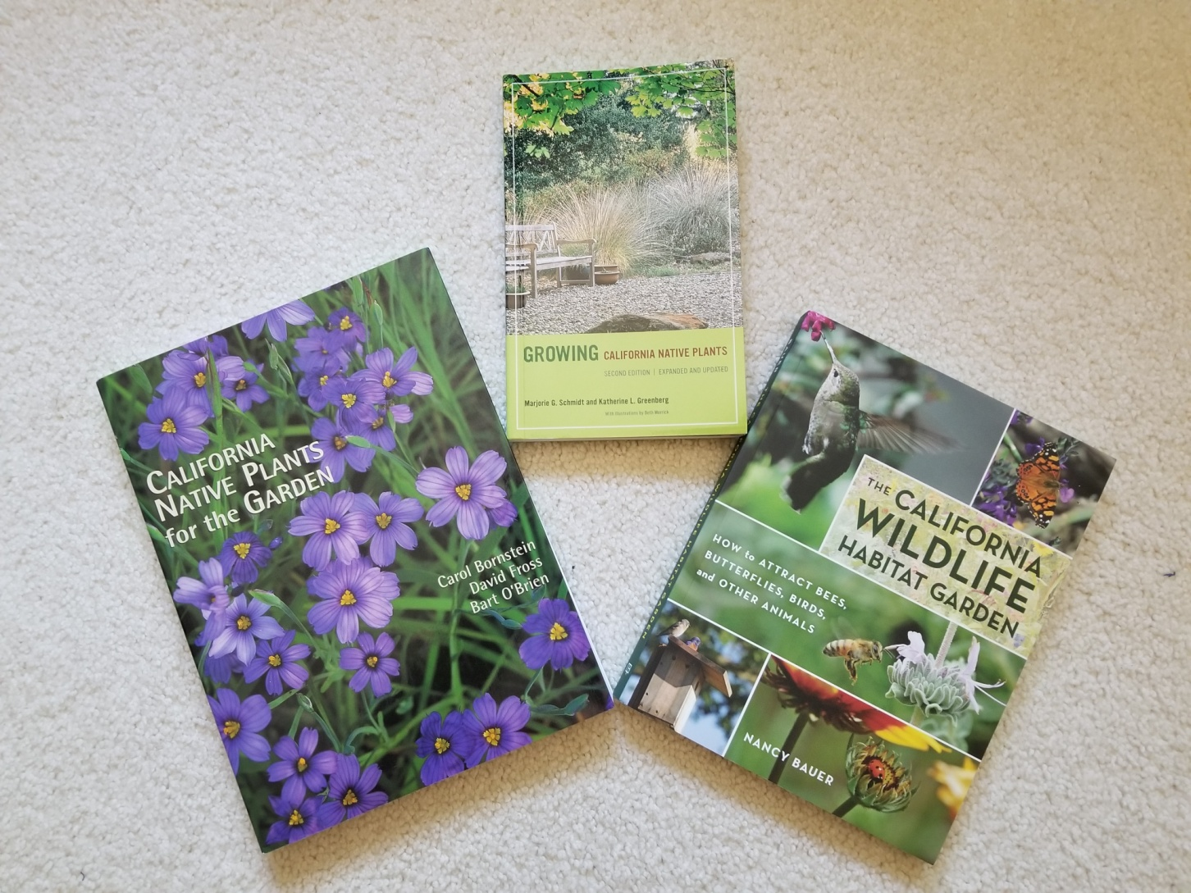
A FEW BOOKS
30

Slide 31
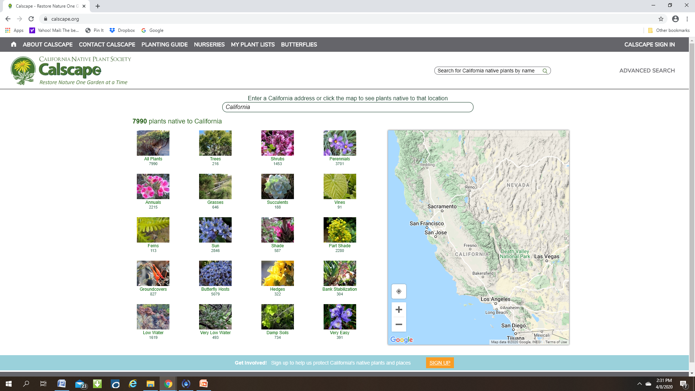
CALSCAPE Website
31

Slide 32
Thank You!
Any Questions?
Master Gardener Hotline: (530) 889-7388
Rot Line: (530) 889-7399
Master Gardener Website: pcmg.ucanr.org
Evaluations, please!
32

