Slide 1
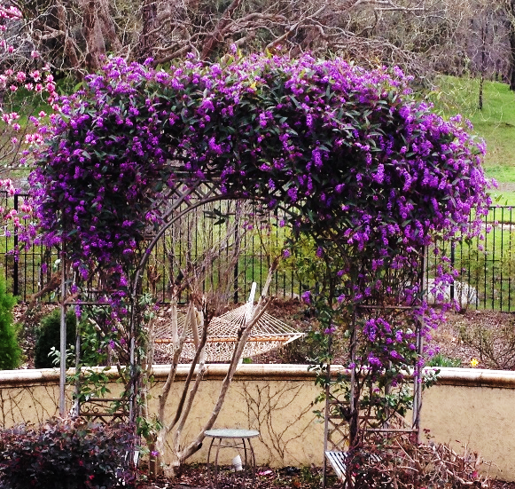
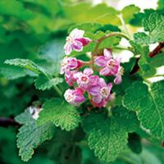
UC Davis Arboretum All Stars
Notes:
Created: April 2022 Created by: Ann Beinhorn
Audience: Local Garden Club (60+ members)
Publicity: UCD webpage:: About the Arboretum All-Stars Program is a joint project of the UC Davis Arboretum and the California Center for Urban Horticulture (CCUH) in collaboration with other partners throughout the state. Together they are working to help you, the home gardener, make eco-friendly plant choices that will enhance the beauty and sustainability of your landscape.
Update History: Presented in August, 2022 for Placer County Master Gardeners’ Public Workshops.

Slide 2
Who Are Master Gardeners?
Master Gardeners of Placer County
Extend research-based, sustainable gardening and composting information
Present accurate, impartial information to home gardeners
Encourage public to make informed gardening decisions

Slide 3
Who Are Master Gardeners?
Where to find us…
Online, in the Media, and Special Publications
Hotline: Call (530) 889-7388 or submit your questions online
Website: pcmg.ucanr.org
Facebook, Twitter, Instagram
Gold Country Media monthly column
Curious Gardener quarterly newsletter on our website
Calendar and Gardening Guide
Notes:
**See articles on individual All Star plants in the Curious Gardener.

Slide 4
Who Are Master Gardeners?
Where to find us…
Workshops, Fairs and Festivals and Special Events
Speakers by Request
Workshops (various venues, check website)
Farmers’ Markets (seasonal: Auburn, Roseville, Lincoln)
Fairs and Festivals Booths (varies)
Garden Faire (April)
Mother’s Day Garden Tour (May)

Slide 5
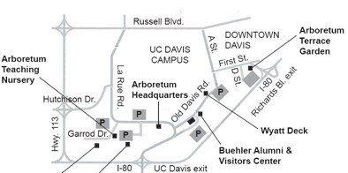
The UC Davis Arboretum

Slide 6
The UC Davis Arboretum
Collections:
AUST Australian EASI E. Asian
ACAC Acacia Grove MEDI Mediterranean
CONI Conifer SWUS Southwest USA
DESE Desert GAZE White Flower Garden (Gazebo)
NURS Arboretum Teaching Nursery
TERR Arboretum Terrace Garden
MWB Mary Wattis Brown Garden (Calif. Native Plants)
STOR Ruth Risdon Storer Garden - a Valley-Wise Garden

Slide 7
Mediterranean Climate
Dry summers; droughts
Mild, wet winters
Occasional flooding
Found in countries around the Mediterranean Sea, California, Australia, South Africa, and Chile
University of Calif. Natural Reserve System
https://ucnrs.org/drought-fire-and-flood-in-mediterranean-climates/
Notes:
We have a common climate with countries from which we import plants. Sometimes a plant native to another country is treated differently here (i.e., evergreen there, as a deciduous here because of our winters).

Slide 8
References
Online:
UC Davis Arboretum All Stars (introduction)
https://arboretum.ucdavis.edu/arboretum-all-stars
UC Davis Arboretum All Star Brochure
https://arboretum.ucdavis.edu/sites/g/files/dgvnsk1546/files/inline-files/AllStarsBook_201415_final-reduced.pdf
UC DavisArboretum All-Star Database
https://arboretum.ucdavis.edu/allstars_browse.aspx?id=2

Slide 9
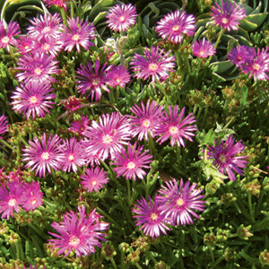
What Makes an All Star?
Must have the following features:
Tested at the UC Davis Arboretum and
demonstration gardens around
California
Attractive for most of the year
Thrives in California’s Mediterranean climate
Includes at least one of these features:
drought tolerant, easy to grow, not much water demand, few pest problems, attractive to wildlife
Notes:
Testing of All Stars has been done in associated locations throughout the state. UC started with California natives. There are many other drought tolerant plants that grow well here too. Among sources, check California Native Plants for the Garden by C. Bornstein, et al.
Another feature of these plants is that they are “power line friendly” (less than 25 ft. mature height).

Slide 10
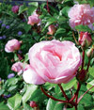
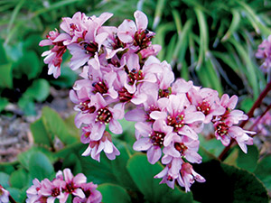
Arboretum All-Star Brochure http://arboretum.ucdavis.edu/allstars_browse.aspx?id=2
Rosa ‘Pink Grüss an Aachen’ -
grüss an Aachen floribunda rose Showy, fragrant pink flowers bloom in clusters in spring and summer; naturally graceful form and practically thornless stems; flowers last longer than some in afternoon shade; leaves remain evergreen in mild winters and turn a beautiful burgundy color. Semi-deciduous.
Bergenia crassifolia ‘pigsqueak’
Dense clusters of pink flowers bloom in winter and early spring; classic California garden plant for dry or moist shady border; broad, shiny leaves provide textural contrast to small-leaved plants.
Presented by plant category
Notes:
Download or order the brochure to have all plants as a handy reference.
Categories are perennial, groundcover, vine,, shrub, tree. Entries are alphabetical by botanical name.
Largest entries are perennials.

Slide 11
The UC Davis All Star Database https://arboretum.ucdavis.edu/plant-database Presented by botanical names, alphabetically
For all 100 All-Stars, there’s a description covering features in the landscape, cultural care, and evergreen/deciduous.
Categories:
Perennial,
Groundcover,
Vine,
Shrub,
Tree
(No annuals)
Notes:
See the database to look up individual plants alphabetically

Slide 12
The UC Davis All Star Database https://arboretum.ucdavis.edu/plant-databa
Categories: Perennial, Groundcover, Vine, Shrub, Tree (No annuals)
See the left column: …… Location in the Arboretum and….
Size …………………………… sm, med, lge.
Bloom Season
Exposure: …………………..5 variations of sun exposure
Pruning Needs
Water Needs/Instructions: Depth & frequency, etc.
**Wildlife Value
Notes:
See the database to look up individual plants alphabetically. There was extensive research on the plants, starting with regular water until well-established.
Wildlife value was a later part of the research. Arboretum locations Australian Collection EASI East Asian Collection ACAC Acacia Grove MWB Mary Wattis Brown Garden (California Native Plants) TERR Arboretum Terrace Garden MEDI Mediterranean Collection NURS Arboretum Teaching Nursery STOR Ruth Risdon Storer Garden - a Valley-Wise Garden CONI Conifer Collection SWUS Southwest USA Collection DESE Desert Collection GAZE White Flower Garden (Gazebo)

Slide 13
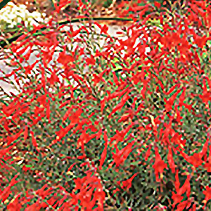
Using the Database https://arboretum.ucdavis.edu/arboretum-all-stars
Common Name
California fuchsia
Latin Name
Epilobium canum
Description
California native plant; easy to grow and tolerates heat and drought; different varieties can have narrow or broad leaves that range from silver to bright green.
Notes:
The species name was changed from Zauschneria Californica. Bloom coincides with migration of hummingbirds (summer-fall). Carpenter bees & honeybees have to pierce the bloom to get to the nectar. Invasive species spread by rhizomes.

Slide 14
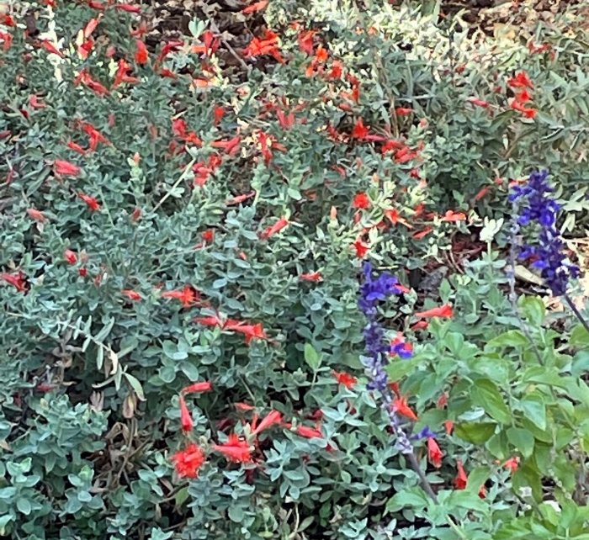
Using the Database
Varieties of California fuchsia
Notes:
Above: perennial
Native to western US- Mexico. The varieties range from small (<1 ft) to large (2 ft.). Larger ones tend to be leggy, but tolerate sun to part shad. Leaves can be fuzzy and light green to smooth & dark green.
Some of the All Star entries do not name a variety, such as this one and Lagerstroemia.

Slide 15
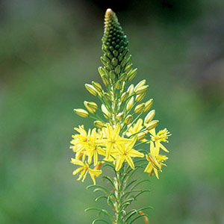
Using the Database: perennials
cape balsam
Bulbine frutescens
Small, evergreen perennial is a wonderful addition to dry perennial borders with its long-blooming spikes of delicate, star-shaped yellow flowers; fleshy, bright green foliage adds a sculptural element. Tolerates drought and poor soils.
Notes:
Zbergenia requires a sheltered place in hotter areas. Does well under trees & can get to 1 ½’. Bold leaves make for a great border.
Cape balsam is a vigorous grower, and a winter-bloomer. Divide frequently, as it can spread. Does well in containers.

Slide 16
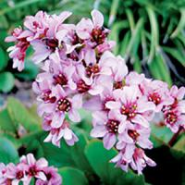
Using the Database: perennials
C
pigsqueak
Bergenia crassifolia
Dense clusters of pink flowers bloom in winter and early spring; classic California garden plant for dry or moist shady border; broad, shiny leaves provide textural contrast to small-leaved plants; attracts beneficial insects.
Notes:
Bergenia requires a sheltered place in hotter areas. Does well under trees & can get to 1 ½’. Bold leaves make for a great border.

Slide 17
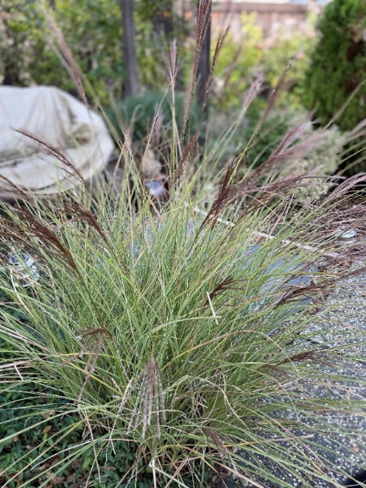
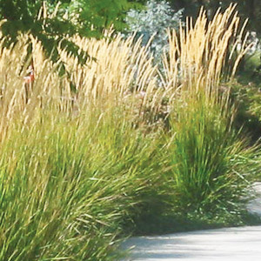
Using the Database: perennials
C
Japanese silvergrass
Japanese silvergrass Miscanthus sinensis
Leaves may turn red, orange, and yellow
in the fall; many varieties are available,
with different leaf patterns and a
range of sizes; thrives in clay soil.
Karl Foerster feather reed grass
Calamagrostostis x Acutiflora
‘Karl Foerster’
Attractive, upright dark green foliage; fluffy blooms in spring turn into attractive buff spikes that last all summer and fall; a vertical plant that performs well in narrow spaces.
Notes:
Miscanthus siinensis is a warm season grass, and Calamagrostis is a cool season grass. This Miscanthus has variegated leaves and blooms with amber flowers.
This Calamagrostis blooms are much taller than the 3’ grassy, clumpy plant.

Slide 18
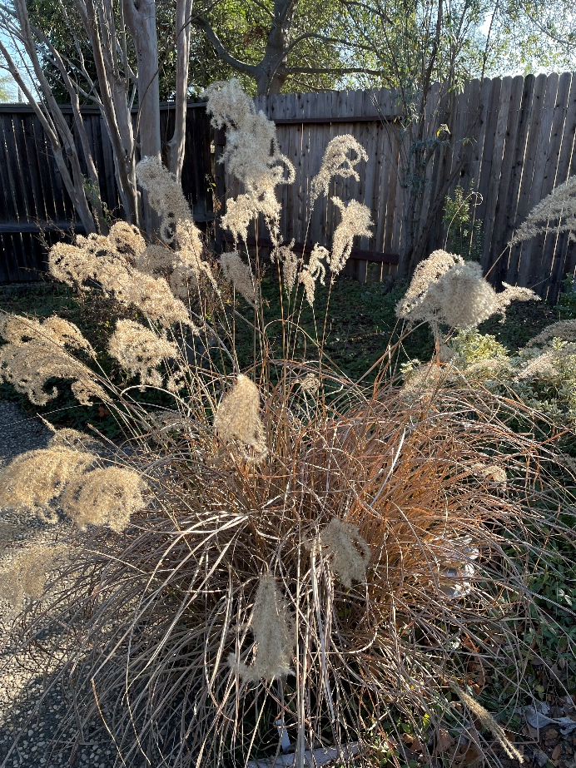
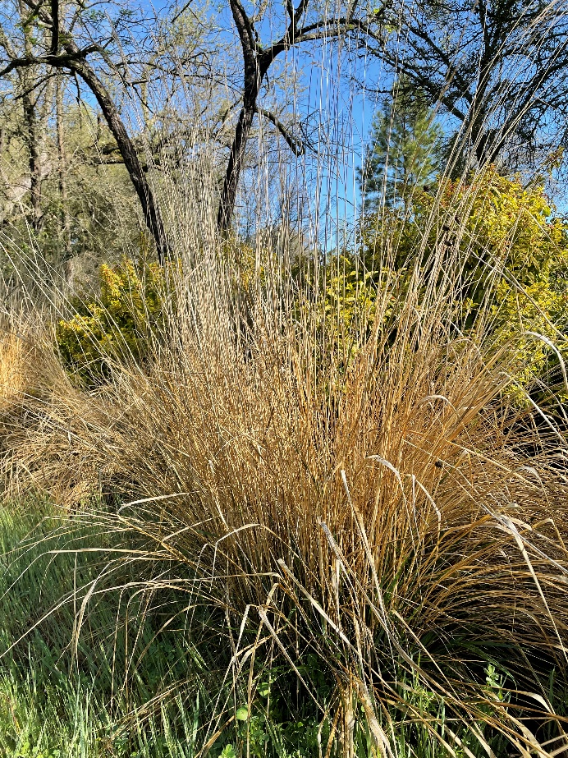
Using the Database: perennials
-Grasses in winter-
Miscanthus sinensis
Calamagrostis x Acuflora
Notes:
Wintering grasses can have an intriguing look and be protection against the frost. Also dormant plants can be an overwintering place for beneficial insects in the garden.

Slide 19
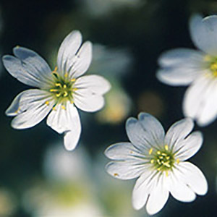
Using the Database: groundcovers
snow-in-summer
Cerastium tomentosum
Gives a cool look to hot Central Valley gardens; can thrive in low to medium amounts of irrigation; silver foliage good for contrast with green-leaved plants.
Cooper’s iceplant
Delosperma cooperi
Linear succulent foliage creeps along the ground, making an attractive apple-green mat; bright pink-purple flowers bloom in spring, summer, and fall.
Notes:
Cerastium is a European native & tolerates a wide range of soil types & exposures. Good for borders & slopes.
Thid Delosperma needs moderate water & afternoon shade here.

Slide 20
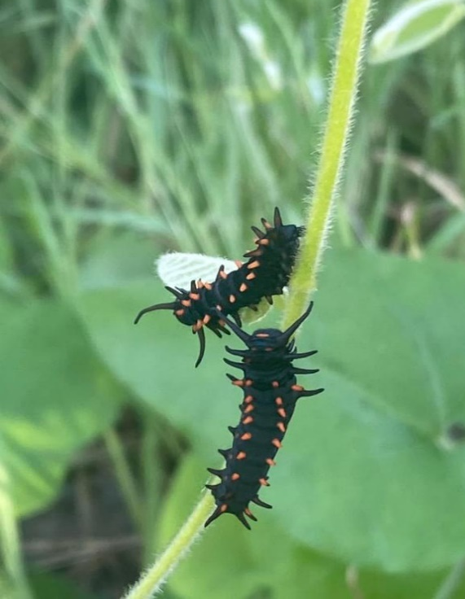
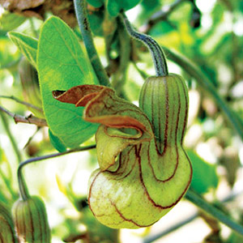
Using the Database: vines
California pipevine
Aristolochia californica
California native plant; leaves provide food for pipevine swallowtail butterfly larvae; versatile plant that can be used as a climbing vine or a groundover. Deciduous.
Notes:
The pipevine may have a disagreeable odor so plant where you have space. Native to Calif. Coastal & Sierra Nevada mtn. Ranges under 1500 ft.
Hardenbergia is a vigorous grower, and will fill your arbor. Prune after bloom to train. Can grow 10 feet.

Slide 21
Using the Database: vines
lilac vine
Hardenbergia violacea
Vigorous evergreen vine can be used to cover an arbor, pergola or wall; small, purple, pea-like flowers bloom in late winter to early spring; other cultivars have white or pink flowers.
Notes:
Hardenbergia is a vigorous grower, and will fill your arbor. Prune after bloom to train. Can grow 10 feet.

Slide 22
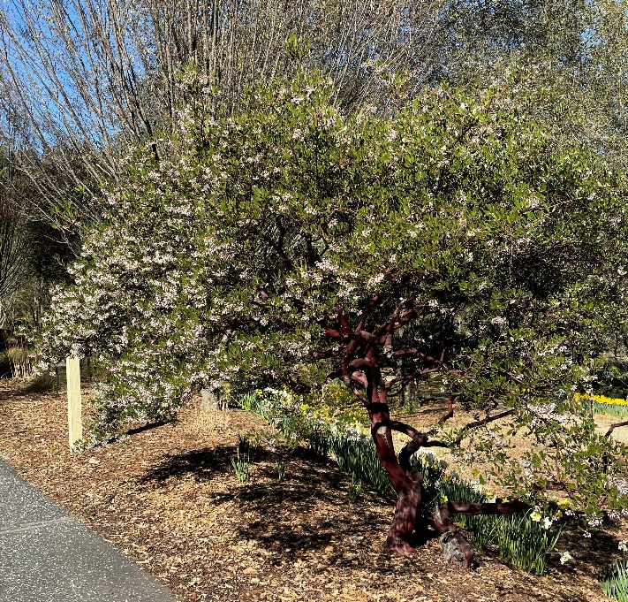
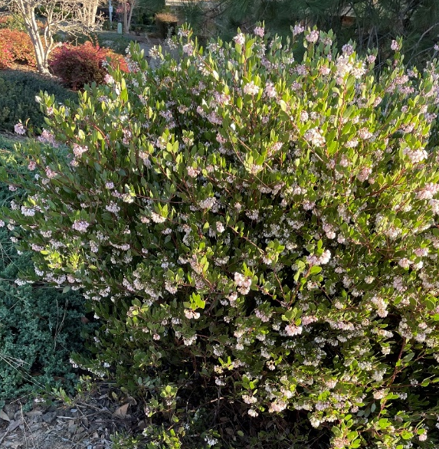
Using the Database: shrubs
Vine hill manzanita
Arctostaphylos densiflora
‘Howard McMinn’
California native plant; known for its smooth, wine-red bark.
One of the few manzanitas that tolerates our clay-loam soils; attracts hummingbirds and beneficial insects. Evergreen
Notes:
Attracts hummingbirds, bees & butterflies. Gets 4-6’ high, 6’wide. Slow growth & all soil tolerant but not overly moist soil. Should be pruned to prevent cluttered branches, and susceptible to branch dieback (fungal disease). Serves as a hedge or barrier plant.

Slide 23
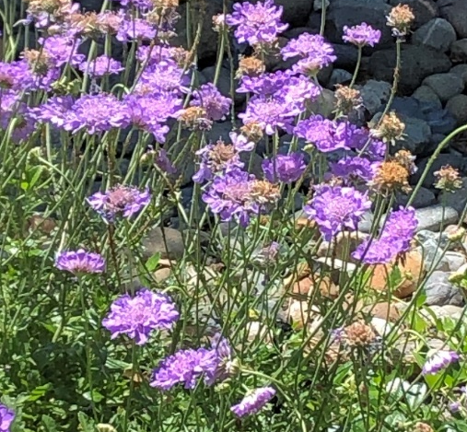
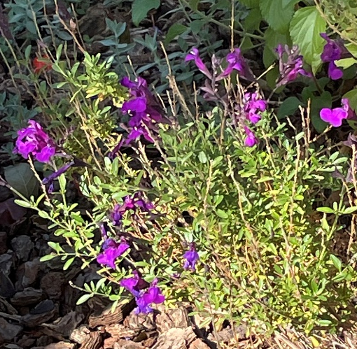
Using the Database: shrubs
Winnifred Gilman Cleveland sage
Winifred Gilman sage
Salvia clevelandii ‘Winnifred Gilman’
Santa Margarita foothill penstemon
Penstemon heterophyllus
‘Margarita B.O.P.’
California native plant; flowers are golden yellow as buds, bright blue as blooms, then change to purple-pink; unlike many California native penstemons, it thrives in garden conditions.
California native plant; evergreen shrub produces maroon-stemmed, blue-violet flowers; heat and drought tolerant; attracts hummingbirds, butterflies and beneficial insects.
Notes:
This penstemon is a Calif. native, lives about 20 years. Tolerates full sun to part shade.
Salvias are the largest genus in the mint family. Square stems, strong scent. Native to coastal scrub areas & chapparel below 3,000 ft. in So. Calif.

Slide 24
Using the Database: shrubs
Winnifred Gilman Cleveland sage
Winifred Gilman sage
Salvia clevelandii ‘Winnifred Gilman’
Santa Margarita foothill penstemon
Penstemon heterophyllus
‘Margarita B.O.P.’
California native plant; flowers are golden yellow as buds, bright blue as blooms, then change to purple-pink; unlike many California native penstemons, it thrives in garden conditions.
California native plant; evergreen shrub produces maroon-stemmed, blue-violet flowers; heat and drought tolerant; attracts hummingbirds, butterflies and beneficial insects.
Notes:
This penstemon is a Calif. native, lives about 20 years. Tolerates full sun to part shade.
Salvias are the largest genus in the mint family. Square stems, strong scent. Native to coastal scrub areas & chapparel below 3,000 ft. in So. Calif.

Slide 25
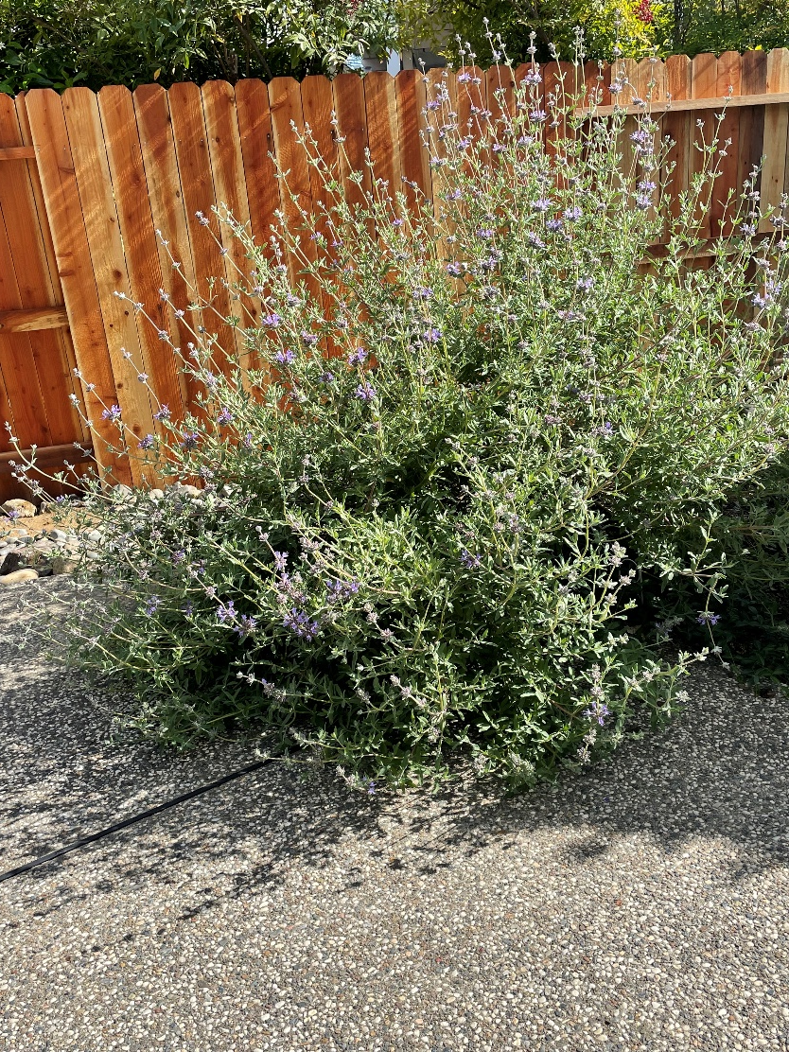
Using the Database: shrubs
pozo blue
Cleveland sage
Salvia clevelandii
‘Pozo Blue’
(not an All Star)
Notes:
This penstemon is a Calif. native, lives about 20 years. Tolerates full sun to part shade.
Salvias are the largest genus in the mint family. Square stems, strong scent. Native to coastal scrub areas & chapparel below 3,000 ft. in So. Calif.

Slide 26
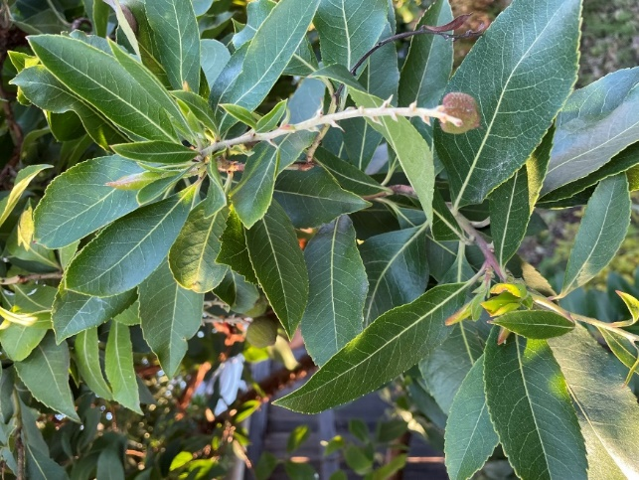
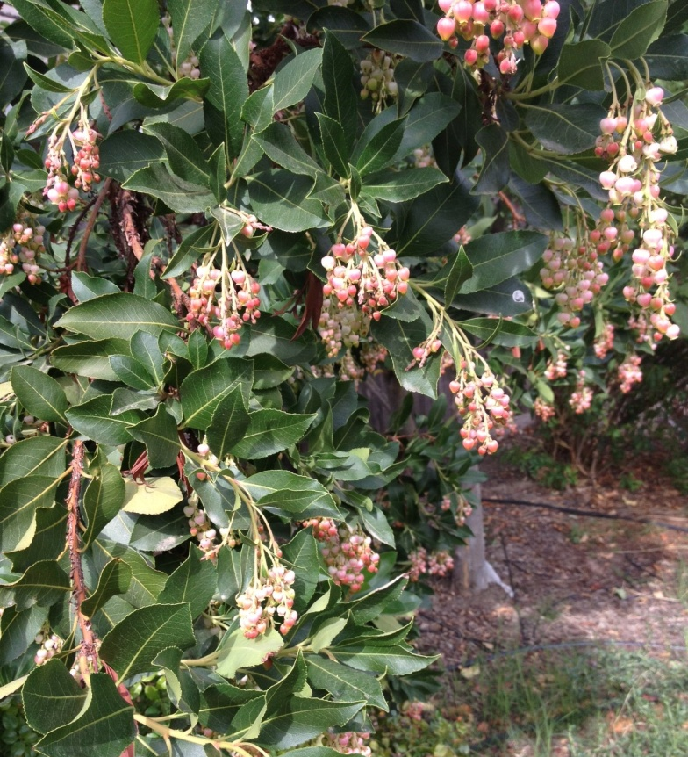
Using the Database: trees
Marina madrone
Arbutus ‘Marina’
Shiny evergreen leaves and attractive smooth coppery bark; drooping clusters of pink flowers, large red berries.
Very attractive to hummingbirds.
Notes:
This madrone can get to 30’ tall, but much sorter in the city garden. Peeling bark of the madrone species is beautiful.

Slide 27
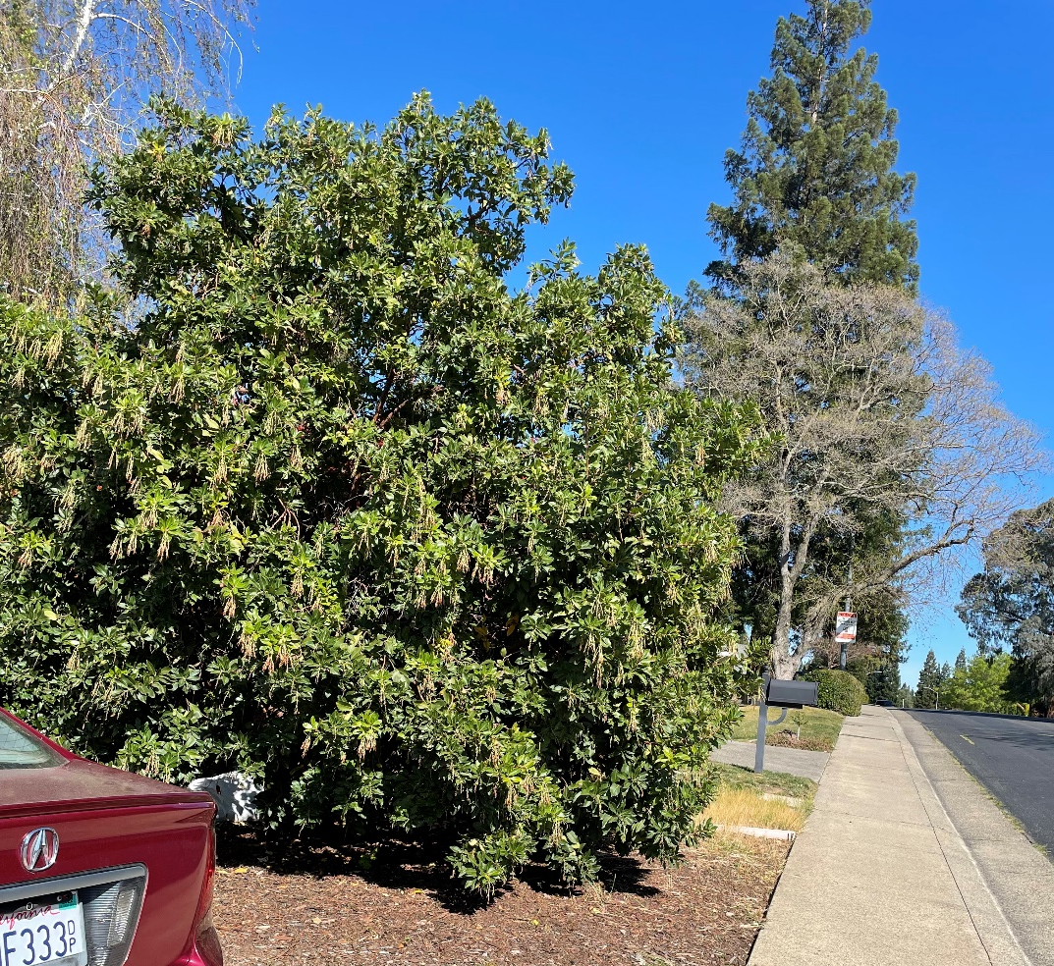
Using the Database: trees
Marina madrone Arbutus ‘Marina’
Notes:
This madrone can get to 30’ tall, but much sorter in the city garden. Peeling bark of the madrone species is beautiful. Prune occasionally to reveal beautiful peeling bark.

Slide 28
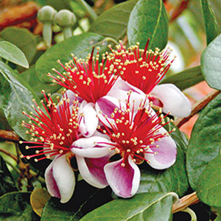
Using the Database: trees
pineapple guava
Acca sellowiana
(Feijoa sellowiana )
Attractive spring flowers are edible and sweet; large green berries have a pineapple-like flavor; can be used as hedging or as a screen; attracts hummingbirds
.
Notes:
This species is more frequently referred to by the Acca genus. It’s a South American native. Thrives in dry soil& full sun. Fruit comes 4-5 months after the spring flowers. Bees and birds enjoy the blooms.

Slide 29
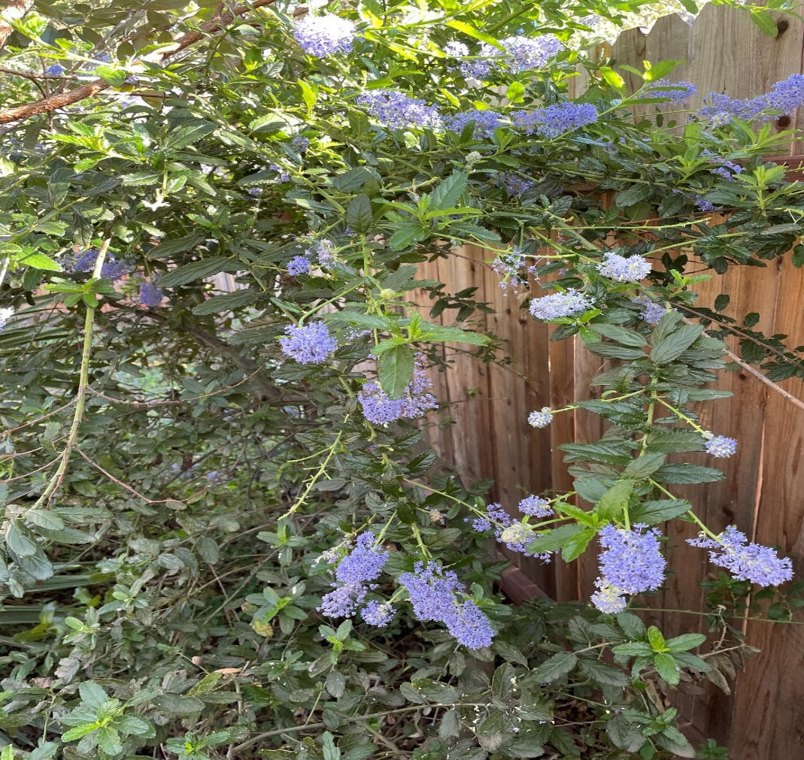
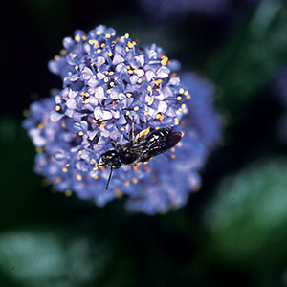
Using the Database: trees
Ray Hartman California lilac
Ceanothus ‘Ray Hartman’
California native plant; one of the best ceanothus cultivars for gardens because it can tolerate some summer irrigation; makes a good screen or small garden tree. Evergreen.
.
Notes:
Ceanothus is known as “protein for deer”. It’s a short-lived plant. ‘Ray Hartman’ gets to 18’. Good screen or hedge.

Slide 30
References
Online:
UC Davis Arboretum All Star (introduction)
https://arboretum.ucdavis.edu/arboretum-all-stars
UC Davis Arboretum All Star Brochure
https://arboretum.ucdavis.edu/sites/g/files/dgvnsk1546/files/inline-files/AllStarsBook_201415_final-reduced.pdf
UC DavisArboretum All-Star Database
https://arboretum.ucdavis.edu/allstars_browse.aspx?id=2

Slide 31
Thank You!
Any Questions?
Master Gardener Hotline: (530) 889-7388
Master Gardener Website: pcmg.ucanr.org

