Slide 1
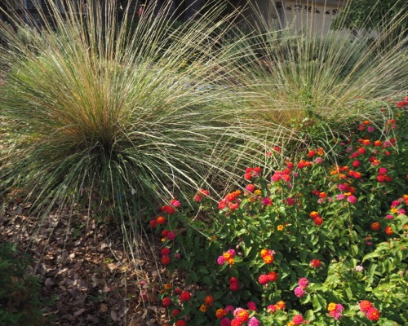
UC Davis Arboretum All-Star Grasses
Notes:
Created: October, 16th 2019
Created By: Julie Long, Placer County Master Gardener
Audience: Gardening Enthusiast
Publicity:
Update History:
Photographs by Julie Long

Slide 2
Who Are Master Gardeners?
Master Gardeners of Placer County
Extend research-based, sustainable gardening and composting information
Present accurate, impartial information to home gardeners
Encourage public to make informed gardening decisions

Slide 3
Who Are Master Gardeners?
Where to find us…
Online, in the Media, and Special Publications
Hotline: Call (530) 889-7388 or submit your questions online
Website: pcmg.ucanr.org
Facebook, Twitter, Instagram
Gold Country Media monthly column
Curious Gardener quarterly newsletter on our website
Calendar and Gardening Guide

Slide 4
Who Are Master Gardeners?
Where to find us…
Workshops, Fairs and Festivals, and Special Events
Speakers by Request
Workshops (various venues, check website)
Farmers’ Markets (seasonal: Auburn, Roseville)
Fairs and Festivals Booths (varies)
Garden Faire (April)
Mother’s Day Garden Tour (May)

Slide 5
What is an Arboretum All-Star?
Arboretum All-Stars are the top 100 plants recommended by the horticulture staff of the UC Davis Arboretum. These plants thrive in California’s Mediterranean climate and have qualities that make them great choices for sustainable home gardens
What makes an All-Star? It must have the following features:
Attractive for most of the year
Thrives in California’s Mediterranean climate
Tested in the UC Davis Arboretum
It may also have one or more of the following features:
Low maintenance
Drought tolerant
Attracts beneficial wildlife including pollinator insects
Power Line friendly (grows to a height of 25’ or less)
www.arboretum.ucdavis.edu
https://plantright.org/about-invasive-plants/plant-list/

Slide 6
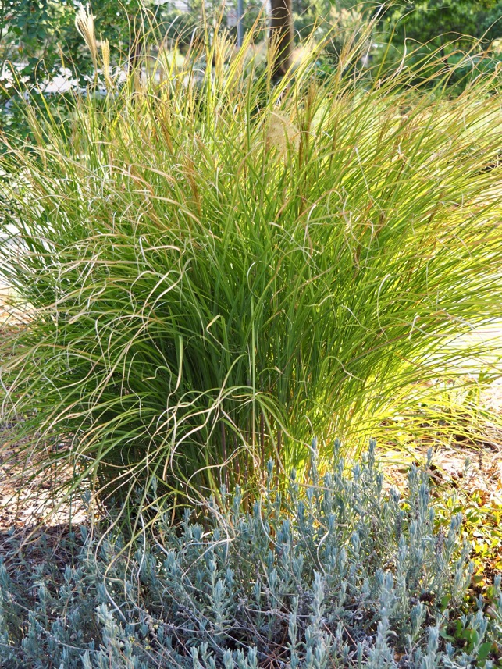
Miscanthus sinensis (dwarf varieties) Japanese silver grass “Sarabande”
Leaves may turn red, orange and yellow in the fall
Large grass (over 3’ tall) with broad growth
Thrives in clay soil
Low water requirements
Full to part-sun exposure

Slide 7
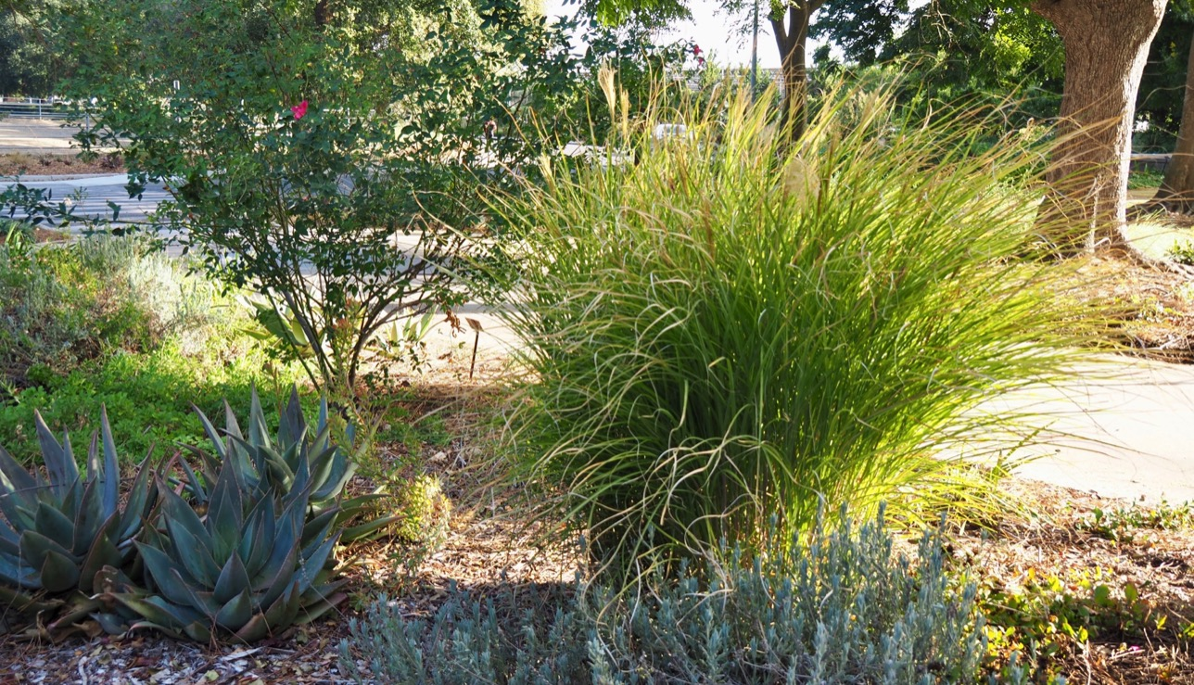
Japanese silver grass “Sarabande” in a landscape setting

Slide 8
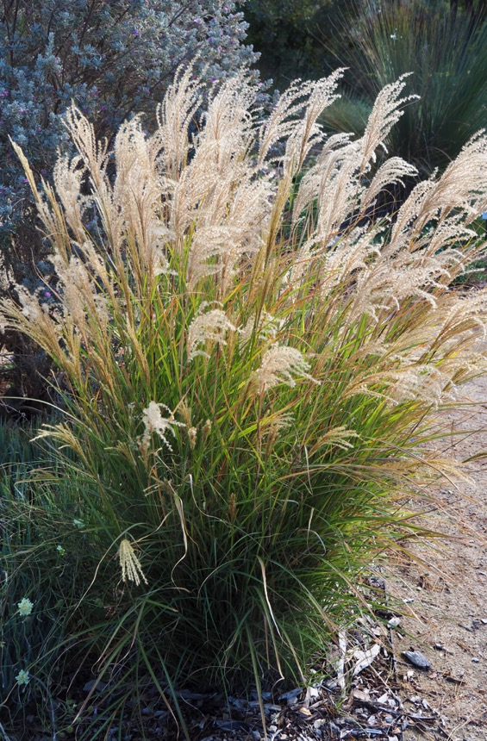
Miscanthus sinensis silverspider Silver spider Japanese silver grass
Leaves may turn red, orange and yellow in the fall
Large grass (over 3’ tall) with upright growth and graceful, arching leaves and shimmering, silver-white plumes
Thrives in clay soil
Low water requirements
Full to part-sun exposure

Slide 9
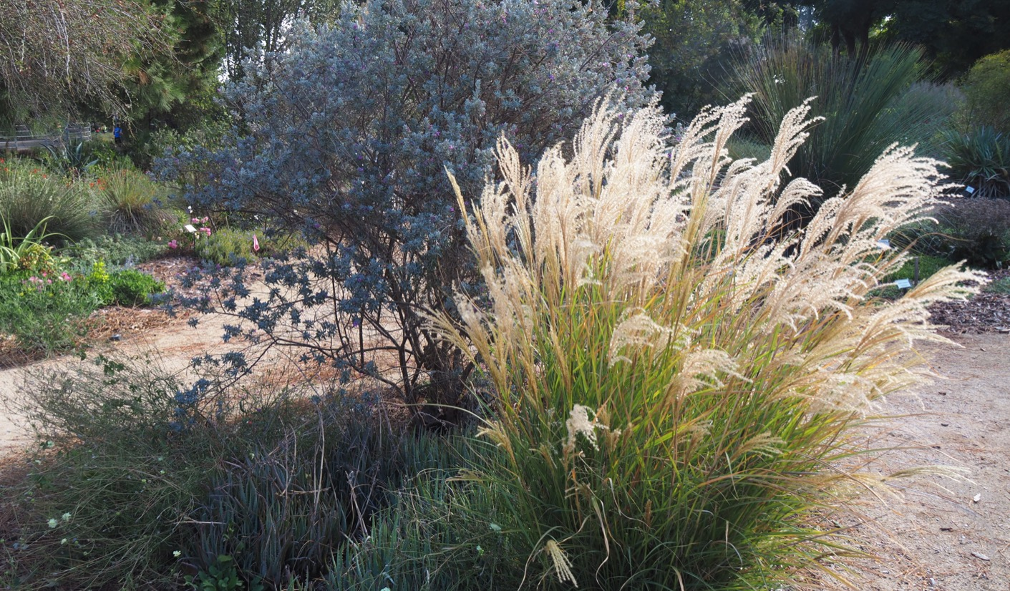
Japanese silver grass in a landscape setting

Slide 10
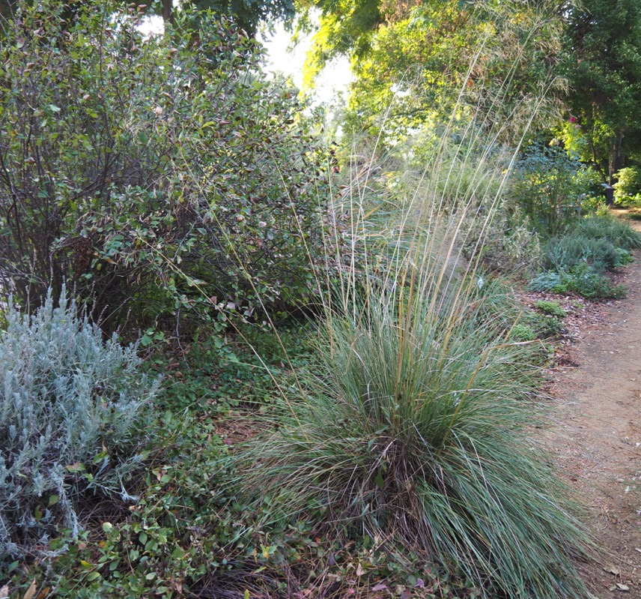
Stipa gigantea (Celtica gigantea) giant feather grass
Large and dramatic (over 3’ tall)
Waving flower wands add movement
Looks good year-round
Low water requirements
Full to part-sun exposure

Slide 11
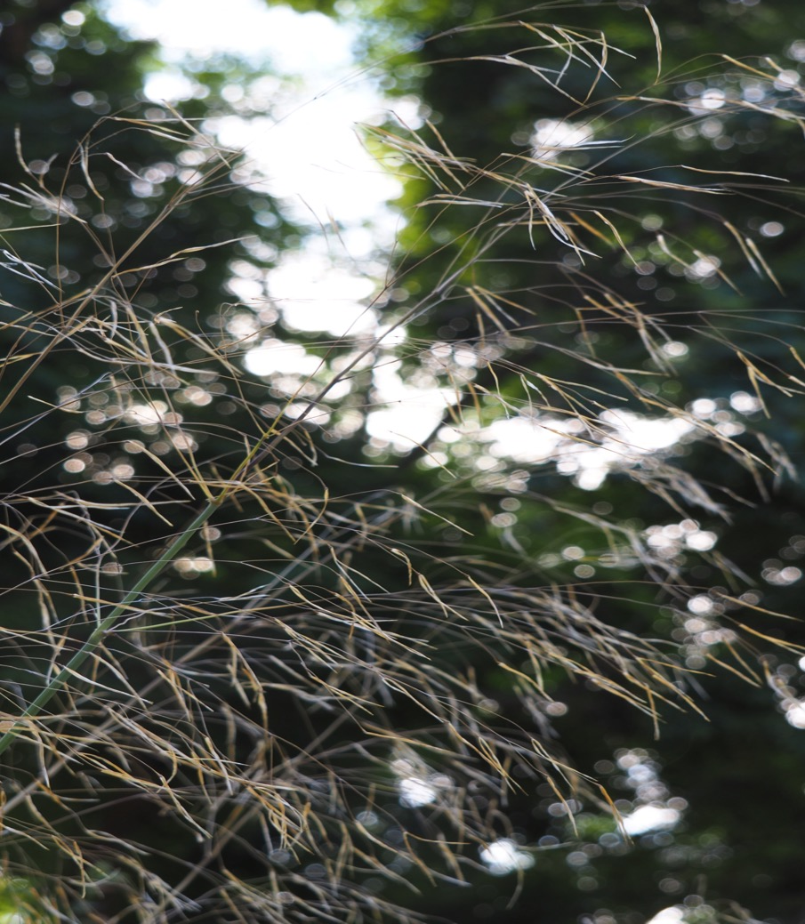
Delicate flower detail of the Giant feather grass

Slide 12
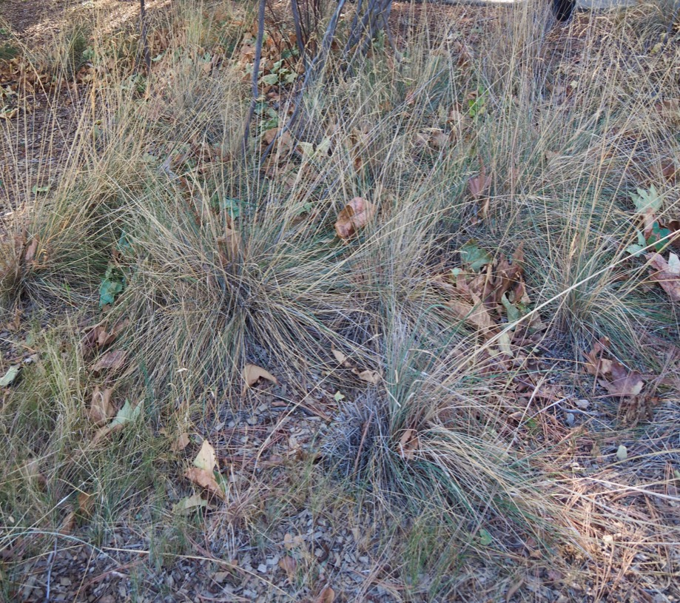
Festuca californica California fescue
California native
Tolerates summer drought and different soil types
Medium (1-3’tall) grass with graceful gray-green leaves and airy flowers
Low water requirements
Partial sun exposure

Slide 13
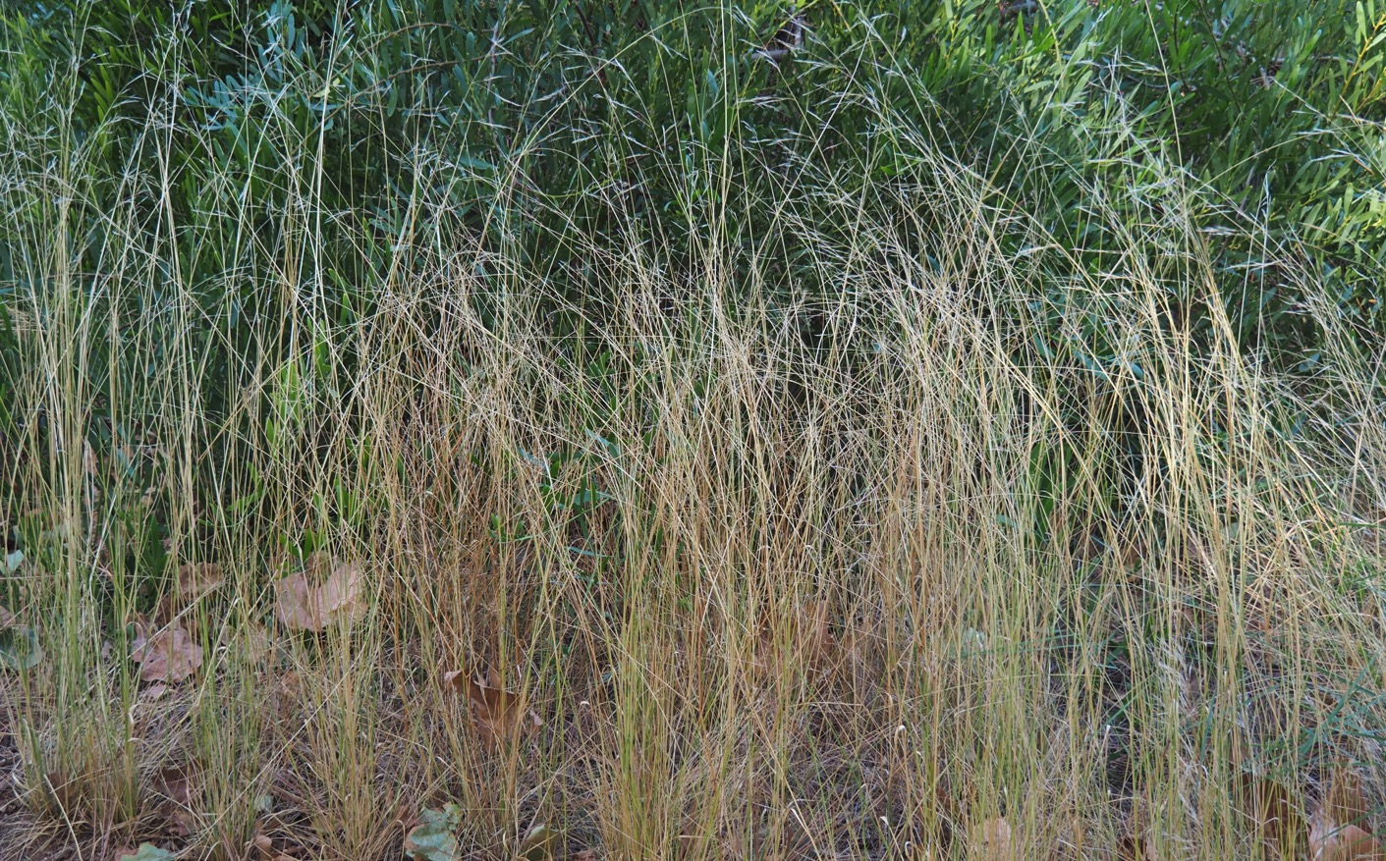
Another view of California fescue

Slide 14
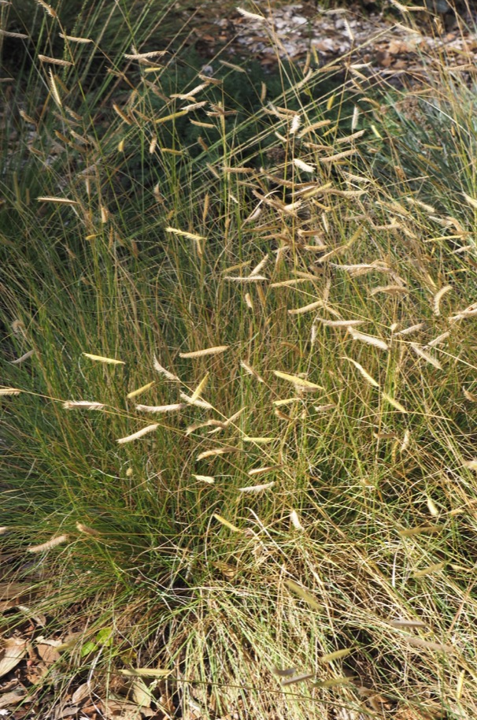
Bouteloua gracilis blue grama grass
California native
Medium (1-3’tall) with a tidy, upright shape
Nicknamed “eyelash grass”
Low water use
Full to part-sun exposure

Slide 15
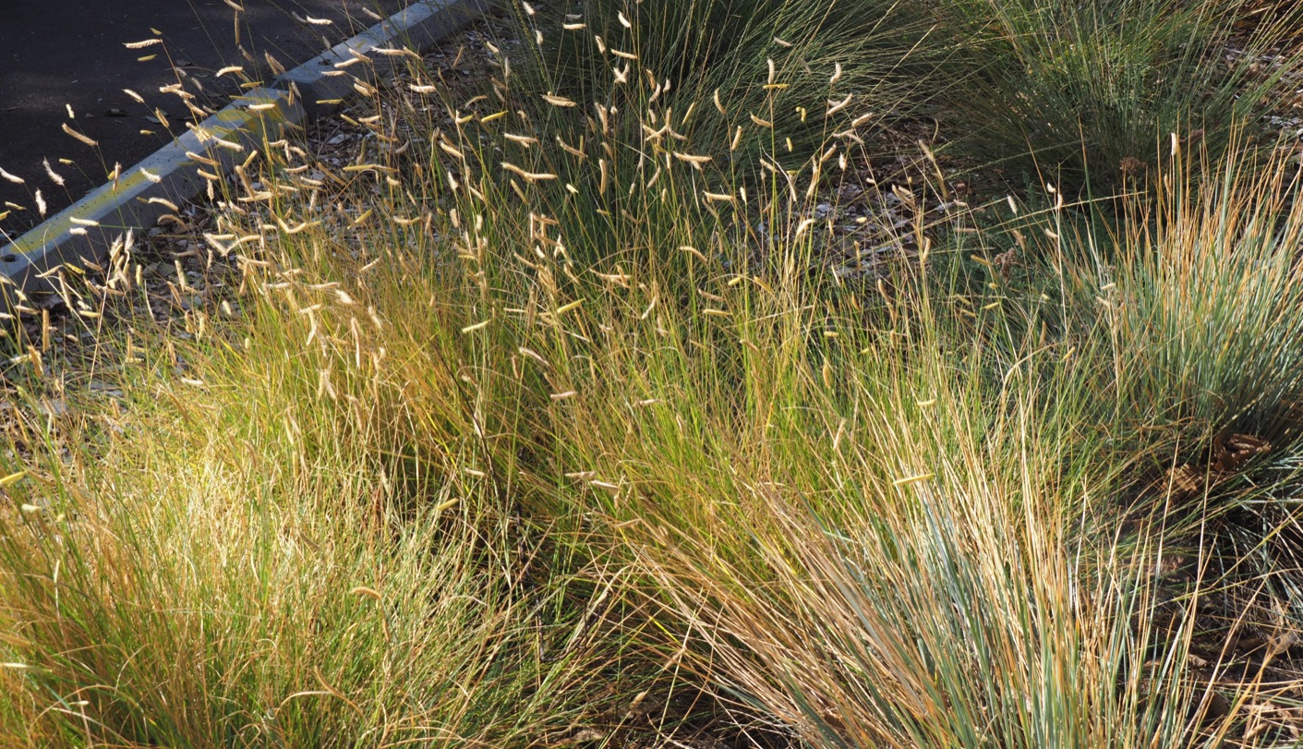
A grouping of blue grama grass wave gracefully in the sun

Slide 16
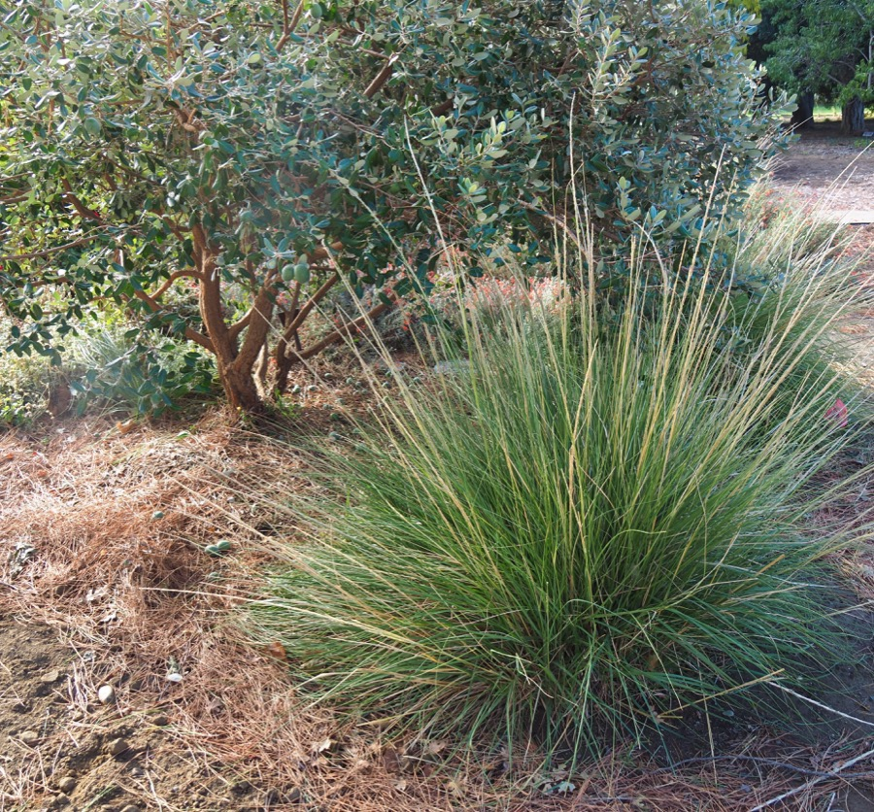
Muhlenbergia rigens deergrass
California native
Large (over 3’) grass that makes a nice, informal screen.
Needs almost no maintenance
Low water use
Full to part-sun exposure

Slide 17
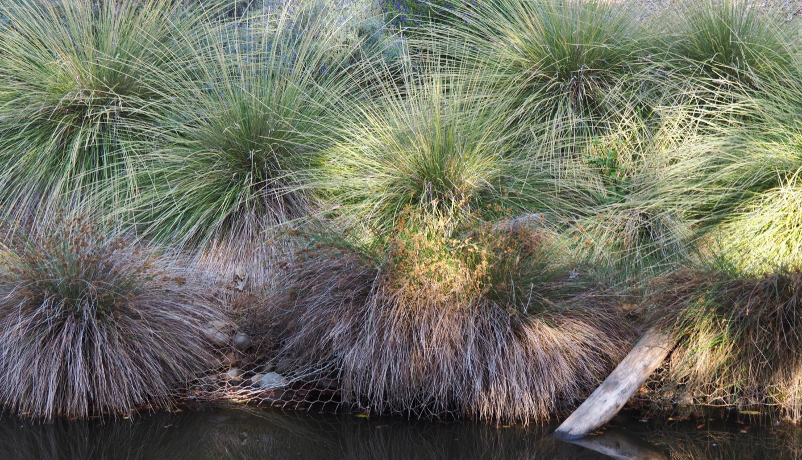
Deergrass en masse makes a statement!

Slide 18
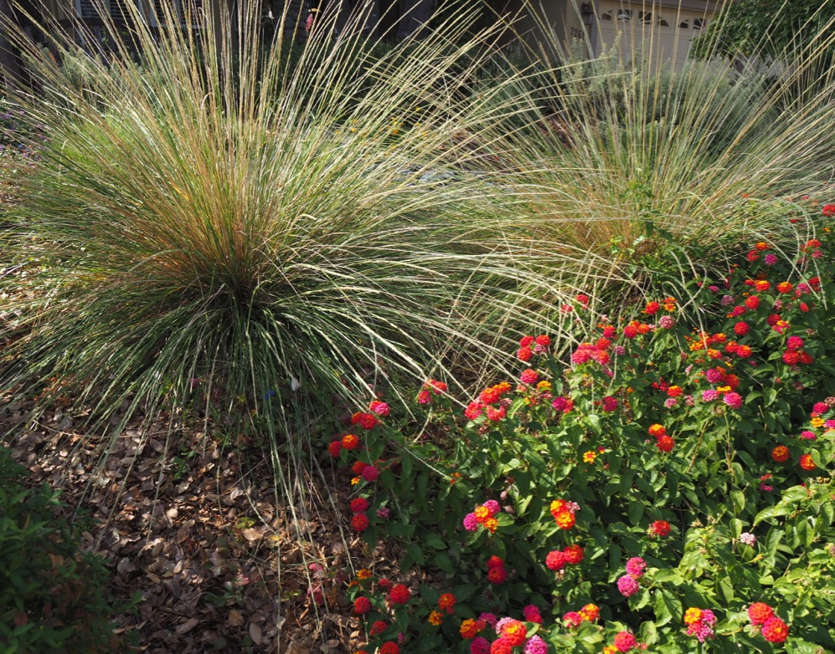
Muhlenbergia dubia pine muhly
Dwarf deergrass
Medium size (1-3’)
Adds texture and movement to the garden
Almost zero maintenance
Looks good all year-round
Low water requirements
Full to part-sun exposure

Slide 19
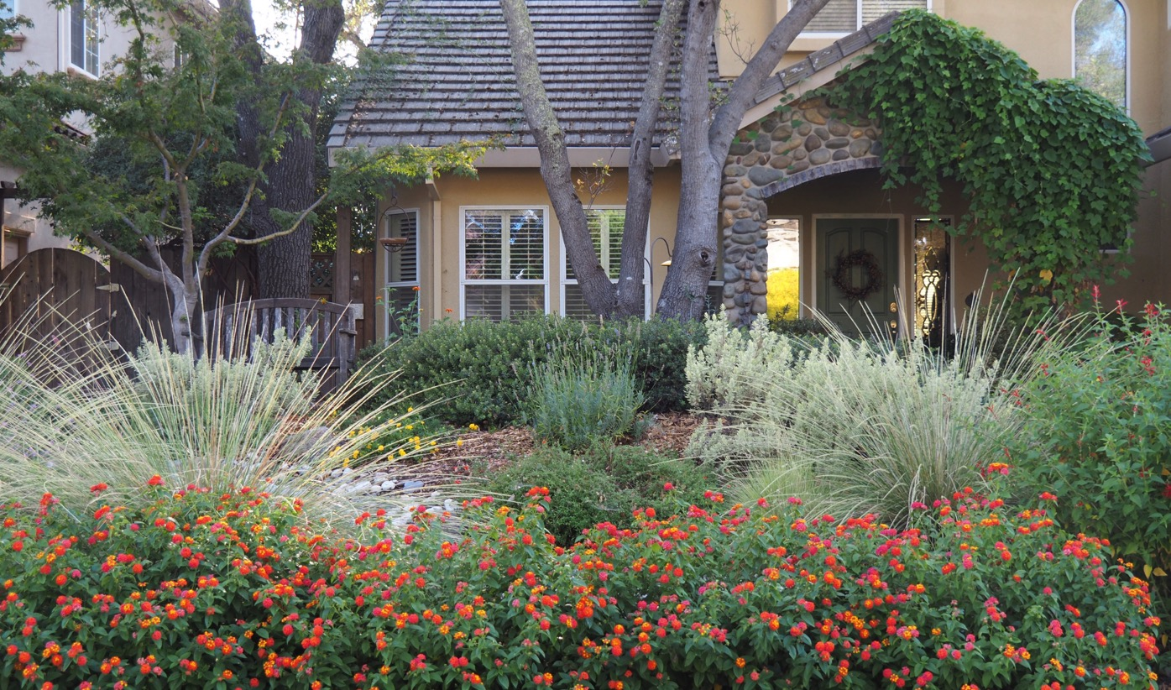
Pine muhly adds interest and texture in a landscape

Slide 20
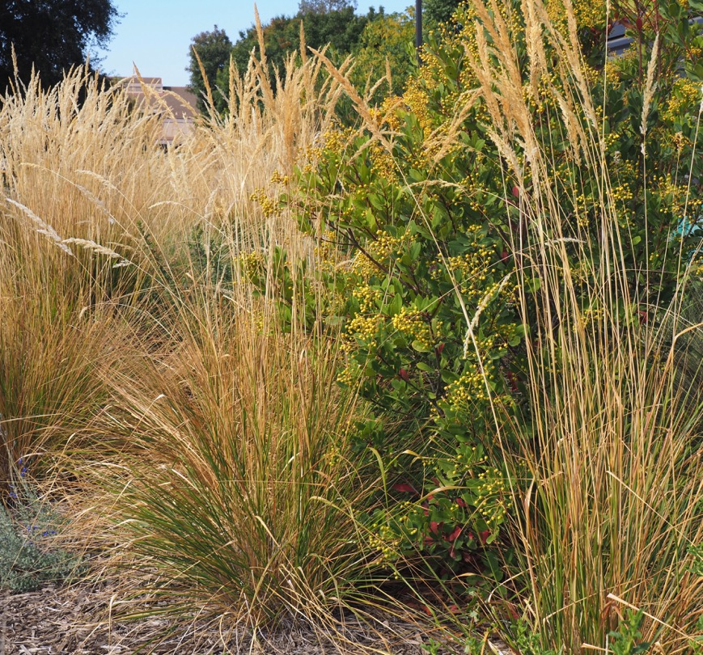
Calamagrostis x acutiflora “Karl Foerster” Karl Foerster feather reed grass
Large striking grass (over 3’ tall) with tall vertical growth. Makes a stunning screen
Has pretty blooms that turn into buff spikes in summer and fall
Moderate water requirements
Full to part-sun exposure

Slide 21
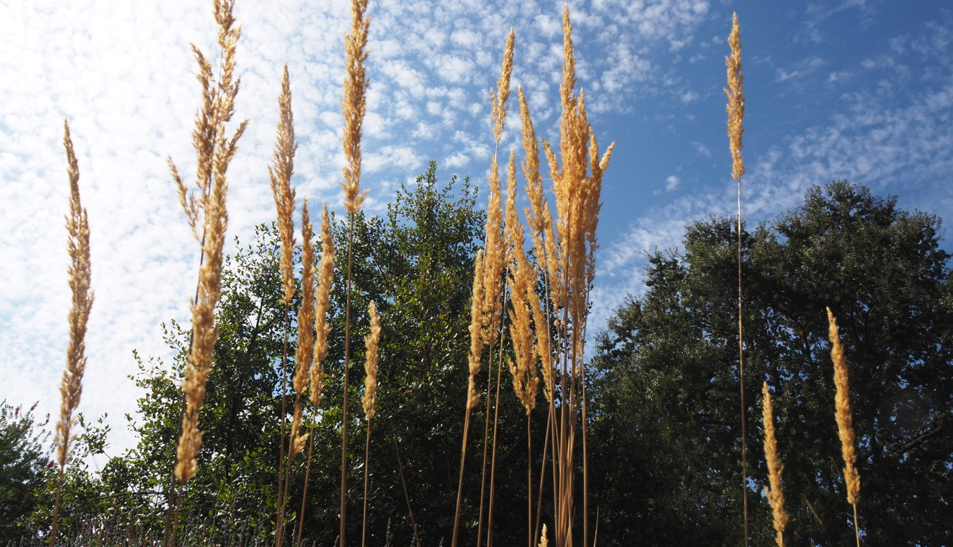
Autumn brings beautiful buff colored spikes on the Karl Foerster feather reed grass

Slide 22
Thank You!
Any Questions?
Master Gardener Hotline: (530) 889-7388
Rot Line: (530) 889-7399
Master Gardener Website: pcmg.ucanr.org
Evaluations, please!

