Slide 1
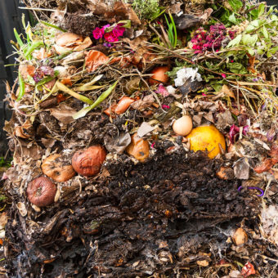
Composting and Mulching Basics

Slide 2
Who Are Master Gardeners?
Master Gardeners of Placer County
  Extend research-based, sustainable gardening and composting information
  Present accurate, impartial information to home gardeners
  Encourage public to make informed gardening decisions

Slide 3
Who Are Master Gardeners?
Where to find us…
Online, in the Media, and Special Publications
  Hotline: Call (530) 889-7388 or submit your questions online
  Website: pcmg.ucanr.org
  Facebook, Twitter, Instagram
  Gold Country Media monthly column
  Curious Gardener quarterly newsletter and on our website
  Calendar and Gardening Guide

Slide 4
Who Are Master Gardeners?
Where to find us…
Workshops, Fairs and Festivals and Special Events
  Speakers by Request
  Workshops (various venues, check website)
  Farmers’ Markets (seasonal: Auburn, Roseville)
  Fairs and Festivals Booths (varies)
  Garden Faire (April)
  Mother’s Day Garden Tour (May)

Slide 5
Why Compost?
  Divert waste from our landfill, extending landfill life. Western Placer Waste Management has had its use permit extended from 2030 to 2058 thanks to recycling and composting.
  Saves resources, $ to homeowner and community
  Benefits environment
  Improves soil structure
Notes:
By composting you prevent methane gas, toxic leachate, and hydrogen sulfide

Slide 6
Placer County Needs Continue to Compost!
From Western Placer Waste Management Authority (July 1, 2013 – June 30, 2014)
  Placer Residential Waste Disposal = Trash 213,163 tons
  Per year (1 lb per day per resident)
  Green Waste 49,760 tons of this waste is classified as “other organic” which means its COMPOSTABLE
Notes:
We have been unable to obtain more recent data from the Waste management authority

Slide 7
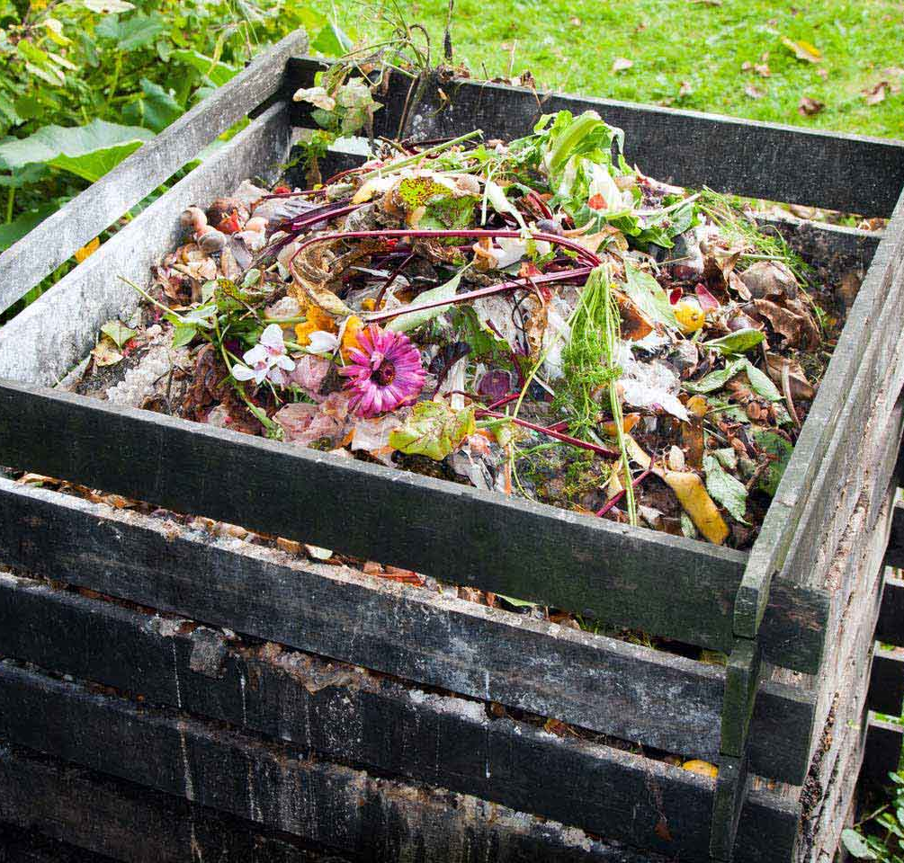
Compost Happens!!!
Felder Rushing’s Two Rules of Composting:
1. Stop Throwing That Stuff Away!
2. Pile It Up Somewhere!

Slide 8

Choosing A System
The system you choose to manage your compost will depend on:
Labor – How much time and effort do you want to put into maintaining optimum conditions.
Rate of Composting desired – Requires close supervision to generate faster composting. Little to no supervision is required for slow, static “cold composting”.

Slide 9
Organic Material Availability – The kind of material put into a composting system makes a big difference in the rate of decomposition.
Location of the Compost site – Will it be visible to you neighbors?
Cost – This can be an important factor for some people. Compost made in an expensive system is the same quality as compost made in an inexpensive or free system.

Slide 10
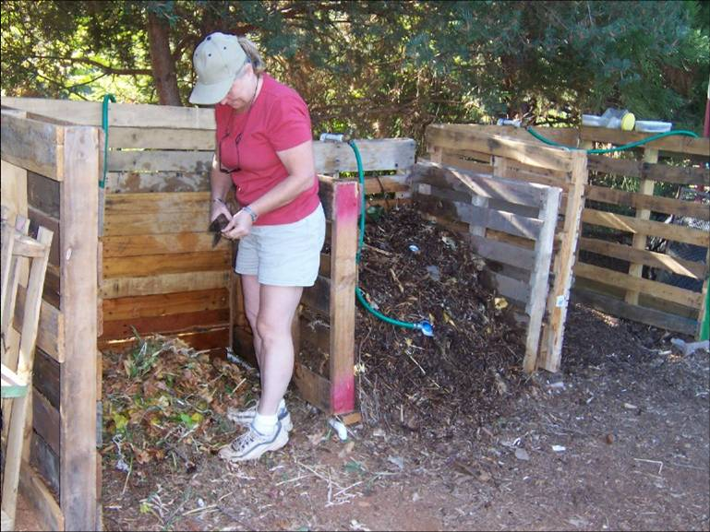
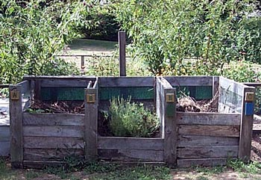
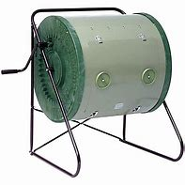
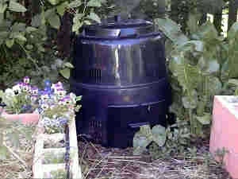
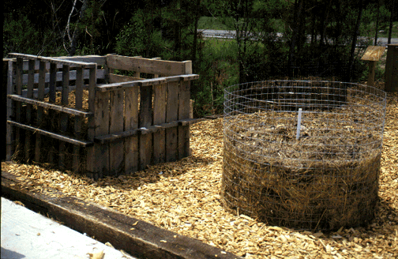
What kind of bin should I use?
Notes:
Compost in the tumblers has to be watched closely as it dries out very quickly. It’s a good idea to cover your pile with something to protect it from the elements. Tightly woven burlap or shade cloth works well as it allows the exchange of gases.

Slide 11
What goes in the Pile?
Grass clippings
Yard waste
Leaves, pine needles
Vegetable trimmings
Food scraps
Eggshells
Wood chips (shredded to size)
Newsprint
Sawdust
Notes:
Eggshells need to be washed so not to attract critters such as skunks. Sawdust from treated wood cannot be used. Compost all manures. Horse manure needs to be hot composted due to medications and weed seeds not breaking down and will kill microorganisms in pile.

Slide 12
What does NOT go in the Pile?
Disease infected plants
Plants with severe insect attack
Ivy, morning glory and succulents
Pernicious weeds, e.g. Bermuda grass, oxalis, cheeseweed (mallow)
Cat and dog manures
Meat, dairy, and fish scraps
Wood ash (add after composting is finished)
Notes:
Add only one cup of wood ash per large pile

Slide 13
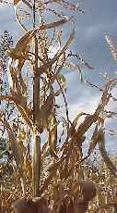
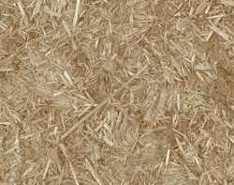
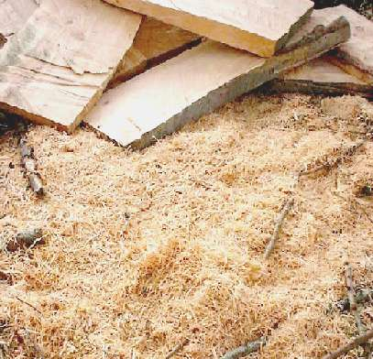
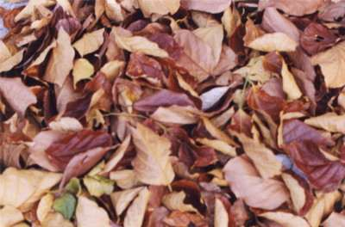
Organic Matter: Carbon or “Browns”
Carbon rich sources are called “browns”
Usually dry, low moisture content, lightweight
Examples: dry leaves, straw, sawdust,
wood chips, corn stalks, cardboard/paper

Slide 14
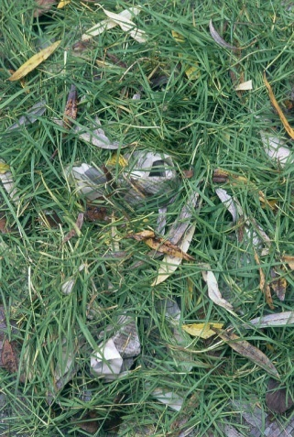
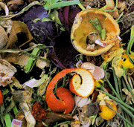
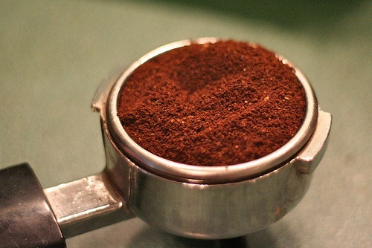
Organic Matter: Nitrogen or “Greens”
N is needed to get the decomposition process started and keep pile “cookin”
Examples: vegetable and fruit scraps, grass clippings, coffee grounds, manures, and alfalfa hay

Slide 15
Making the Pile: Important Considerations
Size of pile should be 3’x3’x3’ to 5’x5’x5’
Do you have all the organic material (batch) or will you add continuously (continuous)?
Have you chopped up your materials?
Moisture and aeration: what’s the rule?
Compost tools: hay fork, aerator…

Slide 16
Compost Considerations
How Long Does it take?
Moisture (wet versus a dry pile). Pile should be as moist as a wrung-out sponge
Oxygen. Ideal mixture is 50% oxygen 50% moisture.
Active aeration and passive aeration
How hot is the pile
What is going into the pile. Particle size and moisture.
Seasonal considerations

Slide 17
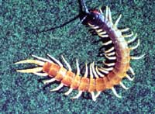
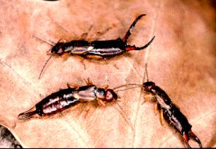
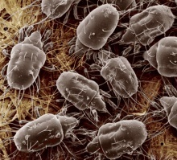
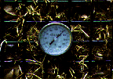
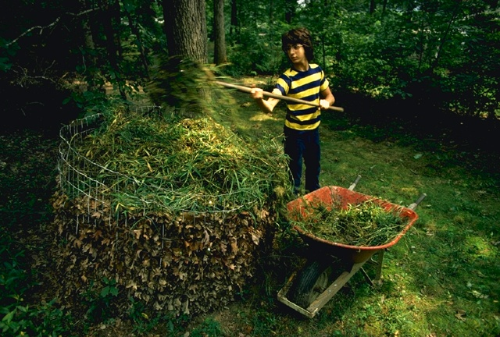
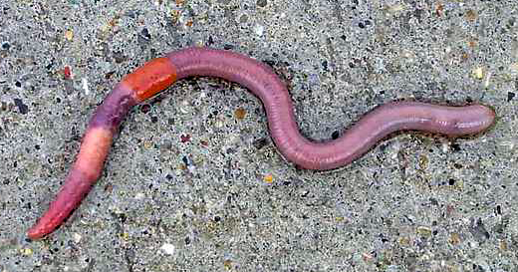
Compost Processes
& Critters in the Compost Pile

Slide 18
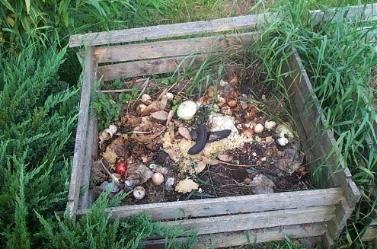
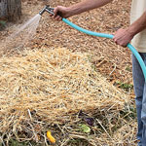
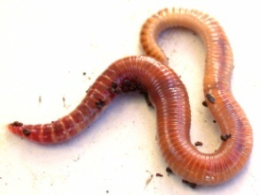
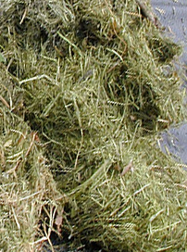
The Compost Process depends on:
  Organic Matter Composition
    Carbon (Browns)
    Nitrogen (Greens)
  Microorganisms
  Macroorganisms
  Water
  Oxygen
  Temperature

Slide 19
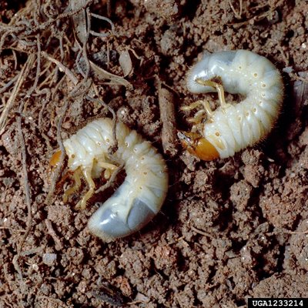

Macroorganisms
The decomposers we can see.
Included are: Ants, centipedes, snails, sow bugs, worms, beetles, earwigs, grubs
They are they physical decomposers because they grind, chew, suck, bite, and tear material.

Slide 20
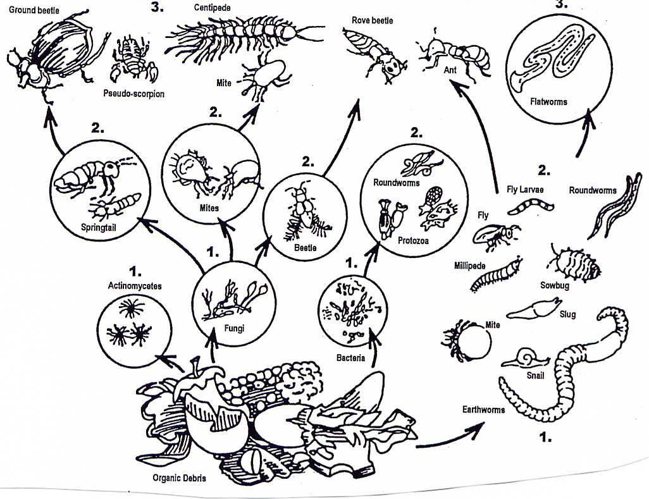
A Compost Pile is an Ecosystem
Function =
decomposition of
organic matter into stable humus

Slide 21
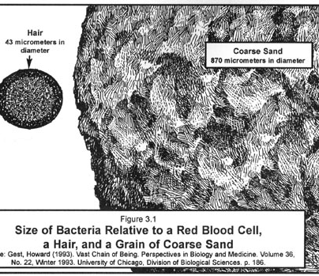
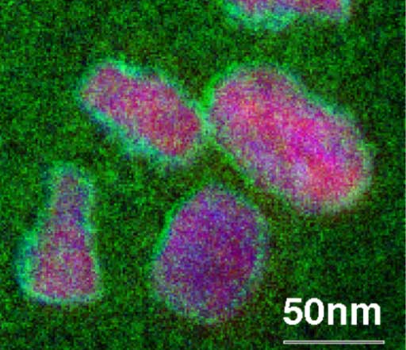

Microorganisms
Bacteria are the powerhouse in the compost pile. They breakdown plant matter & create carbon dioxide and heat.
In the right conditions, population growth is amazing—bacteria can double every hour!
Notes:
Bacteria are decomposers. Under the right conditions they can double in size every hour. The work that they’re doing creates the heat in the pile

Slide 22
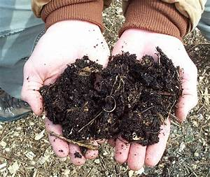
Harvesting
Your compost is done when:
most of the material is broken down and unrecognizable.
the temperature cool and very little heat is produced.
Finished compost can be sifted with a 1/2 “ screen to remove large pieces
Large pieces can be put back into the pile or used as mulch

Slide 23
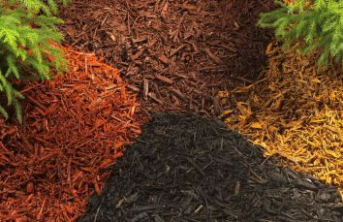
Let’s Talk Mulch
What is MULCH?
What does mulch do?
  Suppresses weeds
  Conserves moisture
  Moderates soil temperature
  Prevents compaction
  Controls Erosion
  Invites worms
Nature does not like bare soil, either you cover it with mulch or it will be covered with weeds!
This Photo by Unknown Author is licensed under CC BY-SA-NC
Notes:
If you want to use mulch on a hillside, don’t use a mulch that is uniform in size.
On a slope, you want to use mulch that varies in size.
Redwood bark doesn’t break down quickly. That’s one of the benefits, but it doesn’t feed the microbes as as a mulch of varying sizes.
The thickness of mulch that’s applied depends on the type of soil.
Some mulches that decompose quickly, apply 4 to 6 inches deep.
Regarding covering the soil, if you want to have native bees, then leave a small area bare and near the plants that they like.
Voles (field mice) – Uncover the soil for a while so they’ll go elsewhere.

Slide 24
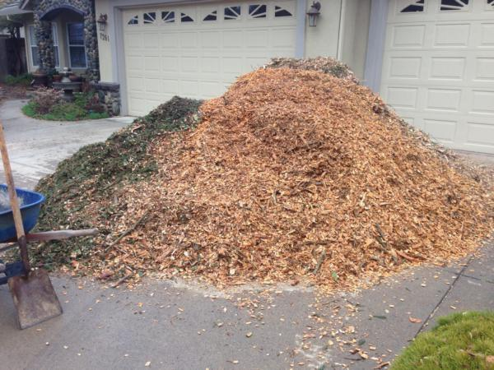
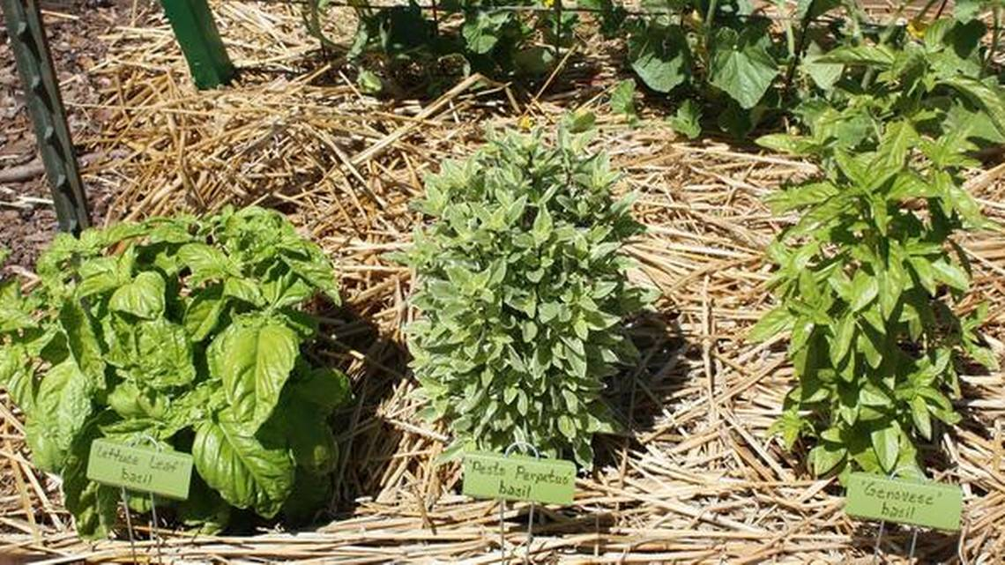
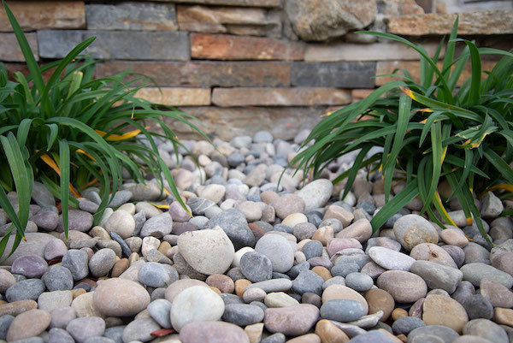
Types of Mulch:
Assortment of Bark
Rice Straw
Pine Needles
Tree Chips
Fallen Leaves
Rock
Notes:
Pine needles are safe to use around evergreens and acid loving plants such as azaleas. Using rice straw, tree chips and fallen leaves is a way of recycling. And keeping product out of landfills. Leaves that are thick such as magnolia work better when chopped.

Slide 25
Does mulch help?
Soil structure benefits greatly by microbes promoted by mulching and distributed by compost
Mulch and Compost are pro-biotic (encourage life, encourage beneficials)
By suppressing beneficials, we allow pathogens to over-populate and attack soil microbes and plants
Some beneficial microbes produce an antibiotic that suppresses pathogens
Beneficials out-compete pests
Notes:
Pro-biotic – Encourage all the things that should be going on in the soil.
Regarding not tilling or tilling – With compost pile and you turn it, it’s warm
But with soil, you’ll break up the life.
Yes, it feels fluffy for a period of time, but then it ends up compacting.
As long as we have a decent population of beneficials, they will help suppress pests.

Slide 26
Why You Want to Protect Your Soil
“Soil”- mix of minerals, organic matter, living organisms, water, and air space
In 1 teaspoon of healthy soil
    8 BILLION microbes
In 1 teaspoon of dirt
Approximately 50 microbes!
Mulch and compost encourage life…they’re pro-biotic

Slide 27
Mulch Care
Water mulch with oscillating sprinkler
Before and after spreading and smoothing
Helps provide moisture to encourage worms
Promotes decomposition of mulch
Important in months when we don’t get rain
Add new mulch yearly to keep up depth
Allow leaves from trees and plants to drop where they are
Creates new coat of mulch
Plants leaves are the best for replacing nutrients
Sprinkle or “veneer” fresh mulch on top
Notes:
You want to keep the depth of your mulch roughly 3-4 inches. Some mulch takes longer to break down and may not need to be replenished yearly
It is recommended you mow over the leaves to prevent them from matting and aids with their decomposition

Slide 28
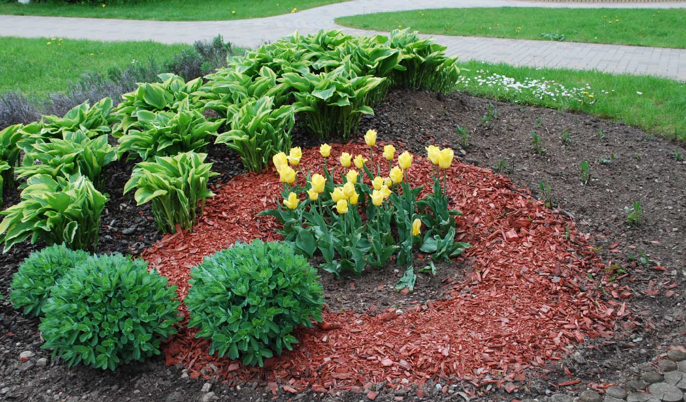
How Much Mulch Should I Use?
Application Depth
    * 2-4” thick in close plant spacing
    *6” thick in open plant spacing
Application Area
    * 6” from trunks
* 12” from buildings
Notes:
Make sure to keep mulch away from stems, etc. to prevent rot, and away from buildings so not to invite termites

Slide 29
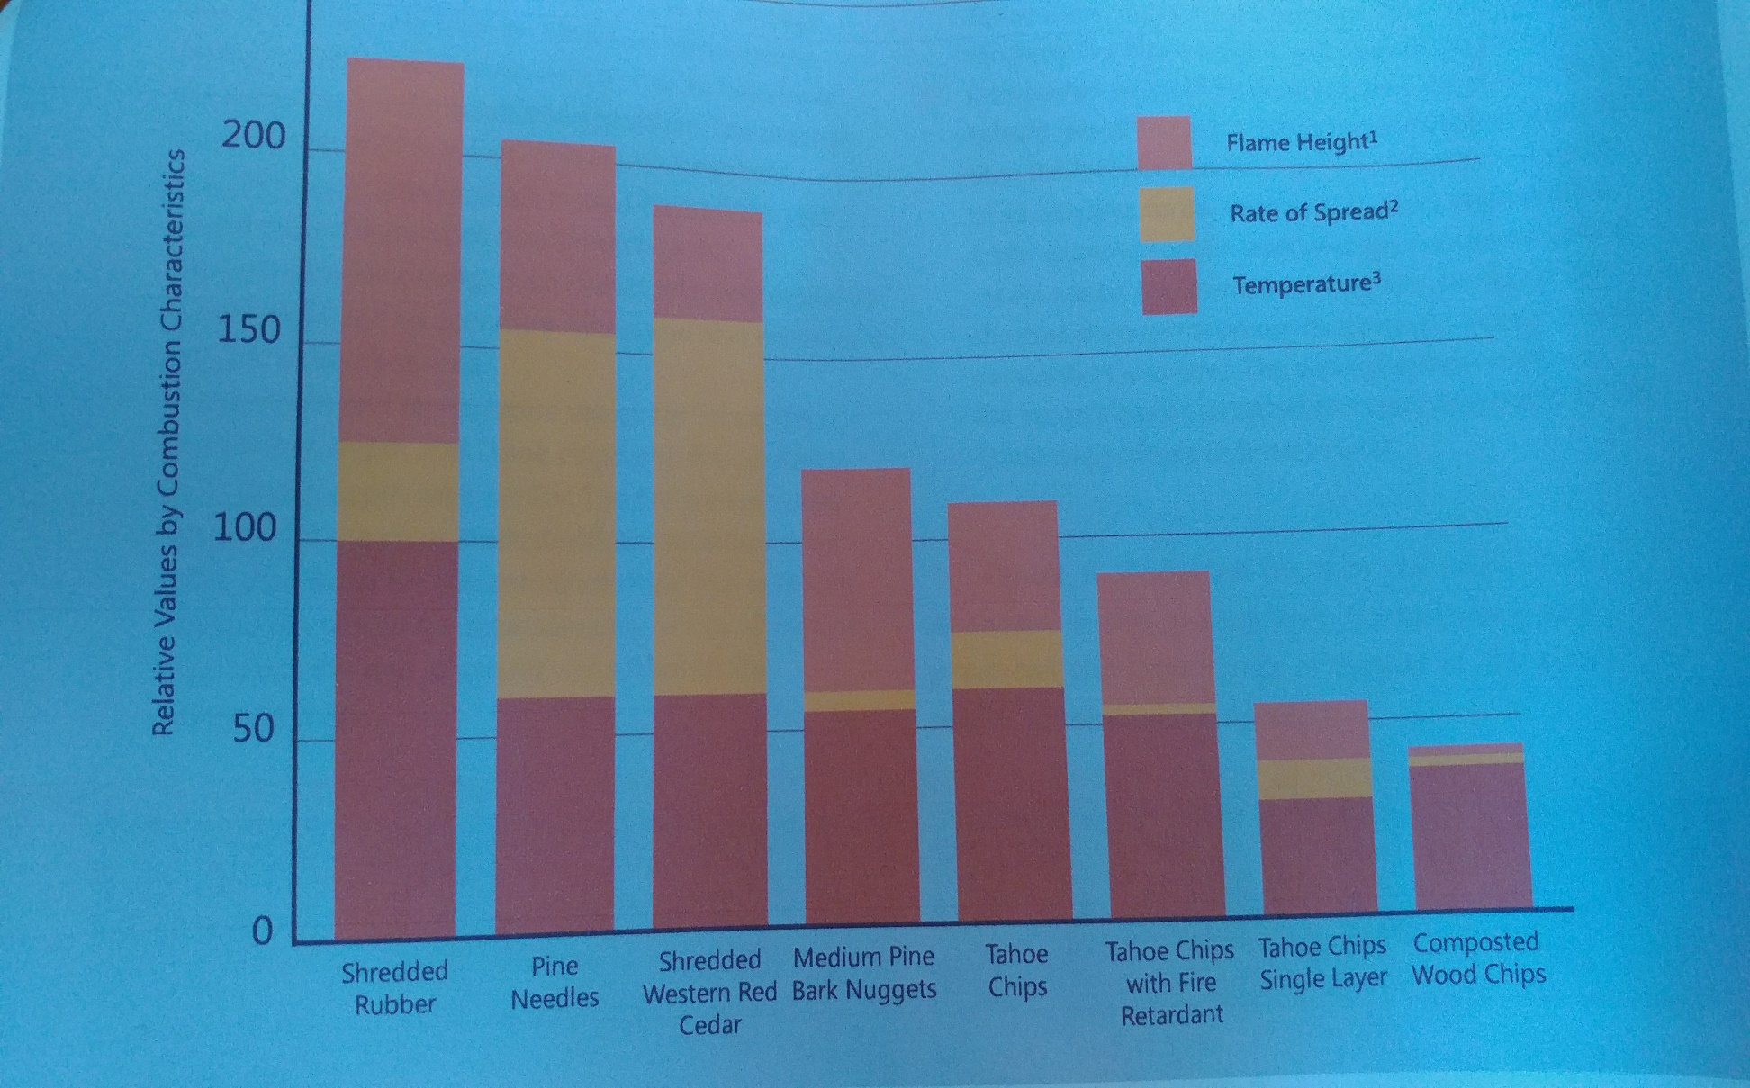
Fire Dangers
Stephan Quarles, UCCE Wood performance and Durability Advisor and Ed Smith, UC Nevada Resource Specialist
Notes:
This is a graph from a study conducted by Oregon State and University of Nevada, Reno where they tested the flammability of different mulches. The most flammable was shredded rubber and the least flammable was large wood chips, especially those made from trees native to our Sierras.

Slide 30
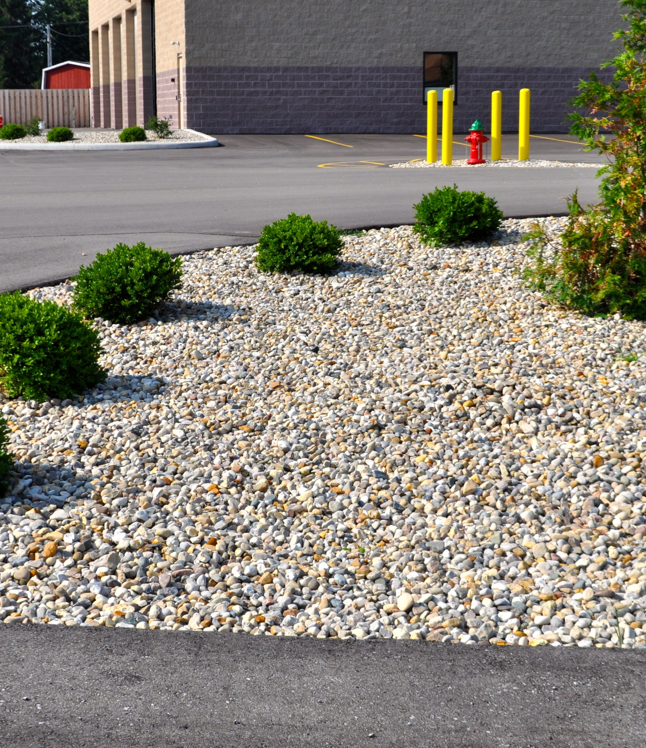
What About Mulching With Rocks?
Notes:
Many people like mulching with rocks. Rocks come in a variety of colors, won’t wash away and are virtually maintenance free. The downside is the retain heat at night stressing your plants, reflect light and heat onto your house and provide no habitat for the beneficials living in your soil such as worms. There can be a problem with weeds growing out of crevices. The same goes for shredded rubber which some people also purchase as mulch. Remember shredded rubber is made from tires, however studies have shown a split as to whether the gases ruber releases when hot is harmful or not.. Per University of Washington

Slide 31
Lasagna or Sheet Mulching
*Cut down grasses, weeds, etc. close to ground
Cover with barrier such as newspaper or cardboard
Top paper with dried leaves or compost
Sprinkle with coffee grounds
Moisten
Repeat 3-4 times. Pile will compost down in height
Ready to plant in 3-4 months
CC
Notes:
Check our website or the Roseville Utility Exploration Center for past recorded workshops for more in-depth information. The workshop title is: Replacing Your Lawn

Slide 32
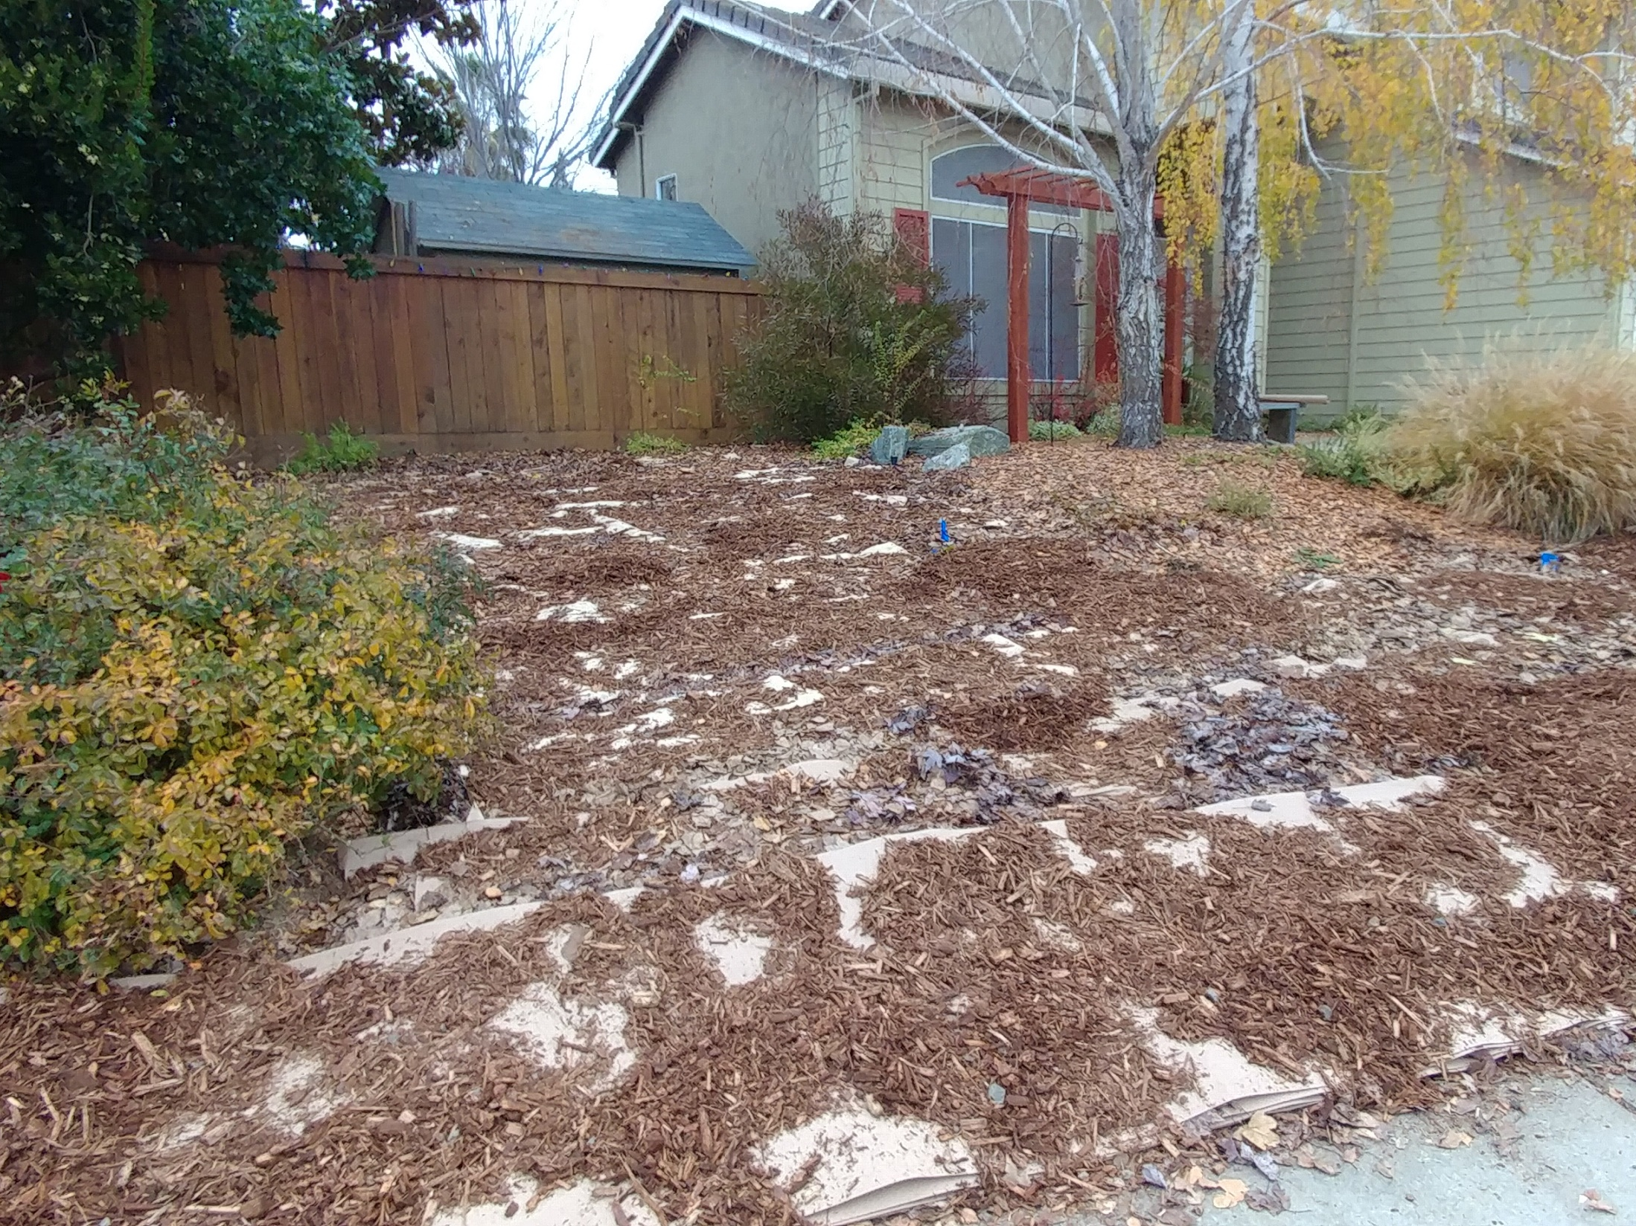
Notes:
This is what sheet mulching looks like before all the mulch is placed on top. This was down Thanksgiving week, and the yard was ready to plant in early April

Slide 33
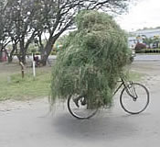
Grasscycling. What’s That?
Leave your grass clippings on lawn after mowing to decompose.
Leaves nutrients in the soil, reducing need for fertilizer and pesticides.
Helps environment by reducing material sent to the landfill
It does not cause thatch!
This Photo by Unknown Author is licensed under CC BY-SA
Notes:
Your grass clippings are full of nitrogen. Thatch is dead or decomposing roots and stems. It is common in clay soil where the water sits on top of the soil slowing down the microbial activity for decomposition

Slide 34
Summary
Compost is fully decomposed organic material that is worked into the ground
Promotes healthy soil and healthy plants
Discourages erosion
Saves time and money
Holds moisture
Mulch goes on top of the soil
Reduces moisture loss
Suppresses weeds
Saves time and money

Slide 36
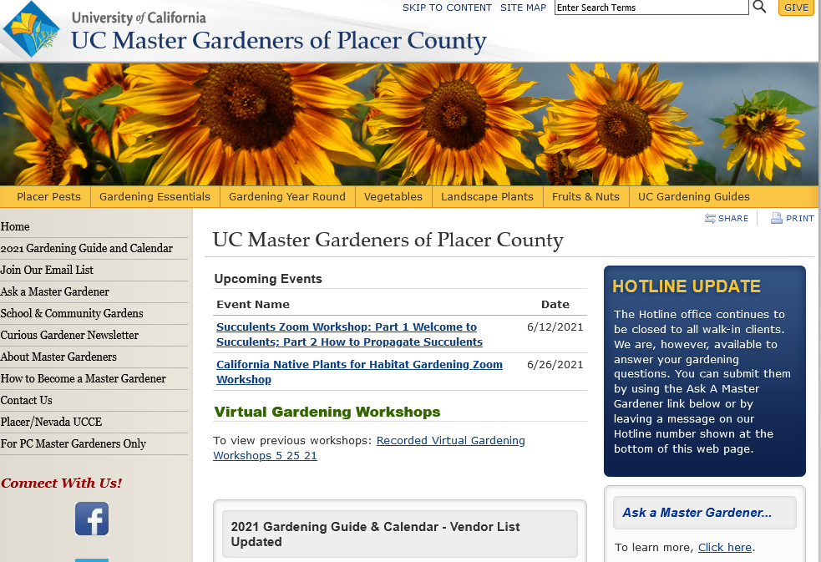

Slide 37
Thank You!
Any Questions?
Master Gardener Hotline: (530) 889-7388
Master Gardener Website: pcmg.ucanr.org
Evaluations, please!

