Slide 1

Gardening in
Placer County Soils
Presented by
Placer County Master Gardeners
Placer County
Notes:
Created by Ann Beinhorn & Marie Salers, 2018. Adapted from Gardening in Clay Soils by Marie Salers & Ann Beinhorn, 2011. Presented to Big History Group at Sun City Lincoln Hills 2018. Publicity: Club newsletter. Presented again to Meadow Vista Garden Club, 01-2019.

Slide 2
Who Are Master Gardeners?
Master Gardeners of Placer County
  Extend research-based, sustainable gardening and composting information
  Present accurate, impartial information to home gardeners
  Encourage public to make informed gardening decisions

Slide 3
Who Are Master Gardeners?
Where to find us…
Online, in the Media, and Special Publications
  Hotline: Call (530) 889-7388 or submit your questions online
  Website: pcmg.ucanr.org
  Facebook, Twitter, Instagram
  Gold Country Media monthly column
  Curious Gardener quarterly newsletter and on our website
  Gardening Guide and Calendar

Slide 4
Who Are Master Gardeners?
Where to find us…
Workshops, Fairs and Festivals and Special Events
  Speakers by Request
  Workshops (various venues, check website)
  Farmers’ Markets (seasonal: Auburn, Roseville)
  Fairs and Festivals Booths (varies)
  Garden Faire (April)
  Mother’s Day Garden Tour (May)

Slide 5
Agenda
The Elements of Soil
  Definition of Soil
  Soil Texture
  Soil Structure
  Organic Matter
Amending the Soil
  pH
  Organics

Slide 6
The Elements of Soil

Slide 7
Definitions: What is “Dirt”?
What is Soil?
Dirt: Not soil!
Soil: a highly organized material composed of minerals, organic material, air & water.
influences water absorption, runoff & erosion
can be made from glacial ice, wind, gravity, water, or parent rock material that may have left its place of origin.
Notes:
“Dirt” is a term used by geologists to refer to soil depleted of organic materials.
Parent material comes from the original minerals usually at a higher elevation.

Slide 8
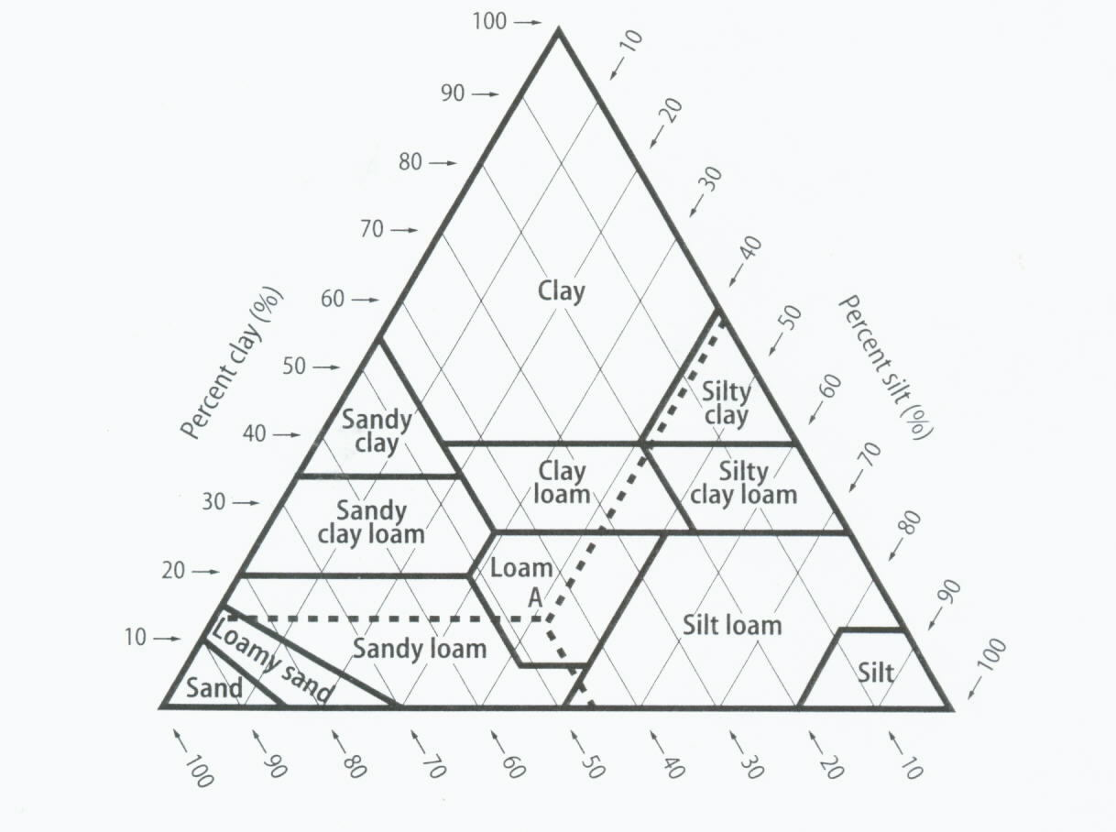
The 12 Basic Soil Texture Classes
Clay
Silt
Sand
Notes:
The chart shows 12 basic soil structures derived from the 3 types of soil particles.

Slide 9
What is Clay?
developed from silica and other basic minerals
“heavy”, wet and sticky in the winter,
hard and dry in the summer
Soil texture is an inherent property that you cannot change. Instead, direct your efforts toward improving soil structure.
(See your handout)
Notes:
Clay soils hold minerals well, but they can hold as much as 4 inches of water in the top foot of soil.
Clay is comprised of very fine particles .. .0002mm. 89 acres of surface area in 1 pound of clay soil.

Slide 10
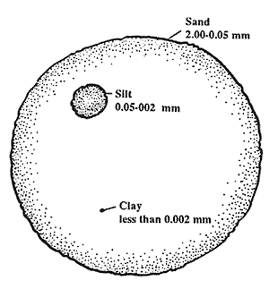
Soil Texture:
The natural relative proportion of various soil particles
Sand, Silt and Clay
Sand: 2.00 mm-.05 mm
Silt: .05-.002 mm
Clay has the smallest grain particles, (<.002mm), which cover each other the most, leaving the smallest pores.
Soil pores are the spaces between the particles
Notes:
You can see the great difference in the three sizes, their differences in free surface area, and potential pore space.
Texture gives you a distinct feel.

Slide 11

Texture influences soil water-holding and gas-exchange capacity
Texture
Storage capacity (in./ft.)
Silty clay loam
Clay loam
Sllt loam (most)
Silty clay
Sandy loam (least)
1.8
1.8
2.0
1.6
1.4
Notes:
The physical properties of a textural class include the ability to hold water and allow gaseous exchange. Too many finer particles can result in very slow percolation, and too many large particles leach water.

Slide 12
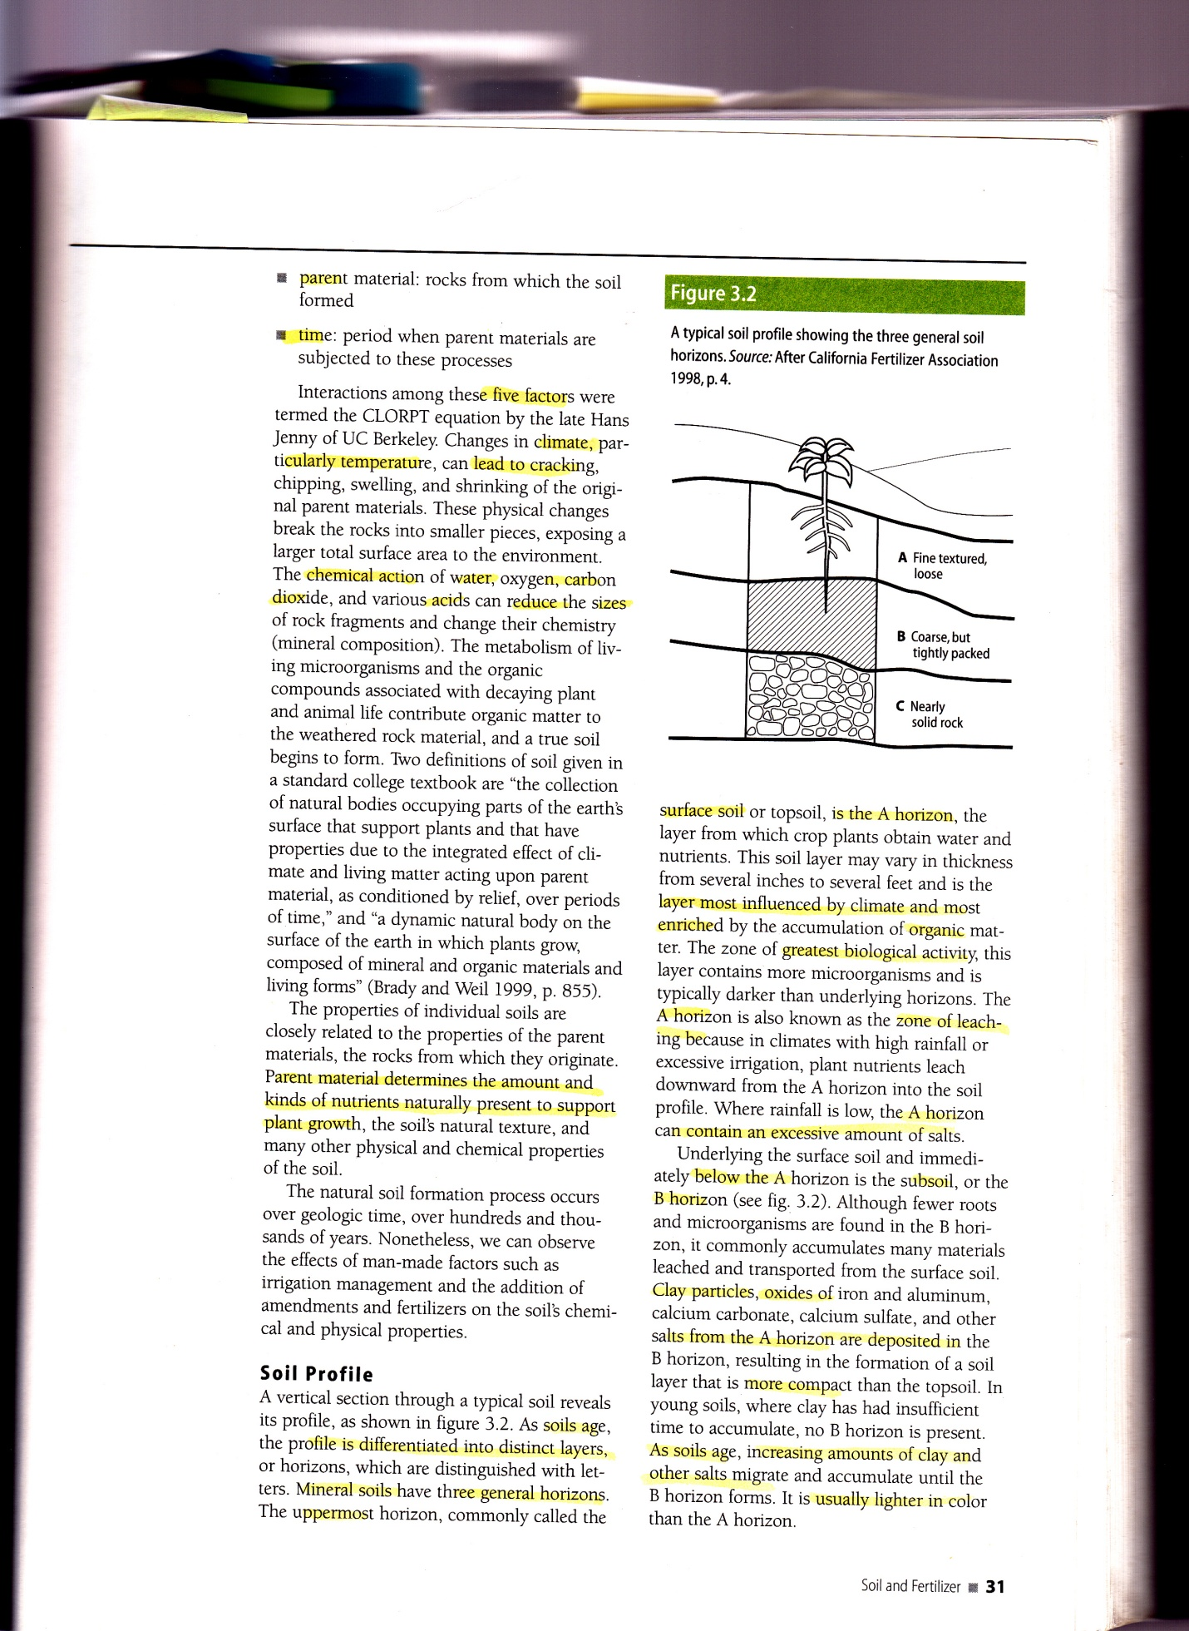
Soil Organic Matter
Factors influencing organic matter accumulation
Topography “A” Horizon accumulation
Native vegetation
Climate
Time
Organisms
Notes:
The picture shows some of the horizons that have built up over time. C= unconsolidated parent material, B=Accumulation of organic, mineral & inorganic chemicals,
A= Organic material and mineral material intimately mixed. Above Zone A you get a narrow layer of organic material.
Zbedrock is below the C Zone.

Slide 13
Soil Structure
  made of aggregates: small groups of particles
  defined by size, shape and stability of the aggregates
  the major influences availability of nutrients and water to the plants.
  influenced by living microbes, insects and earthworms
  damaged by tilling & compaction
Notes:
See definition: The way sand, silt & clay are bonded together as aggregates.
Mayn be recognized visually, such as platy, massive, granular, single-grained, etc.

Slide 14
Soil Structure is:
ideal when large and small pores occur in proportion to the relative needs of the plants.
good for growing if “loamy”
  nearly equal proportions of sand silt & clay
  best gaseous exchange and water-storage capacity
Notes:
The composition of soil aggregates is important for the health of plants.

Slide 15
Loam: The Ideal, Healthy
Soil Structure
17-27% clay
<52% Sand
28-50% Silt
***.. and best if it has about 5% organic matter, shown by a darker, browner color (humus).
Notes:
You will find humus in locations with many layers of organic matter that are highly decomposed and rich in nutrient ions for plants (See definition). Soil chemical and physical properties are largely a function of the humus and clay in the soil.

Slide 16
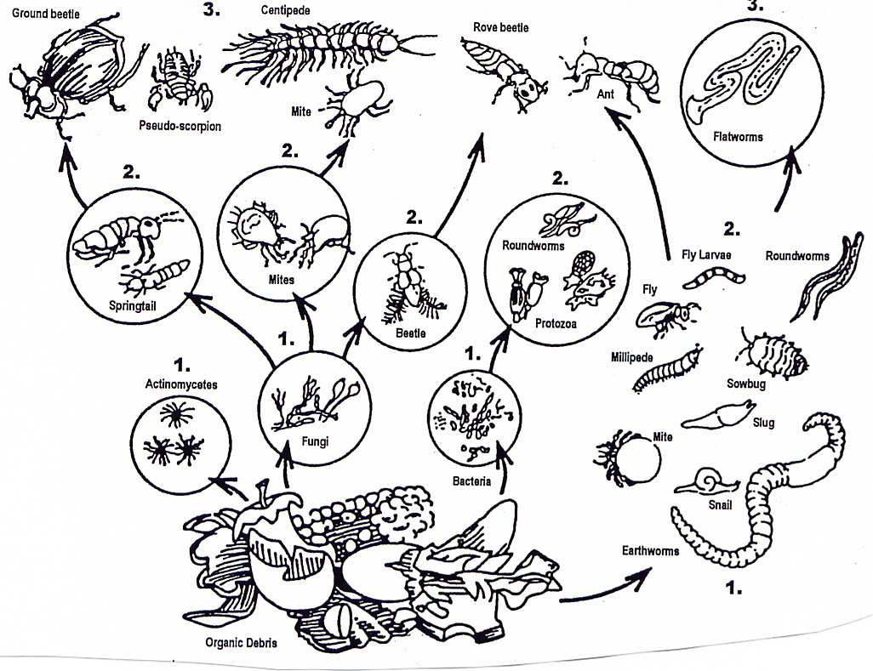
Soil Organics:
The Soil Food Web
Notes:
Note micro organisms in circles and macro organisms, labeled by 3 categories in the food chain..

Slide 17
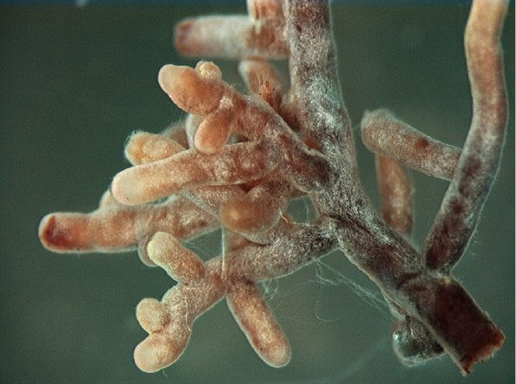
Organic Matter:The Soil Food Web
Smallest: bacteria, fungi, protozoa, algae
    extract nitrogen & carbon from the atmosphere
    decompose plants and minerals
    enable plant nutrient availability
  Medium-Sized: nematodes, and more
    recycle nutrients Mycorrhizae and roots
  Bigger: earthworms, insects and more
    break down organic matter,
    recycle nutrients,
    improve soil pore space
Notes:
Micro to Macro organisms all play a part in nourishing the soil.

Slide 18
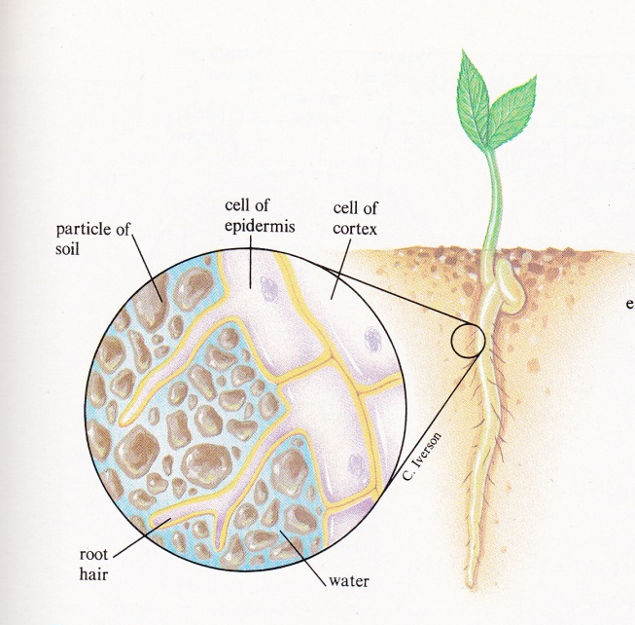
Clay Soil & Your Garden
What do roots need?
  Water ..but not water-logged
  Oxygen billions of root hairs
  Nutrients
Notes:
The cell wall of the root hair magnified to show osmosis of water, nutrients and air from the soil.

Slide 19
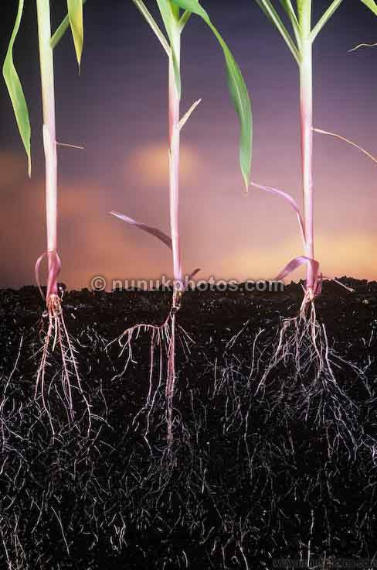
The Chemical Value of Clay
Organic matter and clay are needed to transport nutrients to the plants
Notes:
(The chemical cation exchange capacity of clay can be stated without using the term CEC). Clay is important for soil nutrition.

Slide 20
An East Roseville Soil Sample
  pH: 7
  Soil Texture: Sandy Clay Loam
  50% Clay
  4 % Silt
  46 % Sand
  Available Minerals:
  N (Nitrogen): trace
  P (Phosphorus): high
  K (Potassium): high
  (Best soil= about 40% silt, 40% sand, 20% clay)
Notes:
This Roseville location had a pinkish grey color, but is loamy and responds well to amendments for plant vigor. The lot was originally an oak woodland.

Slide 21
AMENDING THE SOIL

Slide 22
Soil pH
Little rainfall> alkaline soil
Lots of rainfall> acidic soil
Best pH for plants is 6.5-7.5
To ^ acidity, add pine needles, composted oak leaves, soil sulfur
To ^ alkalinity, add any form of lime
Notes:
See soil amendment definition in your handout. Show a soil testing kit.

Slide 23
Soil Mycorrhizae
=Symbiotic relationships between fungi present in the soil and plant roots
Water & nutrients for the plant
^ Pathogen resistance, drought tolerance, general tolerance of stresses on the plant
Food (carbon) for the fungi
So…don’t till, don’t over-water, don’t over-fertilize!
Notes:
Refer to your glossary for a definition for mycorrhizae. Tilling is damaging to the microorganisms, and compacts the soil pores.

Slide 24
Organic Amendments that Influence Soil Structure
Compost (The yield from the progressive conversion of organic materials into smaller units, becoming humus)
Worm castings
Steer, chicken manure
Bat guano
Blood meal
Alfalfa
Cotton seed meal
Green manures from cover crops
Organic fertilizer (Note the ratio of N-P-K)
Organic mulches
Notes:
Adding organic materials to your soil is very influential on the structure and chemical properties needed for plants.

Slide 25
Commercial Soil Mixes
Organic potting mix
  Fir bark, lava rock, sphagnum peat moss, sand, aged redwood
Cactus mix
Pumice, fir bark, aged redwood, sand
General Soil Amendment
  Compost, (rice hulls, recycled forest products, arbor fines, dairy manure, poultry manure), dehydrated poultry manure, hydrolyzed feather meal, gypsum
Notes:
Gypsum is calcium sulfate. You may find some gypsum in these mixes, but it is only effective in improving soil aggregation and water infiltration when the soil has excessive sodium salts from irrigation.

Slide 26
References
Books:
Essential Soil Science M.R. Ashman & G. Puri
Master Gardener Handbook University of California ANR pub #3382
Online:
USDA
https://www.nrcs.usda.gov/wps/portal/nrcs/main/soils/health/
UC Agricultural and Natural Resources:
ANR pub #31-156, “Working With Foothill Soils”
http://anrcatalog.ucanr.edu/pdf/8037.pdf
PCMG Curious Gardener, "The Marketing of Mycorrhizae” http://pcmg.ucanr.org/newsletters/Curious_Gardener Newsletters76595.pdf
ANR pub #8059, “Vegetable Gardening Basics”
http://anrcataloghttps://anrcatalog.ucanr.edu/pdf/8059.pdf

Slide 27
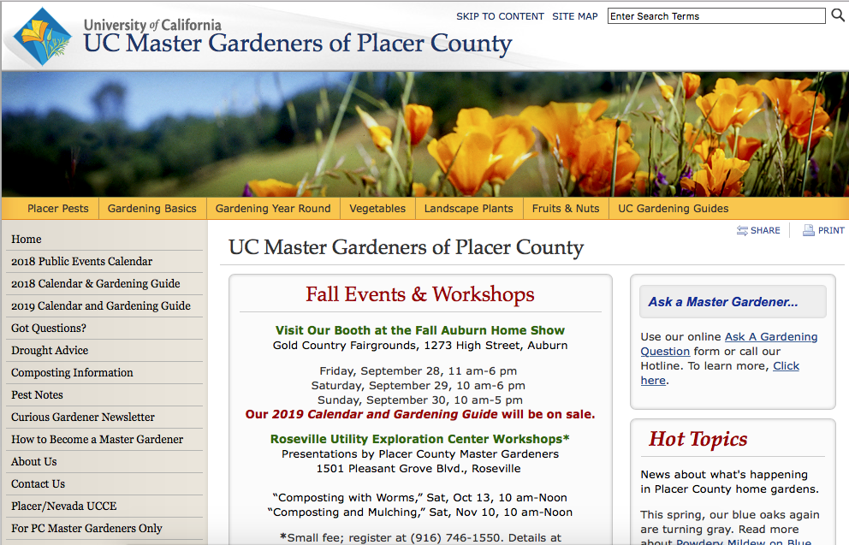

Slide 28
Thank you
            Questions?
Gardener Hotline: 530 889-7388
Master Gardener website:pcmg.ucanr.org

