Slide 1
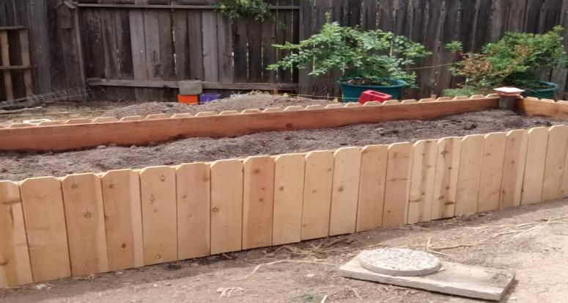
Raised Bed Gardening
Notes:
Created: September 2020
Created by: Kathy Netto and Kelly Warman
Audience: Vegetable Gardeners, Small yard Gardeners
Publicity: Text that could be published on calendar, Facebook, newsletter to attract an audience
Update History: for each update to the presentation include date, name of updater, explanation of update
(were additional slides added, were web links updated, etc.)

Slide 2
Who Are Master Gardeners?
Master Gardeners of Placer County
  Extend research-based, sustainable gardening and composting information
  Present accurate, impartial information to home gardeners
  Encourage public to make informed gardening decisions

Slide 3
Who Are Master Gardeners?
Where to find us…
Online, in the Media, and Special Publications
  Hotline: Call (530) 889-7388 or submit your questions online
  Website: pcmg.ucanr.org
  Facebook, Twitter, Instagram
  Gold Country Media monthly column
  Curious Gardener quarterly newsletter on our website
  Gardening Guide and Calendar

Slide 4
Who Are Master Gardeners?
Where to find us…
Workshops, Fairs and Festivals and Special Events
  Speakers by Request
  Workshops (various venues, check website)
  Farmers’ Markets (seasonal: Auburn, Roseville)
  Fairs and Festivals Booths (varies)
  Garden Faire (April)
  Mother’s Day Garden Tour (May)

Slide 5
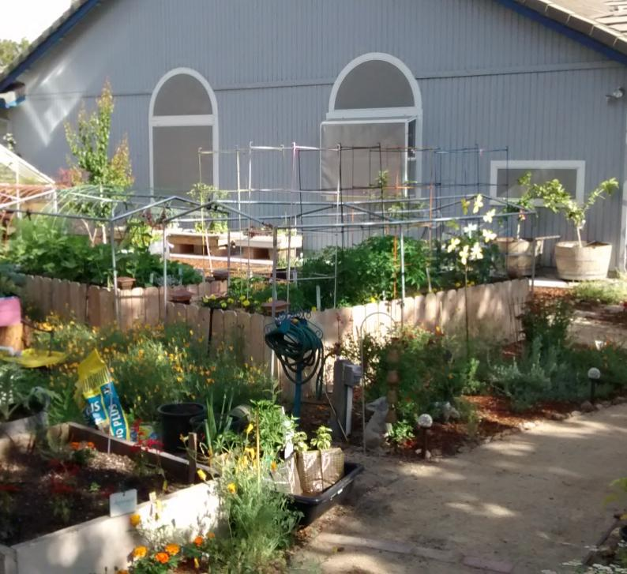
Why A Garden?
Grow your own vegetables …fresh and nutritious + Variety
Teaching and Family connection
Sustainability
Fun
Notes:
During the last several months there has been an increased interest in folks wanting to grow their own food.
By growing your own you know where it’s been, how it was grown and you know it’s fresh.
You can try new varieties, that may not be available in the store, like rainbow carrots
Because families are spending more time at home a garden can be a great family project or an outdoor science lab to support distance learning
Playing in the soil can be fun.

Slide 6
What is Your Goal?
Growing a few fresh vegetables?
Expanding to a larger garden?
Urban homesteading – Growing all your own food?
Somewhere in between?
MAKE A PLAN AND SET A GOAL
Notes:
Before you get started have a goal in mind of what you what to do.
Are you an inexperienced gardener and just want to get started OR just want a few fresh veggies – Start small with one bed
Have you been doing this for awhile and want to expand or you are changing from in ground growing – Make a plan to see what you need in materials and what will fit into your space
Are you planning on becoming an urban homesteader and grow all your own food. I fit into this category minus the chickens. I didn’t just jump into this it has evolved over a number of years with research and some trial and error
Where ever you are in gardening, have a plan and goal will add to the success of your adventure.

Slide 7
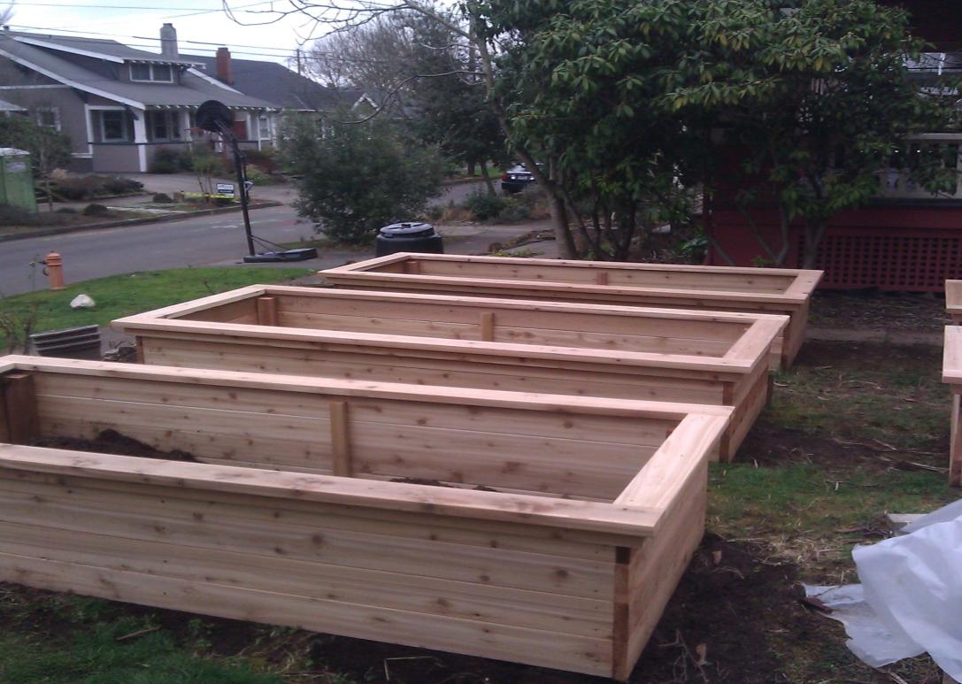
  Why Consider Raised Bed Gardening?
Notes:
Raised beds can maximize your growing opportunity if you have limited growing space, poor soil or mobility difficulties.
Plants can be placed closer together
They add interest to your garden and can make it look tidier, especially if you live in an area with strict CCRs
The soil in raised beds tends to warm up quicker in the Spring, giving you a jump on the season.

Slide 8
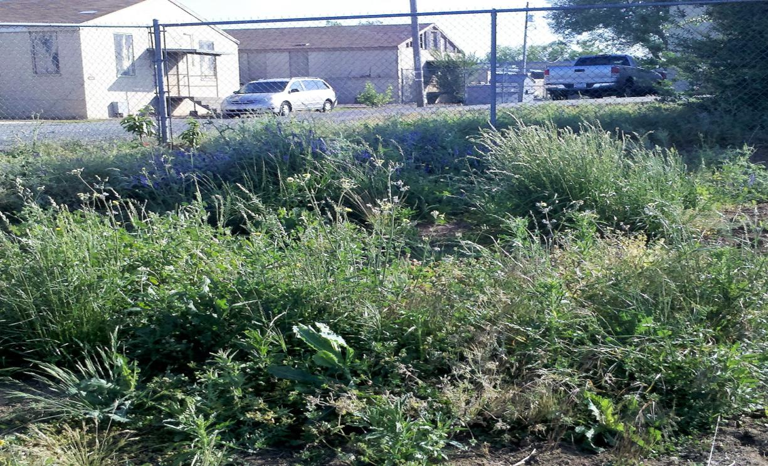
Advantages of Raised Beds
Gardening in poor soil conditions
Notes:
Growing in raised beds is a great way to be able to garden where the soil is poor. They can be expensive due to start up costs such as material to build the beds and soil to fill them.

Slide 9
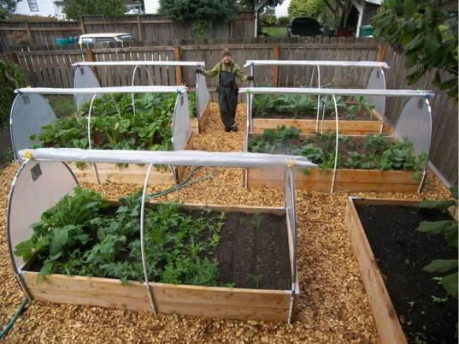
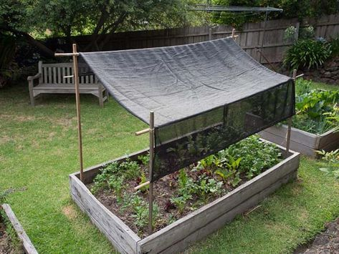
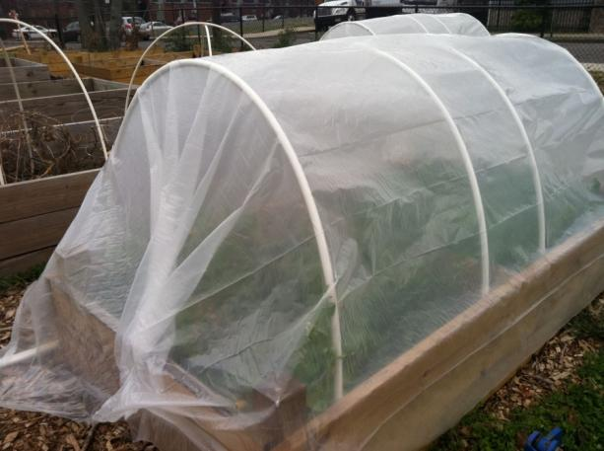
Extend the growing season
Notes:
Soil warms faster in spring
Beds can be covered to protect crops in winter and
Can use shade cloth to reduce sun exposure during summer

Slide 10
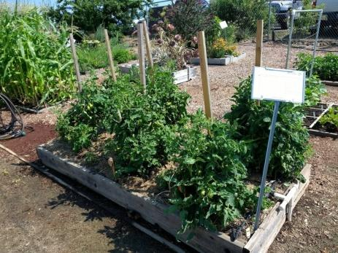
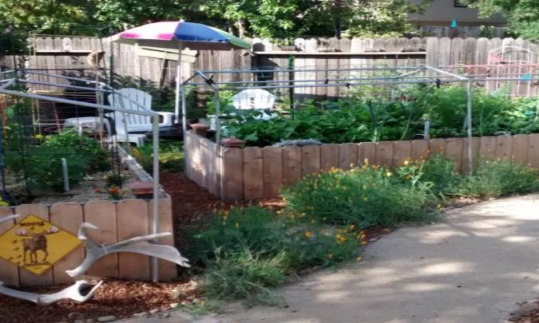
Produce higher yields
Notes:
Better root growth from improved soils leads to higher yields for food crops and lusher growth of ornamental plantings.
Can be grown in a smaller area than with conventional techniques.
No space is wasted between rows
No soil compaction from walking on soil

Slide 11
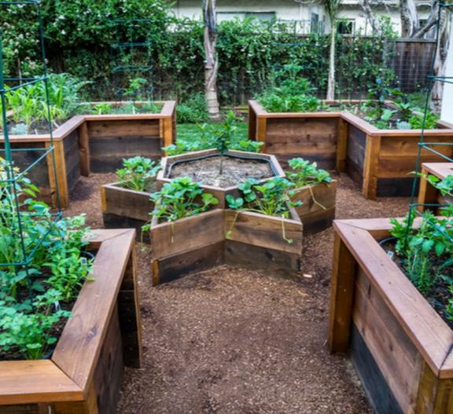
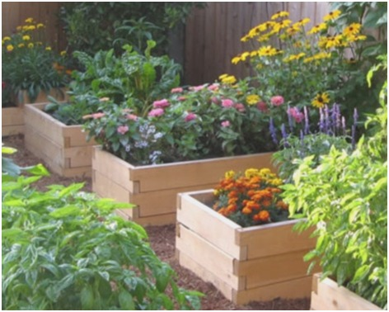
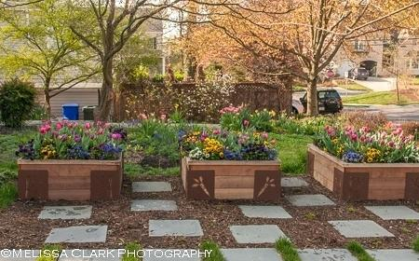
Attractive
Notes:
Raised beds can be constructed from a number of materials and styled to fit your taste. Keep in mind that the raised beds should be no wider than 3 -4 feet to allow you to reach the center of the bed

Slide 12
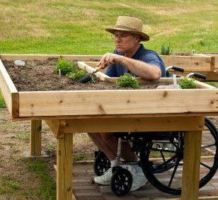
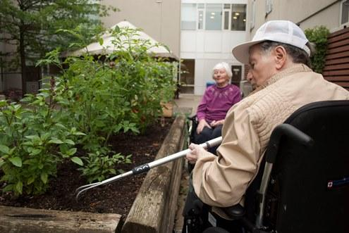
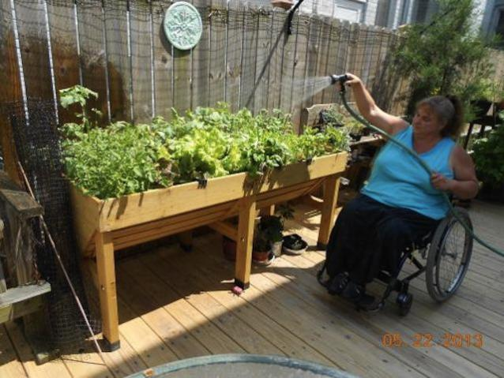
Accessible
Notes:
They can be built to meet the needs of various abilities. Taller beds like the ones in the picture, are nice for someone who has trouble bending or kneeling. Beds can also be constructed for wheelchair assess.

Slide 13
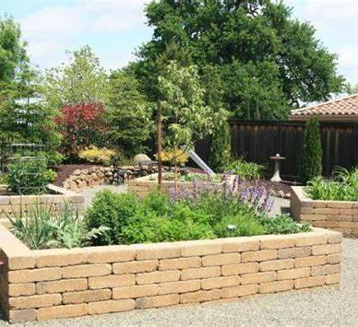
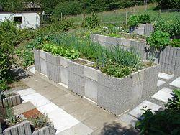
Let’s Get Started!
Materials – Choose an option that best suits your yard size, budget and growing needs.
Adobe Bricks
Cinder Blocks
Notes:
Wood, bricks or block, metal – avoid using wood that has been pressure treated with arsenic, railroad ties (treated with creosote)
3-4 feet wide maximum (so can reach across)
The depth of a raised bed is a matter of personal preference. Most plants need at least a 6- to 12-inch rooting zone, but deeper would be better
Leave enough space in-between beds for wheelbarrow
Break up long beds (two 25 ft better than one 50)
May want a ledge so can sit
Hardware cloth on bottom if gophers are a problem in your area

Slide 14
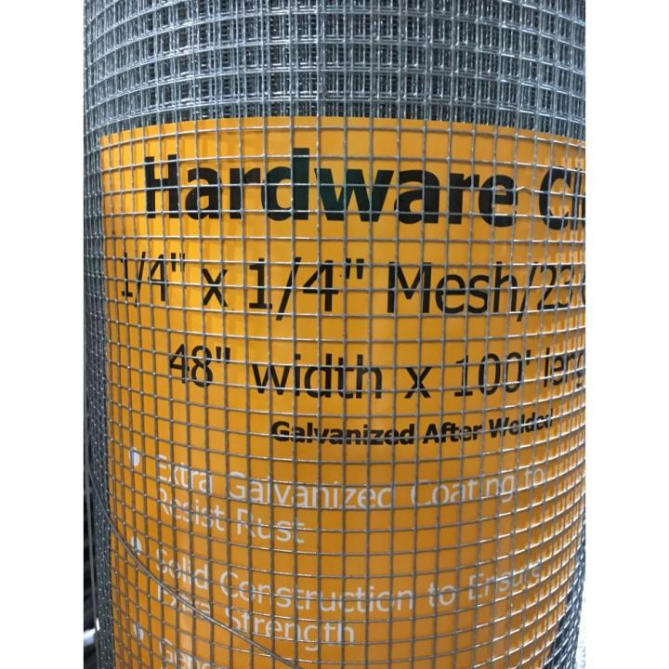
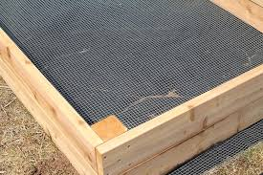
Hardware Cloth -
Optional
Notes:
Hardware cloth is only needed if you have burrowing pests like gophers.
Securely attach the hardware cloth to the bottom of the raised bed making sure there are no gaps.

Slide 15
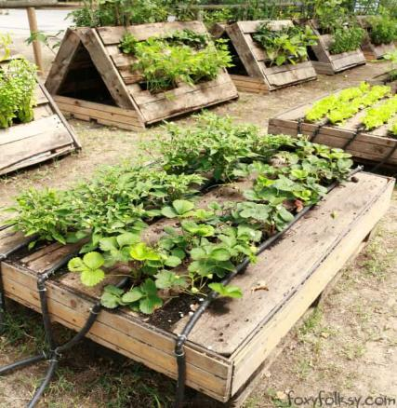
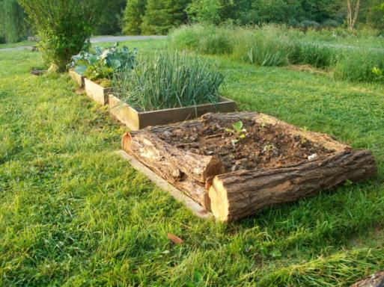
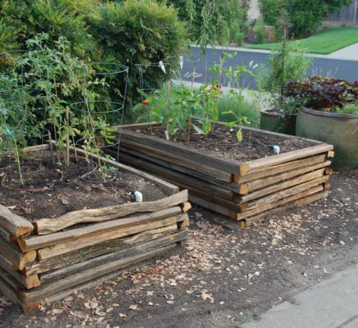
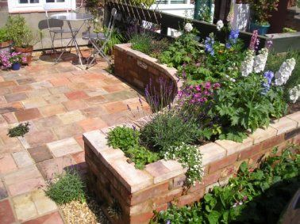
Design Ideas
Natural Wood
Pallets
Bricks
Reclaimed Wood
Notes:
Know your source – when using recycled/ reclaimed wood or pallets make sure that they were not treated with any chemicals.

Slide 16
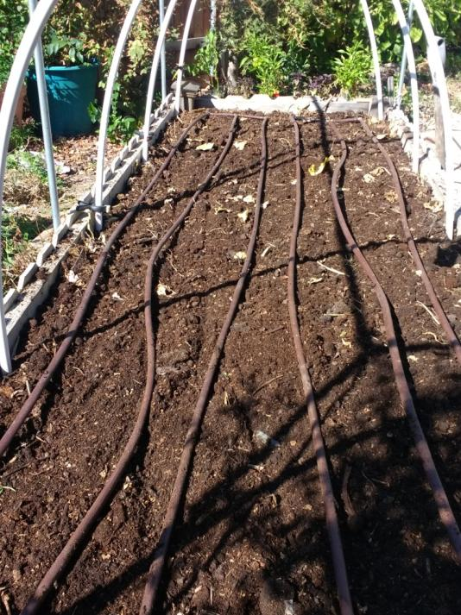
Water
Drip – individual emitters, in-line emitters, or soaker hose
Hand watering
In-line drip emitters
Notes:
Watering your raised bed is easy.
You can use in-line emitters like what is shown in this bed or emitters to individual plants. Both work well to put the water at the soil level thus reducing water loss to evaporation. The inline and soaker products come in both ¼” and ½” sizes depending on your bed size
Drip will help keep the water off the foliage of the plants, reducing the risk of fungal disease or powdery mildew.
Hand watering is also an option but it takes time and it means dragging the hose around.
Our winters are often mild and can be dry so we do need to irrigate those winter crops in between rain storms.

Slide 17
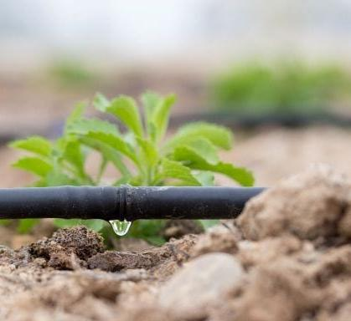
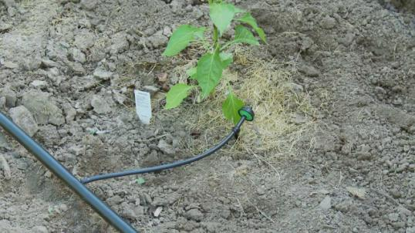
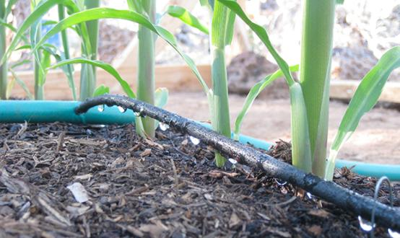
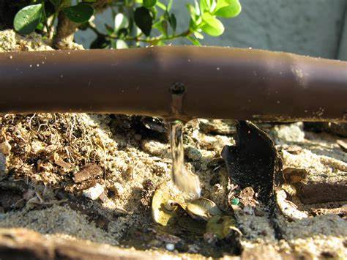
Examples of Drip
¼” In-line drip
Individual emitter
Soaker hose
½” In-line emitter
Notes:
Which style you choose is up to you.
The inline emitters are made to put out a measured amount of water in gallons per hour. The product package will tell you how much water you will get. Make sure to stagger the emitters in the raised bed for the best coverage
Individual emitters also put out a measured amount of water. They often come color coded based on their gallons per hour. This method will allow you to customize the watering for the needs of your plants.
The soaker hose is a soft spongy line that has microscopic holes that allow the water to ooze out

Slide 18
Size and Spacing
Start by making a layout sketch of your garden area.
The size of the bed is up to you, but try to limit the width to 3-4 feet.
The larger the bed the more soil you will need.
Allow 3 feet between beds
3 ‘
Notes:
When making a sketch of the area notice the direction of the sun and plan to place you beds in an East/West location that will get at least 4-6 hour of sun light
Make sure that you have a water source close by and note that on your sketch
Limiting the width of the bed to 4 feet will allow access to the center of the bed from both sides
Spacing between beds is important to allow for wheel barrows, wheel chairs and harvesting.

Slide 19
A Sample Layout
South
East
West
W
W
W
Raised Beds
North
Notes:
You don’t need anything fancy for a garden layout. I used this design when planning my raised bed garden. This plan can also be useful for planning where to plant your veggies
I have also notated where the water supply is located

Slide 20

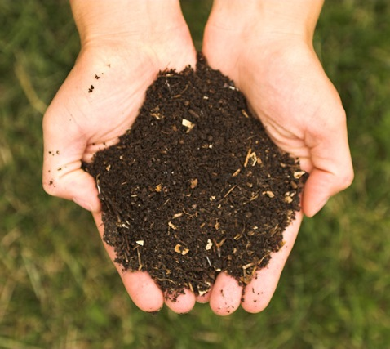
Soil
Use a good quality planting mix…either bagged or bulk
Amendments and fertilizers should be added before planting
Avoid working wet soil
Compost and Well-Aged Manures
Notes:
This is the most important part of your bed
Make sure to purchase good quality soil – a top soil blend or raised bed mix. If you are building larger beds or more than 1 bed, bulk purchasing might be a less expensive option.
The soil in the raised bed will need to be amended after each growing season with at least 4” of organic compost.

Slide 21
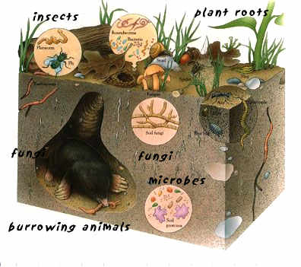
Caring For Your Soil
Apply a layer of mulch after planting
Avoid working the soil when it is wet
Feed your soil – it’s alive
Rejuvenate each growing season
Notes:
Applying a layer of mulch after planting will help to maintain soil moisture, control weeds and protect the soil from becoming compacted by pounding rain. A layer of mulch will also help to protect they roots of your plants
By not working the soil when it’s wet you will help to prevent clods from forming and the soil and soil compaction
Feed your soil. The soil is alive with all kinds of critters, fungi and microbes even in raised beds. Keeping you soil happy and well fed you plants will thank you for it.
Rejuvenate– raised beds are, especially tall beds are essentially big containers and your plants will need some extra attention. Plants may require regular feeding weather its organic fertilizer, synthetic fertilizer or compost. After each growing season raised beds will need to be rejuvenated with plenty (3-4”) of organic matter like compost to maintain soil health. Make sure to mix the compost into the soil so that it can be at the roots of the new plants

Slide 22
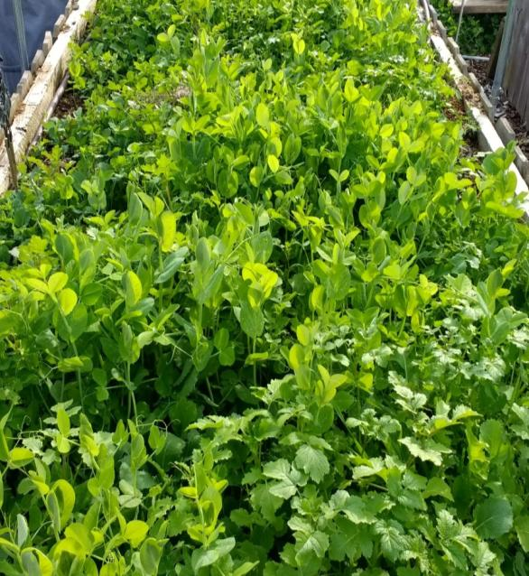
Skipping a Season?
Make sure to protect the soil
Plant a cover crop, also known as green manure
Adds nitrogen to the soil
Use a mulch layer
Notes:
At some point you may wish to not have a garden especially in the fall and winter.
Don’t allow your beds to sit fallow (uncovered) plant a cover crop. My favorite cover crop is a mixture of beans, peas, and vetch which are all legumes. The plants require little attention except some water if you are in a dry zone. Just before they bloom chop up the plants and turn into the soil. Plant to do this at least 3 weeks before planting to allow them to decompose.
Another way to protect your soil is to add a layer of mulch. You can use leaves, straw, cardboard, or even bark

Slide 23
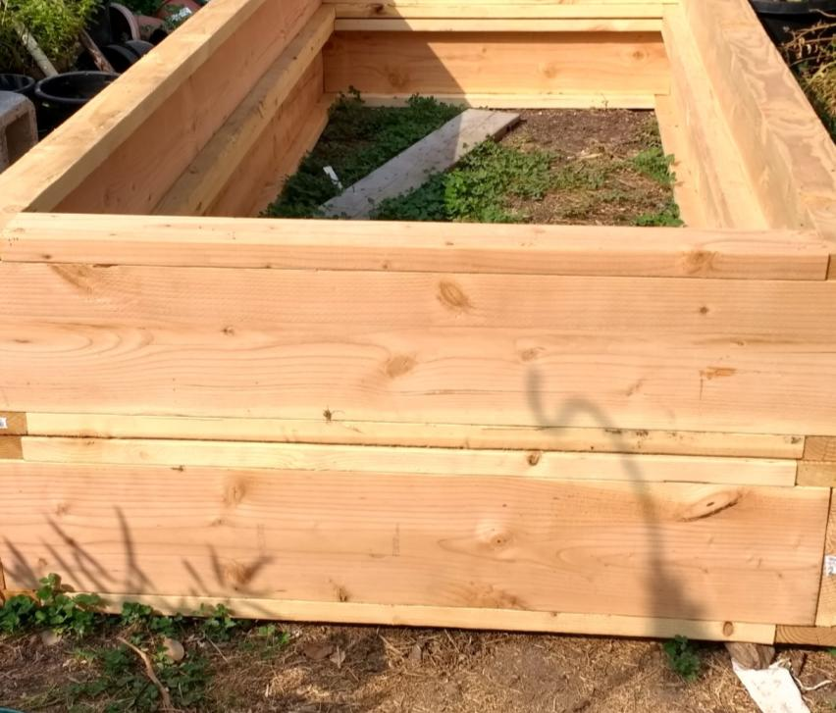
Here’s The Math
Bed Volume:
10x4x2=80 cubic feet
One Yard of soil is
27 cubic feet
I will need 3 yards to fill this bed
L=10’
H=2’
W=4’
Notes:
You will need to figure out the volume of your new bed so that you know how much soil to purchase.
This is my new bed – it is 10’ long x 4’ wide x 2’ high. Multiply the length x width x height and you have your volume in cubic feet.
Soil is sold by the yard and one yard of soil is equal to 27 cubic feet.
I will need to purchase 3 yards of soil to fill this bed with a little left over

Slide 24

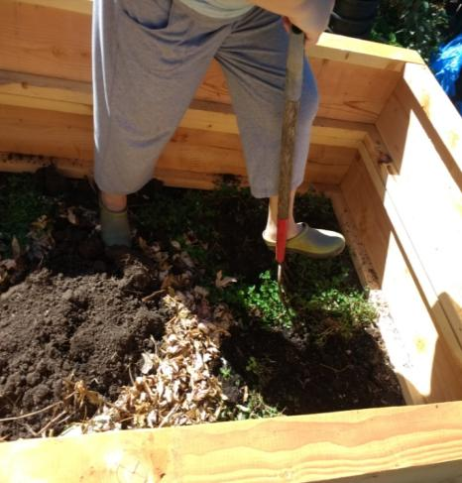
Fill it Up!
Loosen the ground
Add your soil and amendments
Add your water lines
Notes:
Loosening the ground soil will allow for better drainage, especially if your soil is compacted
Now is the time to add your soil and amendments to the bed. Using a garden rake to smooth out the soil as you go
Add the water source to the bed and you are set to go

Slide 25
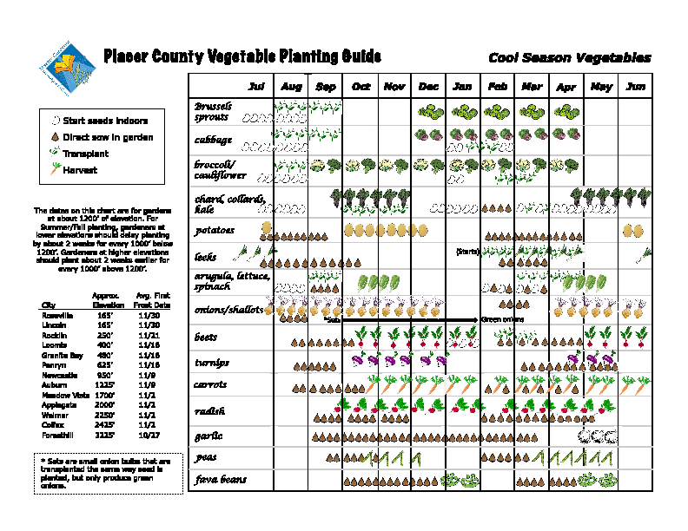
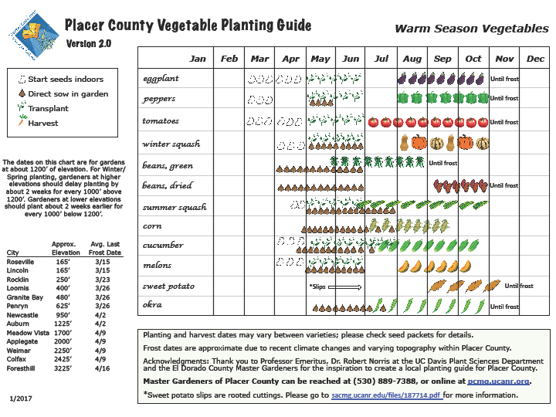
What Comes Next?
Make a plan – what do you want to grow?
What will your family eat?
Will you start from seeds or buy plants?
Consult our Vegetable Planning Guide
https://pcmg.ucanr.org
Notes:
Make a plan of what you want to grow and what will fit into your area. Some crops like broccoli and spinach will continue to produce over the season as where cauliflower you only get one. Make the best use of your space.
Plant what your family will eat. It’s fun to try new things but keep it to one or two varieties
Decide if you want to start from seed or buy plants. Starting from seed will require some preplanning.

Slide 26
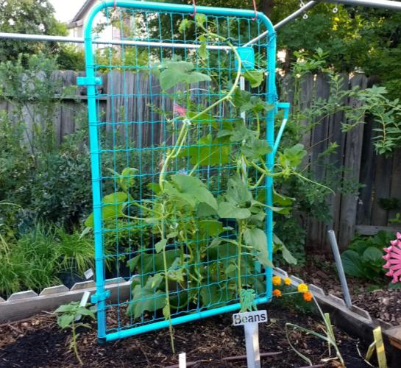
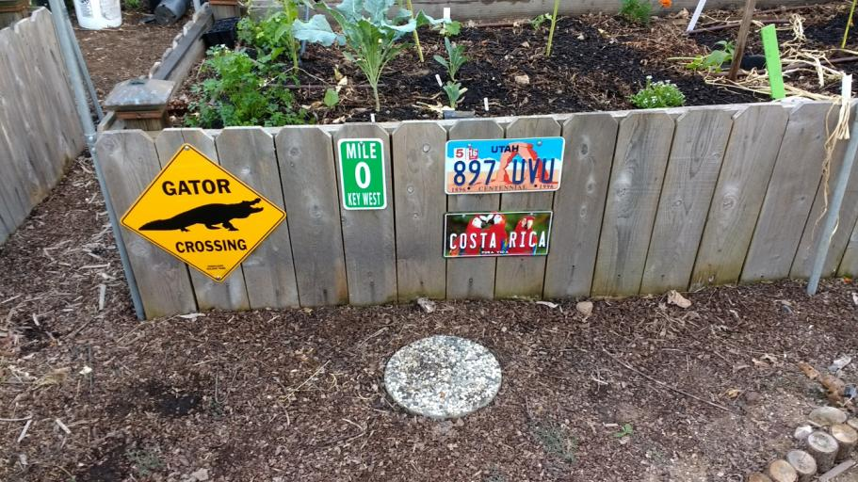
Let’s Get Planting
Now that they are built, its time to plant!

Slide 27
Resources
https://anrcatalog.ucanr.edu/pdf/8059.pdf
https://ucanr.edu/sites/soils/files/305668.pdf
https://cagardenweb.ucanr.edu
Vegetable Gardening Basics
Raised Bed Ideas
The California Garden Web

Slide 28
Thank You
Any Questions?
Master Gardener Hotline: (530) 889-7388
Master Gardener Website: pcmg.ucanr.org
Visit our website to download handouts and a pdf of this presentation

