Slide 1
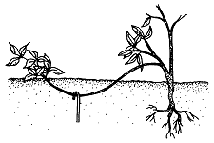
Principles of
Plant Propagation
Notes:
Created: Original2011. Amended 2018 and 2021.
Created by: Ann Beinhorn and Marie Salers
Audience: Home gardeners Who want to improve their skills
Publicity: Propagation is the term for the multiplication of plants, either by natural means or by the actions of the nurseryman or gardener. This introductory workshop will show you some of the many ways you can propagate plants.
Update History: for each update to the presentation include date, name of updater, explanation of update
(were additional slides added, were web links updated, etc.) In 2021, slides were added and wording added to show to a general audience for online presentation for Prblish Workshops.

Slide 2
Who Are Master Gardeners?
Master Gardeners of Placer County
  Extend research-based, sustainable gardening and composting information
  Present accurate, impartial information to home gardeners
  Encourage public to make informed gardening decisions

Slide 3
Who Are Master Gardeners?
Where to find us…
Online, in the Media, and Special Publications
  Hotline: Call (530) 889-7388 or submit your questions online
  Website: pcmg.ucanr.org
  Facebook, Twitter, Instagram
  Gold Country Media monthly column
  Curious Gardener quarterly newsletter and on our website
  Gardening Guide and Calendar

Slide 4
Who Are Master Gardeners?
Where to find us…
Workshops, Fairs and Festivals and Special Events
  Speakers by Request
  Workshops (various venues, check website)
  Farmers’ Markets (seasonal: Auburn, Roseville)
  Fairs and Festivals Booths (varies)
  Garden Faire (April)
  Mother’s Day Garden Tour (May)

Slide 5
Agenda
Principles of Plant Propagation
Seeds
Layering
Separation and Division
Cuttings
  herbaceous
  woody
Grafting and Budding

Slide 6
Propagation Terms
Propagation: The multiplication of plants by sexual or
asexual means
Seed: A mature ovary containing an embryo
Clone: A new plant identical to the parent
Hardening off: Treating plants to make them more
resistant to harsh environmental conditions

Slide 7
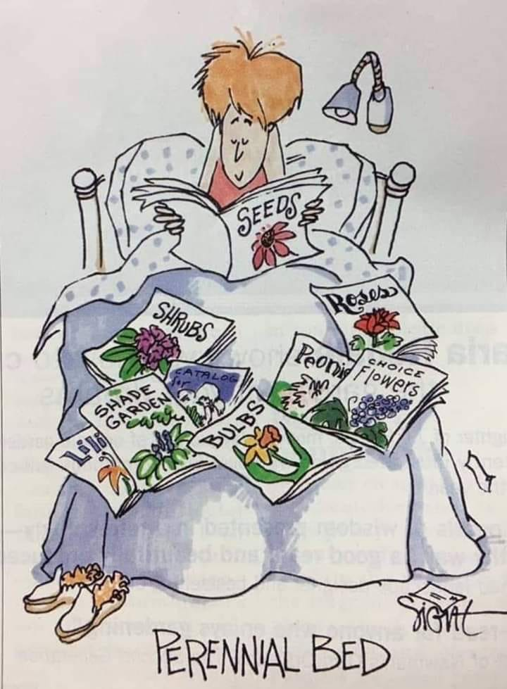
Seeds
by permission: http//twowomenandahoe.com
Notes:
This humorous picture was acquired by permission of Jan Bills, website owner of twowomenandahoe

Slide 8
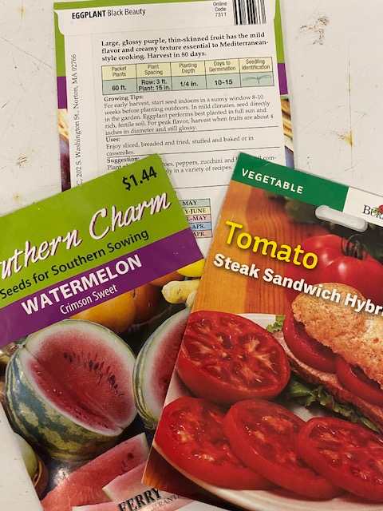
Propagation by Seed
Propagation by seed is sexual reproduction
What can be grown by seed:
  Many annuals and vegetables
  Most biennials
  Some perennials, some woody plants
  Advantages:
  Inexpensive
  Easy to store
  Many varieties and ways to plant
Notes:
There are seeds for many plants, but other methods of propagation may be better for some plants (i.e. woody).
Seeds can be purchased in pelts, which are held together for protection.

Slide 9
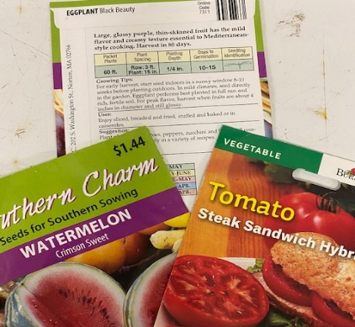
Seed Selection
Seed packets: important information
  Note year, germination time, season, thinning, time to transplant
Seeds you gather are free!
  Choose healthy, locally-adapted plants
  Preserve natural diversity
  Protect heirloom varieties
Notes:
F1 vegetable hybrids do not breed true.

Slide 10
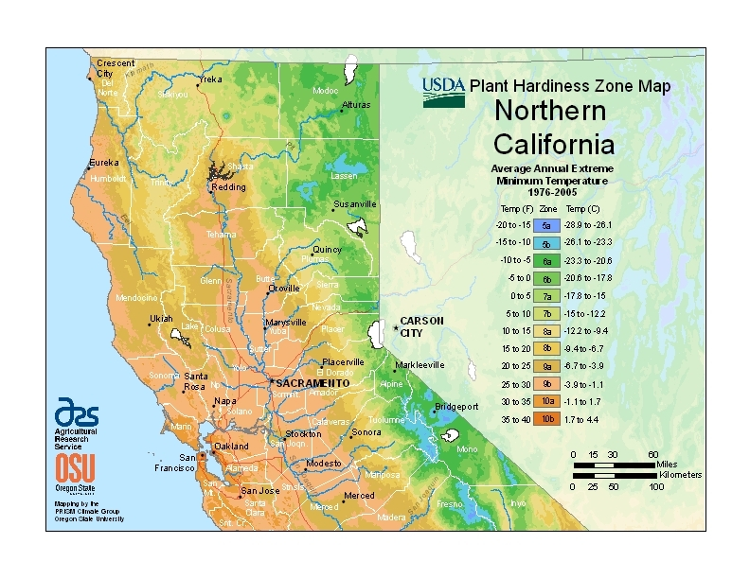
USDA Zones
Notes:
Know your own USDA zone, and know that nurseries use USDA zones when selling to the consumer.

Slide 11
Seed Gathering
3 Basic Rules
  Let seeds ripen on the plant as long as possible.
  Dry seeds well.
  Store seeds in a cool, dark place in sealed containers.

Slide 12
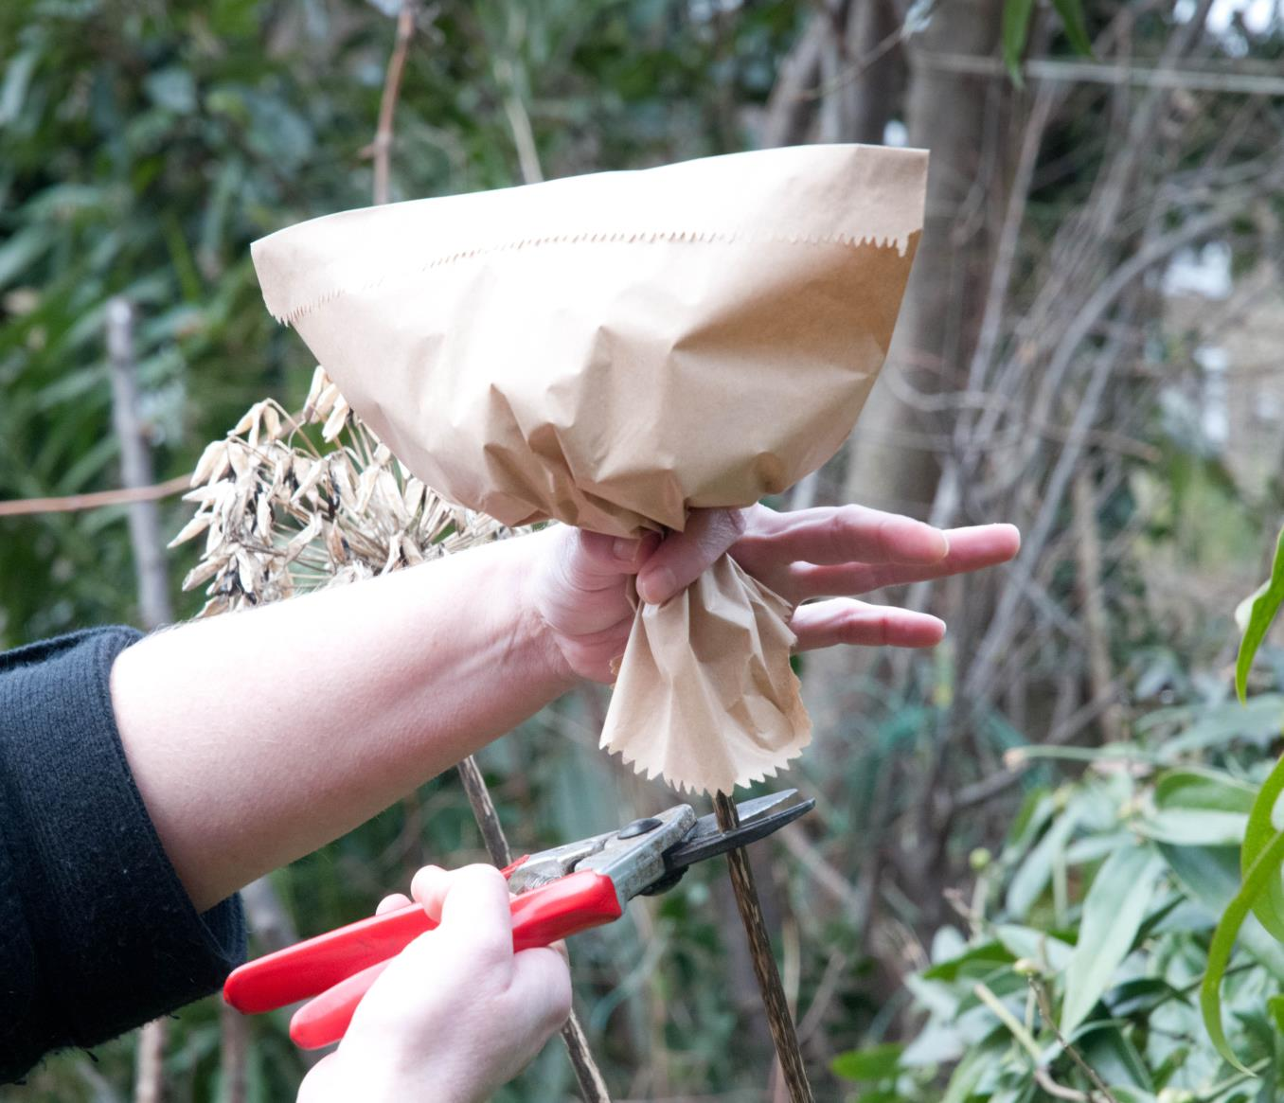
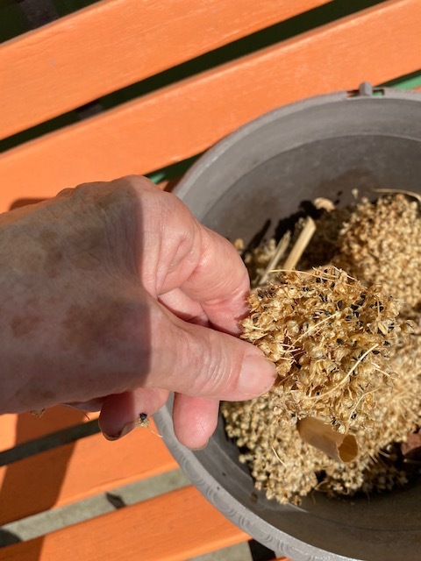
Bag Fragile Seeds
Separate from chaff
Notes:
Note the dried flowers on this plant. Bag covers flower and you can separate seeds.

Slide 13
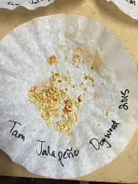
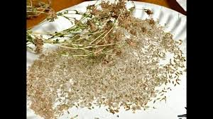
Dry Your Seeds
Notes:
Labeling is easy and important.

Slide 14
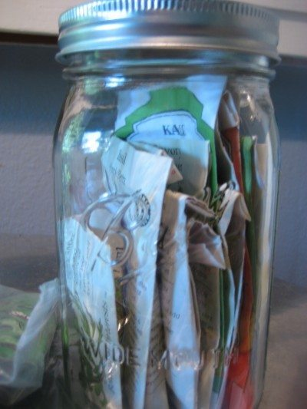
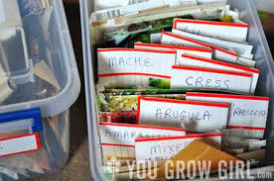
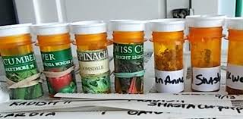
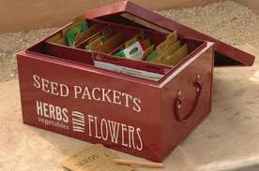
Store Seeds Safely
Notes:
Recycled containers Storage should prevent germination by protecting the seeds from heat, light and moisture.
label and store your seeds
▪ After allowing the seed to dry, funnel the seeds into small paper bags, small glass jars, sealable bags, or other moisture-proof containers.
▪ Clearly label with the date, species and the variety.
▪ Store your seed packets in a cool, dry, dark location until ready to use.
you are ready to plant.
▪ If stored seed becomes moist and warm, some may begin to germinate or become moldy and contaminated with pathogens. A kitchen freezer is an ideal location for storing seed.
https://asi.ucdavis.edu/sites/g/files/dgvnsk5751/files/inline-files/pepperproject-savepepperseeds_0.pdf

Slide 15
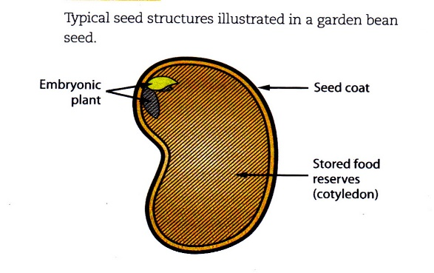
Seed Germination
  -is a metabolic activity
  within an embryo resulting
  in the emergence of a
  seedling plant
  -is dependent on the seed coat; may enter dormant phase
  -relies on the stored nitrogen & carbohydrates in the seed

Slide 16

What causes germination?
Clean soil; controlled environment
Water (continuous)
Oxygen (continuous)
Light (variable)
Temperature (range)
Notes:
The depth you plant a seed should be generally 2 to 2 ½ times as deep as the seed is wide. This factor has some control of amount of light. Germination can be dependent on warmth (65-75 degr.), but chilly temperatures may be needed for some seeds to germinate. Heat mats may hasten germination. Many plants have a wide range of temperatures in which they germinate.

Slide 17

What breaks seed dormancy?
Scarification
  Mechanical (abrasion)
  Hot water
Stratification
  Temperature
  Water
Notes:
Breaking the seed coat can be done by you per species. Refrigeration may be necessary to preserve or stratify seeds.

Slide 18
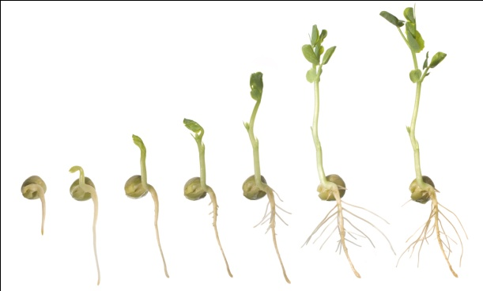
Planting seeds
Sterile media & containers
Proper depth (2-4x seed
diameter) -Some tiny seeds
may go on top of media-
Fine water spray
Indirect light for containers
Cotyledon-to-true leaves
Homemade media: 1 part perlite,
1 part vermiculite, 1 part peat moss
Notes:
Media must be pre-moistened. Finish with a fine water mist.

Slide 19
Seedling success
Thin, transplant per instructions
Fertilize only after second set of true leaves
Start with no direct sun to seedlings in containers
“Harden-off”: Gradual light & temperature exposure

Slide 20
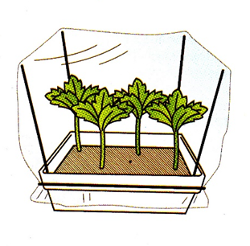
Remember:
All tools and containers must be sanitized
Use sterile soils
Ensure drainage
Humidity must be regulated
Air flow should be monitored
Notes:
Keep all materials clean with any propagation technique. Sanitize and clean cutting tools. Don’t re-use soils. Use moist media in propagation.
The potting container is covered with a plastic sheeting or dome which preserves a humid environment.

Slide 21
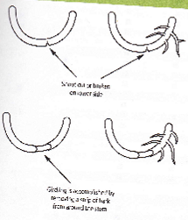
Layering Mimics Nature
Definition: A type of asexual propagation which takes place on stems still attached to the parent plant.
How? The stem’s cells
become root cells
Occurs naturally:
blackberries, currants,
hydrangeas
Notes:
This is a natural occurrence for bl;ackberries and currants. The stem must be gently wounded or twisted to break into bark. Adventitious cells are stimulated to become roots with the help of natural auxin hormones.
The resultant plants don’t suffer from water shortage or carbohydrate loss because they are still attached to the parent plant. (unlike some cuttings)

Slide 22
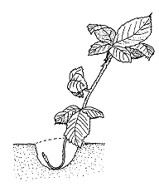
Layering
Tip layering
  Ex: raspberry canes
  Simple layering:
  Ex: spirea, quince
rhododendron,
honeysuckle,
wisteria, grape
Notes:
Propagate in spring. Stake the tip of stem with leaves, about 6-12” vertically. Forming plant gets nutrients, water from parent.Remove shoots in fall or the next spring. Ex: heartleaf philodendron, wisteria, pothos

Slide 23
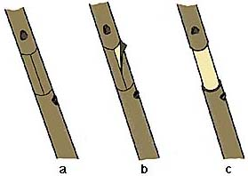
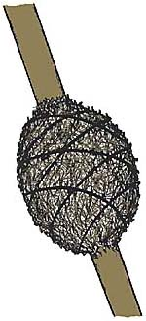
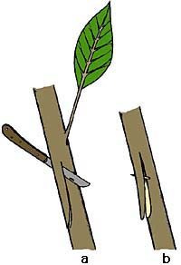
Air Layering
For difficult-to-root plants: Camelia, Azalea, holly, Ficus
girdling and slit cuts wrapping in sphagnum moss
Notes:
Air layering is a useful method of producing roots in spring or summer on the stem of indoor or landscape plants that have become "leggy" through the loss of their lower foliage. The stem is wounded; for slit cut, a piece of wood can be inserted to hold wound open. Cover with moist sphagnum moss; cover with plastic wrap until roots develop.

Slide 24
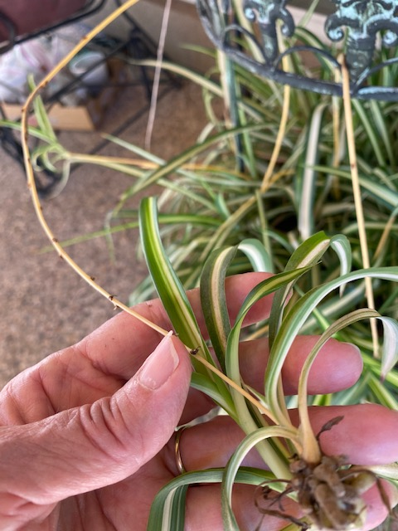
Separation
Examples:
Spider plant
Rosette-shaped plants
that put out offsets that root
Gladiolus Dahlia
Underground stems, corms or bulbs
Many succulents
Notes:
Spider plantlets can be separated from the parent plant before rooting. Tuberous roots and can develop into new plants, as long as they have a bud that
Is attached to each new root (ex. Dahlia).

Slide 25
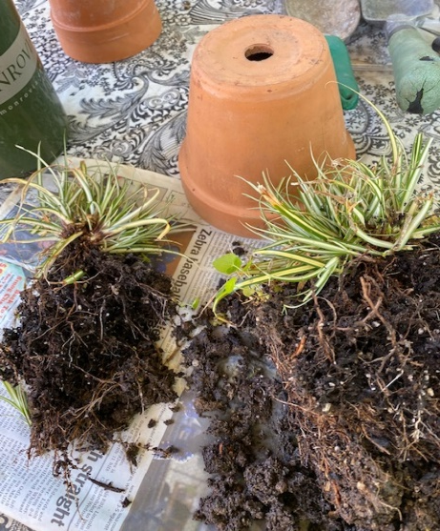
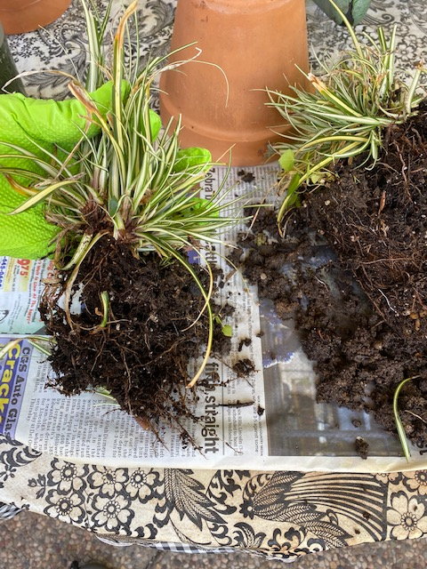
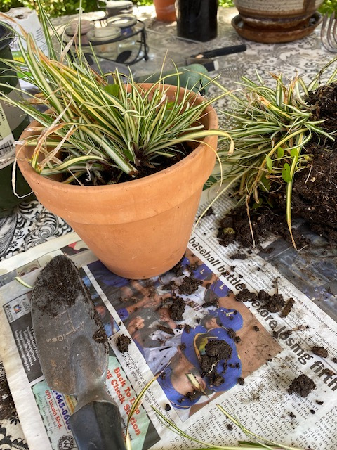
Division
Separation from a parent plant to form new plants
Notes:
Used for monocots and certain other clumping plants that have many roots. Useful for agapanthus, bulbous plants (Watsonia).
Divide summer or spring-flowering plants in fall and fall bloomers in the spring.

Slide 26
Advantages to planting after division or separation
Almost foolproof new plants
with better flowering
Parent plant seems healthier
Parent plant looks better

Slide 27
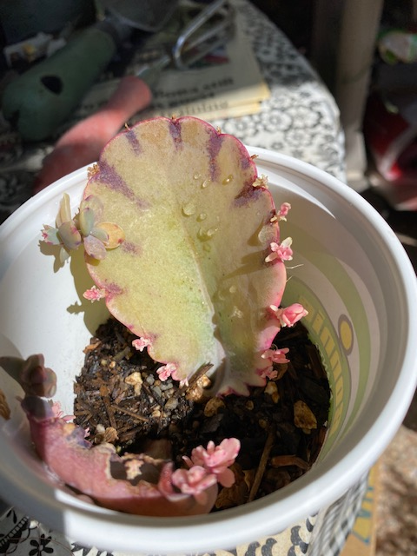
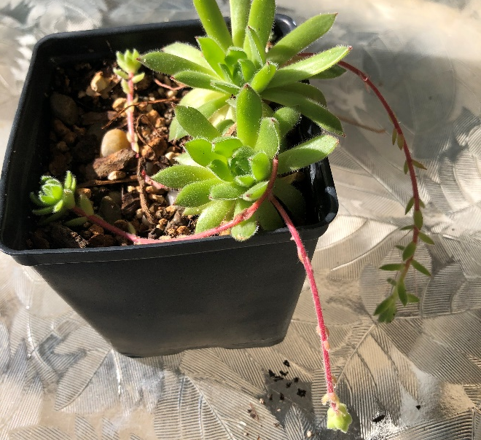
Succulents offset Offsets
Notes:
Succulents set offsets to lay on soil or drop onto soil and form new plants with roots.

Slide 28
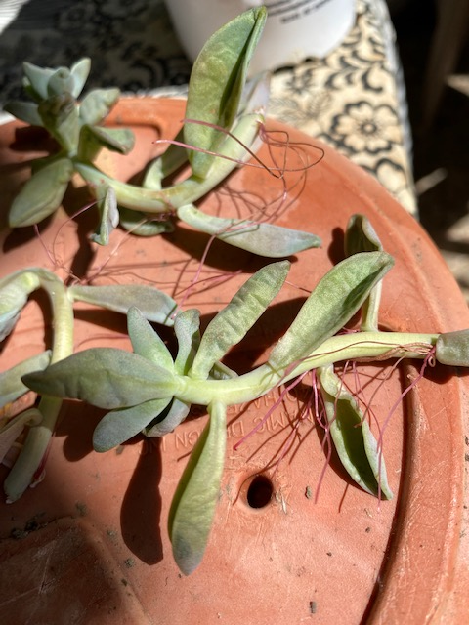
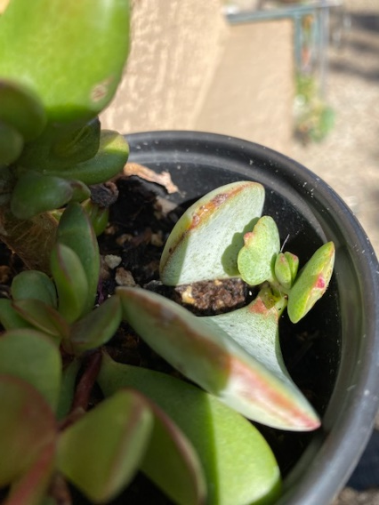
Succulents
Notes:
Succulents can form new plants from fallen leaves. Before propagating it’s best to allow a cutting to sit out and callous. During this time it may even develop new roots.
MG presentation on succulent propagation will be on June 12 2021.

Slide 29
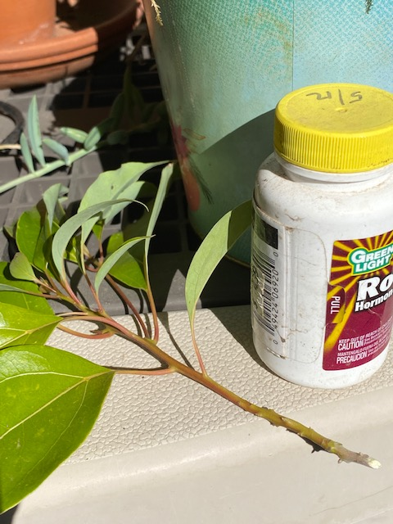
Cuttings
Adventitious Plant Parts:
can take on new roles (differentiate)
are cut below a node or above a node
are facilitated by rooting hormone
For both herbaceous and woody plants,
stem cuttings are taken, especially in spring
Polarity: (up/down)
Plant parts maintain their spatial orientation when
separated from the mother plant.
Notes:
Mention herbaceous cuttings. Cuttings from lateral shoots generally root better than terminal shoots. Use younger plants that are not drought-stressed or over-fertilized.
Take cuttings in the a.m., if possible. Store in a cooler or refrigerator before sticking. Cut the top straight; angle-cut the bottom. Use a dibble & clean media. Herbaceous plants are easiest to root.

Slide 30
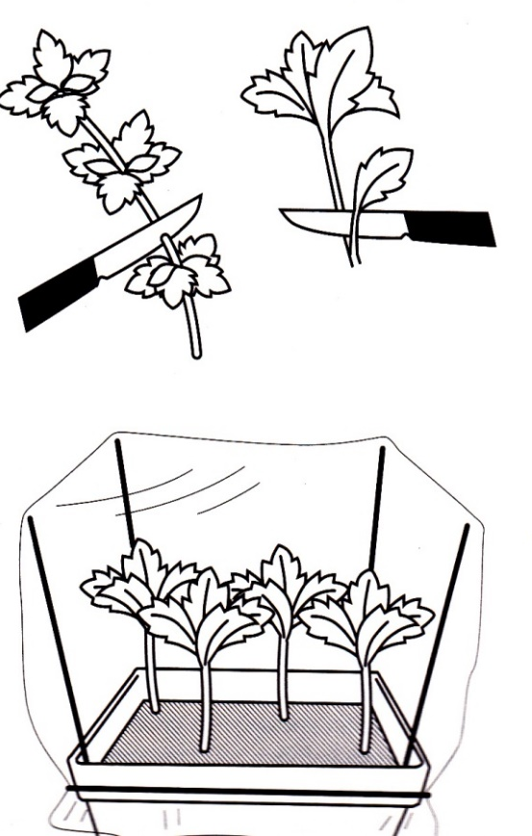
Cuttings
Softwood
from non-flowering shoots of deciduous plants
from new shoots, spring or early summer
3-5” long, at least 2 nodes under soil level without leaves; add hormone to lower end
No direct sun; may use bottom heat mat, keep moist
Roots in 2-5 weeks
Notes:
Buds must be present in soil: from a bud, roots may grow. Give a very gentle pull on a cutting to see if it rooted. Transplant to their own pots when well-rooted.
Be patient..

Slide 31
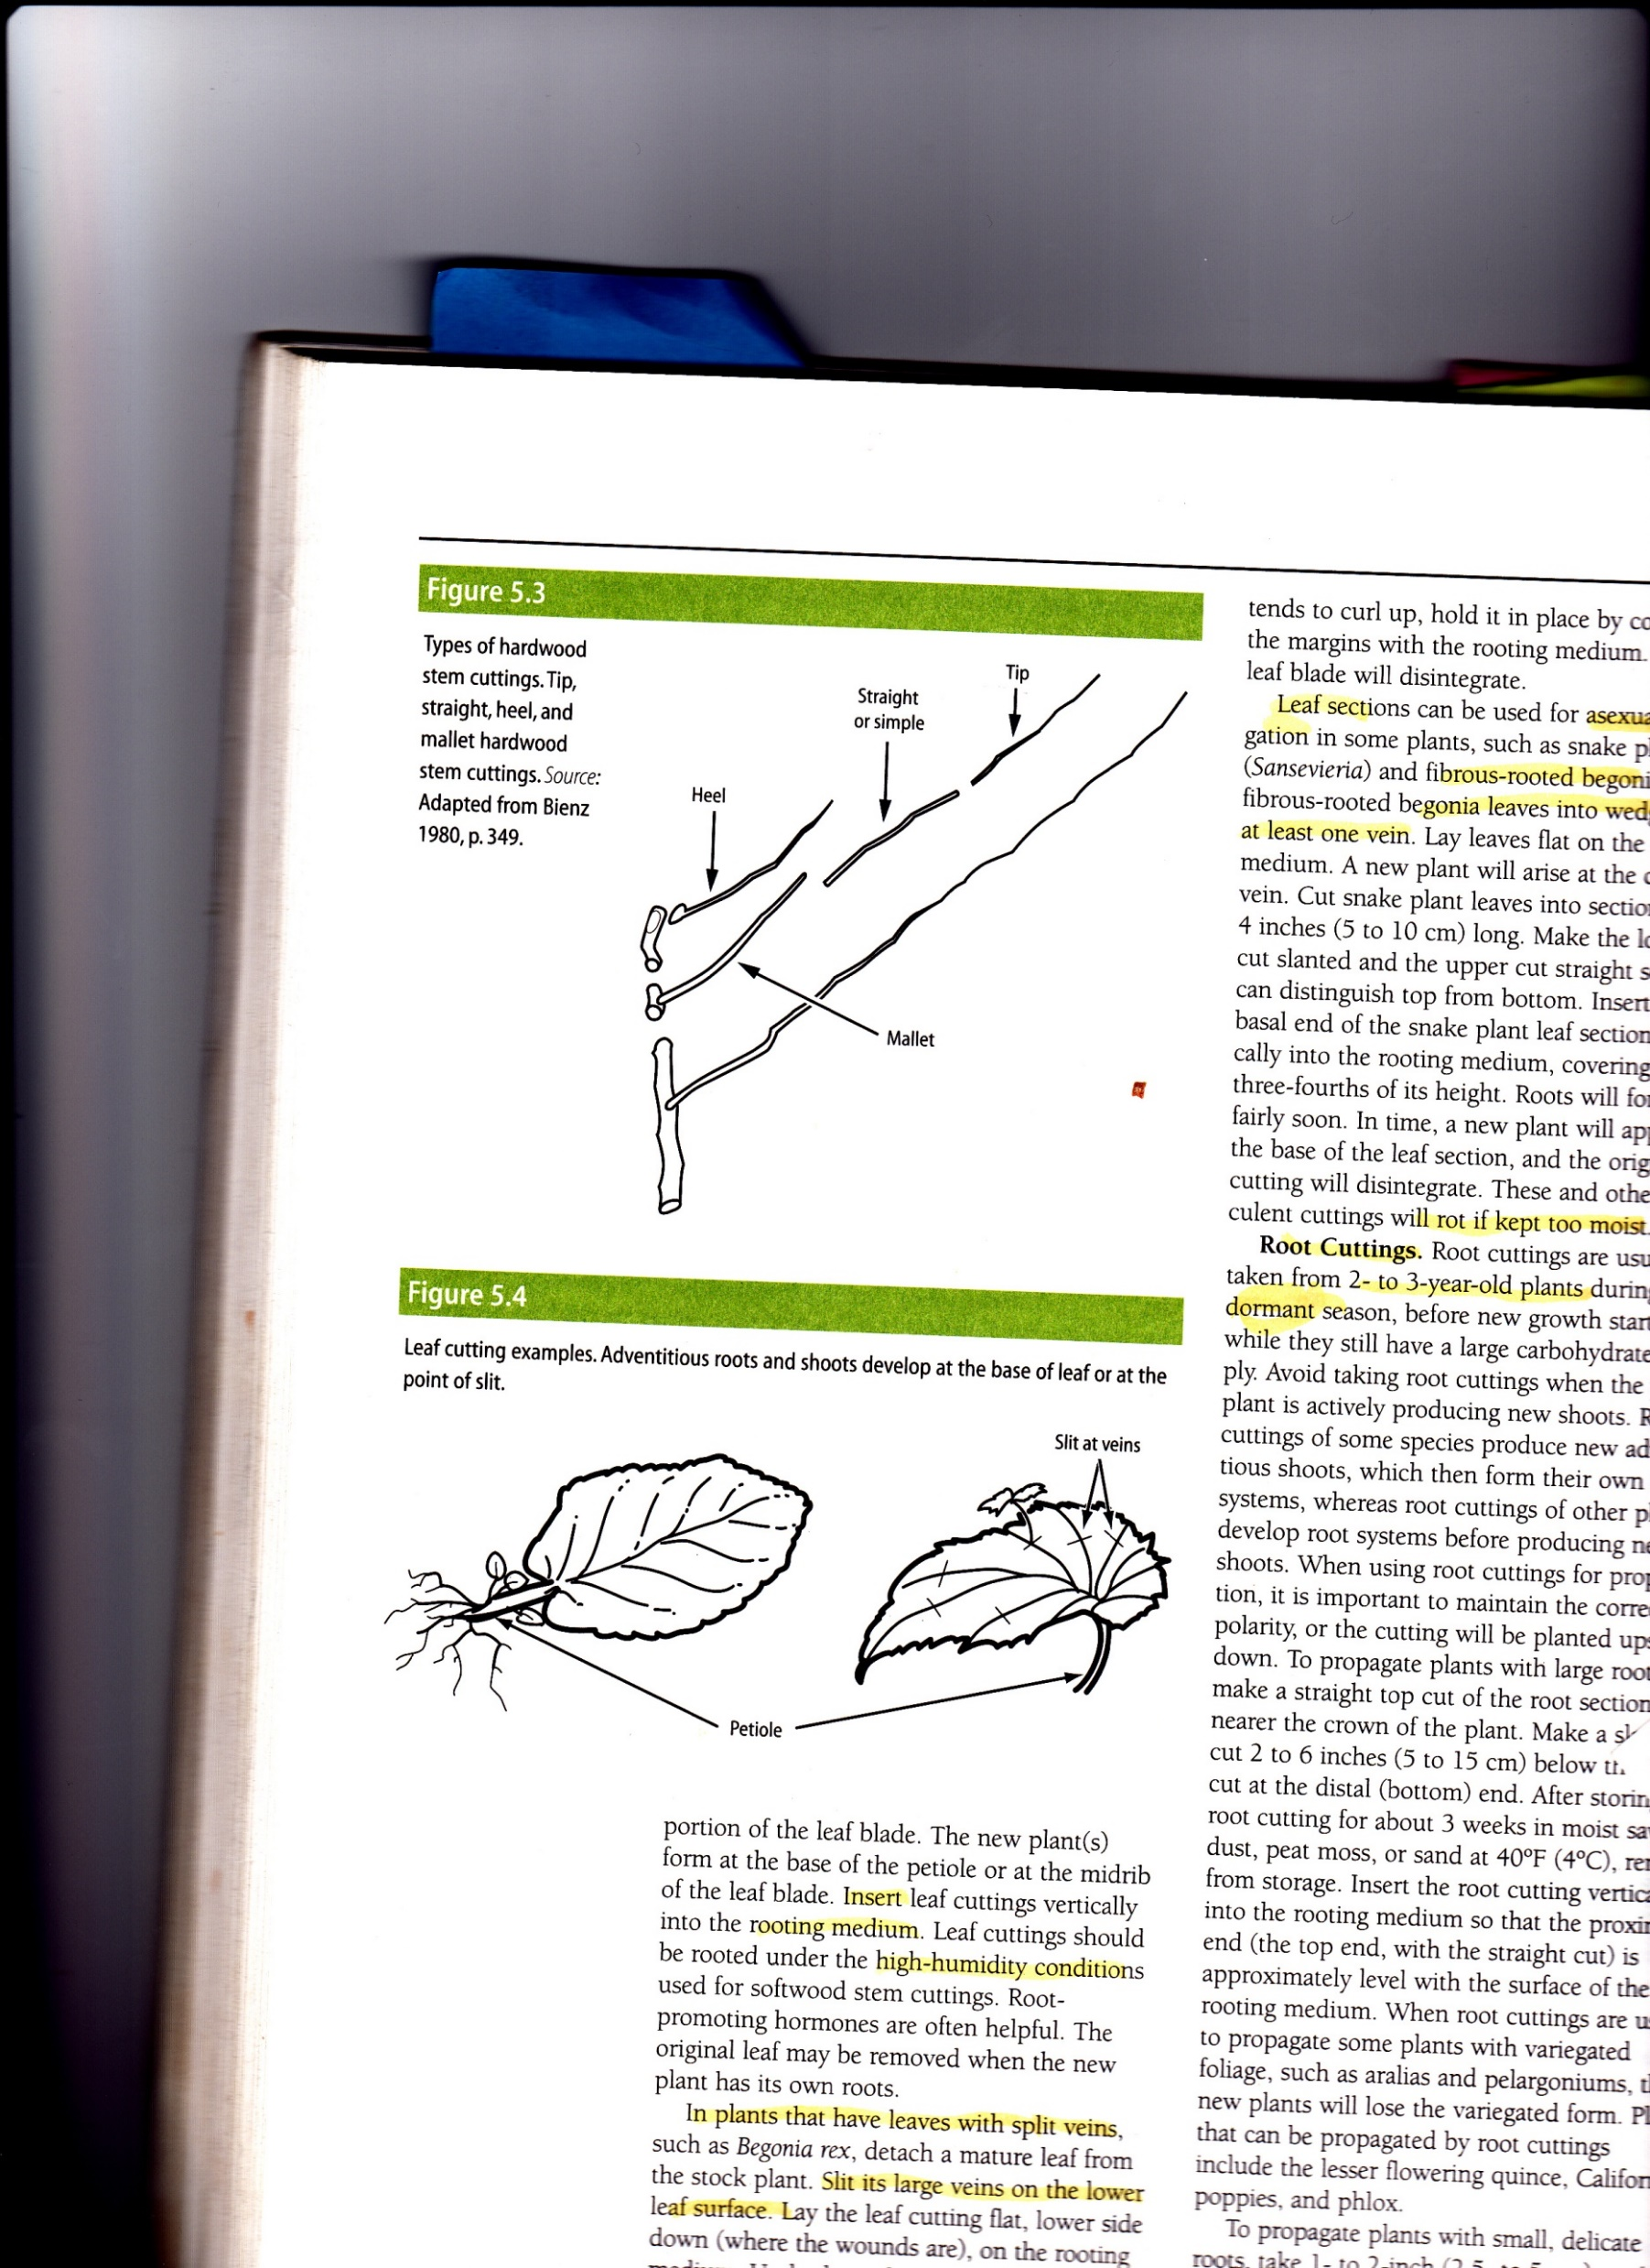
Cuttings
Hardwood
(not good for fruit trees)
While plant is dormant (winter, early spring)
4-12” long, straight cut
Hormone powder to bottom of cutting.
Mallet: 2 –year-old wood base, 1-year-old wood at tip
Notes:
Hardwood cuttings are slowest to root, so nurseries may use other methods. Evergreens respond to varied timing of season (SW SH HW)

Slide 32

Other cuttings
Greenwood/Semi-hardwood: (July-Sept.)
Roots in 4-6 wks.
Root: during dormancy, (quince, California poppies, phlox) Use younger plants.
Leaf: only certain plants
African violet, tuberous
begonia
Leaf cutting
Notes:
Asparagus root crowns are available to purchase, or you can divide the roots of old plants.

Slide 33
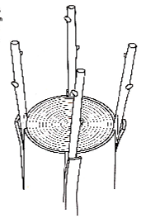
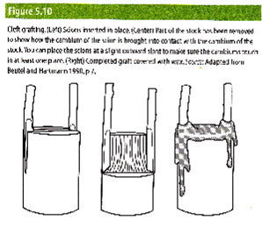
Grafting
The process of inserting a part of a plant into or onto another plant in a way that will unite and continue growth as a single unit.
Cleft grafting
Scions are cut to fit wedges
Bark grafting
Notes:
Grafting is a process of propagation by inserting a part of one plant into or onto another plant to result into a single plant. The rootstock (“stock”), is chosen for the proven ability to thrive and withstand local environmental changes or some pests. The “scion” of the same genus, is a branch, bud or shoot with dormant buds that will produce stems and branches of the new desired plant. The scion for these trees are placed slightly diagonally outward.

Slide 34
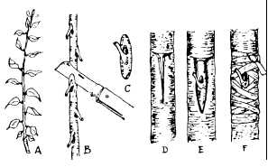
Budding
Scion Rootstock
Done in summer
Fruit tree maintains the characteristics of the parent
Rose acquires the vigor and disease-resistance of the rootstock.
Notes:
T-budding is the chosen method for rose grafting because it is relatively easy to do with just a piece of the scionwood. The rootstock should be a healthy well-watered plant.
Rootstock must be healthy. This is the most common graft used for roses.

Slide 35
In conclusion…..
Gardening is a challenge, but pick your own challenges!
Different plant species respond to different propagation techniques.
Trial & error: Gain and lose a little, then gain a lot.

Slide 36
Resources
Evans, Ervin and Blazich, Frank. Propagation by Stem Cuttings for the Home Gardener.
North Carolina State University Extension. 1999
https://content.ces.ncsu.edu/plant-propagation-by-stem-cuttings-instructions-for-the-home-gardener
Evans, Ervin and Blazich, Frank. Plant Propagation by Leaf, Cane, and Root Cuttings: Instructions for the Home Gardener. North Carolina State University Extension. 1999
http://www.ces.ncsu.edu/depts/hort/hil/hil-8700.html
Pittenger, Dennis R. California Master Gardener Handbook. UCANR Publication #9027. 2015.
Toogood, Alan, Editor-in-Chief. Plant Propagation. American Horticultural Society. 1999.

Slide 37
Thank You!
Any Questions?
Master Gardener Hotline: (530) 889-7388
Master Gardener Website: pcmg.ucanr.org

