Slide 1
From blah to Beautiful…sheet mulch your lawn and create a pollinator paradise
Save water too!
Notes:
Created: 6/24/2017
Created by: Julie Pingree Long
Audience: Homeowners
Publicity: From blah to beautiful...Learn the best way to get rid of your high maintenance your lawn and create a pollinator paradise!
Update History: Updated 8/9/2022 for Tri Counties Home & Garden show.

Slide 2

Master Gardeners of
Placer County
Extend research-based gardening and composting information
Present accurate, impartial information to home gardeners
Give knowledge to make informed gardening decisions
Placer County

Slide 3
Master Gardeners of
Placer County
Where to Find Us
Demo Garden (Workshops & Open days)
Curious Gardener (Quarterly online)
Speakers’ Bureau
Farmers’ Market Tables (Auburn, Roseville)
Fairs and Festivals Booths
Garden Faire (March)
Mothers’ Day Garden Tour (May)
Social Media: FB, Twitter, Instagram
Gold Country Media Q/A

Slide 4
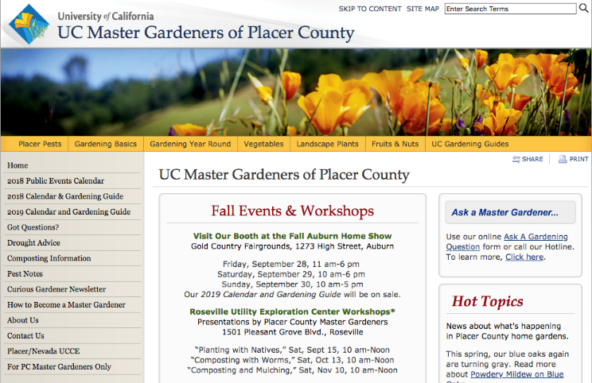
Master Gardeners of
Placer County
pcmg.ucanr.org

Slide 5
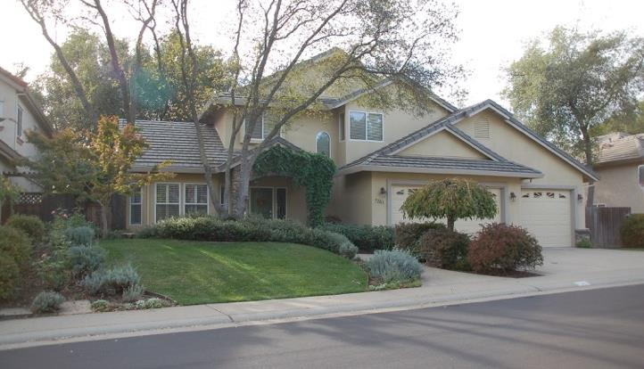
Before the layer mulching…a bit boring!

Slide 6
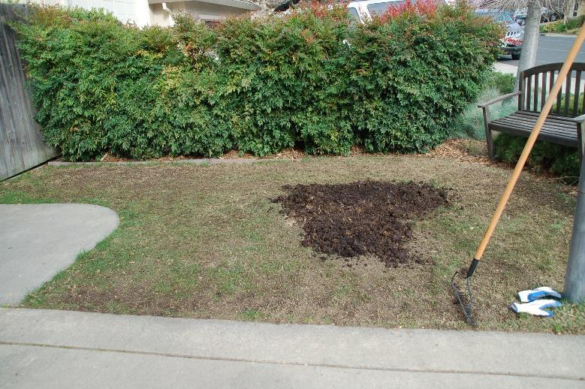
Mow Lawn as Low as Possible and Cover with 2” to 3” of Compost

Slide 7
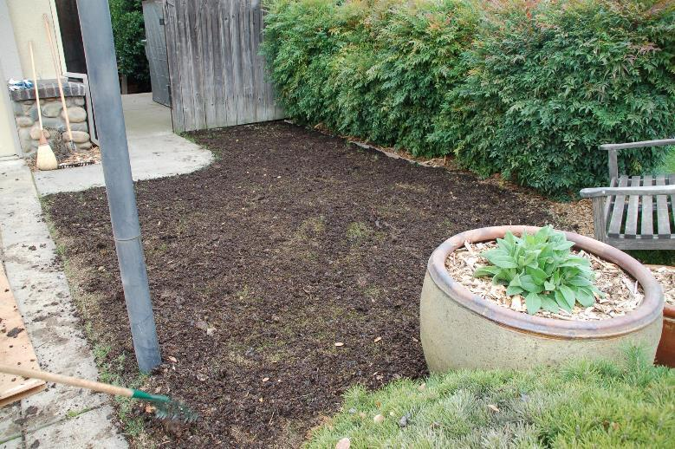
Entire Lawn Area Covered with Compost

Slide 8
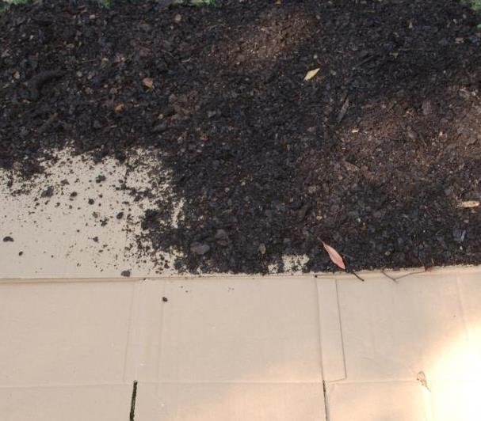
Cover Compost with Cardboard and Top with Mulch

Slide 9
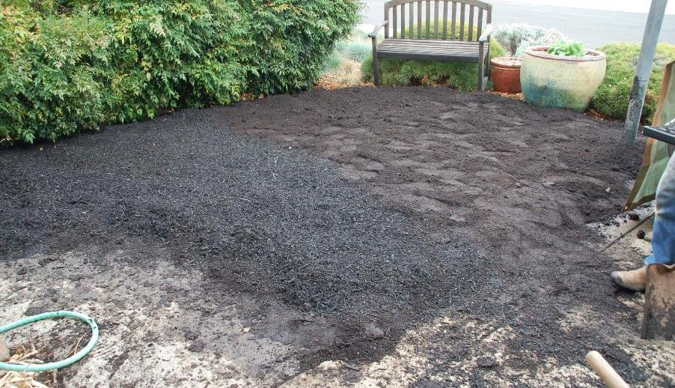
Showing the layers…we actually added another compost layer to the process, but it is not necessary.

Slide 10
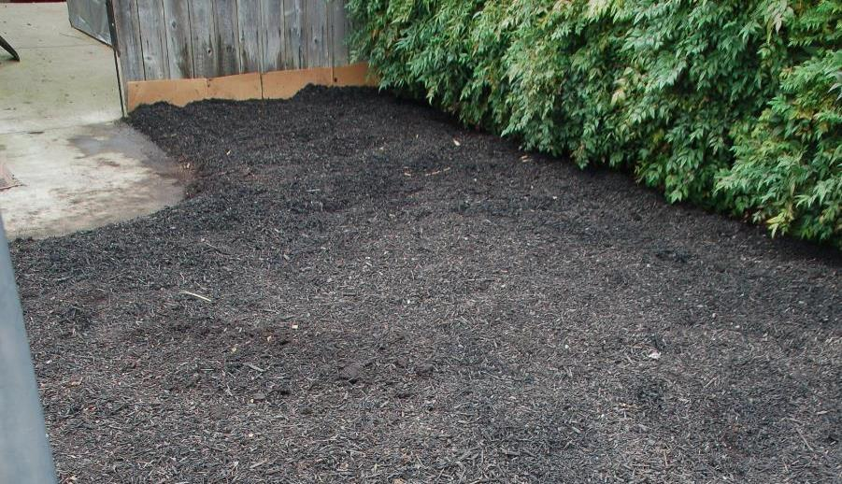
Finished!

Slide 11
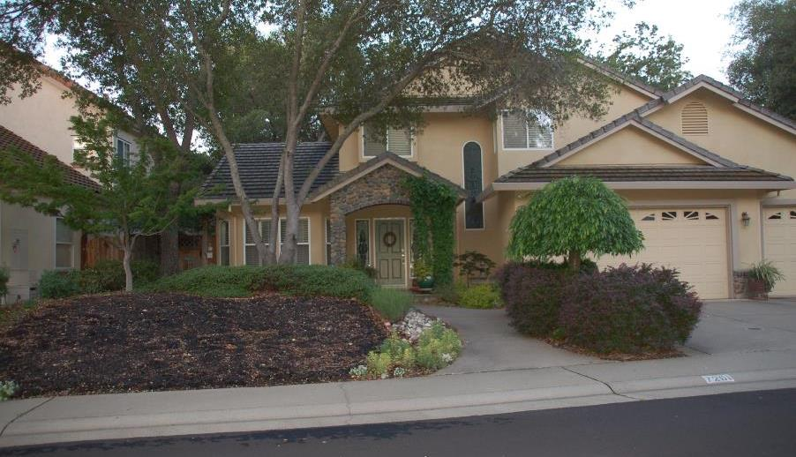
Cool weather and rainfall work together to start the breakdown of layers

Slide 12
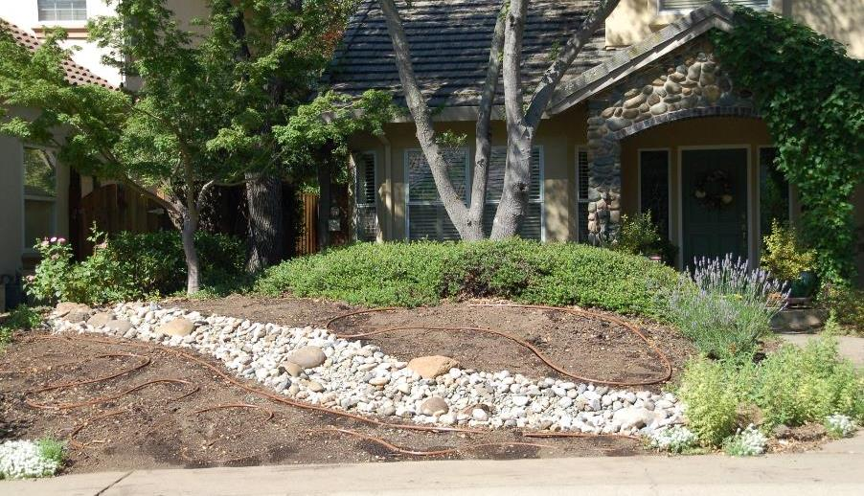
Six months later, layer mulching complete. Dry bed and irrigation are in. Landscaping begins.

Slide 13
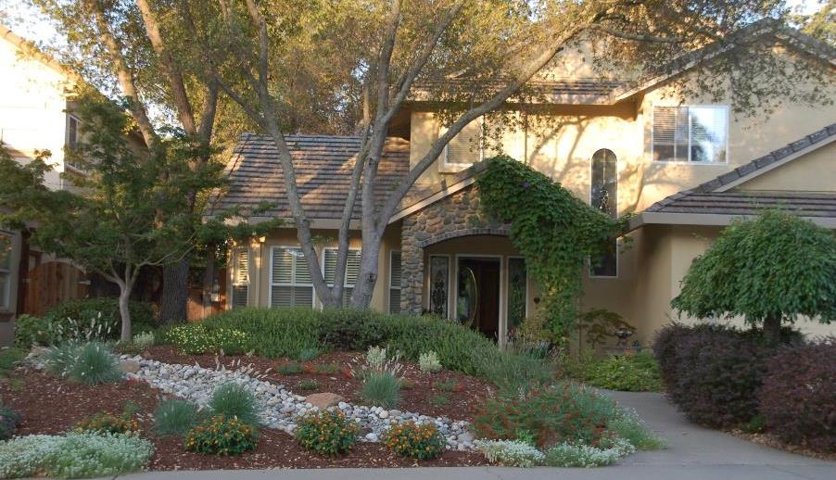
Landscaping done! Grow please ☺

Slide 14
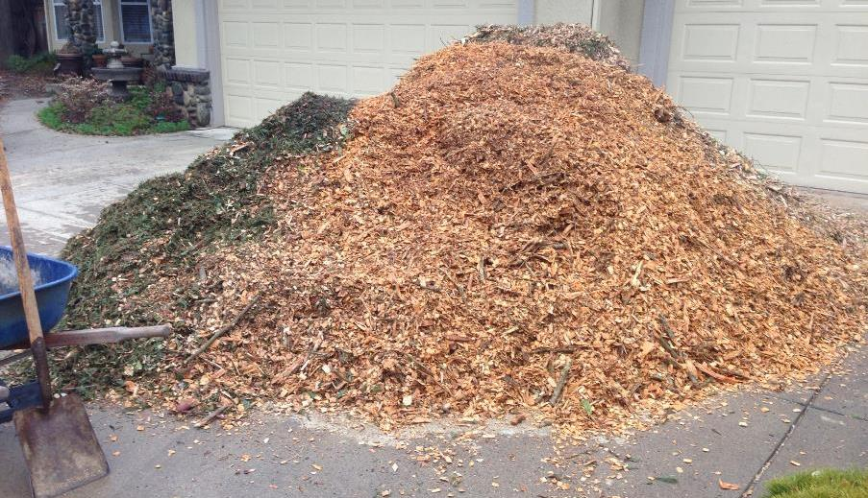
Mulch mulch mulch!

Slide 15
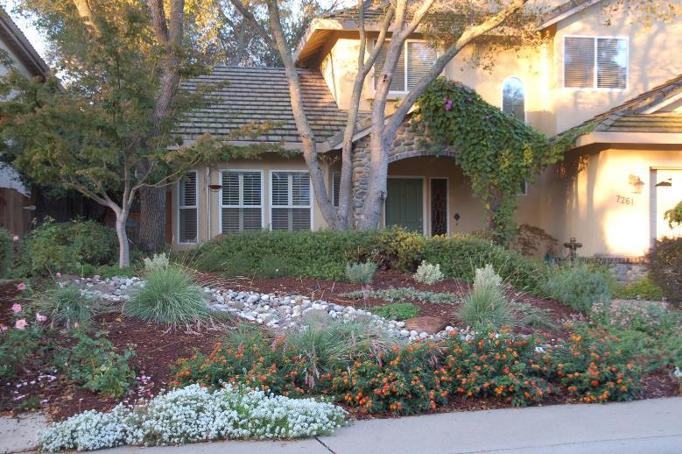
Three months after planting

Slide 16
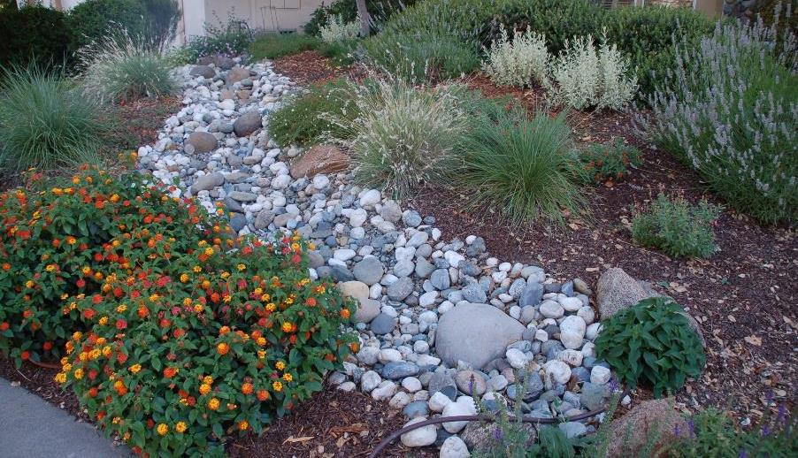
One year later…the plants have taken off!

Slide 17
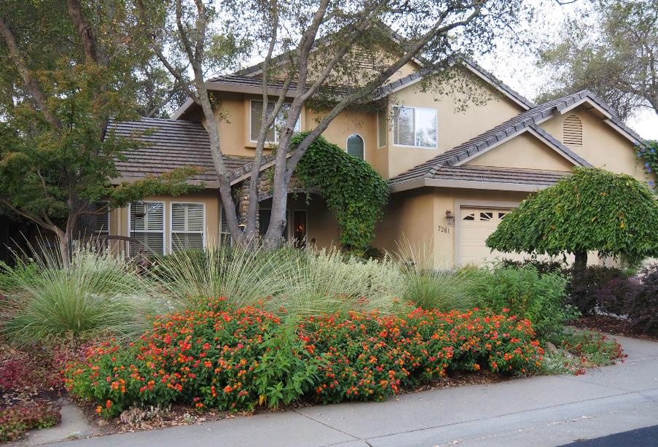
Two years later

Slide 18
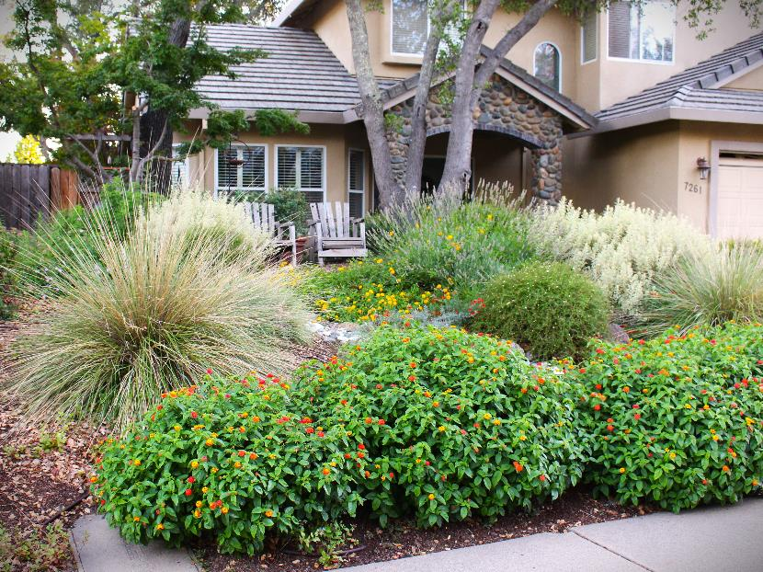
Six years later

Slide 19
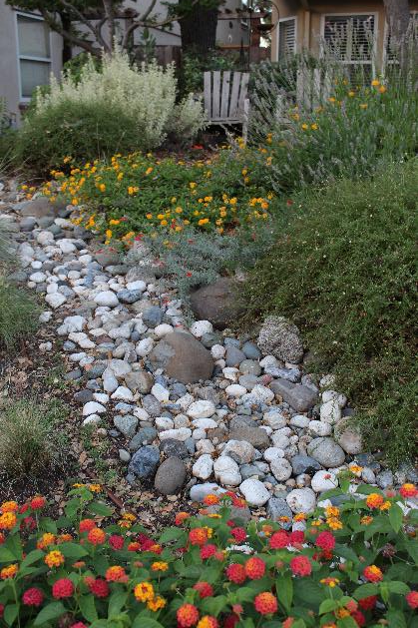
Another view six years later

Slide 20
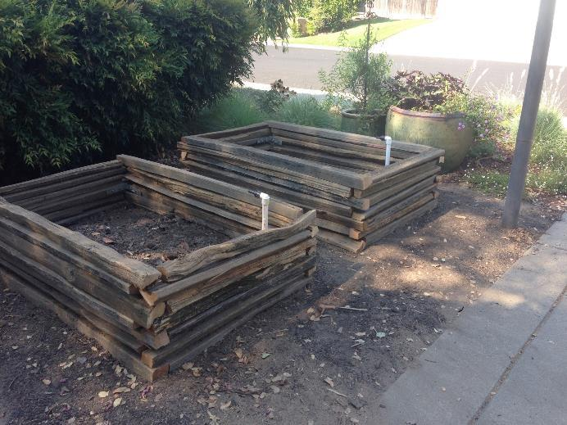
Side benefits…space for vegetables

Slide 21
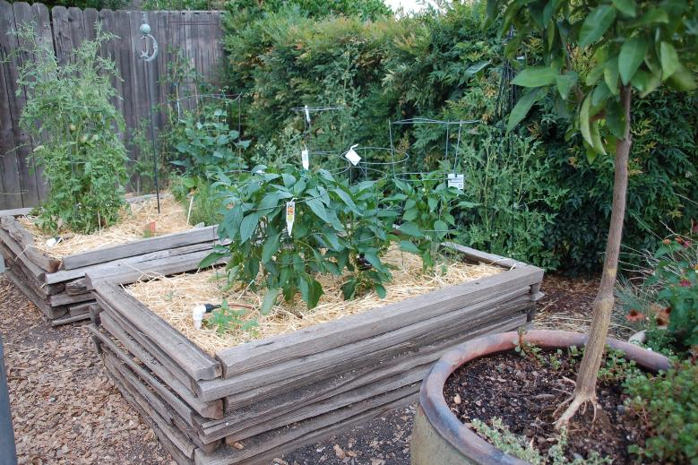
Success!

Slide 22
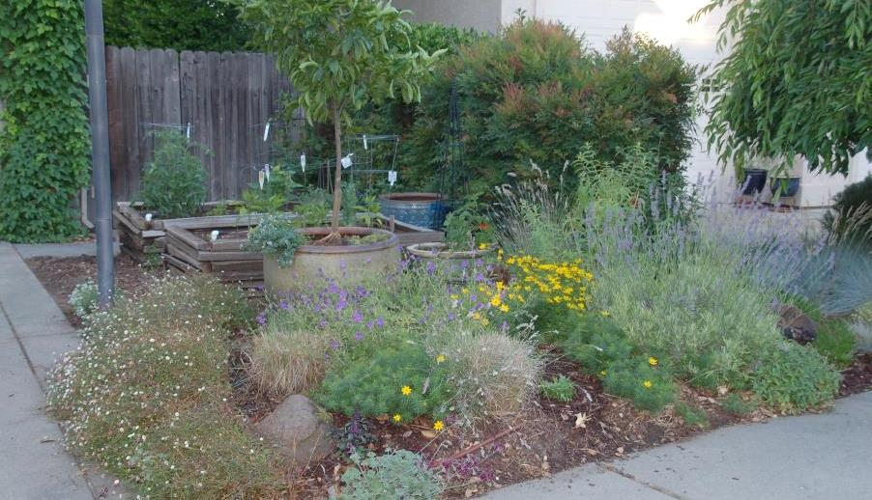
Raised veggie beds are buffered from the street by flowers and herbs

Slide 23
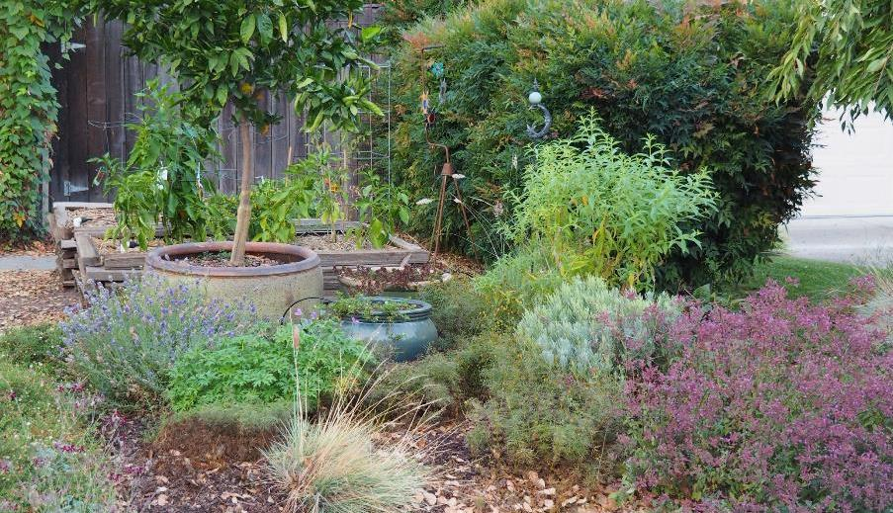
It continues to flourish

Slide 24
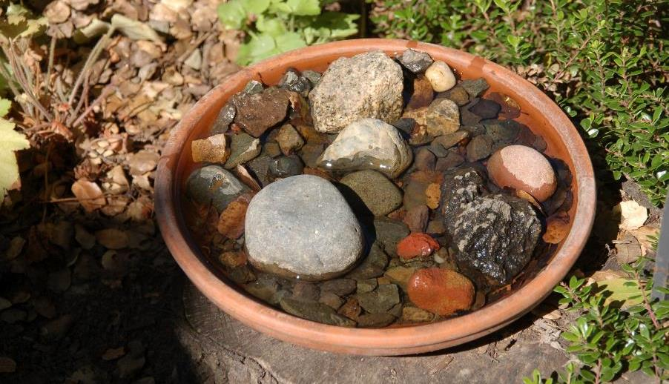
Attracting pollinators by providing several water sources

Slide 25
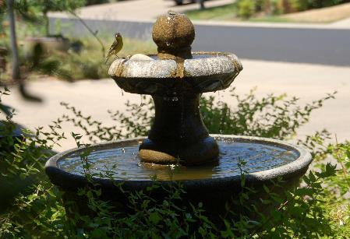
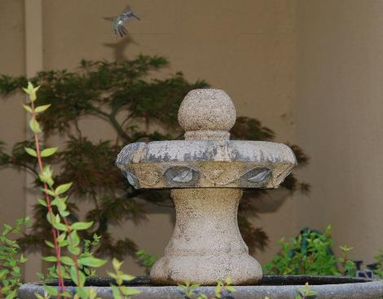
The fountain draws in many varieties of birds, bees, and other flying creatures

Slide 26
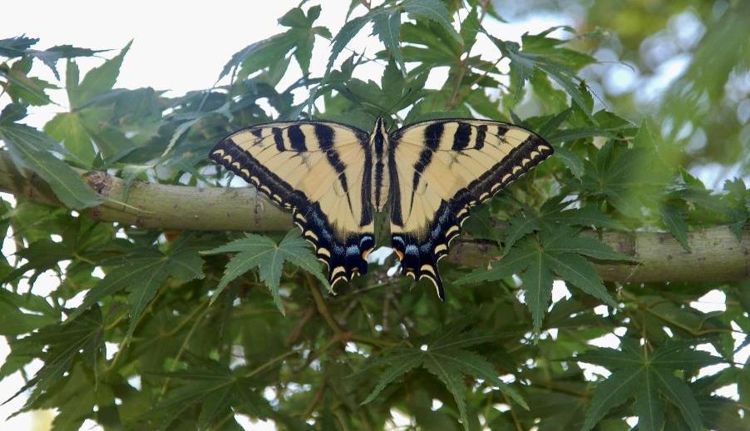
A Western Tiger Swallowtail butterfly resting in our Japanese Maple tree

Slide 27
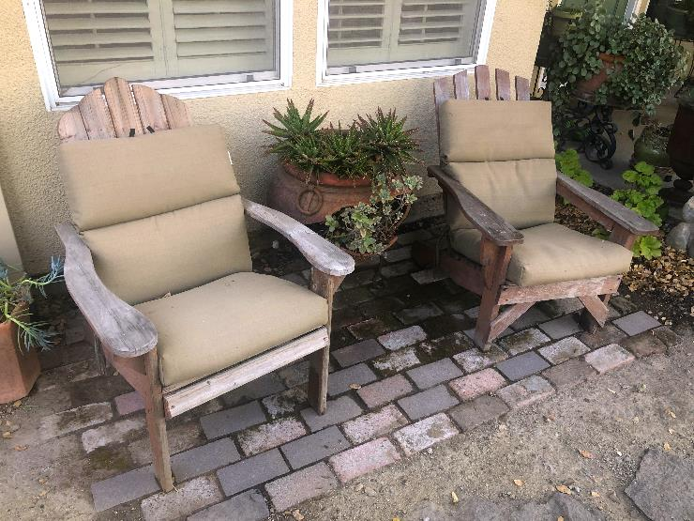
Our favorite spot to watch the on-going activity

Slide 28
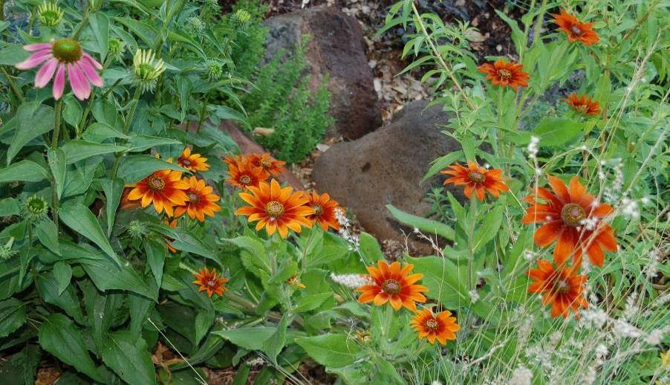
Not only are they pretty, coneflowers are loved by the bees

Slide 29
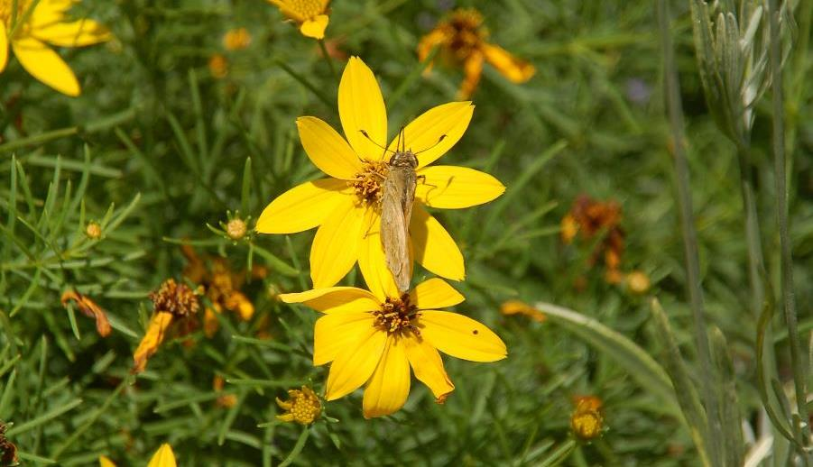
A small butterfly alight on Coreopsis Moonbeam

Slide 30
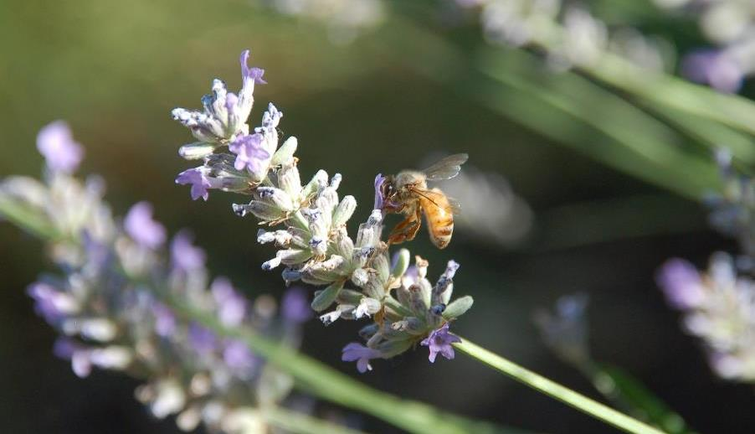
Loving the buzz of activity! Lavender is a favorite

Slide 31
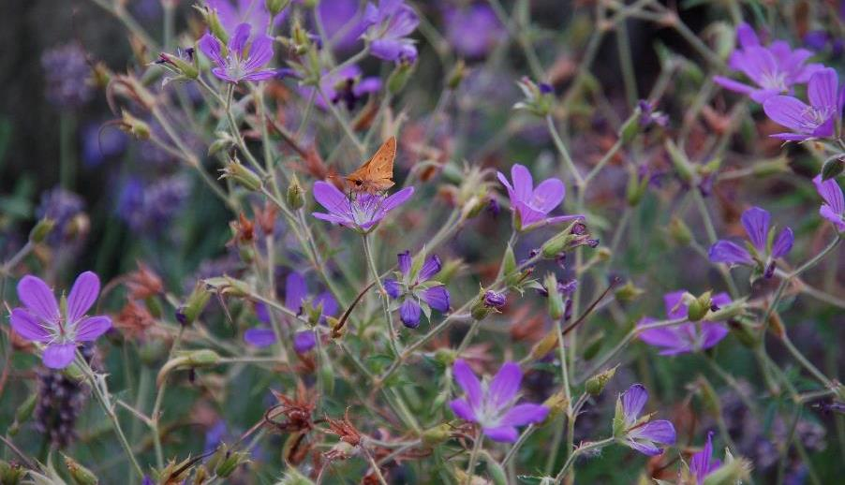
Orion Geranium with a Fiery Skipper butterfly

Slide 32
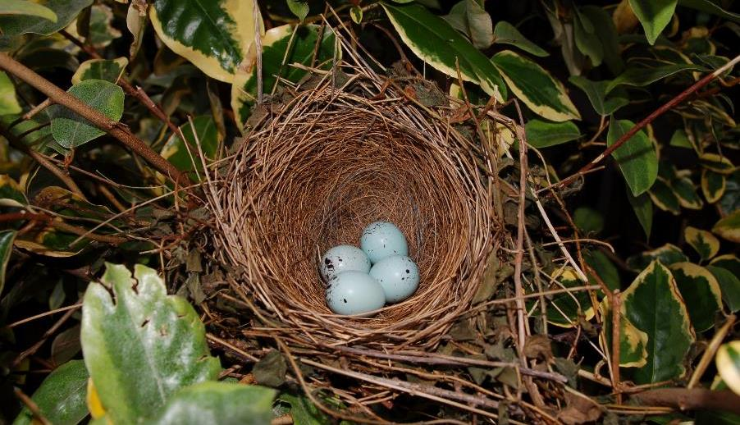
Questions?

Slide 33
Thank you
Questions?
Master Gardener Hotline: 530 889-7388
Master Gardener website: pcmg.ucanr.org
Placer County

