Slide 1
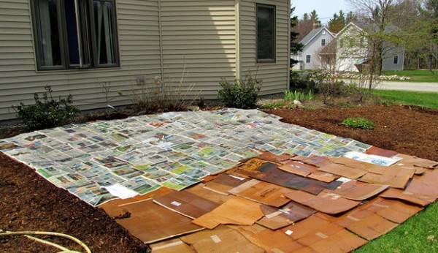

Let’s Replace That Lawn!
Presented by the UC Master Gardeners of Placer County
Notes:
Created by Becky Fritchie 11/2020 for a workshop requested by the RUEC; informational workshop for those that want to replace their lawns, have a weedy area or bare dirt and don’t know what to do with it

Slide 2

Who Are Master Gardeners?
Master Gardeners of Placer County
Extend research-based, sustainable gardening and composting information
Present accurate, impartial information to home gardeners
Encourage public to make informed gardening decisions

Slide 3

Where to find us…
Online, in the Media, and Special Publications
Hotline: Call (530) 889-7388 or submit your questions online
Website: pcmg.ucanr.org
Facebook, Twitter, Instagram
Gold Country Media quarterly column
Curious Gardener quarterly newsletter and on our website
Gardening Guide and Calendar

Slide 4
Who Are Master Gardeners?
Where to find us…
Workshops, Fairs and Festivals, and Special Events
Speakers by Request
Workshops (various venues, check website)
Farmers’ Markets (seasonal: Auburn, Roseville)
Fairs and Festivals Booths (varies)
Garden Faire (April)
Mother’s Day Garden Tour (May)

Slide 5
Let’s Talk Sheet Mulching or Replacing Your Lawn

Slide 6
Also called Lasagna Composting
Excellent way to convert grassy area to vegetable or flower beds.
Best started in the Fall. This is a slow process.
Plan ahead … make sure you have supplies.
Notes:
Good to start in fall and use up all those leaves trees have dropped, along with taking advantage of the rainy season. Be careful doing this in times of drought, as the cardboard needs to be kept damp. Not many supplies are needed, just paper or cardboard, leaves and coffee grounds. Lots of all.

Slide 7
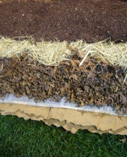
Lasagna or Sheet Mulching
Cut down grasses, weeds, etc. close to ground
Cover with barrier such as newspaper or cardboard
Top paper with dried leaves or compost
Sprinkle with coffee grounds
Moisten
Repeat 3-4 times. Pile will compost down in height
Ready to plant in 3-4 months
Notes:
Keep the cardboard, etc. away from existing trees and shrubs as it may interfere with their gas/water exchange. Also keep away from buildings as you don’t want to invite termites!

Slide 8
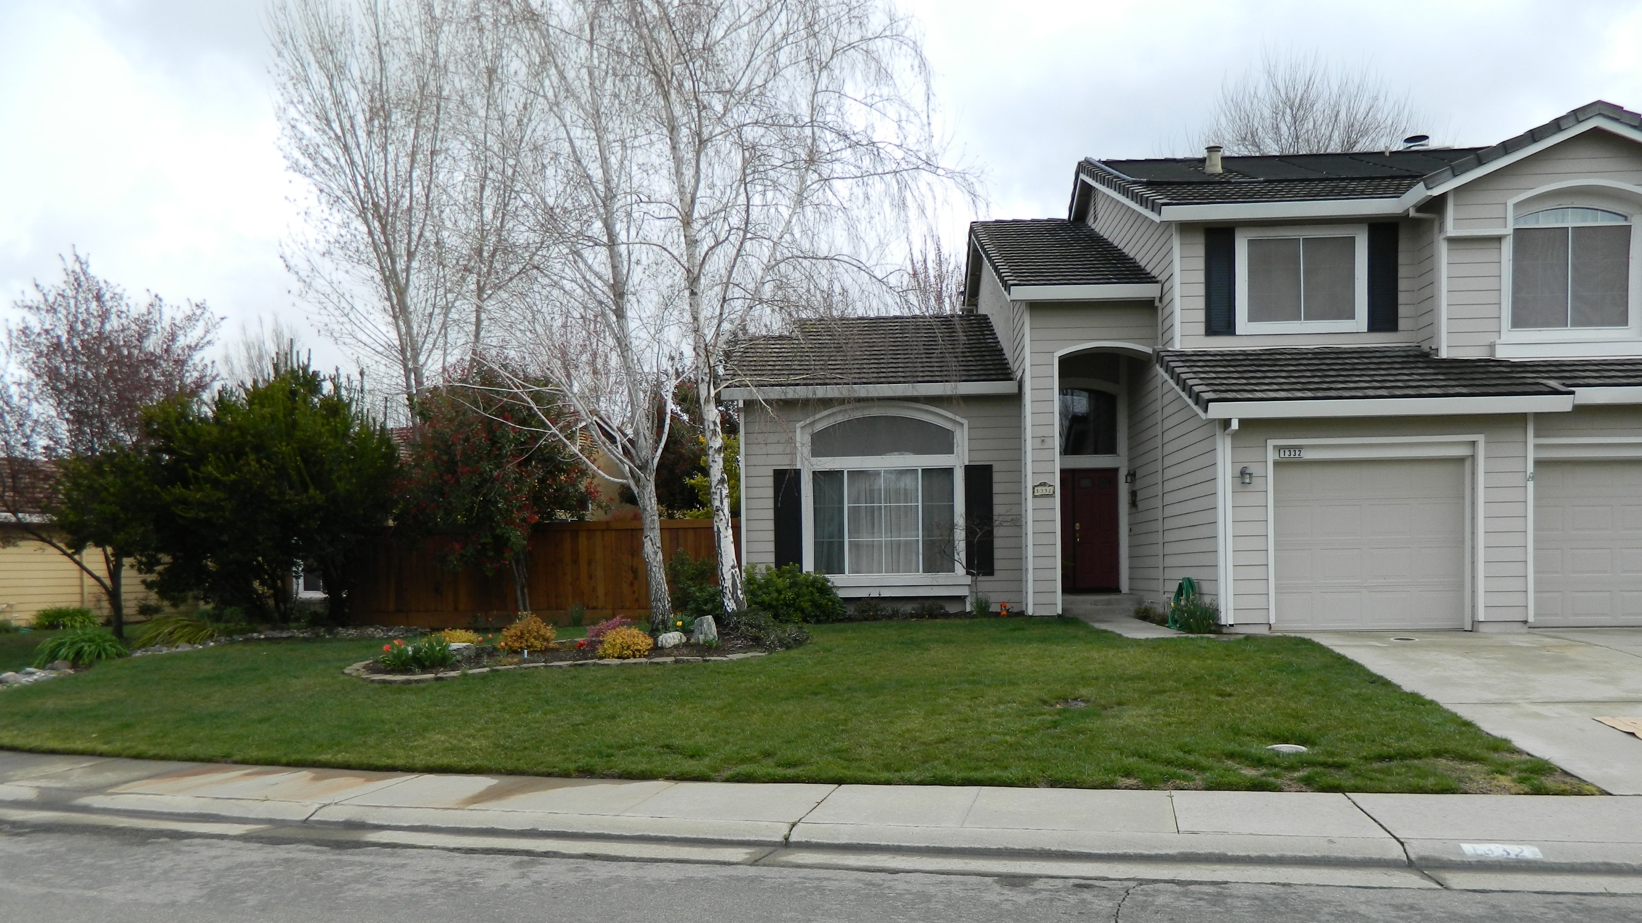
BORING!
Notes:
My yard. Boring. Too much time spent on watering and too much money spent on water which ran down the yard into the storm drain. Qualified for the City of Roseville Cash for Grass program

Slide 9
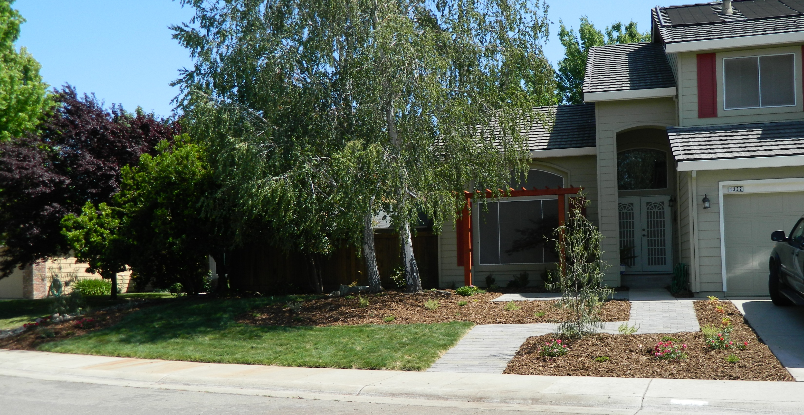
Notes:
New plants are all drought tolerant, including native Manzanita. Better with no mow grass. This grass is clumpy though allowing weeds to grow and not as drought tolerant as hoped. The new pavers are permeable allowing water to stay on the property. The yard still isn’t working for us.

Slide 10
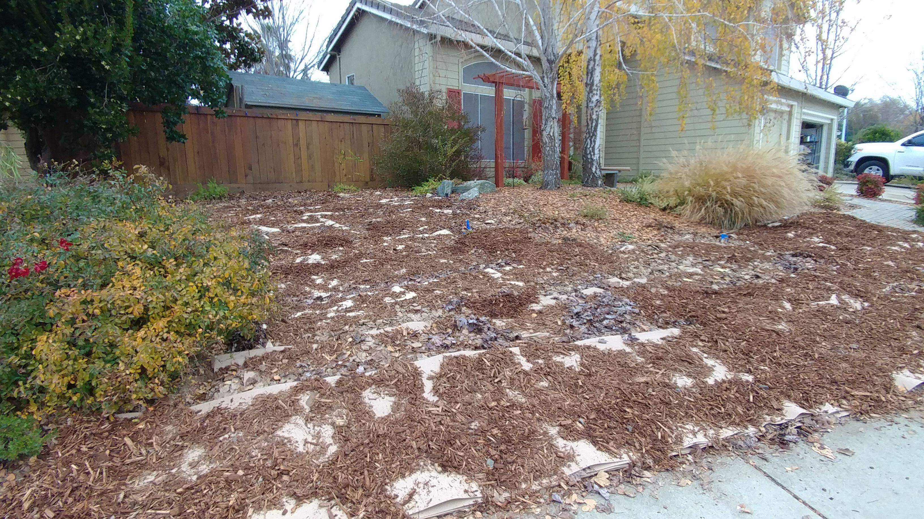
Notes:
4 layers of sheet mulch. More mulch was added on top after this photo was taken. I used the roll of brown paper you can pick up inexpensively in the paint section of the big box stores . Coffee grounds were picked up at local “Starbucks”. I recommend you put in a barrier where the yard and sidewalk meet. This work was done around Thanksgiving.

Slide 11
Waiting is the hard part!
Sheet composting is a slow process. There is little or no heat reaction from the microorganisms to speed the process along.
A bed is “finished” and ready for planting when the layers have decomposed to the point that the original materials are no longer recognizable, and it looks and smells like fresh earth.
Notes:
This gives you the time to plan your irrigation and design your landscape

Slide 12
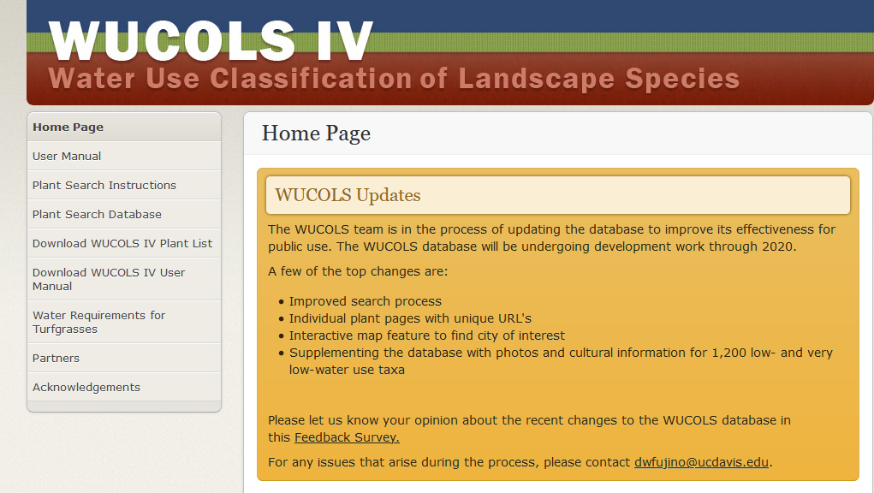
Notes:
Fabulous tool…Through the plant search database you can look up plants in your city, and filter your search by water type and type of plant

Slide 13

Notes:
Another great website to look up plants. This one is for native plants for your area

Slide 14
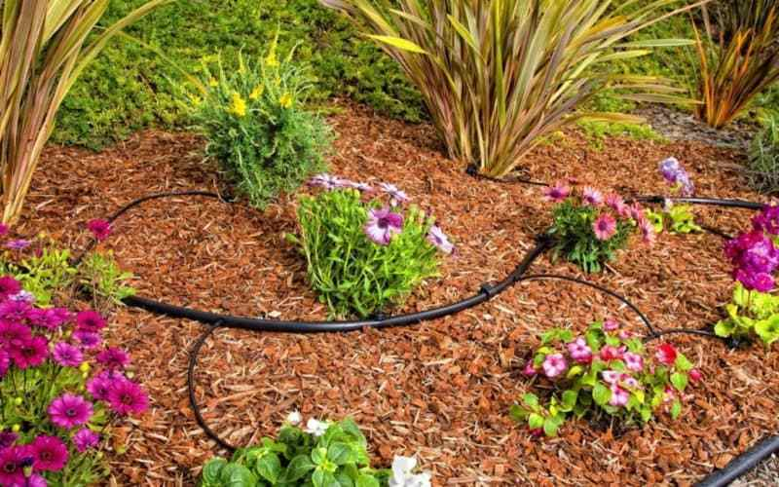
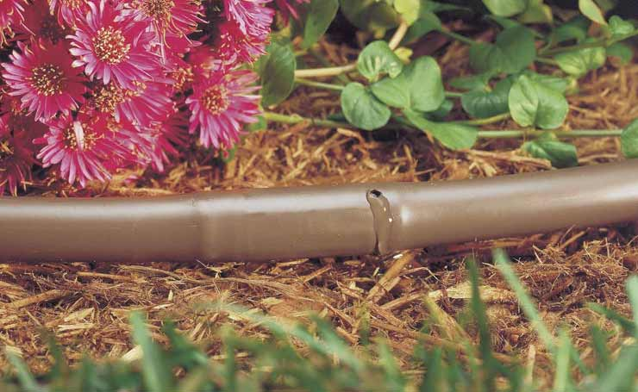
Drip irrigation doesn’t waste water
Notes:
These emitters are sitting on top of the mulch to give you an idea of options. In reality they would be covered with mulch to hold the moisture in

Slide 15
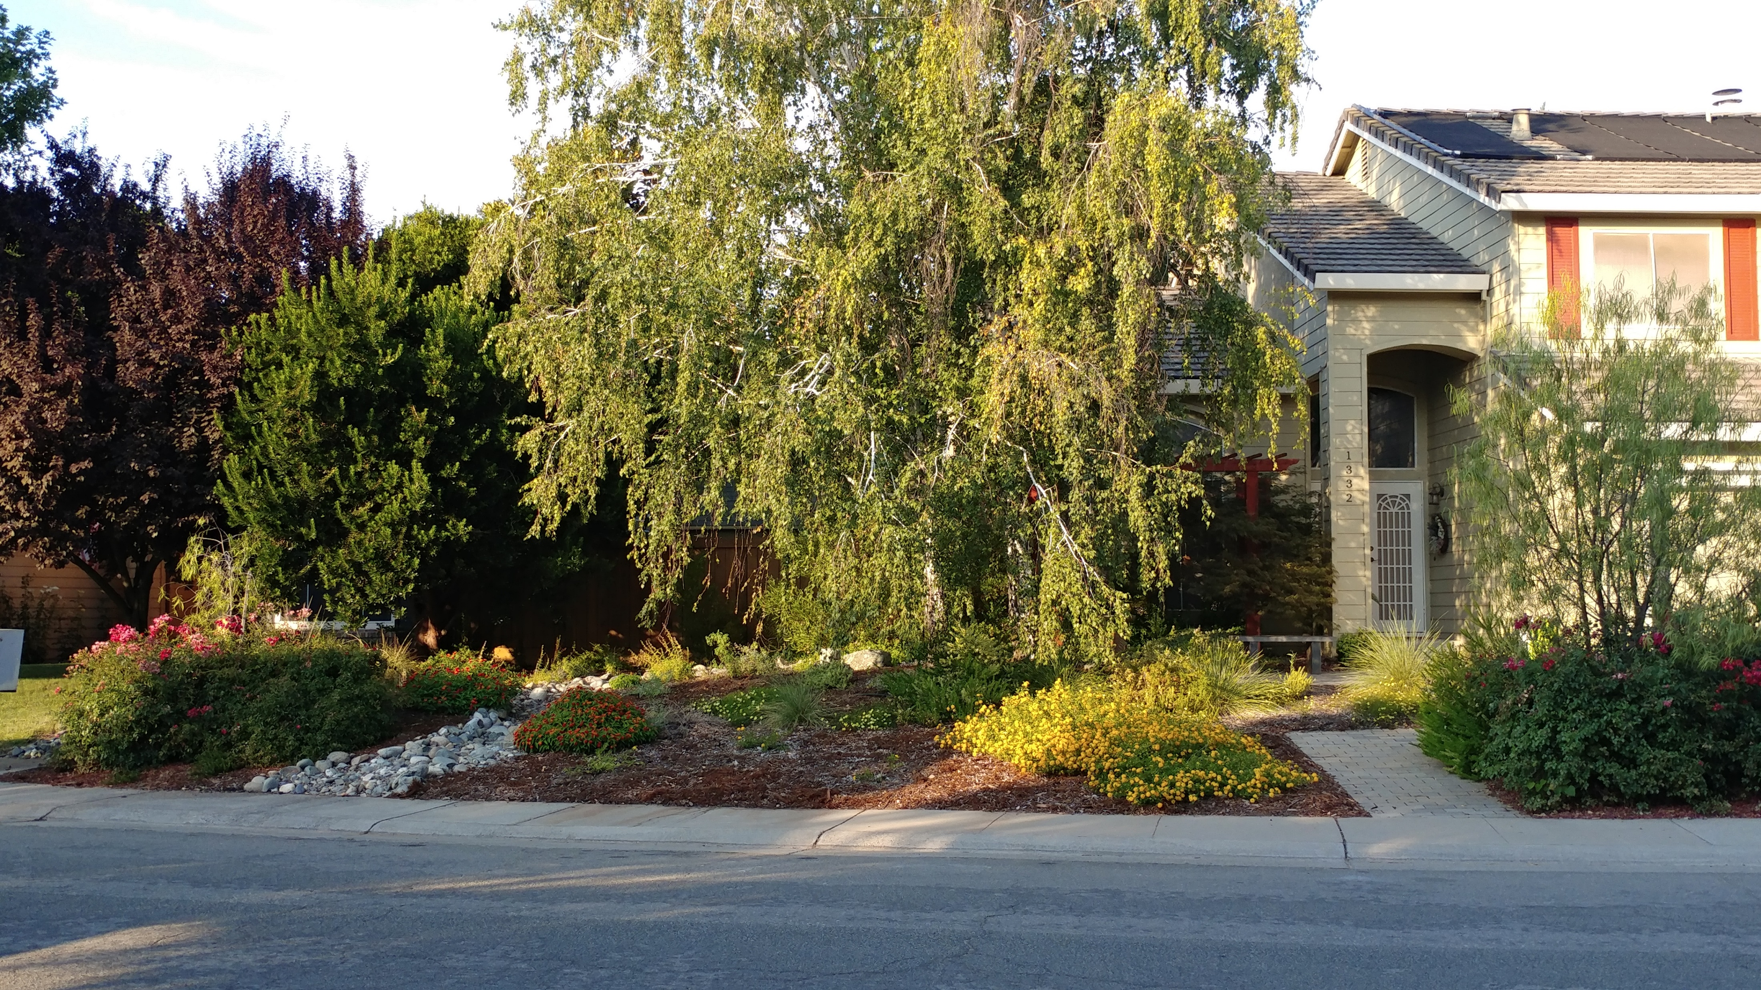
Notes:
Mid summer the following year. This yard attracts tons of pollinators.

Slide 16
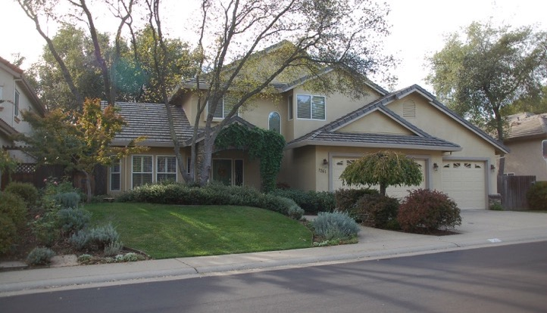
Photo courtesy of J. Long
Notes:
This is a before photo of another MG’s yard. She thought her yard was boring also!

Slide 17
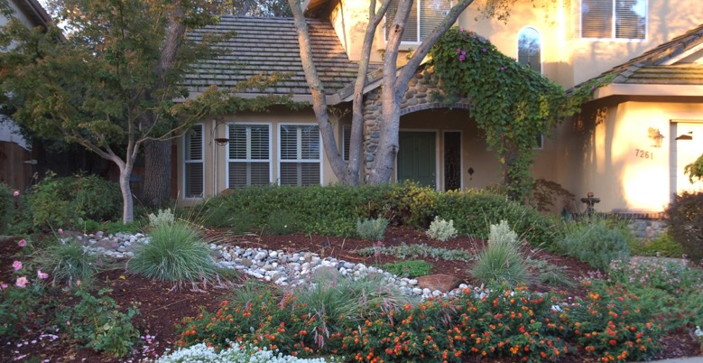
Photo courtesy of J. Long
Notes:
She turned it into an award winner using a sheet mulching technique

Slide 18
So why Sheet Mulch?
It saves you time doing lawncare
It enriches your soil
It cuts down on weeds
Depending on plant selection, it could save $$ in water
Notes:
Depending on which plants you select, you may attract wildlife and beneficial insects. It can also decrease the amount of time and money put into maintaining a lawn. Less water, no fertilizer

Slide 19
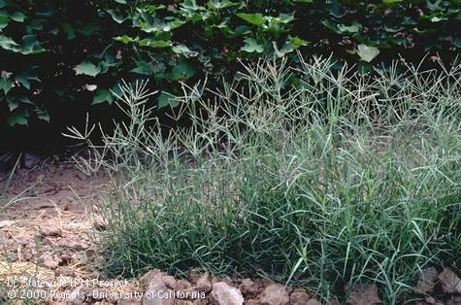
Let’s Talk Briefly About Bermudagrass

Slide 20
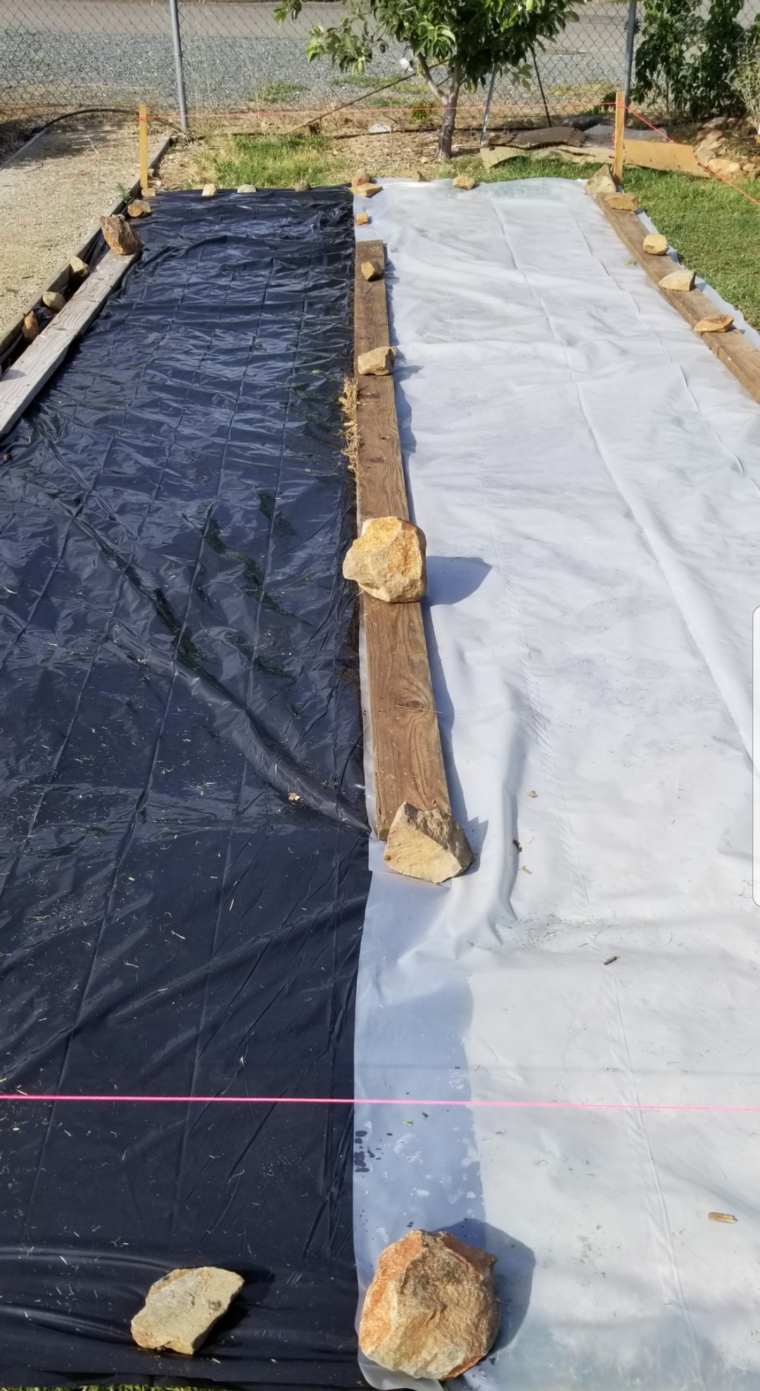
Above ground shoots are called stolons
Below the ground shoots are called rhizomes
It likes moist soil
Never add to home compost!
Cover with black polyethylene during summer months
Clear plastic mulching ( Solarization) also during summer months
Photo Credit: D. Abella
Notes:
I will talk about non-herbicide bermudagrass management. Shoots can grow 1-6” in untouched soil, and as deep as 6’ in healthy, moist soil. It can be controlled during the summer months by completely withholding water. Spade a couple of times to bring rhizomes to the surface. Black plastic eliminates sunlight. Takes 6-8 weeks. For clear plastic, use ultraviolet protected polyethylene. For both types: closely mow grass, water, and extend plastic 2 feet out making sure infested area is covered. Seal with dirt, etc. making sure there are no holes. Leave covered for a minimum of 6 weeks. You will find more information about bermudagrass eradication in the UC IPM Pest Notes, whose link is on the next slide

Slide 21
Resources:
https://extension.oregonstate.edu/sites/default/files/documents/12281/sheetmulching.pdf
http://ipm.ucanr.edu/PMG/PESTNOTES/pn7453.html

Slide 22
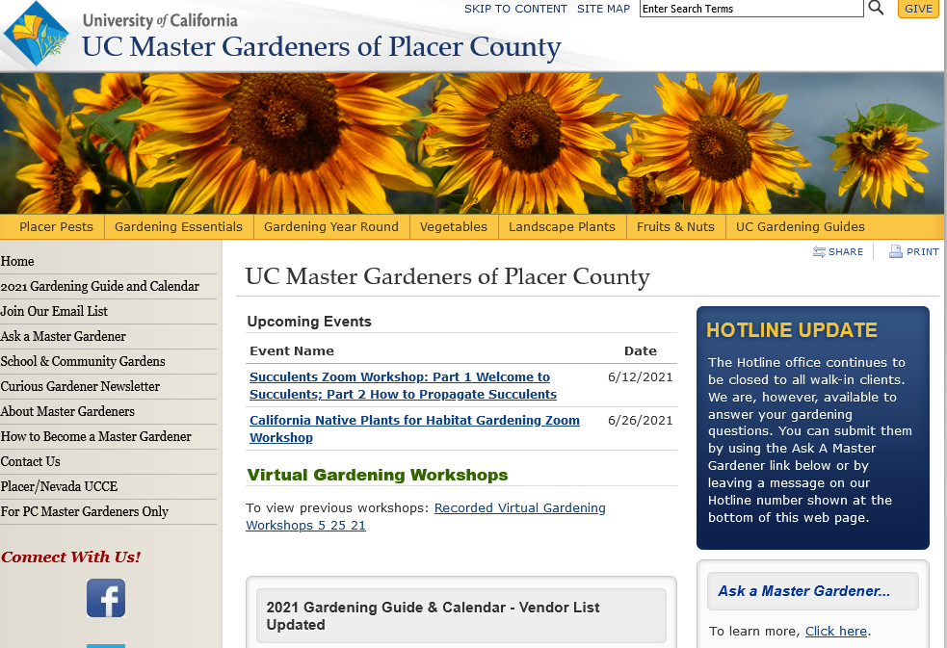

Slide 23

Thank You!
Any Questions?
Master Gardener Hotline: (530) 889-7388
Rotline (530)889-7399
Master Gardener Website: pcmg.ucanr.org

