Slide 1
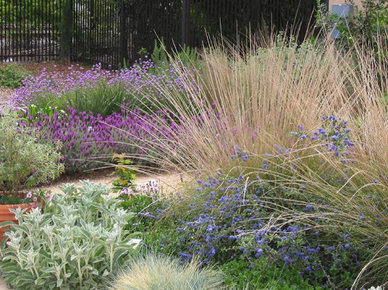
Gardening in a Changing Climate
Notes:
Created: 2/2021
Created by: Peggy Beltramo
Audience: Developed for Zoom presentation. Also given as general meeting CE.
Publicity: Gardening in a Changing Climate. As our climate continues to change, gardeners must adapt to these changes. Find out how our gardening climate is changing and what we can do to respond to those changes.
Update History: for each update to the presentation include date, name of updater, explanation of update
(were additional slides added, were web links updated, etc.)

Slide 2
Who Are Master Gardeners?
Master Gardeners of Placer County
  Extend research-based, sustainable gardening and composting information
  Present accurate, impartial information to home gardeners
  Encourage public to make informed gardening decisions

Slide 3
Who Are Master Gardeners?
Where to find us…
Online, in the Media, and Special Publications
  Hotline: Call (530) 889-7388 or submit your questions online
  Website: pcmg.ucanr.org
  Facebook, Twitter, Instagram
  Gold Country Media monthly column
  Curious Gardener monthly newsletter and on our website
  Gardening Guide and Calendar

Slide 4
Who Are Master Gardeners?
Where to find us…
Workshops, Fairs and Festivals and Special Events
  Speakers by Request
  Workshops (various venues, check website)
  Farmers’ Markets (seasonal: Auburn, Roseville, Lincoln
  Fairs and Festivals Booths (varies)
  Garden Faire (April)
  Mother’s Day Garden Tour (May)

Slide 5
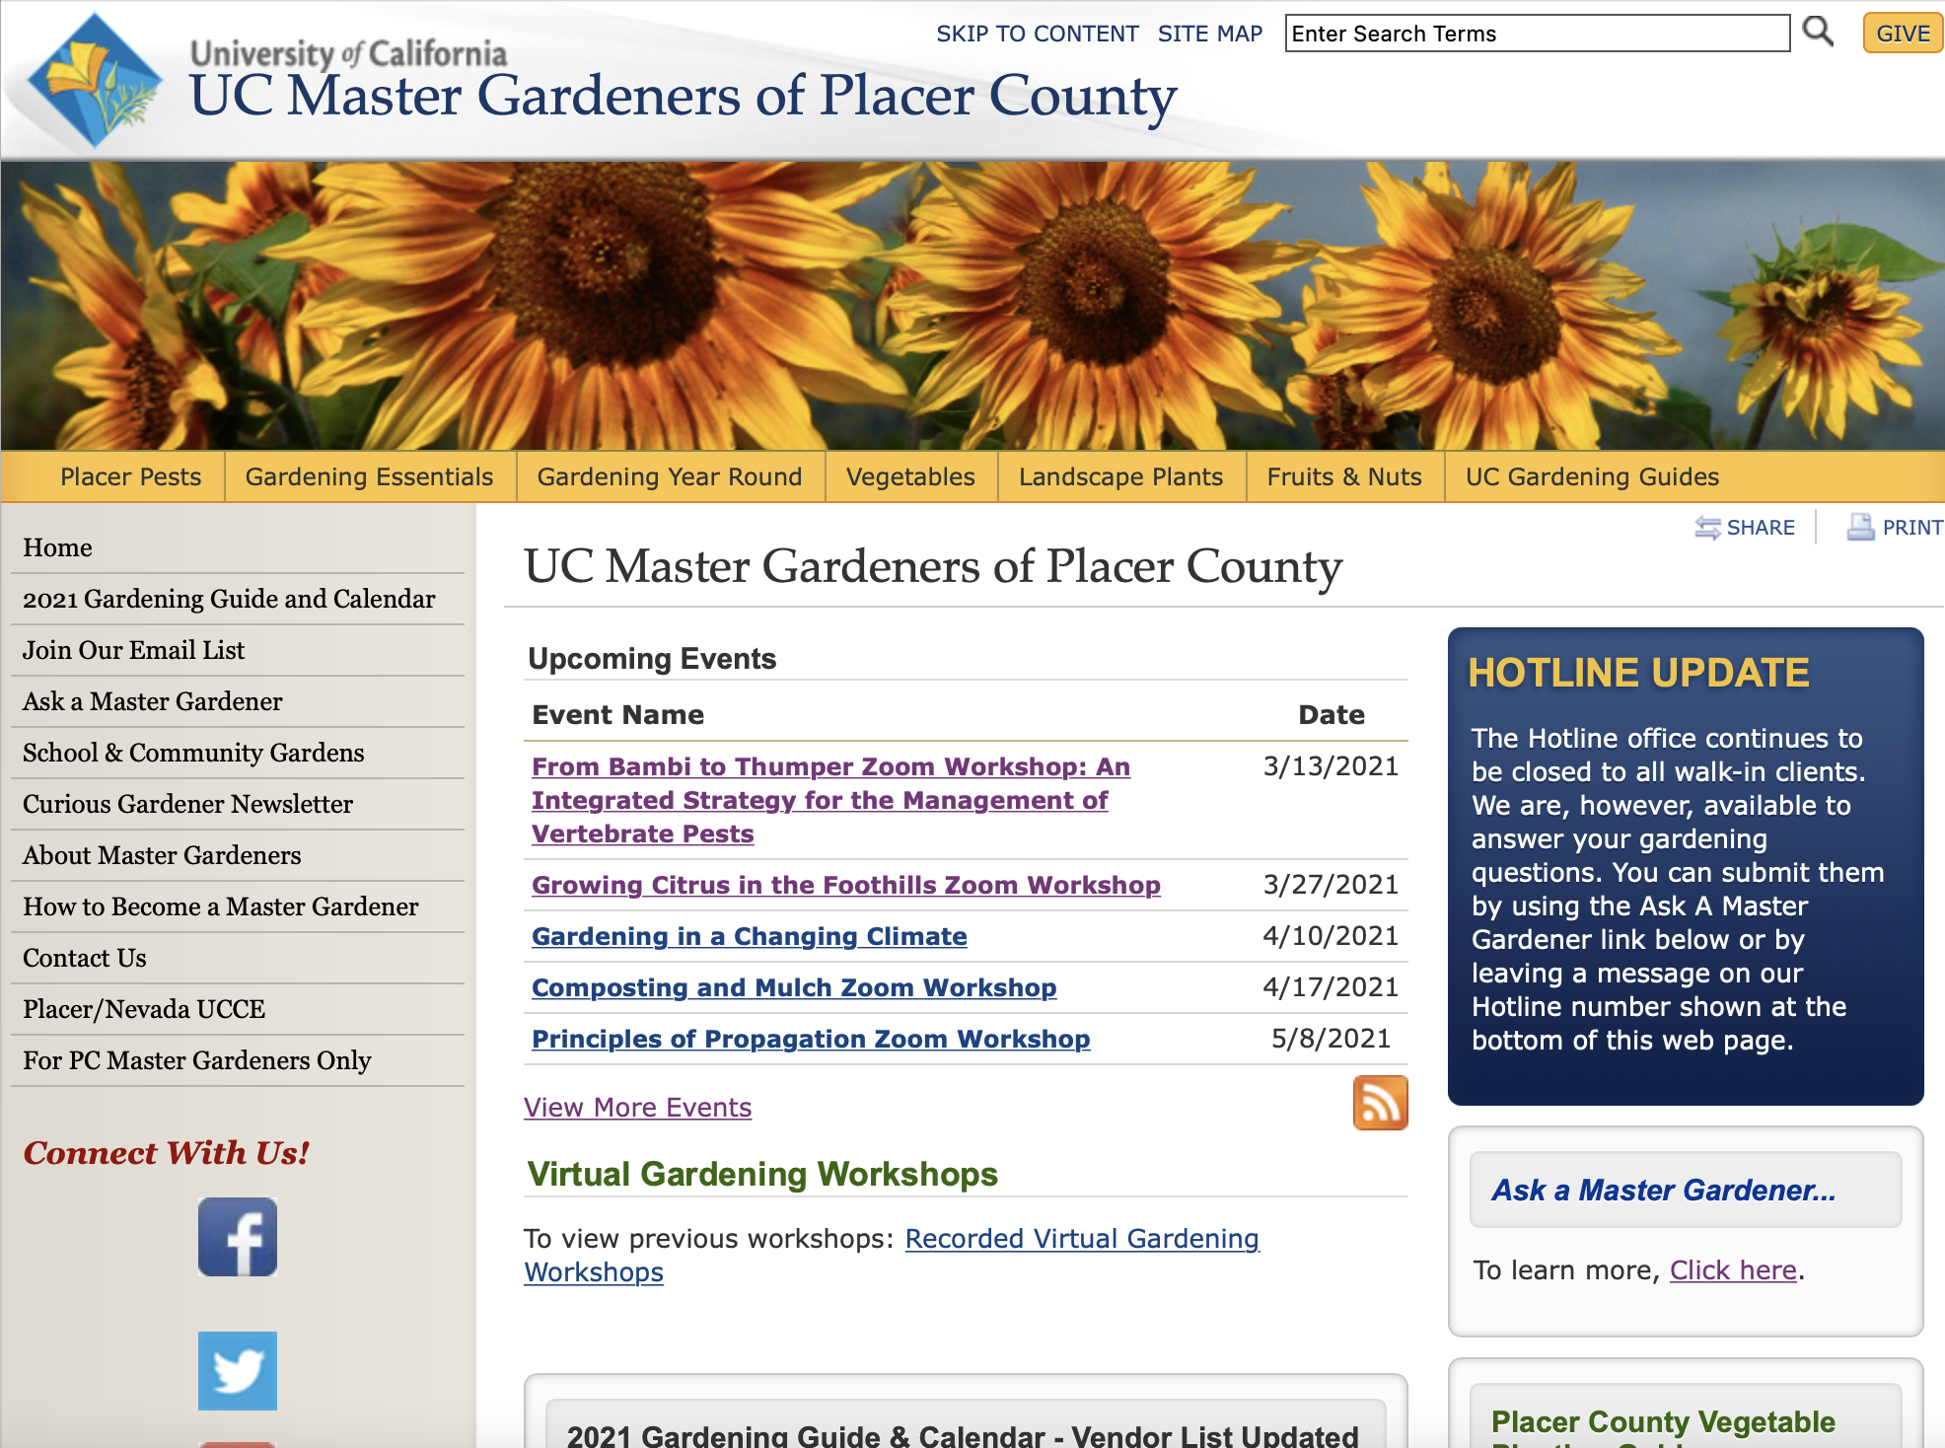
Homepage pcmg.ucanr.org
More
Join
Zoom
???
Join
Zoom
More
Notes:
Green—MORE gardening information
Yellow–-Zoom workshops to come and already recorded
Red—join our Email list, and our quarterly newsletter.
Orange—ASK A QUESTION????

Slide 6
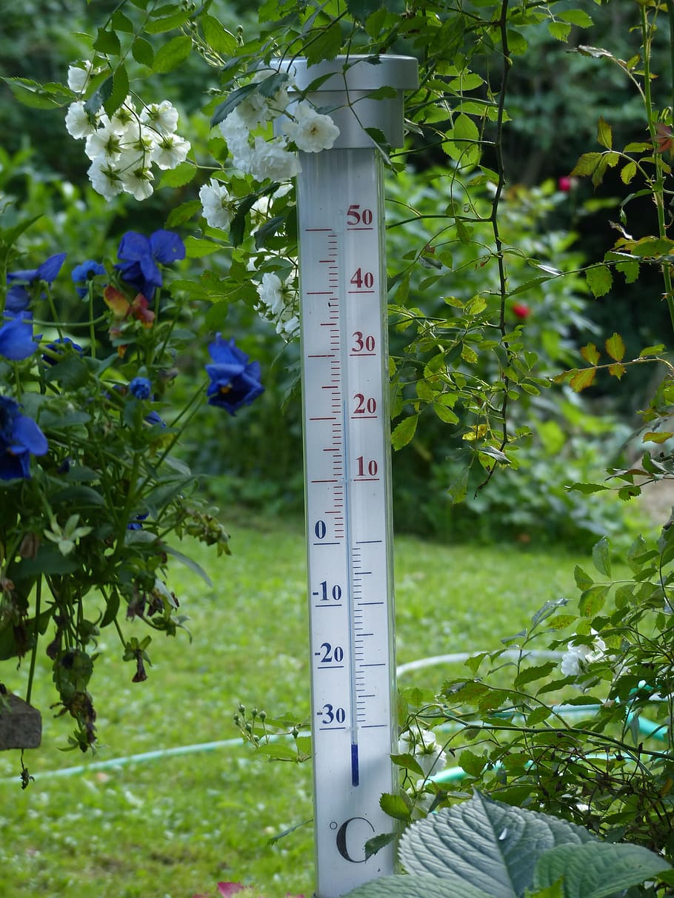
Agenda
What is Climate Change?
The Science of Change
Adapting Gardening Practices
Be Fire Smart
Ask Questions
A Handout with links
is available on our website: pcmg.ucanr.org
Notes:
Master Gardeners are charged with trusting and reporting the science of gardening, so I will not discuss reasons for climate change; nonetheless, gardening is always an adventure, and it will be more so as we move forward. If we look at trends, we can better care for our gardens and make wiser choices. Just remember that plants don’t respond to averages, they respond to extremes.

Slide 7
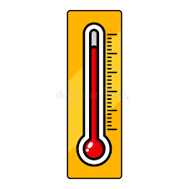
What is Climate Change?
Measured in small increments
Changes add up over time
Can have a huge impact on our gardens
Notes:
We will see that small incremental changes do add up over time and can significantly affect our gardens.

Slide 8
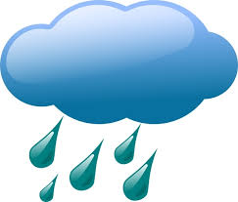
What is Climate Change?
Weather vs. Climate
Weather
What the temperature will be tomorrow or whether it will rain on Thursday.
Climate
Looks at long term (about 30 year)
averages of daily weather.
Notes:
Examining the science, are we talking about weather or climate? What is the difference?
https://ucanr.edu/blogs/blogcore/postdetail.cfm?postnum=28204
https://climatechange.ucdavis.edu/science/

Slide 9

Climate Change Vocabulary
Mitigation
Adaptation
Phenology
Synchrony
Carbon sequestration
Ecosystem services

Slide 10
Mitigation vs. Adaptation
Mitigation (of climate change):
Implementing actions to reduce the sources of greenhouse gas emissions.
Adaptation (to climate change):
Adjusting to actual and expected climate impacts
Can moderate harm
Can exploit beneficial opportunities
Notes:
https://nca2014.globalchange.gov/report/response-strategies/adaptation
“Can society manage unavoidable changes and avoid unmanageable changes?”, Research demonstrates that both mitigation (efforts to reduce future climate changes) and adaptation (efforts to reduce the vulnerability of society to climate change impacts) are needed in order to minimize the damages from human-caused climate change and to adapt to the pace and ultimate magnitude of changes that will occur.,,,

Slide 11
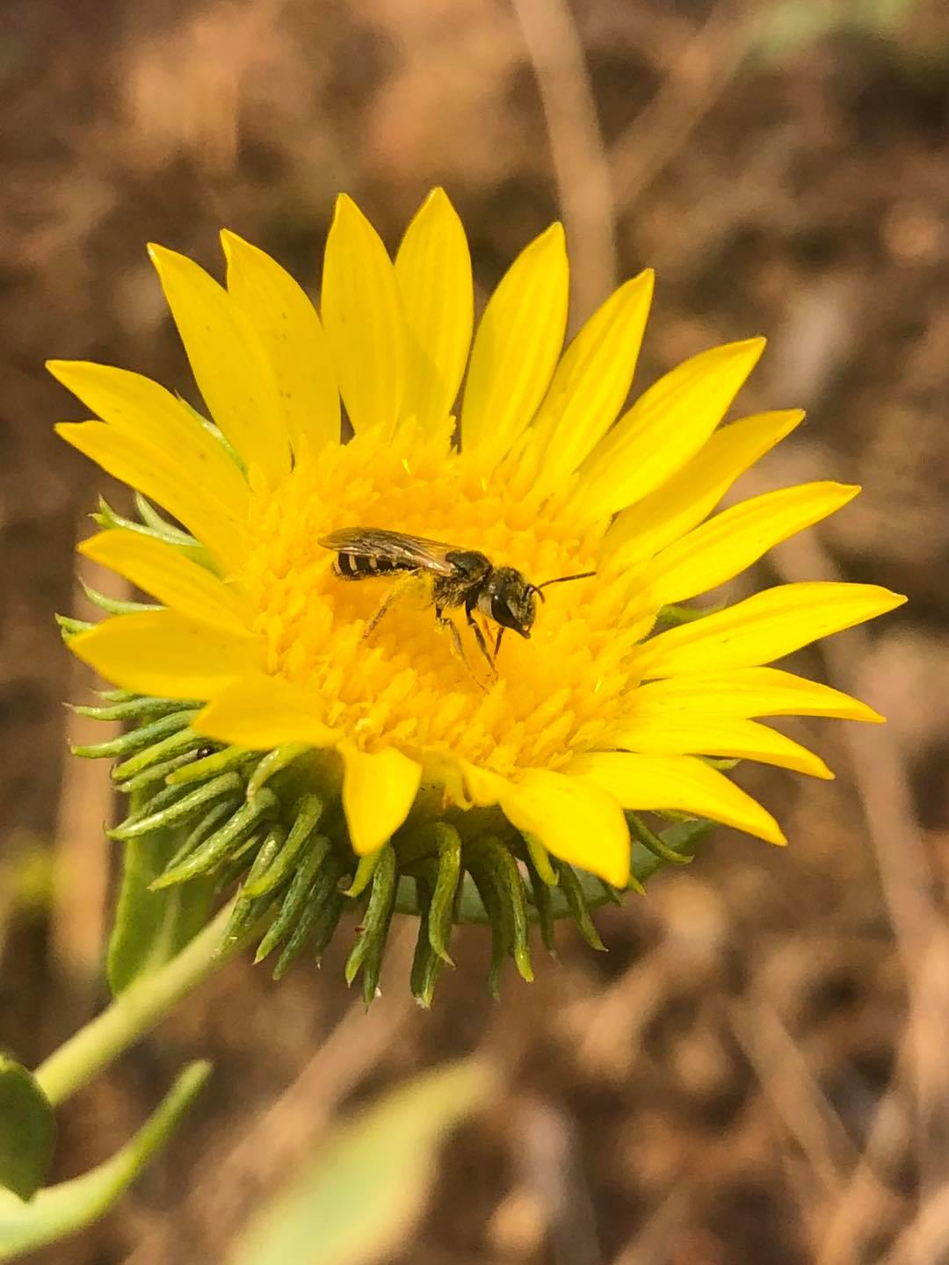
Phenology and Synchrony
Phenology Annual cycles of plants and animals
Extremely sensitive to climate changes
Not all species respond with the same speed
Synchrony Events that occur at the same time
Climate change can disrupt species’ interactions
Plants bloom before pollinators are active
Birds reproduce before caterpillars arrive
Notes:
https://www.sciencebase.gov/catalog/item/5956a3f1e4b0d1f9f050d931

Slide 12
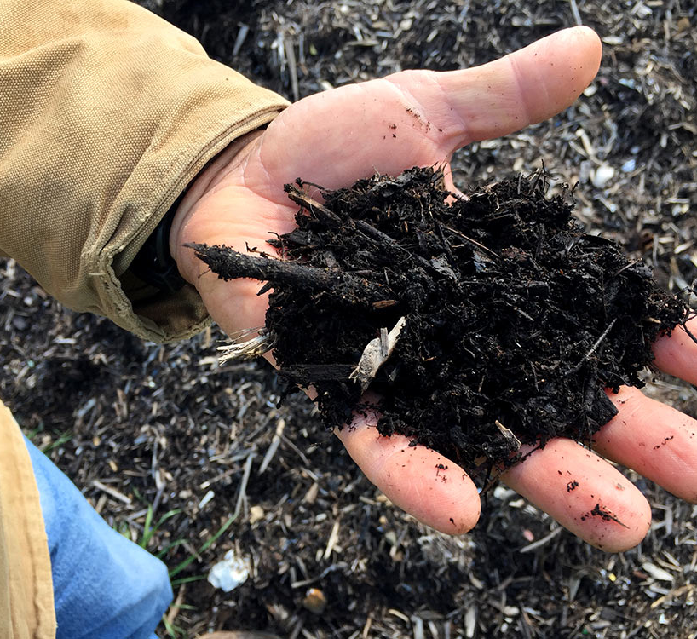
Carbon Sequestration
Removing carbon from the atmosphere
Storing it in a fixed molecule
In soil
In the ocean
In plants
Notes:
https://climatechange.ucdavis.edu/science/carbon-sequestration/

Slide 13
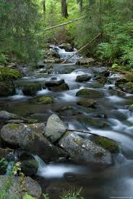
Ecosystem Services
Ecosystem--a community of organisms and their
environment, functioning as an ecological unit
Ecosystem Services are the benefits
of an ecosystem to human life,
such as clean water, food, and
the decomposition of organic matter.
Notes:
https://ucanr.edu/blogs/blogcore/postdetail.cfm?postnum=38819
https://climatechange.ucdavis.edu/science/climate-change-definitions/

Slide 14
The Science of Change
Here are 6 examples of the most common ecological responses to climate change that scientists have documented:
Notes:
https://cpb-us-e1.wpmucdn.com/blogs.cornell.edu/dist/1/7755/files/2018/11/Course-Book-Fall-2018-289zx3u.pdf
Pages 15-16
Observing Signs of Climate Change Impacts in Garden Systems
Gardeners are in unprecedented times. The warming trends observed across all seasons bring uncertainty around stability of temperature averages and ranges (figure 11). Observed increase in frost-free season length and changes in hardiness zones have gardeners questioning how confidently we can rely on frameworks that have provided a foundation to plan and achieve success in our garden settings (figure 11 and figure 12). Our decision-making process now, more than ever, means attaching importance to the increasing number and strength of extreme weather events including prolonged periods of excessively high temperatures, drought, floods, and heavy downpours.

Slide 15
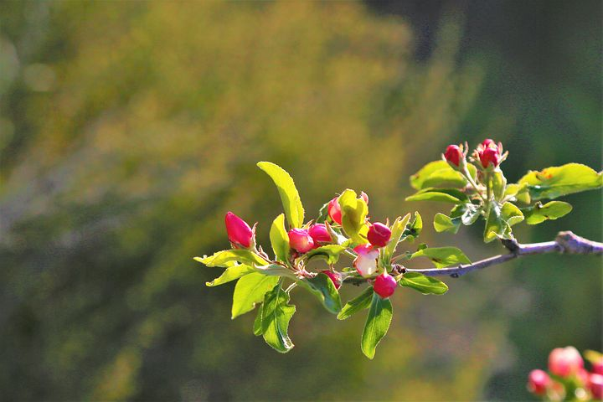
The Science of Change
Spring is arriving earlier:
Leafing out and bloom events are generally happening earlier

Slide 16
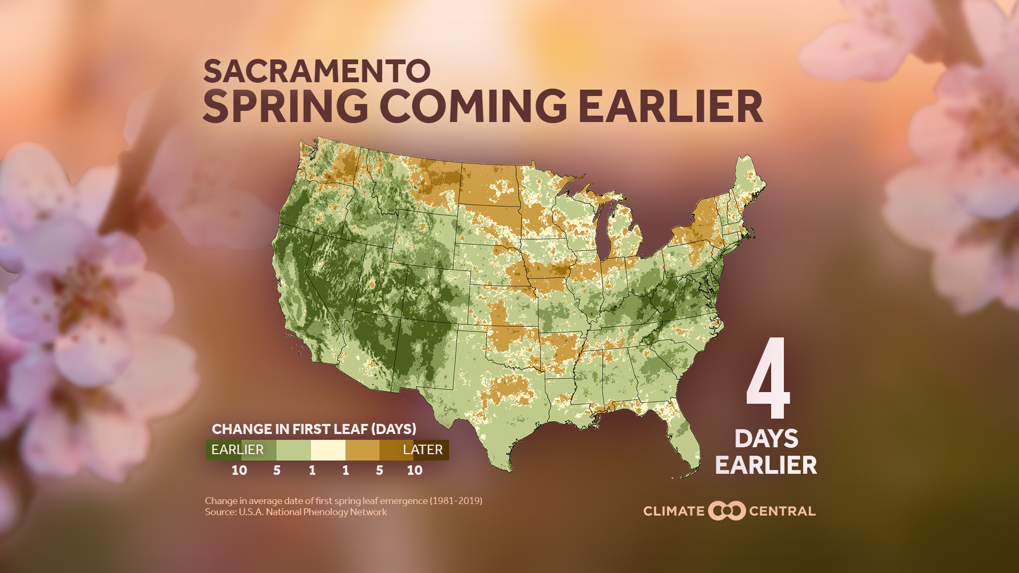
Notes:
Our warming climate is causing spring to arrive earlier across much of the U.S. Our analysis finds that spring ‘leaf out’ is happening earlier in 76% (181) of the 239 cities analyzed, compared to 1981. The most dramatic changes are in Flagstaff, Ariz. (18 days earlier), followed by Colorado Springs, Colo. (17 days) and Reno, Nev. (17 days).
https://www.climatecentral.org/gallery/maps/spring-coming-earlier-number-of-days-local
Earlier springs create a mismatching in availability of food (and other resources) with important natural events such as migration, hibernation and reproduction.
It might seem appealing to shake off the winter cold sooner, but earlier springs can have negative consequences such as longer allergy seasons, more persistent pests (like mosquitoes), and risks to fruit production.
Our warming climate is causing spring to arrive earlier across much of the U.S. Our analysis finds that spring ‘leaf out’ is happening earlier in 76% (181) of the 239 cities analyzed, compared to 1981. The most dramatic changes are in Flagstaff, Ariz. (18 days earlier), followed by Colorado Springs, Colo. (17 days) and Reno, Nev. (17 days).
Earlier springs create a mismatching in availability of food (and other resources) with important natural events such as migration, hibernation and reproduction.
It might seem appealing to shake off the winter cold sooner, but earlier springs can have negative consequences such as longer allergy seasons, more persistent pests (like mosquitoes), and risks to fruit production.
https://medialibrary.climatecentral.org/resources/spring-coming-earlier-2020

Slide 17
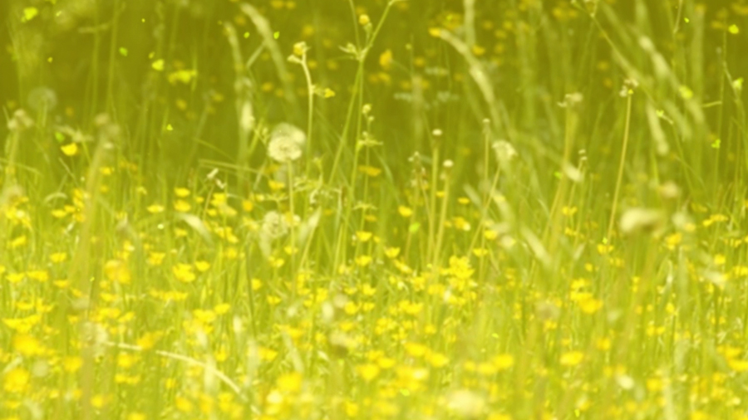
The Science of Change
Rising temperatures mean
  pollen seasons will start earlier
  and last longer,
  causing an uptick in asthma and allergies
Achoo!
Notes:
https://www.ncbi.nlm.nih.gov/pmc/articles/PMC3053965/
There are several potential mechanisms by which climate change might affect allergic disease. First, longer pollen seasons may increase the duration of human exposure to aeroallergens and may thus increase allergic sensitization. Second, longer pollen seasons may increase the duration of allergy symptoms in individuals with allergic disease. Finally, higher atmospheric pollen counts may increase the severity of allergic symptoms (6).

Slide 18
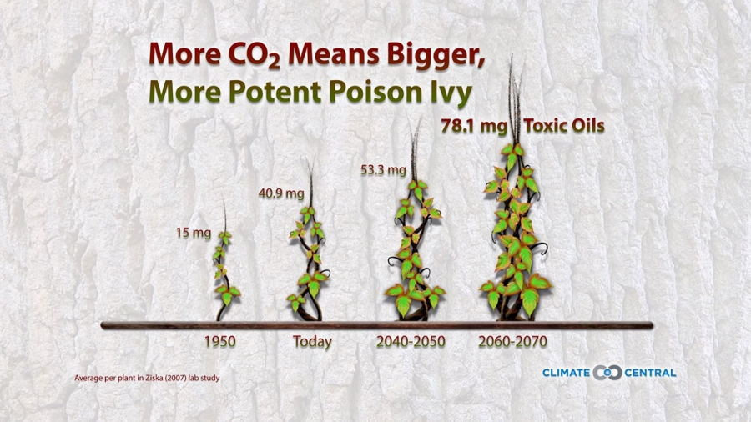
Notes:
Poison ivy plants respond to higher levels of carbon dioxide in controlled experiments by growing bigger and producing more toxic oil.
https://www.climatecentral.org/gallery/graphics/global-warming-and-poison-ivy

Slide 19
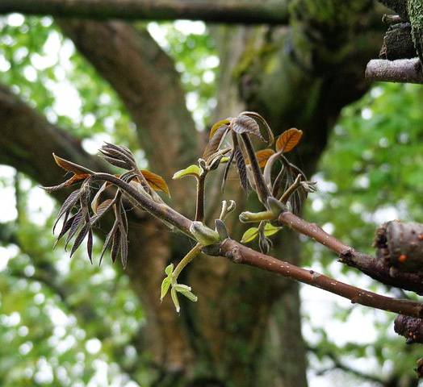
The Science of Change
Frost and freeze damage threaten plants when an earlier spring is combined with more extreme winter storms.
Notes:
More extreme storms (freeze/snow in Texas) after early spring temperatures tease plants and animals to emerge.

Slide 20
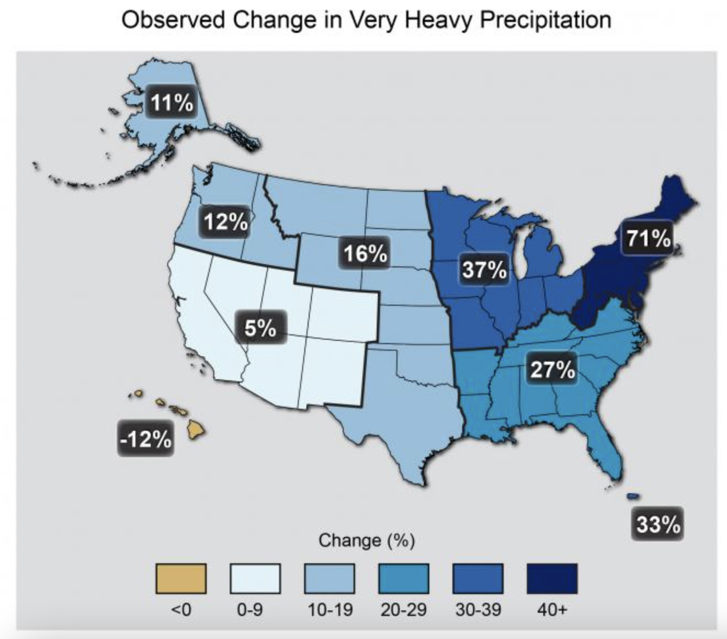
Notes:
5% increase in number of very heavy rainstorms.
https://toolkit.climate.gov/image/762.
Date: 2015

Slide 21
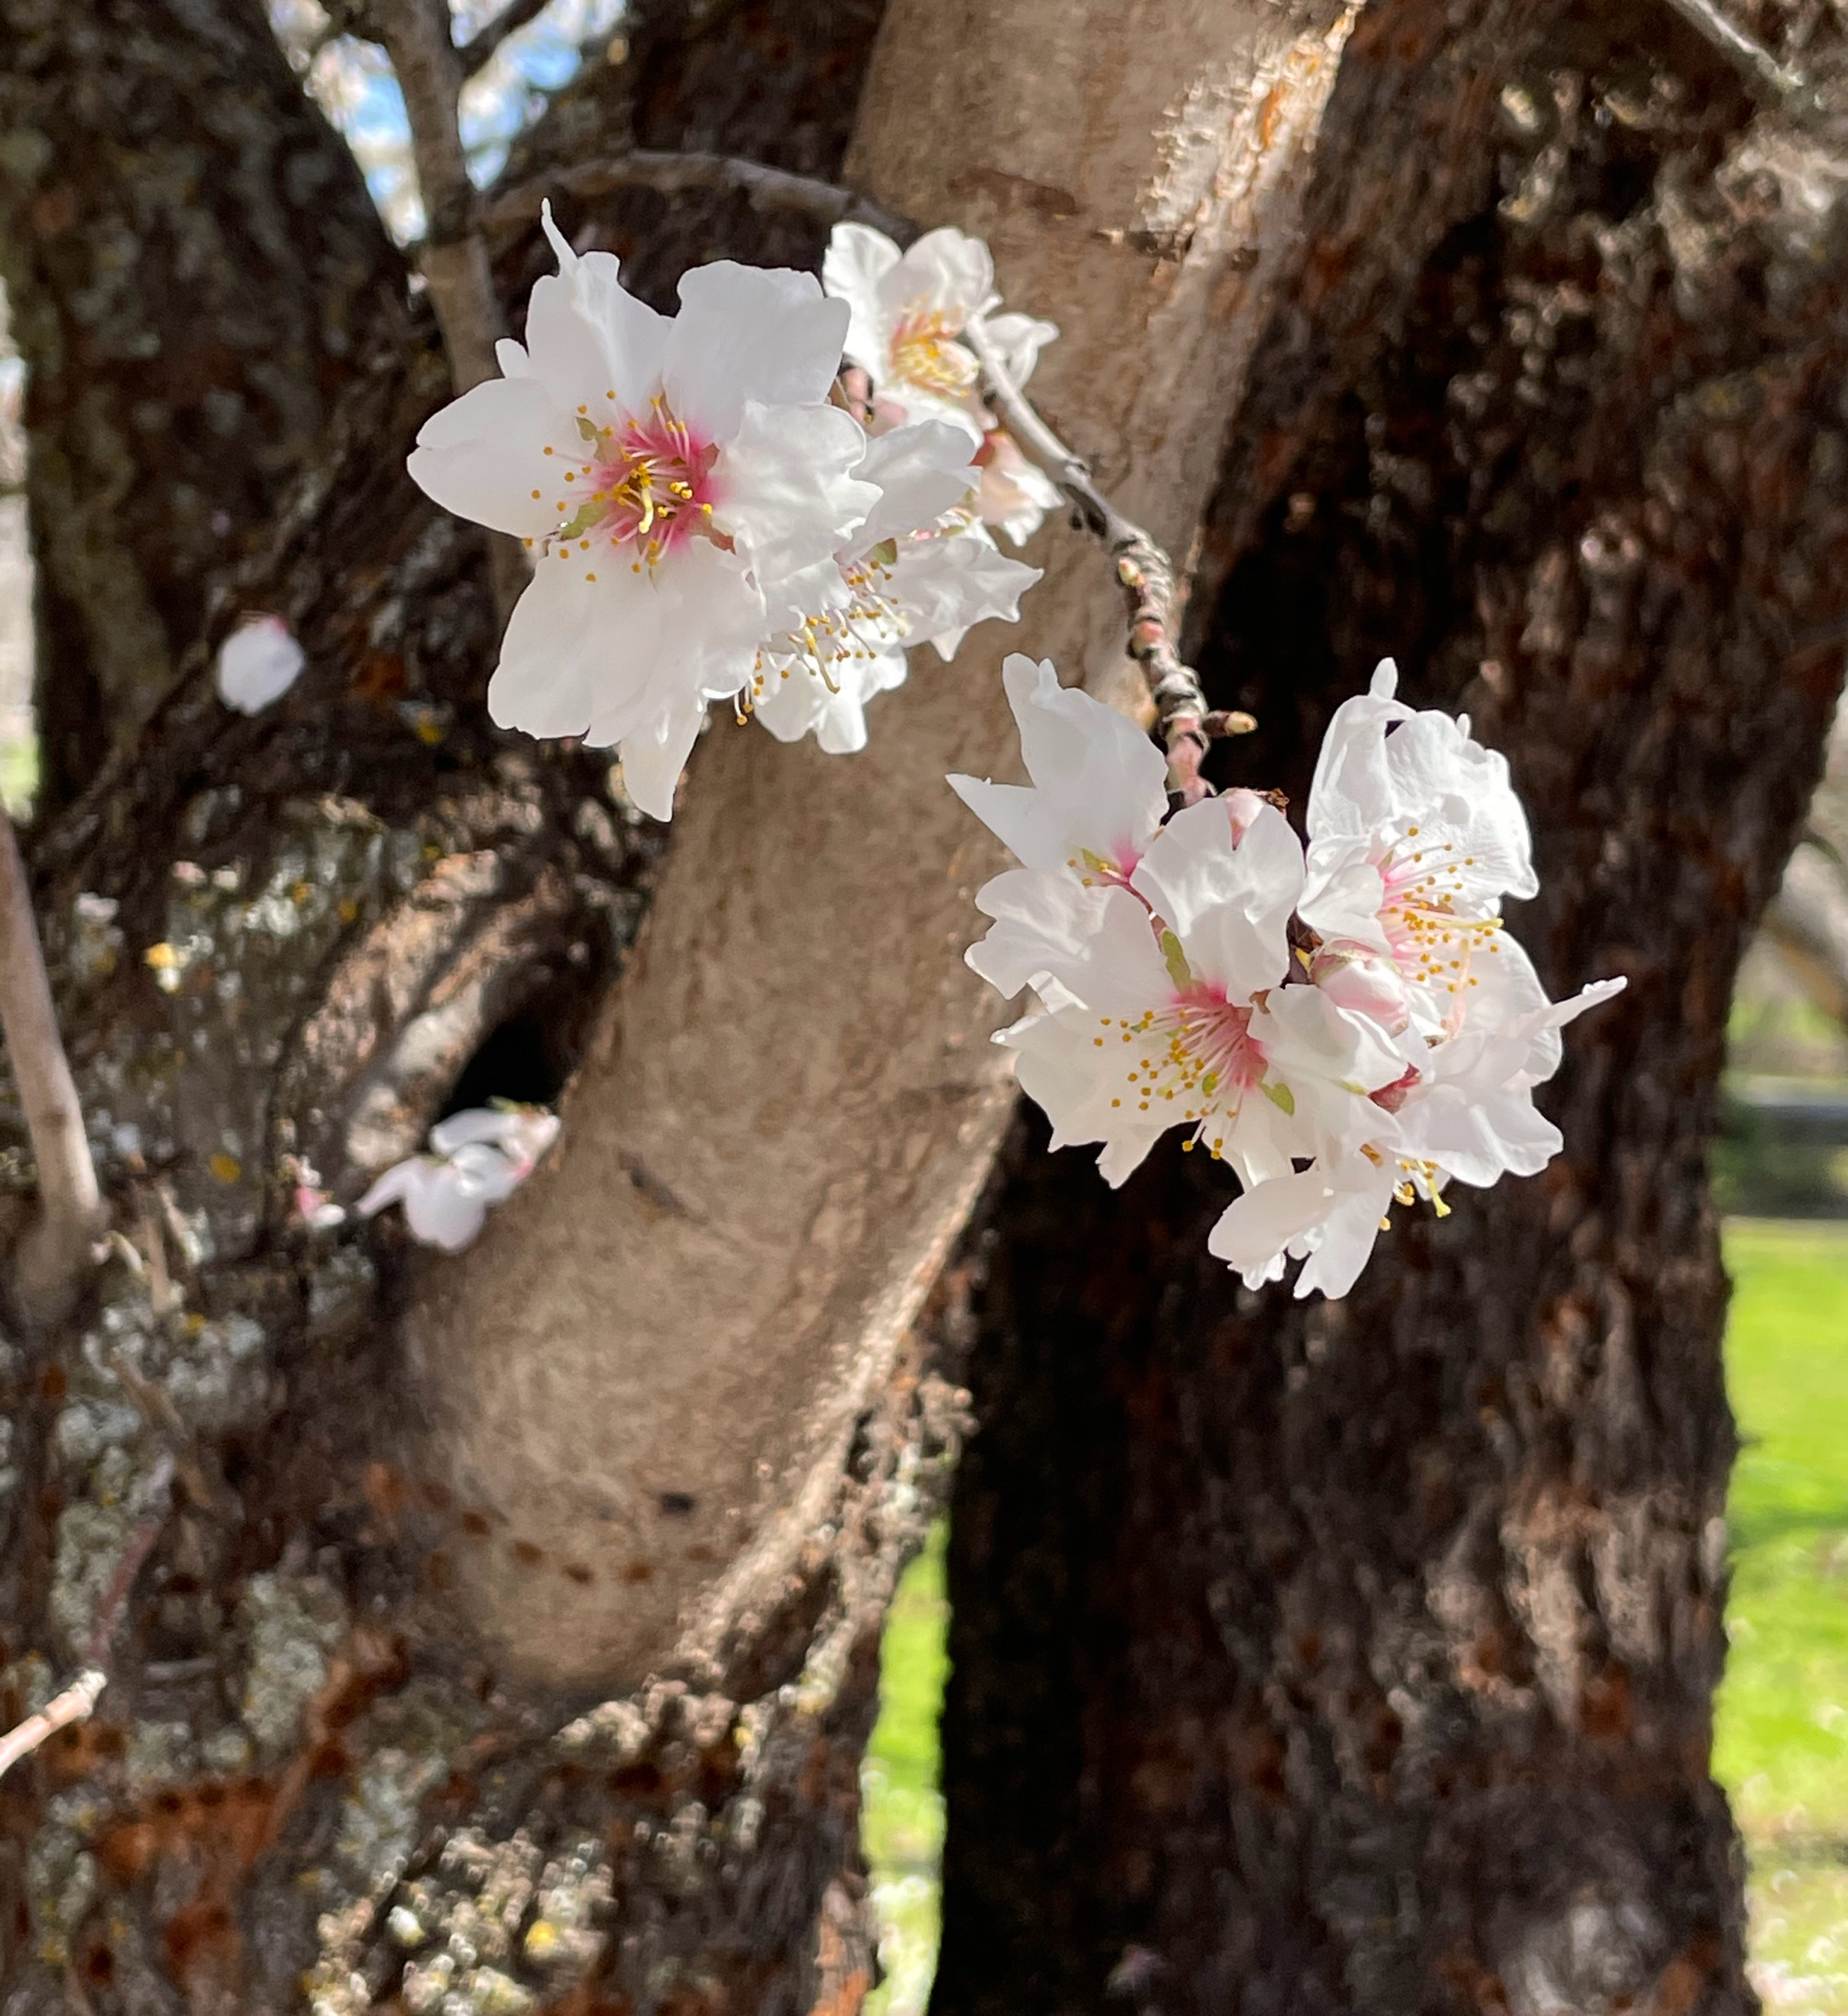
The Science of Change
Reduction in winter chilling is expected to impact fruit and nut trees through too few chilling hours for fruit set
Almond Blossom
Notes:
https://sacdigsgardening.blogspot.com/2021/04/winter-chill-brings-out-spring-lilacs.html
More about chill hours.

Slide 22
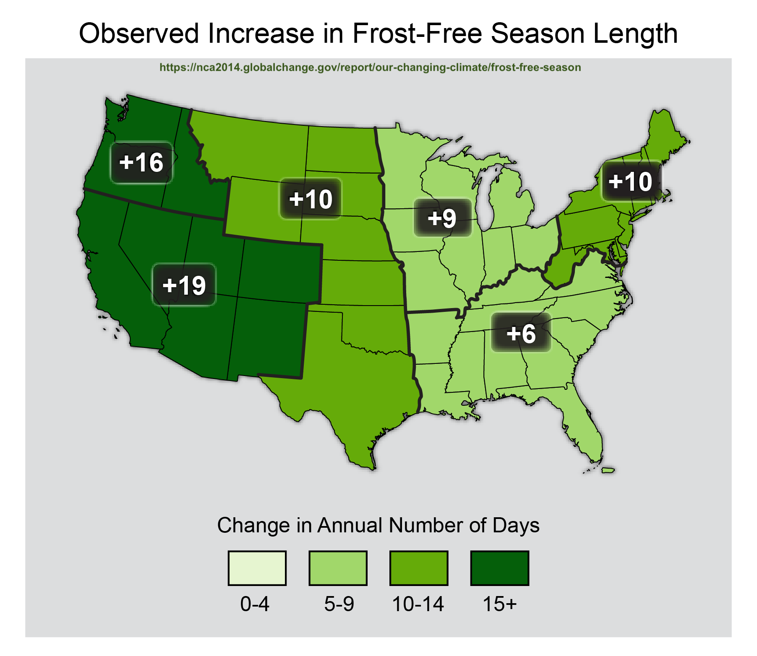
Notes:
https://toolkit.climate.gov/image/2703.
Date: 2018

Slide 23
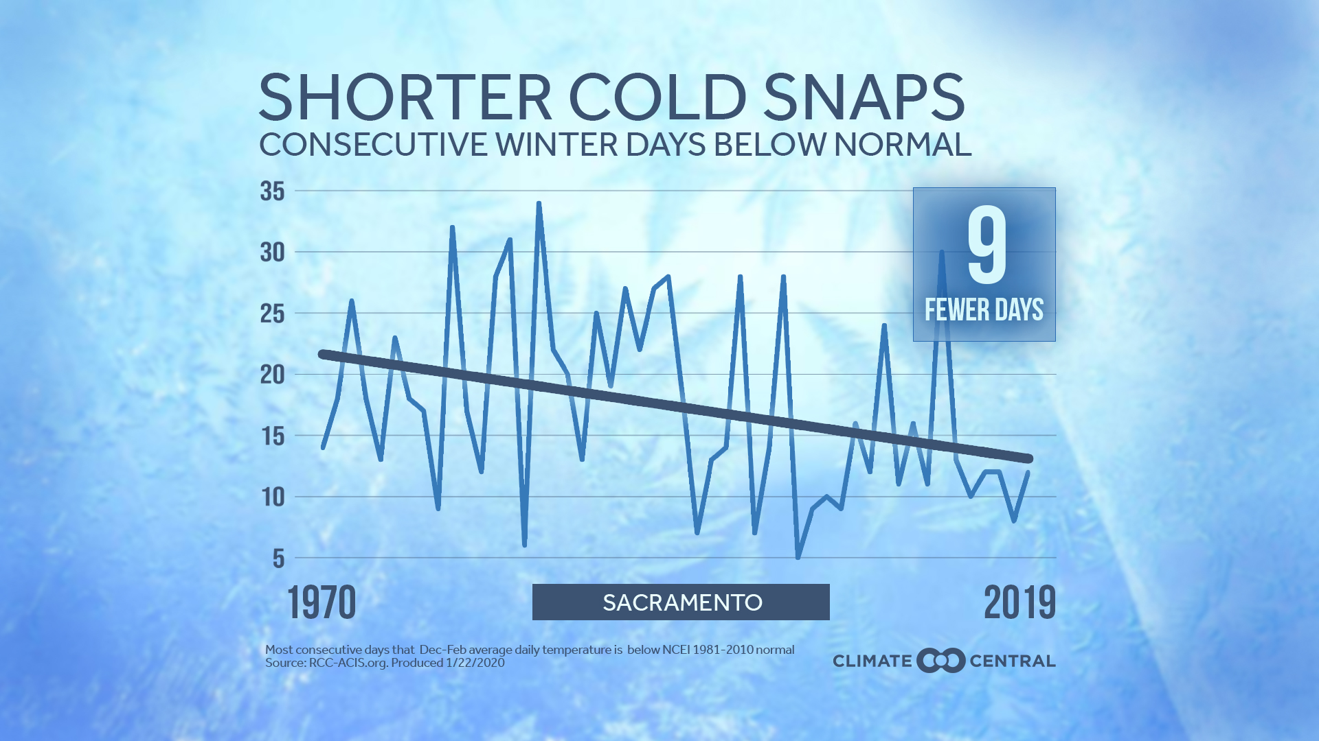
Notes:
Rising temperatures sometimes seem most noticeable during periods of extreme heat such as summer heat waves. However, for much of the U.S., winter is the fastest warming season. Cold weather still occurs in a warming climate but, on average, winters are not as cold as they used to be and cold snaps that do happen are becoming shorter and less frequent.
https://www.climatecentral.org/gallery/maps/winter-losing-its-chill

Slide 24
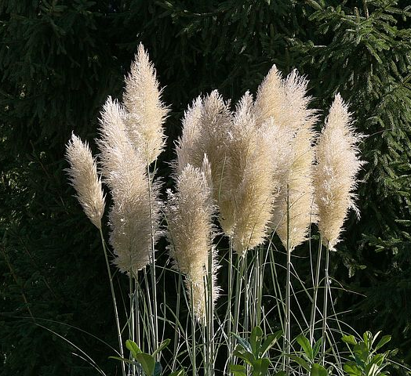
The Science of Change
Invasive species are more responsive to climate changes, facilitating naturalization and invasion.
plantright.org
pampas grass
Notes:
Invasives are more adaptable
Aggressive vs. invasive. Thugs in your garden are aggressive plants.
Invasive plants invade natural areas, altering growing conditions ad supplanting native species.
)http://marinmg.ucanr.edu/PLANTS/PLANTS_TO_AVOID/)
There is growing concern that changing climate conditions will amplify the negative impacts of non-native invasive species and facilitate their expansion.
https://earthlab.uw.edu/2020/04/new-nw-casc-synthesis-explores-the-effects-of-climate-change-on-invasive-species-in-the-northwest/

Slide 25
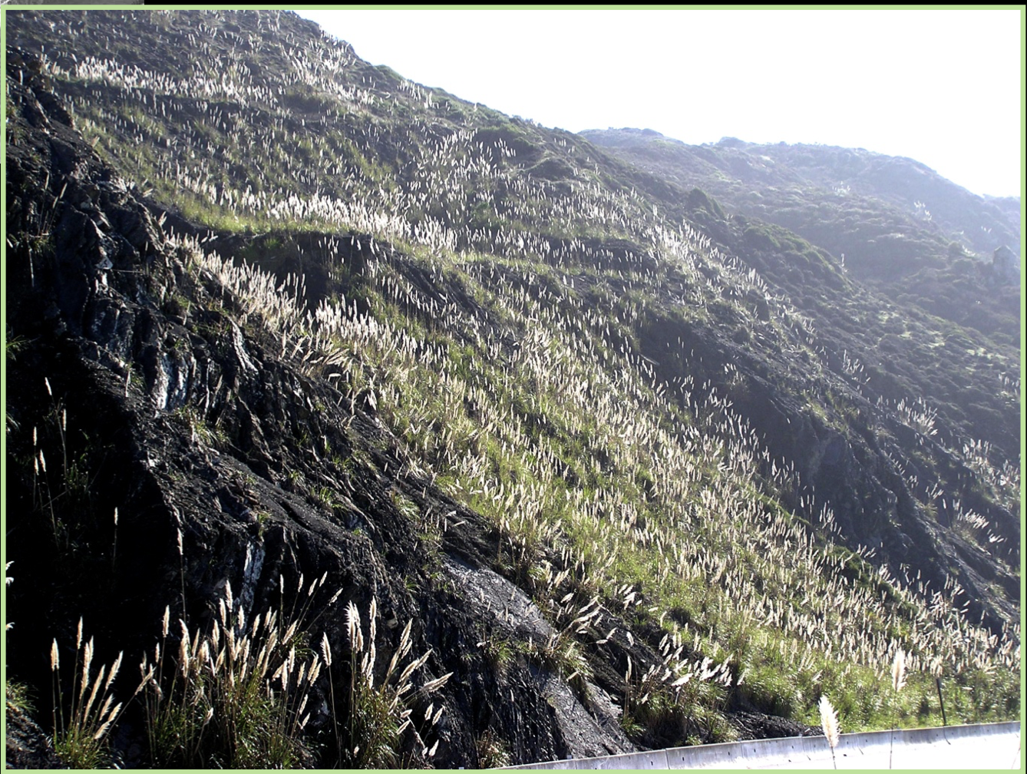
Notes:
PPT
https://ucanr.edu/sites/master_gardener/files/53787.pdf

Slide 26
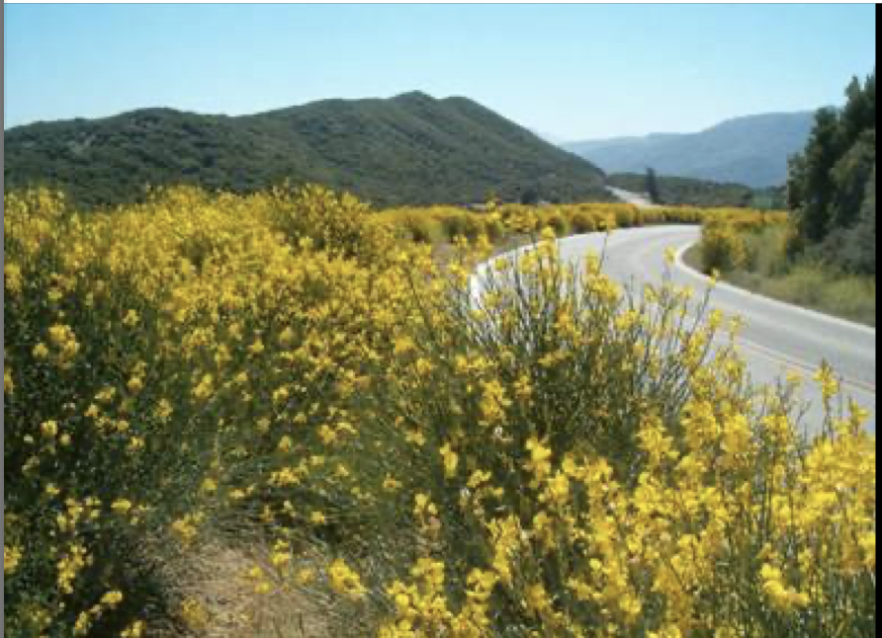
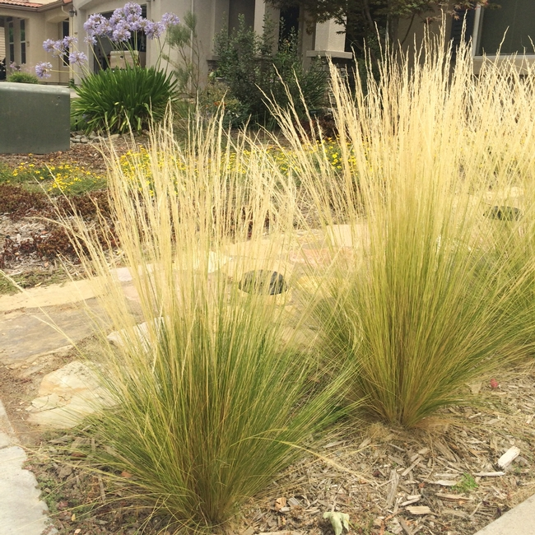
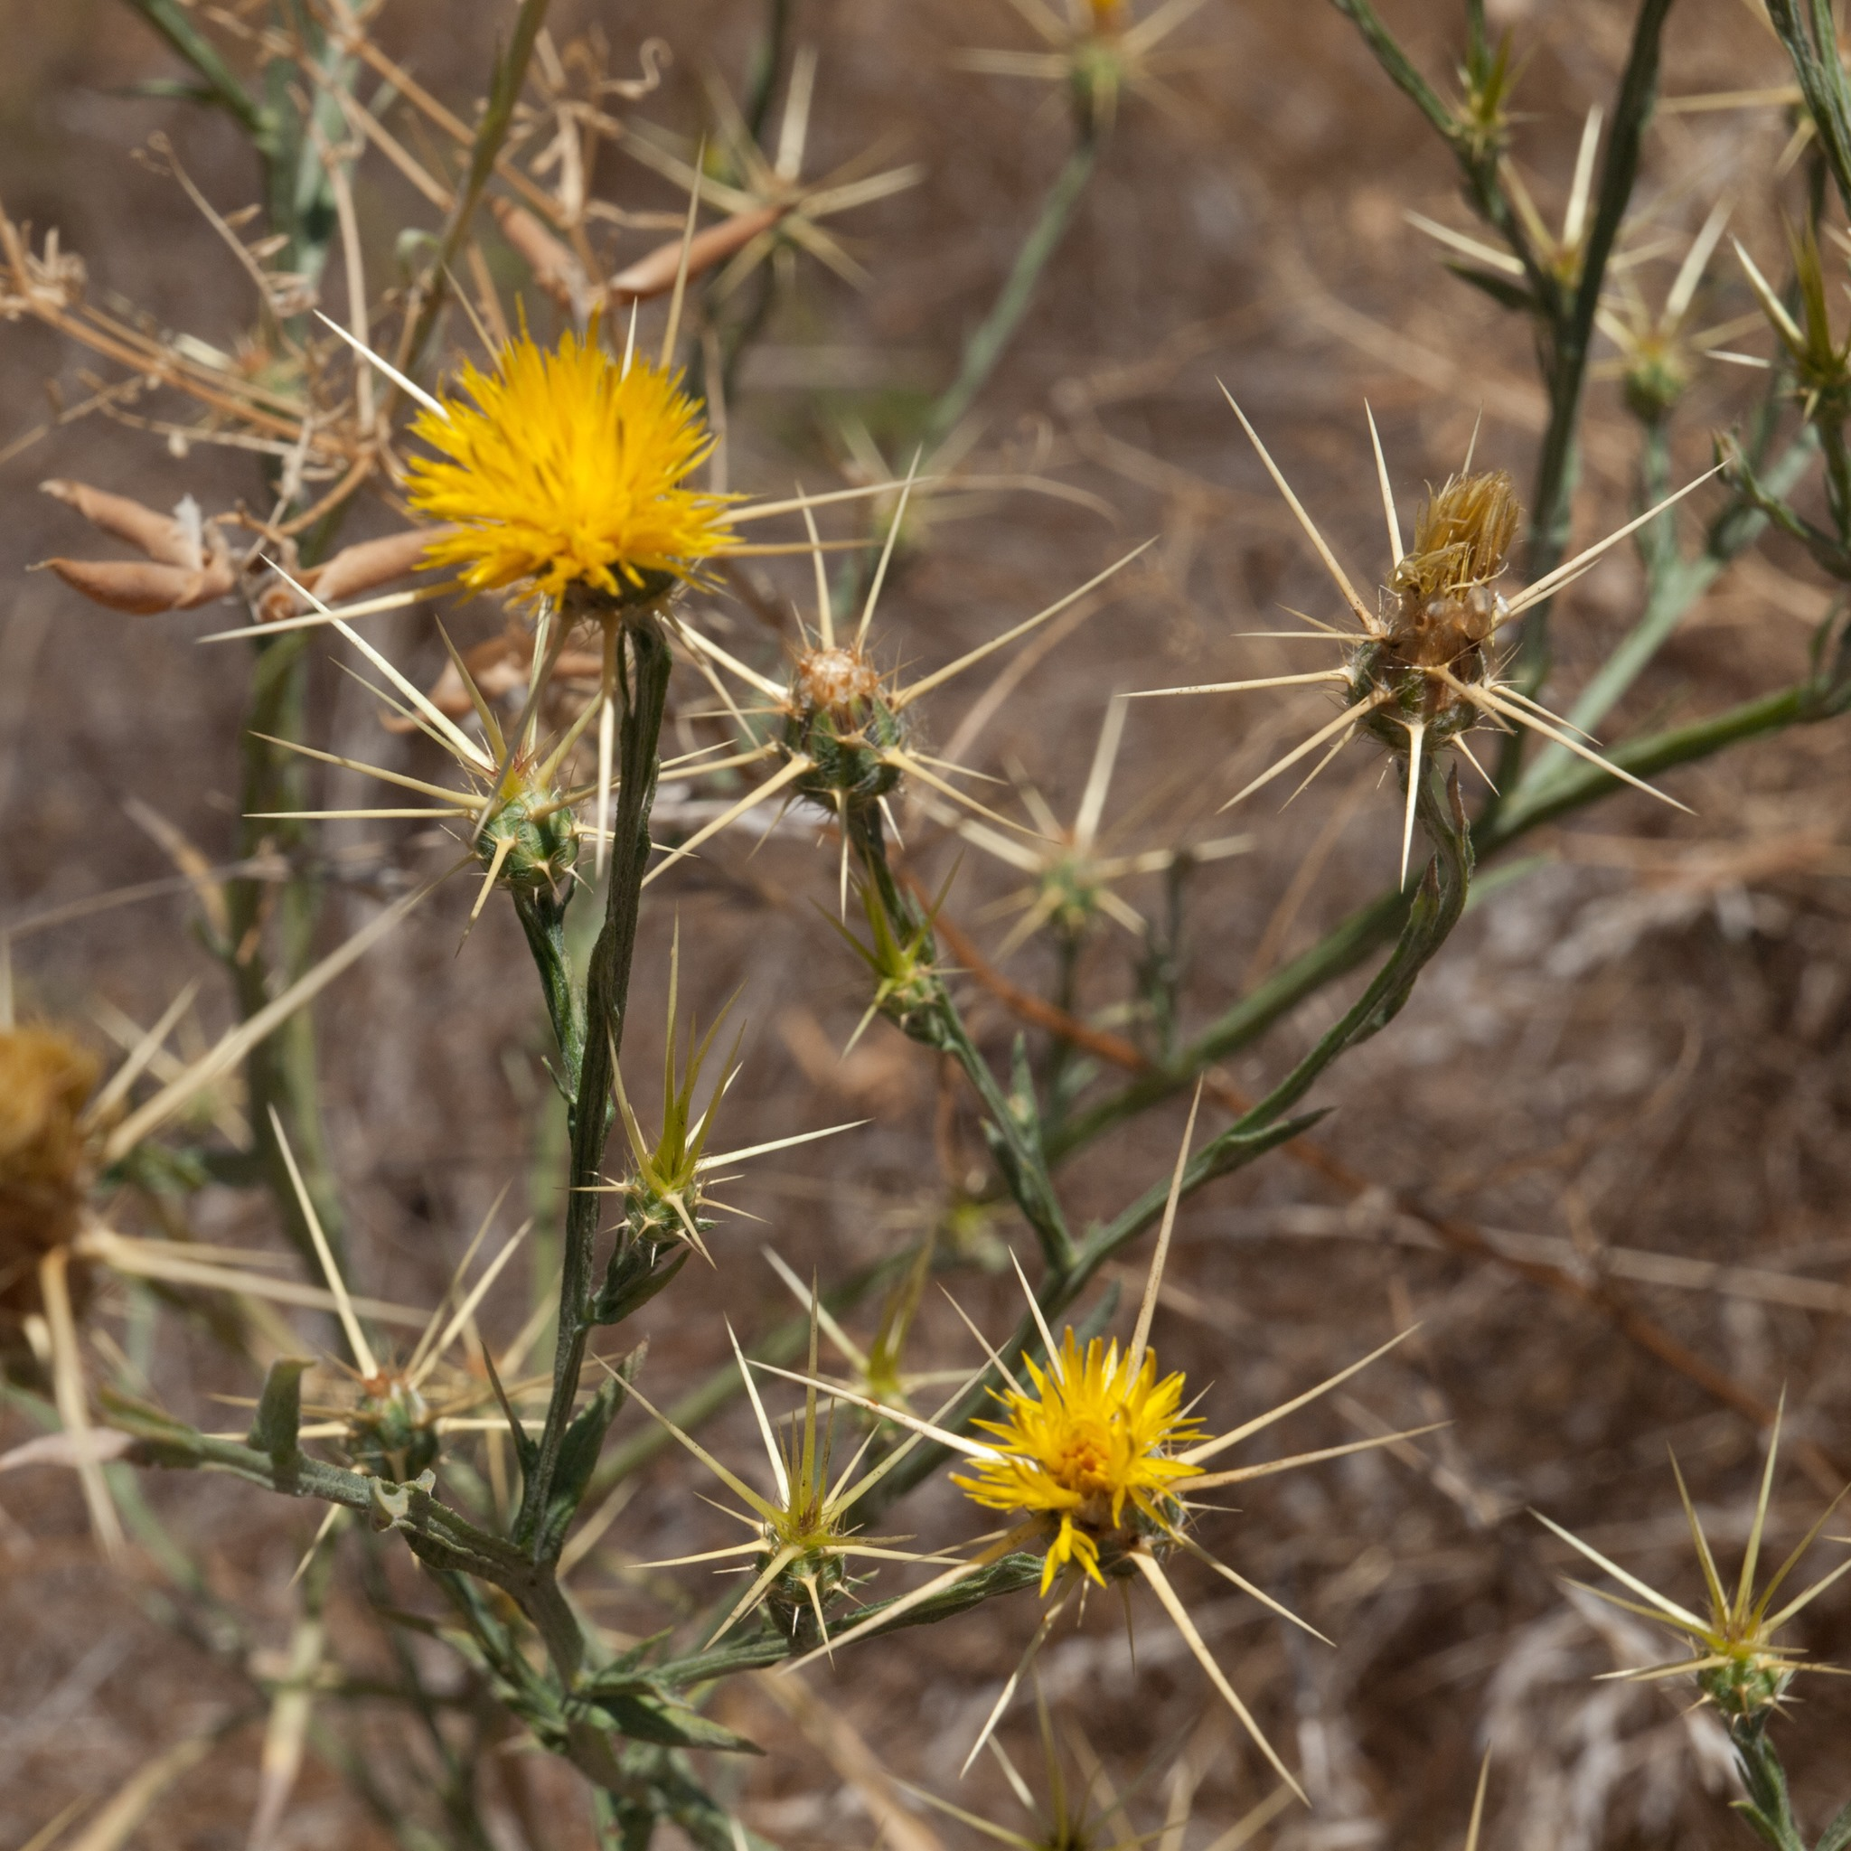
Broom
Mexican Feather Grass
Star Thistle
Notes:
PlantRight PPT
https://ucanr.edu/sites/master_gardener/files/53787.pdf
https://ucanr.edu/blogs/blogcore/postdetail.cfm?postnum=10622
Scotch brooms pull nitrogen from the atmosphere and deposit it into the soil adding nitrogen while native plants thrive in low-nitrogen soils seed pods that are naturally spring loaded
Life span 7-8 years, then they die and become tinder-dry woody skeletons that can burn high and hot.
also displacing the birds and animals that would live in this environment with native plants.”
http://ipm.ucanr.edu/PDF/PESTNOTES/pnbrooms.pdf
https://www.fs.fed.us/database/feis/plants/forb/censol/all.html
Star thistle seeds viable in the soil for up to 10 years. A single plant can produce hundreds or thousands of seeds

Slide 27

Resource List

Slide 28
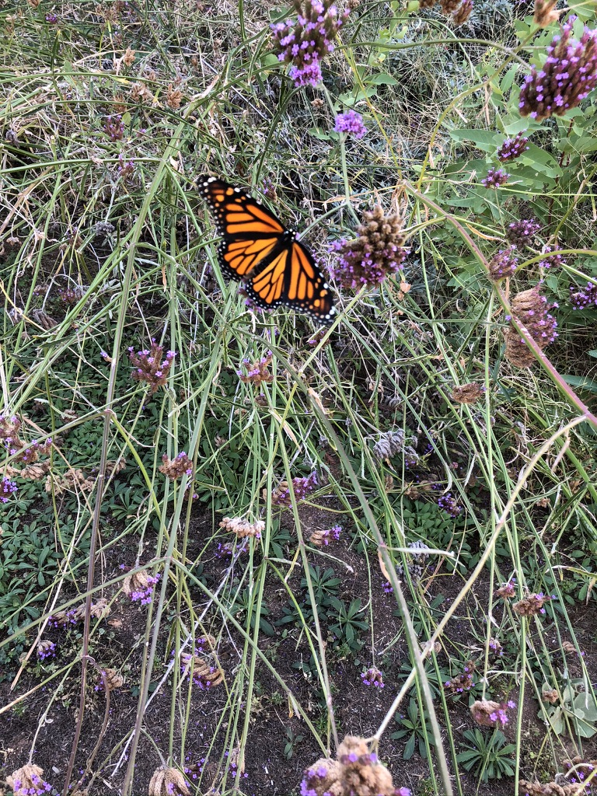
The Science of Change
Extinctions have occurred
in hundreds of species
Notes:
It’s tricky to declare a plant extinct—if you don’t find it, you don’t know it is still there, BUT. ”Our research, published today in Current Biology, found some plants have been going extinct up to 350 times faster than the historical average — with devastating consequences for unique species.”
https://www.universityofcalifornia.edu/news/plants-are-going-extinct-350-times-faster-historical-norm

Slide 29
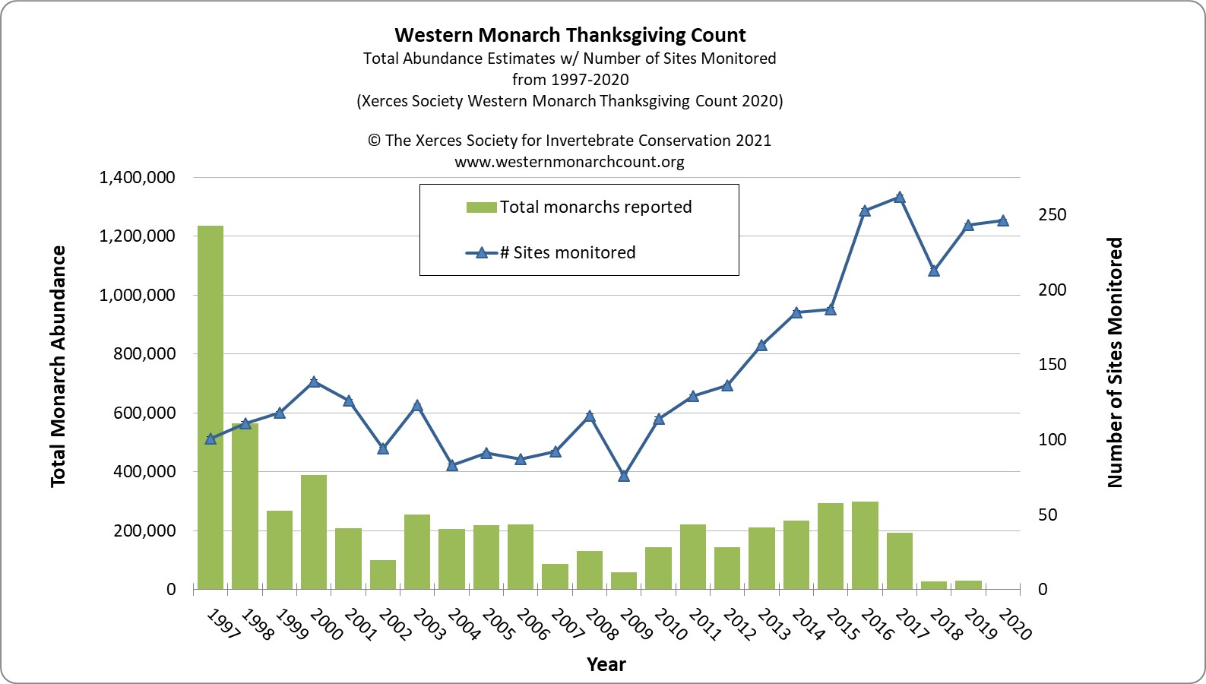
Where Have all the Monarchs Gone?
sites
Monarchs
sites
Monarchs
only 1,914 monarchs counted in 2020
a shocking 99.9% decline since the 1980s
Notes:
Only butterflies whose populations are stable or increasing managed to expand and thrive as the climate has warmed.
https://cpb-us-e1.wpmucdn.com/blogs.cornell.edu/dist/1/7755/files/2018/11/Course-Book-Fall-2018-289zx3u.pdf
Monarchs are tracked, counted, monitored on their migratory journey—devastating losses within western migration. Only 1914 counted. Graph line is number of sites monitored—green bars is number of butterflies!
https://xerces.org/blog/western-monarch-population-closer-to-extinction-as-wait-continues-for-monarchs-protection
https://ucanr.edu/blogs/blogcore/postdetail.cfm?postnum=45525&fbclid=IwAR0fkGFj4ebU30scDqnppfCuj5vwwFD7s14Cz_oefKM3KbFqfmsFX8z6JfE

Slide 30
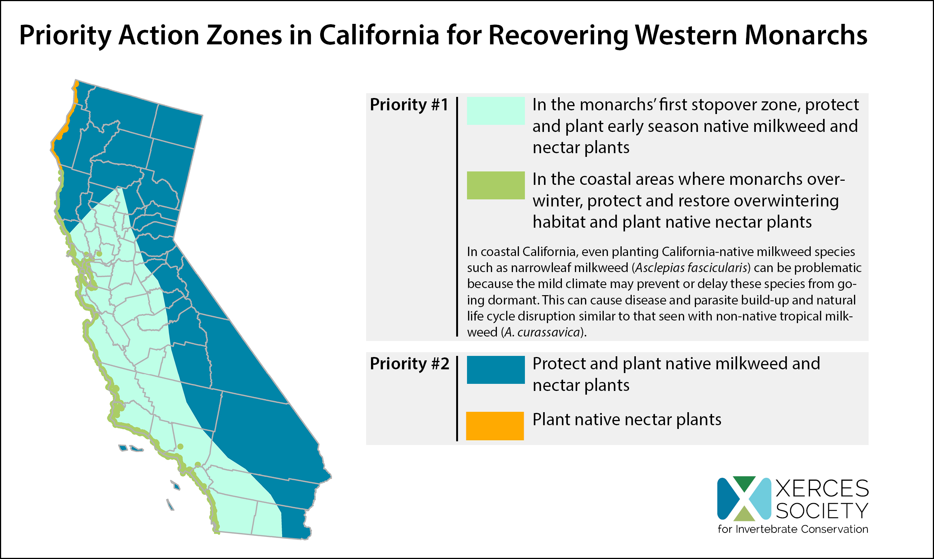
Plant for Monarchs
Notes:
https://www.xerces.org/blog/western-monarch-population-closer-to-extinction-as-wait-continues-for-monarchs-protection

Slide 31
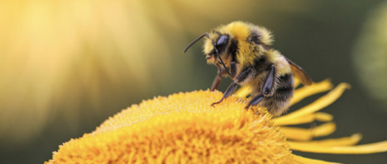
Climate Change Adaptation
Bumblebees Bite Leaves
Prompts plants to pollinate early when bees lack pollen
Bees bite the leaves of plants that are lacking flowers
Causes plants to bloom as much as
a month earlier than they normally would
May help both bee and plant resilience
Notes:
Posted on June 5, 2020
Bumblebees can prompt plants to pollinate early when they lack pollen. Credit: Dmitry Grigoriev
Bumblebees are taking a bite out of the negative impacts of climate change by prompting plants
to pollinate sooner. According to new research published in the journal Science, bumblebees
that don’t find enough pollen will bite the leaves of plants that are lacking flowers. This damage
apparently has a sweeping effect, causing bitten plants to bloom as much as a month earlier than
they normally would. This discovery is exciting, as plants and bees often depend on each other
for survival. But as the timing of flower blooming may be changing due to climate change, bee
researchers have often worried about possible mismatches that could be disastrous for both
pollinators and plants. Some researchers believe the discovery about this behavior may help
bee and plant resilience in the face of climate change.
https://wildlife.org/bumblebees-bite-leaves-to-work-around-climate-change/

Slide 32
The Science of Change
Plants react to extremes, not to averages.
Uncertainty; keep eyes on the weather
Respond appropriately
Protect what you have
Notes:
Deep reflection on our strategies in tending our lawns, trees, shrubs, flowers, and vegetables will be required to manage and adapt to this latest – and biggest - challenge to successful gardening.
“Adapting gardening practices to climate change becomes an exercise in managing risk. Like managing other types of risk, diversity is the best tool gardeners have for dealing with climate change.” Bert Cleg, University of Michigan. (https://www.finegardening.com/article/gardening-in-a-changing-climate)

Slide 33
Adapt Gardening Practices to Climate Change
Monitor your Garden
Improve and protect the soil
Choose plants for our climate
  Ca. natives (and other low water plants)
Support our native pollinators
Continuous floral resources
Eliminate invasive plants
Adapt your food garden
Notes:
Gardening is a risky business. Gardeners are always looking up to the sky, checking wind direction and strength, bending over to pull out invasive weeds, agitating over the curled or rusty leaf, and frustrated by the lack of rain, or too much. The conditions for a truly successful, beautiful, and healthy garden, namely good soil, ample water, suitable air temperature, manageable pests -- and a dose of luck -- all need to be in balance with each other.
https://cpb-us-e1.wpmucdn.com/blogs.cornell.edu/dist/1/7755/files/2018/11/Course-Book-Fall-2018-289zx3u.pdf
http://marinmg.ucanr.edu/BASICS/CLIMATE_CHANGE_-_YOUR_GARDEN/Adapting_to_a_Changing_Climate/
http://marinmg.ucanr.edu/BASICS/CLIMATE_CHANGE_-_YOUR_GARDEN/

Slide 34
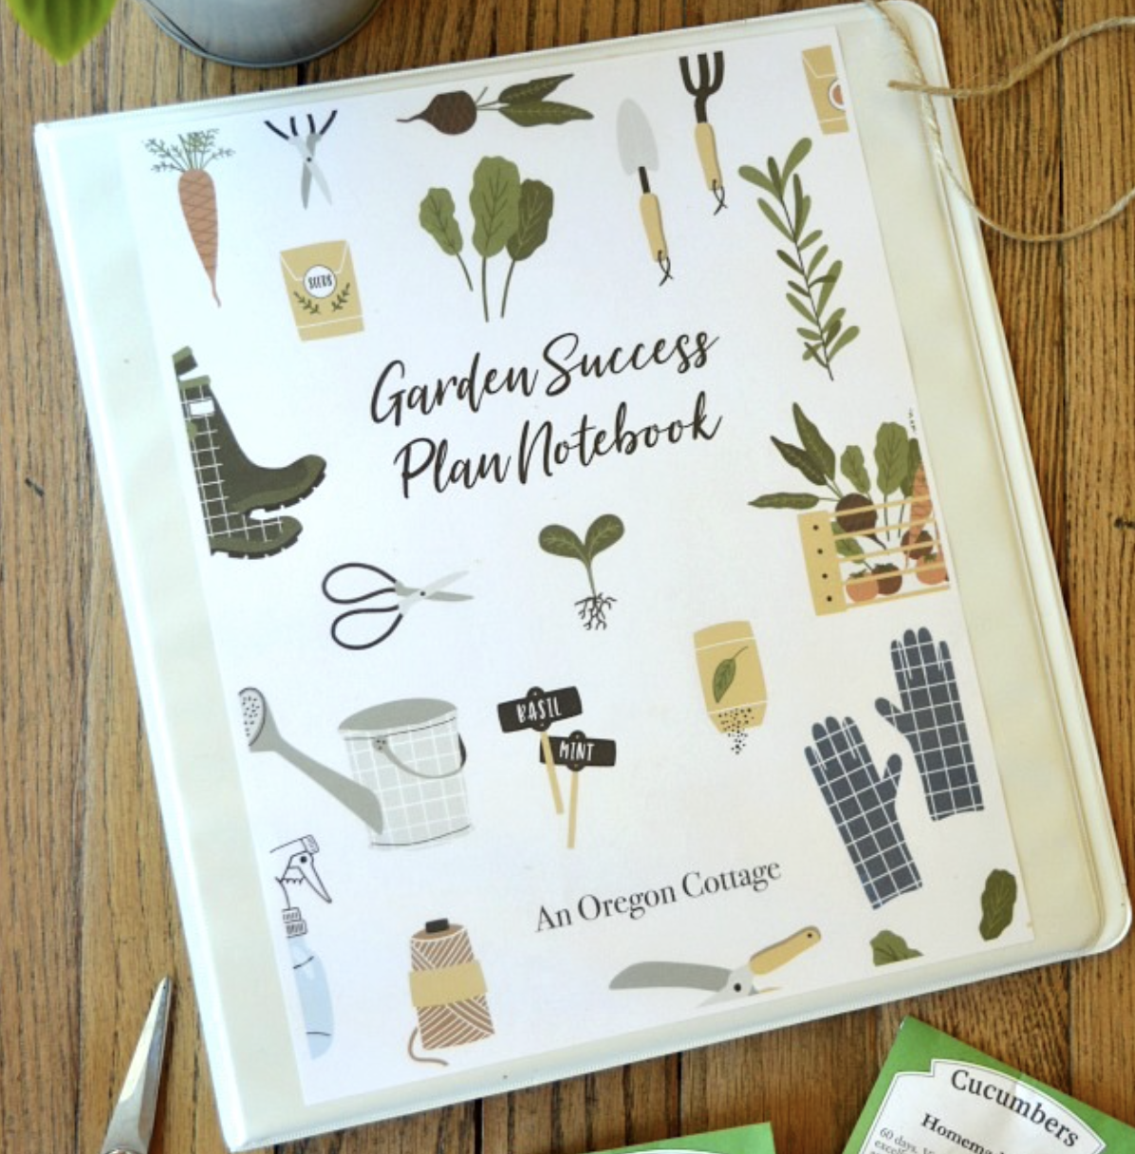
Monitor Your Garden
Observe and keep a record
Document garden characteristics
  Sun exposure
  Soil type
  Climate Zone
  Water availability
  Use hydrozones
Notes:
http://marinmg.ucanr.edu/BASICS/SITE_ANALYSIS__Getting_To_Know_Your_Garden/
Keep track of your garden and what you do there.

Slide 35
Strengthen Soil’s Ability to Store Carbon
Apply compost, yard waste and other organic matter to feed microbes in the soil
Reduce—or eliminate-- tillage
Irrigate efficiently
Use cover crops
Keep landscapes vegetated and soil hydrated for plants to grow and sequester carbon
Notes:
https://climatechange.ucdavis.edu/news/climate-change-solution-beneath-feet/
A number of conventional farming and gardening practices are now scientifically understood to harm soil health by preventing the formation of carbon-rich, healthy soil. Over-application of synthetic NPK fertilizer shuts down soil production of nitrogen and slows down or even halts humus formation and carbon storage; on a diet of NPK fertilizer, plants cease to produce liquid carbon, relationships break, and the soil begins to deteriorate. Also, plowing, tilling, or extensive digging slices up soil aggregates, breaks up the vast fungal networks, and, by exposing the soil to air, releases carbon dioxide and nitrous oxide. Soil structure declines, and so does its biological health. Finally, leaving soil bare in winter means depriving the soil biome of the benefits that growing plants provide, by interrupting vital relationships and starving the soil critters. These three practices can result in compacted, poorly textured, low carbon soil that is infertile, unable to manage water or grow plants, and prone to blowing away.
https://www.ecolandscaping.org/01/developing-healthy-landscapes/climate-change/gardening-healthy-soil-carbon-sequestration/

Slide 36
Choose plants for our climate
Resource List
California native plants support native animal species and are adapted to our growing conditions.
calscape.org
7988 plants native to California
644 native to my zip code
632 native to my address
Advanced search to select
Butterflies—lists host plants
Notes:
calscape.org Website to locate plants that are native to your yard. Put in your address to select for your area.
TOP BAR Choices PLANTING GUIDE NURSERIES MY PLANT LISTS BUTTERFLIES

Slide 37
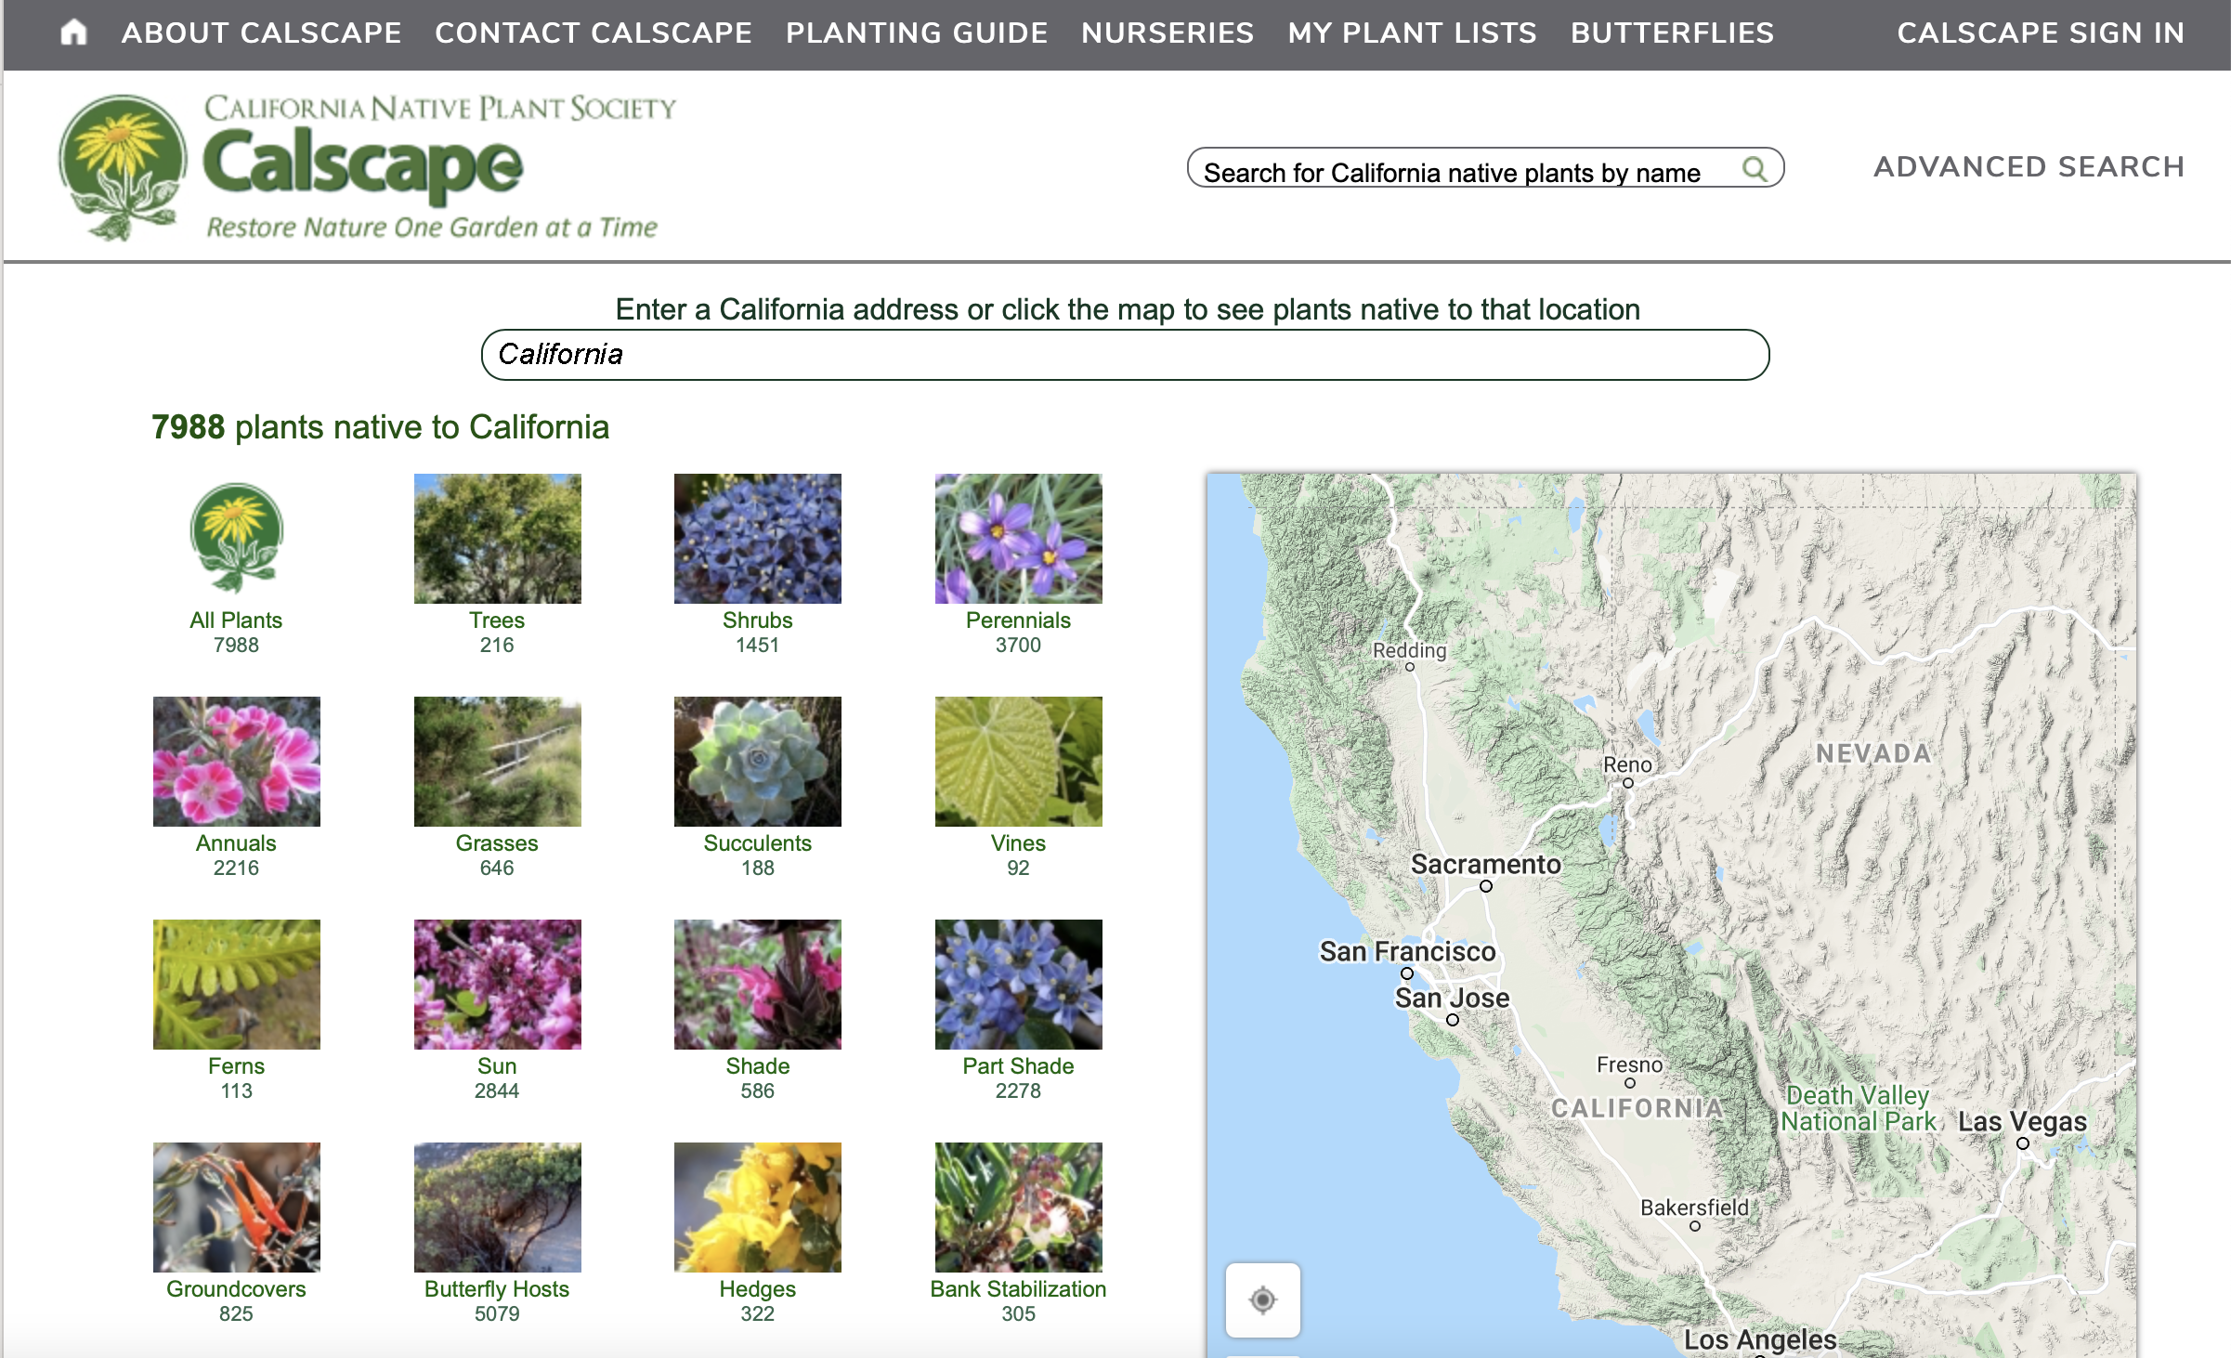
Calscape.org
Resource List

Slide 38
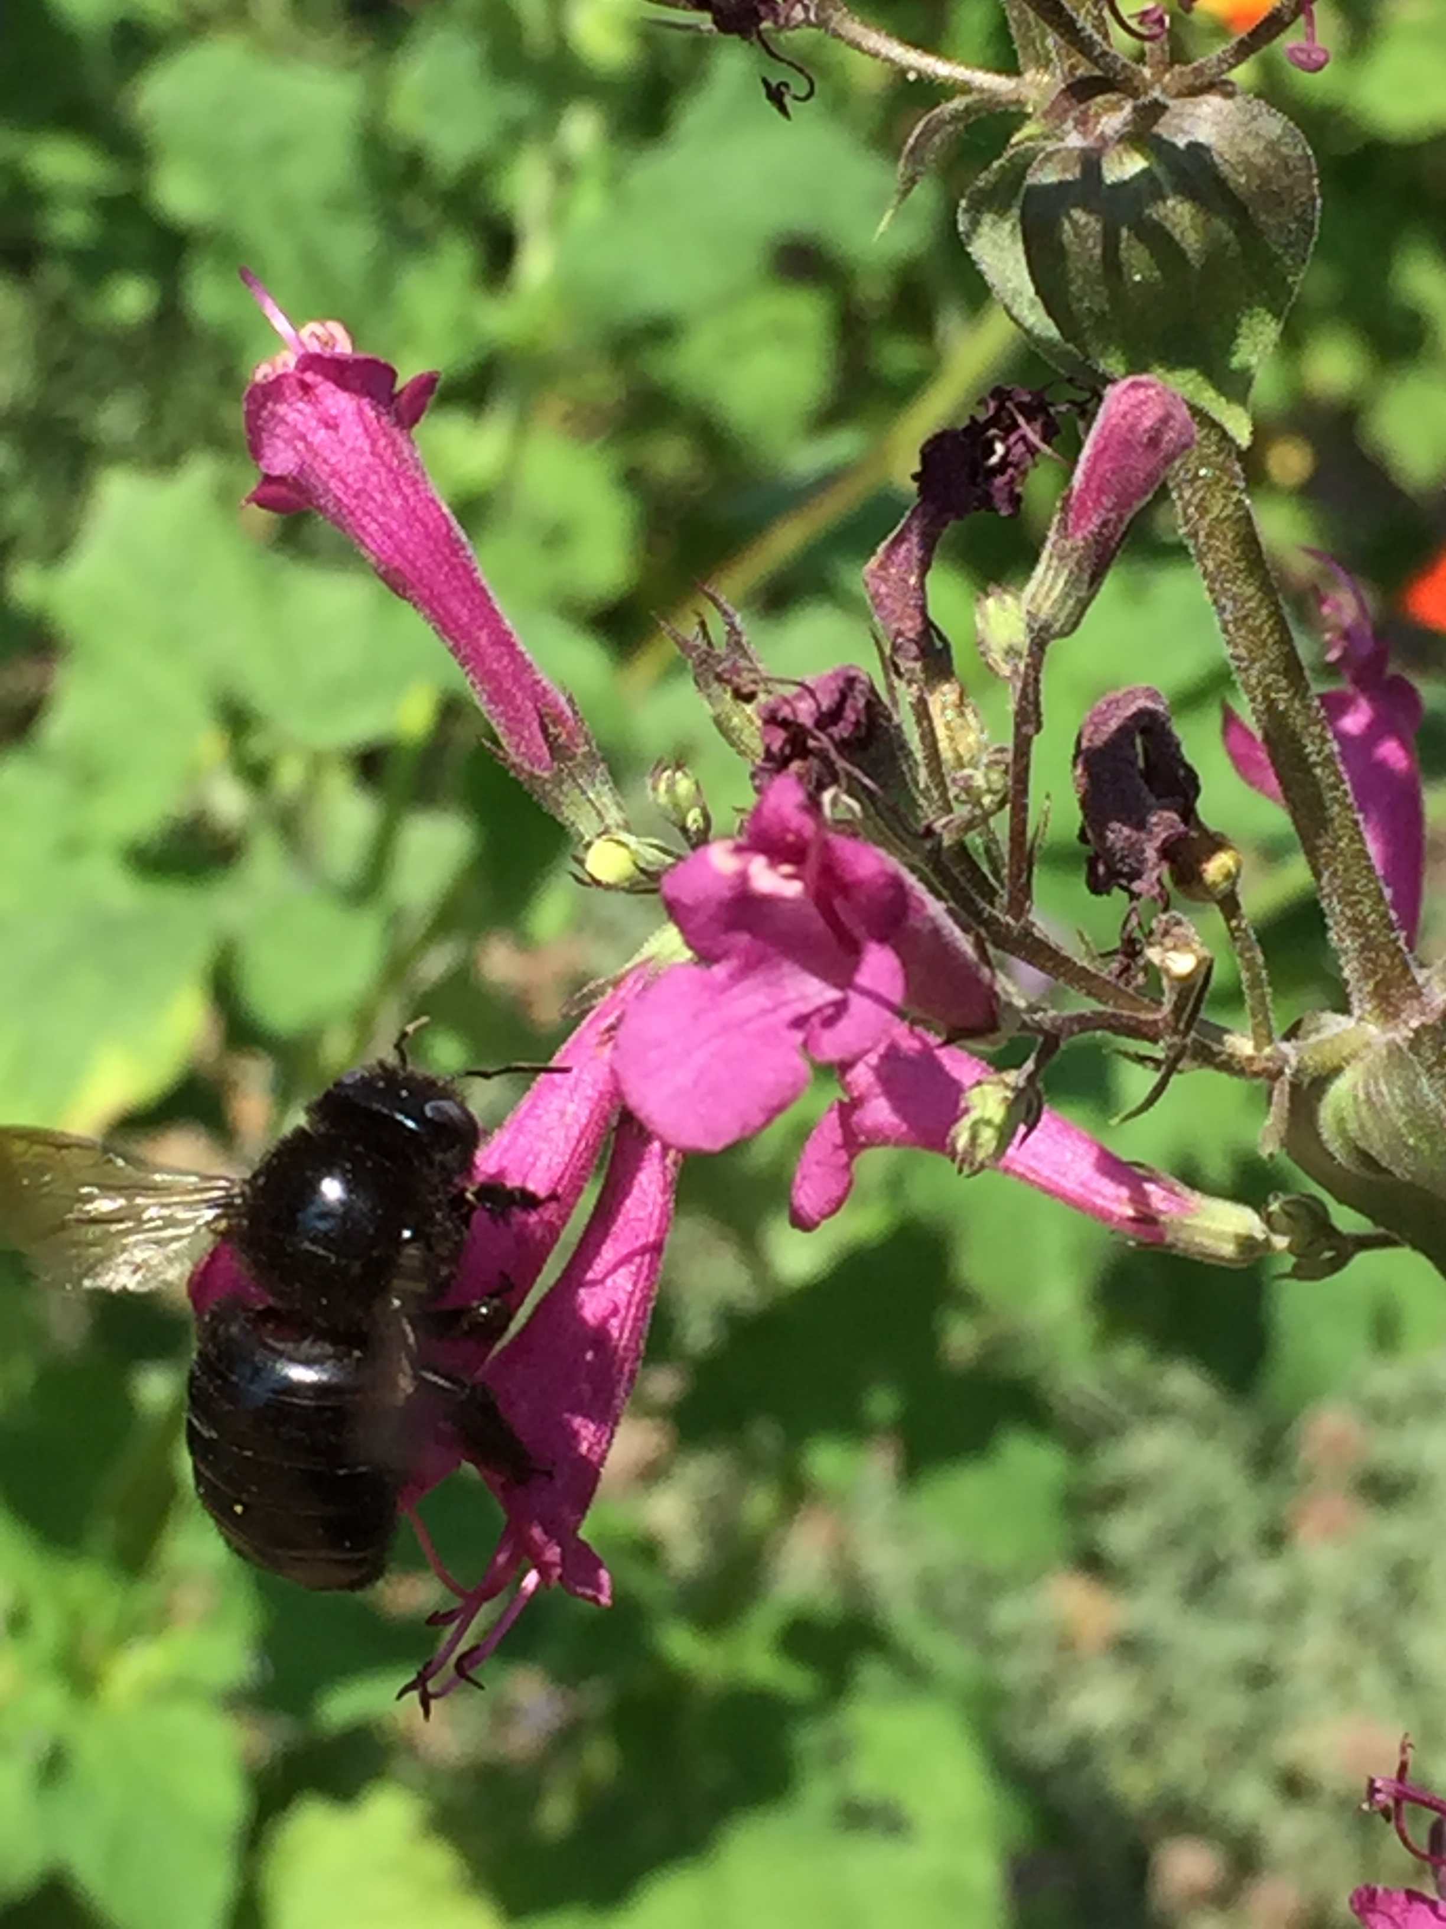
Support our native pollinators
More than 75% of flowering plants depend on pollinators
1 in 3 bites of food you eat is thanks to pollinators
Carpenter bee on Lepechinia

Slide 39
Eliminate invasive plants
Manage weeds and uninvited plants
Remember: Do not plant a pest!

Slide 40
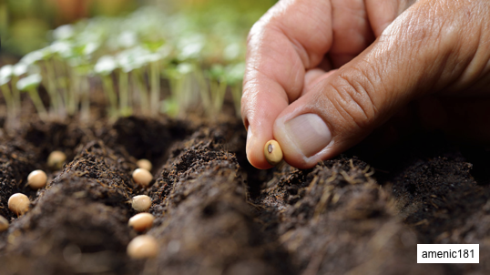
Adapt your food garden
Check planting dates
Choose varieties for your area
Monitor sun and water

Slide 41
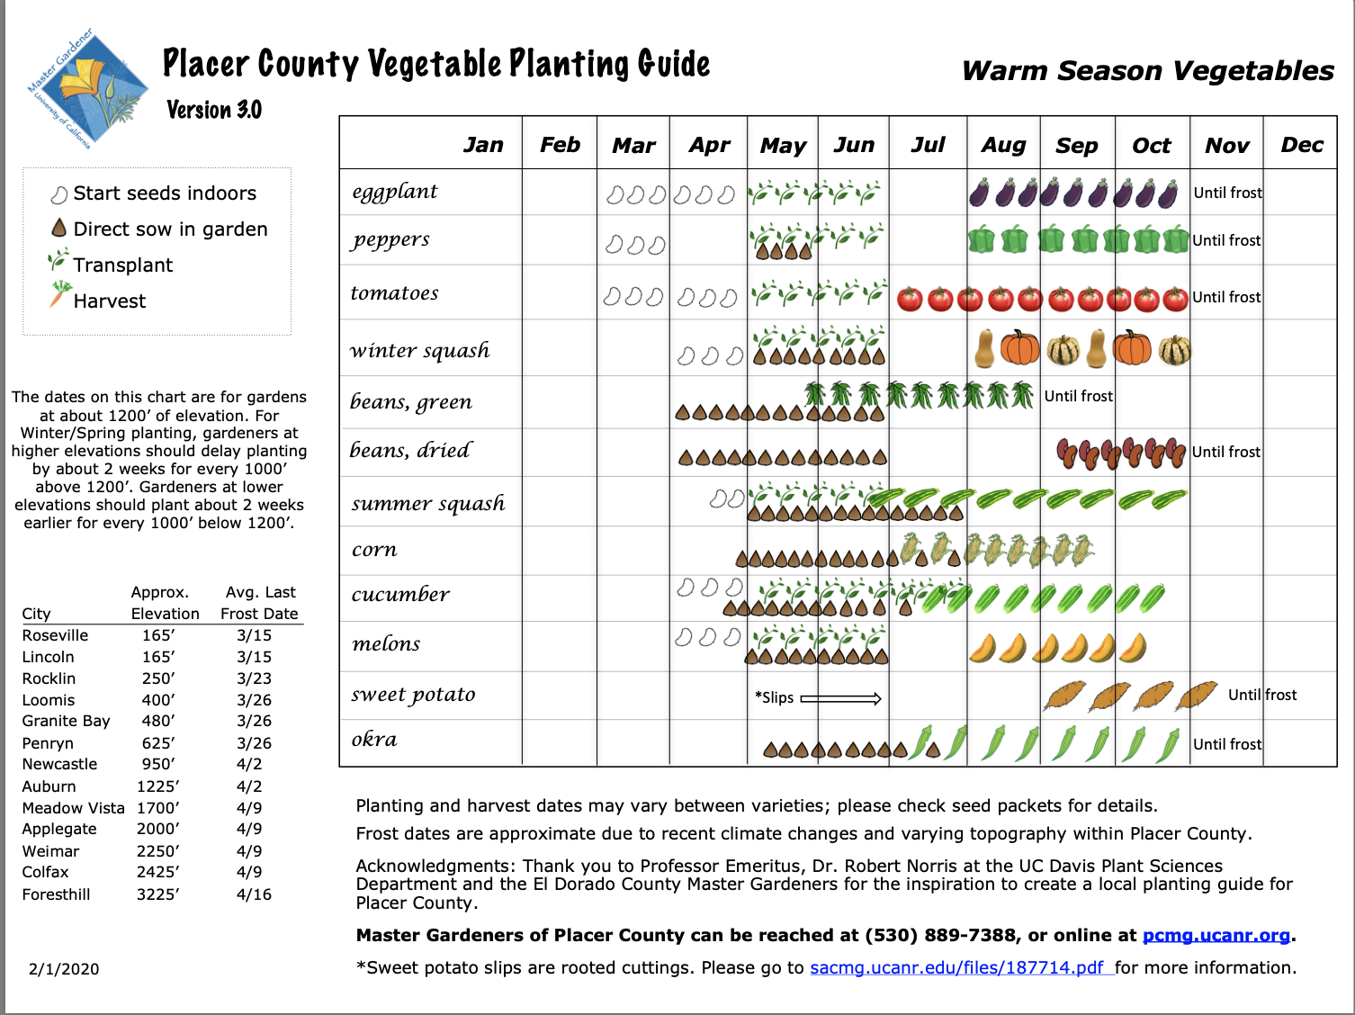
Vegetable Planting Guide
Resource List
Notes:
Available at pcmg.ucanr.org. Cool Season Veg on reverse. Free download.

Slide 42
Notes:
Hydrometer needs to be calibrated. Best sensor probe???----Your fingers!
Soil moisture sensors measure plant-available water as a function of soil volumetric water content as it relates to matric potential,

Slide 43
http://marinmg.ucanr.edu/BASICS/
Resource List
Build Your Basic Gardening Foundation and Become a More Informed Gardener
Build a great foundation of climate-conscious, earth-friendly
gardening principles and knowledge tailored to the needs,
climate and conditions of gardens in Marin. Dig in!
Earth-Friendly Gardening
Site Analysis
Climate & Microclimate
Climate Change & Your Garden
Fire-Smart Landscaping
Soil
Compost & Other Soil Amendments
Mulch
Irrigation
Conserving Water & Energy
Minimizing Waste
Remember, that Marin is a different
climate zone than Placer County
Lots of info about gardening here
Notes:
There is so much great information on this website that these resources are included, but remember to be careful. If an article is talking about general gardening practices, it will be relevant information; however, if specifics are being mentioned, remember we do not garden in Marin!

Slide 44
Climate Change & Your Garden
http://marinmg.ucanr.edu/BASICS/CLIMATE_CHANGE_-_YOUR_GARDEN/
BACK TO BASICS
Climate Change Mitigation -
Be Part of the Solution!
How Can Gardeners Adapt for a Changing Climate?
CLIMATE & MICROCLIMATE
What is Your Climate Zone?
How to Assess Your Microclimate
Notes:
http://marinmg.ucanr.edu/BASICS/CLIMATE_CHANGE_-_YOUR_GARDEN/Adapting_to_a_Changing_Climate/

Slide 45
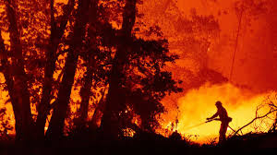
Be Fire Smart
Photo UCANR

Slide 46
Be Fire Smart
Increased warming, drought, and insect outbreaks, due to climate change have increased wildfires and impacts to people and ecosystems in the Southwest.
Fire models project more wildfire and increased risks to communities across extensive areas.
Notes:
https://nca2014.globalchange.gov/highlights/regions/southwest
https://climaterealityproject.org/blog/how-climate-change-affecting-California
“Today's fire season in the western United States starts earlier, lasts longer, and is more intense than in the last several decades,” AG Becerra’s office writes. And in California, which gets about 75 to 80 percent of its freshwater from the Sierra Nevada snowpack, that combination of rising temperatures and decreasing precipitation, particularly in the winter and early spring, could prove especially dangerous.

Slide 47
Be Fire Smart
5 largest fires in California history
AUGUST COMPLEX FIRE August 2020 1,002,097 acres
Dixie FIRE July 2021 963,309acres
MENDOCINO COMPLEX FIRE July 2018 459,123 acres
SCU LIGHTNING COMPLEX FIRE August 2020 396,624 Acres
CREEK FIRE Sept. 2020 379,895 acres

Slide 48
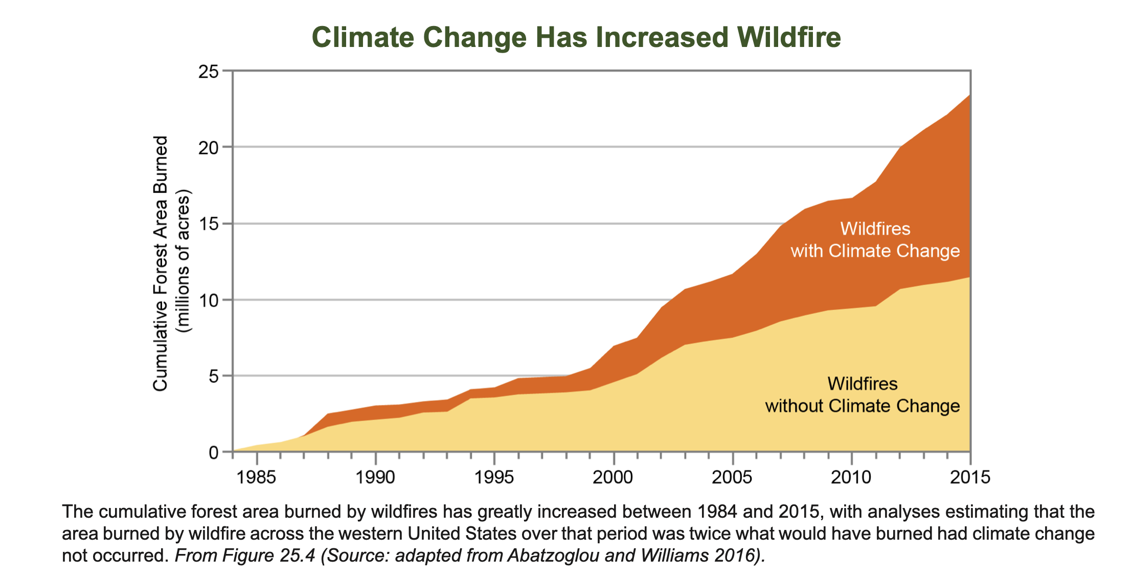
Be Fire Smart
Notes:
The annual average wildfire season in the Western U.S. is 105 days longer, burns six times as many acres, and has three times as many large fires (more than 1,000 acres) than it did in the 1970s. Climate change is expected to continue increasing temperatures and reduce moisture across the West, in part by causing a smaller and faster melting snowpack. These changes will further pre-condition Western landscapes for more, and more intense, wildfires.

Slide 49

Resource List
Be Fire Smart
Prepare defensible space
Use fire resistant landscaping.
Ready Set Go!
Personal Wildfire Action Plan
Notes:
https://www.fire.ca.gov/media/4996/readysetgo_plan.pdf
https://www.readyforwildfire.org/prepare-for-wildfire/get-ready/fire-resistant-landscaping/

Slide 50
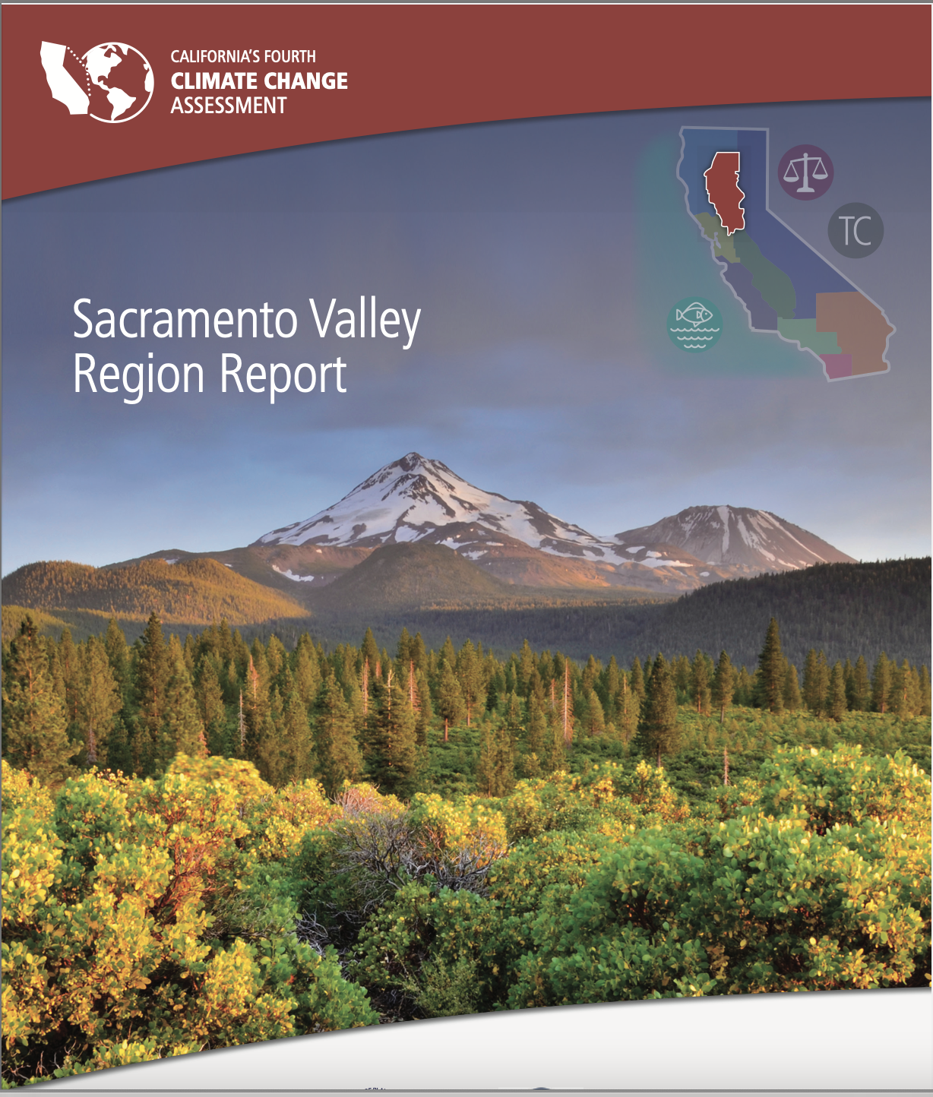
Fourth Climate Assessment
Sacramento Valley
Resource List
Notes:
https://www.energy.ca.gov/sites/default/files/2019-11/Reg_Report-SUM-CCCA4-2018-002_SacramentoValley_ADA.pdf
This report summarizes current and future climate change impacts and risks in California’s Sacramento Valley Region and highlights a set of promising climate-solutions for stakeholders, with the potential to promote resiliency, protect the environment, improve public health, create jobs, and grow the economy.

Slide 51
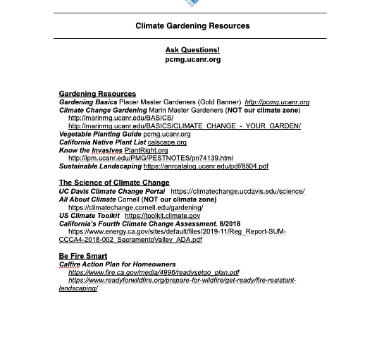
Resources Handout

Slide 52
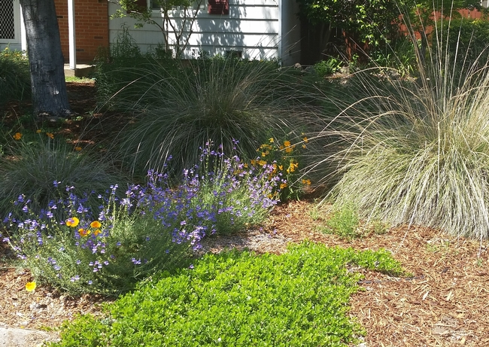
Thank You!
Any Questions?
Master Gardener Website: pcmg.ucanr.org
Master Gardener Hotline: (530) 889-7388
Composting Rot Line: (530) 889-7399
Notes:
Further info. https://www.climatehotmap.org/global-warming-effects/plants-and-animals.html

