Slide 1
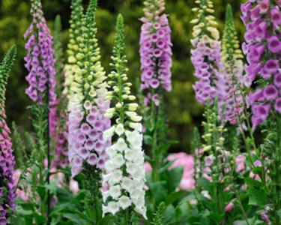
Gardening With Toxic Plants Protecting Kids, Pets, and You!
Notes:
Created: 2007?
Created by: Sharon Ross
Audience: Preschool teachers
Publicity:
Update History: August 2021, Carolyn McElhany, Additonal slides added for more detailed information on sources for identifying poisonous plants and their toxins. All links updated and verified

Slide 2
Who Are Master Gardeners?
Master Gardeners of Placer County
Extend research-based, sustainable gardening and composting information
Present accurate, impartial information to home gardeners
Encourage public to make informed gardening decisions

Slide 3
Who Are Master Gardeners?
Where to find us…
Online, in the Media, and Special Publications
Hotline: Call (530) 889-7388 or submit your questions online
Website: pcmg.ucanr.org
Facebook, Twitter, Instagram
Gold Country Media monthly column
Curious Gardener quarterly newsletter and on our website
Calendar and Gardening Guide

Slide 4
Who Are Master Gardeners?
Where to find us…
Workshops, Fairs and Festivals and Special Events
Speakers by Request
Workshops (various venues, check website)
Farmers’ Markets (seasonal: Auburn, Lincoln, Roseville)
Fairs and Festivals Booths (varies)
Garden Faire (April)
Mother’s Day Garden Tour (May)

Slide 5
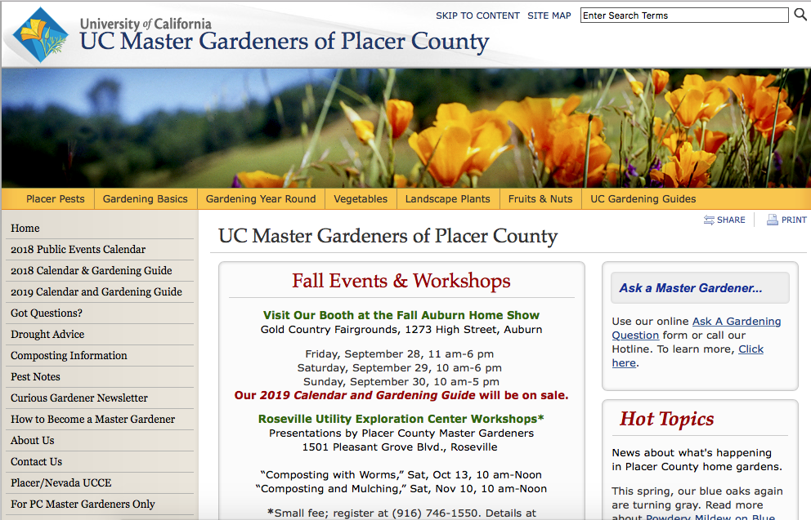
Who Are the Master Gardeners?
Notes:
A view of our website and quick orientation to helpful links.

Slide 6

Let’s Look at your Handout
Resources
Placer County Master Gardener’s
University of California:
Agriculture and Natural Resources
UC Davis School of Veterinary Medicine
California Poison Control System/Plants

Slide 7

Agenda
Did you know?
Reactions to toxic plants
California Poison Control System Report
Sources for Toxic Plant Information and Plant Lists
Mushrooms
Herbal Medicines
Preventing Exposure to Toxic Plants
Treatment for Plant Poisoning
Pets/Livestock and Toxic Plants
Safe Plants
Notes:
What we will cover
Did you know? Facts to get us started

Slide 8


Did You Know?
Each year 100,000 people call poison control about plant and mushroom exposures
Hundreds of species of poisonous plants grow in the United States
There is no simple test to identify plants that are poisonous
Don’t assume a plant is nontoxic because birds and animals eat it
Heating and cooking do not necessarily destroy toxic parts
Teas and homemade medicines can be poisonous
Young children and pets will often chew on anything no matter how it tastes
Notes:
Did you know? (What we will cover) Facts to get us started.
Detail for 2nd bullet
Some of the most beautiful trees, shrubs, vegetables and vines cand be poisonous under certain conditions.
While they provide shade, colorful flowers, or food, parts can be toxic.
Skin rashes are the most common health complain that arise from handling certain plants, but fatalities can occur when toxin-containing plants are ingested

Slide 9
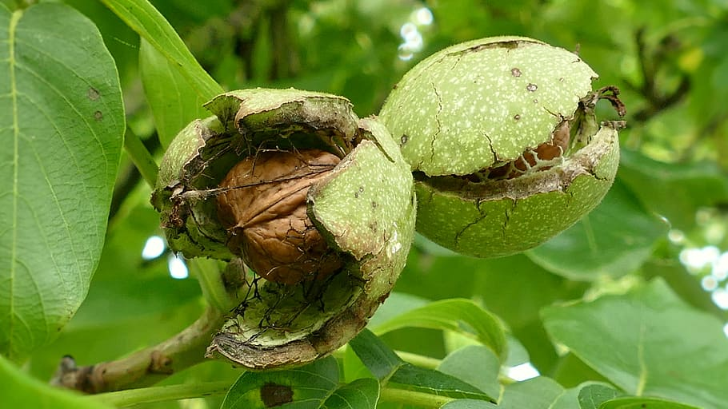
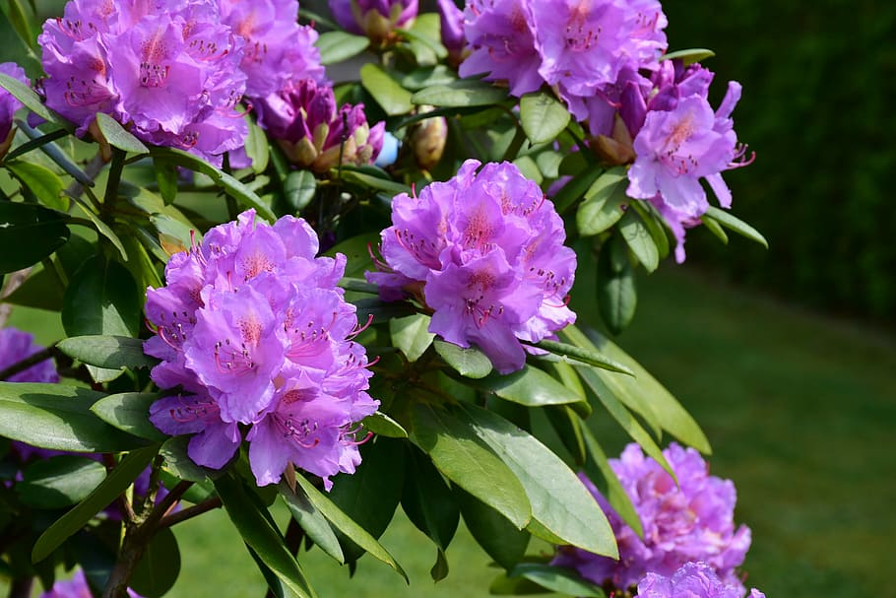
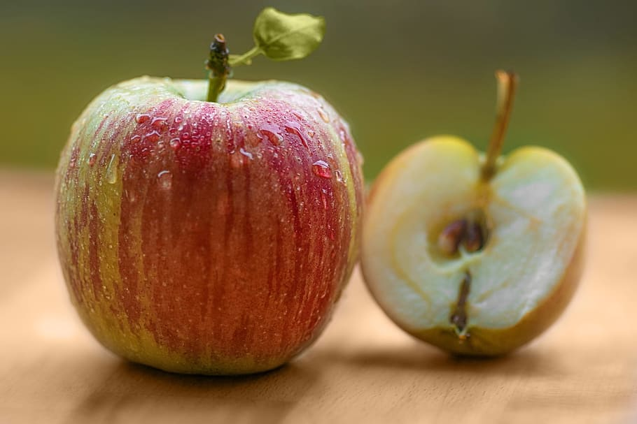
Reactions to Toxic Plants
Parts of the plant (sap, leaves, seed, flowers, stems) or the whole plant may contain toxic compounds
Eating a small amount may not be a problem, but large or repeated doses can be harmful
Symptoms include :
Skin, mouth, or tongue irritation
Stomach upset
Vomiting, diarrhea, or stomach cramps
Cardiovascular complications
Signs of poisoning many not appear for many hours after exposure
Notes:
Symptom's detail:
Immediate burning pain is common, mouth and tongue swelling, or breathing problems may occur.
Some plants may cause a skin rash. Sometimes the rash occurs only after being in sunlight, or gets worse with sunlight.
Pictures: The sap from the walnut tree may cause a skin rash or irritation. The irritant (sap) is under the husk that surrounds the shell.
The whole plant of Rhododendrons and Azaleas are poisonous potentially causing both cardiovascular (as well as irregular heart rhythm), and GI problems.
All varieties of apple and pear plant parts (excluding the fruit) contain cyanide, but the seeds have the highest concentration. Seeds must be well chewed to release to release poison. While eating seeds is not recommended, eating an apple or pear including the seeds will not cause any danger to a child or adult. Problems occur when chewing large quantities of seeds. Symptoms from large quantities of seeds included shortness of breath, weakness, light-headedness, stupor, heartbeat irregularities, cardiovascular collapse, coma, and death.

Slide 10
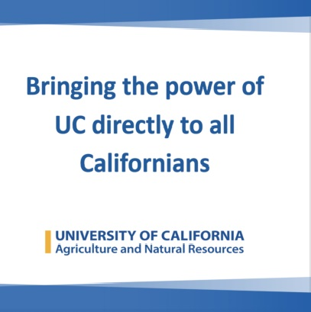
Two Reliable Resources
California Poison Control System
Provides:
Immediate, free, and expert treatment advice
Referrals over the telephone
University of California Agriculture and Natural Resources (ANR)
Publication and website provides:
Lists of common poisonous plants
Typical symptoms
Instructions on making a plant ID file
Notes:
Two reliable sources for specific information on which plants are toxic, what part of the plant is toxic, and what symptoms they cause are the California Poison Control and the University of California’s Agriculture and Natural Resources.
The California Poison Control System provides immediate, free, and expert treatment advice and referral over the telephone in case of exposure to poisonous or toxic substances. Pharmacists, nurses, and poison information providers answer the calls to 1-800-222-1222 and are available 24 hours a day, 7 days a week, 365 days a year. Language interpreters are always available, just say the language you need when you call.

Slide 11
Toxic Plant Lists
California Poison Control
Two formats of plant lists: Non-toxic and toxic
Each then has two lists: plants by common name and plants and by scientific name
Plants on toxic list include rating by type of reaction their toxin causes
University of California Agriculture and Natural Resources (ANR)
List by scientific name
Includes:
Common Name
Name of toxin
Which plant part contains the toxin
Human body part affected by the toxin
Notes:
Links are listed on your Resource Handout

Slide 12

California Poison Control System Report
Plants are a major cause of poisoning in children under the age of 6 years
Adults, pets and farm animals can also be victims
Reactions can depend on a variety of factors:
age and size of the patient
health factors such as allergies
amount of the exposure
ALWAYS call the poison center for up-to-the-minute treatment advice
Know the names of your house and garden plants
CPC provides alphabetical lists of the more common safe and toxic plants by both common name and scientific name
https://calpoison.org/
Notes:
Some plants may be safe and some dangerous. It is important to know which species you have and to check both the non-toxic plant list as well as the toxic plant list to make sure the plant you have is safe. Each year about one in four calls to poison control centers across the US about plant and mushroom exposure involves a plant of unknown identity. It is important to know the identity before calling.
You must have a name of the plant (either the common name or the Latin name) to get the most reliable specific information. Poison center staff cannot identify plants over the phone from the description of the plant. There are over 1,000,000 species of plants. A call to the poison center about an unknown plant described as having big, shiny green leaves is not enough information to know what the plant is. If you do not know the name of the plant, take the plant or a part of the plant with leaves, berries or flowers to a reputable plant nursery for a positive identification. Try to get the common name and the Latin scientific name. Then call the California Poison Control System at 1-800-222-1222 for more help.

Slide 13
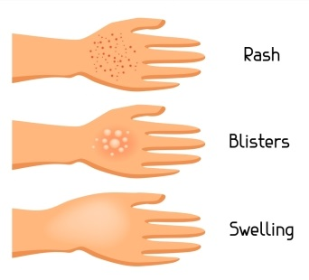

CPC Toxic Plant Lists
Plants are rated by type of reaction
Dermal – 1
Redness
Itching
Rash to painful blisters like skin burns.
Oxalates-fast onset – 2a
Immediate pain and irritation to the lips, mouth, and tongue
In severe cases, they may cause breathing problems by causing swelling in the throat
Notes:
The ratings are:
Dermal 1
Oxalates-Fast onset 2a
Oxalates- late onset 2b
Moderate 3
Major 4
Oxolate -Oxalic acid is an organic compound found in many plants. These include leafy greens, vegetables, fruits, cocoa, nuts and seeds ( 1 ). In plants, it's usually bound to minerals, forming oxalate. The terms “oxalic acid” and “oxalate” are used interchangeably in nutrition science.
Dermal 1
Symptoms ranging from redness, itching, and rash to painful blisters like skin burns.
Oxalates-fast onset 2a
Juice or sap contain tiny oxalate crystals that can cause immediate pain and irritation to the lips, mouth and tongue. In severe cases, they may cause breathing problems by causing swelling in the throat.

Slide 14
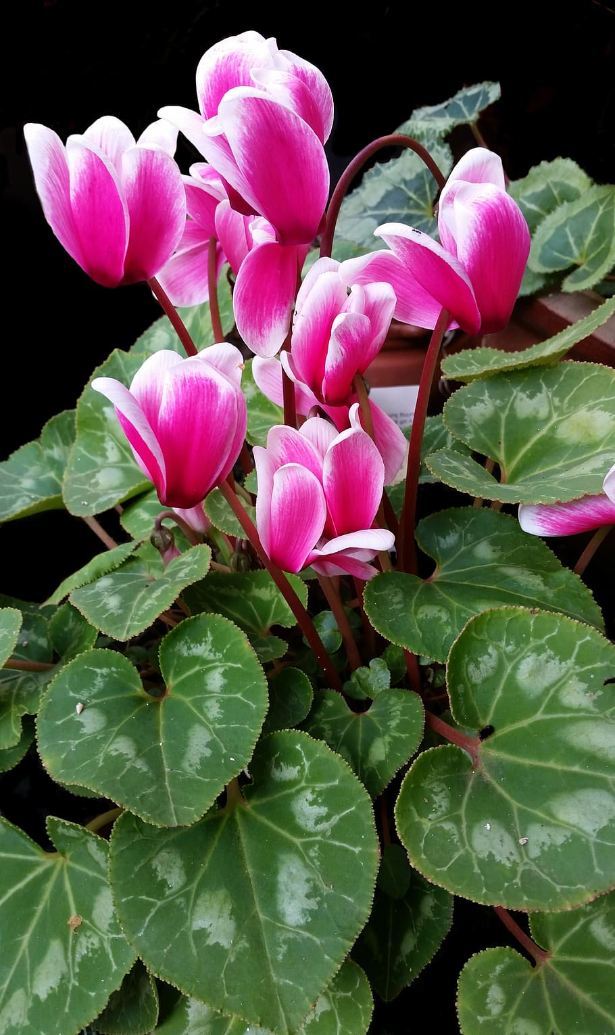
CPC Toxic Plant Lists
Oxalates-late onset – 2b
Do not cause immediate problems.
Can cause kidney damage
Nausea
Vomiting and diarrhea
Moderate – 3
Nausea
Vomiting
Diarrhea
Other symptoms that may cause illness but ARE not life-threatening
Major – 4
Serious effects to the heart, liver, kidneys or brain
If ingested in any amount, call the poison center immediately
Cyclamin Cycmen purpuascens
Notes:
Oxalate-late onset 2b-
These also contain oxalate crystals that lodge in the kidneys and can cause kidney damage as well as nausea, vomiting and diarrhea but they do not cause immediate problems.
Moderate - 3 Ingestion of these plants is expected to cause nausea, vomiting, diarrhea and other symptoms that may cause illness but is not life-threatening.
Major - 4 Ingestion of these plants, especially in large amounts, is expected to cause serious effects to the heart, liver, kidneys or brain. If ingested in any amount, call the poison center immediately.
A cyclamen is shown here. The whole plant is toxic and is in the moderate category.

Slide 15
Sample of CPC Toxic List by Common Name
Common name | Latin or scientific name | Rating
A
Absinthe | Artemesia absinthium | 4
Acacia palida | Leucaena leucocephala | 4
Acacia, black | Robinia pseudoacacia | 4
Acacia, false | Robinia pseudoacacia | 4
Aconite | Aconitium napellus | 4
Acorn | Quercus spp | 1,3
Adam-and-Eve | Arum maculatum | 1,2a
African lily | Agapanthus spp | 1
Agapanthus | Agapanthus spp | 1
Notes:
Shown here is a sample of the California Poison Controls list by common name. It is easy to be deceived by plants…one part may be edible while another is poisonous.
Look at the list and see which number is in the last column. Read the rating information guide below the list to see how the plant is dangerous.

Slide 16
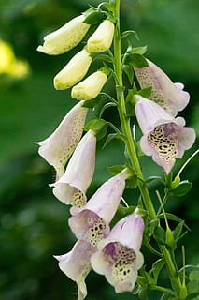
Poisonous Plants Publication University of California Agriculture and Natural Resources (ANR) https://anrcatalog.ucanr.edu/pdf/8560.pdf
Website and additional ANR Publication 8560 includes:
Description of typical adverse symptoms and health effects of poisonous plants and plant parts
How to make a plant identification file
Detailed information on toxins, how they are classified
Table of poisonous plants
Foxglove
Djigitalis purpurea
Notes:
Once again it is important to emphasis that identity of a plant is crucial before contacting CPC.
A more general classification can be found on the website and a very detailed, comprehensive resource (ANR publication 8560 can be downloaded .
This publication explains the importance of and gives directions on creating a file, photographing your plants, and tagging them so you have the information when needed.
ANR Publication 8560 – https://anrcatalog.ucanr.edu/pdf/8560.pdf
Note that you can down the .pdf of the publication on the website.
Picture:
Foxglove is a garden herb that grow 1 to 5 feet tall. It has tubular flowers in a variety of colors with rosette-like leaves. It is the original source of the drug digitalis, which is used to medicinally to stimulate a weakened heart. Eating fresh or dried leaves and swallowing seeds can cause poisoning and death.

Slide 17
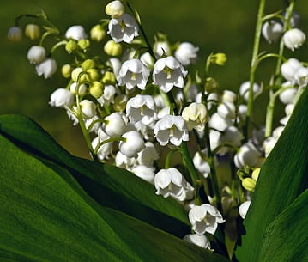
UC Toxicity Classification
Major Toxicity-1
Cause serious illness or death (call poison control or your doctor immediately)
Minor Toxicity-2
Ingestion may cause minor illness
Oxalates-3
Can irritate the skin, mouth, tongue
Dermatitis-4
May cause skin rash or irritation
Lily of the Valley Convallaria majalis
Notes:
Toxicity Class (third column in table below)
Major Toxicity: These plants may cause serious illness or death. If ingested, immediately call the Poison Control Center -- (800) 222-1222 -- or your doctor.
Minor Toxicity: Ingestion of these plants may cause minor illnesses such as vomiting or diarrhea. If ingested, call the Poison Control Center or your doctor.
Oxalates: The juice or sap of these plants contains oxalate crystals. These needle-shaped crystals can irritate the skin, mouth, tongue, and throat, resulting in throat swelling, breathing difficulties, burning pain, and stomach upset. Call the Poison Control Center or your doctor if any of these symptoms appear following ingestion of plants.
Dermatitis: The juice, sap, or thorns of these plants may cause a skin rash or irritation. Wash the affected area of skin with soap and water as soon as possible after contact. The rashes may be very serious and painful. Call the Poison Control Center or your doctor if symptoms appear following contact with the plants.
Shown here is Lily-of-the-valley a sweet, fragrant, spring-blooming perennial herb. It is a good ground cover in partial shade. Leaves, flowers, and berries are toxic and contain cardic glycosides

Slide 18
Sample UC Toxic Plants (by common name)
Toxic plants: Common name | Scientific name | Toxicity class
Achillea | Achillea millefolium | 2,4
Aconite | Aconitum spp. | 1
African boxwood | Myrsine africana | 2
African lily | Agapanthus spp. | 2,4
Agapanthus | Agapanthus spp. | 2,4
Agave | Agave spp. | 2,3,4
Aglaonema | Aglaonema spp. | 3,4
Ailanthus | Ailanthus altissima | 2,4
Alder | Alnus spp. | 4
Notes:
Note toxicity class in right hand column.

Slide 19
ANR Poisonous Plant Chart
Notes:
This is an additional chart that is found on the UC/ANR website. The Codes for this chart are very technical. The key for these codes are found at the end of the chart.
The first on the list Acokanthera or busman’s poison indicates the toxic part as WP which means whole plant, the toxin is indicated by a – which means unknown, and the effect is very toxic.
The second Aconitum or monkshood shows WP (whole plant toxic), Toxin A- alkaloid and CT-cardiotoxin, and the effect GI-gastrointestinal and sever NS-nervous system.
This is more information that most of us need but is a very thorough resource for those that are interested or need those details.

Slide 20
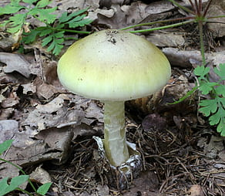
Mushrooms
Eating any mushrooms collected outdoors should be considered dangerous.
Symptoms of mushroom poisoning can include:
abdominal pain, cramping, vomiting, diarrhea, liver damage, and death.
Serious illnesses and deaths have been linked to mushrooms that cause liver damage
Teach children never to touch or taste outdoor mushrooms
Call the Poison Control Center even if you only think that someone has eaten one.
Symptoms may not appear until many hours later. Do not wait until symptoms appear.
Death Cap Mushroom
Amanita phalloides
Notes:
Eating mushrooms collected outdoors can be very risky because many poisonous mushrooms look and taste like ones that are safe to eat. There is no easy way to tell the difference between safe and unsafe mushrooms.
Picture:
The death cap mushroom is highly toxic. Amanita phalloides, commonly known as the death cap or the death cap amanita, is a deadly poisonous basidiomycete fungus,

Slide 21
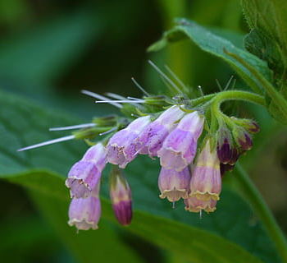
Herbal Medicines
Herbal medicine is the use of drugs found in plants for prevention and cure of disease
Some are safe but others may produce harmful side effects
FDA approval is not required for package or marketing claims
Herbs taken with prescribed or over-the-counter drugs may cause health problems
Some herbal products contain active ingredients that can produce unexpected side effects
Comfrey
Symphytum
Notes:
Because scientific studies have not been done on many herbs, pregnant women, breast-feeding mothers, and infants and young children should probably not use herbs. Older people with serious health conditions should also be careful about the use of herbs.
Bullet-1
A "natural" product from a plant is not necessarily better than the same chemical produced in a laboratory
Bullet-2
An herbal treatment that does not work, even if it won't hurt you, could delay getting necessary medical treatment.
Bullet-3
FDA approval is not required
Unlike approved drugs, herbs are almost entirely unregulated for safety, uniformity of contents, and contamination.
The correct dose of herbal products is often hard to determine.
Herbal remedies may have other unlabeled medicines or materials mixed in with them.
Bullet-5
Some herbal products contain active ingredients that can produce unexpected side effects (for example, saw palmetto contains estrogen, a female hormone).

Slide 22
UC Examples of Potentially Harmful Plant Remedies
Herb | Potential Toxic Effect
Borage (Borago officinalis) | Skin irritation
Calamus (Acorus calamus) | Skin irritation, stomach upset, may cause cancer
Chaparral (Larrea indentata) | Liver damage
Comfrey (Symphytum officinale) | Liver damage
Ephedra; Ma-huang (Ephedra sinica) | Agitation, high blood pressure, rapid heart beat, convulsions
Germander (Teucrium chamaedrys) | Liver damage
Life root (Senecio aureus) | Liver damage
Pennyroyal (Mentha pulegium) | Liver damage. Concentrated oil can cause convulsions, shock, and multi organ failure
Sassafras (Sassafras albidum) | Liver damage. Concentrated oil can cause hallucinations, trembling, shock, and possibly cancer.

Slide 23

Preventing Exposure to Toxic Plants
Label Plants
Know the name before poisoning happen
Have both common and scientific name
Show grandparents and babysitters where the label is
Children and Pets
Consider removing toxic plants from the garden
Keep houseplants out of reach
Teach children not to put ANY part of a plant in the mouth (leaves, stems, bark, seeds, nuts, berries, bulbs)
Do not allow sucking nectar from flowers, making tea from nectar or chewing on jewelry made from seeds or beans
Notes:
Label Plants
Before buying a plant, have the store label it with both the common and scientific name.
Show grandparents and baby sitters where the plant label is. It is very hard for poison specialists to identify plants from a description given on the phone. Know the names of your plants before a poisoning happens.
Children
If you have small children or curious pets, consider removing toxic plants from your garden and house. House plants should be placed out of reach of the very young.
Teach children not to put any part of a plant in the mouth. This means leaves, stems, bark, seeds, nuts, berries, and bulbs. Do not allow children to suck nectar from flowers or make "tea" from the leaves. Never chew, or let children chew, on jewelry made from seeds or beans.
Other Information
Do not eat plants or mushrooms collected outdoors unless you are certain they are safe.

Slide 24
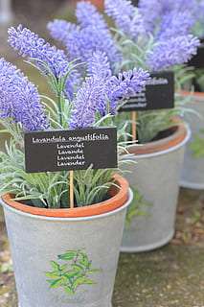
Preventing Exposure to Toxic Plants Handling Toxic Plants
Storage
Label bulbs and seeds
Keep away from children, pets, and food storage areas
Protection
Use protective gloves and clothing when handling plants that can irritate skin
Wash clothes afterwards
Discard Plant flowers and leaves
Ensure children and pets can’t get to them
Caution when burning yard trimmings
Avoid when made of twigs and other parts of poisonous plants
Can irritate or harm the eyes, throat, and other parts of the body
Notes:
Handling Toxic Plants
Store labeled bulbs and seeds safely away from children, pets, and food-storage areas. Avoid confusing bulbs with edible onions.
Use protective gloves and clothing when handling plants that may be irritating to the skin. Wash clothes afterwards.
Discard plant leaves and flowers in a safe way so that children and pets cannot get to them.
Smoke from fires made of twigs and other parts of poisonous plants, including poison oak, can irritate or harm the eyes, throat, and other parts of the body.

Slide 25


Treatment for Plant Poisoning
Mouth
Remove any parts of the plant or mushroom from the patient's mouth and clean out the mouth.
Skin
Wash the area exposed to the plant with soap and cool water as soon as possible.
Eyes
Flush eyes with lukewarm water for 10 to 15 minutes
Be very gentle, as vigorous or prolonged rinsing can hurt the eyes
Meanwhile, call the Poison Control Center: (800) 222-1222

Slide 26

Pets and Toxic Plants
Some plants that are not a problem to humans can be a problem for animals
Because dogs, especially, will eat large amounts, it is important to keep pets and these plants apart
UC has information specific to animals
Notes:
Some plants that are not a problem to humans can be a problem for animals. The plant names that are listed in bold typeface are known to be dangerous to animals (dogs and cats). Because dogs, especially, will eat large amounts, it is important to keep pets and these plants apart.

Slide 27
UC and Plants Toxic to Animals
Do not use lists of plants poisonous to people
Some animals and birds may safely eat plants that are unsafe for humans
UC provide a list of resources specifically for pets (See the links for the sites below on the UC Safe and Poisonous Garden Plants page under Plants Toxic to Pets) https://ucanr.edu/sites/poisonous_safe_plants/
UC Davis School of Veterinary Medicine: Pets and Toxic Plants
Cornell University: Plants Poisonous to Livestock and other Animals
University of Illinois: Plants Toxic to Animals
The ASPCA: Toxic and Nontoxic Plants for Animals
In case of suspected ingestion contact either your local veterinarian or the APCC 24-hour emergency poison hotline at 1-888-426-4435.
Notes:
Information on this website is about plants poisonous to people. Do not use the plant lists on this site to learn about safe or toxic plants for animals. Some links are provided below on plants poisonous to animals.
Pets, especially cats and dogs, frequently ingest plants. If a plant is known to be hazardous to humans, it may be toxic to animals as well. However, some animals and birds may safely eat plants that are unsafe for humans.
Beware: pets and toxic plants
A surprisingly large number of common garden and household plants are toxic to pets, and reactions to toxicity range from mild to life-threatening. Pets, like young children, explore the world with their senses, and they are therefore vulnerable to accidental poisoning. Many of these plants make wonderful additions to the garden, but it's important to know which plants are toxic. Avoid planting these where pets (or children) will have frequent unsupervised access to the plants.
Cornell University - a growing reference that includes plant images, pictures of affected animals and presentations concerning the botany, chemistry, toxicology, diagnosis and prevention of poisoning of animals by plants and other natural flora
ASPCA-American Society for the Prevention of Cruelty to Animals.
This list contains plants that have been reported as having systemic effects on animals and/or intense effects on the gastrointestinal tract. Please note that the information contained in our plant lists is not meant to be all-inclusive, but rather a compilation of the most frequently encountered plants. Individual plants may differ in appearance from the photos used on our listings. Please be sure to check the name of the plant to determine its toxicity.
Also, be advised that the consumption of any plant material may cause vomiting and gastrointestinal upset for dogs and cats. Plants listed as either non-toxic, or potentially toxic with mild GI upset as their symptoms are not expected to be life-threatening to your pets.
If you believe that your animal is ill or may have ingested a poisonous substance, or if you have any further questions regarding the information contained in this database, contact either your local veterinarian or the APCC 24-hour emergency poison hotline at 1-888-426-4435.

Slide 28
Safe Plants
Both CPC and UC have lists of plants considered safe to humans (your handout has links for these lists)
Lists are in alphabetical order, one by Scientific and one by common name
Even non-toxic plants can cause vomiting in humans and animals
Children can choke on a plant piece and have gagging or choking
Notes:
A note on "safe" plants: The plants on this list are generally believed to be safe. However, if you suspect that a child (or adult) has eaten quantities of any of these plants (or any of their parts), or if you notice symptoms such as illness or dermatitis after handling these plants, call your Poison Control Center for additional information: (800) 222-1222.

Slide 29
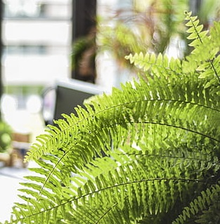
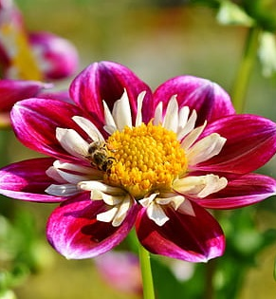
Safe Plants Examples
African daisy
African violet
Baby tears
Boston fern
Bottlebrush
California poppy
Canna lilly
Christmas cactus
Coleus
Coreopsis
Dahlia
Daylily
Escallonia
Staghorn fern
Zinnia
Boston Fern
Zinnia

Slide 30
Resources
California Poison Control
https://calpoison.org/topics/plant#toxic
University of California
Safe and Poisonous Garde Plants
https://ucanr.edu/sites/poisonous_safe_plants/
ANR publication 8560 https://anrcatalog.ucanr.edu/pdf/8560.pdf
Davis School of Veterinary Mediciine
https://ccah.vetmed.ucdavis.edu/dogs/dog-health
Notes:
The ANR publication is 6 pages long and if this is an in-person presentation a copy can be downloaded, printed, and available as a “table copy” for those interested, to check whether they want to download it for themselves. Put a label on the top:
Table Copy
Download a dopy for yourself, if you wish

Slide 31
Thank You!
Any Questions?
Master Gardener Hotline: (530) 889-7388
Rot Line: (530) 889-7399
Master Gardener Website: pcmg.ucanr.org
Evaluations, please!

