Slide 1
What’s In a Name?
A Look at Botanical Latin
If you do not know the names of things,
the knowledge of them is lost, too.
—Carolus Linnaeus
Notes:
Created: Created 3/17. Adapted to template 12/20
Created by: Peggy Beltramo
Audience: Garden Club 3/17. CE 8/19
Publicity: What’s in a name? A look at those complicated plant names that you can’t spell or pronounce. Why we need Botanical Latin names and what they tell you about your plants.
Update History: Prep. for Zoom workshop 2021

Slide 2
Who Are Master Gardeners?
Master Gardeners of Placer County
  Extend research-based, sustainable gardening and composting information
  Present accurate, impartial information to home gardeners
  Encourage public to make informed gardening decisions

Slide 3
Who Are Master Gardeners?
Where to find us…
Online, in the Media, and Special Publications
  Hotline: Call (530) 889-7388 or submit your questions online
  Website: pcmg.ucanr.org
  Facebook, Twitter, Instagram
  Gold Country Media monthly column
  Curious Gardener quarterly newsletter on our website
  Calendar and Gardening Guide

Slide 4
Who Are Master Gardeners?
Where to find us…
Workshops, Fairs and Festivals, and Special Events
  Speakers by Request
  Workshops (various venues, check website)
  Farmers’ Markets (seasonal: Auburn, Roseville)
  Fairs and Festivals Booths (varies)
  Garden Faire (April)
  Mother’s Day Garden Tour (May)

Slide 5
WEBPAGE PHOTO HERE

Slide 6
What’s In a Name?
A Look at Botanical Latin
HANDOUTS

Slide 7
What’s In a Name?
A Look at Botanical Latin
Agenda
Name It
Write It
Say It
Hear It

Slide 8
What’s In a Name?
A Look at Botanical Latin
We pause for a moment
to bring you this
public service announcement.
Notes:
“Impress your friends, family and co-workers! Yes, in just a few short weeks, you too can become fluent in Botanicaleese! Communicate easily with landscape architects, upscale garden designers and the dude down at the garden center. Join millions of people worldwide who have become happier, healthier and more attractive to the opposite sex after learning to speak botanical Latin!” Courtesy of Kathy Stoner, Napa MG

Slide 9
What’s In a Name?
A Look at Botanical Latin
Name It
Common vs. “Latin” names
Botanical Names
Botanical Latin
Binomial Nomenclature
Notes:
Common names usually reflect some conspicuous or valuable characteristic of the plant, not its taxonomic group.
18 different species have Bluebell as part of their common name.
Botanical Names Botanical Latin
why Latin? or Latinized words (may be Greek or???). = language of science
NOT JUST FOR PLANT GEEKS
tall vs. ground cover; swamp vs. dry; shade vs. sun
Binomial Nomenclature “2 name names”

Slide 10
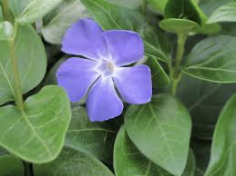
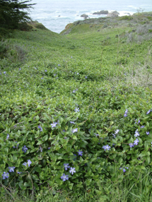
What’s In a Name?
A Look at Botanical Latin
Name It
This one is Invasive!
Both plants
are Periwinkles
Vinca minor
Vinca major
Notes:
Vinca minor is a desirable groundcover, but Vinca major is a VERY invasive plant!
If you just ask for periwinkle or even Vinca, you may get more than you bargained for! To quote: “Be careful what you ask for!”

Slide 11
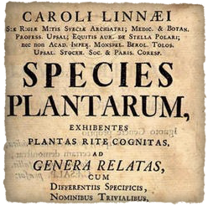
What’s In a Name?
A Look at Botanical Latin
Name It
Carl Linnaeus, Swedish Botanist
(also known as Carl von Linné or Carolus Linnaeus)
Father of Taxonomy
1752 Species Plantarum
One name for each plant
Deus craevit, Linneaus disposuit
Notes:
Carl Linnaeus Born in Sweden in 1707, he is considered the “Father of Modern Taxonomy”. In 1753, he published the Species Plantarum in which he defines the binomial or the genus/species naming system for plants that is still in use today. During his life he was responsible for the naming of nearly 8,000 plants, as well as many animals and the scientific designation for humans: Homo sapiens.
At times, Linnaeus thought of himself as the second Adam. "Deus creavit, Linnaeus disposuit," he liked to say—God created, Linnaeus organized.
https://www.smithsonianmag.com/science-nature/organization-man-151908042/
Carl Linnaeus, also known as Carl von Linné or Carolus Linnaeus, is often called the Father of Taxonomy. His system for naming, ranking, and classifying organisms is still in wide use today (with many changes). His ideas on classification have influenced generations of biologists during and after his own lifetime, even those opposed to the philosophical and theological roots of his work. https://ucmp.berkeley.edu/history/linnaeus.html
Accolades
By the end of his life in 1778, Carl Linnaeus had become one of the most acclaimed scientists in Europe, the first civilian in Sweden to be dubbed a knight of the Order of the Polar Star (1753) and ennobled as Carl von Linné (1761). The Swiss philosopher Jean-Jacques Rousseau wrote during Linnaeus' lifetime: "I know no greater man on earth."^{[1]}
FYI (In 1959, Carl Linnaeus was designated as the ectotype for Homo sapiens,^{[5]} which means that following the International Code of Zoological Nomenclature, Homo sapiens is validly defined as the animal species to which Linnaeus belongs. wikipedia

Slide 12
What’s In a Name?
A Look at Botanical Latin
Name It
A botanical name becomes valid only when it is:
Published according to very specific rules
Contains illustrations and
technical descriptions of the plant.
As of 2011, can be described in Latin or English.
In a scientific journal (can be electronic journal—2011)
Such botanical names are standardized
and are agreed upon throughout the world.
Notes:
Validity of Names
http://phytokeys.pensoft.net/articles.php?id=1383
For the first time in history the Code will allow for the electronic publication of names of new taxa. In an effort to make the publication of new names more accurate and efficient, the requirement for a Latin validating diagnosis or description was changed to allow either English or Latin for these essential components of the publication of a new name. Both of these latter changes will take effect on 1 January 2012. standardized & agreed to

Slide 13
Taxonomy
Kingdom
Phylum
Class
Order
Family
Genus
Species
Notes:
Taxonomy Systematists
2 domains of living things: Plants and Animals
All kingdoms are divided into divisions (Phylla), which are then further divided into classes, orders, families, genera, and species. Each species represents a specific plant.
“King Philip came over for good soup.” mnemonics for Kingdom, phylum, class…

Slide 14
Taxonomy
Kingdom
Phylum
Class
Order
Family
Genus
Species

Slide 15
Taxonomy
Family
Genus
Species

Slide 16
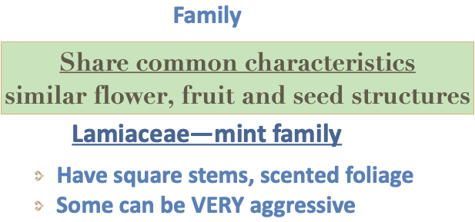
Taxonomy

Slide 17

Taxonomy
Genus
Species

Slide 18
Taxonomy
Genus
Plural = Genera
Notes:
The plural of genus is genera.

Slide 19
Taxonomy
Genus
Species
Notes:
Genus Species
Individual plant names are made up of two parts, the genus and the specific epithet. For example, Salvia mexicana (Mexican sage). Think of it as a plant’s first and last name, but the last name (Genus) comes first, followed by its first name (specific epithet); however, in this case, there is only one “Smith, John” in the whole world, and once John has been named “John”, then there can be no other John Smith ever (at least not in the plant world.) Also, by being named Smith, all plants in that Genus share common characteristics with all the other Smiths.
The plural of genus is genera.

Slide 20
Taxonomy
Species of Angiosperms (flowering plants) contained within The Plant List belong to 405 plant families and 14,559 plant genera.
The Plant List includes 951,140 scientific plant names of species rank for the Angiosperms. The status of the species names for the Angiosperms recorded in The Plant List, are as follows:
http://www.theplantlist.org/1.1/browse/A/#statistics
Notes:
http://www.theplantlist.org/1.1/browse/A/#statistics
It’s complicated!
Species of Angiosperms (flowering plants) contained within The Plant List belong to 405 plant families and 14,559 plant genera.
The Plant List includes 951,140 scientific plant names of species rank for the Angiosperms.

Slide 21
Taxonomy
Species = Genus + specific epithet
Salvia elegans

Slide 22
Taxonomy
Genus specific epithet variety/varietal (var.)
Related to a previously discovered species
Natural mutation
Seeds must breed true
Salvia chamaedroides var. isochroma
Notes:
Plants can be further described by using variety, cultivar, hybrid, and authority notations.
Variety var.--mutation-occurs in nature, is stable, e.g. coast vs. foothill

Slide 23
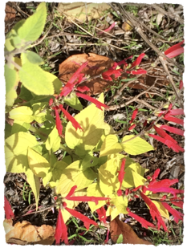
Taxonomy
Genus specific epithet ’cultivar’ (cv.)
cultivar = cultivated variety
an improved form or a hybrid
propagated asexually
Salvia elegans cv. ’Honey Melon’
Notes:
cultivar (cultivated variety) cv. ‘Name’ (not italicized) purposely bred and propagated. Cultivar names are given when the mutation occurs due to human influence.

Slide 24

Taxonomy
Genus specific epithet ’cultivar’ (cv.)
cultivar = cultivated variety
an improved form or a hybrid
propagated asexually
Salvia elegans cv. ’Honey Melon’
S. elegans ‘Honey Melon’

Slide 25
Taxonomy
Genus unspecified species
Salvia sp.
when discussing an unnamed species of Salvia
Plural = Salvia spp.
Notes:
When referring to an unidentified species, use the abbreviation “sp.”: The meadow contained several sedge plants (Carex sp.). The plural form is “spp.”
In botany, the subspecies is indicated by “subsp.” or “ssp.”

Slide 26
Taxonomy
Trademarking can be as simple as writing ™ after a name.
®
For about $250, a name becomes a Registered Trademark
PPAF = Plant Patent Applied For
PP#00,000 Plant Patent Granted: Number
It is illegal to propagate this plant, even for your own garden.
https://www.plantdelights.com/blogs/articles/name-that-plant
Notes:
https://www.plantdelights.com/blogs/articles/name-that-plant
Trademarking can be as simple as writing ™ after a name.
For about $250, a name becomes a Registered Trademark ®
PPAF = Plant Patent Applied For
PP#00,000 Plant Patent Granted: Number
It is illegal to propagate this plant, even for your own garden.

Slide 27
Where Do Plant Names
Come From?
Write It
Genus = a noun

Slide 28
Where Do Plant Names
Come From?
Write It
Genus
Named for a Person
Achillea
Heuchera
Euphorbia
Fuchsia
Notes:
Euphorbus 12 th C. BCe Greek Physician
Achilles Greek Hero
Heucher 17th C. German botanist
Fuchs 14th C. German botanist and physician
Linnaeus used many of his supporters and detractors as inspiration for naming plants. The most beautiful of plants were often named in honor of his supporters and his detractors often supplied the names of common weeds or unattractive plants.

Slide 29
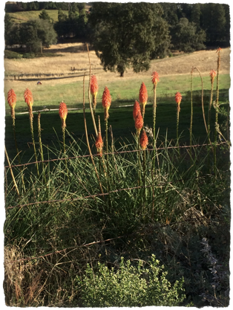
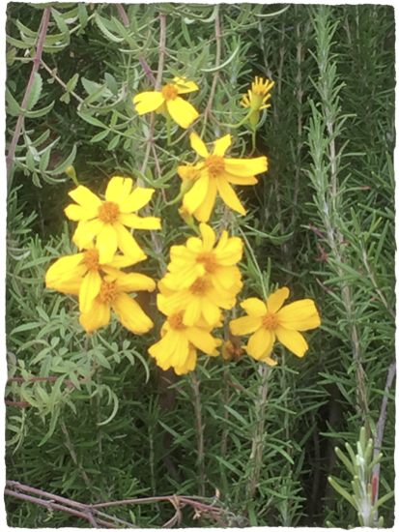
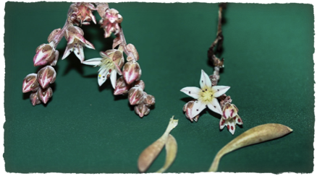
Where Do Plant Names
Come From?
Tagetes lemonii
Kniphofia uvularia
Dudleya hendrixii
Notes:
Tagetes lemmonii Genus named for an Etruscan deity, Tages.
Specific epithet = (J.G. Lemmon 19th C. botanist)
Kniphofia uvaria Johann Hieronymus Kniphof (24 February 1704 in Erfurt – 23 January 1763) was a German physician and botanist. (uvaria=resembling a bunch of grapes)
Dudleya hendrixii 12/15/16 California researchers have named a newly discovered rare plant after Jimi Hendrix. The plant, found in Baja California, Mexico, has been christened Dudleya hendrixii , or "Hendrix's liveforever.” Dudleya = Wm. Dudley 20 C. botanist
Supposedly, the scientist who discovered the plant was listening to Jimi Hendrix on his Walkman.

Slide 30
Where Do Plant Names
Come From?
Write It
Genus
Named for a Characteristic
Cotoneaster
cotone—Latin for quince
-aster—Eng. suffix = resembling
Salvia
salvere—Latin for health, heal
referring to the herb's healing properties.
Notes:
Named for a Characteristic or Use and Quixotic Naming—anagrams, etc.
etymology-origin of a word and historical development of meaning
So, you can see that a genus may get its name in honor of a person. It may get its name from its origins, i.e. what native peoples called it where it was discovered. Most typically, the name comes from one or more of the most prominent characteristics among those which define the group. Horribly, the 26 letters of the English language were so confining (back in the 18th Century), that a number of generic names are simply anagrams of existing genera, yielding names such as Sibara (Arabis=rockcress), Norysca, Ubochea, and Zacateza. A few are anagrams of geographic places such as Lobivia (BOLIVIA)and Jacaima. (JAMAICA)
http://tomclothier.hort.net/page36.html

Slide 31
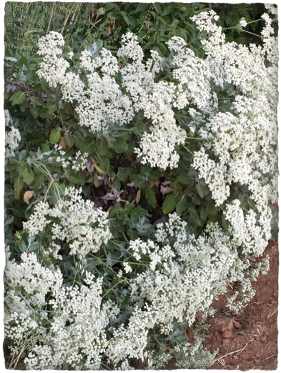
Where Do Plant Names
Come From?
Eriogonum giganteum
erion=wool
gonu=knee
“woolly knees”
refers to hairs
on the stems
Common Name?
Notes:
https://ucanr.edu/blogs/blogcore/postdetail.cfm?postnum=42922
Eriogonum giganteum
erion=wool
gonu=knee
“woolly knees”
refers to hairs
on the stems
COMMON NAME buckwheat

Slide 32
Where Do Plant Names
Come From?
Specific epithet = adjective
Named for a Characteristic
Foliage/flower color
Leaf shape/form
Plant shape/habit
Plant parts
Place of Origin
and MORE
officinalis

Slide 33
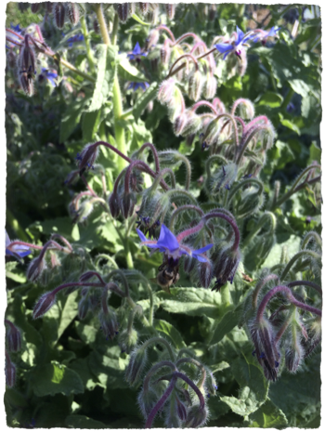
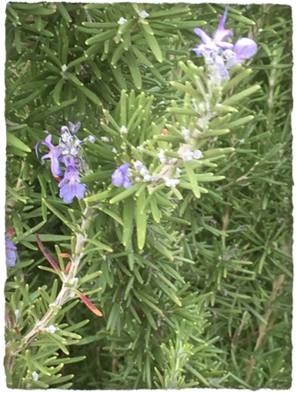
Where Do Plant Names
Come From?
Officinalis =
culinary or medicinal
Borago officinalis
Rosmarinus officinalis
Hold the presses!!!

Slide 34
Where Do Plant Names
Come From?
Officinalis =
culinary or medicinal
Borago officinalis
A new name
Salvia rosmarinus
Notes:
Rosemary is now in the sage family. It has lost its “officinalis” specific epithet…

Slide 35
Where Do Plant Names
Come From?
Say It
William Stearn, considered the authority on botanical Latin (his book Botanical Latin is the standard) states, "How [scientific names] are pronounced really matters little provided they sound pleasant and are understood by all concerned."

Slide 36
Where Do Plant Names
Come From?
Say It
Agastache
However, if you’re still not comfortable uttering the name in public, call these superb plants by one of their common names; hummingbird mint or hyssop.
A gas’ tä key
A gas tā’ key
A gas tä’ key
A ga stash’ ē
A gas tash’
Notes:
A gas tä key, A gas tā key or A gas tä key A ga stash ē or A gas tash. However, if you’re still not comfortable uttering the name in public, call these superb plants by one of their common names; hummingbird mint or hyssop.
https://www.highcountrygardens.com/gardening/Agastache
1. ah-GAH-sta-kee https://plants.ces.ncsu.edu/plants/agastache/
2. ah-GAH-sta-kee
https://www.missouribotanicalgarden.org/PlantFinder/PlantFinderDetails.aspx?kempercode=d554
3. ah -gah-STAH–key sonomamg.ucanr.edu › Plant_of_the_Month › Agastache
4.
https://cals.arizona.edu/cochise/mg/sites/cals.arizona.edu.cochise.mg/files/newsletter/Aug17.pdf
Denver Post
How do you say “agastache”? To rhyme with wacky? Even those who breed the plant don’t agree. Joy Andrews calls it “ah-GAH-sta-key,” a pronunciation she says renowned Colorado garden author Lauren Springer Ogden got from the Brits. An article in Southern Living magazine from in 1996 listed two more: “a-guh-STASH” or “aga-STAH-chee.” High Country Gardens’ honcho David Salman says “agah-STEAK-ee,” but some of his staff say “aga-STOCK-ee.” You could avoid the whole sticky issue by doing what Andrews does: She just pronounces it the way the person she’s talking to is pronouncing it.
https://www.denverpost.com/2008/05/16/you-say-aga-stah-chee-i-say-agah-steak-ee/

Slide 37
by David Salman
How do you pronounce the Latin genus known as Agastache? In Colorado and New Mexico, where we can grow a wide variety of these wonderful perennials, we generally say the name as A gas tä key, A gas tā key or A gas tä key. I’ve also heard it spoken as A ga stash ē or A gas tash. However, if you’re still not comfortable uttering the name in public, call these superb plants by one of their common names; hummingbird mint or hyssop.

Slide 38

Are You Kidding Me?!!!
There are a few guidelines that may be helpful to those learning to pronounce the names I have included in this website. One should try to divide the names into separate syllables on the presumption that each vowel is a different syllable, and try to pronounce each and every syllable. This is not always the case because there are combinations of two vowels such as 'ae' and 'oe' (dipthongs) that form a single sound. In two-syllable words…
23pp.
http://www.calflora.net/botanicalnames/pronunciation.html
International Code of Nomenclature http://www.iapt-taxon.org/nomen/main.php

Slide 39

Hear It
On your handout:
Missouri Botanical Garden.
www.missouribotanicalgarden.org/plantfinder/plantfindersearch.aspx
Fine Gardening Magazine (alphabetical)
http://www.finegardening.com/pronunciation-guide/a

Slide 40
What’s In a Name?
A Look at Botanical Latin
A single organism defines a species.
Old information gives way to new.
Aster = Eurasian plants
Symphyotrichum (90) - A. cordifolius, A. dumosus, A. laevis,
A. lateriflorus, A. novae-angliae, A. novi-belgii
Eurybia (27) - A. divaricatus, A. macrophyllus
Doellingeria (3) - A. umbellatus
Oreostemma (3) - A. alpigenus
Solidago - A. ptarmicoides
Notes:
A single organism defines a species.
Old information gives way to new.
"The only proper reasons for changing the name of a distinguishable group of plants are either a more profound knowledge of the facts resulting from adequate taxonomic study or the necessity of giving up a name that is contrary to the Rules of a Code.” — Tony Avent
https://www.plantdelights.com/blogs/articles/name-that-plant
Because the concept of the genus Aster is linked (by rules of scientific nomenclature, ICBN) to a single species –– Aster amellus, native to Europe and Asia –– the name Aster is most appropriately associated with the Eurasian species, leaving the approximately 180 North American species to find names within other genera.
http://www.guynesom.com/NameChangesInAsterWEB.htm

Slide 41
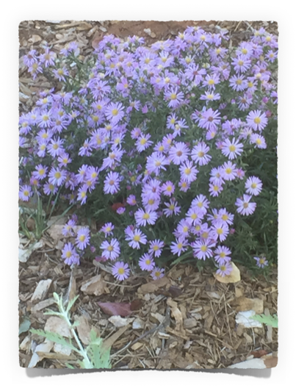
What’s In a Name?
A Look at Botanical Latin
Formerly:
Aster chilensis
Now:
Symphyotrichum chilense

Slide 42
Where Do Plant Names
Come From?
Remember this page?
Officinalis =
culinary or medicinal
Recent DNA studies
show that rosemary
is a member of the
Salvia genus.
It has been reclassified as
Salvia rosmarinus
Rosmarinus officinalis
Notes:
DNA studies are changing how plants are classified. Recently, rosemary was reclassified within the
Salvia genus. Its new name is Salvia rosmarinus. It has lost the officinalis epithet, so it no longer
obviously culinary, but it still has the rosemary signal wit rosmarinus in its name.
(https://ucanr.edu/blogs/blogcore/postdetail.cfm?postnum=45824)
http://khkeeler.blogspot.com/2018/08/what-happened-to-rosemary.html

Slide 43
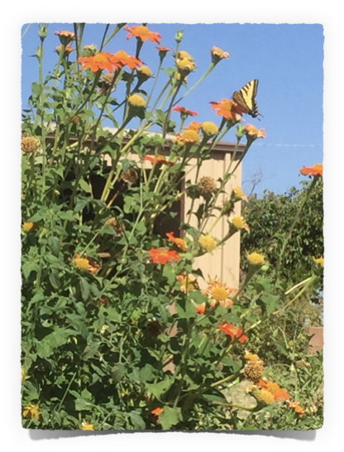
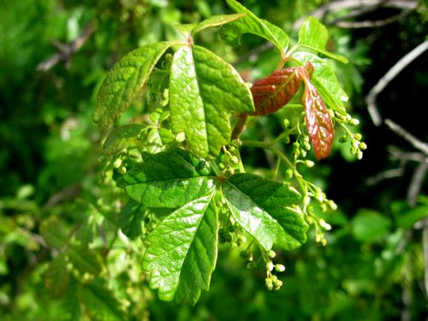
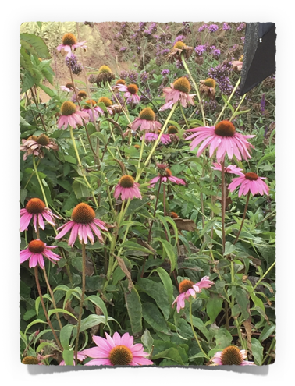
Now, a test:
Toxicodendron diversilobum
Tithonia rotundifolia
Echinacea purpurea
Notes:
The TEST
Look at the specific epithets. Can you guess their meanings?
What about any other words???
Think, pair share—Look at the slide and think about any words you can guess. Then turn to a neighbor and tell what you think, Finally we will share with the group.
Echinacea purpurea. Echinacea comes from the Greek word echinos meaning hedgehog
purpurea = purple
Toxicodendron diversilobum Toxic—poisonous; dendron--leaf
diversilobum = diverse leaf edges.
Tithonia rotundifolia. Tithonus, Greek god, in love with Aurora, goddess of the dawn
rotundifolia. = round leaves
Did you see the swallowtail butterfly?

Slide 44
THE ROSE FAMILY
The rose is a rose,
And was always a rose.
But the theory now goes
That the apple's a rose,
And the pear is, and so's
The plum I suppose.
The dear only knows
What will next prove a rose.
You, of course, are a rose -
But were always a rose.
Robert Frost
Notes:
Many economically important products come from the family, Rosaceae. It includes many edible fruits, such as apples, pears, quinces, apricots, plums, cherries, peaches, raspberries, loquats, strawberries, and almonds. (Wikipedia)

Slide 45

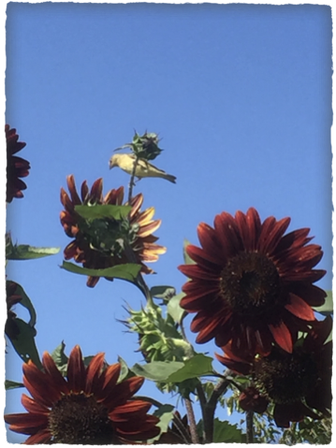
Thank You!
Any Questions?
Helianthus bolanderi
California native
Helianthus annuus
Evaluations, please!
Master Gardener Hotline: (530) 889-7388
Master Gardener Website: pcmg.ucanr.org
Notes:
Note: goldfinch at top of red sunflower
Helianthus modern Latin, from Greek hēlios ‘sun’ + anthos ‘flower’.
annuus—annual plant
bolanderi CA native perennial sunflower
It was named for the California botanist Henry Nicholas Bolander.

