Slide 1

Cool Season Vegetables
Notes:
Prepared by Peggy Beltramo with info from Nikki Duncan
Presented 8/18
Advertising: Loomis Library and Community Center and UC Master Gardeners of Placer County partnered in a kickoff to initiate the Loomis Seed Library in June.
FALL IS THE NEW SPRING! Did you know that you need to plant your fall/winter veg in July and August, so that they get established while the weather is still warm? Come and learn more about how to grow in the winter, starting in August!

Slide 2
Who Are Master Gardeners?
Master Gardeners of Placer County
  Extend research-based, sustainable gardening and composting information
  Present accurate, impartial information to home gardeners
  Encourage public to make informed gardening decisions

Slide 3
Who Are Master Gardeners?
Where to find us…
Online, in the Media, and Special Publications
  Hotline: Call (530) 889-7388 or submit your questions online
  Website: pcmg.ucanr.org
  Facebook, Twitter, Instagram
  Gold Country Media monthly column
  Curious Gardener quarterly newsletter and on our website
  Gardening Guide and Calendar

Slide 4
Who Are Master Gardeners?
Where to find us…
Workshops, Fairs and Festivals and Special Events
  Speakers by Request
  Workshops (various venues, check website)
  Farmers’ Markets (seasonal: Auburn, Roseville, Lincoln)
  Fairs and Festivals Booths (varies)
  Garden Faire (April)
  Mother’s Day Garden Tour (May)

Slide 5

Who Are Master Gardeners?

Slide 6

Cool Season Vegetables
Let’s Look at Your Handouts
Resources
Cool Season Vegetables
Vegetable Families

Slide 7
Cool Season Vegetables
Agenda
Why Garden in the Cool Season?
Advantages/Disadvantages
Growing Conditions (Frost, Freezing)
Soil Preparation
Planting
Watering, Weeding, Pests
Cover the Soil

Slide 8
Why Garden in the Cool Season?
Some crops grow best in cooler weather
Leaf, stem, root vegetables, (not fruit)
HEAT = bitter/go to seed
Who was Persephone?
Need to grow plants to near maturity
Before Persephone date=Fewer than 10 hours of daylight
Nov 16 for Auburn (6:48 am — 4:49 pm)

Slide 9
Cool Season Advantages
Less physical work
Less watering, weeding
Fewer pests
Easy harvesting/overwintering
Soil health = roots in soil
Notes:
Less physical work; less watering, weeding; fewer pests
large variety of crops to plant; easy harvesting/overwintering
promotes soil health (roots in soil to keep microorganisms happy)
eat healthy!

Slide 10
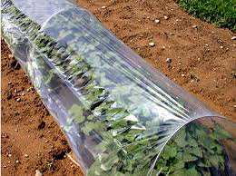
Cool Season Disadvantages
SUN not as efficient, due to angle
Need 6 hours of sun in winter
to equal 3 hours summer
Notes:
Sun Angle===Sun not as efficient. It takes 6 hrs. of winter sun to equal 2 hrs. in summer.
Colder at bottom of hill.
“Sunset ZONE 7. Oregon's Rogue River Valley, California's High Foothills
Growing season: May to early Oct. Summers are hot and dry; typical winter lows run from 23 degrees to 9 degrees F. The summer-winter contrast suits plants that need dry, hot summers and moist, only moderately cold winters.”
When to Plant
Most fall/winter vegetables are planted in August/September; although with climate change, all bets are off.. Refer to planting guide.
Look at veg guide—note direct seed vs. transplant
Frost Freezing
If you are in a colder area, find cold hardy varieties.
Some crops need protection from freezing, even though they prefer cooler weather —like lettuce and radishes.
Use row cover, also good for protection from insect damage. (No need for pollination—we don’t eat fruit of these plants) Row cover sample

Slide 11
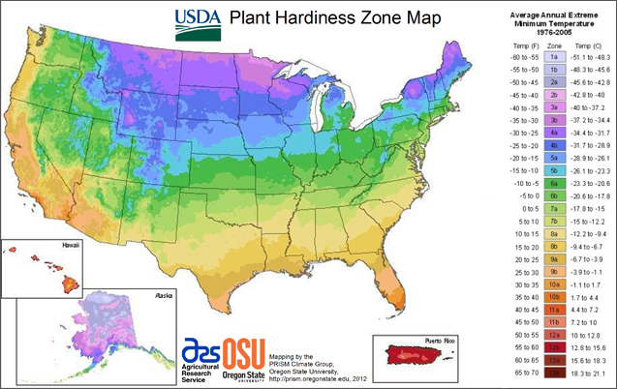
USDA Plant Hardiness Zones
Notes:
Gardeners in the western United States sometimes are confused when confronted with the 11 Hardiness Zones created by the USDA, because we are used to a 24-zone climate system created by Sunset Magazine. The Sunset zone maps, considered the standard gardening references in the West, are more precise than the USDA's, since they factor in not only winter minimum temperatures, but also summer highs, lengths of growing seasons, humidity, and rainfall patterns.

Slide 12

Sunset Hardiness Zones
7
Zone 7-Colfax
Zone 9-Auburn, Lincoln
Zone 14-Roseville, Rocklin
    Granite Bay
Notes:
https://www.sunset.com/garden/climate-zones/climate-zone-central-california
(COLFAX) ZONE 7. Oregon’s Rogue River Valley, California’s High Foothills
Growing season: May to early Oct. Summers are hot and dry; typical winter lows run from 23 degrees to 9 degrees F/-5 degrees to -13 degrees C. The summer-winter contrast suits plants that need dry, hot summers and moist, only moderately cold winters.
ZONE 9. Thermal Belts of California’s Central Valley
Growing season: late Feb. through Dec. Zone 9 is located in the higher elevations around Zone 8, but its summers are just as hot; its winter lows are slightly higher (temperatures range from 28 degrees to 18 degrees F/-2 degrees to -8 degrees C). Rainfall pattern is the same as in Zone 8.
ZONE 14. Inland Northern and Central California
Growing season: early Mar. to mid-Nov., with rain coming in the remaining months. Periodic intrusions of marine air temper summer heat and winter cold (lows run from 26 degrees to 16 degrees F/-3 degrees to -9 degrees C). Mediterranean-climate plants are at home here.

Slide 13
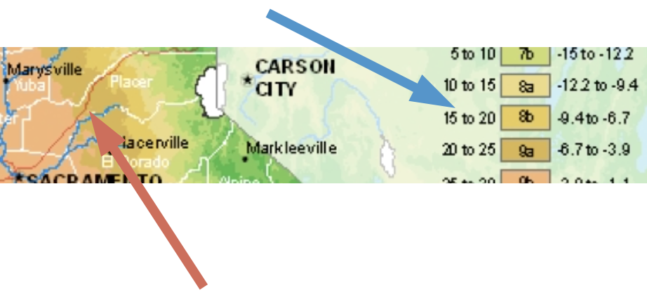
Sunset Hardiness Zones
Zone 7-Colfax
Zone 9-Auburn, Lincoln
Zone 14-Roseville, Rocklin
    Granite Bay

Slide 14
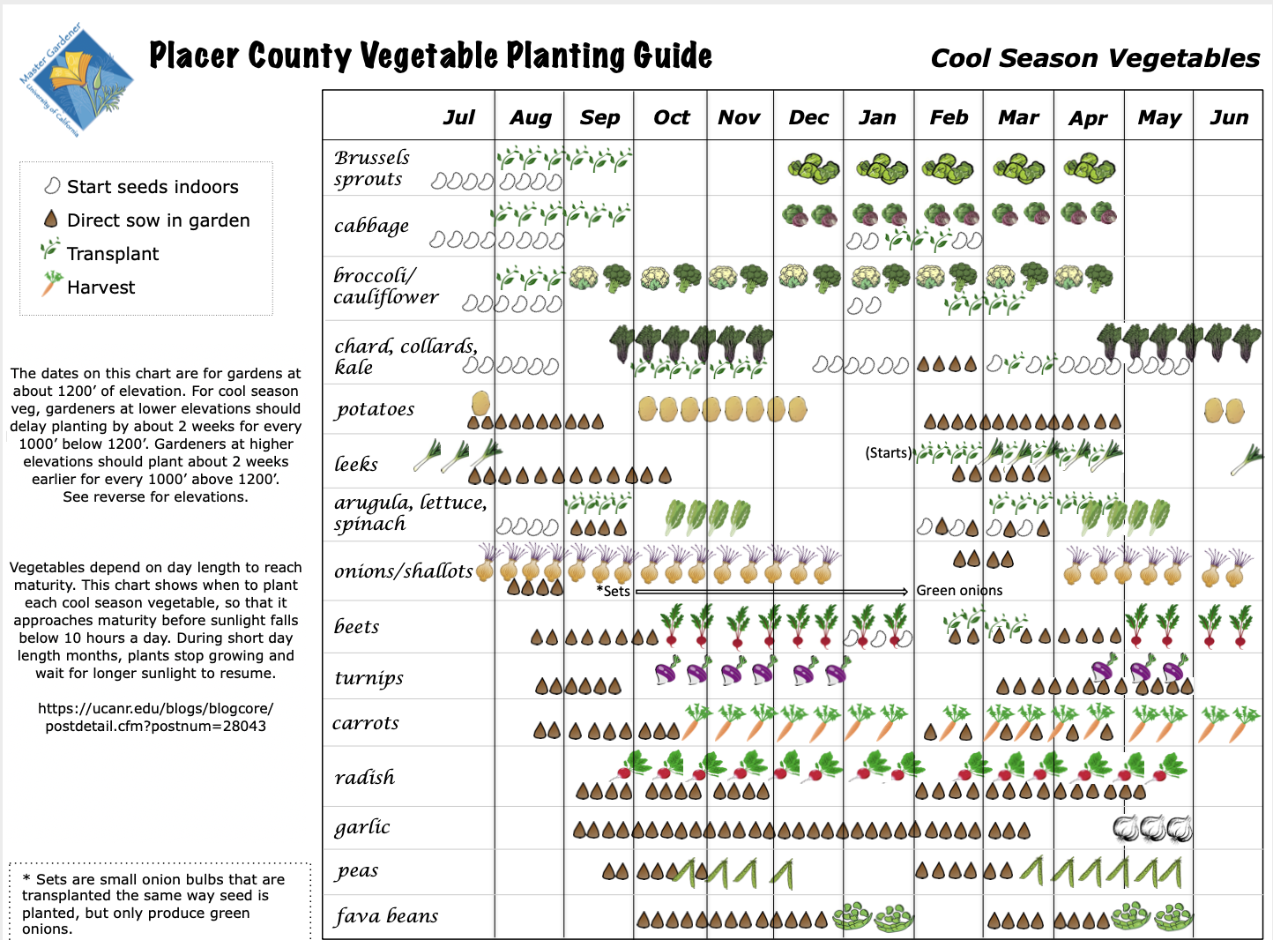
Cool Season Vegetables
Notes:
Two sides= Cool season Veg vs. Warm Season Veg

Slide 15
Cool Season Vegetables
Notes:
Two sides= Cool season Veg vs. Warm Season Veg

Slide 16

Cool Season Vegetables
Notes:
Two sides= Cool season Veg vs. Warm Season Veg

Slide 17
Laminated Vegetable Guide
Available today!
$2.00 donation
(Recovery cost)

Slide 18
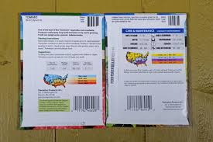
Read the Seed Packet
Notes:
http://blackfoxhomestead.com/uncategorized/how-to-read-a-seed-packet/

Slide 19
Soil Preparation
Weed beds
Feed your soil: Add compost
Fertilize? MAYBE…
Mulch to protect soil
Notes:
weed soil, add compost. Healthy soil grows healthy plants, fewer pests.
Fertilizer. If you have a soil test, add what is needed. Go lightly on N or not at all. Do not fertilize after late fall. New growth too susceptible to damage
When plants are established, mulch to keep roots warm. Don’t leave bare soil. Soil will compact, erode, lose nutrients.

Slide 20
Planting Hints
Rotate crops—3 yr. schedule
Transplants or direct seeded?
Sucession planting
Use sunscreen (on plants, too)
Protect from freezing—if needed
Notes:
Crop Rotation (Chart of handout)
Plant families need to be rotated, ideally on a 3 year basis. This prevents pests/diseases from remaining in the soil to reinfect next year’s plants; e.g. root knot nematodes on tomatoes.
Seeds or transplants. Refer to chart. Chart of direct seed vs. transplants. Why direct seed? Root disturbance problems.
Succession Planting—to stretch out harvest. (Plant more in 2 weeks, e.g., not all at once.)
Summer Sun - protect new seedlings from hot sun with shade cloth. Use sticks with nail in top to secure. Show sample. (Finish nails have no heads.)
Winter freezes - use row cover or other season extenders to protect from freezing (only those crops that need protection). Many crop flavors are sweeter with frosts and freezing temperatures such as carrots, beets, parsnips, brussels sprouts

Slide 21
Watering/Weeding/Pests
Water between rains, if needed
Weed, as needed
Pests? Use row covers, water spray
Notes:
Only water when needed, in long dry spell between rains
Weeding - some crops such as onions, garlic need weeding! They say you can have one or the other. There will be fewer weeds as they go dormant.
Pests - fewer pests in the winter, because they are overwintering.
Brassicas (see plant families list) most susceptible to cabbage worms and aphids. Use insect row cover to help. Fava beans in spring with get black aphids. Food for the beneficials! Wash off with water.

Slide 22
Protect Your Soil
Protect soil from elements
Mulch with straw (NOT HAY!)
or use cover crops on empty spaces
In spring, cut cover crops
and dig in or compost (at 50% bloom)
Notes:
Don’t leave bare soil. Empty areas need protection (and a growing root)
Soil will compact, erode, lose nutrients.Soil organisms need food.
Cover the ground with something. Use straw (hay has seeds—don’t plant a problem!) or cover crops
Cover crops frequently can be grown to harvest and eat!! Can be dug back into the soil or be cut down and composted.
All About Cover Crops http://ucce.ucdavis.edu/files/filelibrary/5842/25997.pdf

Slide 23
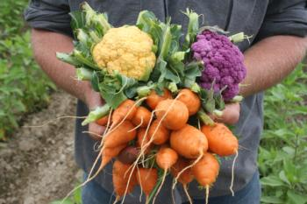
Thank You!
Questions?
Evaluations
Please!
Evaluations
Please!
Master Gardener Hotline: (530) 889-7388
Master Gardener Website: pcmg.ucanr.org

Slide 24
