Slide 1
“Fall” in Love with Gardening
Mary Gish
Placer County Master Gardener

Slide 2
Who Are Master Gardeners?
Master Gardeners of Placer County
Extend research-based, sustainable gardening and composting information
Present accurate, impartial information to home gardeners
Encourage public to make informed gardening decisions

Slide 3
Who Are Master Gardeners?
Where to find us…
Online, in the Media, and Special Publications
Hotline: Call (530) 889-7388 or submit your questions online
Website: pcmg.ucanr.org
Facebook, Twitter, Instagram
Gold Country Media monthly column
Curious Gardener quarterly newsletter on our website
Gardening Guide and Calendar

Slide 4
Who Are Master Gardeners?
Where to find us…
Workshops, Fairs and Festivals, and Special Events
Speakers by Request
Workshops (various venues, check website)
Farmers’ Markets (seasonal: Auburn, Roseville)
Fairs and Festivals Booths (varies)
Garden Faire (April)
Mother’s Day Garden Tour (May)

Slide 5
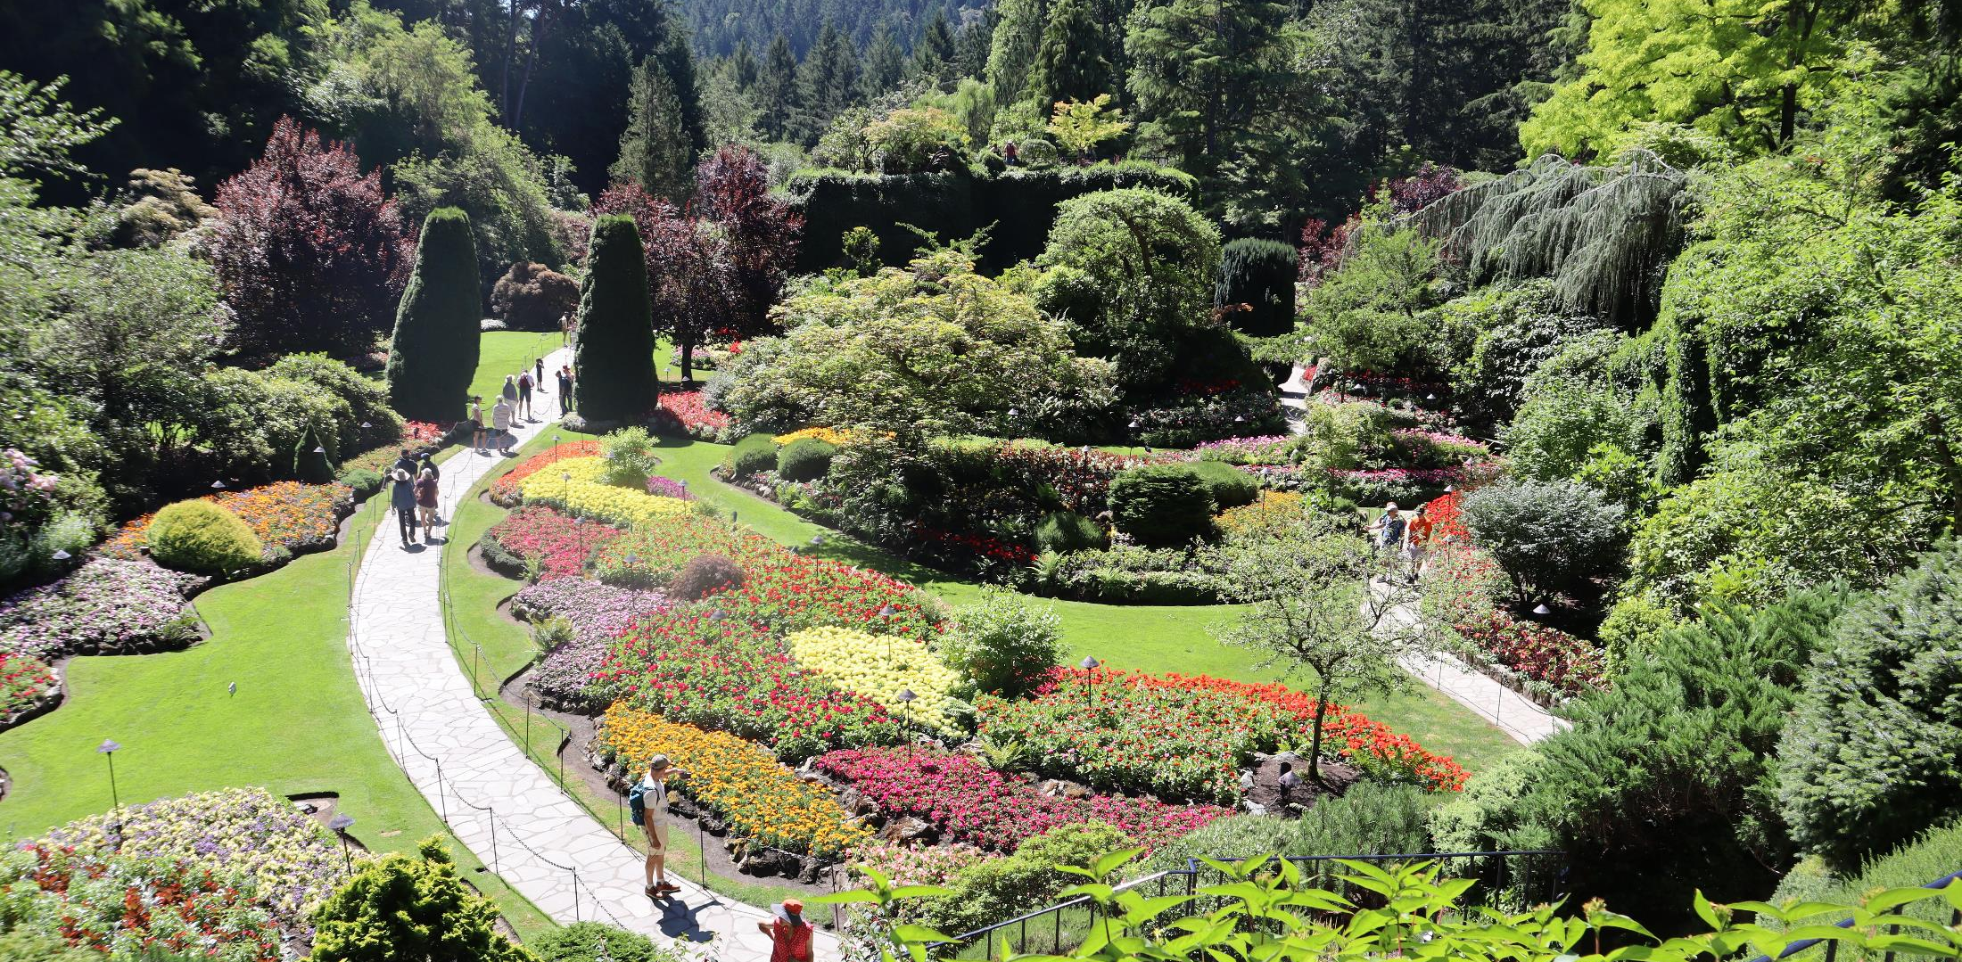
Fall In Love with Gardening

Slide 6
Fall Opportunities
Cooler weather
Good Opportunity for new plantings
Time to prepare for next growing season

Slide 7
Fall Garden Activities
Planting New Plants
Lawn Preparation
Prep the Perennial Garden
Refresh Vegetable Garden
Care for Trees and Shrubs
Clean up Annuals and Containers
Organize

Slide 8
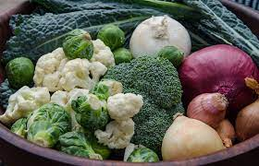
Planting New Plants
Good time to plant shrubs and trees
Good time to plant cool season veggies such as cabbage, broccoli, lettuce, radish, and some root crops.

Slide 9
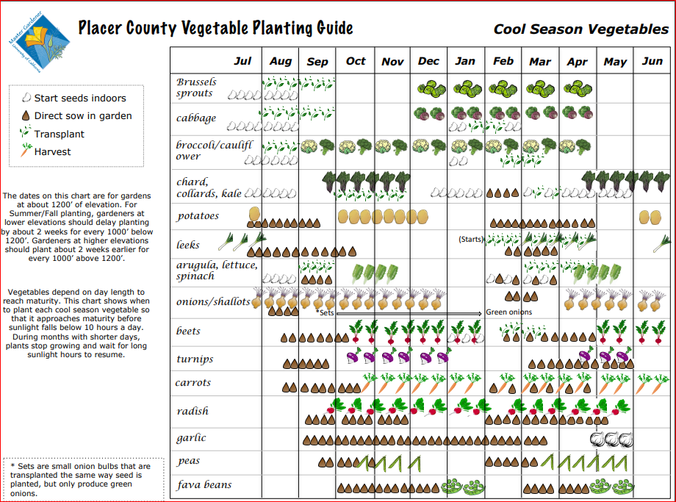

Slide 10
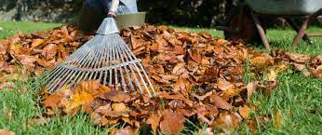
Get Your Lawn Ready for Winter
Deal with fallen leaves
01
Seed or lay sod
02
Cool temperatures is ideal condition for making repairs
Aerate your lawn to loosen compacted soil
03
Keep up with weeds
04
Raise your mower blade
05

Slide 11
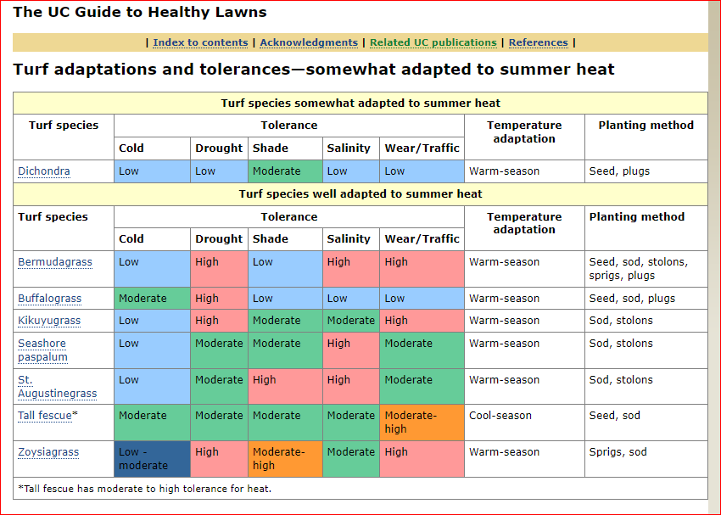

Slide 12
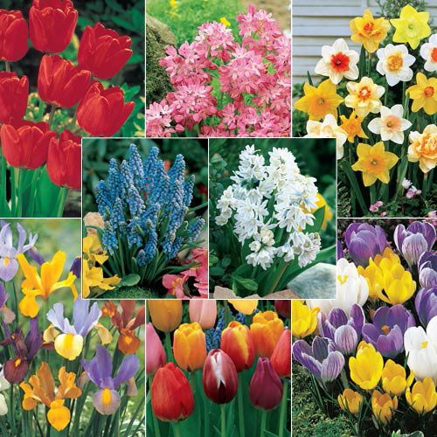
Prep the Perennial Garden
Remove
Remove weeds
Add
Add mulch
Plant
Plant ornamentals, trees, and spring bulbs
Dispose
Dispose of disease or pest-ridden plants
Monitor
Monitor the weather and if rainfall is below normal consider watering once per week.

Slide 13
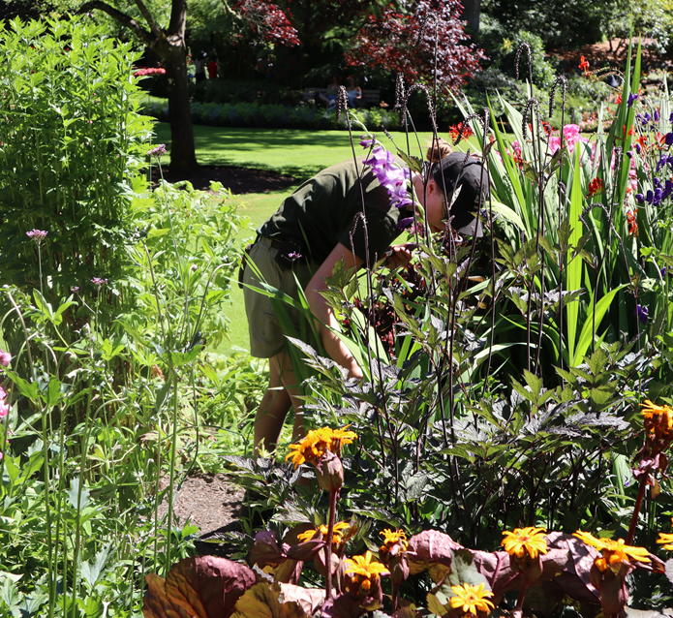
Refresh your Vegetable Garden for Next Year
Clean out
Finalize Harvest
Clean out beds
Put away
Put away stakes, labels and other accessories
Add
Add compost
A 2-3 inch thick layer of compost over your beds

Slide 14
Refresh your Vegetable Garden for Next Year
Plant cover crops like clover, vetch or peas to provide nitrogen when you turn it over in the spring.
Expand your planting space

Slide 15
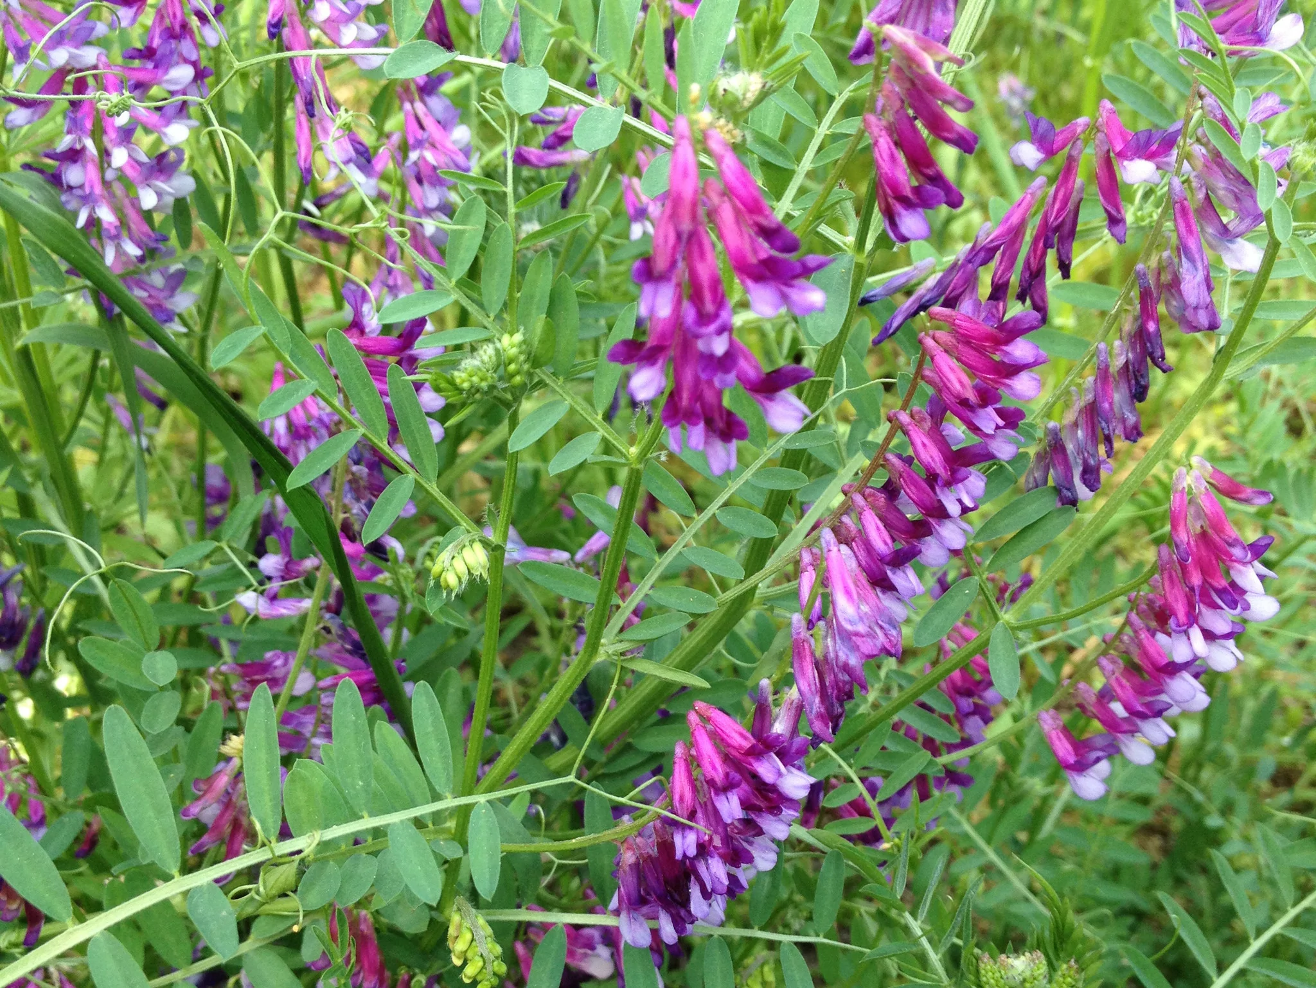
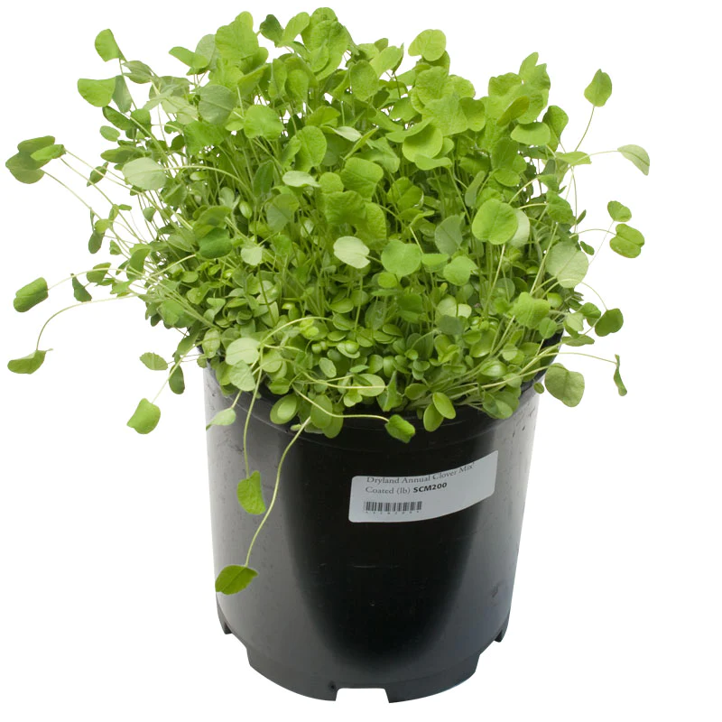
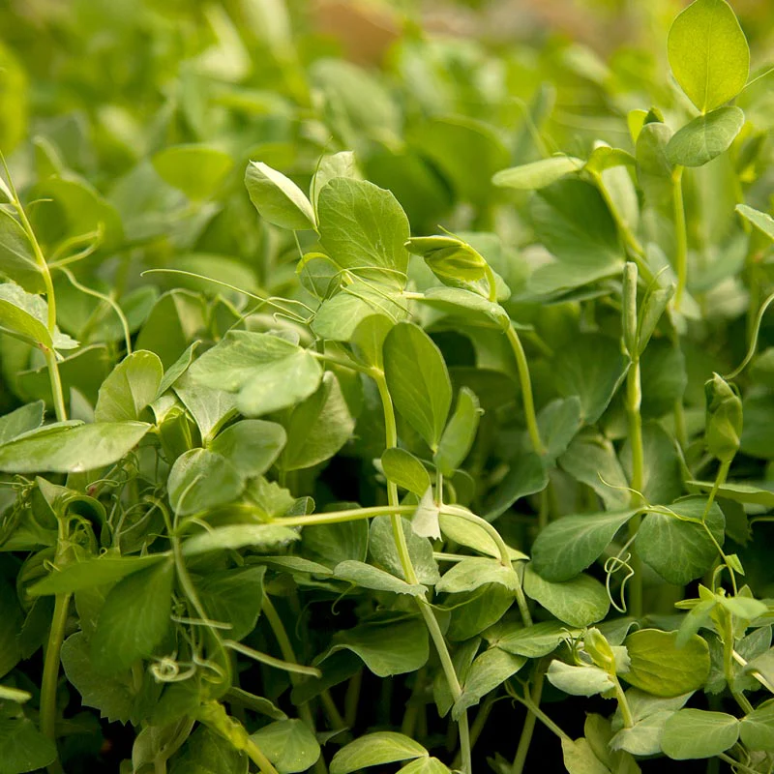
Vetch
Clover
Winter Edible Cover Crop:
Fava Beans (Bell Beans), Peas, Yellow Peas,
and Sugar Snap Peas

Slide 16
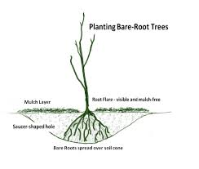
Care for Trees and Shrubs
Fall is an excellent time for planting
Provide adequate watering for newly planted shrubs, trees
May need to be watered daily the first month and 1-3 times per week during the establishment period

Slide 17
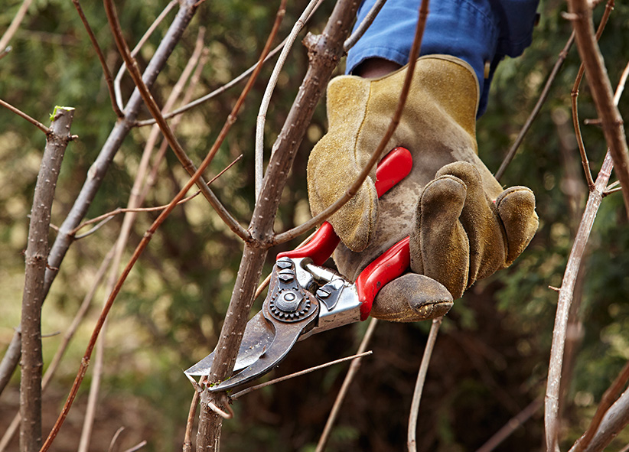
Care for Trees and Shrubs
Replenish mulch
Prune after dormancy starts

Slide 18
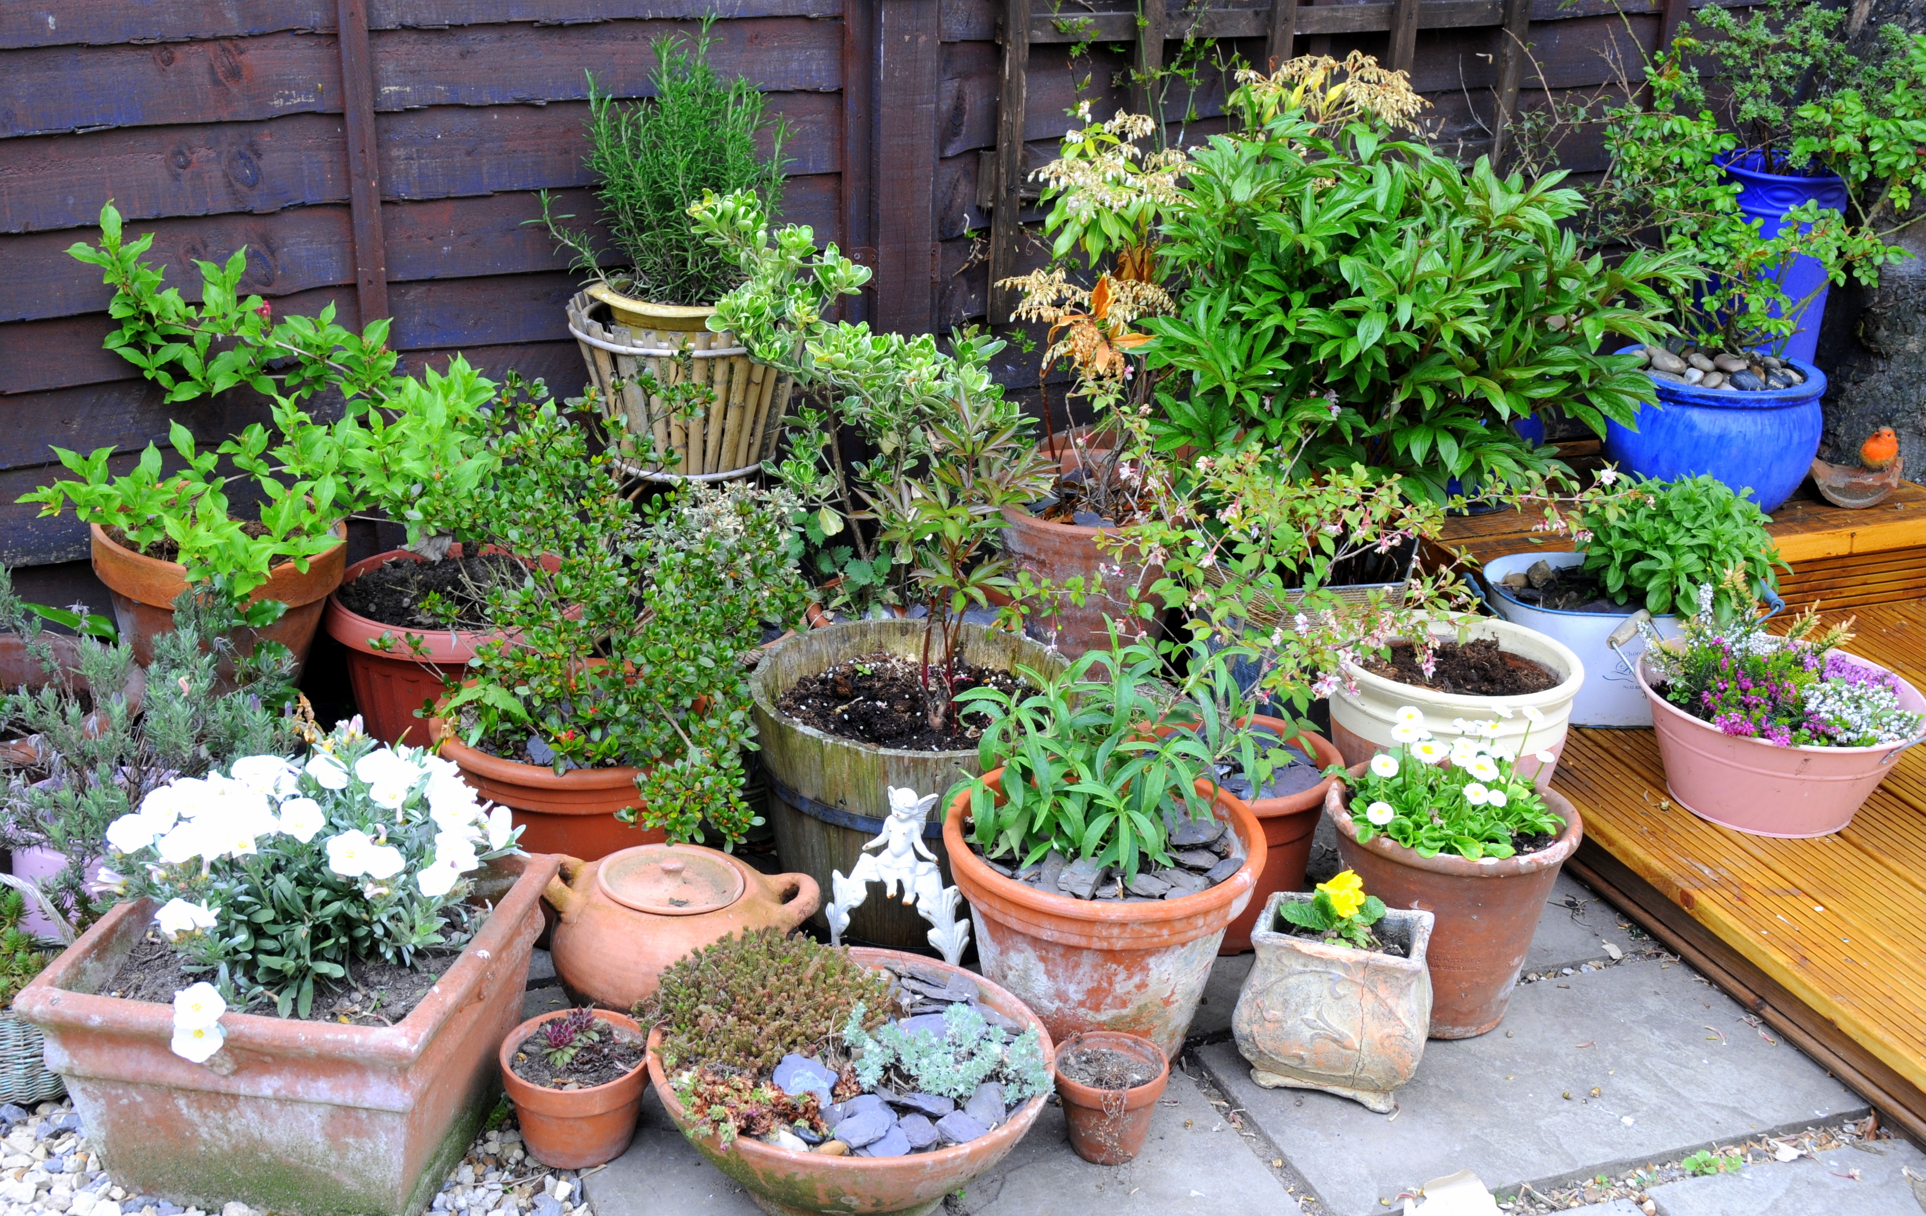
Clean up Annuals and Containers
Empty containers, and store in an area free from freezing temperatures
Clean out flower beds

Slide 19
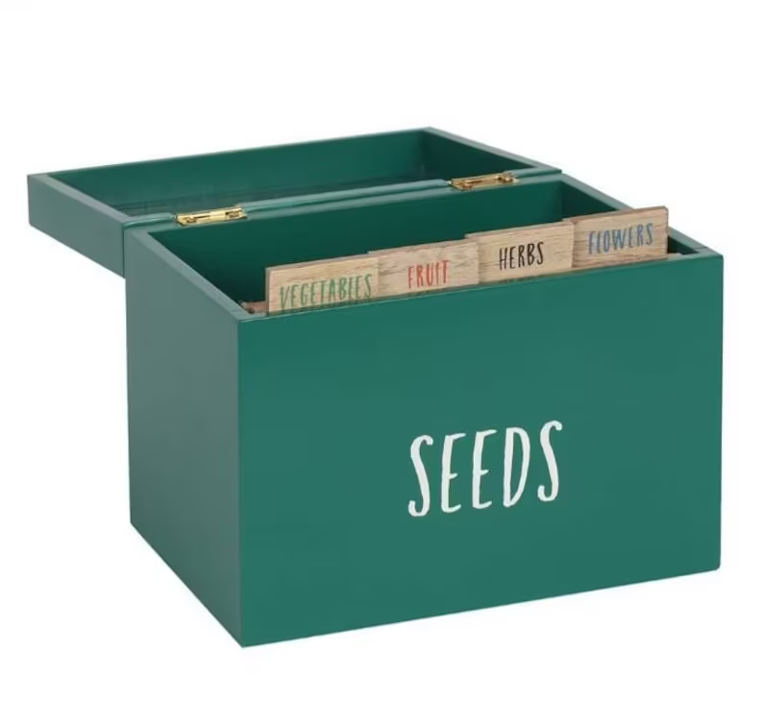
Clean up Annuals and Containers
Collect and store seeds
You can save seeds from celosia, petunia, cosmos and nasturtium for example
Label and store in a cool dry place
Take cuttings to grow indoors
Coleus, geraniums for example
Frost Plan

Slide 20
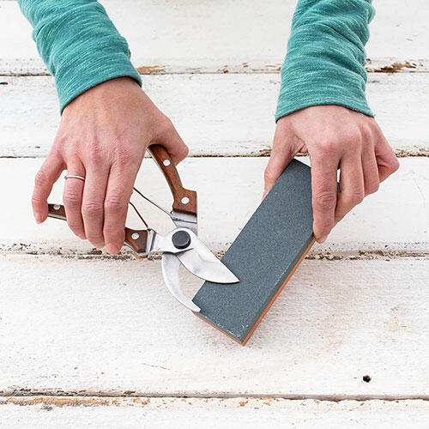
Organize Tools and Gardening Gear
Clean hand tools
Clean and Sharpen blades
Pruners and loppers can get dull with lots of use
Mower blades can be sharpened with a file to restore sharp edges
Store to prevent damage/rust

Slide 21
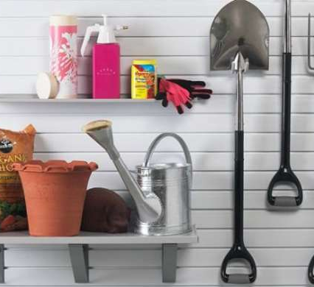
Organize Tools and Gardening Gear
Protect outdoor plumbing and hoses from freezing temperatures
Clean out sprayers
Store all chemicals, and fertilizers in a safe, dry location

Slide 22
Disposing of Pesticides and Fertilizers
Sewage treatment plants aren’t designed to treat toxic chemicals.
Pouring garden chemicals into a storm drain, down the sink, or in the toilet is never an option—and it is against the law!
The only allowable way to dispose of pesticides is to use them up according to label directions or to take them to a household hazardous waste site.

Slide 23
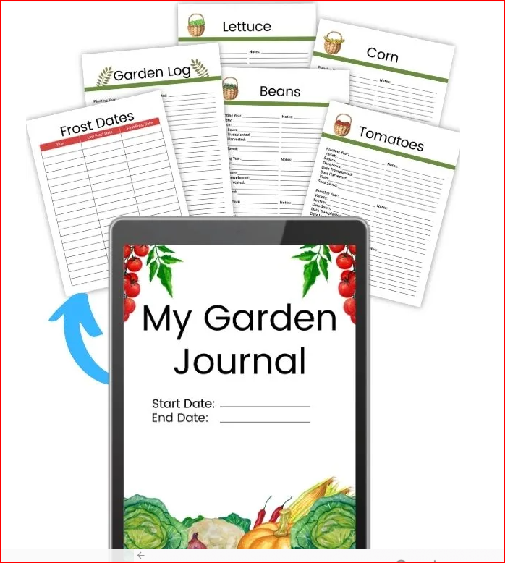
Record Your Season

Slide 24
References
California Master Gardener Handbook (2015) 2nd Ed, Dennis Pittenger, editor. University of California Division of Agriculture and Natural Resources.
Garden Chemicals: Safe Use and Disposal, UCANR Integrated Pest Mgmt. January 2003.
Placer County Vegetable Planting Guide. Retrieved from: https://pcmg.ucanr.org/2019_Calendar/Planting_Guide/, August 2022.
The UC Guide to Healthy Lawns. Retrieved from: http://ipm.ucanr.edu/TOOLS/TURF/TURFSPECIES/charhighht.html, August 2022.

Slide 25
Thank You!
Any Questions?
Master Gardener Hotline: (530) 889-7388
Rot Line: (530) 889-7399
Master Gardener Website: pcmg.ucanr.org
Evaluations, please!

