Slide 1
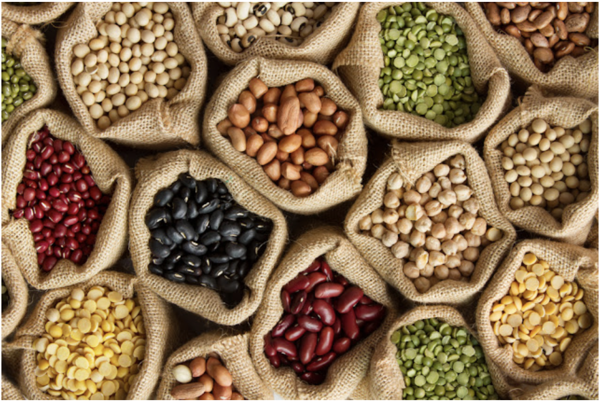
Lettuce Unite! Seed Libraries and Beyond
And the Loomis Seed Library
Notes:
Created: Presented 7/18 Loomis Seed Library Workshop. Adapted with Seed Library Information 1/22
Created by: Peggy Beltramo,
Audience: Vegetable gardeners and seed savers
Topic: Saving Seeds
Publicity: Lettuce Unite!
What is a seed library? How do I “borrow” seeds? How do I “return” seeds? What do I do with those seeds? Learn all about what a seed library is, how to save seeds successfully, and a little about how to grow a summer garden.
https://us02web.zoom.us/j/88426245389?

Slide 2
Who Are Master Gardeners?
Master Gardeners of Placer County
Extend research-based, sustainable gardening and composting information
Present accurate, impartial information to home gardeners
Encourage public to make informed gardening decisions

Slide 3
Who Are Master Gardeners?
Where to find us…
Online, in the Media, and Special Publications
Hotline: Call (530) 889-7388 or submit your questions online
Website: pcmg.ucanr.org
Facebook, Twitter, Instagram
Gold Country Media monthly column
Curious Gardener quarterly newsletter; email and on website
Gardening Guide and Calendar
Notes:
Point out hotline number and website. ON HANDOUT!

Slide 4
Who Are Master Gardeners?
Where to find us…YES!
Workshops, Fairs and Festivals and Special Events
Speakers by Request
Workshops (various venues, check website)
Farmers’ Markets (seasonal: Auburn, Roseville)
Fairs and Festivals Booths (varies)
Garden Faire (April)
Mother’s Day Garden Tour (May)

Slide 5
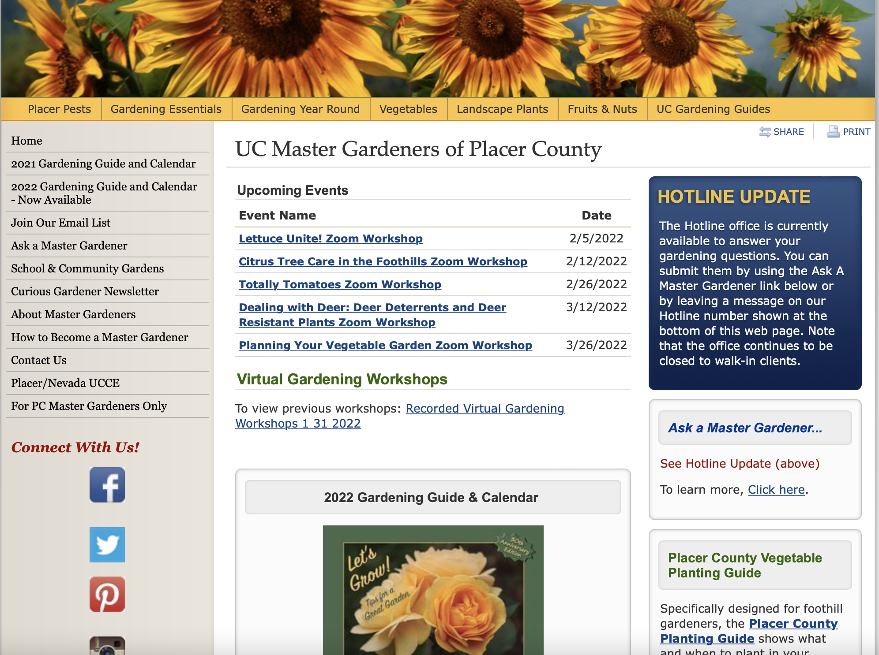
Who Are Master Gardeners?
pcmg.ucanr.org
Notes:
Red arrow = Videos of past workshops
Yellow arrow = where to find Veg guide

Slide 6

Let’s Look at your Handouts
Resources Page
Seed Chart
Six Tips for Saving Seeds
Easy Peasy Seeds
Available on pcmg website with recorded presentation.

Slide 7
Agenda
What is a seed library?
How do I ‘borrow’ seeds?
How do I ‘return’ seeds?
How do I save seeds?

Slide 8
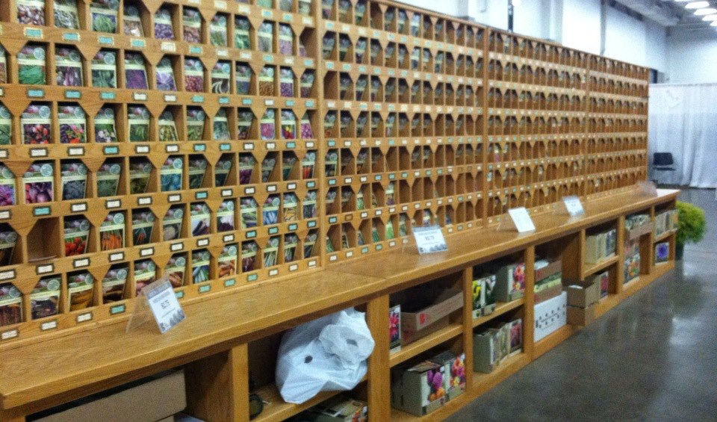
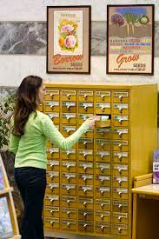
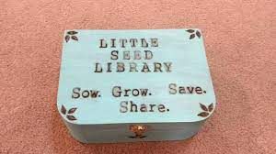
Agenda
What is a seed library?
From mammoth to lunchbox sized!

Slide 9
What is a seed library?
Loomis Seed Library

Slide 10
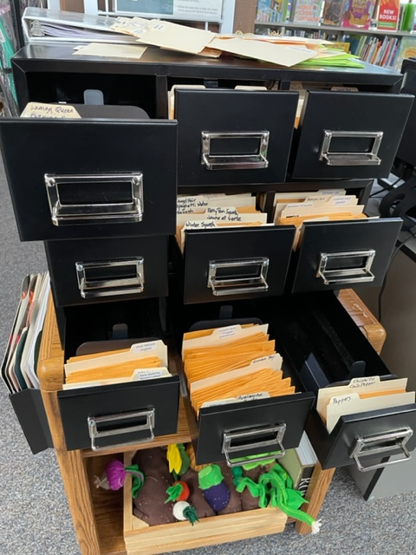
How do I ‘borrow’ seeds?
Drawers hold
seed packets
Spring = Warm Season veg.

Slide 11
How do I ‘borrow’ seeds?
Sign out seeds
Up to 5 packets

Slide 12
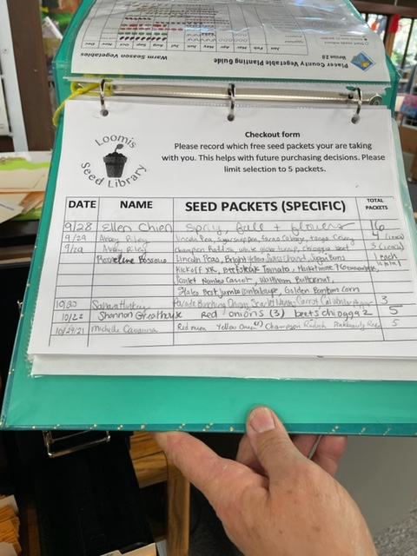
How do I ‘borrow’ seeds?
Enter information

Slide 13
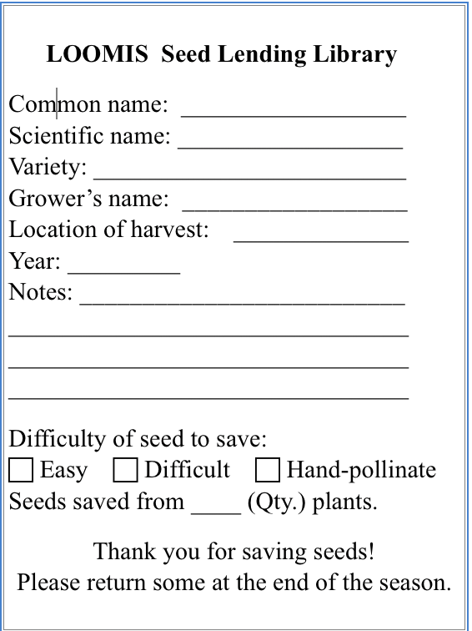
How do I ‘return’ seeds?
Easy as 1-2-3!
1.Follow seed saving protocols
2.Enter data on Seed Label
3.Return seed packet to library.
Returning Seeds is optional

Slide 14
How Do I Save Seeds?
OK
Let’s Get Started…

Slide 15
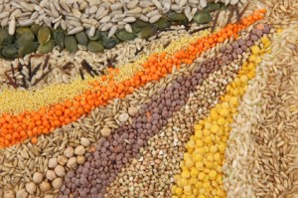
Agenda
Why Save Seeds?
What to Save?
Plan for Saving
How to Save?
Now let’s grow…
Berea College
Notes:
Agenda
Why Save Seeds?
What to save?
Where/When?
How to Save?
How to Grow?
Reference materials,For more information:
https://www.seedsavers.org/how-to-save-seeds
https://www.nationalgeographic.org/media/infographic-design/
https://www.nationalgeographic.org/media/infographic-design/
https://seedalliance.org/wp-content/uploads/2010/04/seed_saving_guide.pdf
https://afghanag.ucdavis.edu/other-topics/files/seeds/tomato-seed.pdf
https://asi.ucdavis.edu/sites/g/files/dgvnsk5751/files/inline-files/pepperproject-savepepperseeds_0.pdf

Slide 16
Why Save Seeds?
The beauty of seeds is rivaled only by their purpose.
Within the confines of the seed coat, every seed
holds a connection to the future and to the past.
The embryonic plant that rests within a seed contains
not only the promise of what is to come as it is nurtured
and grows from a young seedling into a mature plant,
but also the history and traits that properly saved seeds
pass down from generation to generation.
From The Seed Garden: The Art and Practice of Seed Saving
Notes:
The Seed Garden: The Art and Practice of Seed Saving. Buttala, Lee et. al. Seed Savers Exchange. 2021
a deeper understanding of the art, the science, and the joy of saving seeds.

Slide 17
Why Save Seeds?
Cultivate locally adapted plants
Preserve natural diversity
Protect heirloom varieties
Get free seeds
Create new varieties?
By choice or accidentally.
Good thing or not…..
Notes:
Seed saving is the process of saving seeds from open-pollinated fruit, vegetables, grains, flowers, and herbs.
Traditional agriculture relied on saved seed for next year’s crops.
Recent influx of large seed companies
Grow plants identical to the parent plants (which are genetically identical) Hybrid varieties are cross pollinated between two species of a particular genus of plant. The next generation will not come true to those parent plants.
Plusses
Free seeds
Chosen varieties
Local adaptation
Minuses
Seed crossing—isolation distances
Seed care—Viability
https://www.seedsavers.org/how-to-save-seeds

Slide 18
What to Save?
Gardeners Choose
Taste and Texture
Productivity
Bearing-early, late
Disease/pest resistance
Drought tolerance
Slow bolting (temperature)
Notes:
select desirable traits: plant vigor, taste, drought tolerance, early or late bearing, productivity, slow bolting (important in hot climates), disease resistance (E.g. nematodes),

Slide 19
What to Save?
Corporations Choose
Uniformity
Storage life
Shipping stability
Cosmetic values
Notes:
Corporations choose: uniformity, storage life; shipping stability
Market needs: shelf life; cosmetic values,

Slide 20
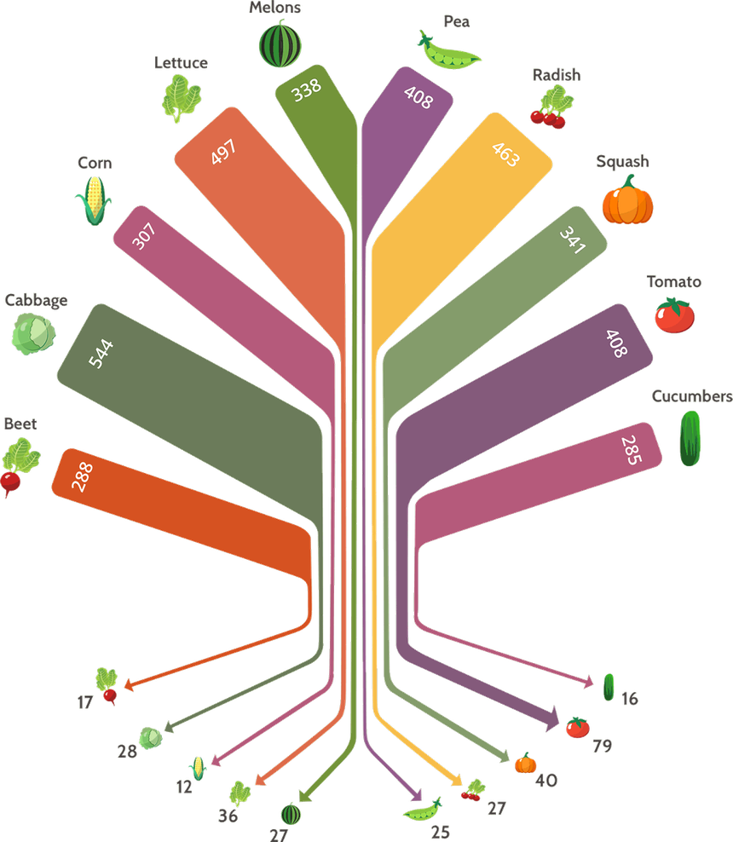
Loss of Seed Variety
TOP = 1903
3,879 choices
Width equals
number of varieties
BOTTOM = 1983
307 choices
(8%)
Graphic courtesy of National Geographic Magazine
Notes:
Graphic difficult to read, but note the width of each “branch”. It represents the volume of varieties. Wide blades at the top—tiny threads at the bottom!
1903 Top of graphic
1983—80 years later Bottom of Graphic
Shows loss of diversity
Minimum in 1903=285 cucumber
Maximum in 1983=79 tomatoes
e.g. CABBAGE went from 544 choices to 28
https://www.nationalgeographic.org/media/infographic-design/

Slide 21
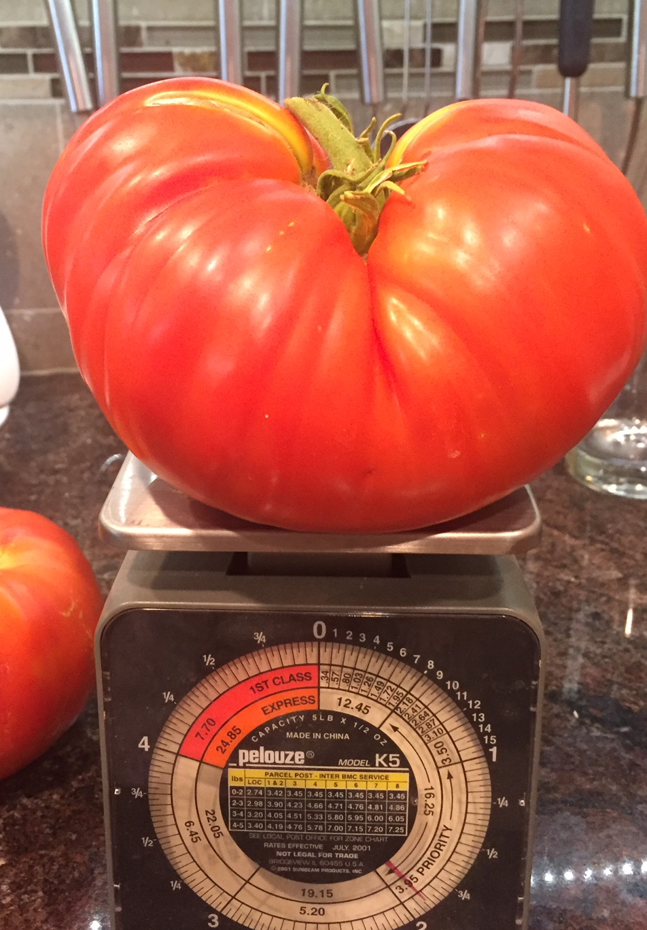
Know Your Parent Plant
Open Pollinated
vs.
Hybrid
1.8 lb. Brandywine heirloom tomato
Photo/tomato Ingrid Elsel
Notes:
Open Pollinated Seeds not hybrids
• Many traditional varieties are open-pollinated. This term is commonly used for what is really controlled pollination, where plants have been in-bred for several generations and have a stable genetic make-up, and out-crossing from different varieties is prevented.
• Seed saved from such “open-pollinated” crops will breed true to type.
Hybrid Seeds
• Many varieties of vegetables and fruits are “hybrids”. This is often designated by a F1 appearing after the variety name. Hybrid varieties tend to have favorable characteristics like high yield, good color, disease, or fruit uniformity.
Hybrids are produced from crosses between two distinct, inbred parent lines. The seed from hybrid plants is not usually saved for future plantings, because it does not produce plants that are true to the original hybrid variety you planted
annual vs. biennial
* Many vegetables are annuals, which produce their seed in one year. Annuals, such as tomatoes, lettuce, beans and peas are good candidates for your first seed-saving project. They are generally self- pollinating, and their seeds will produce plants like the parent plant.
https://www.nationalgeographic.org/media/infographic-design/

Slide 22
Know Your Parent Plant
Open Pollinated vs. Hybrid
Open-pollinated plants
Have stable genetic makeup
Breed true-to type
Hybrid plants
Produced by crossing
two distinct parent lines
Often labeled F1
Notes:
Open Pollinated Seeds not hybrids
• Many traditional varieties are open-pollinated. This term is commonly used for what is really controlled pollination, where plants have been in-bred for several generations and have a stable genetic make-up, and out-crossing from different varieties is prevented.
• Seed saved from such “open-pollinated” crops will breed true to type.
Hybrid Seeds
• Many varieties of vegetables and fruits are “hybrids”. This is often designated by a F1 appearing after the variety name. Hybrid varieties tend to have favorable characteristics like high yield, good color, disease, or fruit uniformity.
Hybrids are produced from crosses between two distinct, inbred parent lines. The seed from hybrid plants is not usually saved for future plantings, because it does not produce plants that are true to the original hybrid variety you planted
annual vs. biennial
* Many vegetables are annuals, which produce their seed in one year. Annuals, such as tomatoes, lettuce, beans and peas are good candidates for your first seed-saving project. They are generally self- pollinating, and their seeds will produce plants like the parent plant.
https://www.nationalgeographic.org/media/infographic-design/

Slide 23
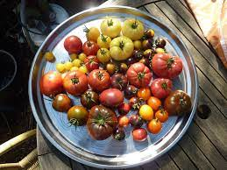
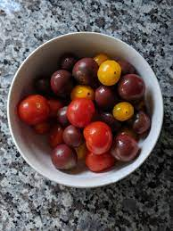
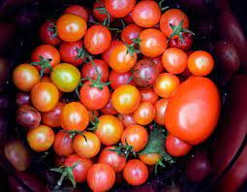
Know Your Parent Plant
Open Pollinated
Notes:
Open Pollinated Seeds not hybrids
• Many traditional varieties are open-pollinated. This term is commonly used for what is really controlled pollination, where plants have been in-bred for several generations and have a stable genetic make-up, and out-crossing from different varieties is prevented.
• Seed saved from such “open-pollinated” crops will breed true to type.
https://www.nationalgeographic.org/media/infographic-design/

Slide 24
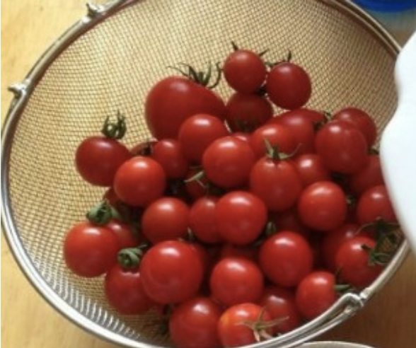
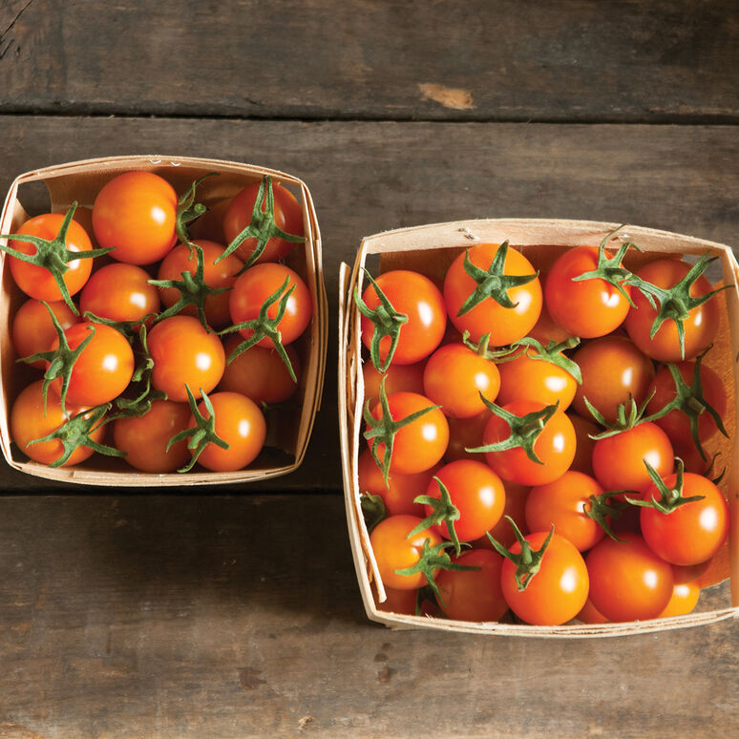
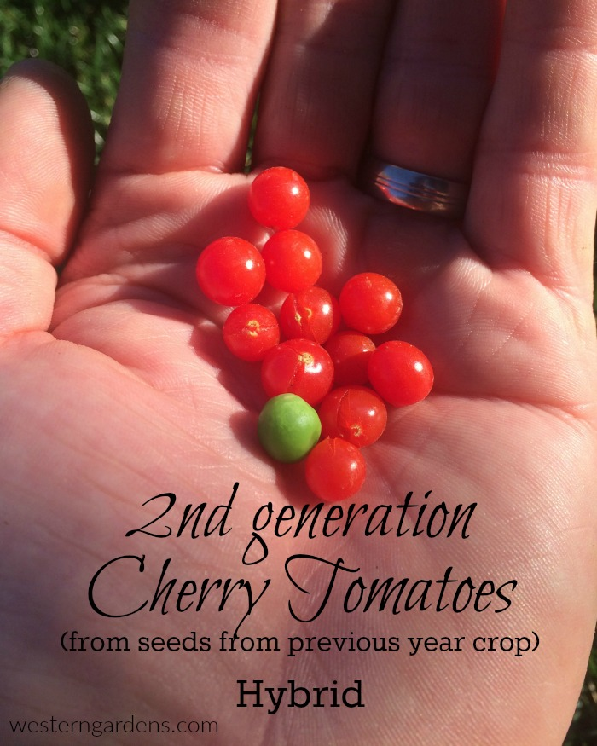
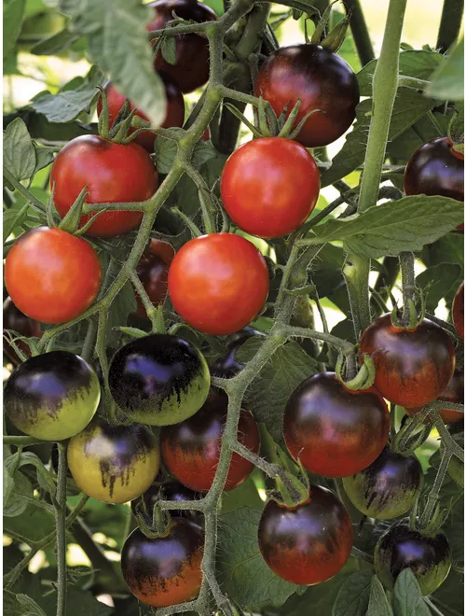
Know Your Parent Plant
Hybrid
Hybrid seed
Sungold
Not like last year!
Year 2
Midnight Snack
Notes:
Save open Pollinated Seeds not hybrids
• Many traditional varieties are open-pollinated. This term is commonly used for what is really controlled pollination, where plants have been in-bred for several generations and have a stable genetic make-up, and out-crossing from different varieties is prevented.
• Seed saved from such “open-pollinated” crops will breed true to type.
Hybrid Seeds
• Many varieties of vegetables and fruits are “hybrids”. This is often designated by a F1 appearing after the variety name. Hybrid varieties tend to have favorable characteristics like high yield, good color, disease, or fruit uniformity.
Hybrids are produced from crosses between two distinct, inbred parent lines. The seed from hybrid plants is not usually saved for future plantings, because it does not produce plants that are true to the original hybrid variety you planted
annual vs. biennial
* Many vegetables are annuals, which produce their seed in one year. Annuals, such as tomatoes, lettuce, beans and peas are good candidates for your first seed-saving project. They are generally self- pollinating, and their seeds will produce plants like the parent plant.
https://www.nationalgeographic.org/media/infographic-design/

Slide 25
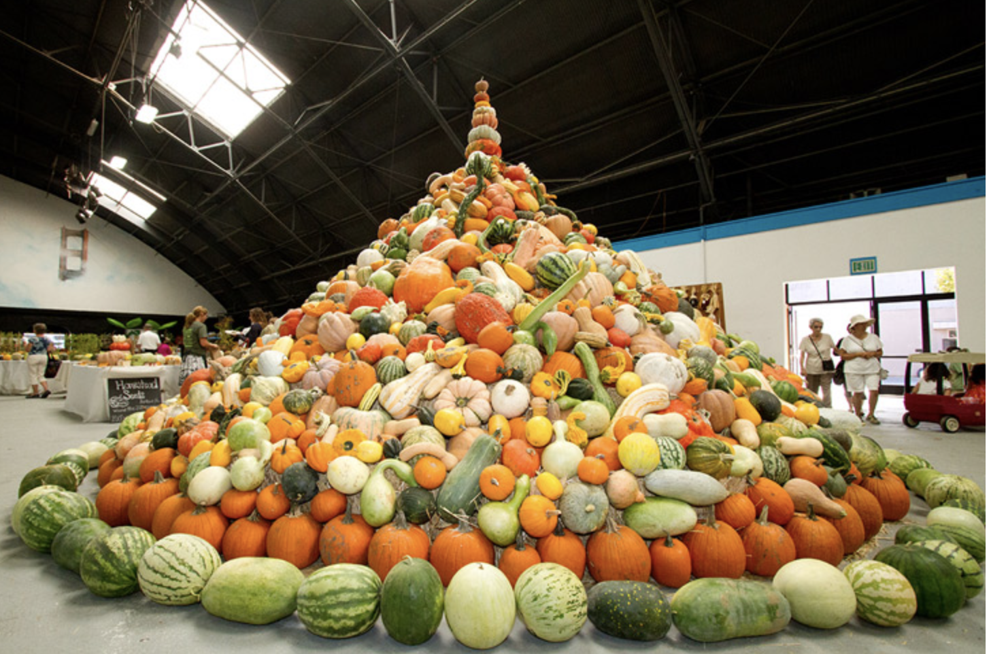
Know Your Parent Plant
Heirloom Varieties

Slide 26
Plan for Seed Saving
Start with easy crops
Grow enough plants
Put space between varieties
Easy Peasy Seeds Handout
Notes:
Start with easy crops. Grow enough for eating and saving seeds. Check isolation distances.

Slide 27
Easy Peas-y
Peas,
Beans,
Lettuce,
Tomatoes,
Arugula - (crosses with wild arugula weeds),
Dill - (crosses with wild dill weeds)
Watch videos
on saving Peas and Beans and Lettuce
to help you get started. (Resource sheet)
Notes:
Super Easy: Easy Peas-y HANDOUT
These seeds can most reliably be saved by the home gardener, even if you've never saved seeds before. Watch our videos on Peas and Beans and Lettuce to help you get started. (Richmond Grows)
Peas
Beans
Lettuce
Tomatoes
Arugula - can cross with wild arugula
Dill - can cross with wild dill

Slide 28
Now, let’s look at the Saving Seeds chart

Slide 29
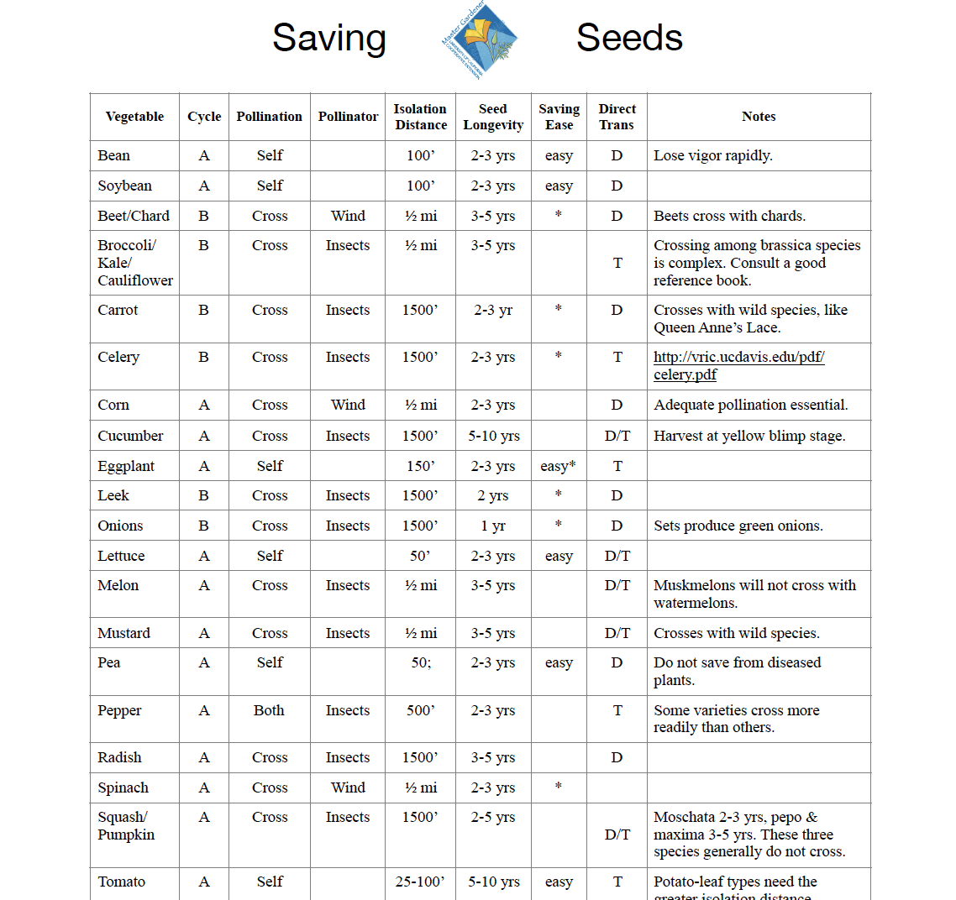
Download
Notes:
Self pollinating plants= Super Easy Yellow arrow
Isolation distances shown within oval
Some crops require 1/2 mile spacing
Chart photo does not have tomatoes (photo sizing limit)
Many tomatoes are hybrids—do not “come true”.
Self-pollinated vegetables usually grow true. There is minimal risk of cross-pollination because the pollen from the male part of the flower (called the anther) usually falls directly on the female part of the flower (called the stigma) with little room for error or cross pollination.

Slide 30
How to Save Seeds
Know when seeds are mature
Collect your bounty
Store safely

Slide 31
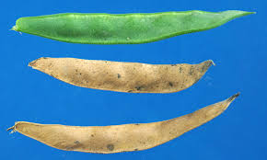
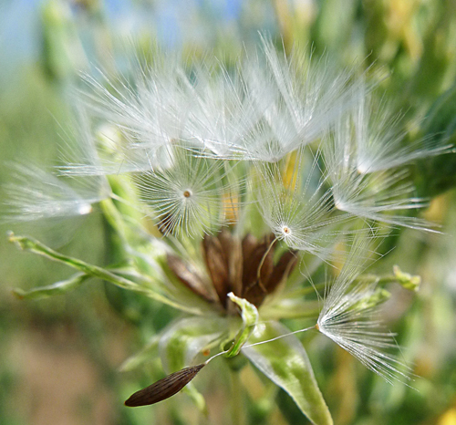
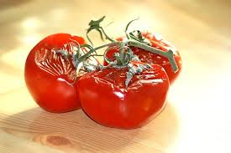
Mature Seeds
Bean seeds
Lettuce seeds
Tomatoes

Slide 32
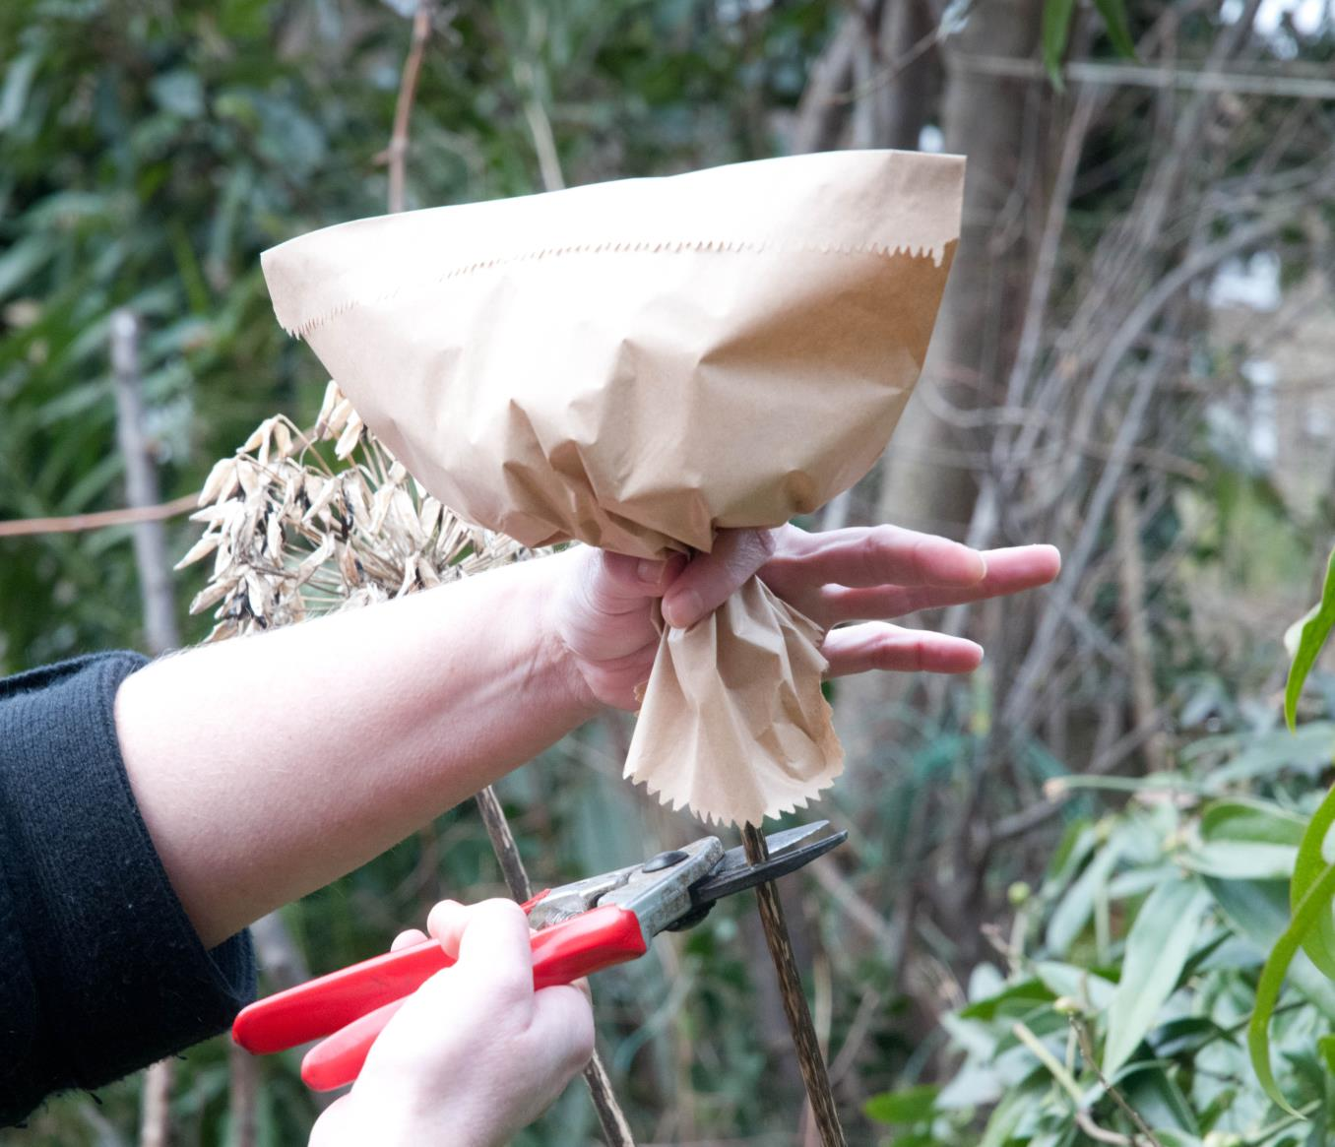
Bag Fragile Seeds

Slide 33
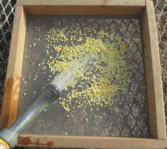
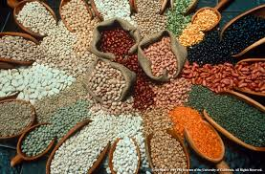
Save Your Seeds
Dry Seed Saving
Decanting Seeds
Notes:
Dry Seed Saving Method
Beans, peas, onions, carrots, corn, most flowers and herb seeds are prepared by a dry method.
•Allow the seed to mature and dry as long as possible on the plant.
•Complete the drying process by spreading on a screen in a single layer in a well-ventilated dry location.
*As the seed dries the chaff or pods can be removed or blown gently away. An alternative method for extremely small or lightweight seed is putting the dry seed heads into paper bags that will catch the seed as it falls out.
*Decant seeds to remove chaff and separate viable seeds
Decanting Seeds
Decanting separates viable (living seeds) from unviable (dead) seeds; often seed savers decant after also soaking or rinsing seeds.
Put the seeds and pulp in a big container and cover with about four times as much clean water.
Put your hand in and rub the pulp and seeds around a bit to loosen things up. Wait a few minutes and you will see that good seeds sink to the bottom and dead, lightweight seeds float to the top.
Skim off the dead seeds and any pulp from the top.
Pour the water and good seeds through a screen or strainer and then start over with new water, following the process another 3-6 times until the seeds are clean.

Slide 34
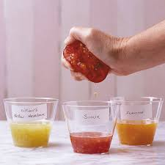
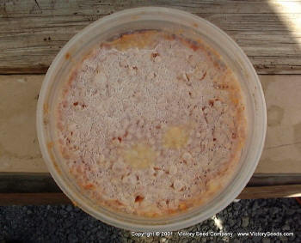
Save Your Seeds
Fungus layer
Decanting Seeds
Wet Seed Saving
Notes:
Cut each tomato into half at its equator, opening the cavities that contain the seeds. Gently squeeze out the jelly-like substance that contains the seeds (Fig. 3). Place the jelly and seeds into a small container for fermentation; add a little water if you are processing only one or two small tomatoes. Loosely cover the container and place in a warm place (around 25–30 °C) for 1–2 days, stirring daily.
A layer of fungus will begin to appear on the top of the mixture after a couple of days. This fungus not only destroys the gelatinous coat that surrounds each seed to prevent germination, it also produces antibiotics that help to control seed-borne diseases such as bacterial spot, canker, and speck.
After fermentation, fill the seed container with water. Let the con- tents settle and begin pouring out the water along with pieces of tomato pulp and immature seeds float- ing on top. Viable seeds are heavier and will settle to the bottom of the container. Repeat this process until water being poured out is almost clear and clean seeds line the bot- tom of the container (Fig. 4). Pour these clean seeds into a fine-mesh strainer. Let the excess water drip out and invert the strainer onto pa- per towel, fine mesh, or newspaper.
https://afghanag.ucdavis.edu/other-topics/files/seeds/tomato-seed.pdf

Slide 35
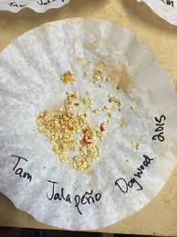
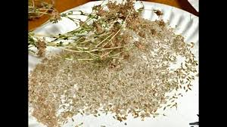
Dry Your Seeds
Notes:
drying your seeds
Moisture is a seed savings worst enemy. Be sure to finish drying them completely. Drying the seeds thoroughly is extremely important and if it isn’t done well then your seeds are much less likely to germinate next year and are susceptible to mold, fungus and bacteria.
Here are the steps for drying seeds:
1. Spread seeds out on a screen or tray in a warm (not above 95°F), dry place that has good air flow.
2. If there isn’t a lot of air flow, set up a gentle fan near the seeds. 3. Stir the seeds occasionally so that they dry on all sides.
https://seedalliance.org/wp-content/uploads/2010/04/seed_saving_guide.pdf

Slide 36
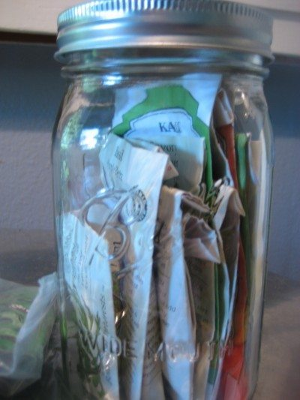
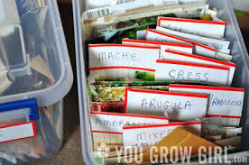
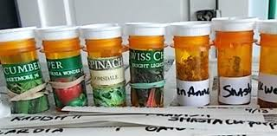
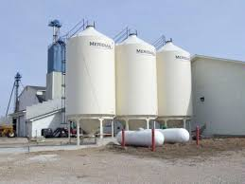
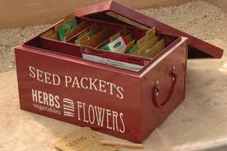
Store Seeds Safely
Notes:
Recycled containers Fancy collections For HUGE amounts!
label and store your seeds
▪ After allowing the seed to dry, funnel the seeds into small paper bags, small glass jars, sealable bags, or other moisture-proof containers.
▪ Clearly label with the date, species and the variety.
▪ Store your seed packets in a cool, dry, dark location until
you are ready to plant.
▪ If stored seed becomes moist and warm, some may begin to germinate or become moldy and contaminated with pathogens. A kitchen freezer is an ideal location for storing seed.
https://asi.ucdavis.edu/sites/g/files/dgvnsk5751/files/inline-files/pepperproject-savepepperseeds_0.pdf

Slide 37
Sharing Seeds
Notes:
Loomis Library Seed Library—library patrons can request seeds, and pick them up curbside. In non-Covid times, seed swaps are a yearly community event.

Slide 38
Seed Saving Rules
Plan for food AND seed
Know the seed saving rules!!!
Not Hybrid varieties!
Start with Easy-Peasy
Seed chart advice
Proper cleaning, drying, storage
Notes:
Loomis Library Seed Library—library patrons can request seeds, and pick them up curbside. In non-Covid times, seed swaps are a yearly community event.

Slide 39
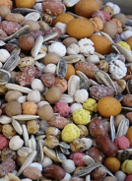
Let’s Recap…
Saving seeds allows:
More choices
Varieties you enjoy
Plants adapted to your garden

Slide 40
Growing Vegetables
pcmg.ucanr.org
Notes:
Do you remember this slide from the beginning of this presentation? Our Master Gardener Home page.
The red arrow is our You Tube channel. You can watch a video about growing a warm season garden here. It will help you get your veggies up and growing!
The blue arrow points to the section where you can access our Placer County Planting Guide
Next slide…

Slide 41
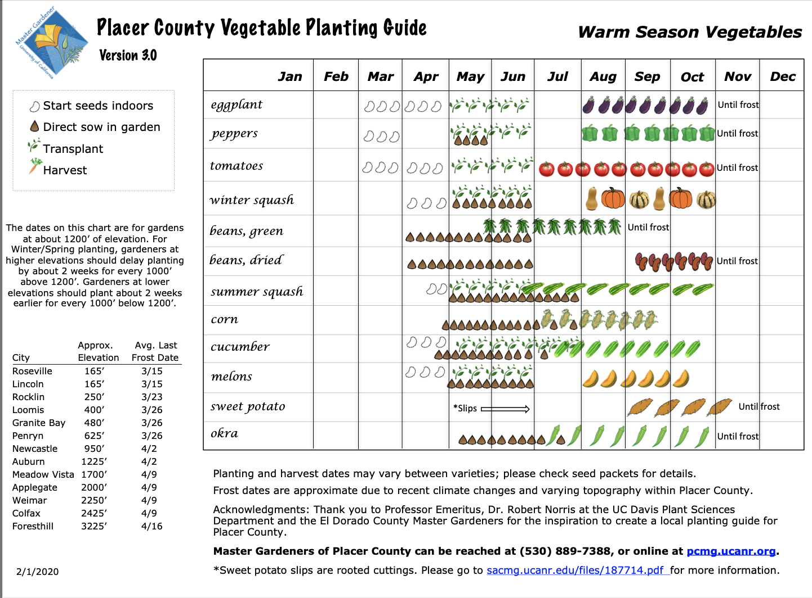
Growing Vegetables
Download
pcmg.ucanr.org
Notes:
Placer County Planting Guide
This is the Warm Season planting guide. The cool season is page two of the document.
We stress warm season, cool season garden, not summer-winter because WHEN you start your seeds may NOT be winter! Or SUMMER! You need to get a head start…
Red arrow is the icon explanation. Start indoors (bean icon)and transplant into garden, as well as direct sow (chocolate chip), and when to expect your harvest.

Slide 42
Thank You!
Any Questions?
Master Gardener Hotline: (530) 889-7388
Master Gardener Rot Line: (530) 889-7399
Master Gardener Website: pcmg.ucanr.org

Slide 44
In Closing
???
Let’s consider this a journey we are embarking upon together, We will learn as we go—
From the plants
From each other
and from our ‘mistakes’
This is an adventure we can share.
Come back and tell us how your journey went.
We will have stories to tell, too.
Notes:
Let’s consider this a journey we are embarking upon together, We will learn as we go—
From the plants
From each other
and from our ‘mistakes’
This is an adventure we can share.
Come back and tell us how your journey went.
We will have stories to tell, too.

Slide 45
Seed Saving Questions
Is this plant a hybrid or an open pollinated variety?
Is this a plant I should save seed from?
How far does this plant need to be planted from others to “breed true” or does this plant need others to be properly pollinated (think “self-pollinated” vs needing “cross pollination”)?
Where/when do the seeds form on this plant?
How are the seeds naturally dispersed?
When are the seeds ripe?
Was the plant that you want to save seed from healthy?
How do you clean the seeds? Dry, ferment, etc.
Store your seeds in a cool dry place.
Don't save them for too long. Check the viability chart.
Don't give up!
Notes:
Is this plant a hybrid or an open pollinated variety?
Is this a plant I should save seed from?
How far does this plant need to be planted from others to “breed true” or does this plant need others to be properly pollinated (think “self-pollinated” vs needing “cross pollination”)?
Where do the seeds form on this plant?
How are the seeds naturally dispersed?
When are the seeds ripe?
Was the plant that you want to save seed from diseased?
How do you clean the seeds? Dry, ferment, etc.
Store your seeds in a cool dry place.
Don't save them for too long. Check the viability chart.
Don't give up!

Slide 46
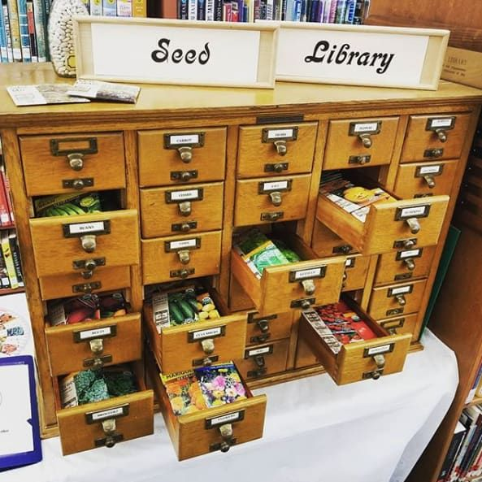

Slide 47

Thank You!
Any Questions?
Evaluations, Please!
Master Gardener Hotline: (530) 889-7388
Master Gardener Rot Line: (530) 889-7399
Master Gardener Website: pcmg.ucanr.org

