Slide 1
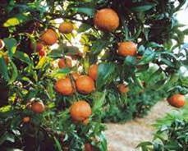
Growing Mandarins in the Foothills

Slide 2
Who Are Master Gardeners?
Master Gardeners of Placer County
Extend research-based, sustainable gardening and composting information
Present accurate, impartial information to home gardeners
Encourage public to make informed gardening decisions

Slide 3
Who Are Master Gardeners?
Where to find us…
Online, in the Media, and Special Publications
Hotline: Call (530) 889-7388 or submit your questions online
Website: pcmg.ucanr.org
Facebook, Twitter, Instagram
Gold Country Media monthly column
Curious Gardener monthly newsletter and on our website
Calendar and Gardening Guide

Slide 4
Who Are Master Gardeners?
Where to find us…
Workshops, Fairs and Festivals and Special Events
Speakers by Request
Workshops (various venues, check website)
Farmers’ Markets (seasonal: Auburn, Roseville, Lincoln)
Fairs and Festivals Booths (varies)
Garden Faire (April)
Mother’s Day Garden Tour (May)

Slide 5
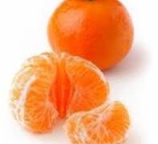
Overview
Mandarins are among the most cold-tolerant citrus
Second only to kumquats
Mandarin production flourishes at elevations from about 400-1000 feet
About 90% of commercial production is the Owari Satsuma mandarin, which are sweet, seedless and easy to peel
Owaris are usually harvested from Nov – Jan
Okitsu Wase Satusma is similar to Owari, but ripens 1-2 weeks earlier
A few other varieties of Satsumas and Clementine mandarins are also produced

Slide 6
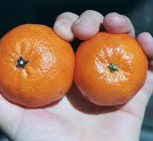
Overview (cont’d)
Mandarins make up the largest and most varied group of citrus
All loose skinned, cold-hardy citrus are mandarins, including what we call tangerines (a marketing term)
Mandarins are high in vitamins A, C and thiamin, and are a good source of calcium and potassium
Mandarins contain lots of synephrine (a natural antihistamine)
They store well in a cool place (60-70 degrees F) for up to one week
Store in refrigerator only if you need to keep them longer, as colder temperatures may alter their flavor

Slide 7
Site Selection & Soil
Plant on ridgetops or south-southwest facing upper slopes with good cold air drainage and shelter from strong winds
Full sun (6-8 hours) is required for good flowering and fruit production
For home planting, place next to south-facing cement or stone walls to mitigate cold
Plant in 12-18 inches of well-drained soil with a PH of 6.0 – 7.0
They do not tolerate wet feet and are susceptible to Phytophthora root disease when overly wet

Slide 8
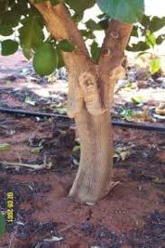
Root Stock
Trifoliate rootstocks are usually used for cold tolerance, fruit quality, disease resistance and semi-dwarfing qualities
Buy certified trees from a reputable nursery to ensure the trees are certified disease-free and true-to-type
If you buy from another county, your county Ag Commissioner must inspect them before you plant

Slide 9

Planting
Plant in spring after frost danger is past (March-April)
Consider planting in a raised berm to help ensure good drainage
Dig a hole as deep as the height of the root ball and twice the width
Do not amend the hole with fertilizer or manure
Plant with the crown several inches above the soil
Be sure the crown does not settle below the soil line

Slide 10
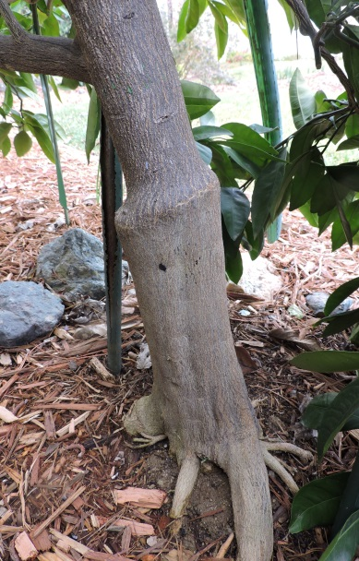
Planting (cont’d)
If possible, place bud union away from sun
Backfill with original soil and tamp well
Spread compost or mulch on the soil surface
Keep it 2-4 inches away from the trunk
To protect from sunburn, whitewash trunk
Use a 1:1 solution of white interior latex paint and water
If tree is tall and spindly, top prune to promote side shoots
Water well after planting

Slide 11
Watering
Water often during first season when the top 6-8 inches of soil begins to dry
Frequency will depend on soil type
Wet soil to depth of 18 inches
Keep roots moist but NOT wet
Allow to nearly dry before next watering
Once established, water under drip line (away from trunk)
Water before temperatures are expected to be about 95 degrees F for several days
If leaves feel warm, tree is starting into drought stress

Slide 12
Fertilizing
Citrus grown in the Foothills normally need regular feedings of Nitrogen, and may need other nutrients as well
For the first year, use about 2 ounces of nitrogen per year per tree, spread out monthly from March – June
Increase the amount as the tree ages and grows (refer to publication 31-018C)
From the 4th year on, each tree requires about 1 pound of nitrogen per year
Apply most of the nitrogen in spring, starting after heavy rains have tapered off
Do not apply nitrogen after July as late applications can adversely affect fruit quality
If you have frost damage, reduce watering and fertilizer

Slide 13
Fertilizing (cont’d)
Nitrogen deficiency
Causes leaves to yellow, starting with older leaves and moving to younger growth
Yellowing in winter is normal – cold, wet soil inhibits nitrogen from being used
Can also cause poor flowering and stunted growth
Severe deficiency can cause leaf drop
Too much nitrogen can adversely affect fruit quality
Phosphorus and Potassium may also be needed yearly
Bone meal is a good source of phosphate

Slide 14
Fertilizing (cont’d)
Here is what I do:
March through June – apply a balanced fertilizer monthly (e.g. 5,5,5 or blood meal)
July through September – apply a low nitrogen fertilizer monthly
October through February – no fertilizer

Slide 15
Frost Protection
Mature Satsuma mandarins can tolerate temperatures down to 20 degrees F
Young trees, stressed trees and trees with fruit are less cold tolerant
Pick ripe fruit before risk of frost
Irrigate well before frost – wet soil helps maintain soil temperature and moderates air temperature above it
Cover young trees entirely with burlap, row cover or plastic
Do not touch foliage
Use old style Christmas lights (not LED lights)
After freeze, remove any frozen fruit

Slide 16
Pruning
Prune after risk of freeze, but well before heat starts (usually sometime in early to mid March)
Keep pruning on young trees to a minimum
Do not cover pruning wounds
Do not damage the branch collar when pruning
Prune low growth to keep off the ground
Remove crossing branches or branches that shade out lower branches
Prune downward growing shoots to allow upward buds to become dominant (cut just above an upward pointing bud)
Every 2-3 years, take out some center growth to add sun and air circulation
You should be able to see some dappled sunlight under the tree

Slide 17
Pruning (cont’d)
Do not prune frost damage until spring, when weather warms
Prune suckers (any growth below bud union), water sprouts and dead or damaged wood anytime
Lop water sprouts at base of branch (just above bud union)

Slide 18
Pest Management
Mandarins can be subject to a number of pests, such as scale, aphids, mites, thrips, leaf miners and mealybugs
Healthy trees typically require no pest management
Refer to reference on citrus pest management
If soil drainage is good, mandarins have very few problems due to disease

Slide 19
References and Resources
Avoiding Cold Damage to Citrus, Cindy Fake. UCANR Publication 31-15C, December 2009.
https://ucanr.edu/sites/placernevadasmallfarms/files/135464.pdf
Citrus Pest Management, Cindy Fake & Lucy Wilson. UCANR Publication 31-013C, November 2008.
https://ucanr.edu/sites/placernevadasmallfarms/files/135463.pdf
Fertilizing Citrus in the Foothills, Cindy Fake. UCANR Publication 31-011C, January 2004.
https://ucanr.edu/sites/placernevadasmallfarms/files/63814.pdf
Growing Citrus in the Sierra Nevada Foothills, Cindy Fake. UCANR Publication 31-018C, March 2010.
https://ucanr.edu/sites/placernevadasmallfarms/files/63813.pdf
A Mandarin by Any Other Name, Cindy Fake. UCANR Publication 31-111, December 2004.
http://pcmg.ucanr.org/files/171580.pdf
Mandarin and Citrus Information on the Internet, Cindy Fake. UCANR Publication 31-012C, February 2008.
https://ucanr.edu/sites/placernevadasmallfarms/files/273347.pdf
Pruning Citrus, Cindy Fake. UCANY Publication 31-008C, January 2012.
https://ucanr.edu/sites/placernevadasmallfarms/files/134946.pdf

Slide 20
Thank You!
Any Questions?
Master Gardener Hotline: (530) 889-07388
Master Gardener Website: pcmg.ucanr.org
Evaluations, please!

