Slide 1
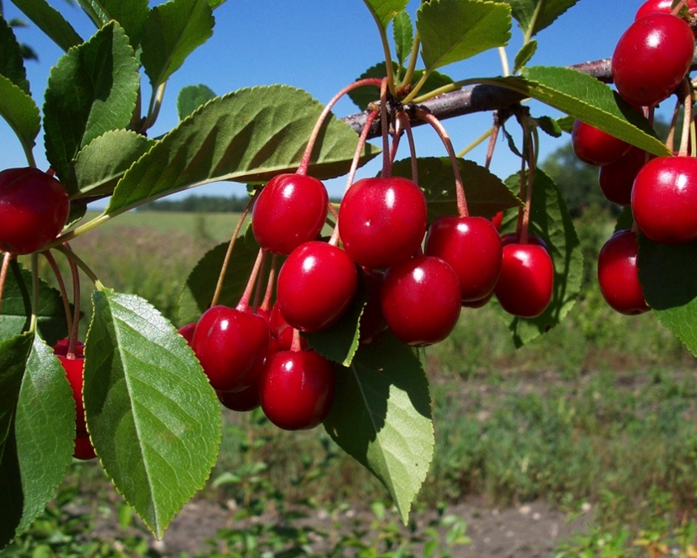
The Backyard Orchard: Top 10
Notes:
Created: 2/28/2014
Created by: Kevin Marini of Placer County Master Gardeners
Audience: Description of intended audience
Publicity: Text that could be published on calendar, Facebook, newsletter to attract an audience
Update History: Originally created 2/28/2014 by Kevin Marini; updated to new template on 11/9/2022 by B. Villareal

Slide 2
Who Are Master Gardeners?
Master Gardeners of Placer County
Extend research-based, sustainable gardening and composting information
Present accurate, impartial information to home gardeners
Encourage public to make informed gardening decisions

Slide 3
Who Are Master Gardeners?
Where to find us…
Online, in the Media, and Special Publications
Hotline: Call (530) 889-7388 or submit your questions online
Website: pcmg.ucanr.org
Facebook, Twitter, Instagram
Gold Country Media monthly column
Curious Gardener quarterly newsletter on our website
Gardening Guide and Calendar

Slide 4
Who Are Master Gardeners?
Where to find us…
Workshops, Fairs and Festivals and Special Events
Speakers by Request
Workshops (various venues, check website)
Farmers’ Markets (seasonal: Auburn, Roseville)
Fairs and Festivals Booths (varies)
Garden Faire (April)
Mother’s Day Garden Tour (May)

Slide 5
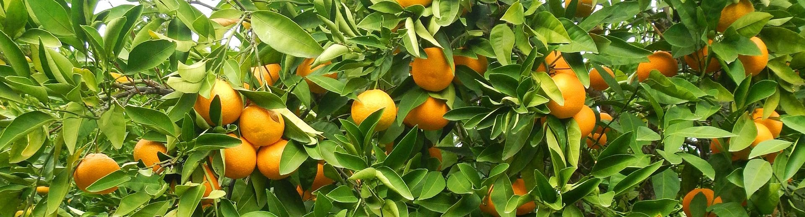
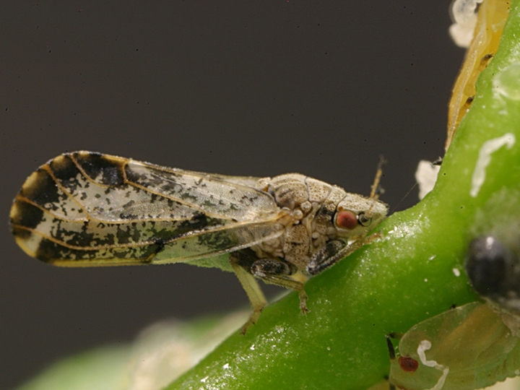
10. Be a “Master Fruit Tree Steward”
Buy locally grown fruit trees
Remove ailing trees and non-producers
Learn about the PESTS you may encounter!
TAKE CARE OF THE TREES

Slide 6
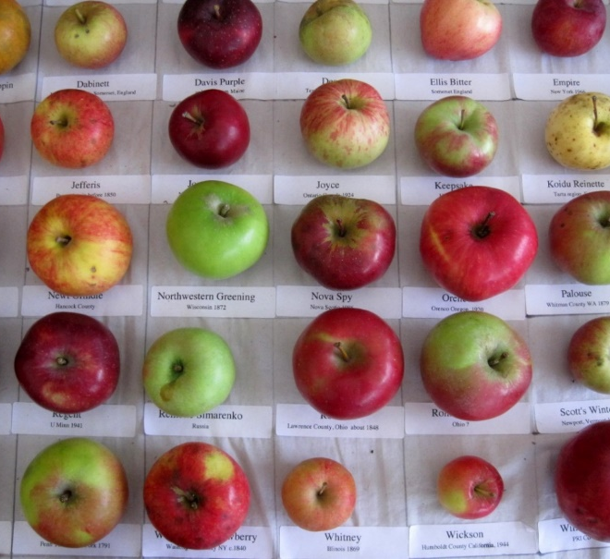
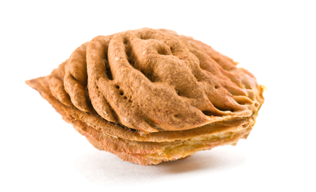
9. Select the Right Tree for the Right Place
Plant what you’ll eat but experiment with varieties, harvest times
Sun exposure, Chill hours, microclimates!
Trees in containers
From seed?

Slide 7
Selecting a Variety - Considerations
What do you like to eat?
How much space do you have?
How much work are you willing to put in?
Pollination – Self-fruitful or need a pollinizer
Growth habit of fruit tree
Climate (hardiness, chill hours…)
Pests in the area

Slide 8
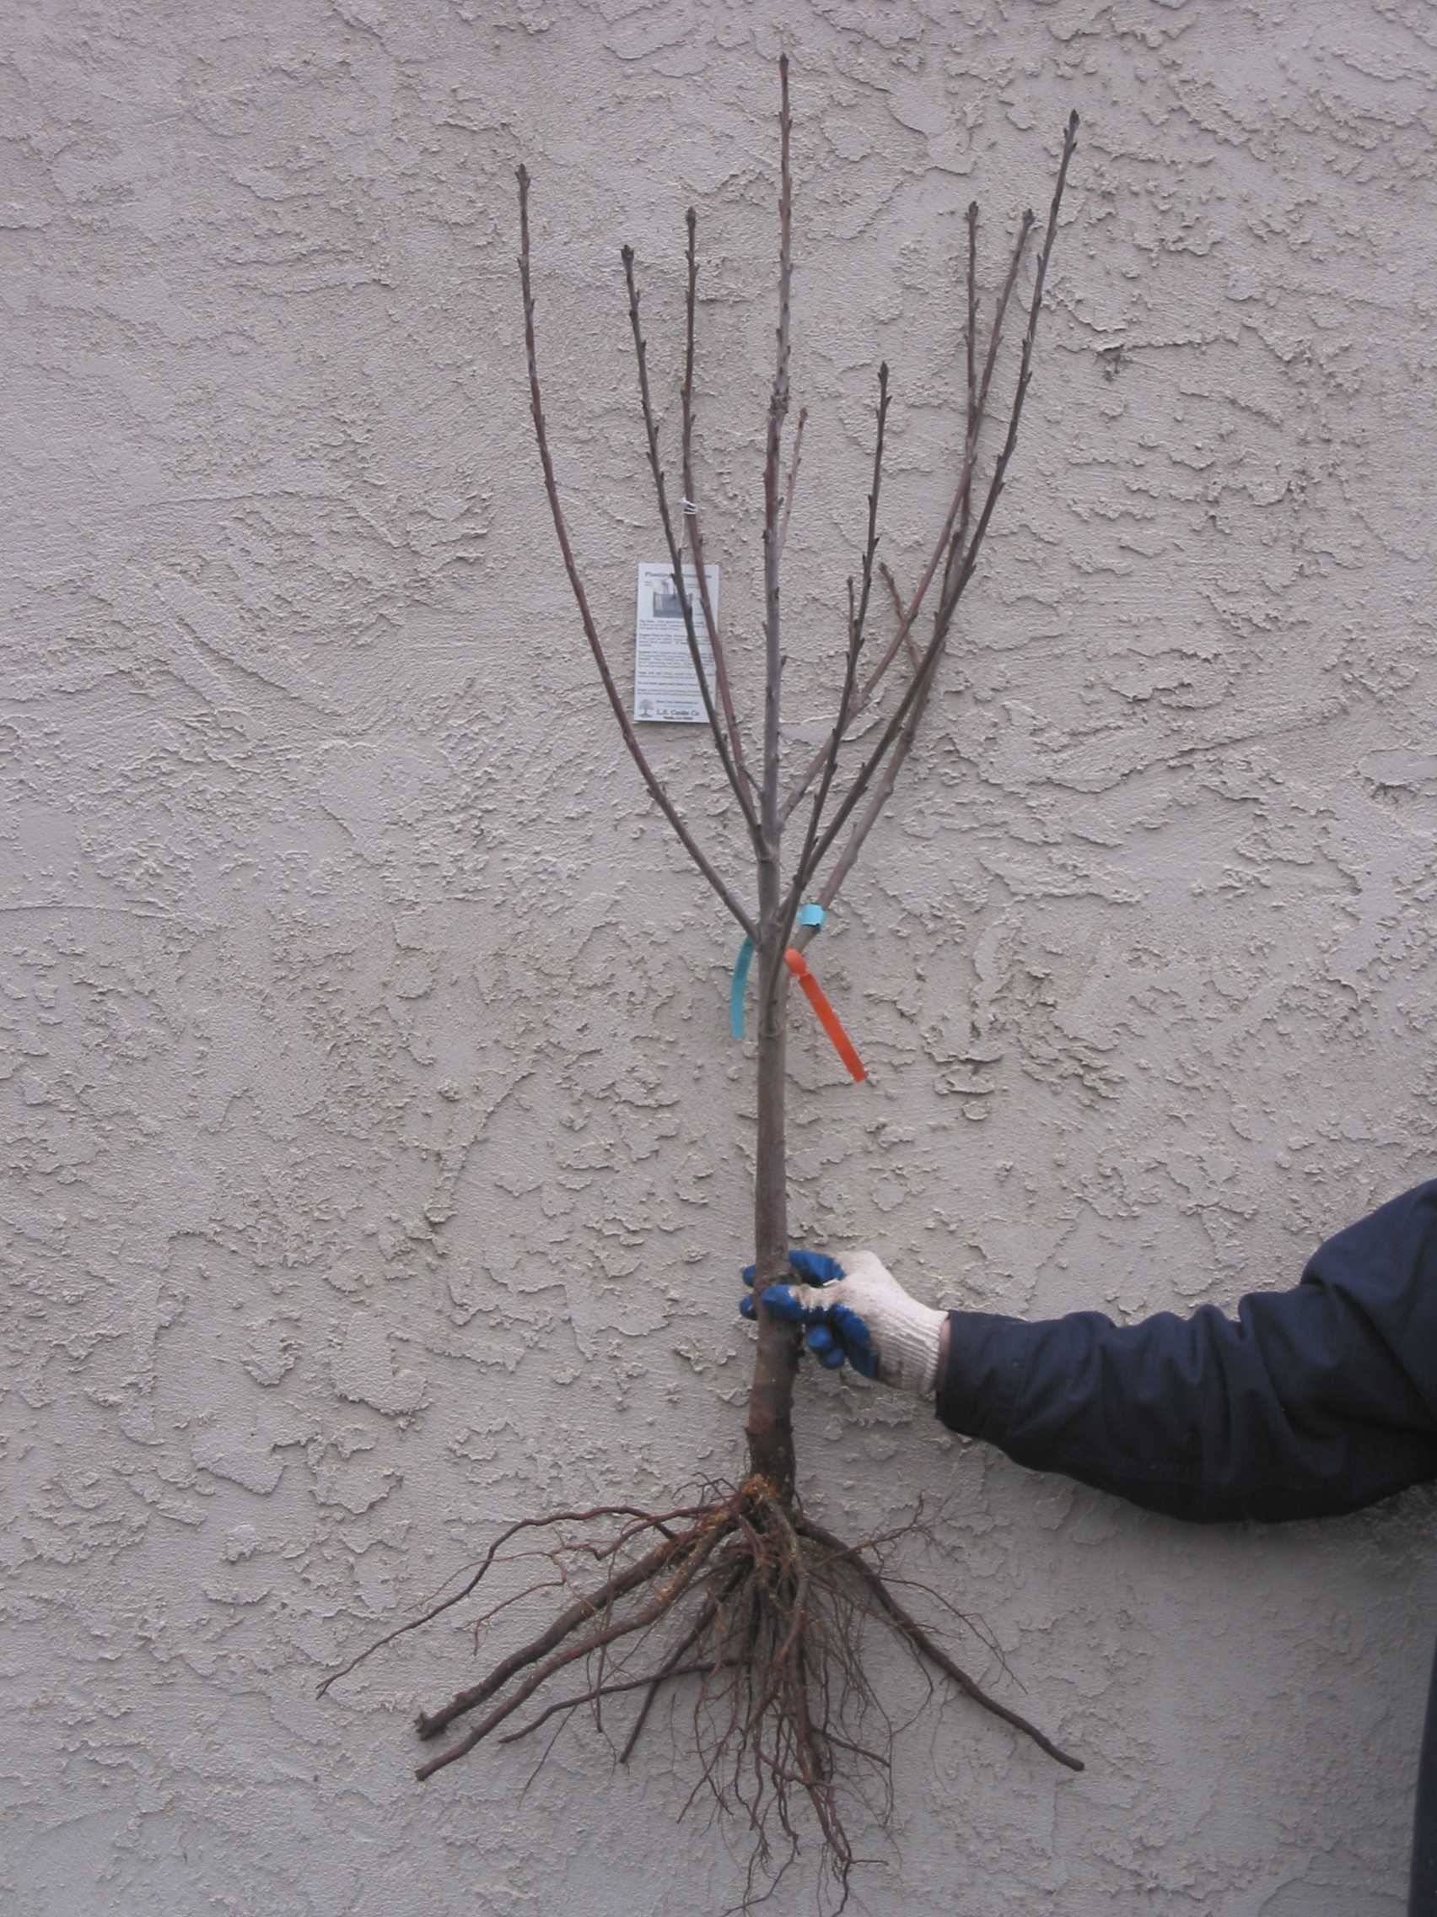
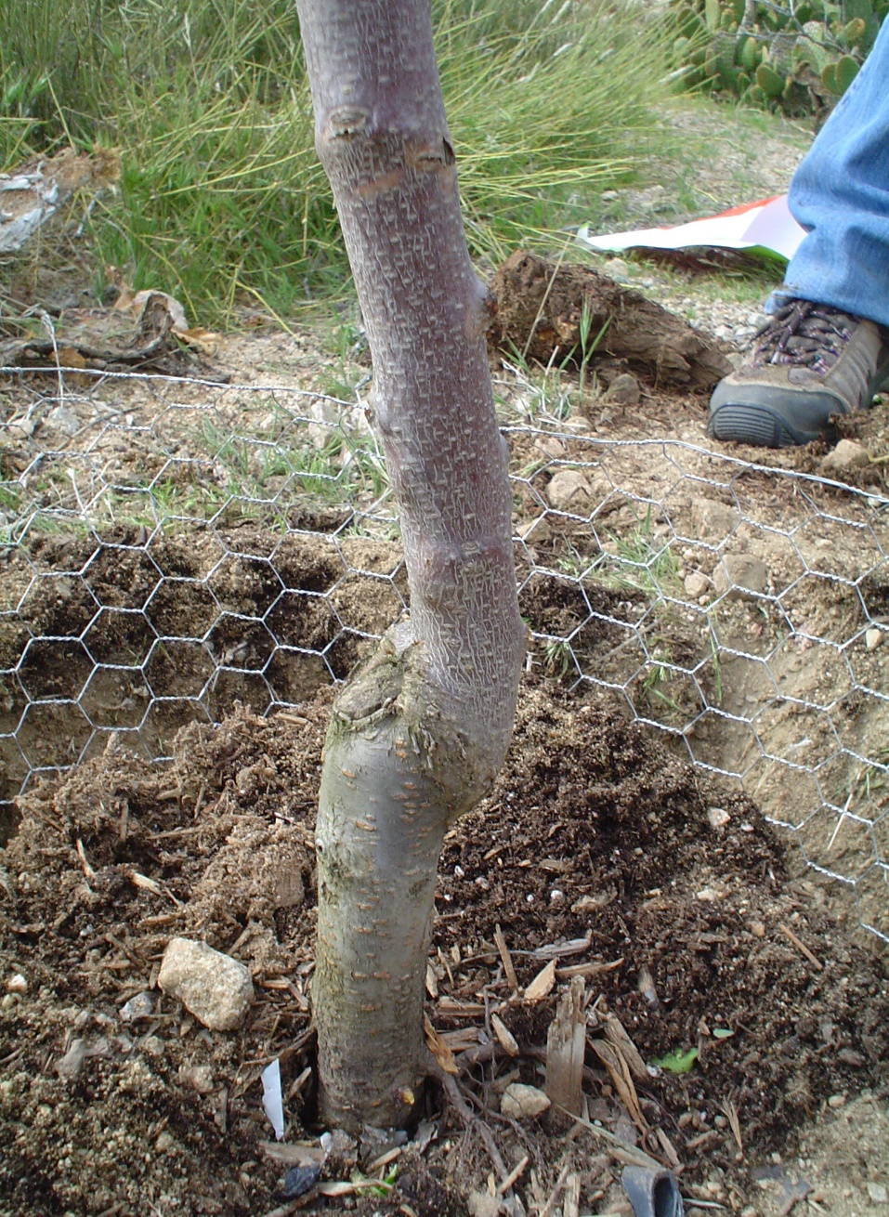
8. ALWAYS Plant Bare root Fruit Trees

Slide 9
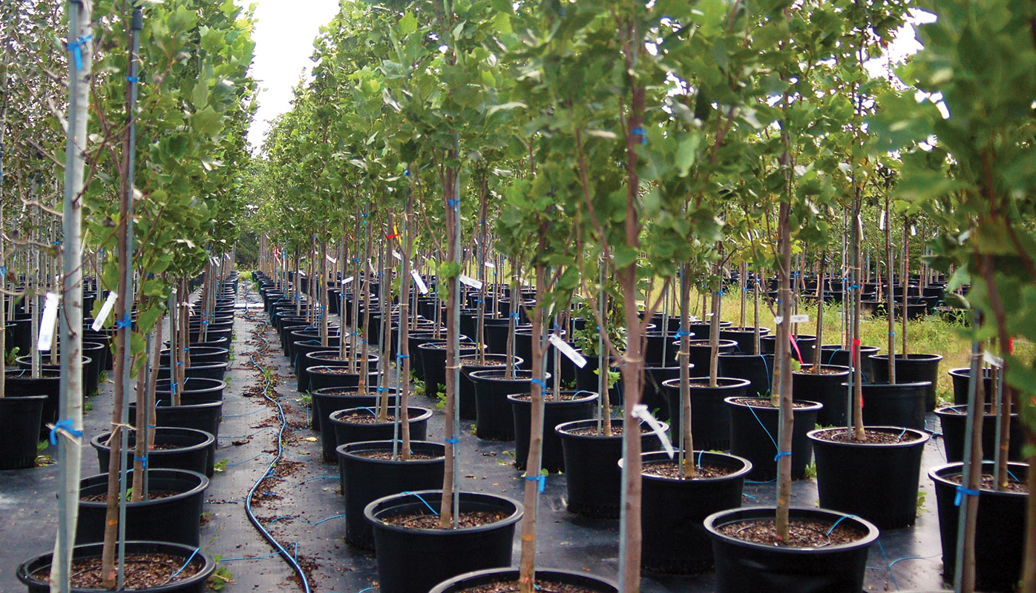
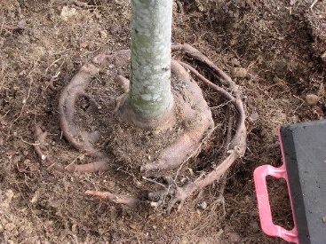
The Container Fruit Tree
A slow tortuous death…

Slide 10
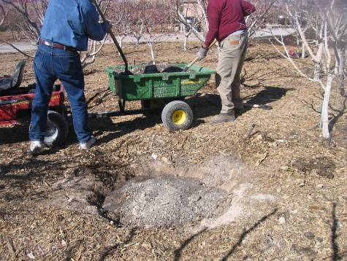
7. Explore and Prepare the Soil
Soil Analysis
“Soil Texture by Feel” test
Drainage test
Remove existing plants, especially perennial weeds!
Soil “history”

Slide 11
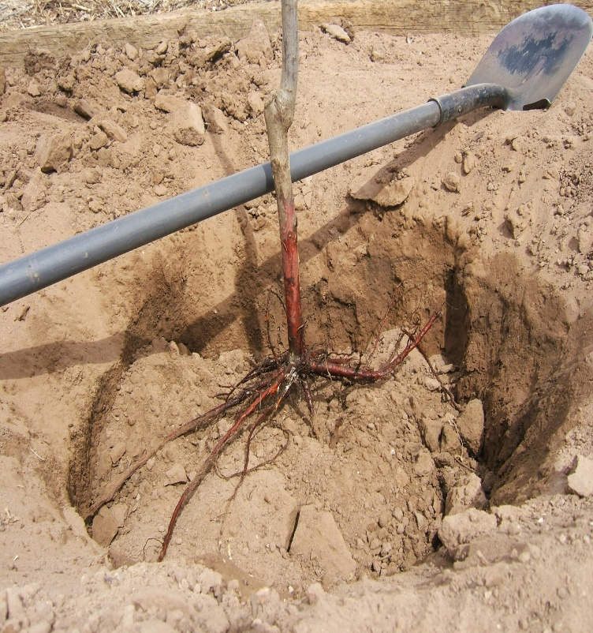
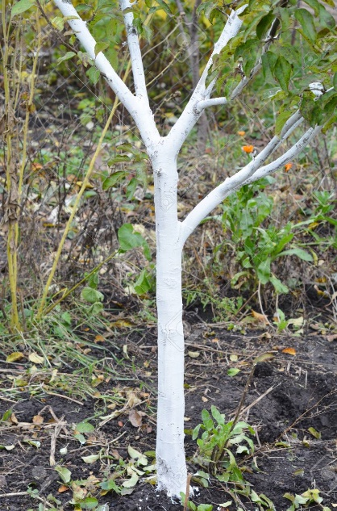
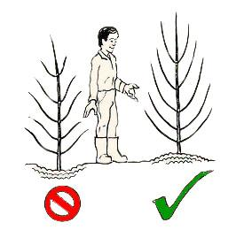
6. Plant the fruit tree with care
Dig wide but not deep hole
Spread out roots over firm soil
Graft union 3-4” above surface
Refill with native soil, no fertilizers
Mulch on top and water in well
Whitewash 50/50 interior latex/water
What is the “wiggle test”?

Slide 12
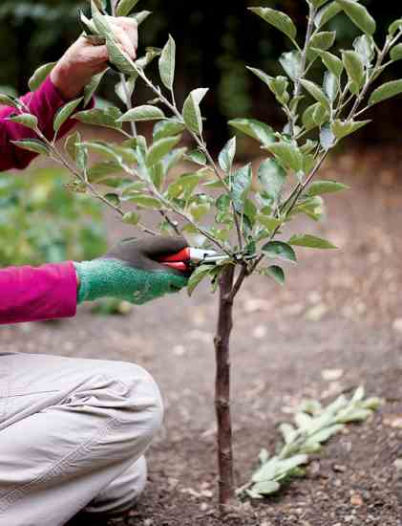
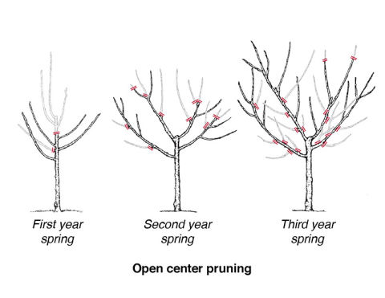
To Prune or Not to Prune at Planting

Slide 13
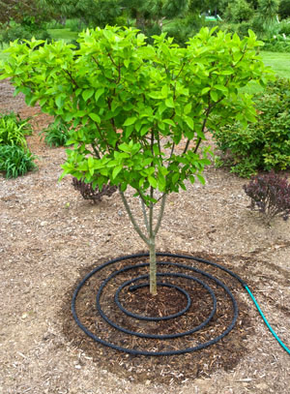
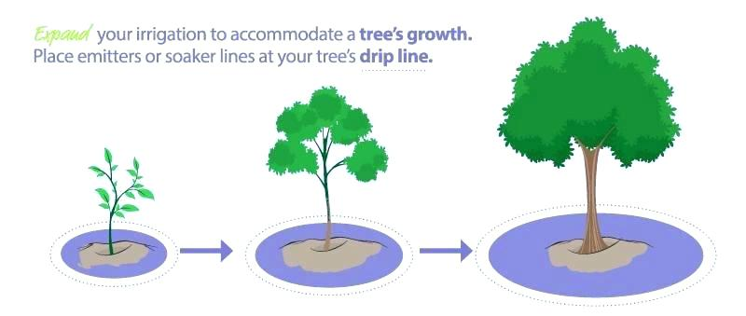
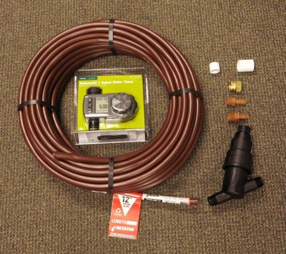
5. Water wisely and “fruitfully”
The UC Davis “TRIC”

Slide 14
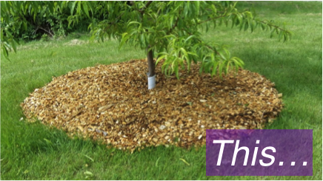
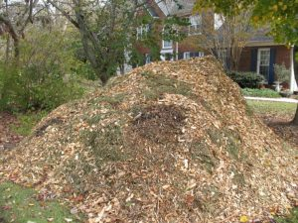
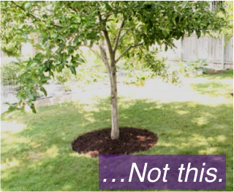
Mulch for Fruit Trees
Remember – Mulch is NOT compost and compost is NOT mulch.

Slide 15
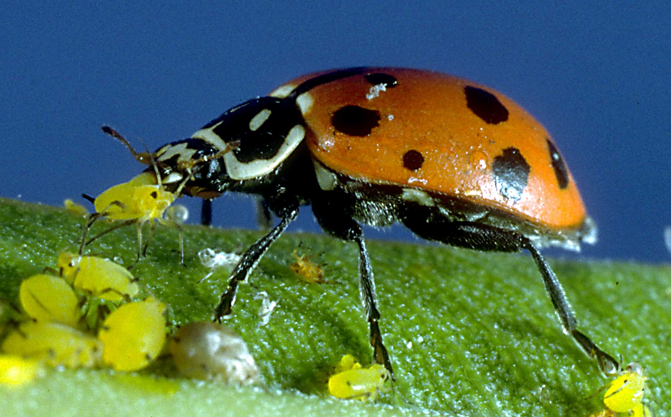
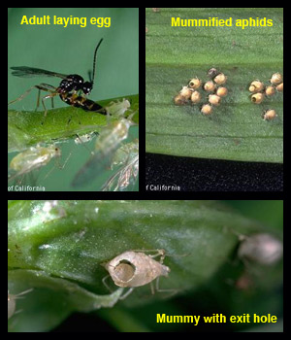

4. Be patient with Insect Pests
UC IPM:
Ipm.ucdavis.edu

Slide 16
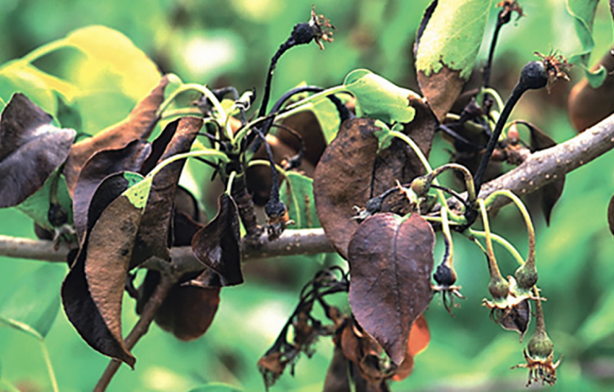
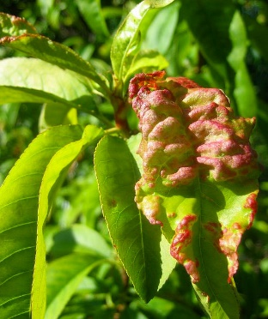
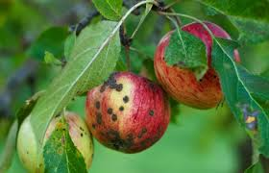
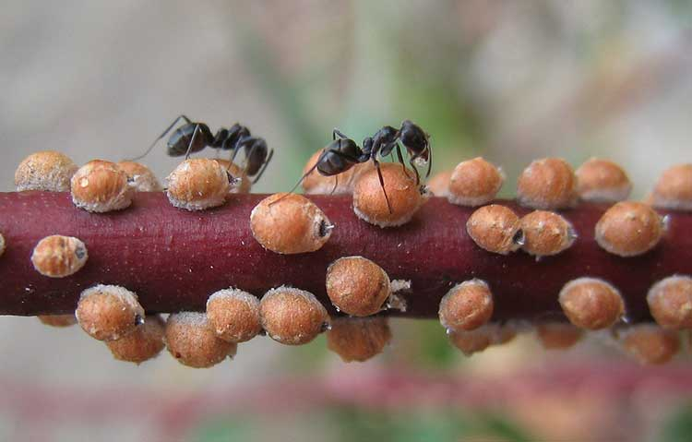
But…prevention is crucial
UC IPM: ipm.ucdavis.edu

Slide 17
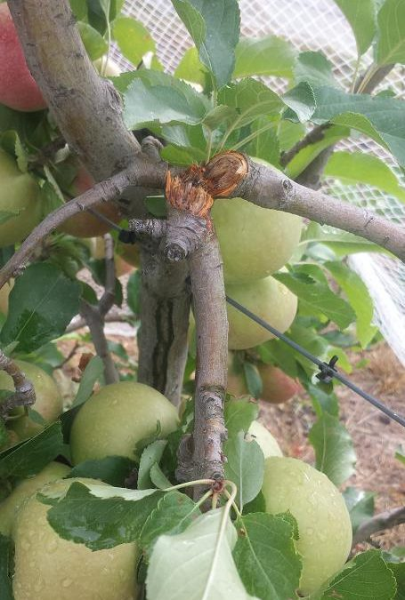
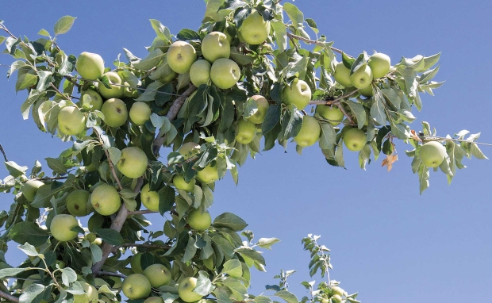
3. Have the courage to thin your fruit!
Thinning fruit applies to most fruit trees to save branches from breaking, improve fruit quality and size, and even out biennial bearing.

Slide 18
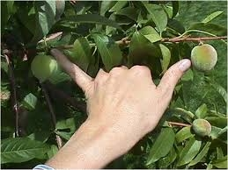
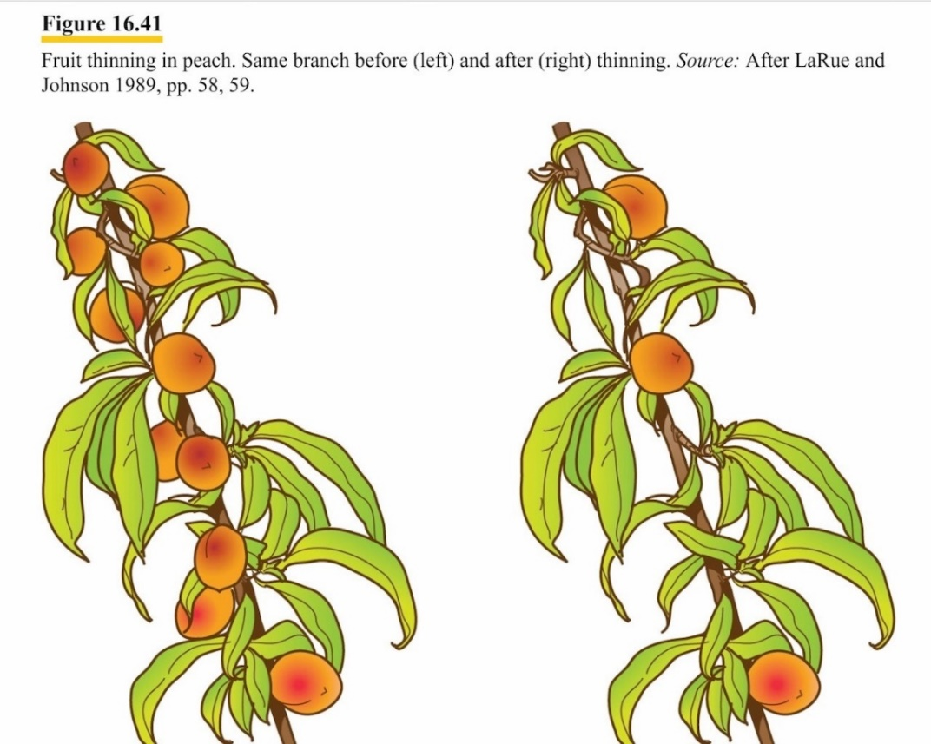
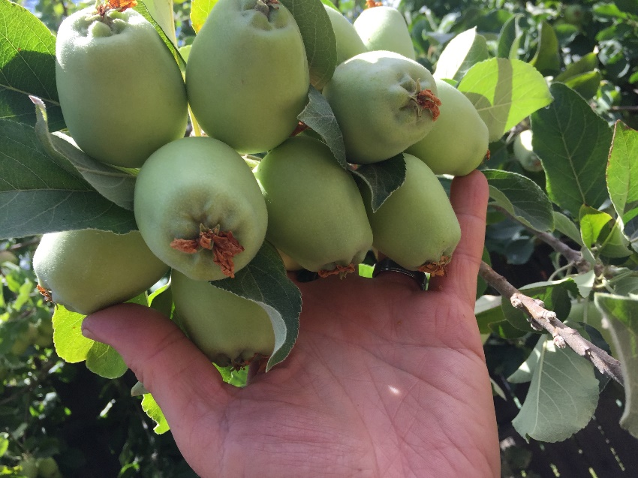
Rule of thumb (and pinky)

Slide 19
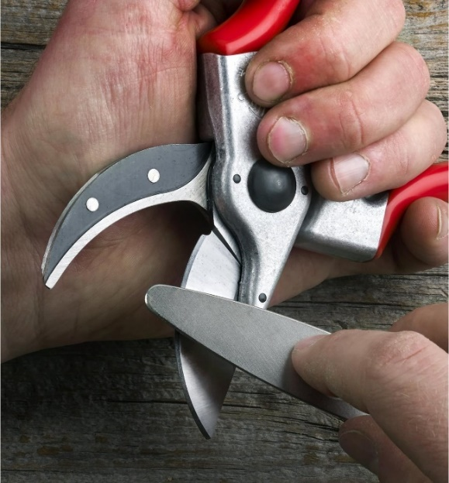
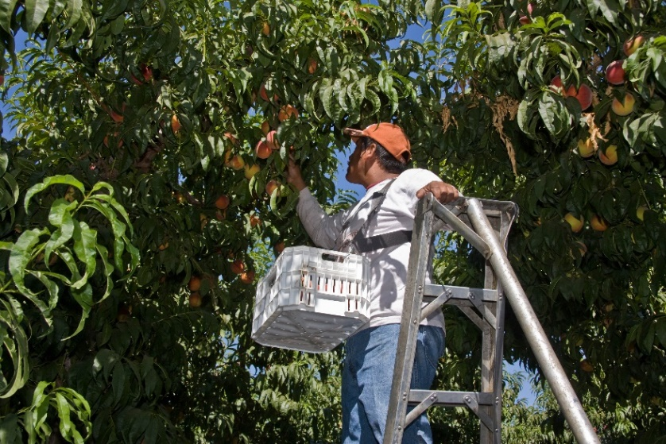
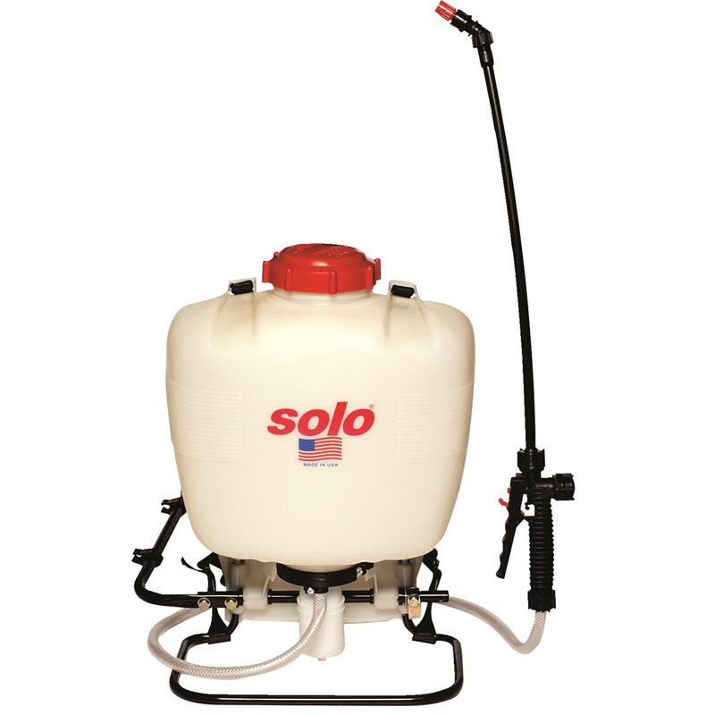
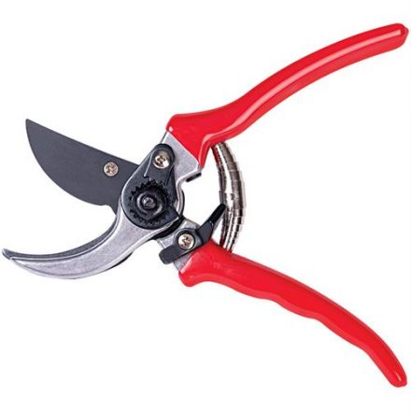
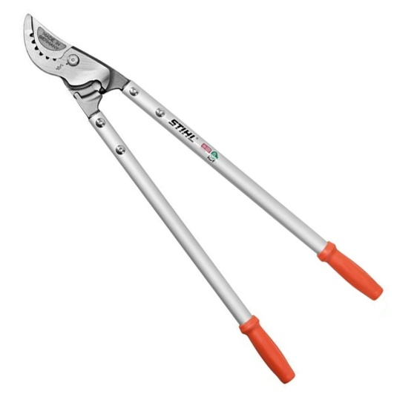
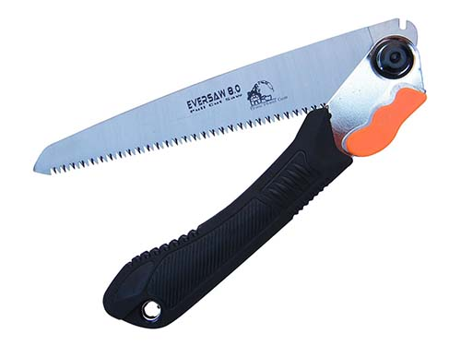
2. Use the right tools for the job

Slide 20
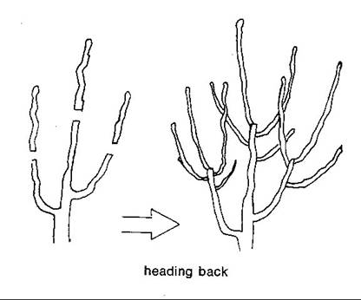
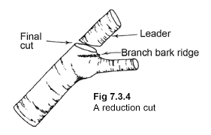
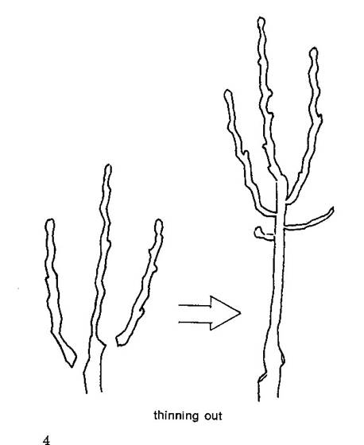
1. Prune with a purpose!
Prune fruit trees for overall structure in the winter and for size control in the summer.
Avoid pruning CHERRIES AND APRICOTS during rainy season (winter)
Heading cut
Thinning cut
Reduction cut

Slide 21
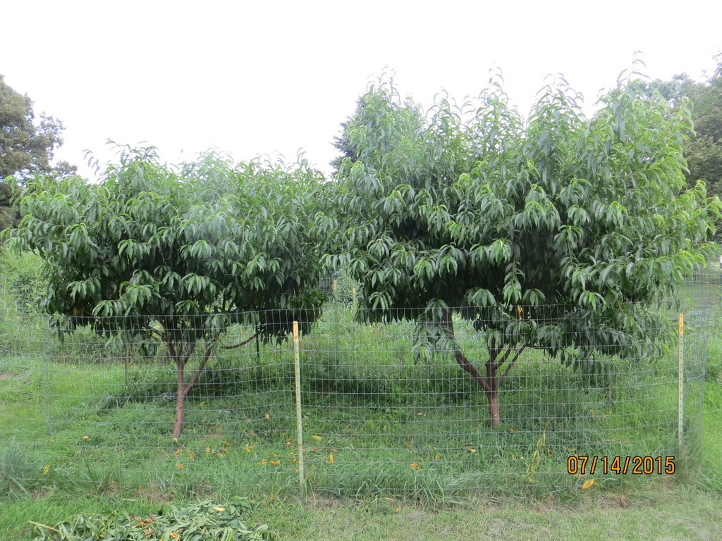
Dormant vs Summer Pruning

Slide 22
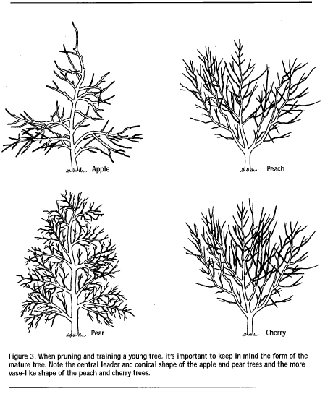
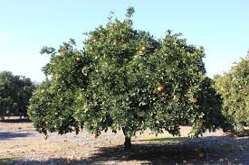
Pruning for structure
Citrus “Skirt Pruning”

Slide 23
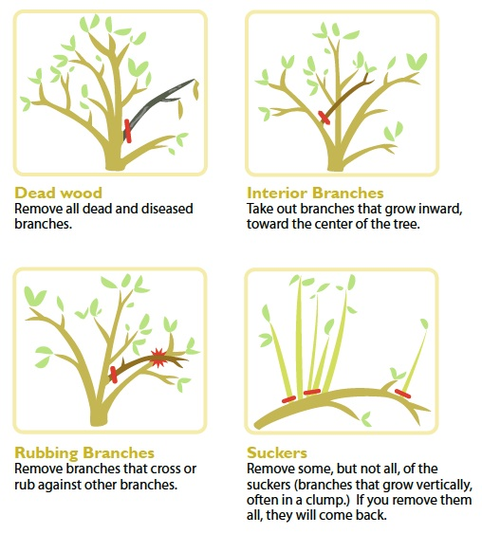
Year-round Pruning

Slide 24
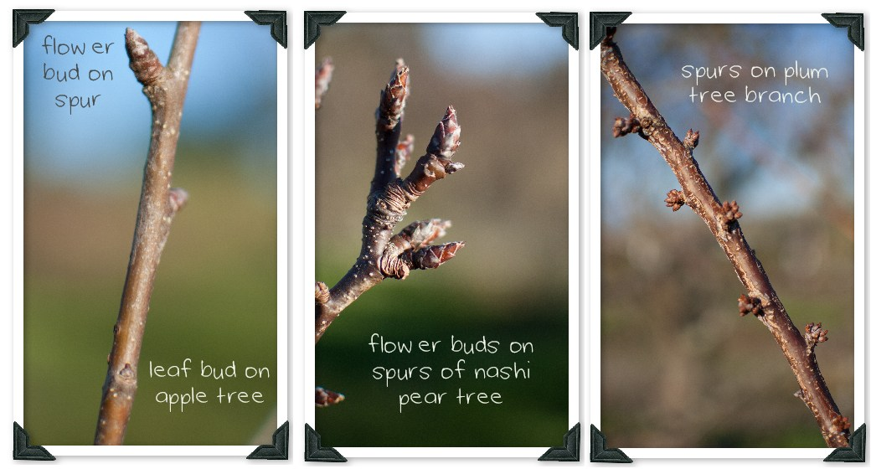
Different fruiting types

Slide 25
Little to no major pruning
Require
more pruning
Pomegranate
Citrus
Fig
Persimmon
Genetic dwarf varieties
Peach
Apricot (summer pruning)
Plums
Apples and Pears
Cherries (summer pruning)

Slide 26
Resources!
https://ccuh.ucdavis.edu/tric - Tree Ring Irrigation Contraption
https://websoilsurvey.sc.egov.usda.gov/App/HomePage.htm - NRCS web soil survey
http://homeorchard.ucanr.edu/ - UC Home Orchard site (there is also a UC “Home Orchard” book)
http://ipm.ucanr.edu/ - UC IPM site!!!
http://pcmg.ucanr.org/ - Placer Co Master Gardeners
http://ncmg.ucanr.org/ - Nevada Co Master Gardeners
Kevin Marini, Krmarini@ucdavis.edu
Commercial sites but tons of info:
Dave Wilson Nursery https://www.davewilson.com/
Four Winds Growers (Citrus) - https://www.fourwindsgrowers.com/

Slide 27
Thank You!
Any Questions?
Master Gardener Hotline: (530) 889-7388
Rot Line: (530) 889-7399
Master Gardener Website: pcmg.ucanr.org
Evaluations, please!

