Slide 1
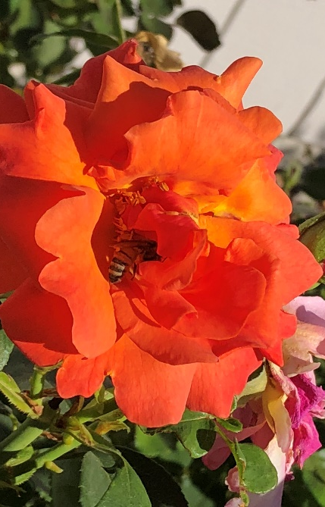
Roses Varieties, Cultural Care & IPM
Notes:
Origin & Updates: Adapted from Roses by Master Gardeners Mary Lou Meredith and Ann Beinhorn, 2010. Revised X 5 by Ann Beinhorn, 2016, 2017, 2018, 2019
Publicity: Hardy, beautiful roses grow well in many places throughout the country. In this workshop, you’ll learn about some of the origins of roses in America. You’ll become acquainted with the categories of roses for your landscape, and learn that roses don’t have to be labor-intensive plants. You’ll learn to recognize some common pests and diseases associated with roses, and how you can safely manage them during different seasons of the year.

Slide 2
Who Are Master Gardeners?
Master Gardeners of Placer County
Extend research-based, sustainable gardening and composting information
Present accurate, impartial information to home gardeners
Encourage public to make informed gardening decisions

Slide 3
Who Are Master Gardeners?
Where to find us…
Online, in the Media, and Special Publications
Hotline: Call (530) 889-7388 or submit your questions online
Website: pcmg.ucanr.org
Facebook, Twitter, Instagram
Gold Country Media monthly column
Curious Gardener quarterly newsletter and on our website
Calendar and Gardening Guide

Slide 4
Who Are Master Gardeners?
Where to find us…
Workshops, Fairs and Festivals and Special Events
Speakers by Request
Workshops (various venues, check website)
Farmers’ Markets (seasonal: Auburn, Roseville, Loomis)
Fairs and Festivals Booths (varies)
Garden Faire (April)
Mother’s Day Garden Tour (May)

Slide 5
Roses: Agenda
A little History
Rose Varieties for the Home Garden
Cultural practices
Planting
Watering
Fertilizing
Pruning
Pest Control

Slide 6
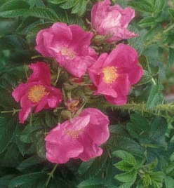
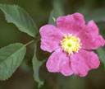
History: Early Roses in California
Rosa rugosa
Asian native
Used hedges around farmlands
Now used at seashores & roadsides
Very cold-hardy
Rosa californica
“Thicket-forming”
Grows by streambeds
Found lower than 1,600 ft. elev.
Native from So. Oregon to Baja California
Notes:
Roses are descendants of Species roses: R.gallica, R. damask, R. chinensis, R. alba, bourbon & moss roses. Then came Old Garden Roses.
ugosa brought into US in 1800’s, Native to Asia & Russia. Tolerates -30 degr. Gets invasive. R californica prefers moister settings(but is also in Central Valley), gets 8’-10’ high x 8’

Slide 7
Rose Varieties
(Select the disease-resistant varieties)
Two main categories:
Garden (“modern”) Roses -valued for their flowers
hybrid teas (most common)
English roses, floribundas, grandifloras, and climbers
“Own-Root Roses”
English roses, old garden roses
Landscape roses – shrub roses mimiatures and groundcover roses
-low maintenance, easy care
Notes:
You can get information from the nurseries who ship roses and the American Rose Society about rose disease resistance.
The era of Modern roses was established im1867. This list of rose varieties is not all-inclusive: Ramblers, Polyanthas, Miniatures and Minifloras are some others. Garden Roses require specific techniques to prune for desired results (as covered under “Why Prune”). “Own root” roses don’t have suckers & resist freezing temperatures.
An “own root” rose is never grafted onto root stock. If you like roses but don’t want to spends a lot of time grooming them, landscape roses can be a success in the right place with basic care.

Slide 8
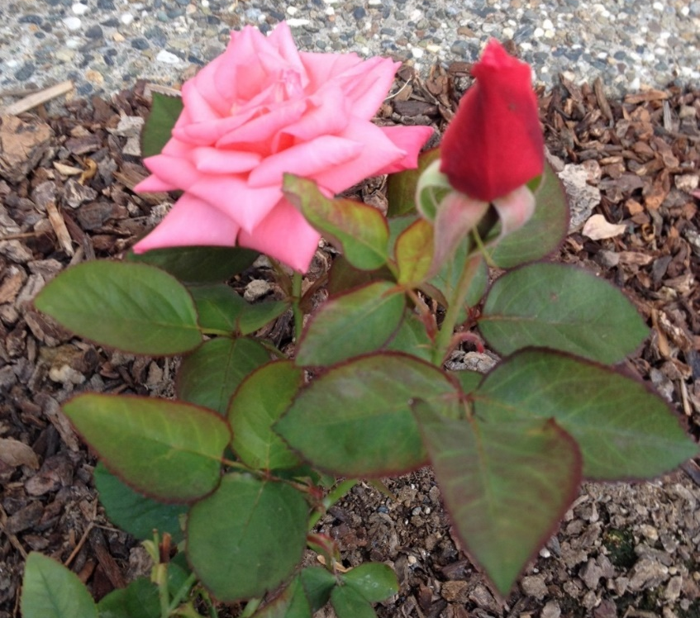
Garden Roses
Miniflora
Miniature
Miniature
Notes:
Left Rosa ‘Joy’. Miniatures were descended from China roses.

Slide 9
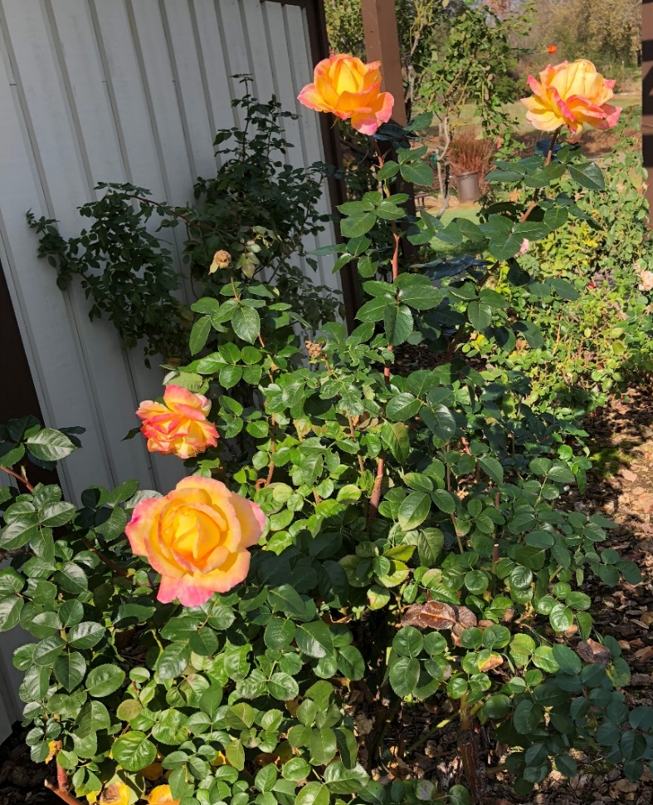
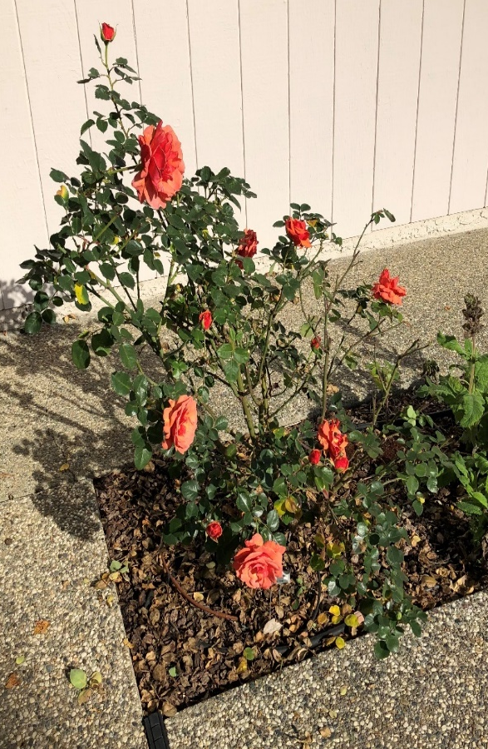
Garden Roses
Hybrid Tea
Floribunda
Notes:
Left: Floribundas are rounded and 3-4’ high, and often bloom in together in “sprays” (q. 6-8 wks)
Right: Hybrid teas are up to 6’ high and bloom as solitary flowers. (Traditional cutting rose)
Grandifloras (taller) were bred from hybrid teas x polyanthas

Slide 10
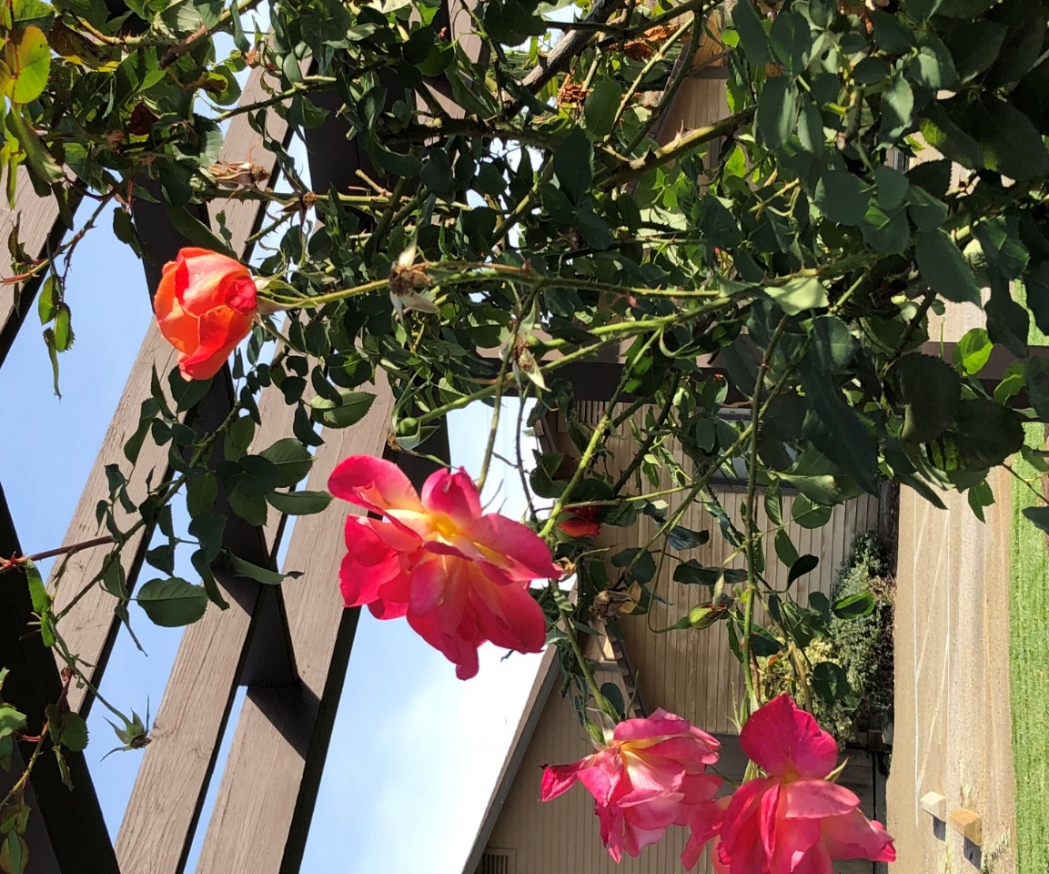
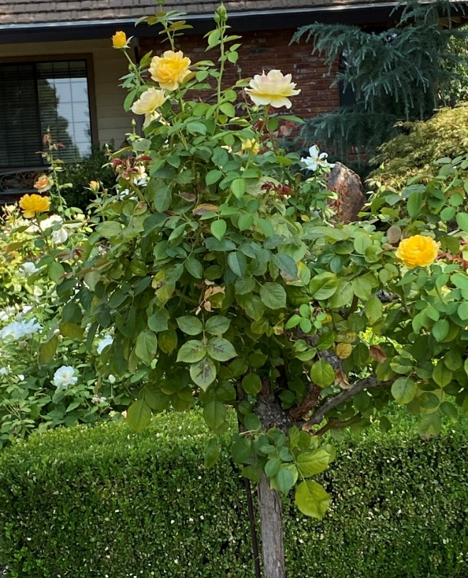
Garden Roses
Climbers
Tree Roses
Notes:
Tree roses could be any modern rose grafted to a plant of the same genus. Grafts from the rootstock, then at the start of the desired flowering plant.
Climbing roses are great to line fences or around an arbor. They are pruned to bear abundant flowers on lateral stems. 6’-12’.

Slide 11
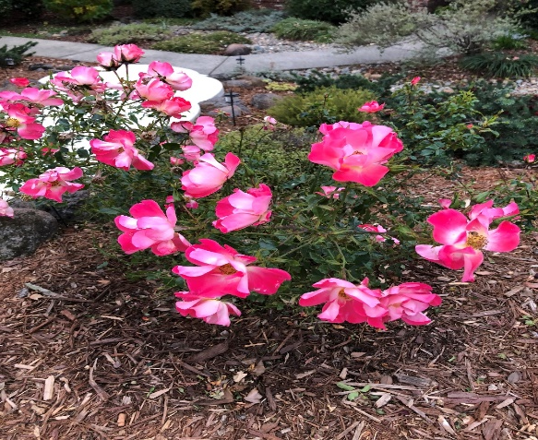
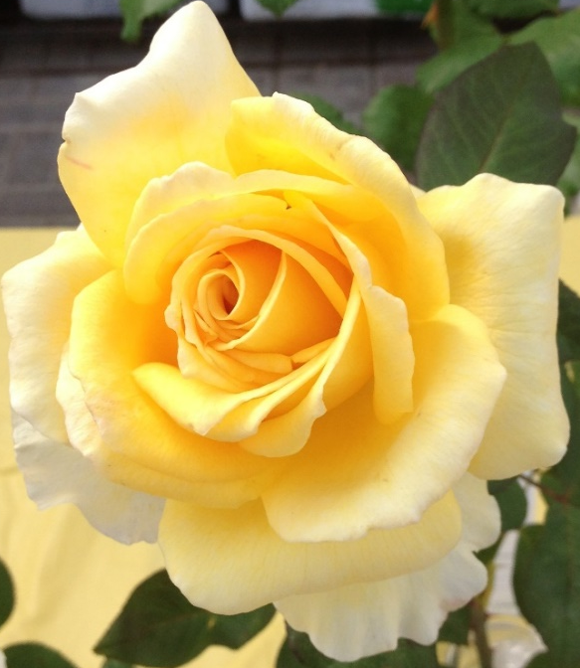
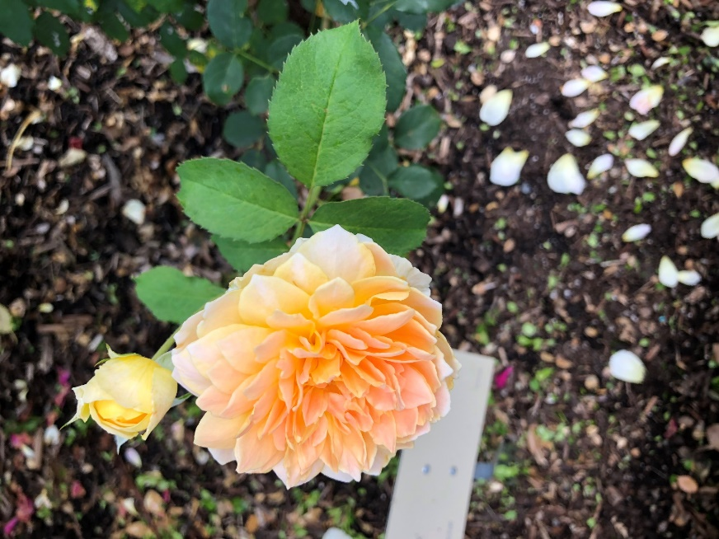
Garden Roses: Flower Forms Hybrid Tea, Single, English Rose
Notes:
All these are being hybridized. Left: The perfect hybrid tea form, Middle: English rose Right: “Single” roses, attractive to pollinators.

Slide 12
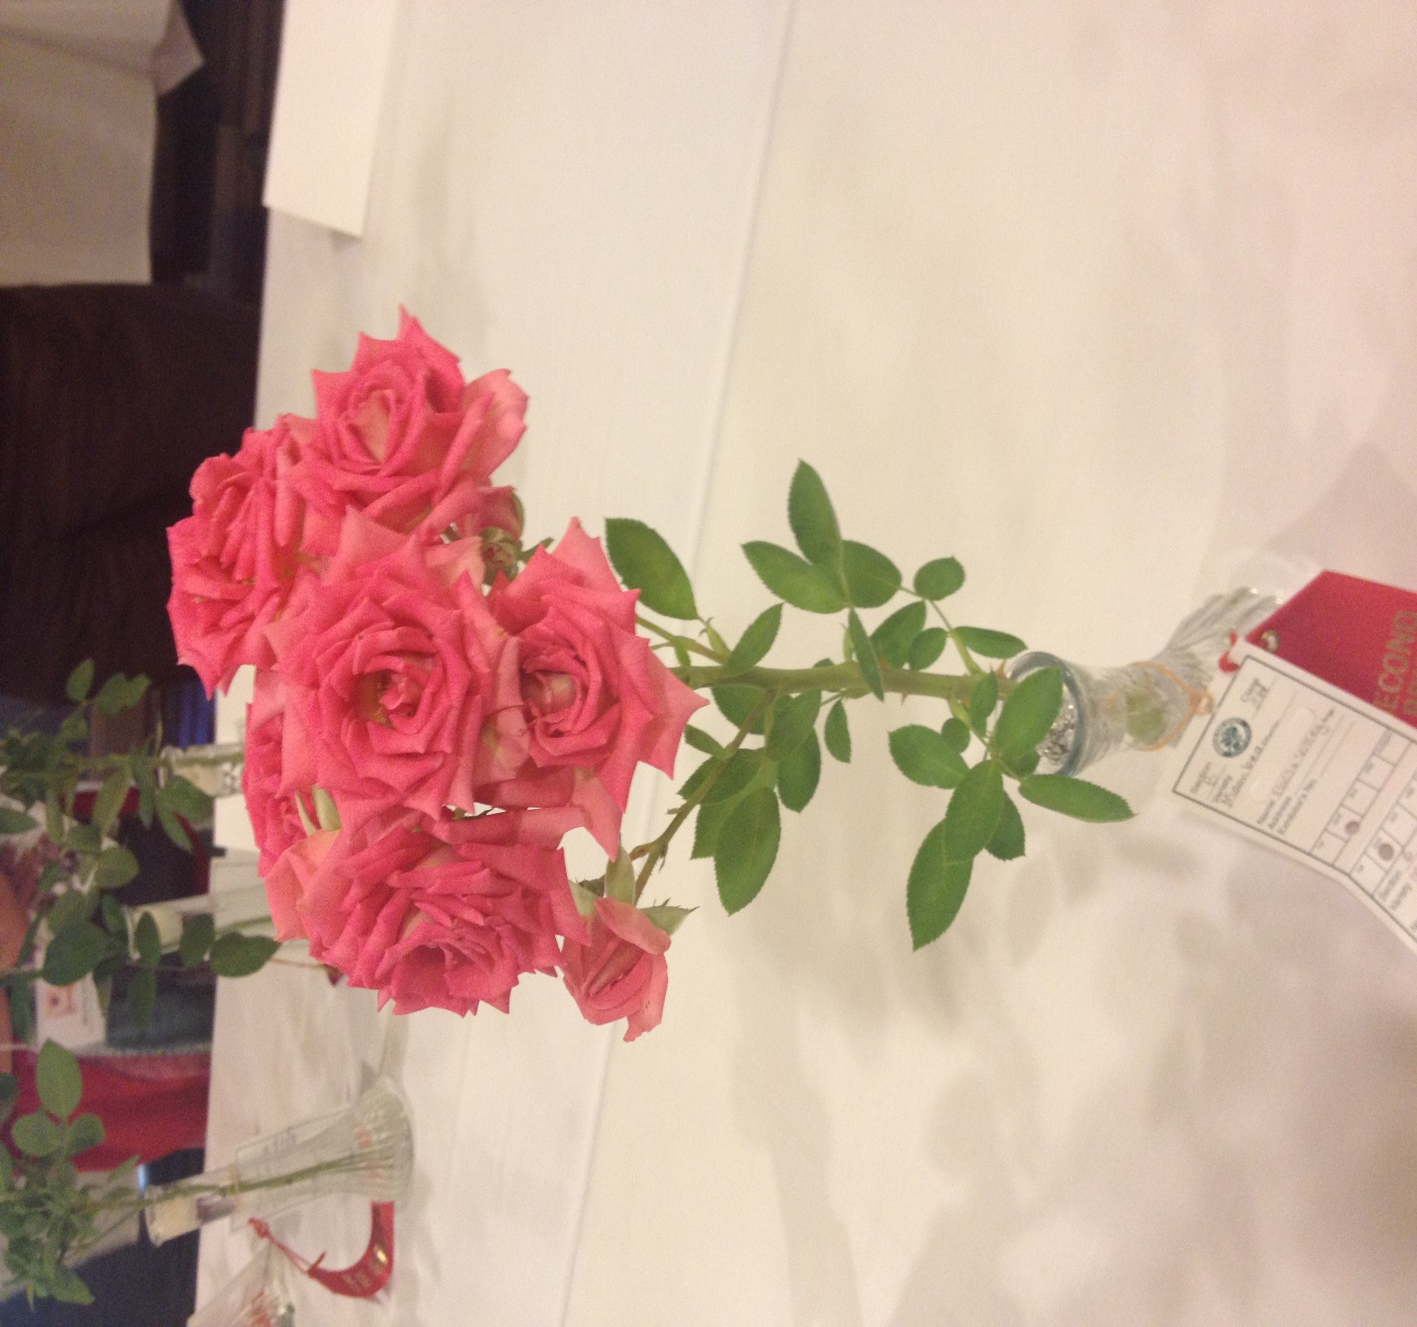

Garden Roses: Bloom Forms
spray solitary
Notes:
Hybrid teas bloom as solitary flowers, but other garden roses can also bloom in clusters too. The pointed center of hybrid teas is admired as a good show rose.
Sprays are found on floribundas.

Slide 13
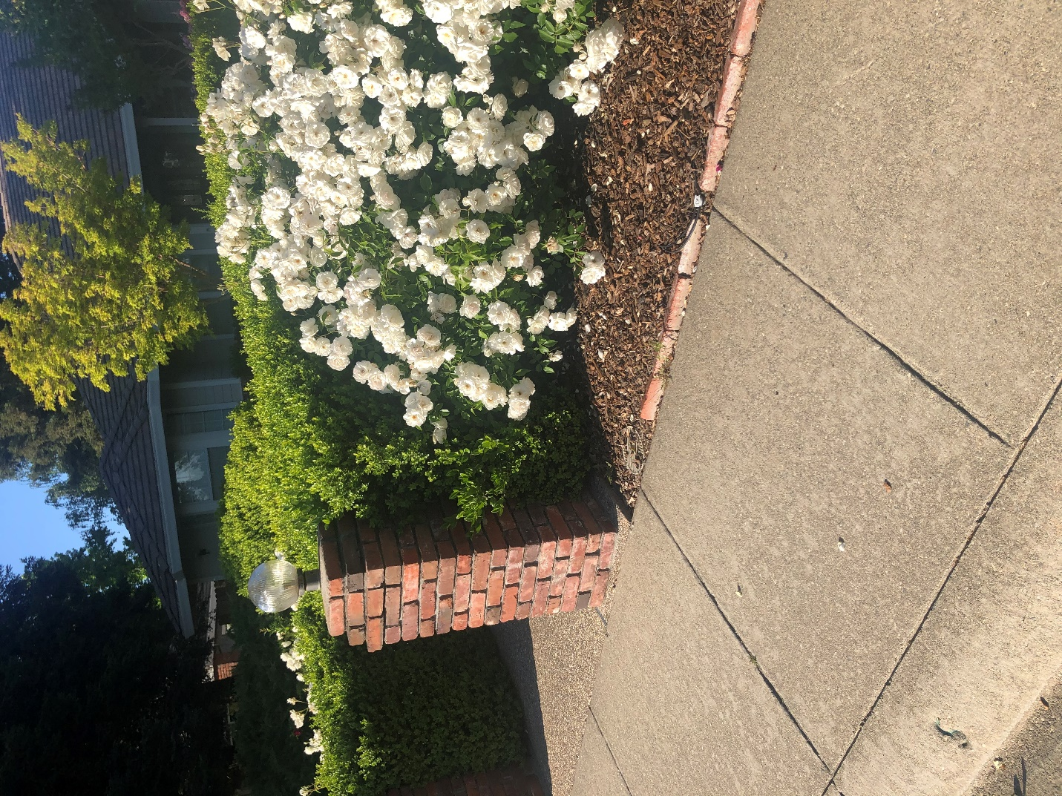
Landscape Roses
Arboretum All Star
Rosa Korbin ‘iceberg’
ungrafted
dubbed “shrub” roses
upright, mounding, or
groundcover
Very good disease resistance
Notes:
Groundcover, Mounding of upright forms for landscape roses often grown in groups. On right is Iceberg, bred in 1958., still a top-ten rose in the world.

Slide 14
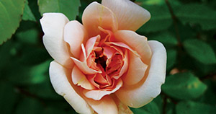
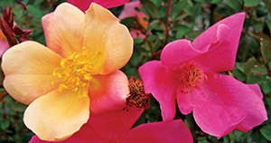
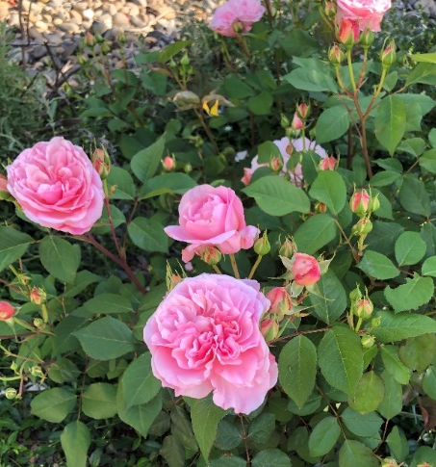
UC Davis Arboretum “All Star” Roses
Perle de Or
Mutabilis ‘butterfly rose’
Gruss an Aachen
Notes:
Mutabilis: shrub Mutabilis: China rose, 1884 Gruus an Aachen: Floribunda 1909 Perle de Or: Polyantha 1884
All-Stars must satisfy one: low maintenance, drought tolerant, attracts wildlife, less than 25’

Slide 15
Cultural Practices: Planting
Optimal soil: pH above 6.5, best at 7.0, well-drained
with organic amendments
Sun Exposure: at least 6 hours
Position: graft at soil level, or if ungrafted, same level as in pot
Separate plants several feet apart for garden roses
Bare-root plants: keep moist & cool, plant soon; form a soil “cone” support, fill in
Notes:
Do a soil test of your property before planting roses. Most of local soils are in the neutral range. You should be able to see the top of the graft in a mild climate setting
(no heavy snows). Very light-flowered roses might be more tolerant of partial shade in our climate. Easier to start bare-root roses in pots.

Slide 16
Cultural Practices: Ongoing
Watering
“moderate” water
drip Irrigation around root crown
-streamers
-tubing with 6” emitter spacing
Fertilizing
after pruning and each bloom cycle (once for once bloomer)
organic
Notes:
Watering should follow evapotranspiration rate (seasonal). Don’t leave completely dry in summer. Sometimes a spray of water in a.m. while hot helps.
Fertilize with slow-release fertilizers coving all over the root crown, under the dripline. Don’t allow water on leaves to linger after dark.

Slide 17
Cultural Practices: Pruning
Why Prune in winter? (For repeat bloomers)
**to keep the plant healthy (removal of diseased, dead
or dying wood, and crossing branches)
** to open up the plant for air circulation
-to influence the flowering periods
-to shape the plant and decrease prickly branch hazard
<Same principles apply to one-time seasonal bloomers>
Notes:
. The first two points are most important for the health of the plant. You may make a shorter plant to yield bigger fewer flowers; a taller plant may have smaller but more bloomsPrickly (thorny) branches are a hazard for pathways.
Prune one-time bloomers after bloom. You can also prune in summer to clean up. One-time bloomers need the routine pruning after bloom.

Slide 18
Prepare to Prune a Rose Plant
Identify the graft if applicable
Identify the wood health, leaf condition and branch condition
Select preferred canes
Start from the top height –or-from the bottom up
Decide how tall your finished plant should be
Use sharp, *clean tools
*Remove old mulch & old leaves
Follow general guidelines
Notes:
Old canes yield few if any blossoms. Suckers are from root stock, and can overwhelm the grafted hybrid. Remove dead, diseased & dying branches.
Throw all discards in the trash.

Slide 19
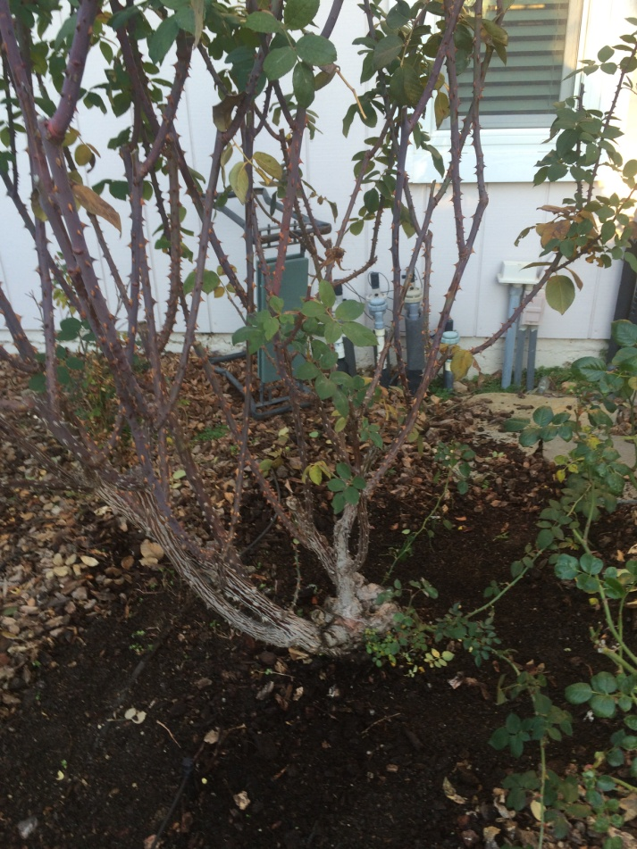
Steps to pruning: Observations
Old canes are rough and rough or split; prickles are gray or white
New canes are green and smooth; prickles are brownish
Dead branches
Crossing branches
Cluttered center
Look for suckers Know the bud union
Notes:
Old canes yield few if any blossoms. Suckers are from root stock, and can overwhelm the grafted hybrid.

Slide 20
How to Prune
General Guidelines
Remove dead, unproductive or diseased wood
Remove crossing branches & twiggy growth
Shape the plant
--Increase air circulation; open center, 3-6 canes
Create room to get around the plant
Remove 1/3 to 1/2 of the healthy wood
Encourage growth of flowering wood
Top-dress with compost & replace mulch
Notes:
Cut lower for more, smaller blooms. Cut higher for bigger but fewer blooms.

Slide 21
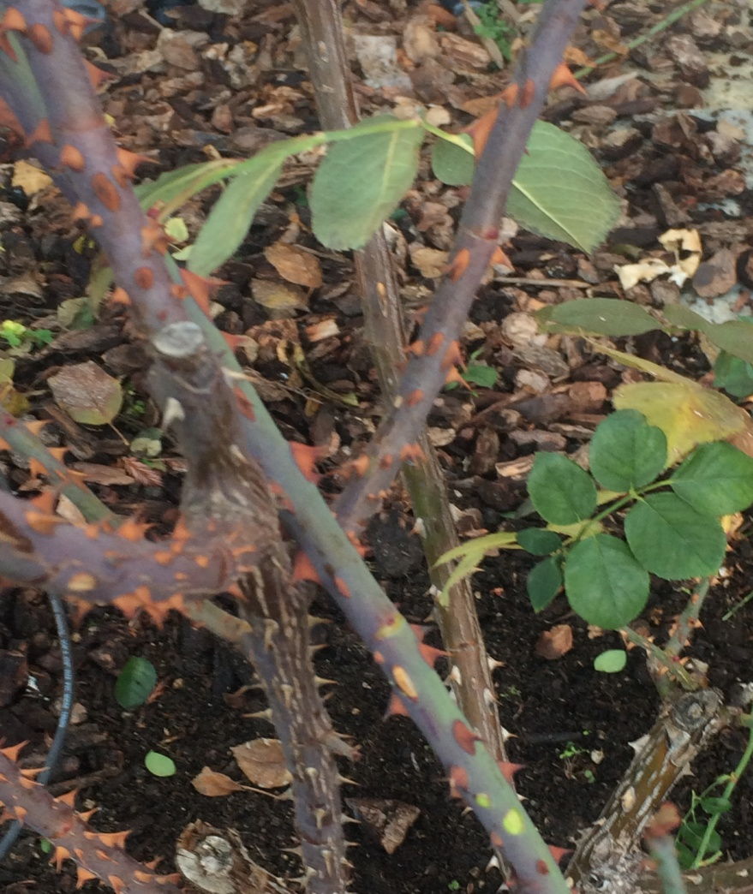
Steps to Pruning: Canes & Cuts
Cut 1/4”-1/2” diagonally above
outward-facing bud.
(No) (No) Yes
Retain 3-6 canes (generally)
Don’t retain twigs < pencil-size
New & old canes
Notes:
Explain what a bud is.

Slide 22
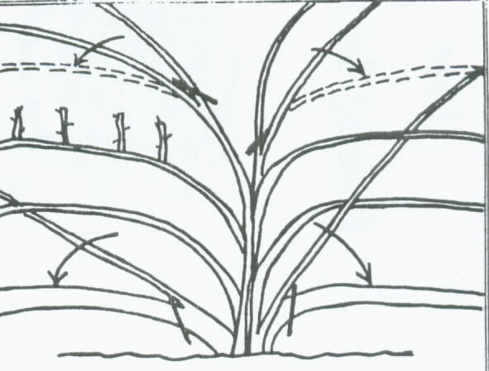
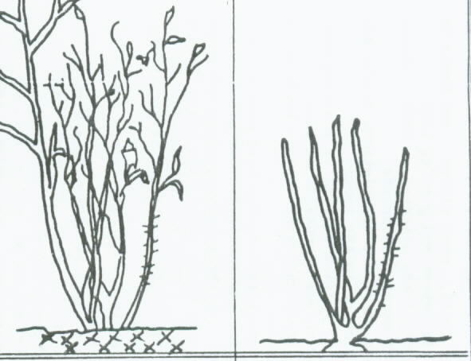
Prune by Variety
Climber
Standard garden rose
Notes:
Look at the finished picture for each: count canes, note spacing, and see where branching and flowering will take place.

Slide 23
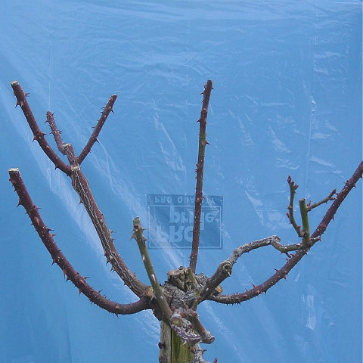
Guidelines: Tree Roses
Select about 6 canes
Open center, vase shape
Notes:
Your final result in a tree rose should be about 6 canes around the base, balanced as much as you can. Keep the center open.

Slide 24
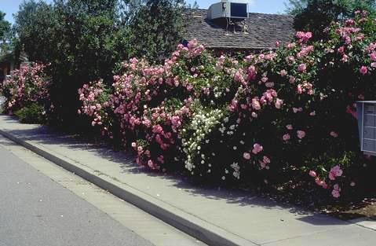
General Guidelines
Landscape Roses
Leave unpruned or do “rejuvenation” pruning
Miniatures can be “headed”
Notes:
Explain what “heading” is.

Slide 25
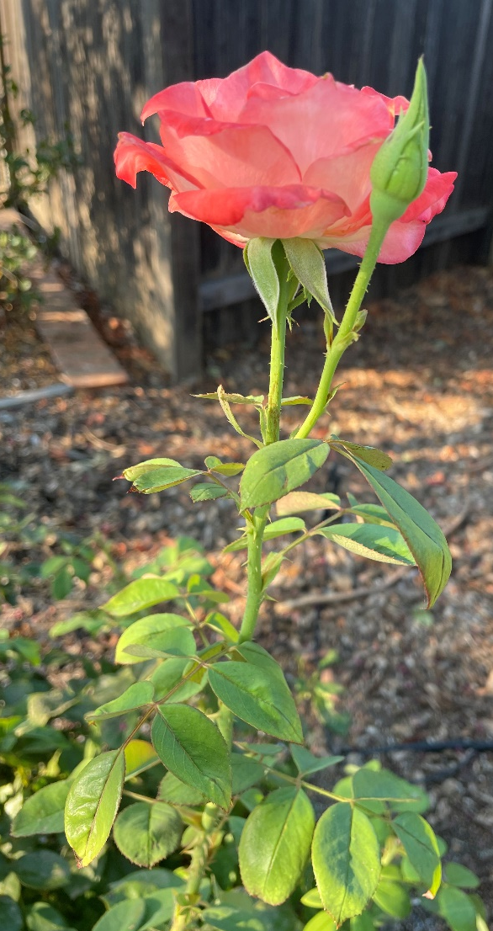
Growth Season Pruning
Deadheading
-Promotes more flowering
-Reduces disease; use clean tools
-Improves air circulation
Notes:
Point out 3-leaflet leaves and 5-leaflet leaves. Cut just above a 5-leaflet leaf. Sample flower: Gemini, hybrid tea with side bud.

Slide 26
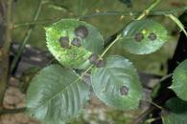
Integrated Pest Management (IPM) Pest: Black Spot
Spots appear on upper surfaces of leaves & succulent stems, sur-rounded by yellow margins
Leaves may drop
Controls:
-Leaves should be wet no more
than 7 hours
-Keep good air circulation
-prune out affected stems
(4 t. baking soda +
1% narrow-range oil solution)
-Neem oil or fungicides (after rain)
Notes:
This disease can overwinter easily in the soil. So practice ground “sanitation”. Common fungus in many varieties. Choose disease-resistant varieties
Serenade is a baking soda formukated fungicide.

Slide 27
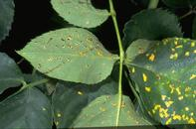
IPM Pest: Rust
Appears in cool, moist weather
-orange pustules on underside of leaves
-discolored upper side of leaves
Controls:
-Avoid overhead watering
-Prune back severely affected
canes
-Winter leaf sanitation
-Treat with neem oil
-Preventive applications of
fungicide
Notes:
This disease can overwinter easily in the soil. So practice ground “sanitation”. This disease is very persistent and can easily spread to other roses.

Slide 28
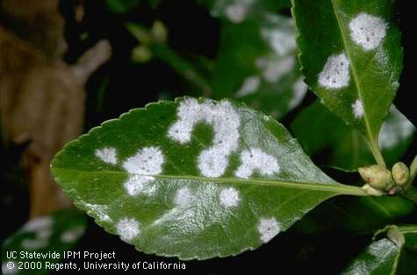
IPM Pest: Powdery Mildew
Appears in spring on leaves. Affects new growth.
Controls:
-Prune to prevent shading & congestion
-Management
* Blast of water
*4 tsp. baking soda per gallon
with 1% solution of
horticultural oil
*Horticultural Oils
*Serenade
*Sulfur fungicide
Notes:
This disease can overwinter easily in the soil. So practice ground “sanitation”. Can spread to other species.

Slide 29
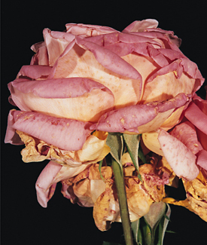
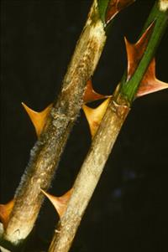
IPM Pest: Botrytis Blight
Occurs during wet conditions at branch tips & flowers
Controls:
-Avoid crowding plants
-Prune out susceptible flowers
-Prune out branches that may
harbor the fungus
-(Prevention) Spray with sulfur-based
fungicide after annual pruning
Notes:
This disease can overwinter easily in the soil. So practice ground “sanitation”.

Slide 30
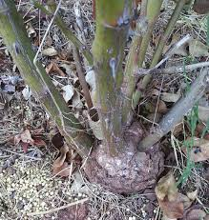
IPM Pest: Crown Gall
Bacterial infection
Controls:
-To prevent, avoid injuring the crown
when cultivating around the rose
-Cut well below the infected growth
to remove gall
-Remove entire plant if crown
is infested
Notes:
This disease can overwinter easily in the soil. So practice ground “sanitation”.

Slide 31
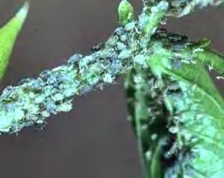
IPM Pest: Aphids
Red, green, yellow, or black
soft-bodied insects
Black color on leaves; honeydew and sooty mold if heavy
Controls:
*Strong stream of water in a.m.
-Control ants
-Insecticidal soaps
-Oils (if temps < 90 degrees) at least 24 hrs. before rain)
Biological Controls:
Natural predators: lady beetles; soldier beetles; syrphid flies
Notes:
Explain why these controls are non-toxic to the environment.

Slide 32
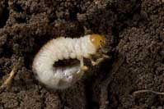
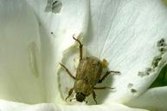
IPM Pest: Hoplia Beetle
One generation per year
Adults feed on light colored blossoms
Controls:
Do regular hand-picking
Discard in a bucket of soapy water
Beetles are attracted to these buckets left in the garden
Biological Controls:
Natural predators: lady beetles; soldier beetles; syrphid flies
Notes:
Adults fly from egg-laying sites to rose gardens. Explain why these controls are non-toxic to the environment. Hoplia beetles are only 1/4” long. They appear between late Mar-May

Slide 33
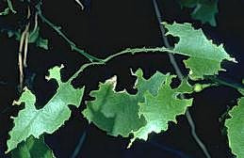
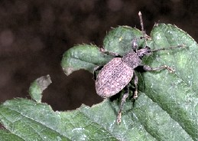
IPM Pest: Fuller Rose Beetle
Wingless weevil, night-feeder
Adults feed on leaves or new blossoms of roses
Controls:
Use proper cultural care; don’t allow other plants’ branches to touch other branches or ground.
Apply Tanglefoot
Pick off adults
Sharp notches on leaves
S
Notes:
These beetles are 3/8” long. Explain what Tanglefoot does & refer to IPM site. Should be painted onto landscape fabric or tape. The beetle is 3/8” long.

Slide 34
Suggested Resources
Books
UC ANR Publication: California Master Gardener Handbook
UCANR Publication #21589: Healthy Roses
Online
Integrated Pest Management of Roses. Cornell University Coperative Extension
http://www.gardening.cornell.edu/factsheets/ecogardening/ipmrose.html
Roses: Diseases and Disorders: Integrated Pest Management for Home Gardeners and landscape Professionals. July, 2019. UCANR Publication 7463. http://ipm.ucanr.edu/PMG/PESTNOTES/pn7463.html
Roses in the Garden and Landscape: Cultural Practices and Weed Control.
February, 2020. UCANR Publication7465. https://ucanr.edu/sites/sjcoeh/files/309219.pdf
More
Rapp, Larry. How to Bud Roses. University of Utah Cooperative Extension. September , 2014.https://www.youtube.com/watch?v=siKRJSGT4sY

Slide 35
Thank You!
Any Questions?
Master Gardener Hotline: (530) 889-7388
Master Gardener Website: pcmg.ucanr.org

