Slide 1
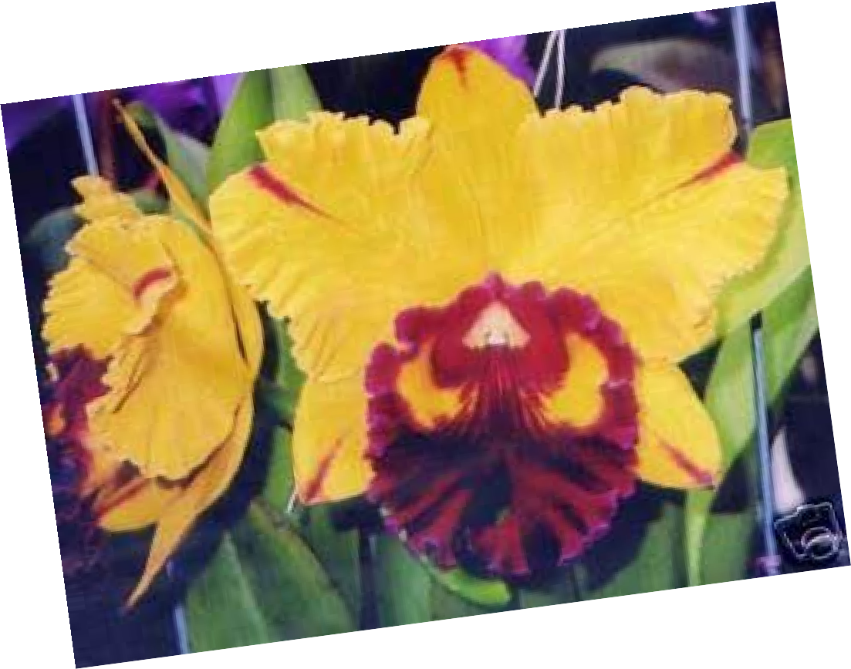
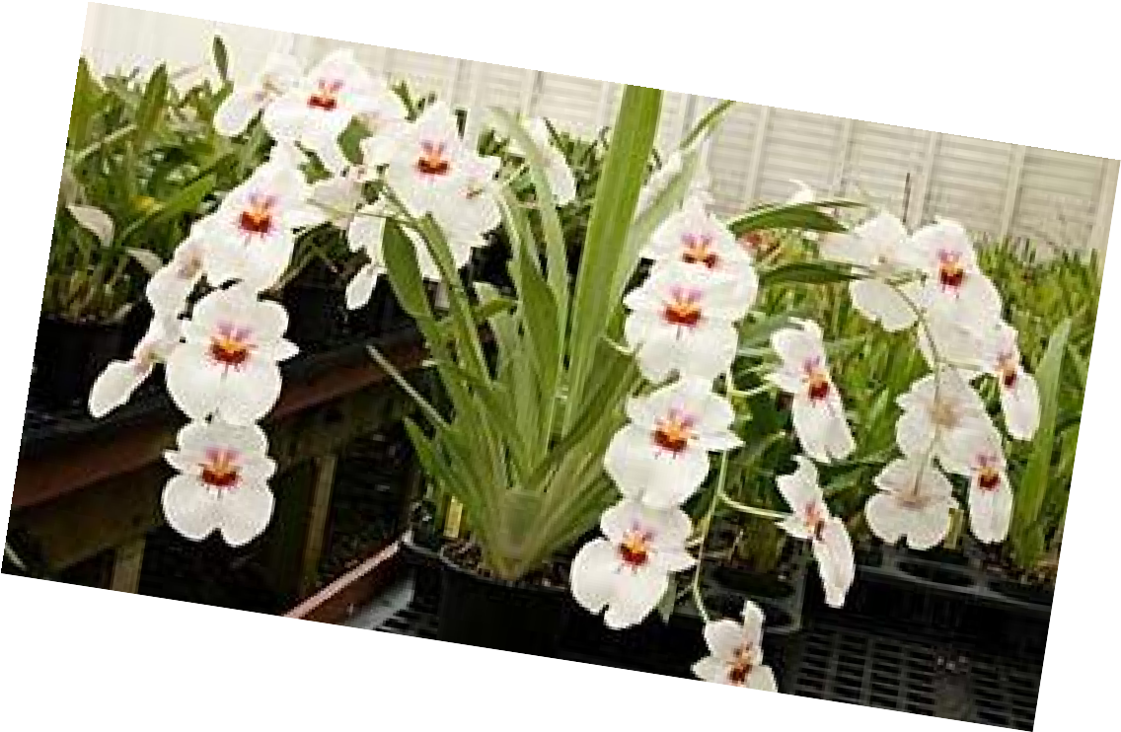
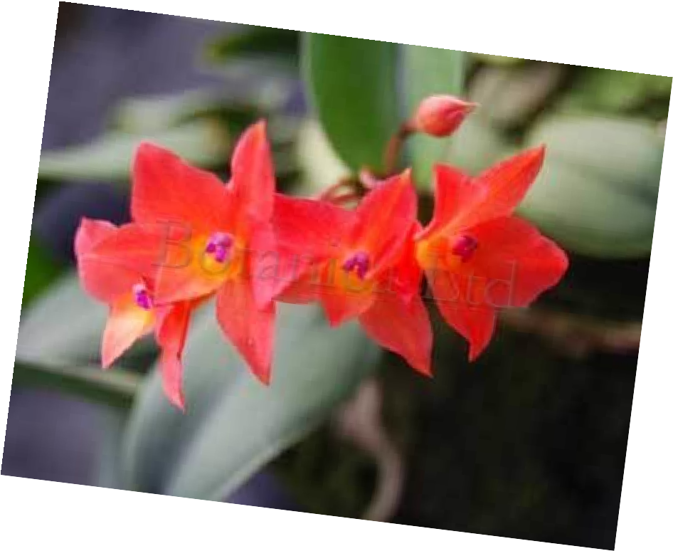
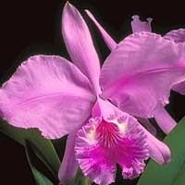
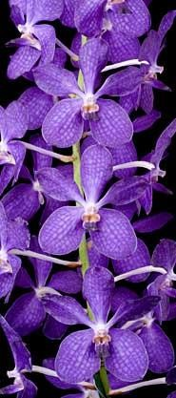


Orchid-mania
Bonnie Bradt
Nevada County Master Gardener

Slide 2
Orchid Facts
Orchids are the largest family of flowering plants (angiosperms)
The majority of orchids in the wild live as “perennial epiphytes” growing anchored on the bark of tropical trees or shrubs but not getting nutrients from them
Orchids belong to the “monocots” (like grasses, bamboo, lilies, cannas, irises, tulips, daffodils)
END OF SCIENTIFIC STUFF

Slide 3
More Orchid Facts
Orchids are primarily grown for their beauty and sometimes for their sweet scent
Orchids are found growing in almost every habitat except deserts and glaciers although most are tropical
“Vanilla” beans are the only edible fruit of the orchid family (yep, it’s an orchid)
It is UNTRUE that growing orchids is hard…
It IS ABSOLUTELY TRUE that getting orchids to BLOOM can be hard!!

Slide 4
In Order of Popularity…

Slide 5
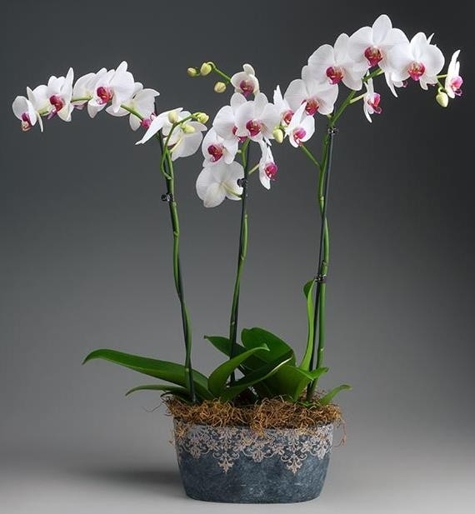
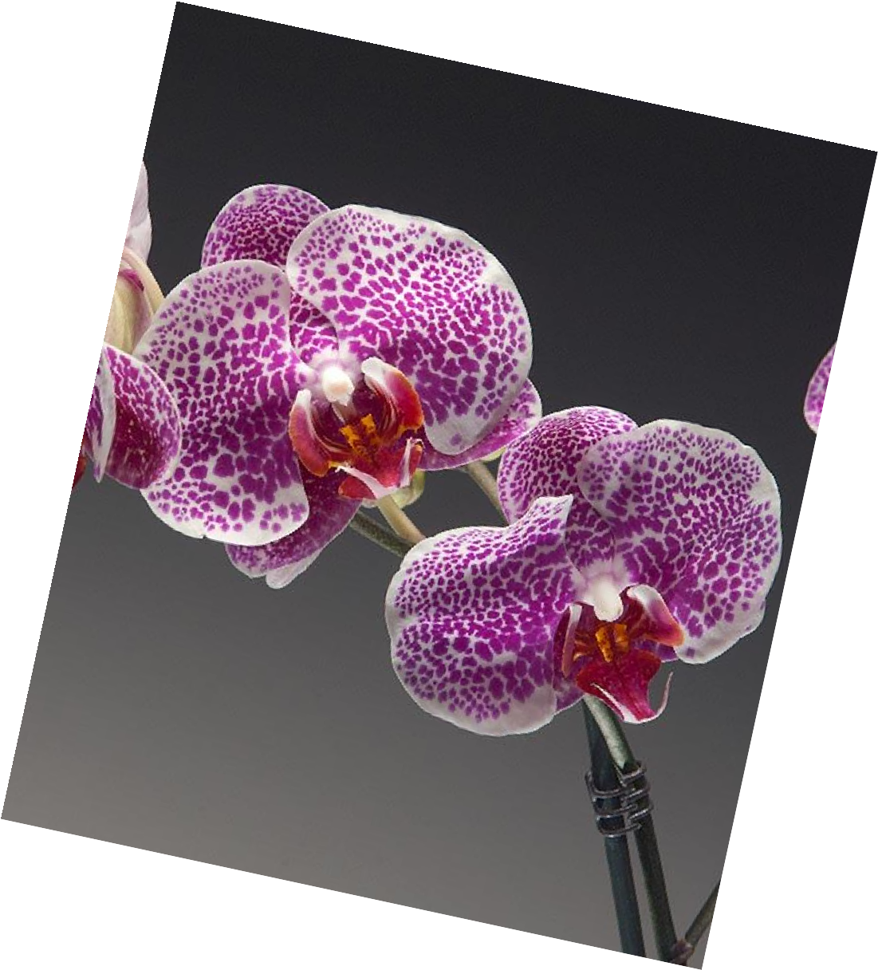
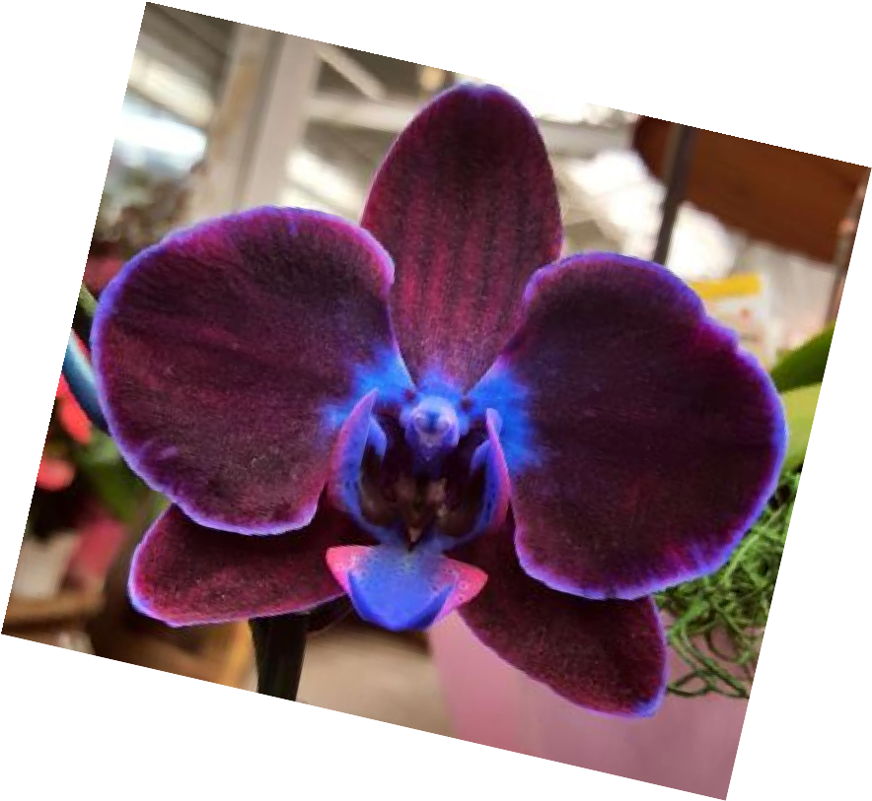

Moth Orchid
Phalaenopsis

Slide 6
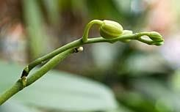
Moth Orchid (cont.)
Only Phalenopsis can rebloom from a previous bloom spike
BUT…

Slide 7
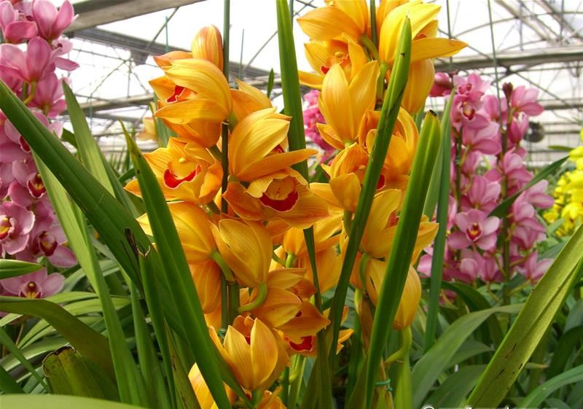
Cymbidium Orchid

Slide 8
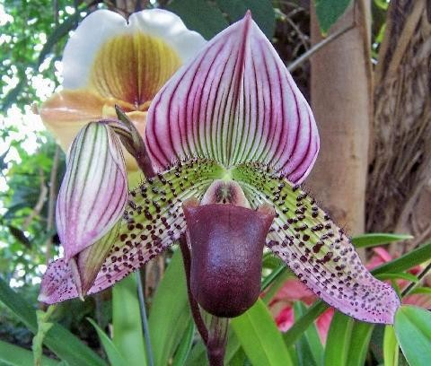
Ladyslipper Orchid
Paphiopedelum

Slide 9

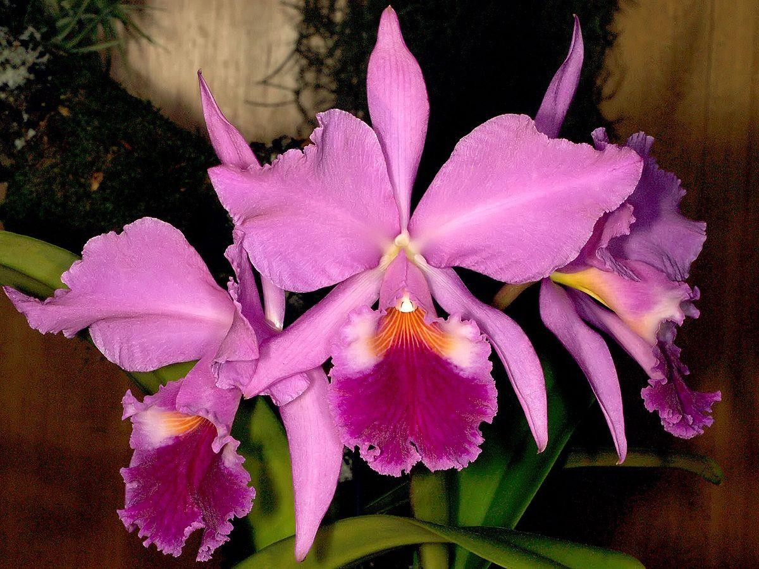


Cattleya- The Corsage Orchid

Slide 10
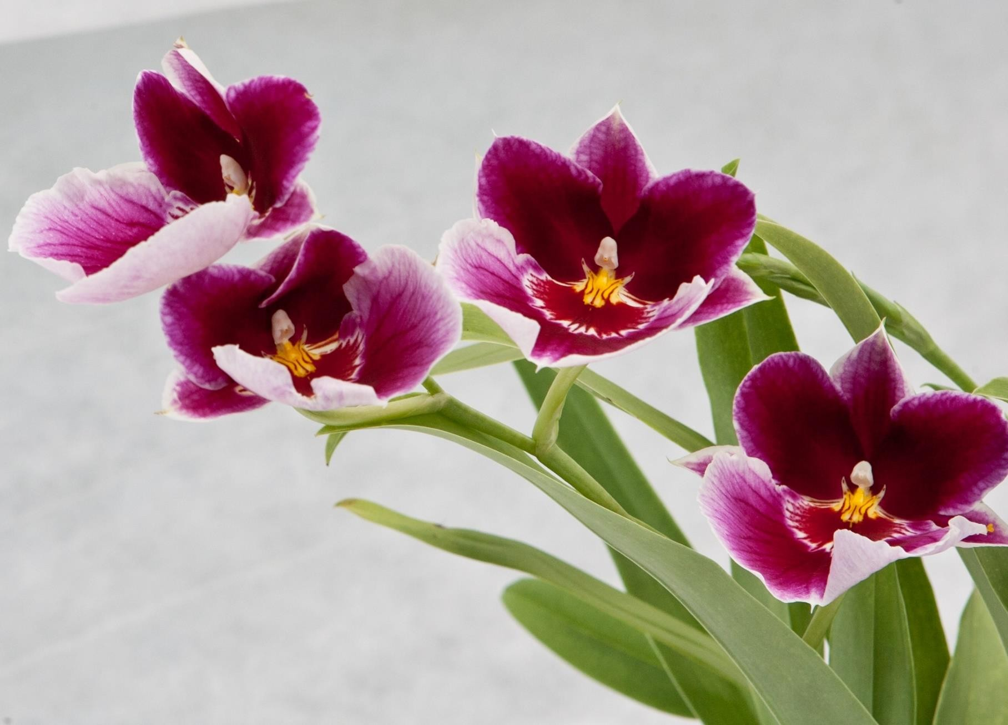
Miltonia- The Pansy Orchid

Slide 11
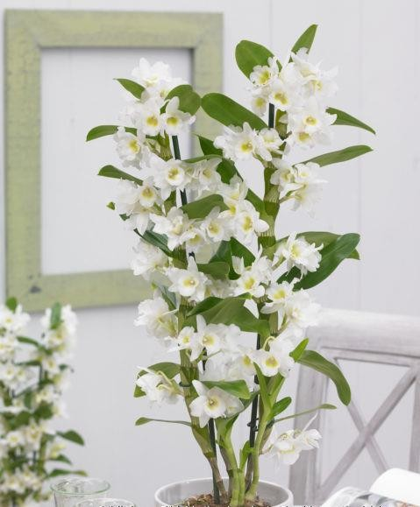
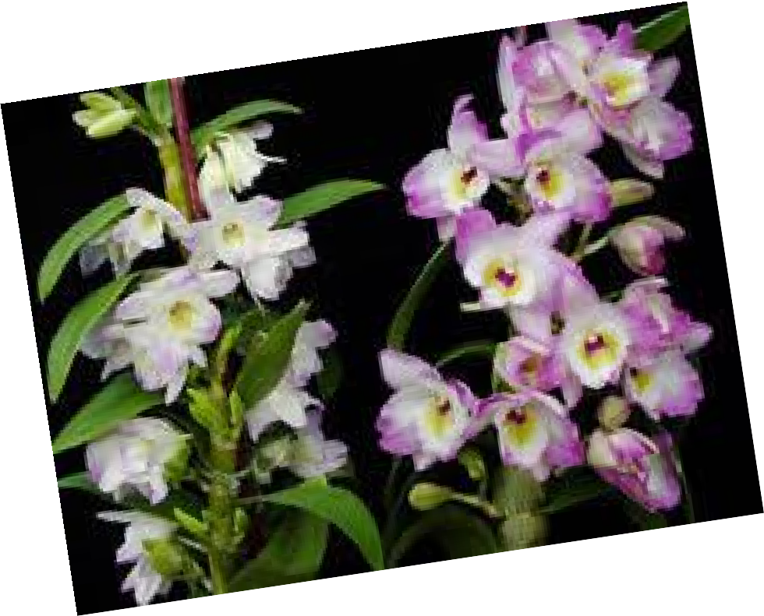
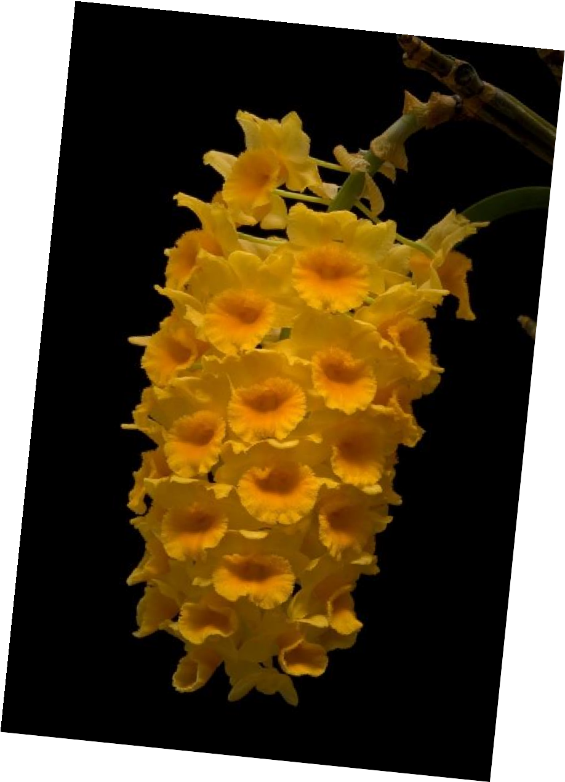
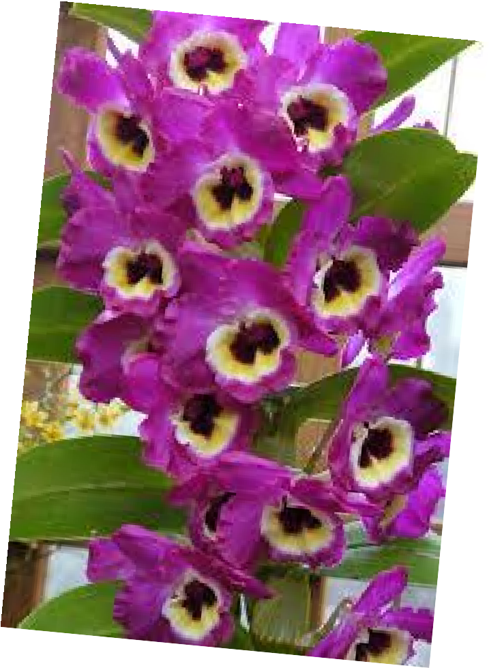
Dendrobium Orchid

Slide 12
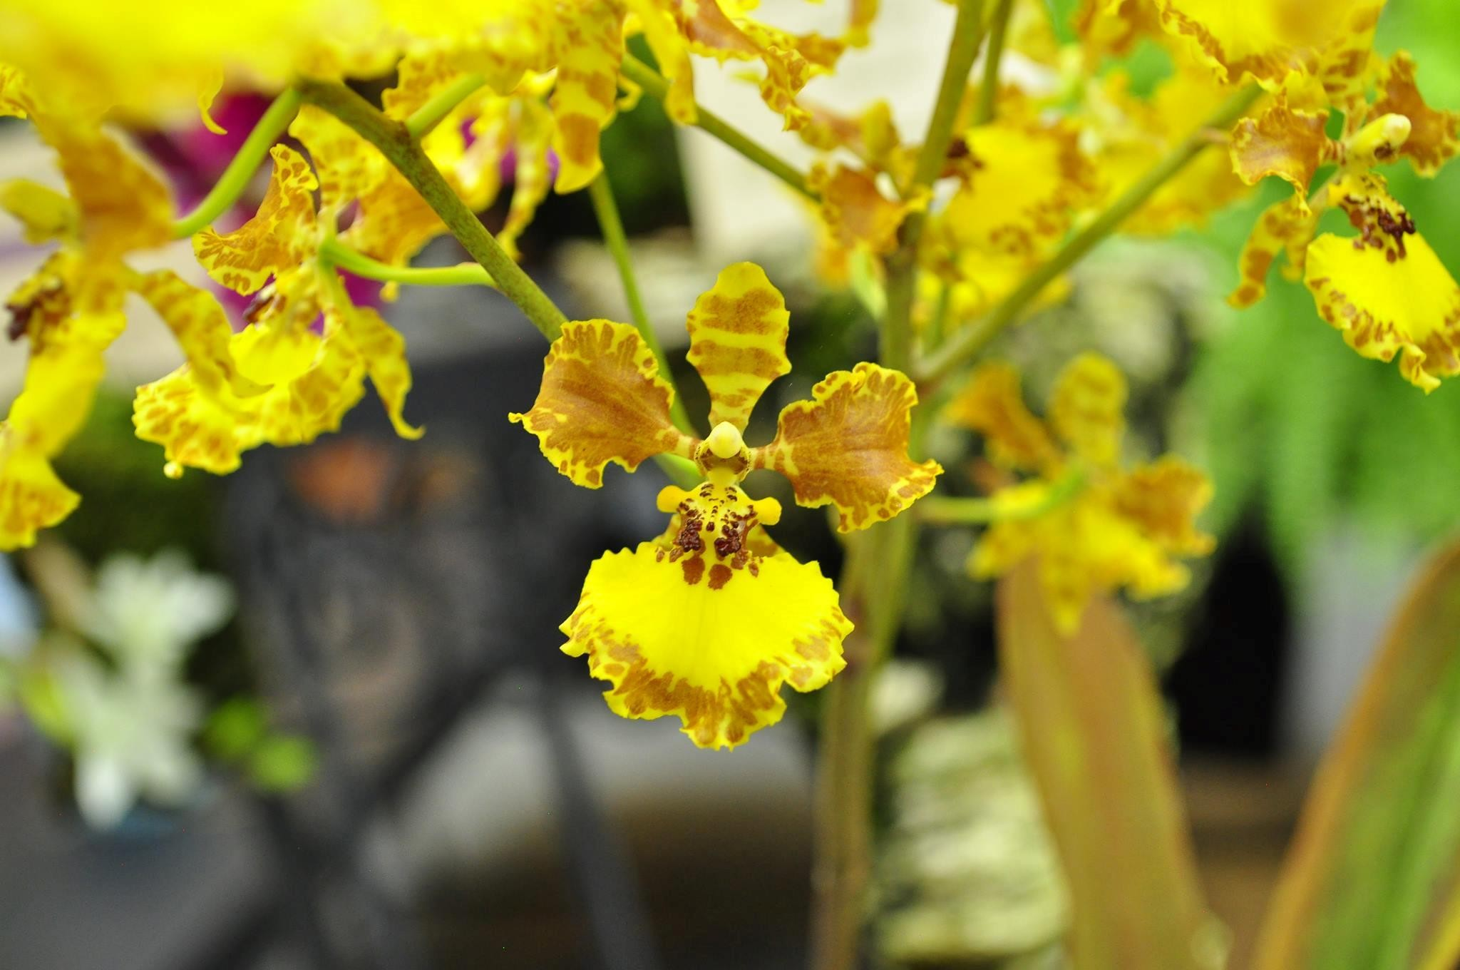
Oncidium Orchid

Slide 13
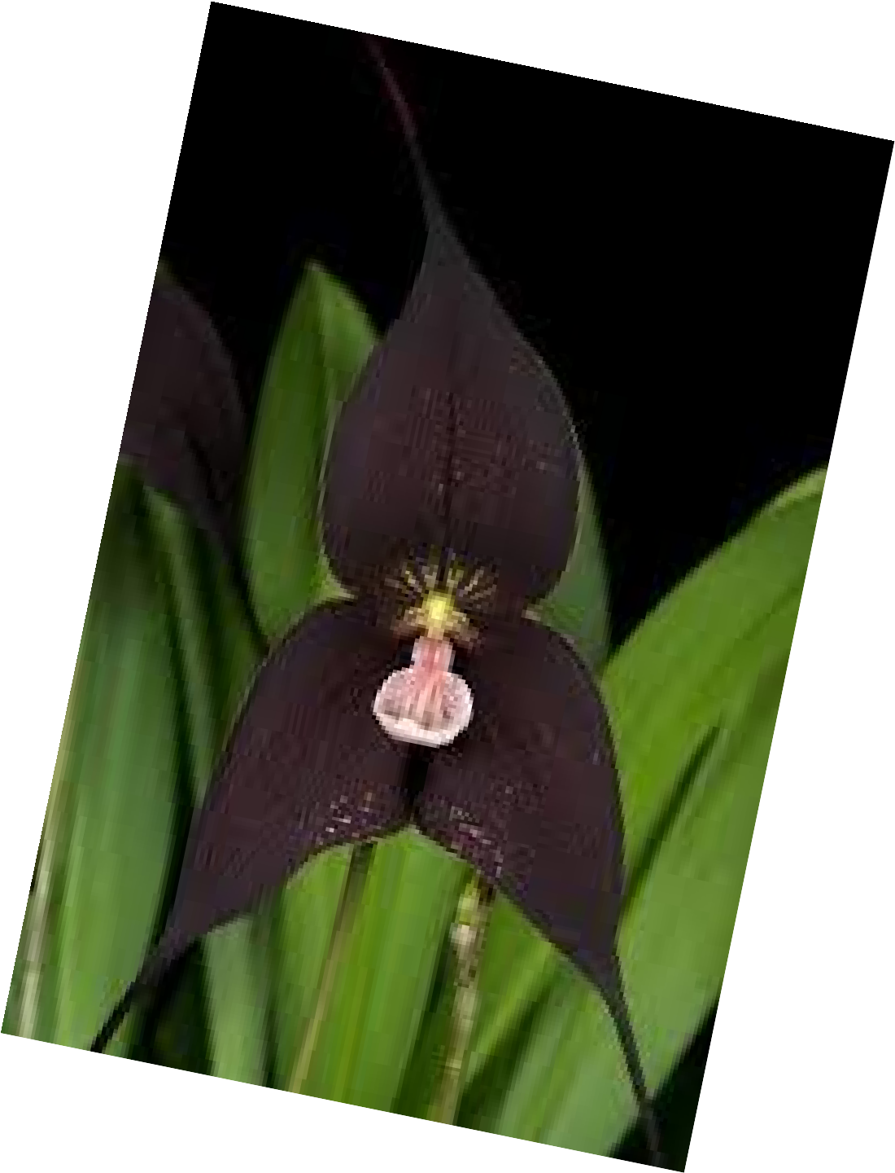
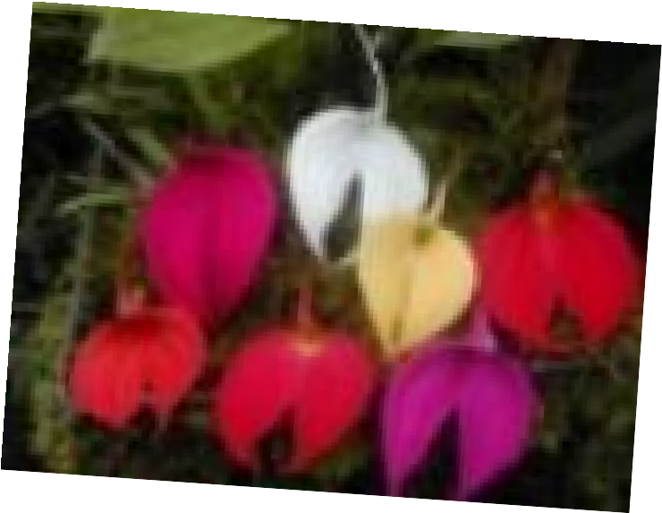
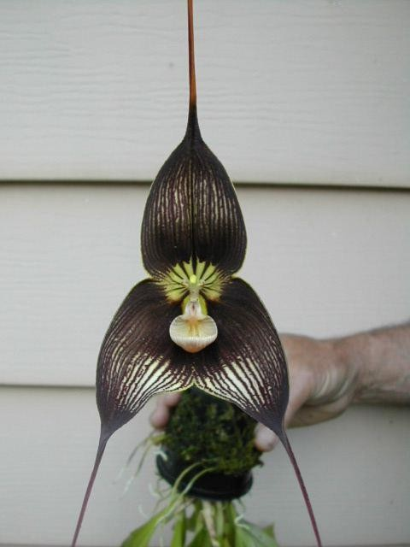
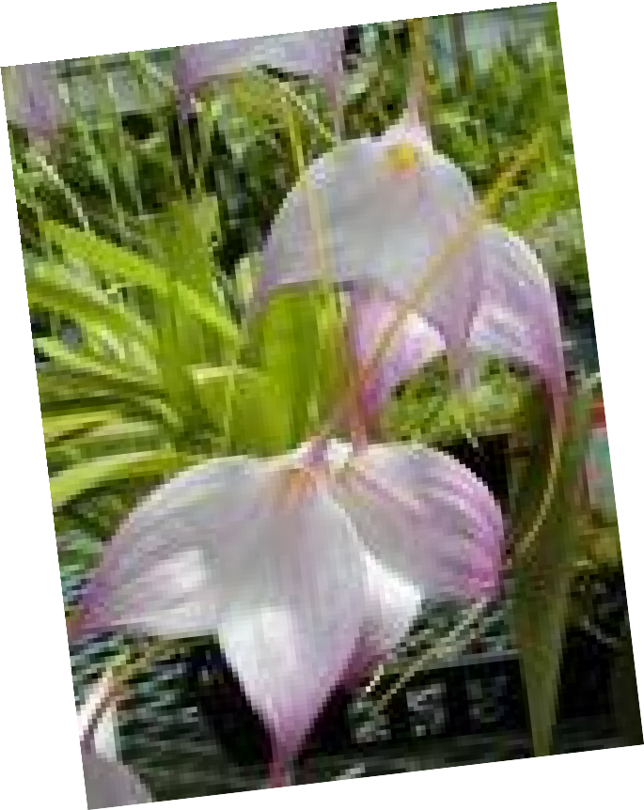
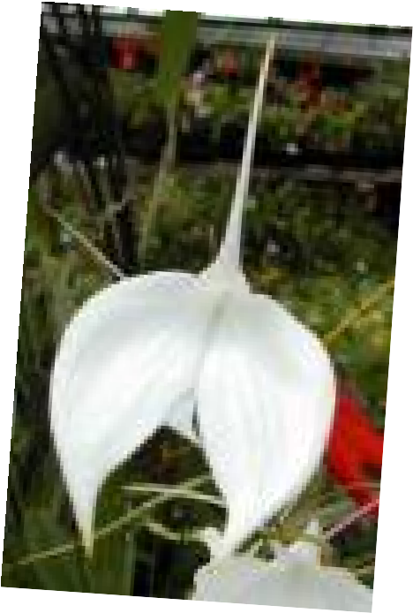
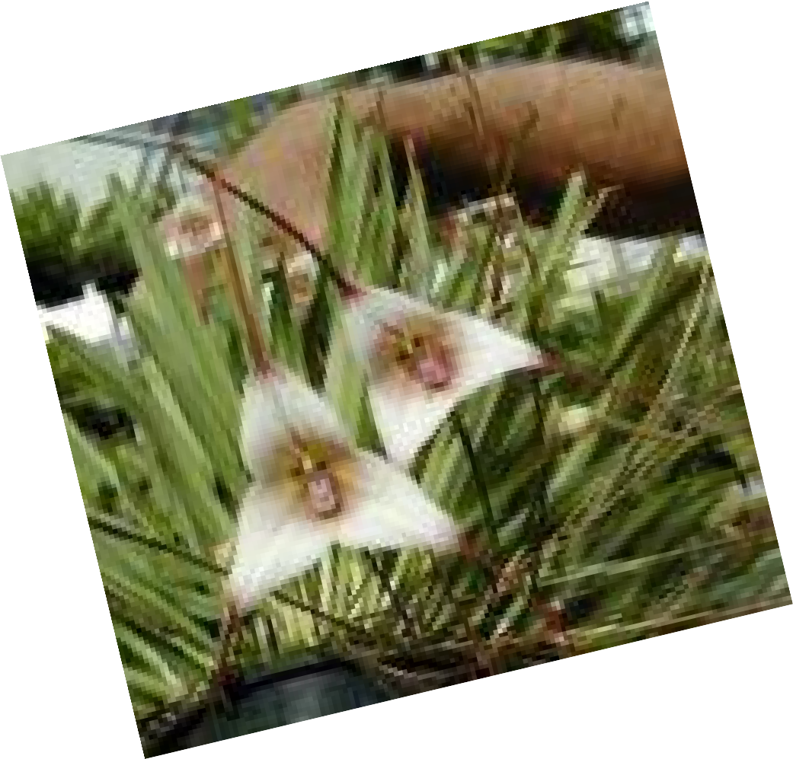
Masdevallia Orchid

Slide 14
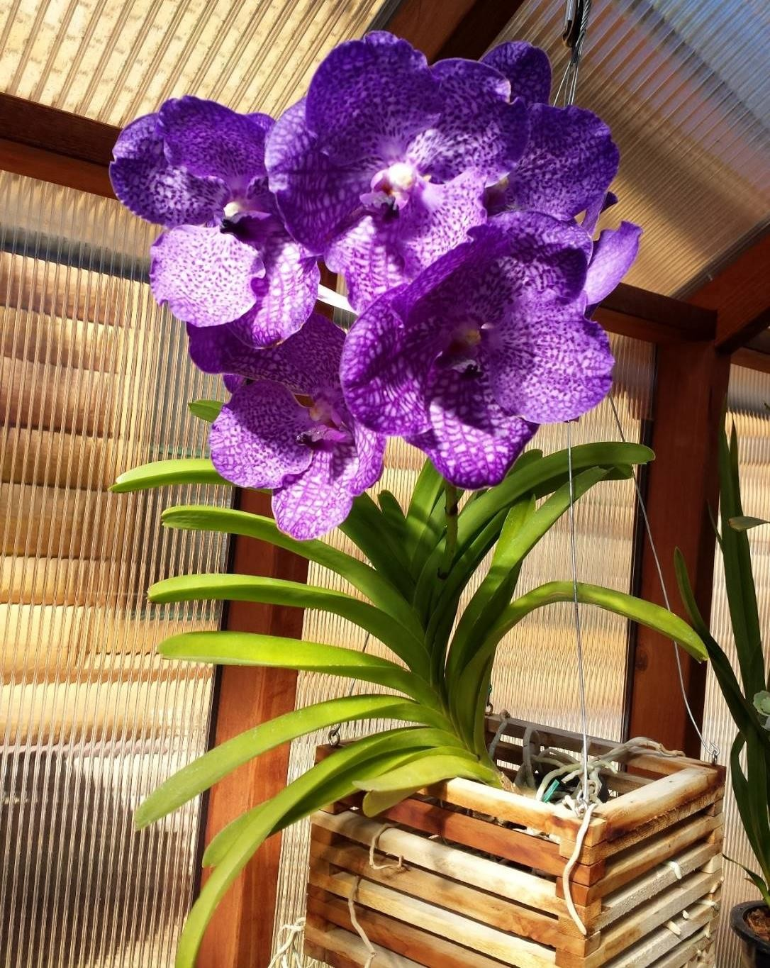

Vanda Orchid

Slide 15
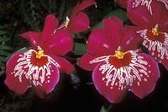
The Wonderful World of Hybrids
Miltoniopsis- Miltonia + Phalenopsis

Slide 16
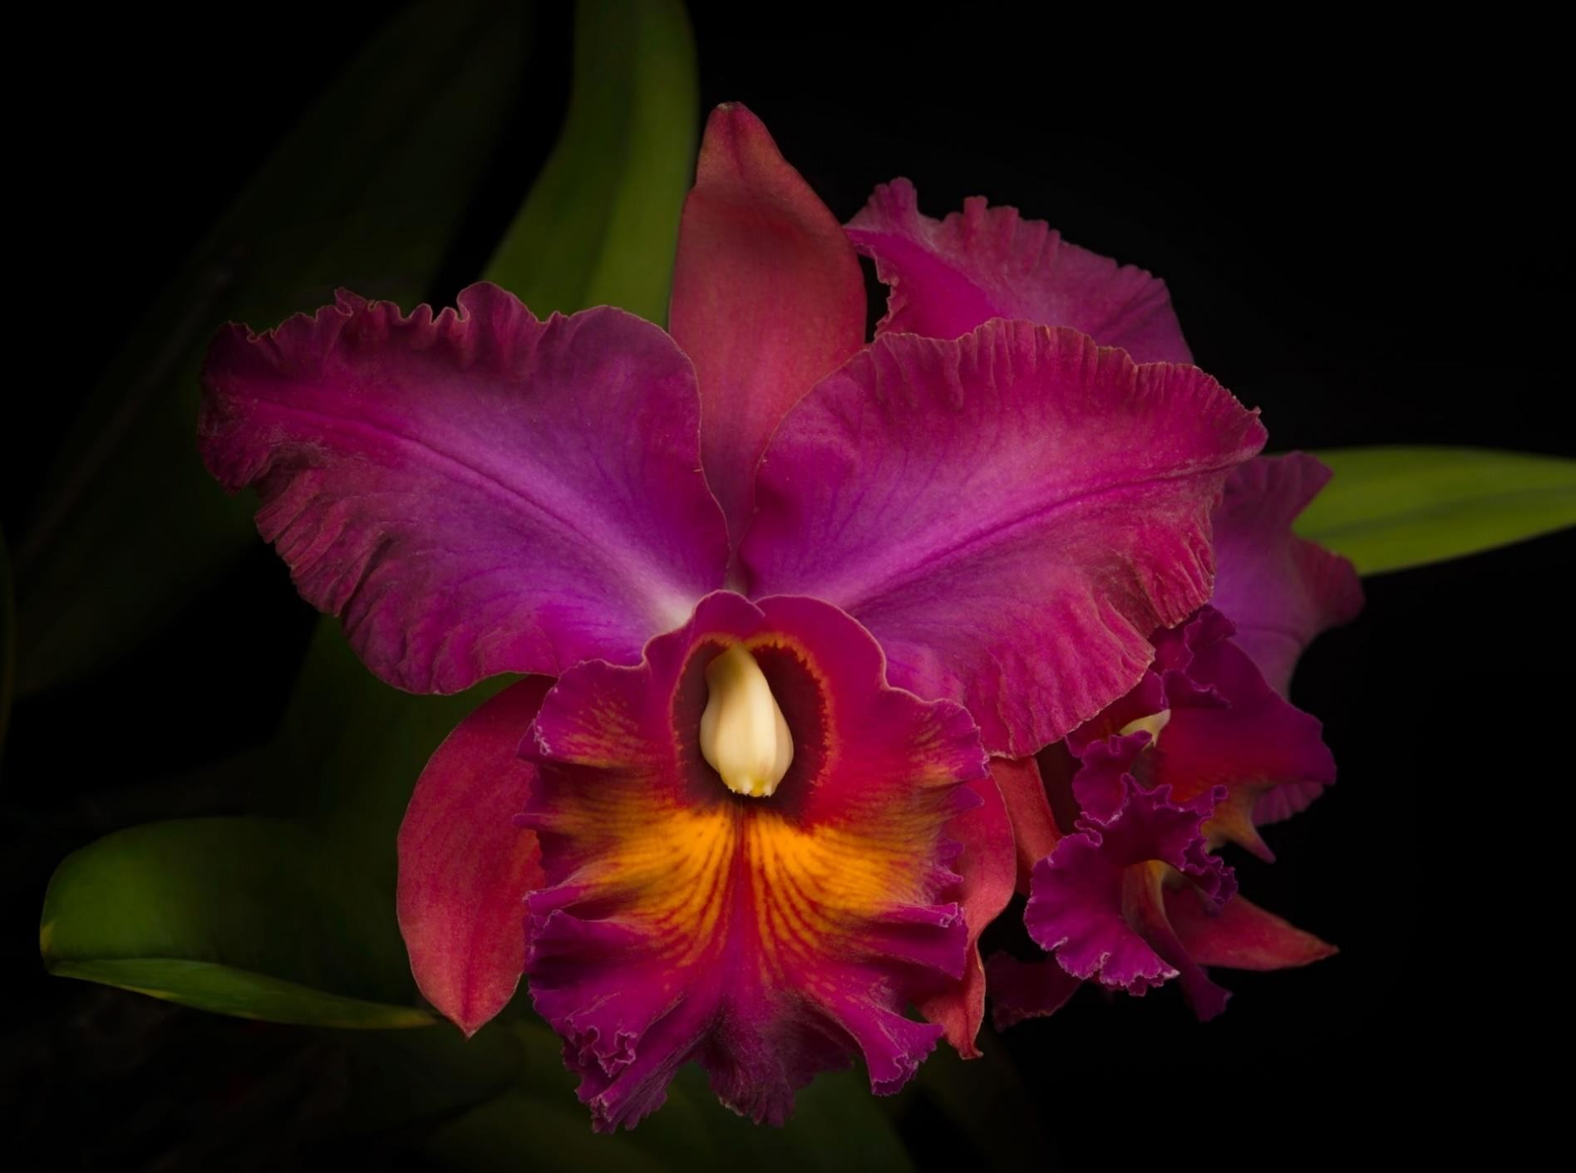
The Wonderful World of Hybrids
Rhyncholaelia + Cattleya

Slide 17
The Only Orchid Producing a Commercially Important
Edible Fruit is…

Slide 18
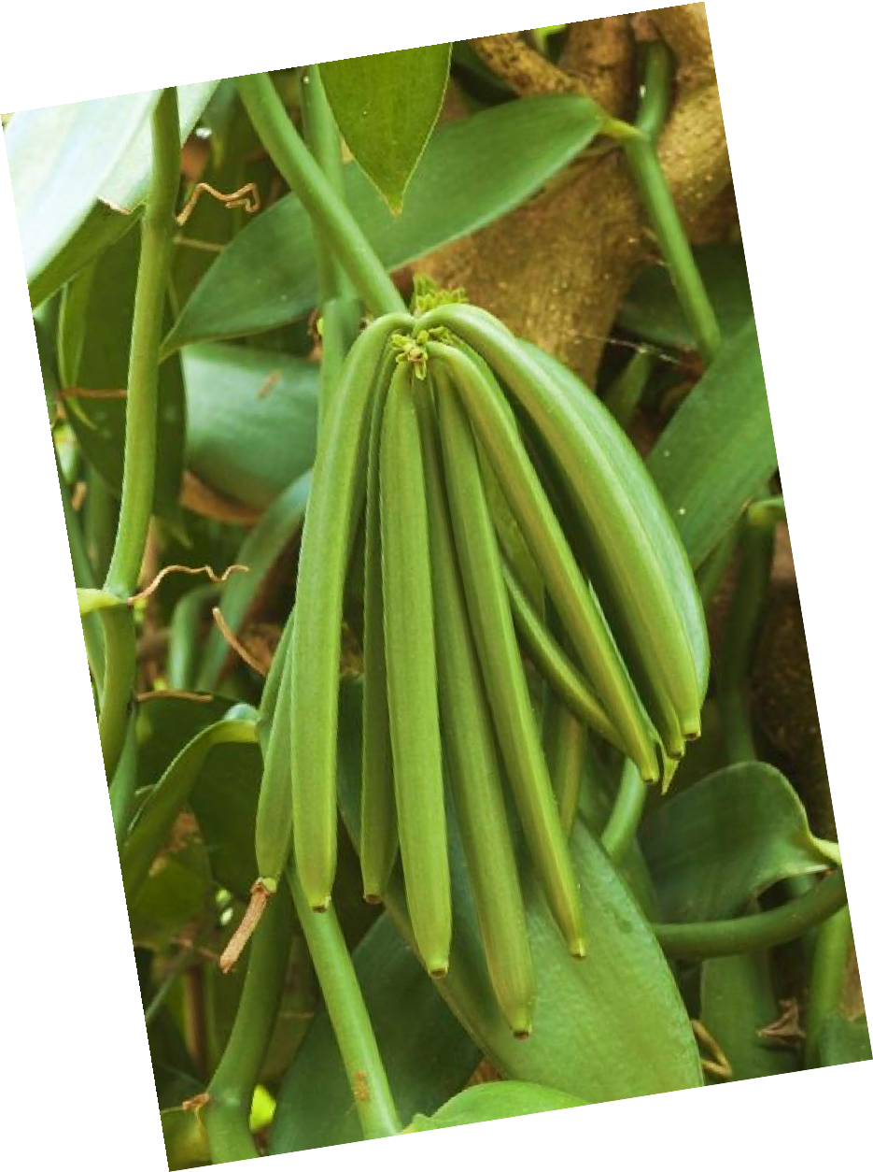
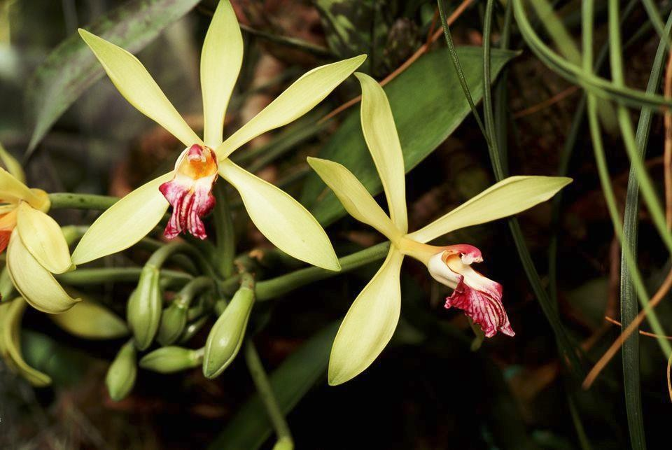
The Vanilla Orchid
Vanilla planifolia

Slide 19
Vanilla Orchid
Native to Mexico. Also grown in Madagascar, Tahiti,
India, Uganda, Central America. Grown from cuttings.
Vanilla is one of the most labor intensive agricultural products in the world. Expensive!
The orchid bloom appears and dies within a few hours unless pollinated by its own pollinating bee or by hand (commercially, done by hand)
The beans (seed pods) must stay on the plant for 9 months before harvesting.
They are then hand picked, go through a curing, drying and resting process up to five months.

Slide 20



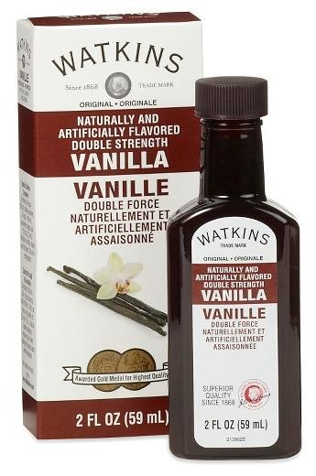
Vanilla (cont.)
PURE!!
PARTLY FAKE!!
FAKE!!

Slide 21
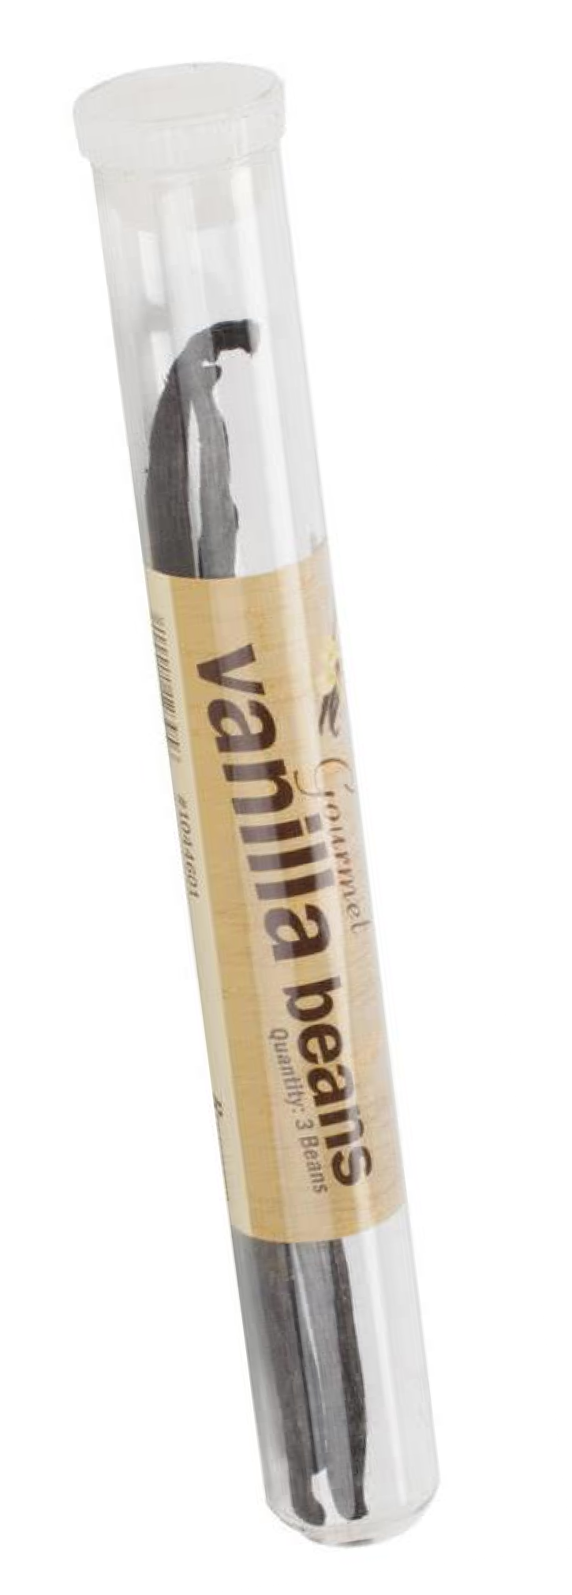
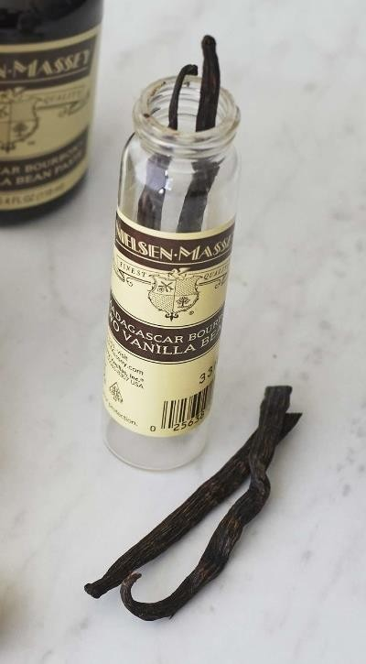
Vanilla (cont.)
2 beans- stored in glass, $20+
“…if consumers become overexposed to the taste of fake vanilla, which is prevalent in processed sweets, they'll lose sight of how good the real thing is…
Patricia Rain, author of Vanilla: The Cultural History of the World's
Favorite Flower

Slide 22
Orchid Care 101

Slide 23
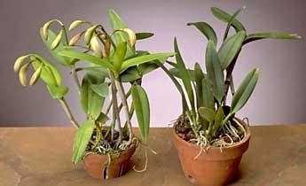
Light

Slide 24
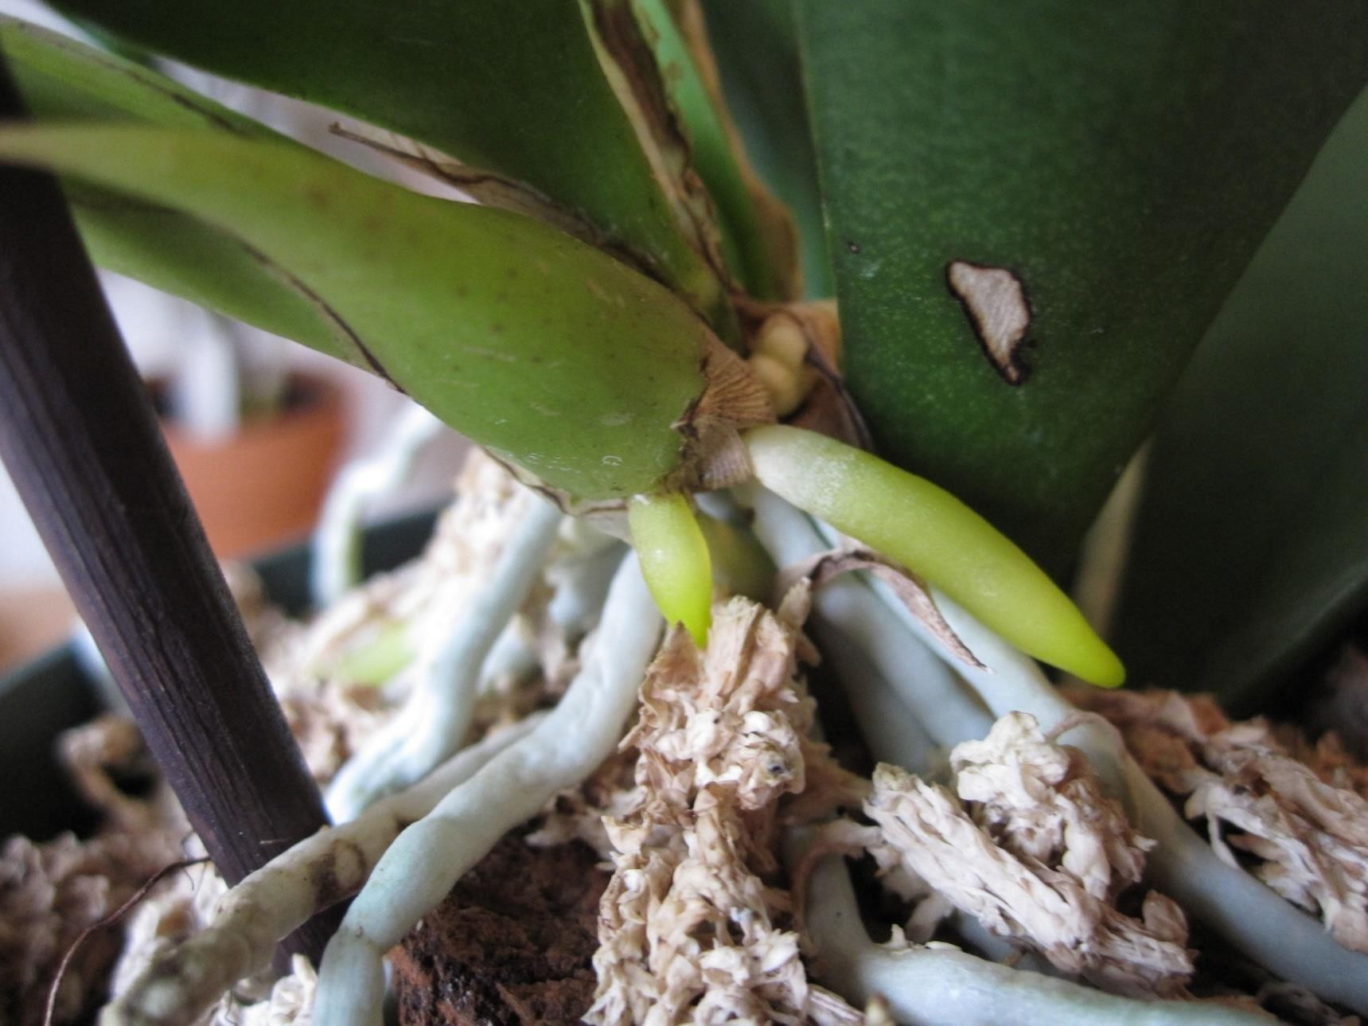
Water – Healthy Roots

Slide 25
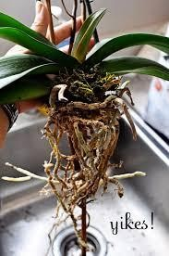
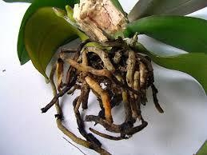
Water – Yucky Roots

Slide 26
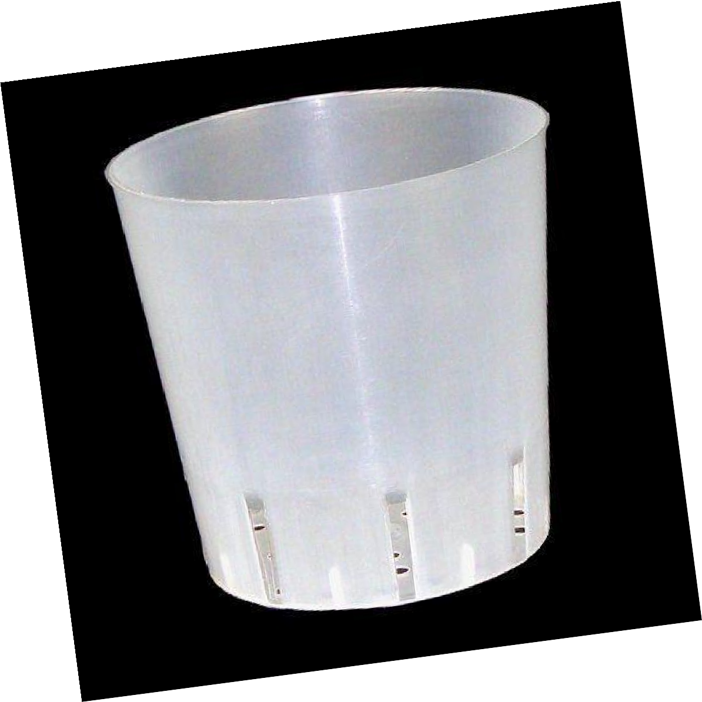
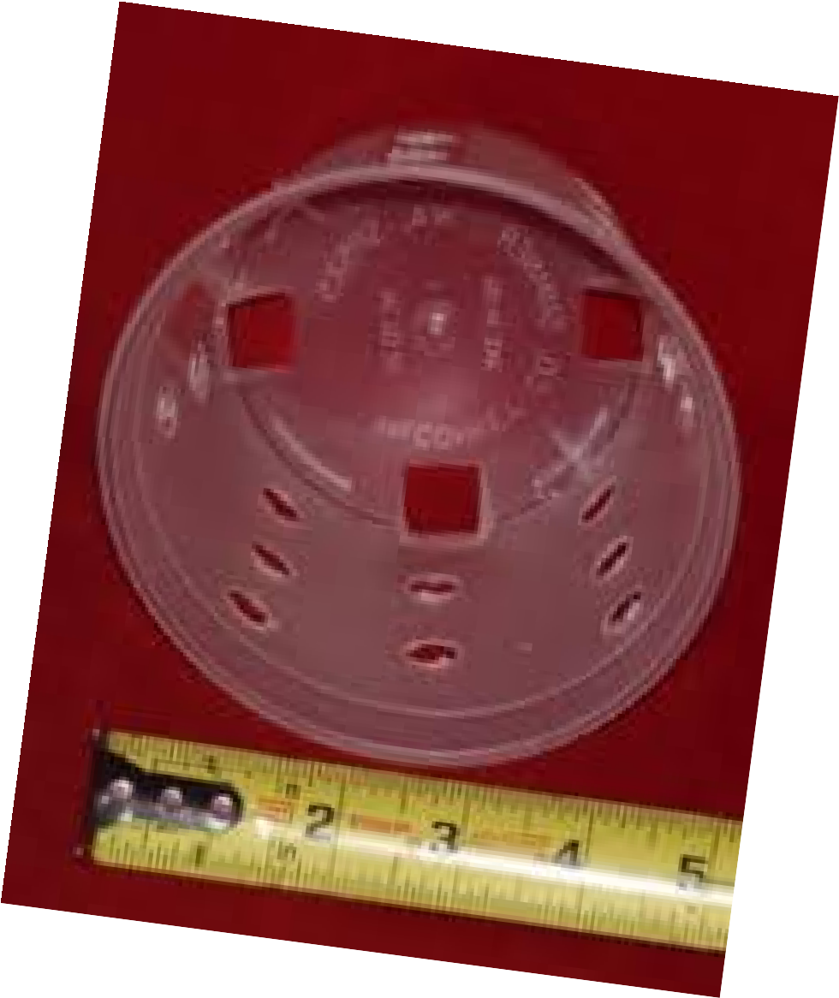
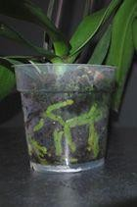
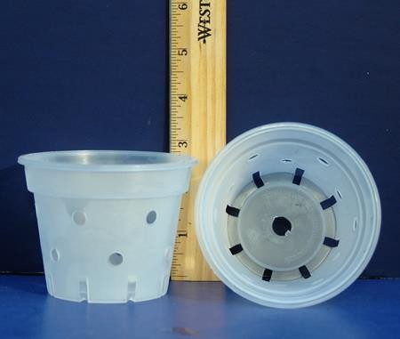
Helps to be Able to See the Roots

Slide 27

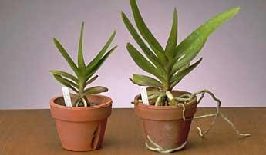

Fertilizer

Slide 28
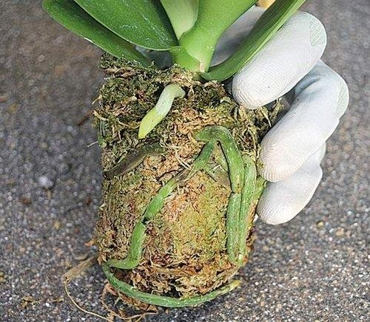
Orchid Repotting
Orchids don’t mind being crowded
If necessary, repot after bloom….~2-3 yrs
Orchids need drainage and air
Repot immediately if they are in solid sphagnum moss

Slide 29
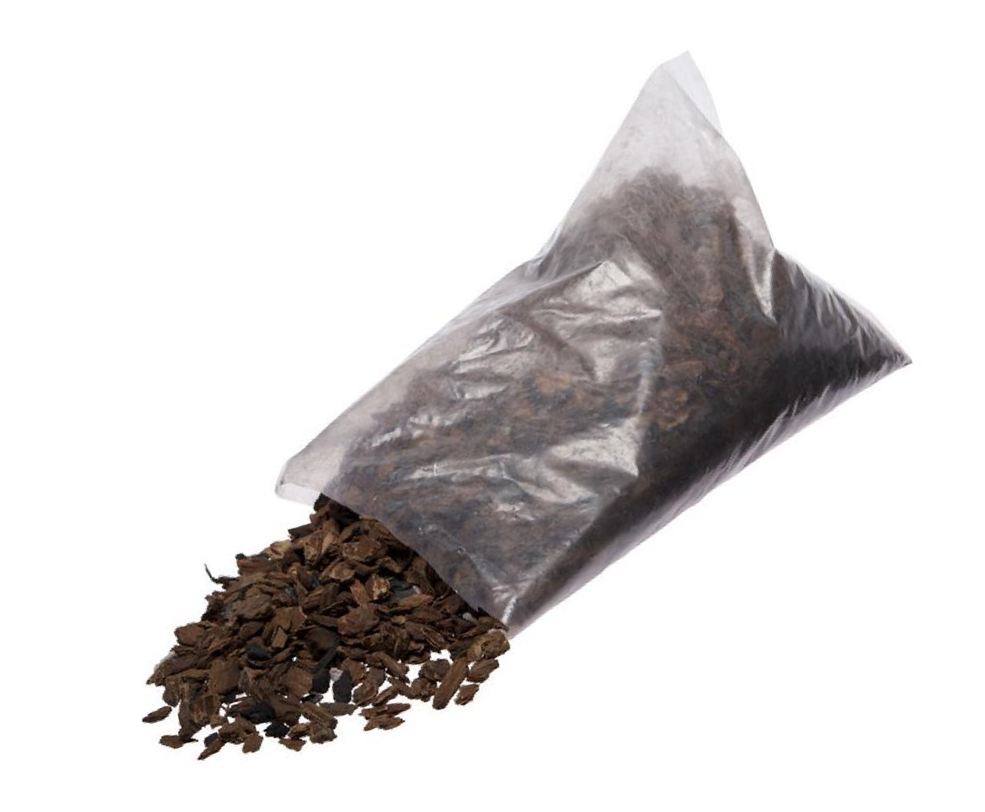
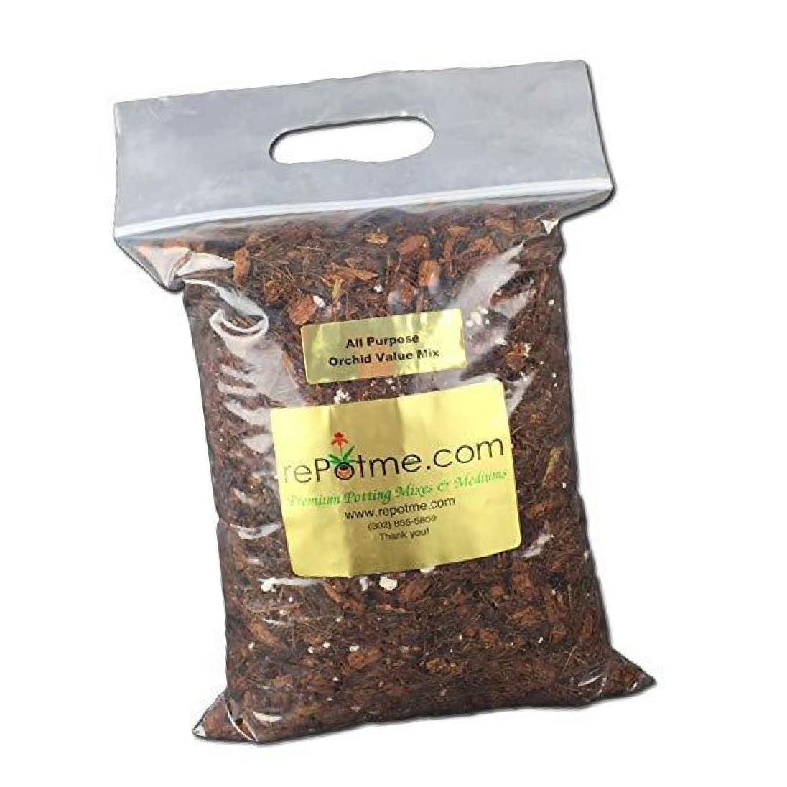
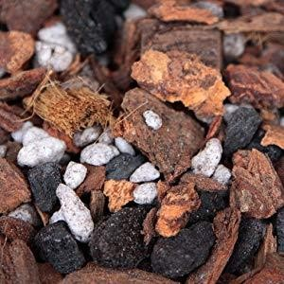
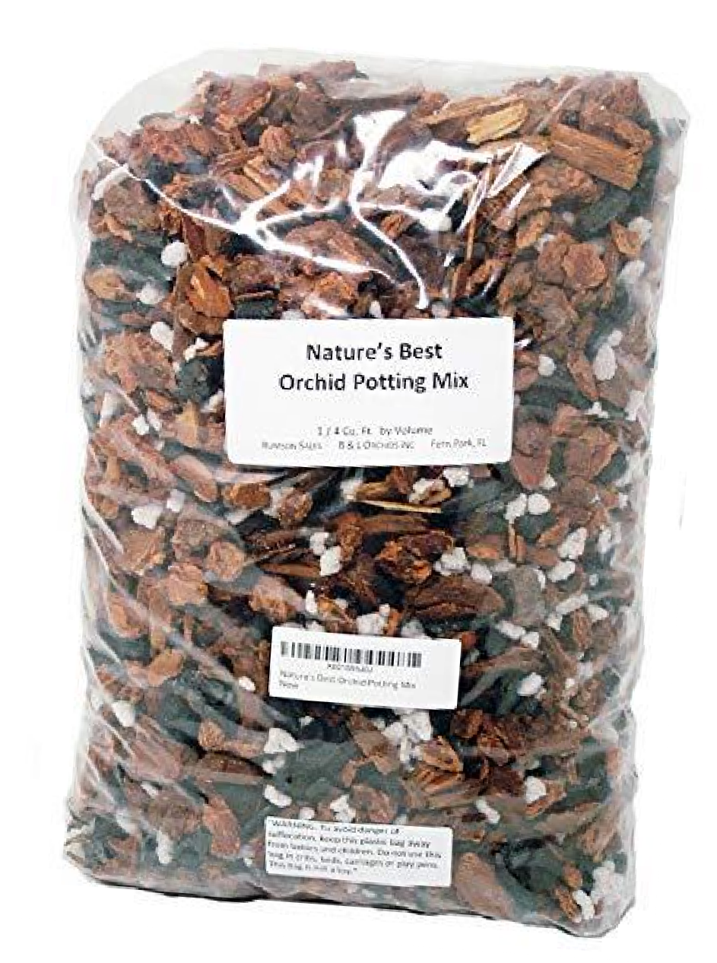
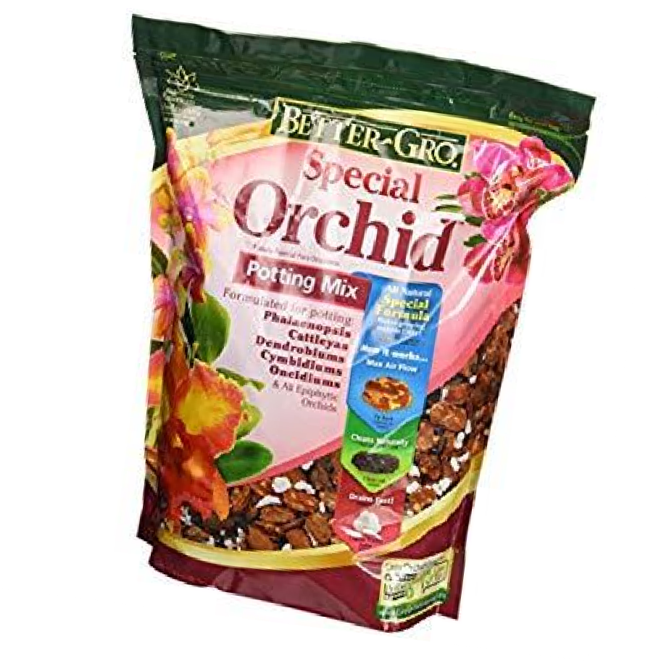
Orchid Repotting Mix
Fir bark, sponge rock (perlite), charcoal, sphagnum moss, coconut products

Slide 30
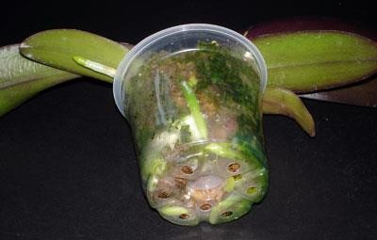
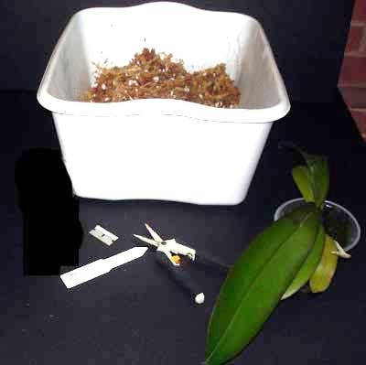
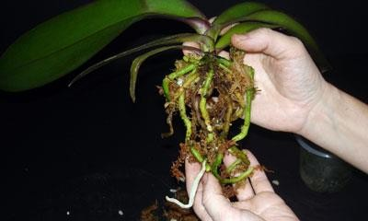
Orchid Repotting

Slide 31




Orchid Repotting

Slide 32


Slide 33

Culture Sheets American Orchid Society
www.aos.org

Slide 34


Slide 35


Slide 36







The San Francisco Orchid Society
Pacific Orchid Exposition
Show and sale Feb 24-26, 2023 Hall of Flowers, Golden Gate Park www.orchidsanfrancisco.org

Slide 37

Breathtaking Orchid Displays

Slide 38

As Far as the Eye Can See…

Slide 39


Slide 40


Slide 41


Slide 42


Slide 43


Slide 44


Slide 45

Orchids for Show and…

Slide 46



Orchids for Sale

Slide 47



Orchid Diseases/Pests

Slide 48




Orchid Diseases/Pests

Slide 49


Thank You

