Slide 1
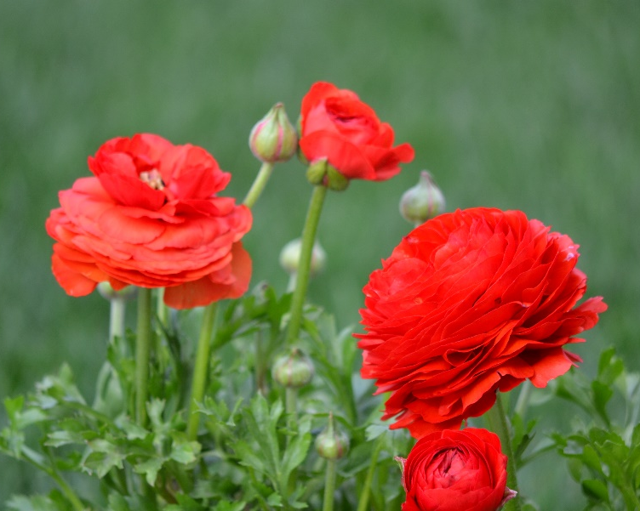
Bulb Planting for Spring Color
Photo: S.Fitzpatrick
Notes:
Created: October 3, 2021
Created by: Sandi Fitzpatrick
Audience: New gardeners
Publicity: Fall is bulb-planting season! A time for gardeners to project themselves into the future -- specifically next spring. Anyone who wants clutches of tulips, clumps of hyacinths or dozens of daffodils in their spring garden must plan and plant in Fall. This hour long session will cover bulbs of all kinds, from buying and planting to caring and naturalizing. Learn how deep to plant daffodils, for example, or why tulip bulbs might need to be refrigerated before planting.
Update History: Initially adapted from PowerPoint initially created by Ann Beinhorn and Marie Salers; Updated 9/2022 to add “lasagna” planting information.

Slide 2
Who Are Master Gardeners?
Master Gardeners of Placer County
  Extend research-based, sustainable gardening and composting information
  Present accurate, impartial information to home gardeners
  Encourage public to make informed gardening decisions

Slide 3
Who Are Master Gardeners?
Where to find us…
Online, in the Media, and Special Publications
  Hotline: Call (530) 889-7388 or submit your questions online
  Website: pcmg.ucanr.org
  Facebook, Twitter, Instagram
  Gold Country Media monthly column
  Curious Gardener quarterly newsletter and on our website
  Gardening Guide and Calendar

Slide 4
Who Are Master Gardeners?
Where to find us…
Workshops, Fairs and Festivals, and Special Events
  Speakers by Request
  Workshops (various venues, check website)
  Farmers’ Markets (seasonal: at Auburn and Roseville; Sunday’s at Fowler’s Ranch, and coming next spring Sun City Lincoln)
  Fairs and Festivals Booths (varies)
  Garden Faire (April)
  Mother’s Day Garden Tour (May)

Slide 5
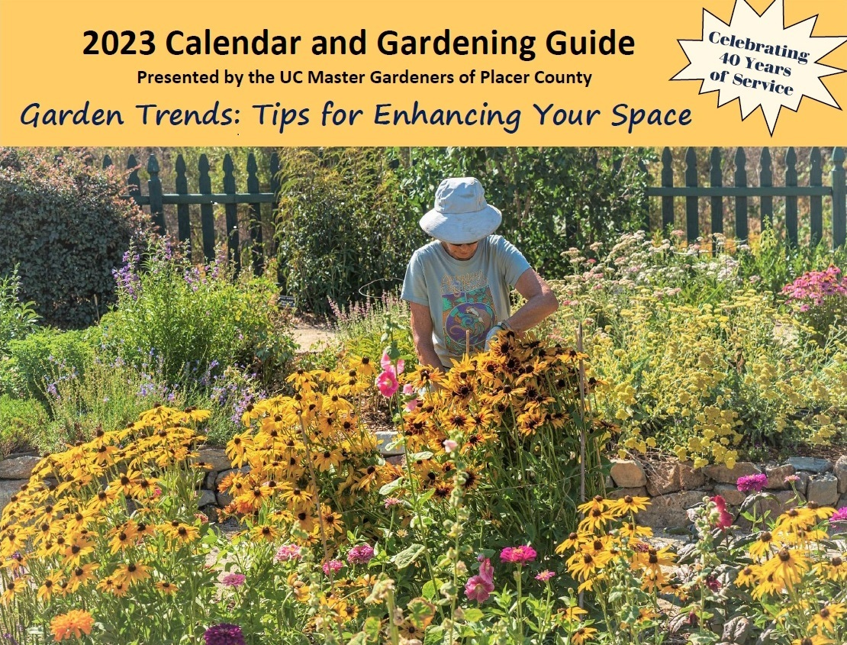
Get your gardening guide before they are all sold out!
Notes:
Some of you might know us for our annual gardening guide/calendar. This is the cover of our 2023 guide. The guide provides helpful garden hints for every month and almost every day. This is a useful tool for people living in Placer, Nevada and El Dorado counties. The guides also make excellent holiday gifts.
2. Our calendar/guide is one sale now. Look for it either on-line or at our many vendors.

Slide 6
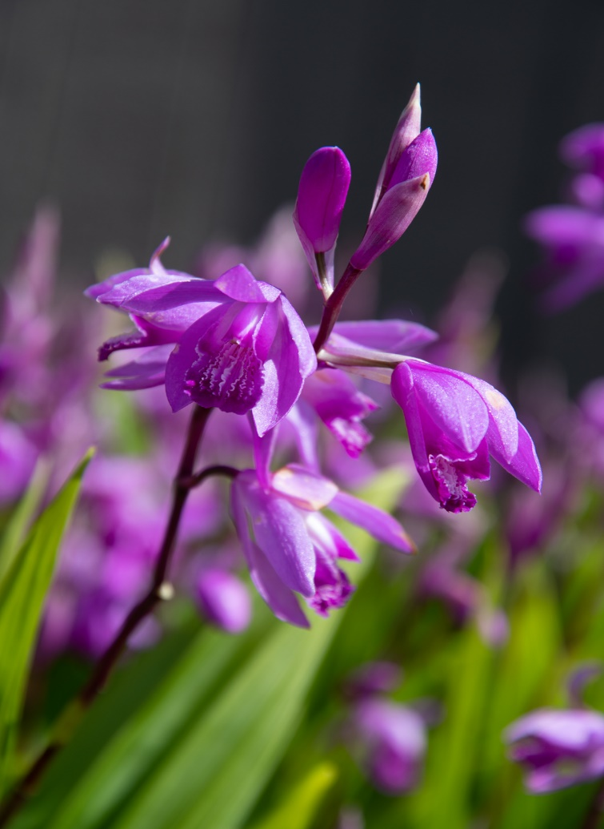
Today’s Topics
Bulb Basics
Bulb Structures
Planting
Maintenance
Pest Management
Forcing
Chinese Ground Orchid Photo: D. Kuroda
Notes:
Today’s topics will include the basics of growing spring bulbs in your garden. Specifically we will look at bulb basics, bulb structures, planting, maintenance, pest management and forcing.
2. While this presentation is primarily on spring bulbs, many summer/fall flowers grow from bulb-like structures, including this Chinese Ground Orchid. Other Examples include gladiolus, dahlias, lily flowers, tuberous begonias and cannas.
3. The picture is of the Chinese Ground Orchid which has small pinkish-purple flowers for weeks in spring. There is also a white variety. The petite blossoms which grow on an 18” stem reflecting the plant name. Chinese ground orchid retains it foliage until it is killed back by frost, making it an unique bulb. My mother-in-law has many clusters of these bulbs and calls them “poor man orchids.”

Slide 7
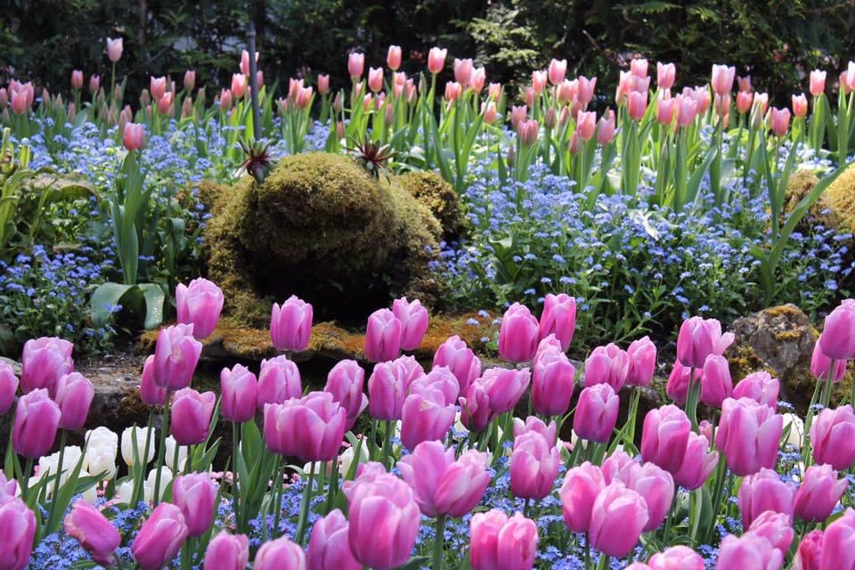
Photo: L. Merrick taken at Butchart Gardens, British Columbia, Canada
A bulb is a plant that stores its complete life cycle in an underground storage structure.
Bulb refers to a specialized group of perennial plants that reappear year after year.
Notes:
A bulb is defined as a plant that stores its complete life cycle in an underground storage structure.
2. In general, “bulb” refers to a specialized group of perennial plants that reappear year after year.
3. This beautiful photo of mostly tulips was taken by Lynn Merrick, a Placer County master gardener, while visiting the Butchart Gardens in British Columbia, Canada.

Slide 8
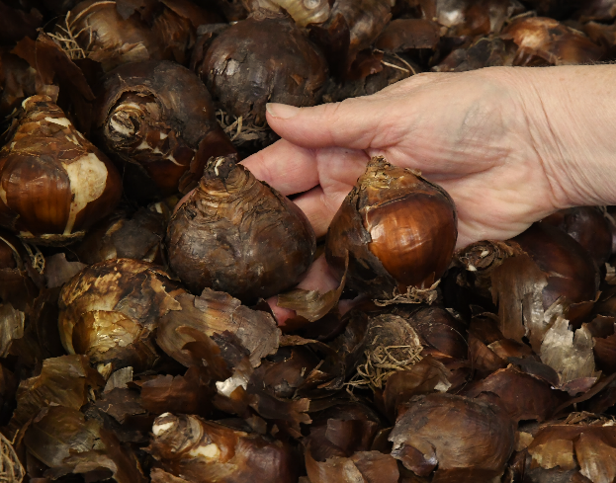
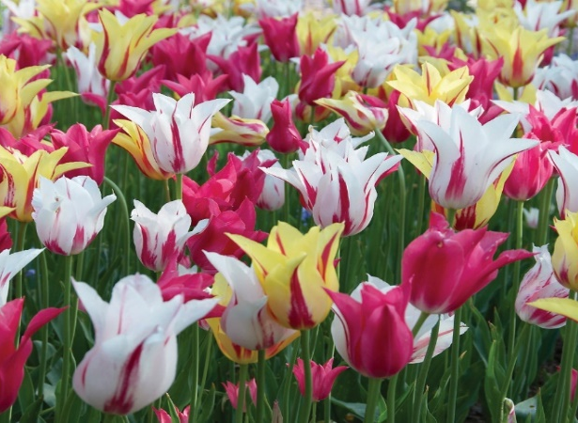
Bulb Basics
Underground structures that store food through a dormant period
Choose plump, firm, heavy
Large bulbs = more flowers
Check hardiness zones & match bulb characteristics
Hardy or Tender
Buy early, late and mid-season bloomers
Re-bloomers
Chill
Division
Top: Daffodil Bulbs Photo: D. Kuroda
Bottom: Tulip Hybrida Dance Fever Collection
Photo: National Garden Bureau
Notes:
Bulbs are underground structures that store food through a dormant period, ready to grow again when the dormancy has ended.
Choose plump firm bulbs that feel heavy. Avoid bulbs that are soft, squishy or shriveled and dry.
Large bulbs generally yield more flowers.
Check your hardiness zones and match to bulb characteristics.
Most spring bulbs are hardy to temperatures below freezing. Other bulbs are considered “tender” in that they are damaged or destroyed by frost and cold temperatures. Many summer bulbs are considered tender.
Some mail order growers pre-chill and will ship at proper time for your area.
Buy early, late, and mid-season bloomers to ensure season long color. Some bulbs are labeled as “re-bloomers” which means they may bloom more than one time in the season.
Tulips and other hardy bulbs may need to be chilled.
As a general rule, separate bulb clumps every 3-5 years to encourage large blooms and to increase the bulb population.

Slide 9
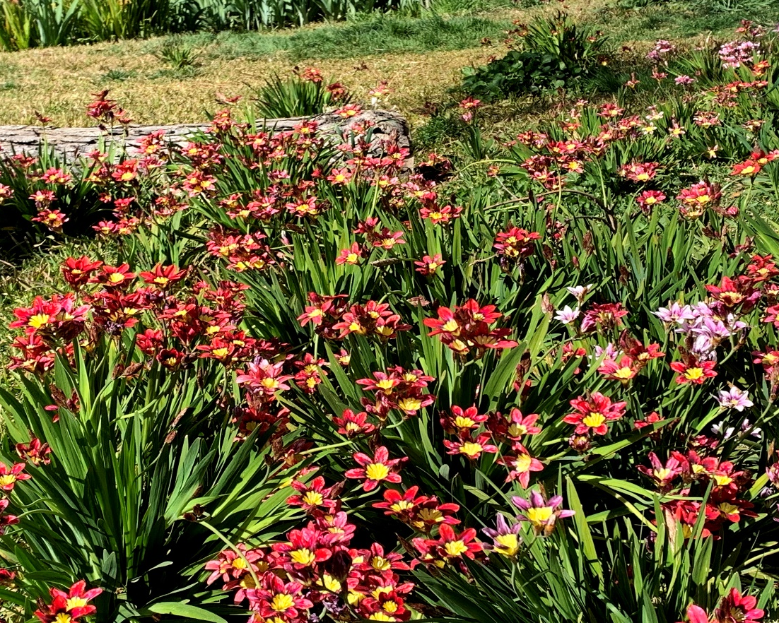
Bulb Structures specialized group of perennial plants that bloom year after year
True Bulb
Rhizome
Tuberous Roots
Tuber
Corm
Field of Sparaxis Sparaxis tricolor – Harlequin flower
Photo: C. Sewell
Notes:
The term “bulb” typically refers to a specialized group of perennial plants that will reappear year after year.
There is one “true” bulb – the others are structures known as rhizomes, tubers, tuberous roots and corms.
Let’s explore each of these further.

Slide 10
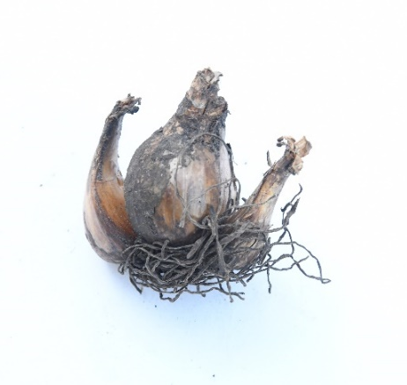
True Bulbs
Compressed underground stem (basal plate)
Contains embryonic plant (growth point)
Surrounded by modified fleshy leaves (scales)
Onion is an example
Tunicate or non-tunicate (imbricate) based on their structure
Divide by separating offsets
Photo: D. Kuroda
Notes:
1. True bulbs are a compressed underground stem that is sometimes called a basal plate.
2. True bulbs contain a modified flower bud or other growth point – an embryonic plant.
3. True bulbs are surrounded by modified fleshy leaves that are referred to as scales.
4. The most familiar true bulb is an onion.
5. True bulbs will be tunicate or non-tunicate based on their structure.
6. Divide true bulbs by separating offsets from the mother bulb.

Slide 11
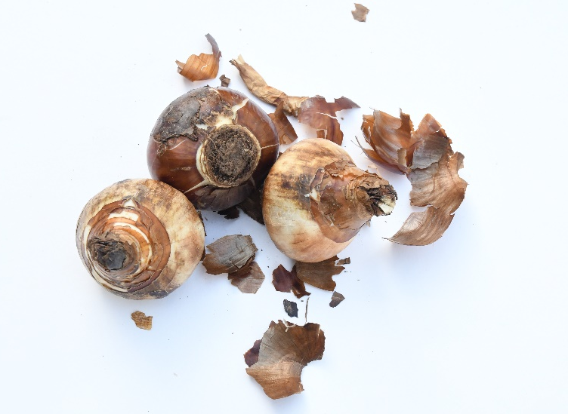
True Bulbs
Tunicate Bulbs:
Papery outer scale
Examples: narcissus, amaryllis,
daffodils, hyacinth
Non-Tunicate Bulbs:
Outer scales that are succulent and separate
Example: lily
Photo: D. Kuroda
Notes:
A tunicate bulb bas a papery, outer scale called a tunic that helps prevent it from drying out. Examples include narcissus, amaryllis, daffodils, and hyacinth.
A non-tunicate bulb does not have the papery coating, instead it has outer scales that are succulent and separate giving the bulb a scaly appearance. A common example is a lily.

Slide 12
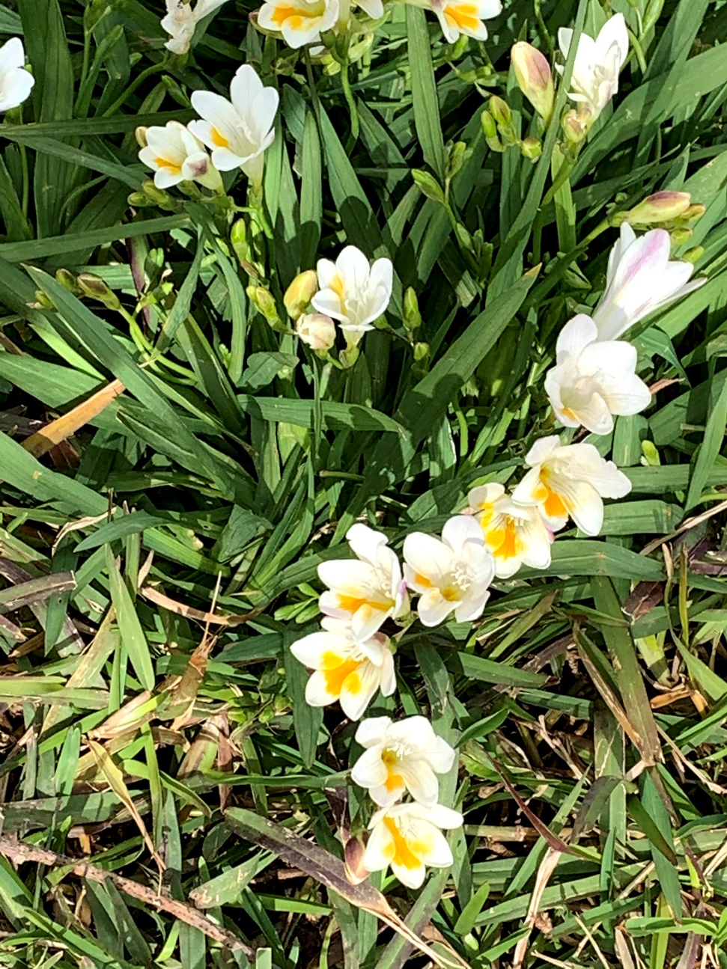
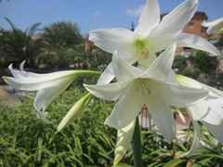
Crinum Powellii ‘Album’
Photo: Missouri Botanical Garden
Butter and Eggs Daffodil
Photo: C Sewell
Notes:
Here are two photos of a true bulb in bloom.
Rather than the traditional daffodil that we all know, I’ve selected the Crinum x Powellii ‘Album’ which is a striking perennial that is in the amaryllis family. It features umbrels of large trumpet shaped flowers (4”) that are snowy white. Blooms appear in late spring and again in fall. This plant is toxic if ingested. It’s common name is swamp lily.
The picture on the right is the “butter and eggs” daffodil, a pale yellow with a darker yellow throat.

Slide 13
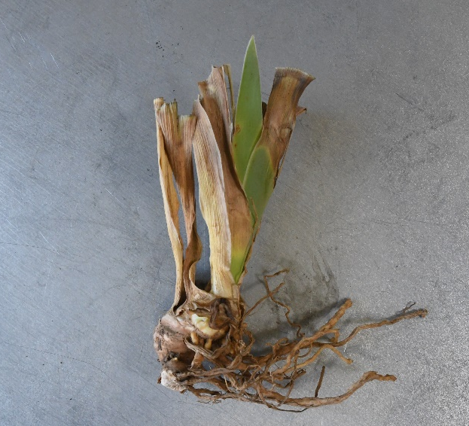
Rhizomes
Thickened stem growing partially or entirely below ground
Modified underground stem
Grows horizontally
Roots grow directly from underside
Primary growing point at one end
Divide by cutting into sections that
have visible growing points
Photo: D. Kuroda
Examples: Agapanthus, Calla, Canna, Bearded iris, Lily of the Valley
Notes:
A rhizome is a modified, underground stem that is unique in that it grows horizontally through the soil.
The roots grow directly from the underside
The rhizome’s primary growing point is at one end.
You can divide by cutting into sections that have visible growing points.
The photo is a bearded iris rhizome ready for planting.

Slide 14
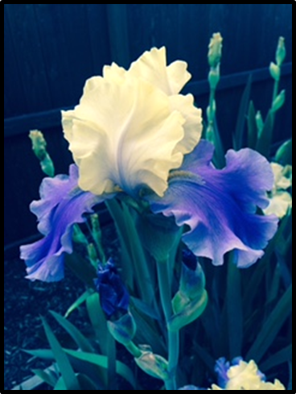
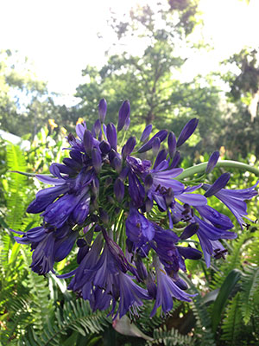
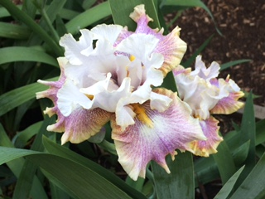
Bearded iris
Photos: S Fitzpatrick
Agapanthus (African Lily) Purple Cloud
Photo Courtesy of: University of Florida’s Institute of Food and Agriculture’s Gardening Solutions program
Notes:
These photos are example of rhizomes in bloom.
The one on the left is a dark purple agapanthus (also known as an African lily) though you will find them is various shades of blue and white. Note even though they are also called lily of the Nile, agapanthus is not a lily at all. Nor is it from the Nile. It is actually from the southern part of Africa
My favorite to grow has to be the bearded iris and the other two pictures are from my yard – hardy, strong blossoms in amazing rich colors. The top one was called Jurassic Park and the bottom is Fall fiesta.

Slide 15
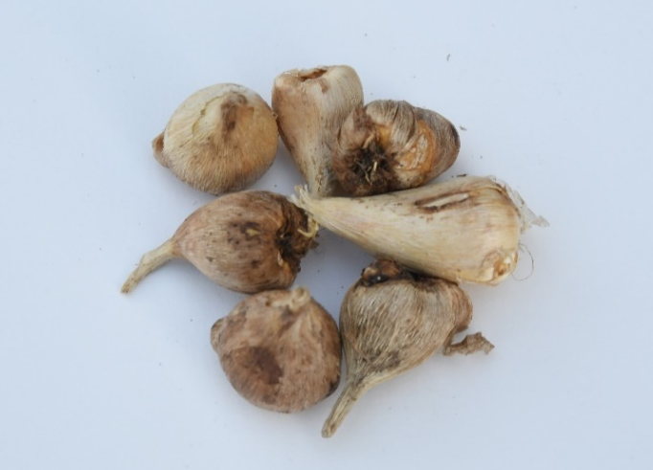
Corm
Similar to a true bulb with underground stem and basal plate
Roots grow from basal plate
Vertically oriented
Terminal bud (growth point) at top
Lasts one season
Divide by separating new corms
Photo: D. Kuroda
Examples: Crocosmia, Crocus, Freesia, Gladiolus, Sparaxis
Notes:
1. A corm is similar to a true bulb in that it is an enlarged underground stem with a basal plate.
2. Corm roots grow downward from the basal plate.
3. Plant corm bulbs in a vertical manner so that the terminal bud is at the top.
4. May only last one season – but I find my comes back year after year.
5. May be divided by separating new corms from the mother bulb. New coms will grow on top of the old one.

Slide 16
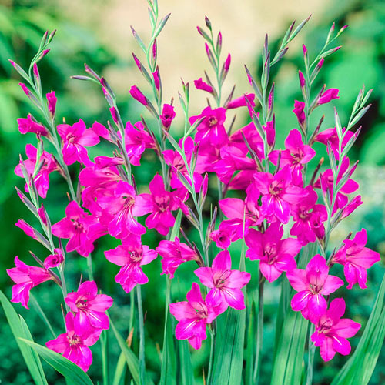
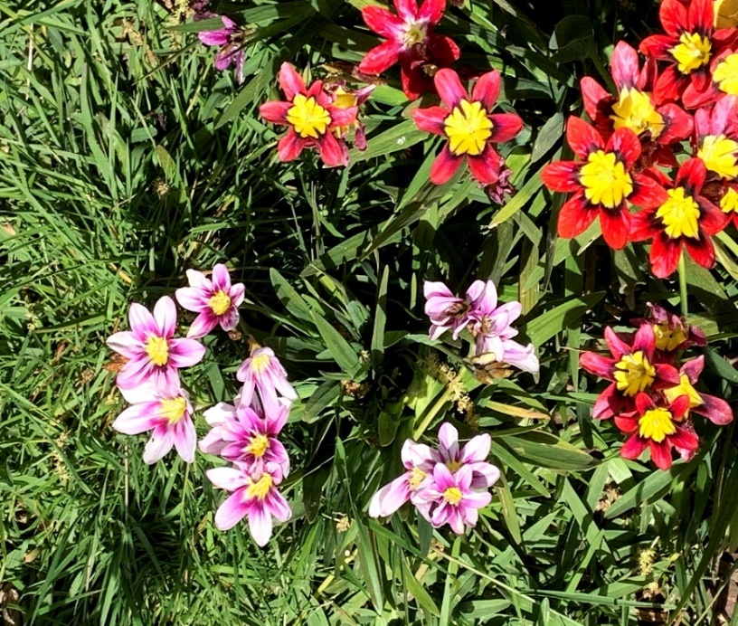
Sparaxis
Photo: C. Sewell
Byantinus Gladiolus
Photo: Brecks webiste
16
Notes:
The photos on the left shows sparaxis in both the pink and red colors. Plants of the Sparaxis genus are hardy bulbs that are usually grown as annuals but my experience is they come back year after year. They are often called Harlequin flower or wandflower and are spectacular with their tri-color display.
Sparaxis may be pink, purple, red, orange or white.
On the right is byzantinus Gladiolus. This is an heirloom corm that likes full sun to partial shade. It is deer resistant and blooms in early summer.

Slide 17
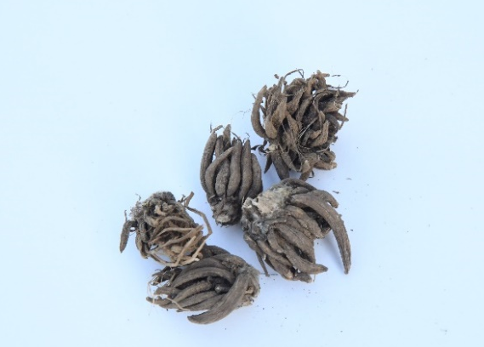
Tuberous Roots
Enlarged, fleshy root tissue
True roots, thickened to store nutrients
Fibrous roots for uptake of water & nutrients
Grow in cluster
Growth buds at base of old stems
Divide by cutting root cluster
Common example: sweet potato
Photo: D. Kuroda
Examples: Alstroemeria, Dahlia, Hemerocallis, Persian Ranunculus, Peony
Notes:
A tuberous root is made up of enlarged fleshy root tissue that acts as the primary storage tissue. These fibrous roots help to uptake water and nutrients.
Often bulbs will grow in clusters.
New buds are present only at the crown or stem end of the root.
Divide by cutting up root cluster.
Common example is the sweet potato.

Slide 18
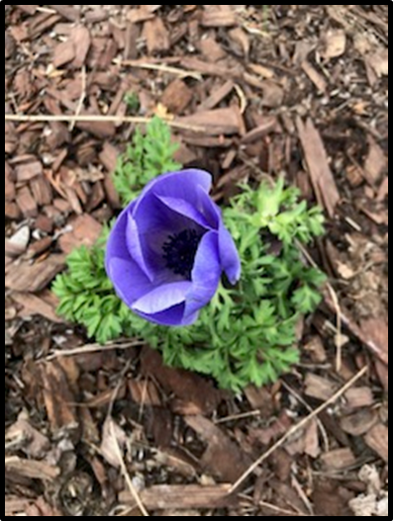
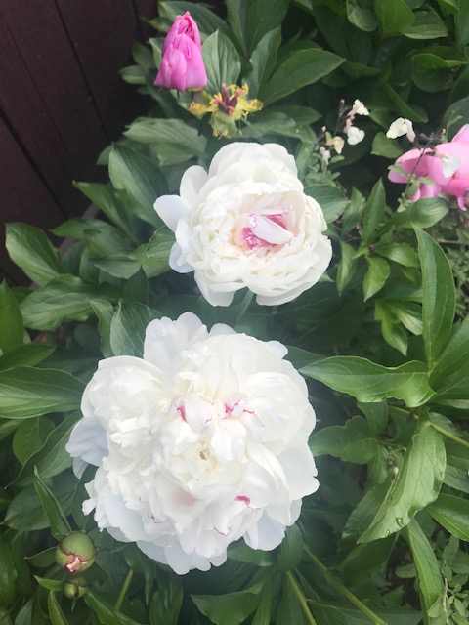
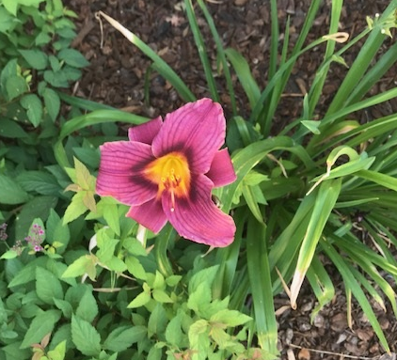
Persian ranunculus
Photo: S. Fitzpatrick
White peony
Photo: S. Fitzpatrick
Hemerocallis
Photo: S. Fitzpatrick
Notes:
These beautiful blooms are examples of tuberous roots. On the left is a white peony from my yard – another favorite of mine.
According to the American Peony Society, with full sun (6-8 hours) and appropriate soil, peonies are easy to grown. Unfortunately, peonies do not supply instant gratification they follow the three-year “sleep, creep, leap” analogy.. Yet once they are established, a peony will reward you for years to come! Peony plants can live for more than 100 years, given basic care and a good planting site. Like many in the bulb family – it depends – meaning peonies aren’t recommended for hardiness zones above 8, but I beg to differ. This one has been growing strong for a decade in zone 9a.
The top right is a newly planted ranunculus in my neighbor’s yard. Ranunculus are knows for their brightly colored, ruffled petals and long vase life. All they ask is for plenty of sunlight, rich soil, and light watering. They do well in our hardiness zone.
The bottom right photo is a day lily (hemerocallis). It’s called grape magic and seems more purple in real life than my photo. This is a re-bloomer which brings frequent color to the garden.

Slide 19
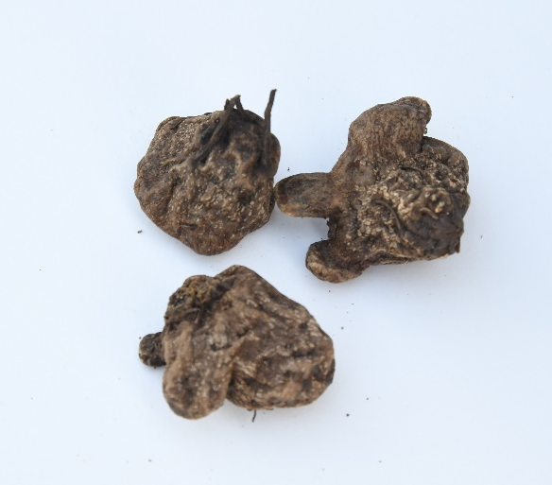
Tuber
Swollen underground stem base, without corm’s shape
No basal plate so roots grow from all sides
Tubers have multiple growth points
As new tubers grow, old disintegrate
Divide: Cut into sections
Most common example: potato
Photo: D. Kuroda
Examples: Anemone (most), Cyclamen, Tuberous begonia
Notes:
1, A tuber is similar to a corm in that it is an enlarged underground stem. However, it is distinct in that it does not have a basil plate. It is the most unique shaped bulb structure.
2. A tuber will root will grow from all sides.
3. A tuber will self reproduces as new tubers grow. The old ones will disintegrate.
4. You can divide tubers by simply cutting into sections.
5. The most common example of a tuber is the white potato.

Slide 20
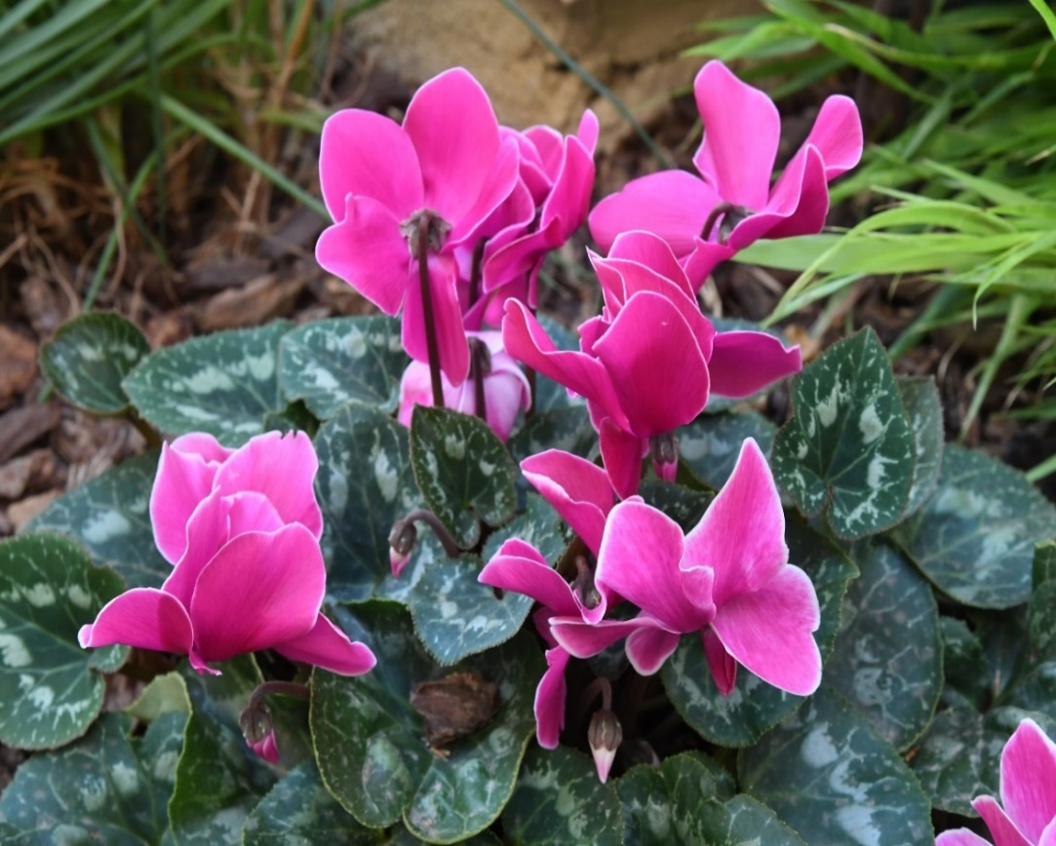
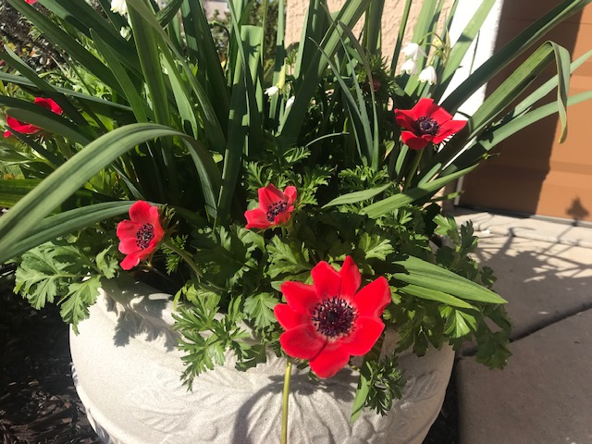
Cyclamen
Photo: D.Kuroda
Anemone planted “lasagna”style
Notes:
The photo on the left is of anemones planted “lasagna style.” Many gardeners know the plants as windflowers, so named because the delicate poppy-like flowers sway in the lightest breezes. (The Greek word "anemos" translates as "wind.“ They do well in our hardiness zone with full sun.
One of my cyclamen bloomed early this year – this photo taken two weeks ago in early October.
Cyclamen are often thought of as an indoor holiday plant – but they can be hardy enough to plant outdoors. Plant cyclamen tubers in late summer or early autumn.
Plant the tubers with the top of the tuber just below the surface of the soil. Space 6 to 10 inches apart. Unlike florist’s cyclamen that grows outdoors only in warm climates, hardy cyclamen tolerates cold climates and freezing winters. However, this cool climate plant might struggle where summers are hot and dry. Be smart about the placement in your garden.
Water the plant regularly during spring and summer but don’t overwater because the tubers may rot in waterlogged soil. Brush excessive leaves and debris from the plant in autumn. Although a light layer of mulch or leaves protects the roots from the winter cold, too much cover prevents the plants from getting light. One tuber can live for generations. This one is five years old.

Slide 21
Planting Formula
Right Depth and Width
Read labels if bulbs are purchased
Plant 2-2.5 times the bulb width
Space bulbs 3 times their width
Plant in clusters (12+)
Right Time
Fall for spring bulbs
Average night temperatures 40-50 degrees
For summer bulbs, plant early spring
Some packages will say to soak in water 2 hours
Notes:
The planting formula includes knowing the right depth, width and time.
Most packaged bulbs contain labels with planting instructions (see next slide).
Without labels, plant bulbs 2 2.5 times their width for depth and 3 times their width for spacing.
If you wanted to plant bulb clusters for impact – use at least 12+ bulbs and if the bulbs are small, use additional.
Fall is the time to plant spring bulbs when the average night temperature is between 40-50 degrees.
If you are considering summer blooms, plant these varieties in early spring. (see chart from Sacramento MGs on coming slide)
Some bulbs will do best with a short soak in lukewarm water.

Slide 22
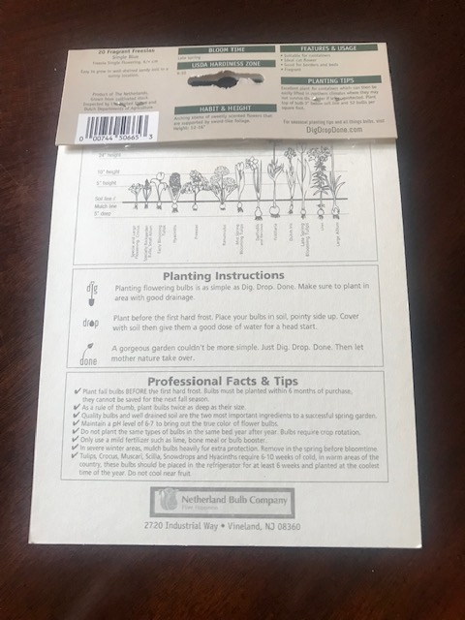
Package Instructions
Notes:
Look at the information you can get from the back of the bulb pack. This is the back from a package of freesias.
The front will usually tell you how many bulbs are in the pack and may guide you to when they will bloom, if they prefer full sun or partial shade, if they attract bees, butterflies or hummingbirds, and the height of the bloom.
The back advises you on hardiness zone, the habit and height, features, planting tips and instructions.

Slide 23
Notes:
1.MGPC doesn’t have a bulb planting schedule. Today we are borrowing from our friends at the Sacramento County Master Gardener Program. Where your zone is consistent with Sacramento, use this guide. If you live in a different elevation this guide may not be applicable to you.
2. I realize this copy may be difficult to read, but the link to this resource will be included once this presentation is posted on our website.

Slide 24
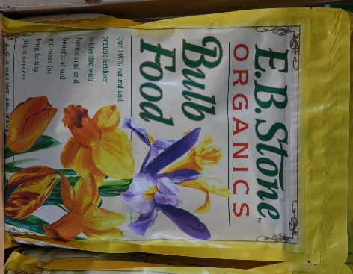
Planting
Location
Full sun during bloom (some p.m. shade)
Color and design
Preparing the Site
Well, drained soil that is loosened
Add all-purpose fertilizer and compost
Rake surface smooth
Plant
Set bulbs in firmly at correct depth, pointed tip up, or naturalize
Cover bulbs with soil and water thoroughly
Cover with 2” layer of loose mulch
Notes:
Bulbs require full sun of 4-6 hours/day – though a few prefer some afternoon shade in our hot climate. Insufficient sunlight will produce foliage but not necessarily vibrant blooms.
Planting is a good time to plan out your desired color scheme and design.
Bulbs prefer soil that is well drained and loosened. Add all-purpose fertilizer and compost to enhance the soil. Rake the surface smooth.
To plant, set the bulbs in firmly at the correct depth, pointed tip up. There are bulb planting tools to get the depth correct.
If you prefer a “natural” looking patch of bulbs, gently toss and plant where they land.
Cover bulbs with soil and water thoroughly.
Cover with 2 inches of loose mulch.

Slide 25
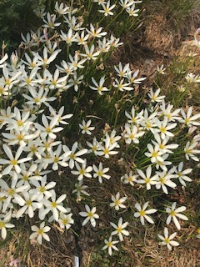
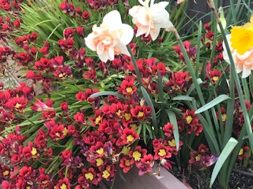
Where to Plant
  Mass planting
  In grass
  Under trees & shrubs
  Perennial borders
  Containers & boxes
  Water & rock gardens
  Ground Cover
  Slopes
  Bulb Beds
Rain lily in mow strip. Photo: S. Fitzpatrick
Sparaxis & Daffodil in bulb bed. Photo: S. Fitzpatrick
Notes:
A gardener’s dream plant – bulbs can be planted in different locations for different effects.
In top photo, Rain lily (AKA August Rain Lily) is planted in my neighbors mow strip. In bottom photo different bulbs spill out of a bulb bed.
Bulbs are spectacular in mass plantings, under trees and shrubs and in perennial borders.
They can be grown in grass but you should wait for the foliage to die back before mowing the lawn.
They will survive on slopes and in beds designed just for bulbs.

Slide 26
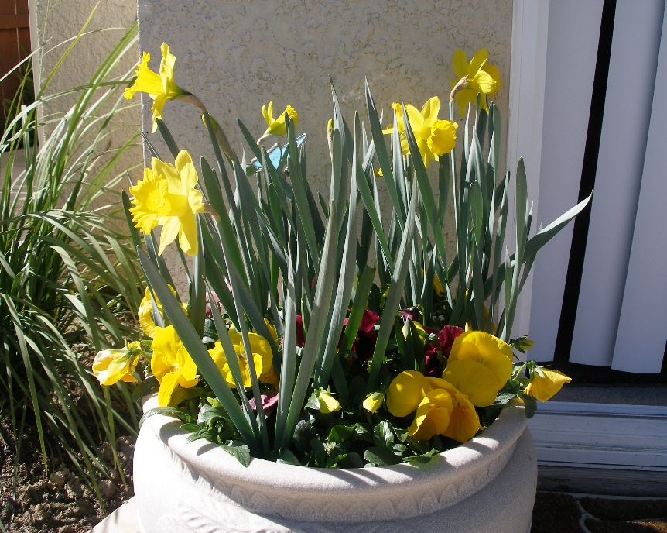
Container Planting
Drainage holes
Minimum: 5-6” diameter and 4-5 inches deep
Loose, crumbly potting soil
(not existing garden soil)
Close, but not touching
Water after planting
Fertilize only if reusing bulbs
Daffodils & Pansies. Photo: S. Fitzpatrick
Notes:
A container of bulbs, or mixed with other plants is an ideal accent to any garden and protect bulbs that may be attractive to small rodents.
In this picture I paired daffodils with yellow pansies. Looking at it now, I wish I had chosen blue pansies for their contrast.
Container size is important for impact and make sure it has drain holes.
Use potting soil to keep soil loose and crumbly – not existing soil from your garden.
Bulbs can be planted close, but not touching.
Water thoroughly after planting.
Apply light fertilizer if you intend to reuse the bulbs - half strength liquid fertilizer every two weeks. I tend to think of my bulb containers as “one and done,”

Slide 27
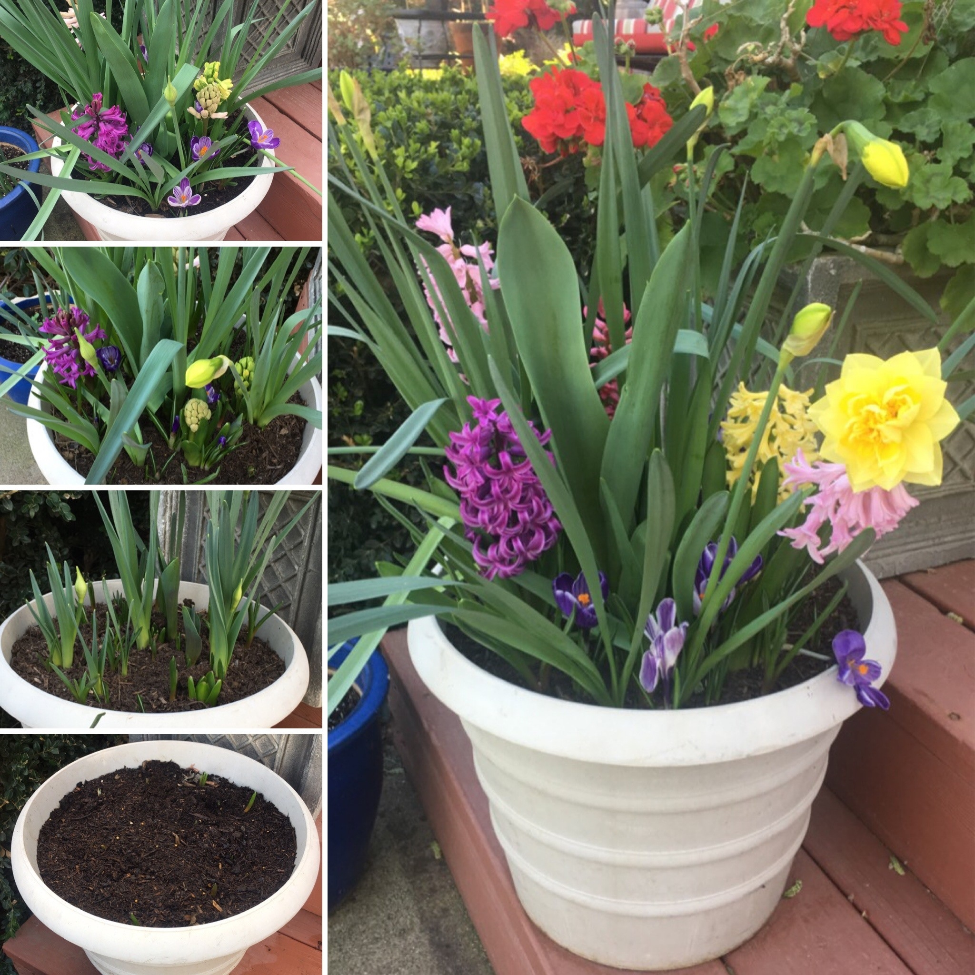
Lasagna planting technique
.
Layering different bulb varieties in the same pot is known as “lasagna style”
Select bulbs based on bloom times, planting depth and color
Advantages: long-lasting flowers and color
Photo: Lauren Snowden, UC Master Gardener Program Statewide Blog (10/18/21)
Notes:
The bulb planting technique of layering is also known as planting “lasagna-style.” Planting bulbs “lasagna-style” involves layering different bulb varieties in the same pot. Each bulb planted is selected based on its blooming times, planting depth and color.
By overlapping bulb bloom times you can create pots of long-lasting flowers and color.
For three waves of bloom, select bulbs that bloom in early-spring, mid-spring, and late-spring. Bulb packages list bloom date information on the labels. When making bulb selections, consider choosing bulbs with overlapping bloom times so that the planting remains colorful all season.
Source: https://ucanr.edu/blogs/blogcore/postdetail.cfm?postnum=50694&utm_source=RSS&utm_medium=RSS&utm_campaign=RSS%2BFeed

Slide 28
Maintenance
  Irrigation
Water after planting until foliage dies back
Frequency determined by soil type and weather conditions
Too much water could result in root rot
Rodent Protection
Some bulbs (crocus and tulips) are tempting
Hardware cloth or containerize
Use bulbs that rodents don’t like
Fertilizing
Large bulbs benefit from all-purpose fertilizer – when shoots appear and again after bloom
OR
Apply compost OR slow release fertilizer in the fall.
Notes:
Depending on soil and weather conditions water after planting until foliage dies back. The frequency of irrigation is determined by soil type and weather conditions.
Crocus and tulip bulbs in particular are tempting to rodents. Apply hardware cloth during soil prep (bottom and sides of bed) to deter. Consider planting these bulbs in containers, or use bulbs (like daffodils) that are not attractive to rodents.
Small bulbs do not need to be fertilized, but larger bulbs will benefit from feeding once or twice a year. One approach is to use an all purpose fertilizer when shoots appear and again after bloom
OR in Fall apply compost or slow release fertilizer.

Slide 29
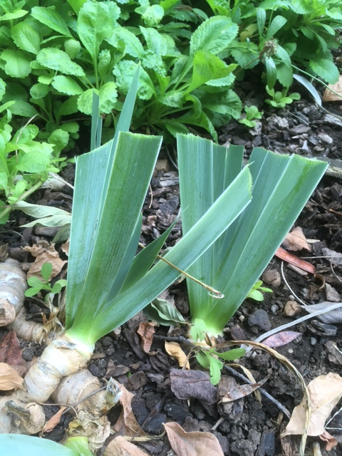
During and After Season
General
Remove blossoms as they fade on hardy bulbs
Leave foliage in place until yellow and dry
Plant annuals or companions near by
Divide after several years (most)
Bearded Iris Care
Remove seedpods after blooms fade
Prune back foliage in fall
Cutting out old growth leaving the new
shoots
Bearded Iris after cleanup
Photo: P. Sakai
Notes:
As a general rule, remove blossoms as they fade but leave foliage in place until yellow and dry. The foliage helps the bulb store nutrients.
Plant annuals or companion plants hear by to “hide” the drying foliage.
Divide bulbs every 3-5 years.
Beaded iris care is a bit different. Remove seedpods after blooms fade. Foliage will last into late summer/early fall.
Prune back foliage and cut out old growth as this photo from Pauline shows. It looks neater but is also reduces the chance of overwintering pests and diseases.

Slide 30
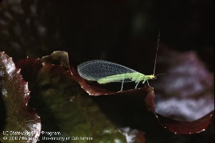
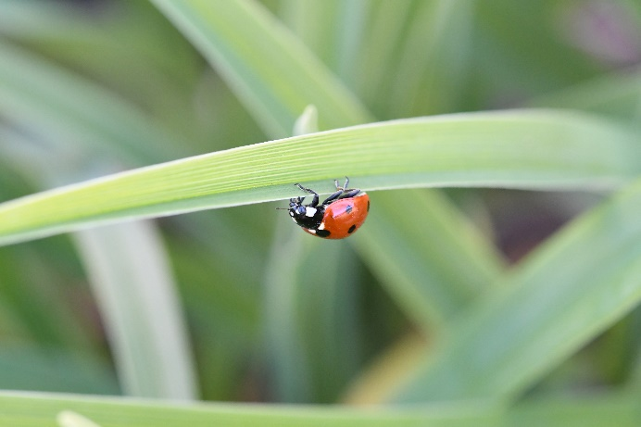
Trouble Shooting
Common pests include aphids, bulb mites, thrips, bulb flies, borers and leafrollers
Solution # 1 water sprays
Solution # 2 Natural Pesticides: Insecticidal soap, horticulture oil or neem oil
Solution # 3 Encourage beneficials: lady beetles or lacewings
Green lacewing adult, Chrysoperla carnea. Credit: Jack Kelly Clark, UC IPM Program
Lady beetle (lady bug) on day lily. Photo: D. Kuroda
Notes:
Fortunately, bulbs do no have many pests. Common pests are those that are soft-bodied insects that suck nutrients from the plant. These include aphids and thrips.
There are 3 recommended solutions: jets of water, natural pesticides and encouraging beneficials to the garden.
These two pictures show two beneficials: green lacewing and lady beetle (lady bug).
Do not use pest management information from other states due to California's restriction on the use of many pesticides.

Slide 31
Trouble Shooting
Basal rot (bulb rot)
Caused by variety of fungi and bacteria
Symptoms: no shoots, leaves & roots wilt and die
Control: disease-free bulbs, proper planting; avoid overwatering and overcrowding
Snails and Slugs
Handpick
Eliminate places where snails and slugs can hide during the day
Use drip irrigation
Notes:
BASAL ROT: Basal rot, also called bulb rot, is a widespread plant disease caused by a variety of fungi and bacteria. It can affect flowers and crops.
Symptoms include bulbs with no shoots and leaves/roots will wilt and die.
The control of basal rot includes the use of disease-free bulbs; proper planting; use of varieties resistant to fungal rots; and rotation with non bulb plants. Avoid overwatering, overcrowding, and over fertilizing.
SNAILS AND SLUGS: ICK! Remove by handpicking. Eliminate places where snails and slugs can hide during the heat of the day. Use drip irrigation instead of spray.

Slide 32
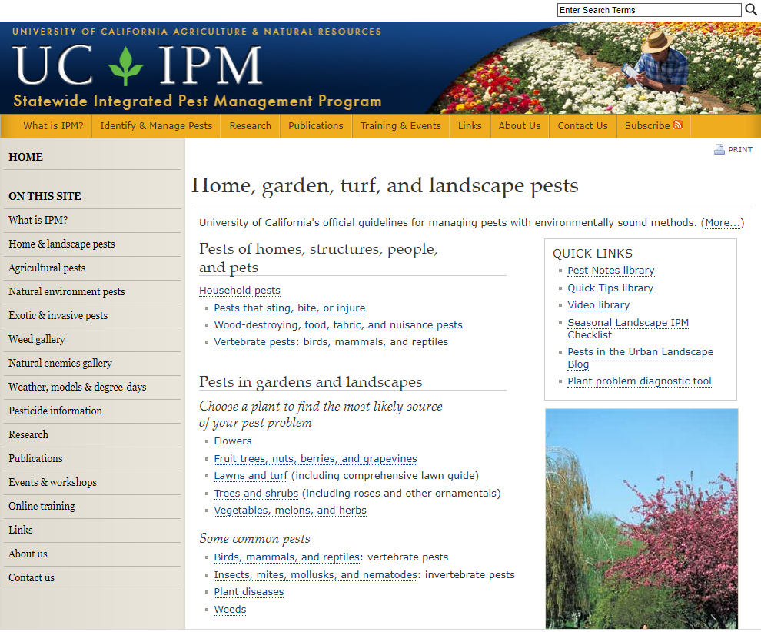
Integrated Pest Management http://www.ipm.ucdavis.edu/.
UC PCMG HOTLINE: (530) 889-7388
Notes:
For many home gardeners, Integrated Pest Management (IPM) is a favorite tool to identify and resolve pest problems. This page shows the link to the IPM website.
For specific garden questions about pests, please call the UC PCMG hotline.

Slide 33
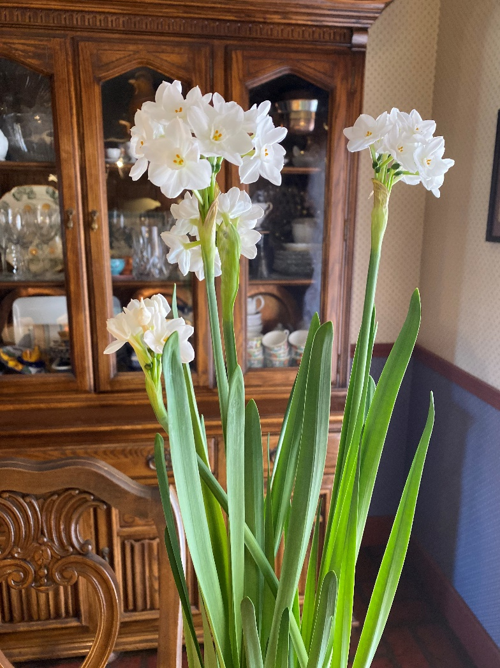
Forcing Bulbs Indoors
Soil, Water, Pebbles
Force means a bloom out of season
Buy best quality
Specially prepared for forcing OR
Chill (35-45 degrees)10-12 weeks
OK to crowd
Popular Choices:
Daffodil, Amaryllis, Hyacinth, Tulips,
Crocus and Paperwhites
Paperwhites
Photo: T. Markel
Notes:
If you are buying bulbs to plant now, you might want to pick up a few to “force.” Force means to bloom out of season. Many spring bulbs can be “forced” into an indoor bloom.
There are 3 methods to force bulbs: soil, water, pebbles.
For best results, start with top quality bulbs.
Bulbs that have been specially prepared for forcing are readily available - early in the season. These bulbs have been pre-chilled. The label may state for “indoor planting.”
If you aren’t able to buy pre-chilled bulbs, place them in a cold place, between 35 and 45 degrees for 10 to 12 weeks for root growth. A refrigerator will work. Use a mesh bag with ventilation.
When forcing, it is OK to crowd the bulbs.
Popular bulb choices for forcing include daffodils, amaryllis, hyacinth, tulips, crocus and paperwhites. T
These paperwhites were grown by Tece Markel, another master gardener.

Slide 34
Forcing Bulbs Indoors
Soil
Fill pot with potting mix. Plant bulbs half way deep. Bulb point should be pointed up and out of soil. Water. Keep in cool place (50-60 degrees) until leaves form. Move to a warmer location with bright, indirect light. Maintain moist soil so roots have moisture.
Water
Fill clear vase with water up to the basal root. Roots should be in water, not the entire bulb. Change water occasionally. Put in cool location (40-55 degrees) until leaves form. Move to north-facing window. Turn daily. Hyacinth is a favorite.
Pebbles
Fill glass container with a handful of pebbles to support the roots. Fill with water to pebble-level. Roots down, tips up. Shoots grow from the tips. Put in cool location. Move to indirect light once flowers appear. Maintain water. Narcissus are fast to bloom.
Notes:
SOIL: The instructions here are similar to what we have described for container gardens. Flower bulbs can be forced indoors in pots filled with a light potting mix. Do not use soil from your garden.
Plant the flower bulbs you will be forcing half to three-quarters of the way deep into the pot. The pointy tops of the bulbs should be out of the soil. Water the bulbs and keep the soil moist.
Keep your planted bulbs in a cool place, 50 to 60 degrees F. until it starts to form leaves. This will help it to form a more compact flower stem, which is less likely to fall over as it reaches its full height.
Once leaves appear, move the flower bulbs to a warmer location. They prefer bright, indirect light. Make sure to keep your forced bulbs watered. The roots should always have moisture.
Once foliage begins to develop, move the bulbs to a slightly warmer (65 F), sunlit spot for flowering; a north-facing window is perfect. Turn them daily to prevent leaning.
WATER: Specially designed containers (hour glass shape) work well for forcing with water. Fill vase with water up to the basal root. The roots should be in the water; not the bulb. Change water occasionally, filling just to the basal root.
Put in cool location (40-55 degrees) until leaves form. Move to a north-facing window, Turn daily to prevent leaning. Hyacinth is a favorite bulb often in specialized vases.
PEBBLE: Fill low glass container with a handful of pebbles to nestle bulbs in (root-down, tips up), and water. Glass container allows you to monitor water level.
The pebbles elevate the bulbs, allowing just the basal root to sit in water.
The bulbs “awaken” once nestled near a water source, and shoots soon begin to grow from the tips. Move to indirect light once flowers appear to prolong the blooming period, and enjoy the fragrance for 1-2 weeks before the blooms wither.
Almost any bulb can be grown in water (with pebbles beneath them to support roots), but the fastest to bloom are the narcissus.
Reference: https://ucanr.edu/blogs/blogcore/postdetail.cfm?postnum=44388

Slide 35
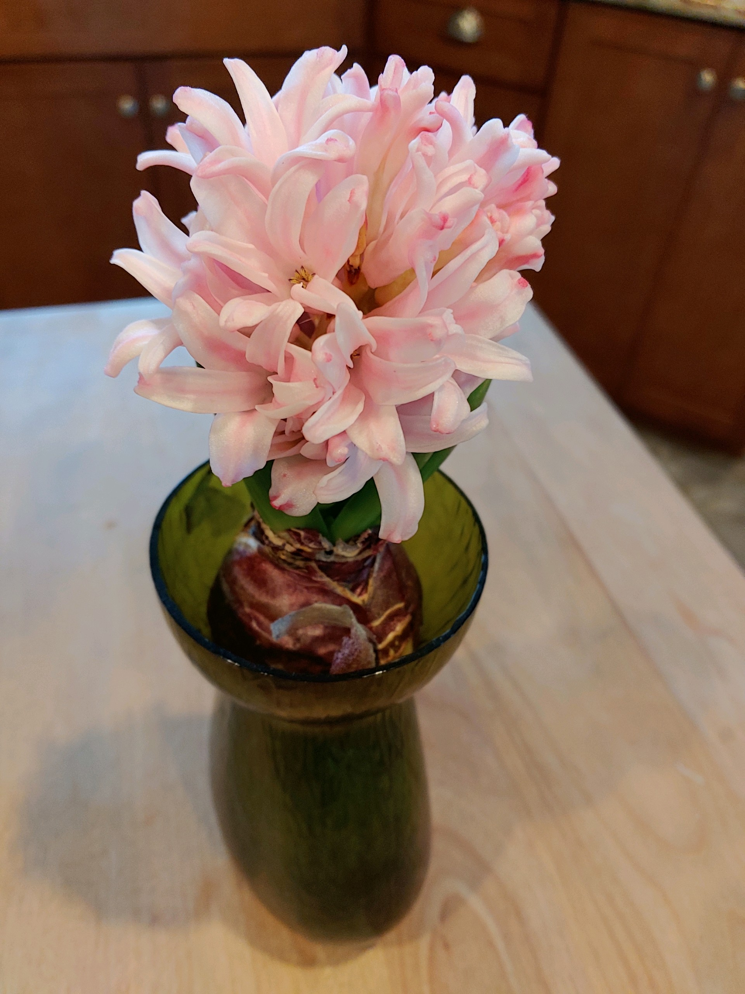
Pink Hyacinth in water
Photo by: B. Fritchie

Slide 36
Tips for Bulb Success
Know the 5 bulb structures
Select sunny location with well drained soil
Plant at best depth, width and timing
Water needs depend on soil and weather
Fortunately, not many pests
General maintenance to support new blooms & eliminate problems
Force spring bulbs to enjoy indoors
Pest management resources/hotline
http://www.ipm.ucdavis.edu/
Notes:
Let’s review the tips we discussed today for successfully growing and enjoying bulbs.
2. And, now, what’s left, is to get planting and wait for the burst of spring color! (click to next slide).

Slide 37
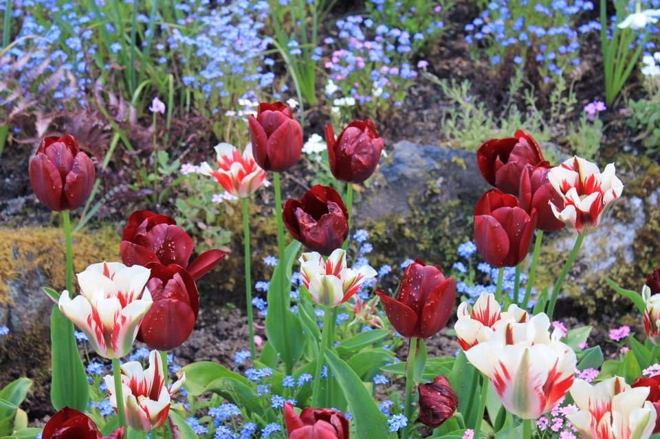
Photo: L. Merrick taken at Butchart Gardens, British Columbia, Canada
Notes:
1. This workshop started and now will end with a photo from the Burchart Gardens.

Slide 38
Thank You!
Any Questions?
Master Gardener Hotline: (530) 889-7388
Rot Line: (530) 889-7399
Master Gardener Website: pcmg.ucanr.org

