Slide 1
UCPath Roadmap's Improved Navigation Webinar
Presented by:
Ankith Mamindla & Patricia Glass
10/06/2022

Slide 2
Agenda
Record Meeting – Published online
Intro to Improved Navigation Project
Project Go Live & Impact
Current UCPath Navigation and Pages
New Improved UCPath Navigation & Pages
System Demonstration
  Basics and Navigations
  Global Search
  NavBar
    Recent Places
    My Favorites
    Navigator
Training Resources
Good To Know – Tips
Questions

Slide 3



Improved Navigation
Improve UCPath transactor experience by deploying Fluid navigation, a more intuitive, modernized solution
GOAL
Fluid Navigation is deployed to internal users and transactors without significant User issues
UCPath Portal integration with Fluid Navigation
Fluid Navigation adoption is a starting point to take advantage of new UCPath functionality
OBJECTIVE
No changes to ESS and MSS pages.
All pages will maintain the look and feel without disruption to the overall functionality.
CHANGES

Slide 4
Key Dates
Go-Live Prep
Set up Favorites instead of Bookmarks (see prior communications)
Cutover – UCPath downtime
Go Live cutover is October 15th
Impacted Modules
  BN, WFA, AM, PY, GL, TAM & E-Performance
Impacted Audience
  Transactors and Inquiry users
Things to do at Go-Live – Monday, Oct 17th
Log into UCPath and check your favorites (All the bookmarks you transferred to Favorites will be here)
Check for your access, no access changed.
Continue business as usual

Slide 5
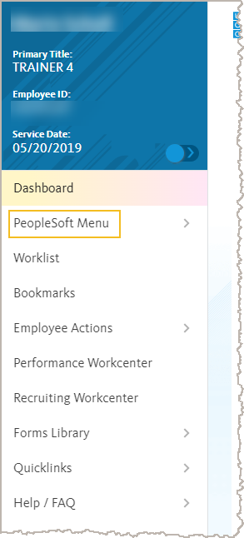
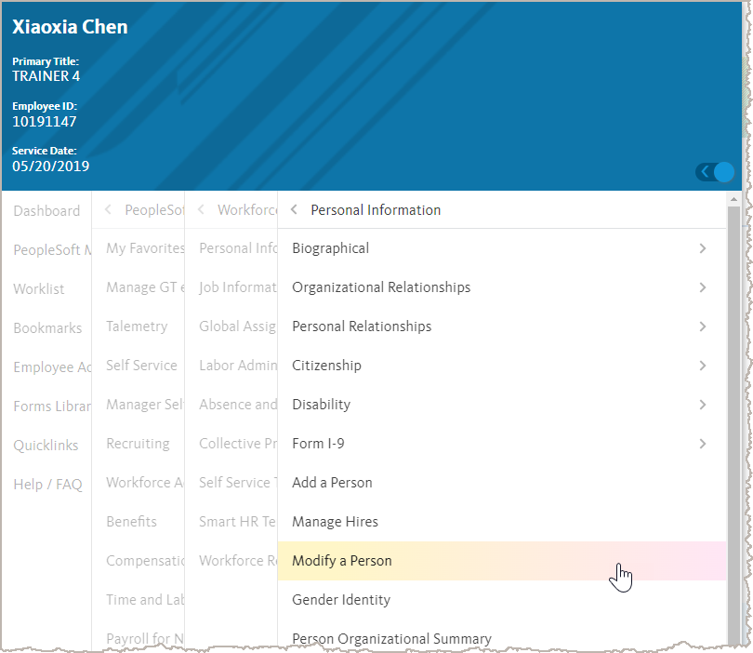
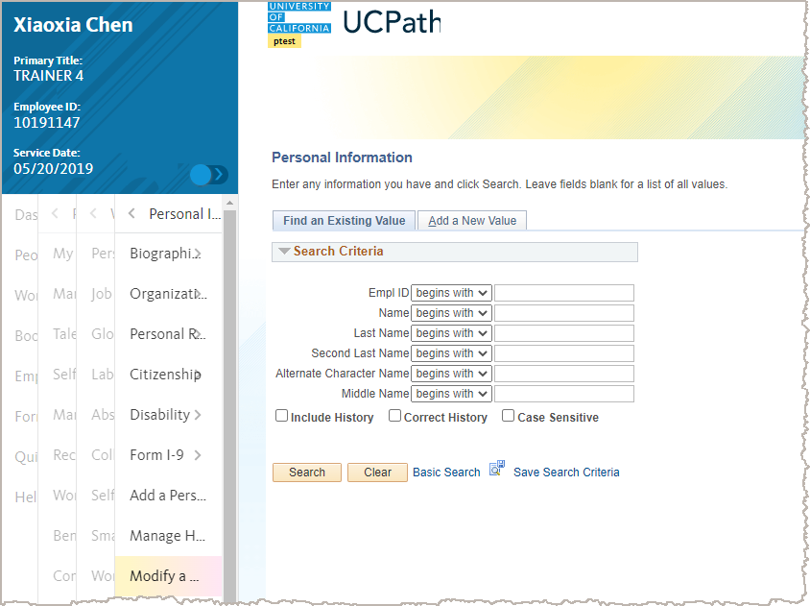
Current UCPath Navigation

Slide 6
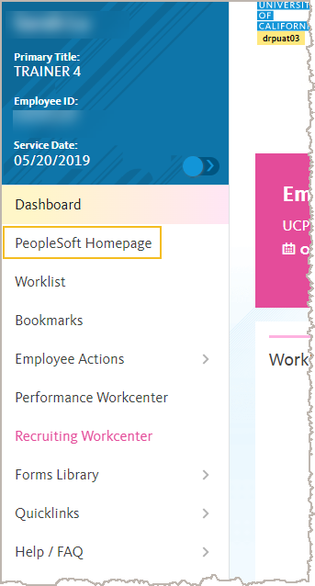
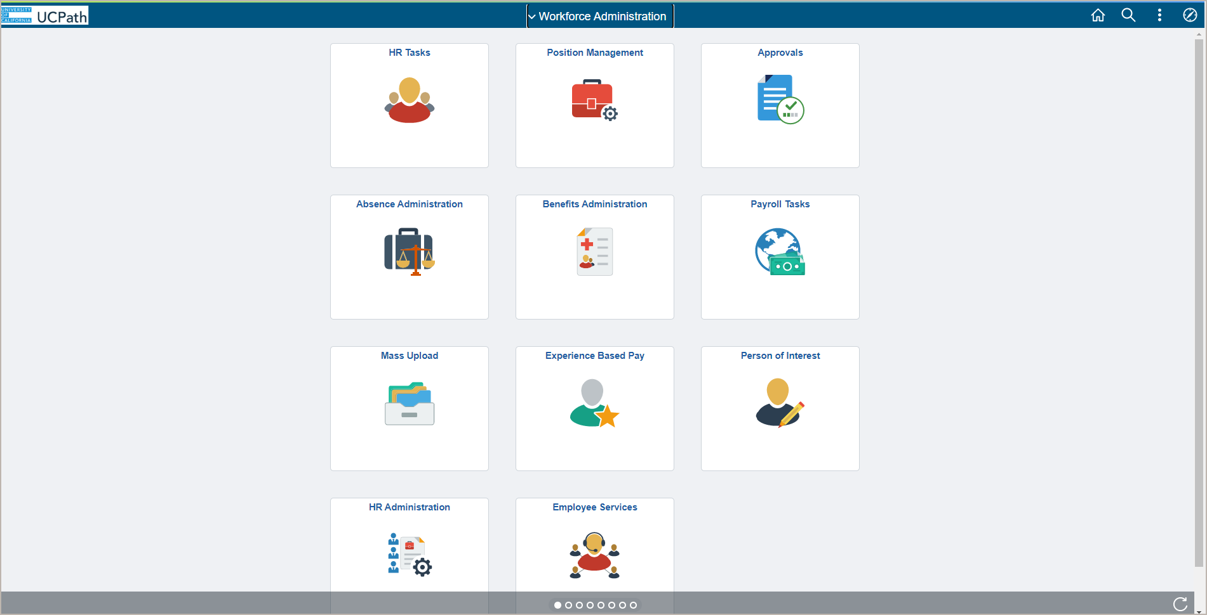
New Improved Homepage
Opens in a NEW browser tab

Slide 7
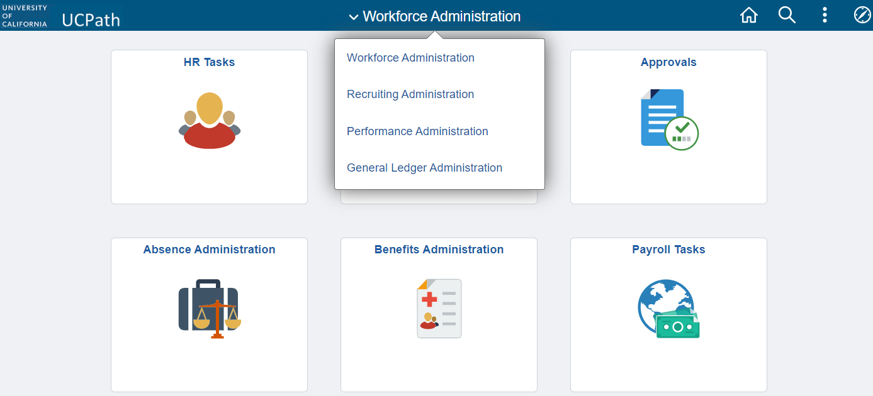
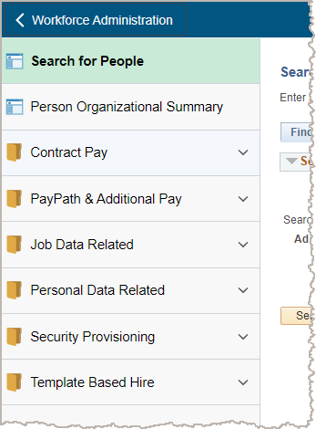
New Improved Navigation
Homepage Collection
Tiles
Navigation Collection
Folders
  Homepage Collection
    Workforce Administration
    Recruiting
    Performance
    General Ledger Administration
  Navigation Collections
    The list of pages and folders on the left pane are the Navigation Collection for this Tile

Slide 8
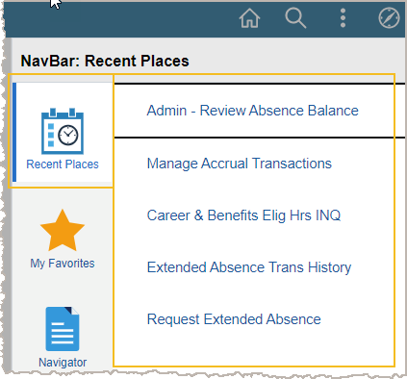
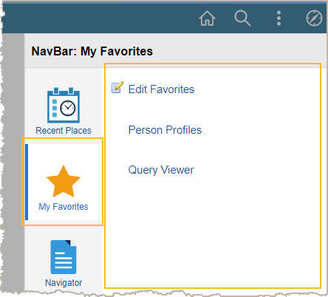
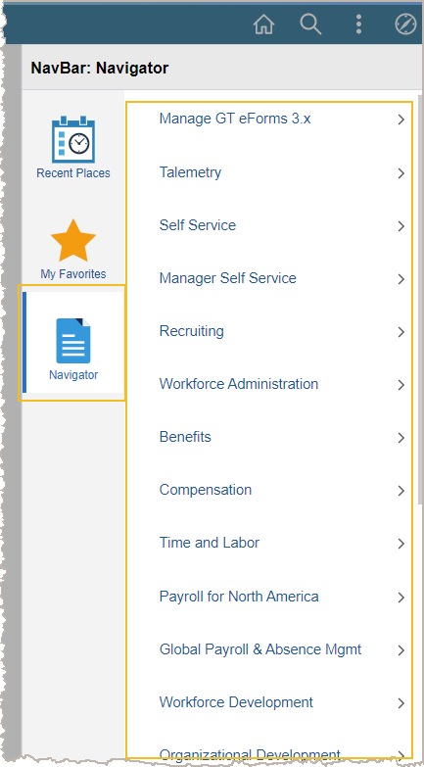
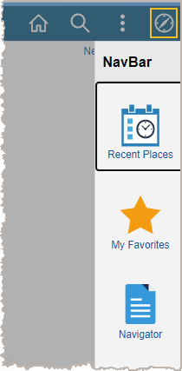
NavBar Overview
Homepage
Global Search
NavBar
  NavBar:
    Recent Places lists the last five pages you have navigated to. Select any of these to jump to that page.
    My Favorites gives you access to any of your saved Favorites and allows you to edit them here.
    Navigator lets you navigate to PeopleSoft pages using the menu selections you’re using now.

Slide 9
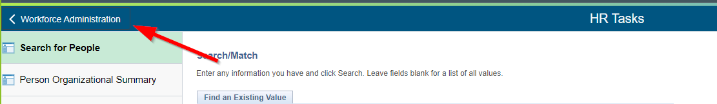
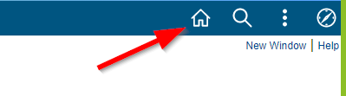
Navigating Back
Multiple ways to return back or to your main Navigation Collection
  Use the contextual back button from within a Tile
    Excludes Portal Workcenters (ex. Recruiting, Performance Management)
  Click the home icon on the top right

Slide 10
System Demo
Basics and Navigations
    Peoplesoft Menu to Peoplesoft Homepage
    New Window Functionality
Navigation Paths
    Tiles and Folders
    Global Search
    NavBar
      Recent Places
      My Favorites
      Navigator

Slide 11
Good to Know – Tips & Recommendations
Use NavBar for adding Favorites (instead of the Navigation Collection)
Recent Places only stores five pages accessed from Navigator
Global Search – Enter complete word for results and only page names
Cannot Go Back to UCPath Portal from Homepage Tab

Slide 12
Questions?

