Slide 1
Freshdesk
Searching for Tickets

Slide 2
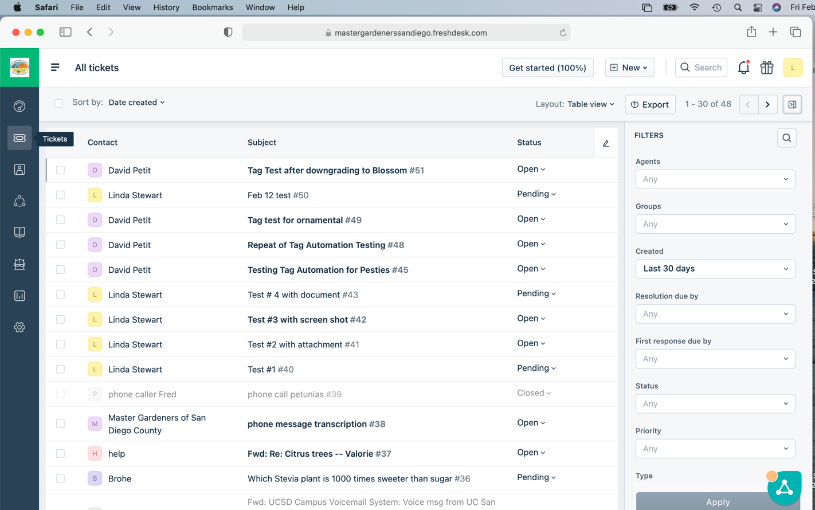
Start at the Tickets list

Slide 3
Click in the Search field and type a word you would find in the ticket. For example: “citrus psyllid”

Slide 4
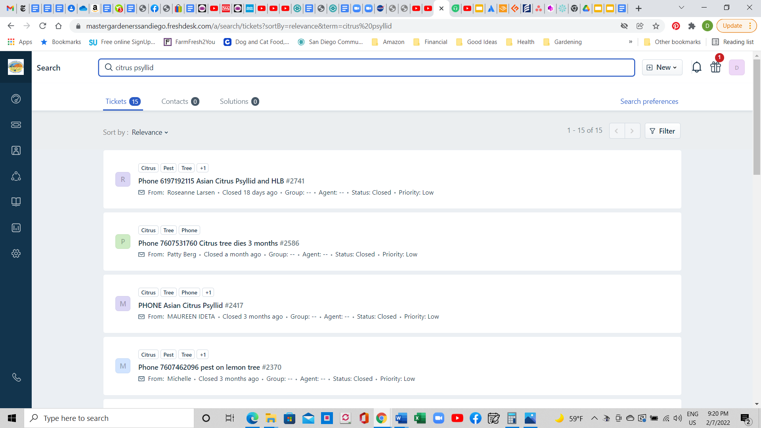
Press enter - and Freshdesk will list all tickets that contain “citrus psyllid”

Slide 5
Filtering for tickets
You can limit a search for tickets by filtering for tickets for a specific Master Gardener, or a limited date range, like yesterday, or last week or the past 30 days.

Slide 6
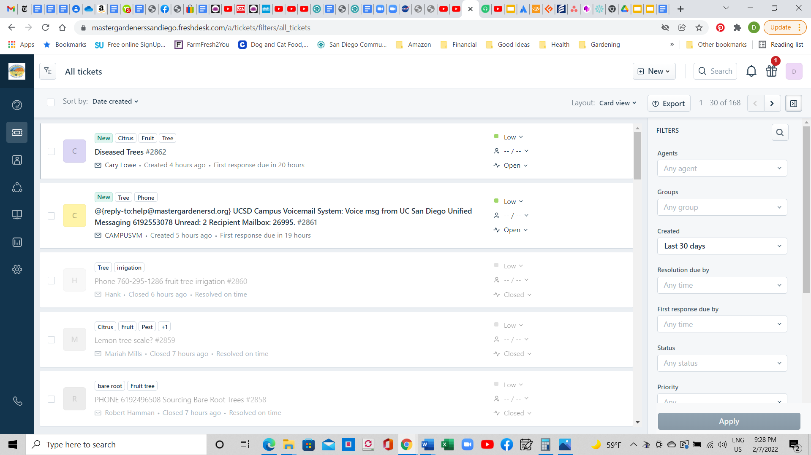
The Filters panel is to the right of the ticket list. Created in the last 30 days is the default period for tickets listed

Slide 7
To see only tickets created in the last 7 days. Click on the pop down arrow of the Created filter and select Last 7 days. Then to apply that new filter, click the Apply button at the bottom of the filter window.

Slide 8
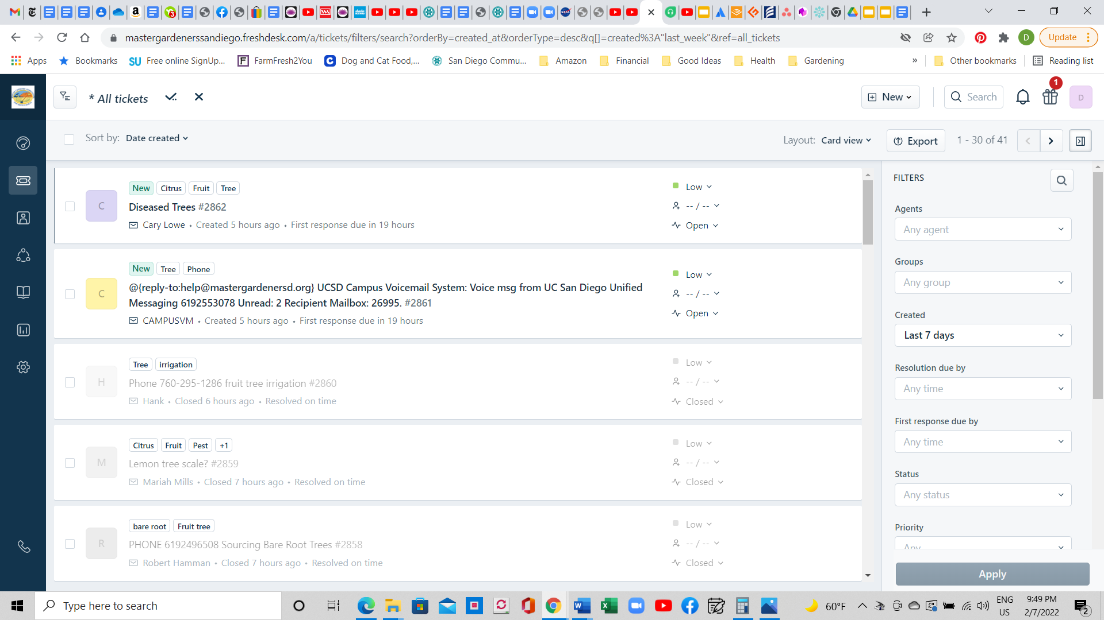
After you click “Apply” the list will list tickets from the past 7 days.

Slide 9
Now scroll down the filters list till you see Master Gardener at the bottom. Then select a Master Gardener from the list. In this example I selected “Linda S” and pressed the “Apply” button

Slide 10
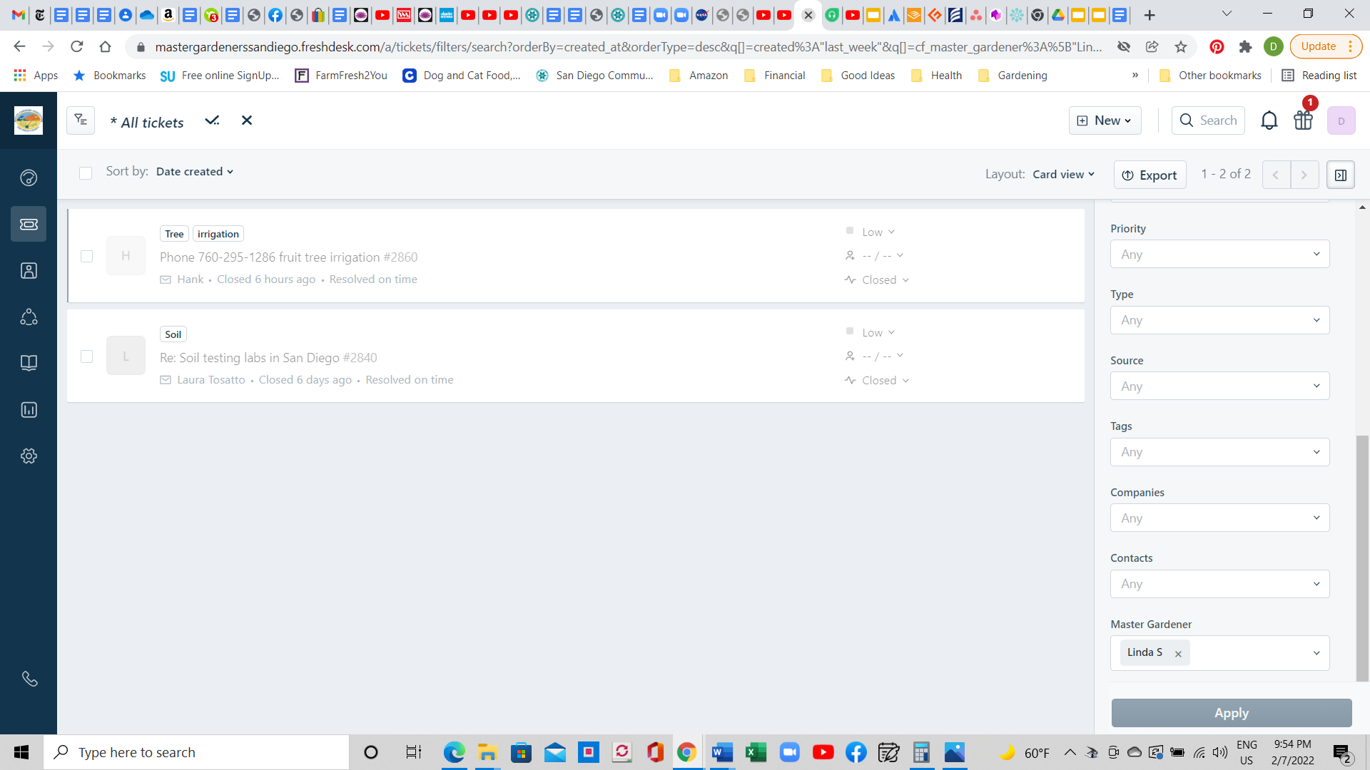
Now only tickets completed by Linda S in the last 7 days are listed.

