Slide 1

Designed for internal training use:
The evaluation process is an important component of telling our story and the impacts we are making in our counties and statewide. Collecting data from participants at events and workshops is critical to our ongoing success. Thank you for your help!
This presentation was designed as a response to request for training materials at Promising Practices Exchange. Please use these slides as a template for training volunteers and staff about the evaluation process.
>>> Don’t forget! DELETE this slide before presenting. <<<
Updated: 9.21.20
Notes:
Questions? Contact:
Tamekia Wilkins, Program Evaluation Coordinator mgevaluation@ucanr.edu (530)750-1368

Slide 2
UC Master Gardener Program: Statewide Evaluation “The 5 W’s”
Questions? Contact: Tamekia Wilkins mgevaluation@ucanr.edu
Notes:
Questions? Contact:
Tamekia Wilkins, Program Evaluation Coordinator mgevaluation@ucanr.edu (530)750-1368

Slide 3
Who, When, and Where are we Evaluating?
Who?
The public
Individuals who are attend UC Master Gardener events and workshops
Not currently an active UC Master Gardener volunteer
When?
Following all qualifying program events and workshops
Where?
All county programs, across California!
Notes:
Who? This phase of the evaluation focuses on members of the public who participate in public education events led by MG Volunteers. Volunteers may attend public education events; however, they will not be included in this phase of evaluation. Volunteers often bring a higher level of knowledge about home gardening and thus, have the potential to skew the data. To ensure that this does not happen and that we capture behavior change among attendees who have not gone through volunteer training which provides tools for gardening we must exclude Volunteers. However, we do want to learn more about Volunteers’ gardening and leading events. To do so, there will be a Phase 2 of evaluation. More details about Phase 2 will come in the future.
When?
As early as September 7, 2017. The start time for counties will differ. As the Program Coordinator it will be important for you to provide a more definite start date. For example, we understand that some counties use online registrations and that registration for these events happen ahead of time. Until the required language is included on the sign-ins (online or paper), participants’ information cannot be used to collect data. Therefore, the goal is to have each county start as soon as possible for the individual county. We would like everyone to have started by January 1, 2018. Starting means obtaining and submitting contact information from qualifying workshops and events.
Where? The data that is collected will be valuable to your county. Counties will receive a report of findings on a quarterly basis which will show local outreach efforts and the impact that has been made. Information included in reports can also be used for demographic purposes and aid in the discussion of who we are serving. It can lead to discussions of how we can strengthen our county’s program.

Slide 4
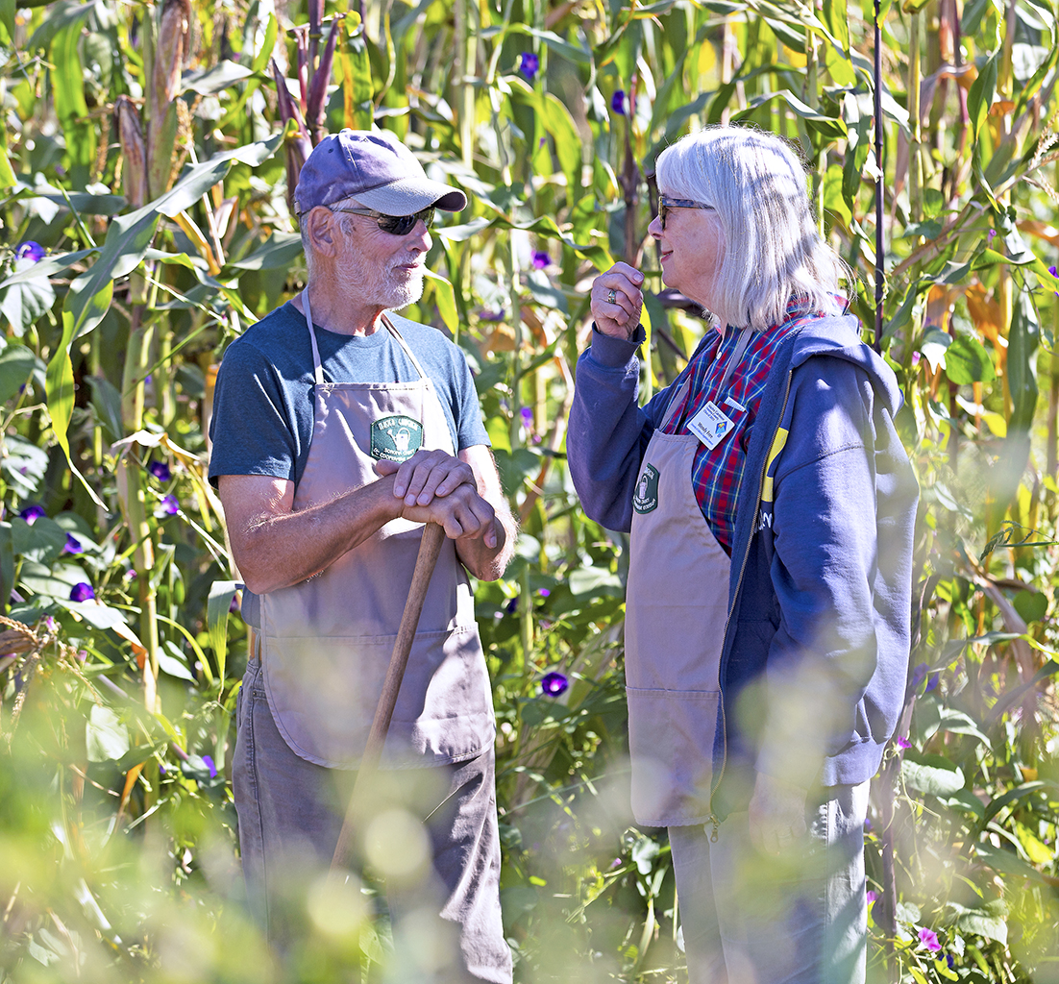
What are we Evaluating?
What?
Public education events that are aimed at helping people to improve on home gardening topics.
These events include: workshops, gardening club talks, library presentations, demonstration garden classes.
Examples include: Pruning demonstrations, irrigation workshops, composting classes
Notes:
What?
Qualifying events and workshops are often at least 30 minutes in duration for all participants at the same time during in-person events. For virtual events, workshops should be at least 15 minutes in duration. All events must have an intended, pre-determined, educational focus.
Events with high educational components are used because they are the best basis for determining behavior change.
Classes conducted at a demonstration garden, workshops to a group of home gardeners, and seminars for community garden coordinators and public school teachers are some examples of qualifying public education events that we are evaluating. We are not evaluating tours in demonstration gardens, demonstrations at farmer’s markets, 1-to-1 technical assistance with the public, or trainings for MG Volunteers. These events are not a part of the evaluation because we are less able to measure behavior change consistently. For example, people may stop by a booth at the farmer’s market to see a demonstration and stay for a few minutes. Because this is the nature of events at farmers’ markets, for example, we are less able to assess participants’ behavior change. We are less certain about the education that was received by those participants who only saw a small portion of the demonstration. Behavior change needs more interaction with the program than a few minutes at a farmer’s market.

Slide 5
Why are we Evaluating?
Why?
Tell the story of the UC Master Gardener Program and the incredible efforts and impacts we are making across the state!
To assess behavior change outcomes of participants at public education events led by UC Master Gardener volunteers.
How many Californians improved their gardening practices as a result of participating in a UC Master Gardener Program public education event?
In what areas have Californians improved (e.g., bin composting, pest management)?
Notes:
Why?
Telling the story of the program is becoming a critical program need – having data supports our case for more program support from our current and future stakeholders and partners. This is an exciting time for our program to lay the foundation for more stable program funding at the local level!
For example, results from the pilot showed that 70% of participants (who took the survey) reported behavior change in bin composting, indicating that they started or improved this composting practice. This information is very useful for local county waste management who are looking for partners to help divert green waste in landfills.
Another example: Nearly 80% of participants reported behavior change in their use of mulch which will reduce the amount of water needed to water plants.
Additional findings from the pilot can be found here: http://ow.ly/vQec30eF7LB

Slide 6
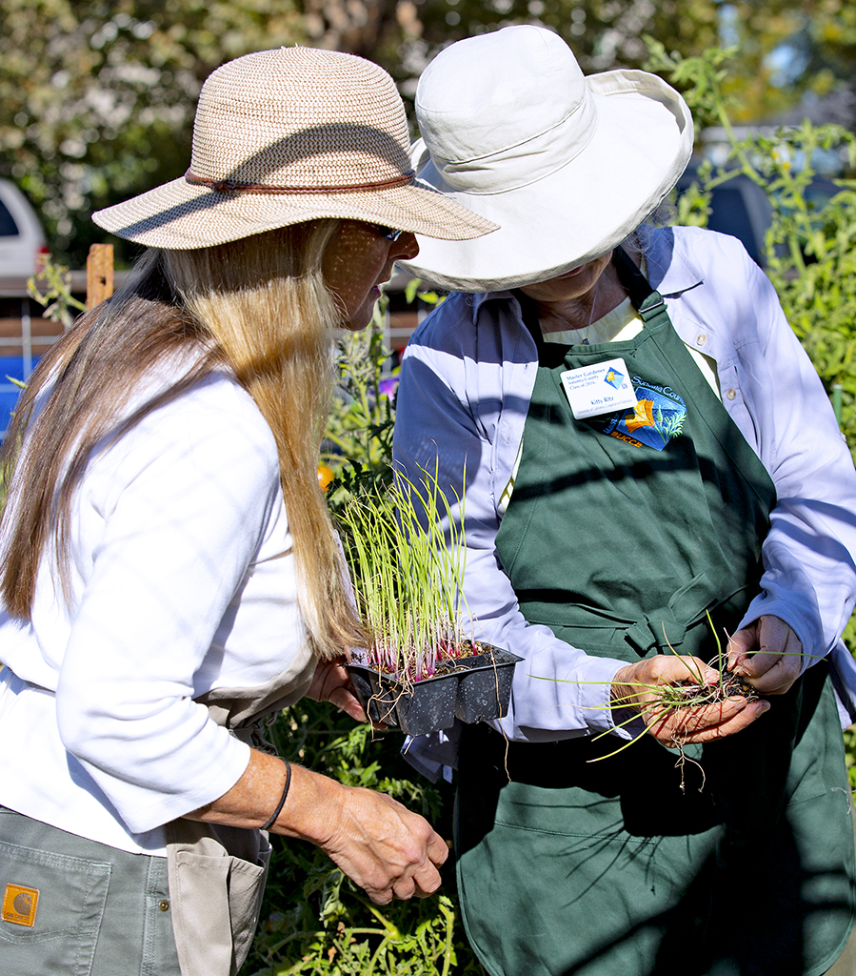
You are the KEY to our Success!
UC Master Gardener volunteers are the face of the program, making direct contact with participants at public education events and workshops.
Last year UC Master Gardeners reach more than 1 million people!
… now let’s tell the rest of our story …
Notes:
Notes: UC Master Gardeners are the KEY to the Master Gardener story!
Imagine how powerful and bigger our voice can be if we discuss behavior change that includes every county in California? As individual counties discuss funding opportunities with current and future partners they can use the statewide data to support why an investment should be made in the local MG program. As a Volunteer you will also be able to see how your efforts are making a difference. With one evaluation plan every county’s data can be analyzed and interpreted by one person instead of each county needing an evaluator to perform these tasks due to inconsistencies in survey items.

Slide 7
Let’s learn more about how our events impact the lives of Californians and in turn, help to create a more sustainable California.
Local and statewide data can paint a “big” picture about the program being a leader in home horticulture.
Working together we will have real data and not have to make assumptions of our impacts.
Notes:
Notes: This evaluation will allow us to all ask the same questions which provides consistency in the reporting of findings across counties. While your goal is to ensure that residents in your county are gaining the knowledge and skills required to improve their gardening practices, it is important to assess whether residents in all counties across the state are improving their gardening practices. To do so, we must ensure consistency in data collection. If we don’t collect the data the same way it cannot be reported the same way and is fragmented. As a result, we cannot show our full impact on Californians and when discussing behavior change with stakeholders you are able to include the numbers for your county only.
THANK YOU FOR ALL YOU DO – WE ARE EXCITED TO BE ABLE TO QUANTIFY IT WITH DATA!

Slide 8
Program Evaluation Quick Guide
STEP 1: Collect participant name and email address via online registration or sign-in sheet for all public education events (sign-in template available in evaluation toolkit).
STEP 2: Socialize the survey at the end of each event. Marketing material and tips are provided in the Evaluation Toolkit to help tell participants about the survey.
STEP 3: Submit completed Contact Sheet (available in the evaluation toolkit). within one week of event, e-mail to Tamekia Wilkins, mgevaluation@ucanr.edu.
See the “Program Evaluation Quick Guide & FAQs” for more detailed insructions. Located in the Evaluation Toolkit, mgcoord.ucanr.edu/ProgramEvaluation.
Notes:
Why?
Telling the story of the program is becoming a critical program need – having data supports our case for more program support from our current and future stakeholders and partners. This is an exciting time for our program to lay the foundation for more stable program funding at the local level!
For example, results from the pilot showed that 70% of participants (who took the survey) reported behavior change in bin composting, indicating that they started or improved this composting practice. This information is very useful for local county waste management who are looking for partners to help divert green waste in landfills.
Another example: Nearly 80% of participants reported behavior change in their use of mulch which will reduce the amount of water needed to water plants.
Additional findings from the pilot can be found here: http://ow.ly/vQec30eF7LB

