Slide 1
What’s the Buzz?
Presented by
Master Gardeners of Placer County
Notes:
Created by P. Beltramo for a school garden club meeting. third to eight graders. H. Clarke Powers Elementary
Given 3/20/19
Basic intro to pollination/pollinators for elementary aged school children. Interactive presentation.
AD
Attracting and protecting our winged visitors. Come and learn who pollinators are, why we need them and what they need in our gardens.
***time keeper we’ll keep going until time runs out. Lots of extra pictures

Slide 2
Who are Master Gardeners?
We:
Extend research-based, sustainable
gardening and composting information
Present accurate, impartial information
to home gardeners
Give knowledge
to make informed gardening decisions
Notes:
For kids—just WHO we are, not where…

Slide 3
Who?
Pollination
What?
Why?
Where?
How?
When?

Slide 4
Who?
Pollination
What?
What?
Why?
Where?
How?
When?

Slide 5
What is Pollination?
?
Notes:
Plants making seeds for the next plants.

Slide 6
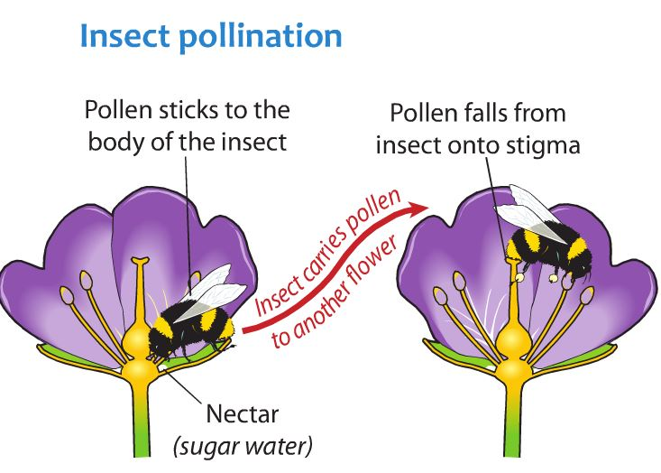
What is Pollination?
Notes:
Pollinators collecting pollen or nectar for food spread the pollen to the next blossom.

Slide 7
Who?
Pollination
What?
Why?
Where?
How?
When?

Slide 8
Who?
Pollination
What?
Why?
Why?
Where?
How?
When?

Slide 9
Why Do We need Pollinators?
?

Slide 10
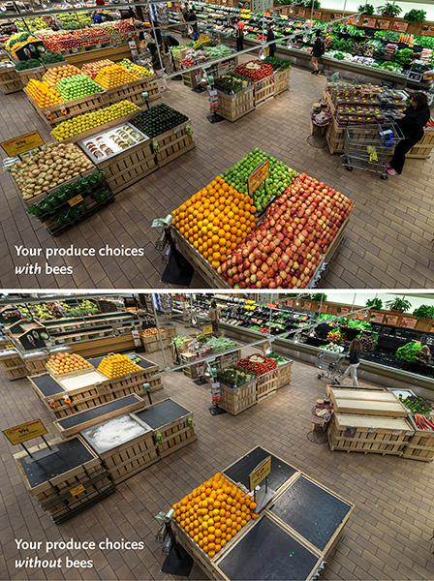
Why Do We need Pollinators?
Notes:
https://media.wholefoodsmarket.com/news/bees
June 14, 2013
The before-and-after photo (above) is shocking – as are the statistics. Whole Foods Market’s produce team pulled from shelves 237 of 453 products – 52 percent of the normal product mix in the department. Among the removed products were some of the most popular produce items:
Apples, Onions, Avocados, Carrots, Mangos, Lemons, Limes, Honeydew, Cantaloupe, Zucchini, Summer squash, Eggplant, Cucumbers, Celery, Green onions, Cauliflower, Leeks, Bok choy, Kale, Broccoli, Broccoli rabe, Mustard greens

Slide 11
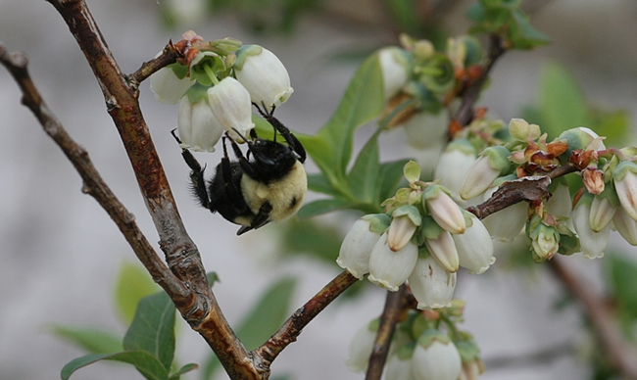
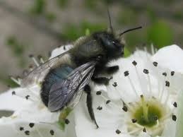
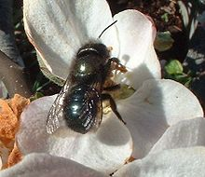
Why Do We need Pollinators?
Meet BOB
Mrs. BOB!
Notes:
BOB = blue orchard be (Mason bee) Osmia lignaria
pollinating apple blossoms
Actually females, Mrs. BOBs, do all the work. They are busy collecting pollen to provision their nests, thus pollinating crops.
This species of native bee works very early in the spring (57 °F) when fruit trees are blooming.
Also other fruit and nut tree blossoms.
More:
https://www.kqed.org/science/1928378/watch-this-bee-build-her-bee-jeweled-nest

Slide 12
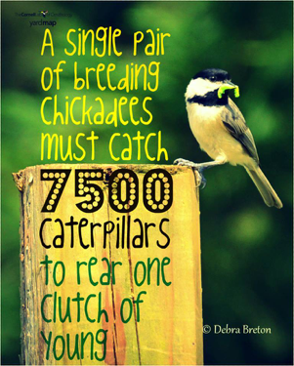
Why Do We need Pollinators?
Notes:
A single pair of breeding chickadees must find 6,000 to 9,000 caterpillars to rear one clutch of young, according to Doug Tallamy, a professor of entomology and wildlife ecology at the University of Delaware.
https://nestwatch.org/connect/news/caterpillar-its-whats-for-dinner/

Slide 13
Who?
Pollination
What?
Why?
Where?
How?
When?

Slide 14
Who?
Pollination
What?
Why?
Where?
Where?
How?
When?

Slide 15
Where do pollinators live?
?

Slide 16
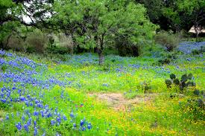
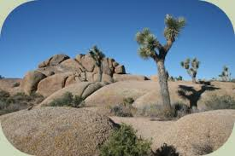
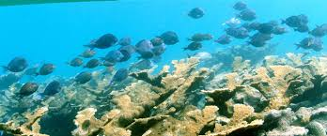
What is Habitat?

Slide 17
What is Habitat?
    Habitat is the place
    where a plant
    or animal lives.

Slide 18

What is Habitat?
    There are 4 components
Food
Water
Shelter
Space

Slide 19
What is Habitat?
Food
Adult food
Food for Young
Notes:
varies by type of pollinator
nectar for adults (flight fuel)
nectar/pollen to feed offspring
OR
“host” plant for butterfly offspring (caterpillars)

Slide 20
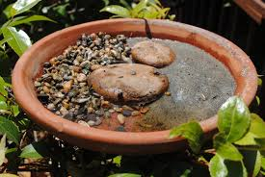
What is Habitat?
Water
Shallow
or with
landing spots
Not clean water!
Notes:
http://ucanr.edu/blogs/blogcore/postdetail.cfm?postnum=26345
dirty water resources
shallow, safe landing, corks, saucer w/ stones, “noodles” in pool
Also wet sand, and wet mud

Slide 21
What is Habitat?
          Shelter and Space
Layers of trees and shrubs
nesting sites
windbreaks and shade
Defend territory
Notes:
Plant in Layers
canopy, understory, shrubs, herbaceous plants, groundcovers
“THINK 3-D,” says Doug Tallamy, co-author of The Living Landscape, “and in fact, maybe think 4-D, since by designing your landscape in all three dimensions, layering plants into complex communities, you’ll add the ‘D’ of diversity, too.”
“4 D” The fourth dimension is diversity
multiples of height, width, breadth, = DIVERSITY

Slide 22
Who?
Pollination
What?
Why?
Where?
How?
When?

Slide 23
Who?
Pollination
What?
Why?
Where?
Who?
How?
When?

Slide 24
Who are Pollinators?
?
Notes:
Think—pair—share
Hold up your fingers to show how many you listed…

Slide 25
Who are Pollinators?
Think
Pair
Share
Notes:
Think—pair—share
Start by think your own ideas. Shhhhh! Don’t tell anyone
When I say “Pair,” turn to a neighbor and whisper your ideas to each other. Count on your fingers how many different kinds of pollinators you are able to list.
When I say, “Go!”, hold up the number of fingers representing how many pollinators you and your partner named.

Slide 26
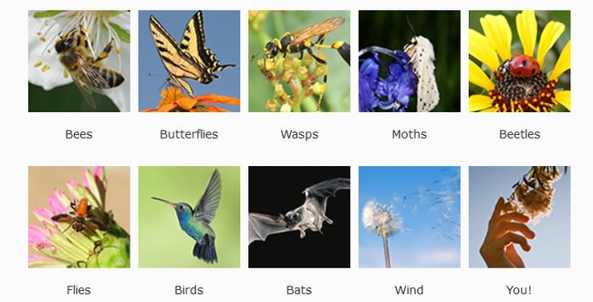
Who are Pollinators?
Notes:
POLLINAOTRS:
bees; butterflies; wasps; moths; beetles; flies; birds; bats; wind; humans
To get animals to help, plants provide:
• food (pollen, nectar)
• scents/perfume
• oils
nest materials
Animal pollinators are
• Most effective agents for plants
• Take pollen directly to right kind of flower
• Flower determines how pollen is collected
• Flower determines how pollen is deposited

Slide 27
Who are Pollinators?
Who Are the Pollinators?
🐝Bees, wasps, beetles, flies
🕊Hummingbirds
🦋Butterflies
🦆Moths
🦇Bats
Notes:
Which one do you think is the best pollinator group?
Why?

Slide 28
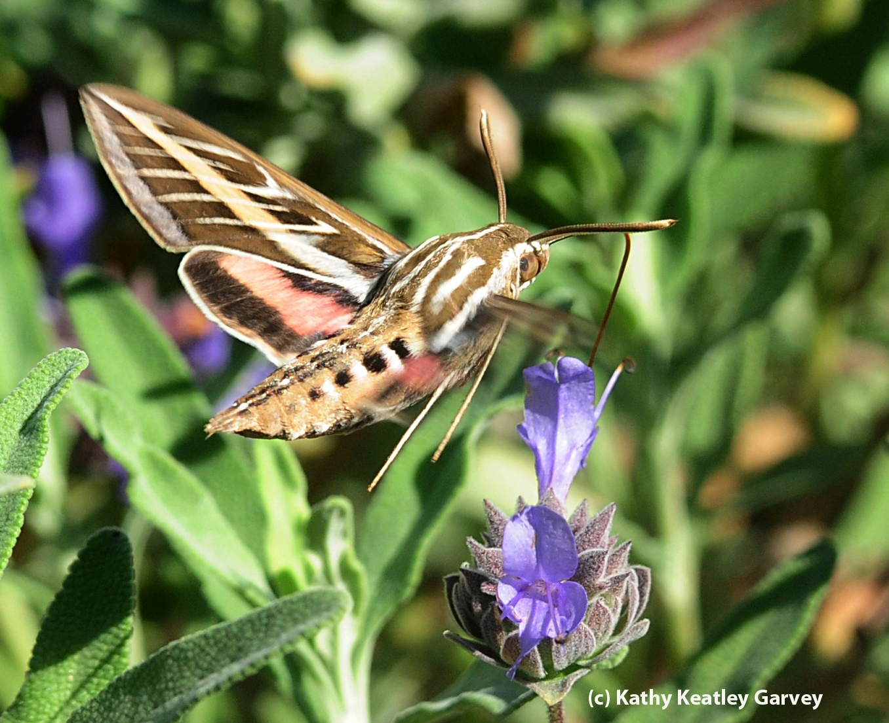
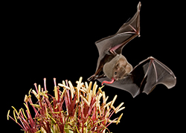
Who are Pollinators?
Who Are the Pollinators?
Moths and Bats
Notes:
Moths mostly fly at night—they like white or light colored flowers.
Local bats are insectivores and are not pollinators, but they do pollinate cactus in the southwest US and Mexico.

Slide 29
Who are Pollinators?
Who Are the Pollinators?
🐝Bees, wasps, beetles, flies

Slide 30
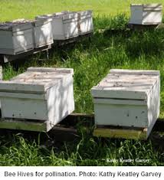
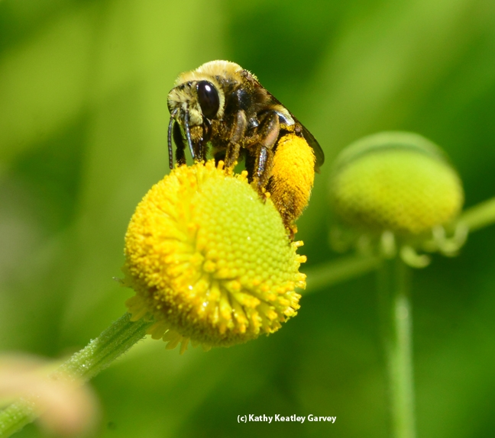
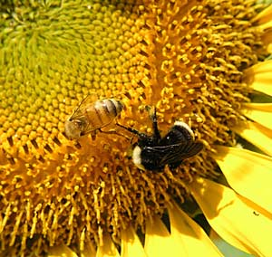
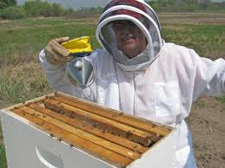
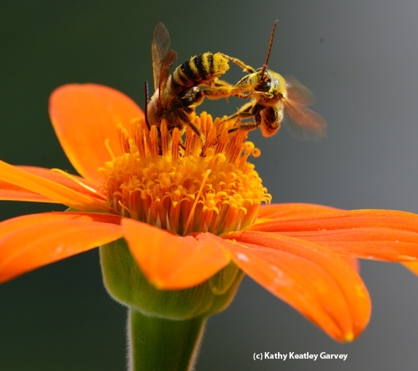
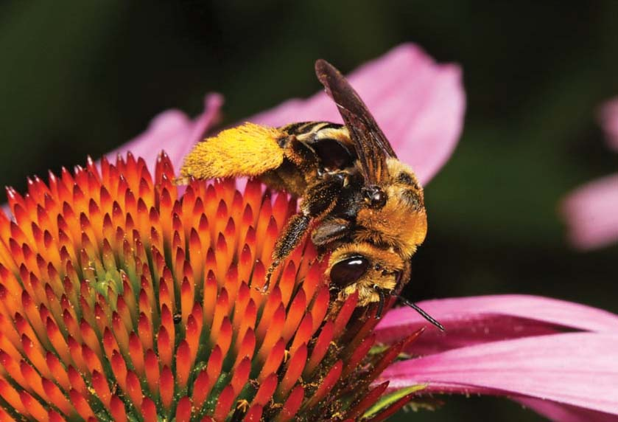
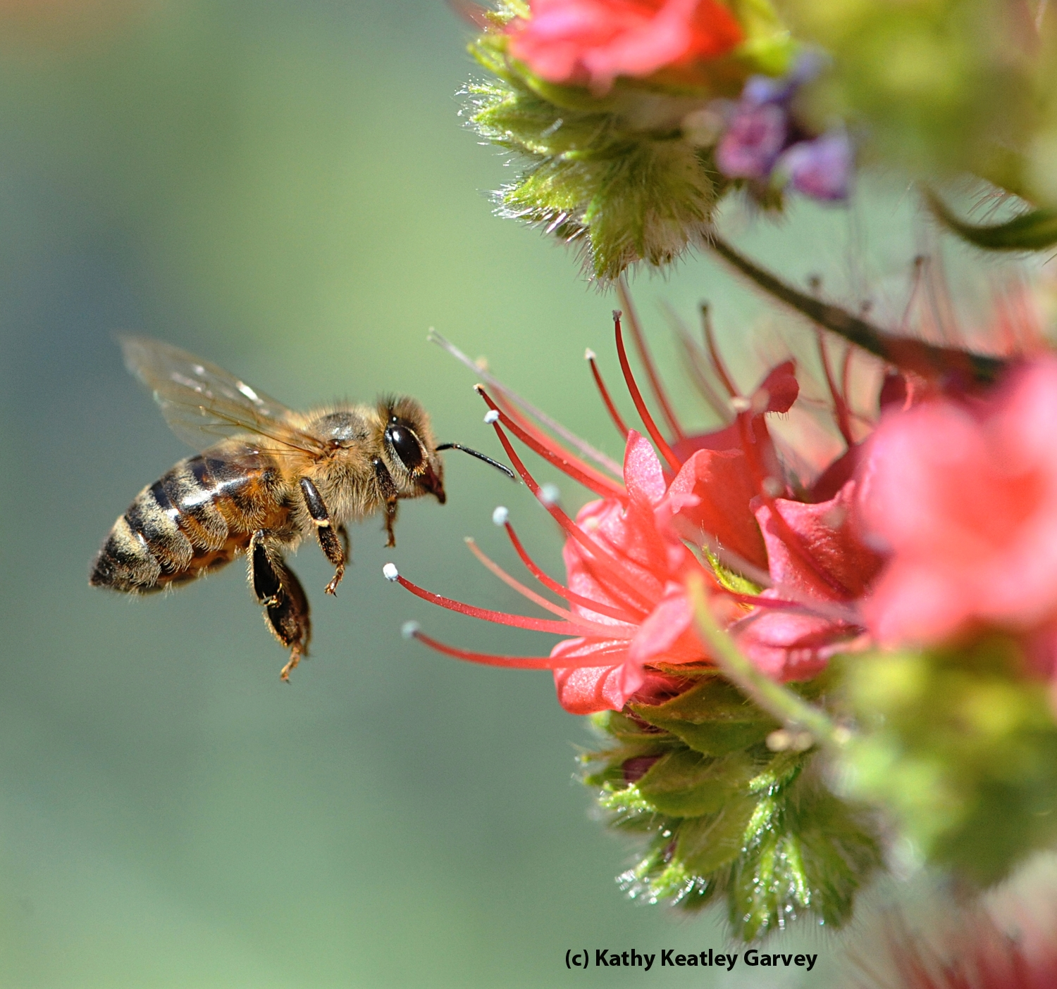
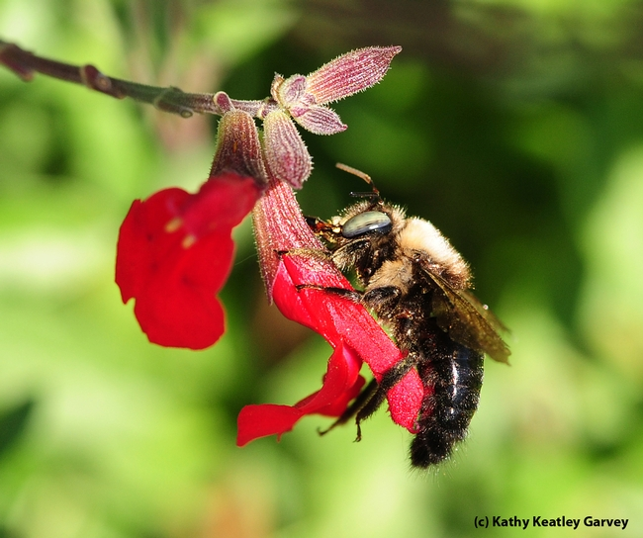
Meet the 🐝 Bees
The Other Bees
Honey Bees
Notes:
Bee hives; bee keeper; honey bee on Echium wildpretti (Tower of Jewels)
1 Honeybee and bumblebee on sunflower;
2 longhorn bee on Helenium (sneezeweed)
3 bumblebee on Salvia (sage);
4 female solitary bee (Svasta obliqua expurgata) on purple coneflower (Echinacea pupurea)
5 bee fight on Tithonia (Mexican sunflower)

Slide 31
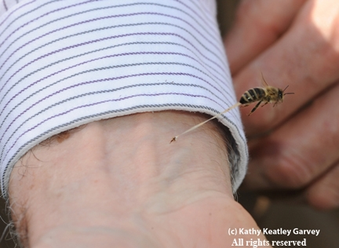
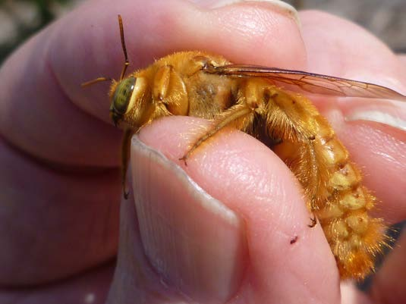
What about Stings?
Kathy Keatley Garvey
Ouch!
Males don’t sting.
Notes:
38 What About Stings? Only female bees can sting. Most bees do not want to sting.

Slide 32
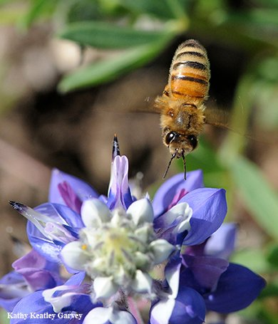
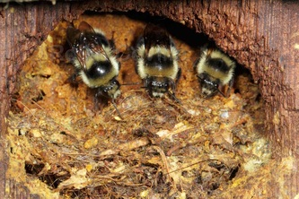
Social Bees
Honey bee
Bumble bee
Honey bees and bumble bees
live together
They defend their nests
by stinging.

Slide 33
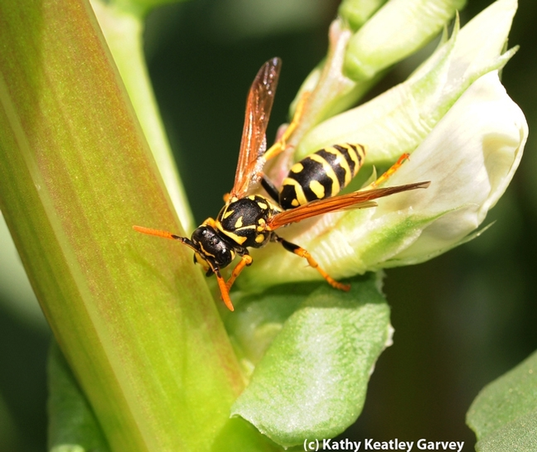
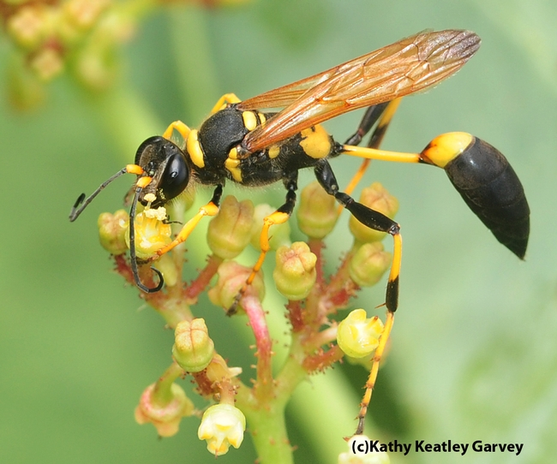
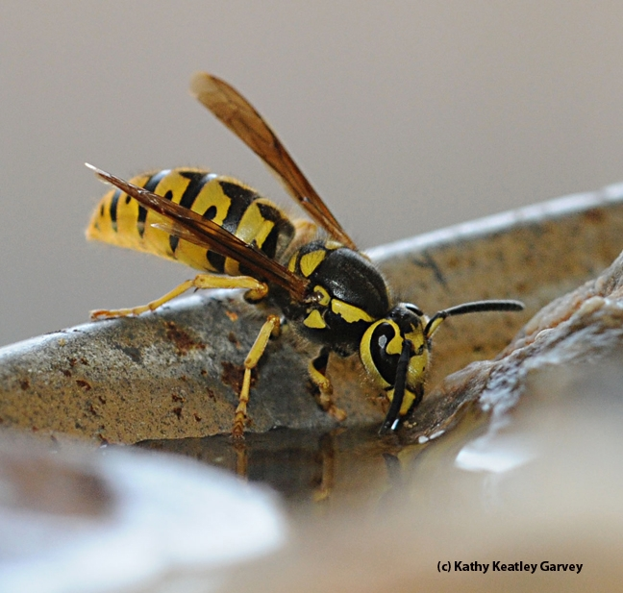
Wasps can sting AND bite
Wasps
Notes:
Western yellowjacket wasp
European paper wasp
mud dauber wasp
Wasps have a waist.
http://ipm.ucanr.edu/PMG/PESTNOTES/pn7450.html
Most social wasps provide an extremely beneficial service by eliminating large numbers of other pest insects through predation and should be protected and encouraged to nest in areas of little human or animal activity.The best way to prevent unpleasant encounters with social wasps is to avoid them.
If you know where they are, try not to go near their nesting places. Wasps can become very defensive when their nest is disturbed.
Concern about yellowjackets is based on their persistent, pugnacious behavior around food sources and their aggressive defense of their colony. Usually stinging behavior is encountered at nesting sites, but sometimes scavenging yellowjackets will sting if someone tries to swat them away from a potential food source.

Slide 34
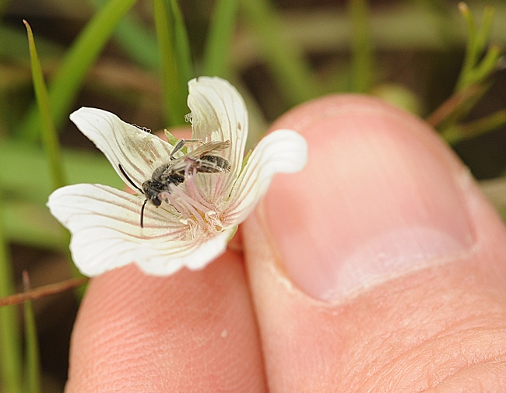
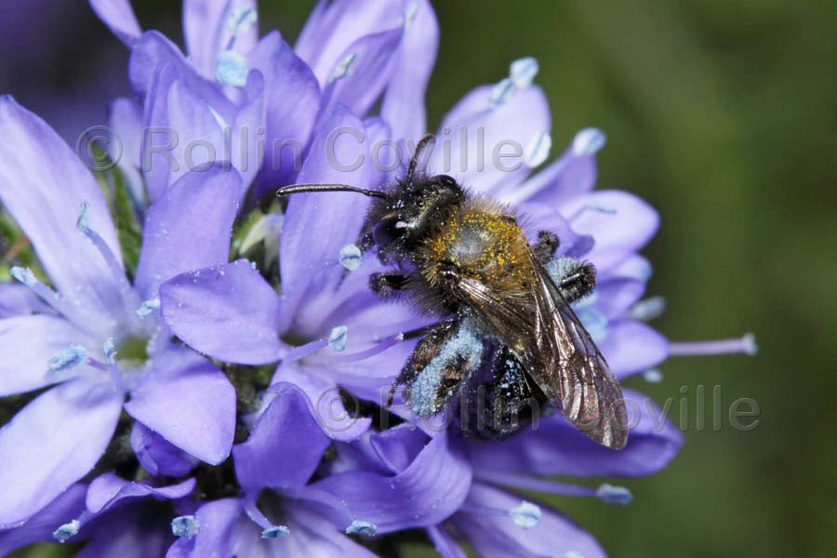
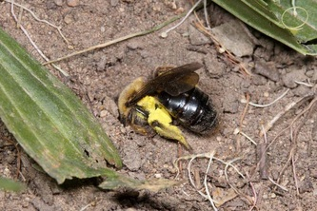
Some bees are gentle!
Meet the 🐝 Bees
“Tickle Bees”
Notes:
Andrenidae Mining Bees
tickle bees: Sabin Elementary, Portland, Oregon
http://www.sabinpta.com/tickle-bee
mining bees in schoolyard. Students observe and protect their friends.
Ground nesters • Sweat bees • Digger bees • Bumble bees
The majority of bees nest in: Bare soil or Sand in the sun
Cavity nesters need plant material or mud to seal egg chambers
Carpenter bees nest in wood

Slide 35
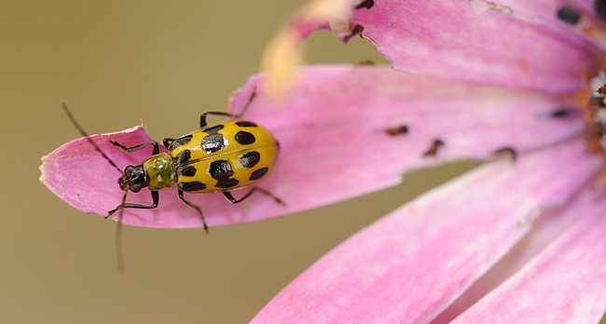
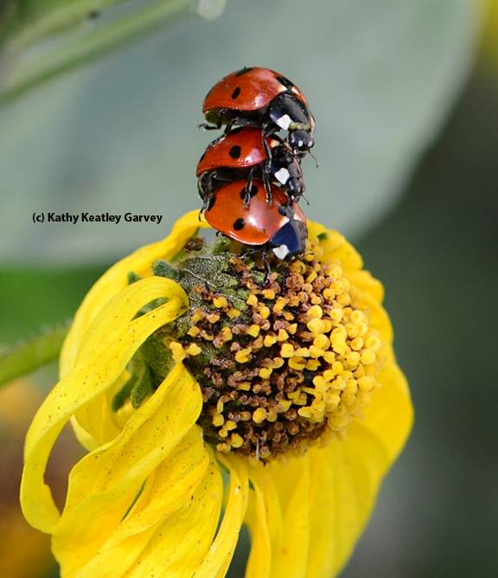
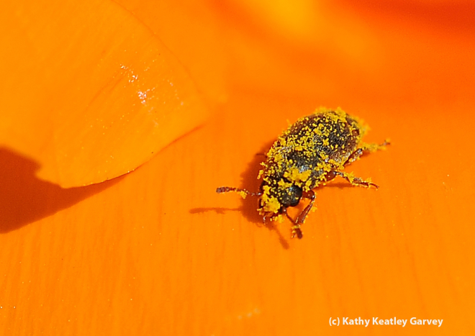
Beetles
Notes:
ladybugs=ladybird beetles
spotted cucumber beetle
POLLEN covered beetle!!!

Slide 36
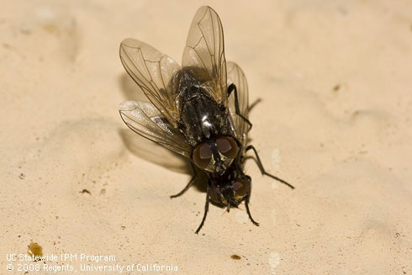
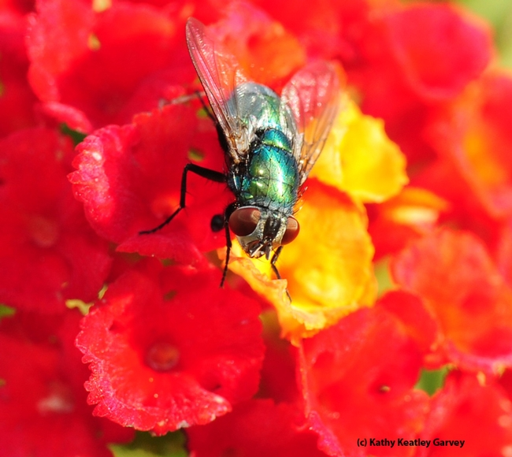
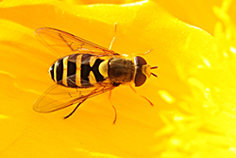
Flies
Notes:
adult house fly
green bottle fly
syrphid fly—wasp mimic Makes her look scary and dangerous!

Slide 37
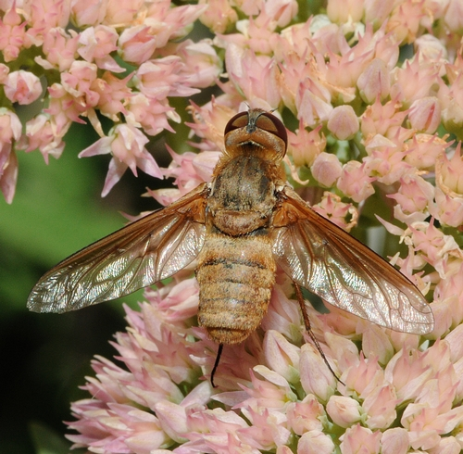
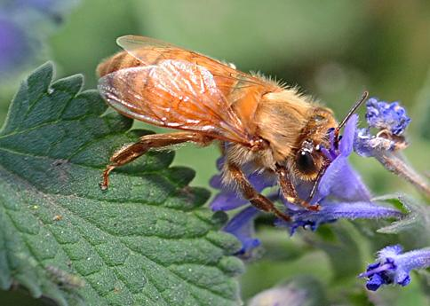
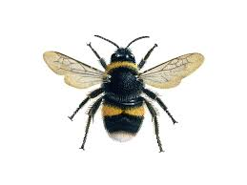

Is it a bee or a fly?
Bee
Fly
Two pairs of wings
Wings closed
One pair of wings
Wings widespread
Notes:
Bees = big eyes; long antennae; 2 pairs of wings; rest with wings closed
Flies = Large eyes; short antennae; one pair of open wings

Slide 38
Who are Pollinators?
Who Are the Pollinators?
🕊Hummingbirds

Slide 39
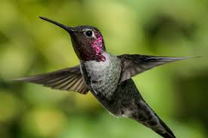
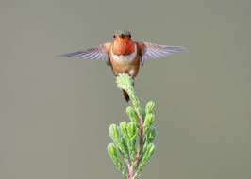
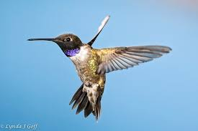
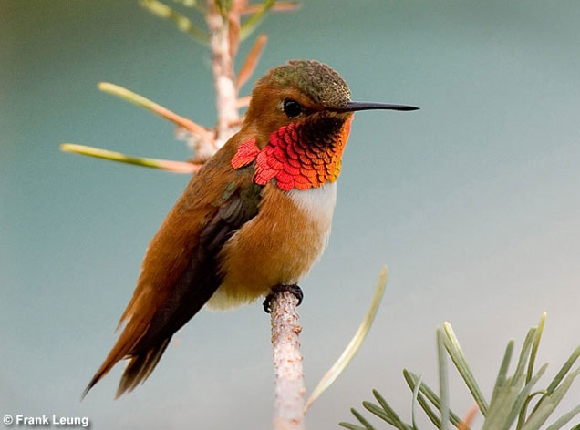
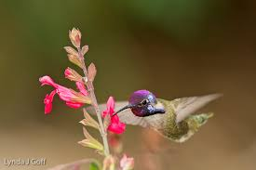
Hummingbirds
Anna's
Allen’s
Black-chinned
Rufous
Costa’s
Notes:
Hummingbirds of the Pacific Flyway
http://ca.audubon.org/news/hummingbirds-pacific-flyway-0
Anna's Hummingbird. The Anna's Hummingbird might be the most common of the hummingbirds to frequent California. ...
Allen's Hummingbird. The Allen's Hummingbird looks quite a bit different from the Anna's, but similar to the Rufous Hummingbird. ...
Rufous Hummingbird. ...
Black-chinned Hummingbird. ...
Costa's Hummingbird.

Slide 40
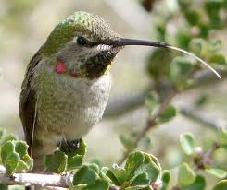
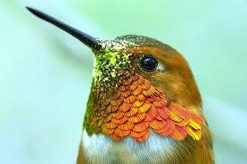
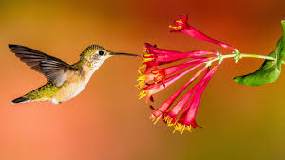
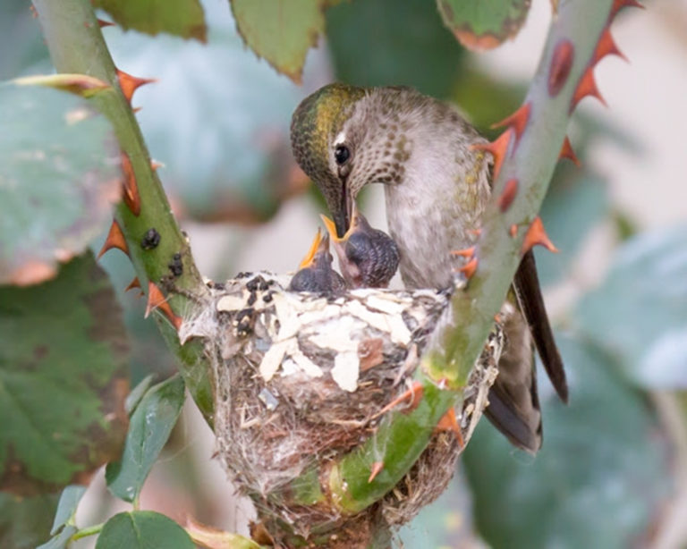
Hummingbirds
Notes:
“tongue”
pollen on face
trumpet shaped blossoms
mama feeding babies

Slide 41
Who are Pollinators?
Who Are the Pollinators?
🦋Butterflies
Notes:
Only drink nectar; pollination is accidental

Slide 42
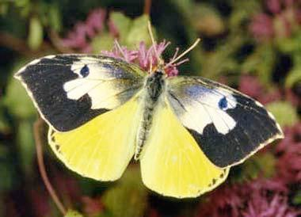

Butterflies
California State Insect
Male
Female
California Dogface butterfly
Zerene Euridice
photo © Peter J. Bryant (used by permission).
Notes:
🦋State insect
CA dogface butterfly endemic (biologically unique) to California
1929 entomologists selected; used over 40 yrs.
In 972 4th graders got legislation passed to make it official!
host plant Amorpha californica false indigo, co-evolved

Slide 43



Monarch Butterfly

Slide 44


Who are Pollinators?
Butterflies
Who Are the Pollinators?
Notes:
painted lady butterfly cabbage white butterfly

Slide 45

Who are Pollinators?
Butterflies
Who Are the Pollinators?

Slide 46
Who?
Pollination
What?
Why?
Where?
How?
When?

Slide 47
Who?
Pollination
What?
Why?
Where?
How?
How?
When?

Slide 48


How Can I Attract Pollinators?
How Do You Attract Pollinators?
Large 3x3 patches
Long bloom time
Butterflies = nectar
Insects = Nectar and pollen

Slide 49

PLANTS! PLANTS! PLANTS!
The “bee year” = March-October
Plant in the sun.
Patchwork Quilt

Slide 50



How Do You Attract Pollinators?
Daisy Type
Flat Clusters
Spikes
Mexican Sunflower
Tithonia rotundifolia
Yarrow
Achillea millefolium
Goldenrod
Solidago californica
Yarrow
Achillea millefolium
Goldenrod
Solidago
Notes:
Pollinators are attracted to large patches of the same type of flower—at least 3 feet x 3 feet.
They prefer to visit the same flower over and over. They can tell if a flower has a lot of food or not much
(like static electricity)

Slide 51



Larval Host Plants
Larval Food = Plant
Adult Food = Nectar
Dutchman’s Pipevine
Aristolochia californica
Pipevine Swallowtail
Caterpillars can be very picky.
Some will only eat one species of plant.
Notes:
The Pipevine Swallowtail (pictured) is a local species who’s only host plant is the Dutchman’s Pipevine (also pictured). If it’s eggs are laid on any other vine or shrub, the hatching caterpillars will not eat and starve to death.
Monarchs will eat multiple species of Milkweed, but no other Genera of plant.
Some butterfly larvae are less picky and will eat multiple plants, but many are specialists and rely on the presence of one particular species in order to survive.

Slide 52

How Do You Attract Pollinators?
Install a Bee Condo

Slide 53


How Do You Attract Pollinators?
Mexican Sunflower
Tithonia rotunfifolia
Blooms spring to fall
Attracts many pollinators
Also butterflies
Even hummingbirds
#TithoniaInEveryGarden
Best pollinator plant
Notes:
"Tithonia in every garden" or hashtag it: #TithoniaInEveryGarden.
Meanwhile, you can't go wrong with Mexican sunflower or Tithonia, which anchors many pollinator gardens in California from early spring through fall. In addition to monarchs, we've seen Gulf Fritillaries, Western tiger swallowtails, mourning cloaks, pipevine swallowtails, skippers, buckeyes, acmon blues, painted ladies and other butterflies sipping nectar from Tithonia. That's not to mention the other pollinators drawn to the colorful orange flower. Among them: bumble bees, carpenter bees, sunflower bees, leafcutter bees, blue orchard bees, sweat bees, syrphid flies or hover flies, and hummingbirds
http://www.ucanr.org/blogs/blogcore/postdetail.cfm?postnum=22079

Slide 54
Who?
Pollination
What?
Why?
Where?
How?
When?

Slide 55
Who?
Pollination
What?
Why?
Where?
How?
When?
When?

Slide 56
Who?
Pollination
What?
Why?
Where?
How?
When?
NOW!!!

Slide 57
NOW!!!

Slide 58
A quiz

Slide 59

Bee or Fly?
Notes:
hover fly (syrphid fly) WINGS OPEN 1 pair of wings

Slide 60

Notes:
male monarch

Slide 61

Notes:
Digger bee and ground nest

Slide 62

Notes:
alfalfa looper moth

Slide 63

Notes:
Paper wasps and nest

Slide 64

Notes:
green bottle fly

Slide 65

Notes:
Thread-waisted wasp

Slide 66

Notes:
cuckoo bee
lays eggs in other bees’ nests. Larvae eat egg and stored food.

Slide 67

Notes:
skipper butterfly

Slide 68

Notes:
Sand wasp—closed wings

Slide 69

Notes:
bumble bee

Slide 70

Notes:
assassin bug attacking yellow cucumber beetle

Slide 71

Real or Fake?
Notes:
Blue mud wasp——non native (Florida)

Slide 72



What color is pollen?
Notes:
Orange pollen—dandelion—Taraxacum officinale)
Yellow—Mexican Hat—ratibida columnnifera
Blue—Siberian squill – Scilla siberica
https://thehoneybeeconservancy.org/2011/04/02/pollen-basket/

Slide 73



Pollen collection
Notes:
light electrostatic charge -= “Used” bloom vs. full store

Slide 74


Thank you
Questions?
Evaluations,
please!

