Slide 1
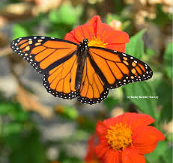
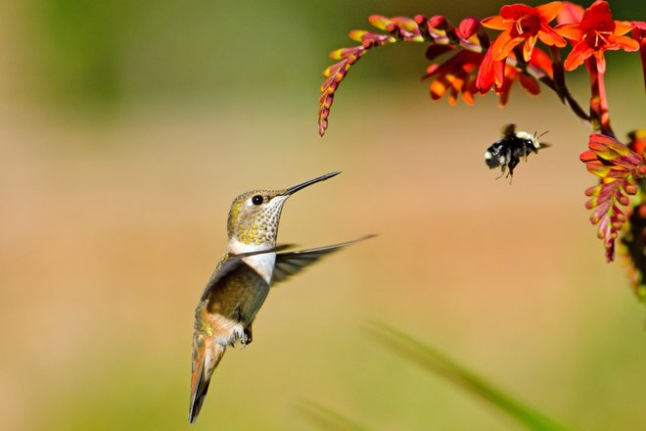
Jewels in the Garden
Notes:
Created: February 2008
Created by: Elaine Applebaum
Publicity:
Jewels in the Garden
Come and meet the flying jewels that visit gardens. Find out how to attract them to your space.
Update History:
#1 Adapted by Peggy Beltramo, 1/16
Presentation by Peggy Beltramo, 5/18 to accompany habitat module and hummingbird presentation by Ann Beinhorn.
Converted to Butterfly PPT—GREEN for use on 1/11/19 by Tece Markel.
*Note: Remember to resubmit any new information to SIM for approval

Slide 2
Who Are Master Gardeners?
Master Gardeners of Placer County
Extend research-based, sustainable gardening and composting information
Present accurate, impartial information to home gardeners
Encourage public to make informed gardening decisions

Slide 3
Who Are Master Gardeners?
Where to find us…
Online, in the Media, and Special Publications
Hotline: Call (530) 889-7388 or submit your questions online
Website: pcmg.ucanr.org
Facebook, Twitter, Instagram
Gold Country Media monthly column
Curious Gardener quarterly newsletter; email and on website
Calendar and Gardening Guide

Slide 4
Who Are Master Gardeners?
Where to find us…
Workshops, Fairs and Festivals and Special Events
Speakers by Request
Workshops (various venues, check website)
Farmers’ Markets (seasonal: Auburn, Roseville)
Fairs and Festivals Booths (varies)
Garden Faire (April)
Mother’s Day Garden Tour (May)

Slide 5
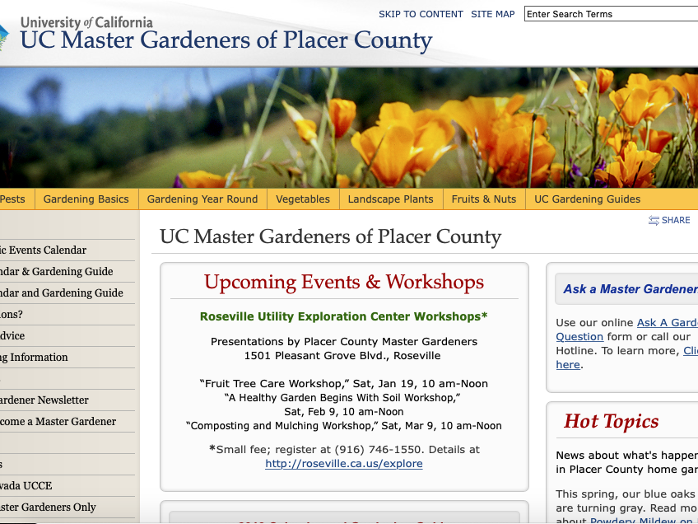
pcmg.ucanr.org

Slide 6

Title
Let’s Look at Your Handouts…
Resources/Pleasing Pollinators
Foothill Butterfly Plants
Tithonia (Mexican Sunflower) SEEDS

Slide 7
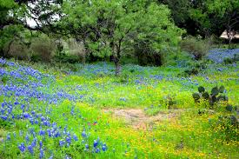
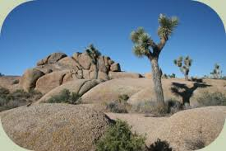
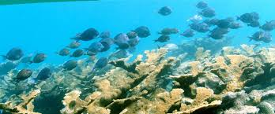
What is Habitat?

Slide 8
What is Habitat?
Habitat is the place
where a plant
or animal lives.
Notes:
Habitat is the place
where a plant
or animal lives.

Slide 9
What is Habitat?
There are 4 components
Food
Water
Shelter
Space

Slide 10
Provide a Healthy Habitat
Food
Adult food
Food for Young
Notes:
varies by type of pollinator
nectar for adults (flight fuel)
nectar/pollen to feed offspring
OR
“host” plant for butterfly offspring (caterpillars)

Slide 11
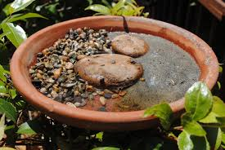
Safe Access to Water
Shallow water or
Landing spots
NOT clean water!
Damp sand or mud =
Minerals for health
Notes:
Butterflies engage in a practice called “puddling” in which they drink up mud. This provides them with important mineral nutrients. You can provide a puddle in your garden by having a drip emitter or leaky hose on bare soil.
Or, if your soil drains too quickly, you can make an artificial puddle by sinking a shallow, non-pervious dish (like a pie tin or plastic trash can lid or pot tray) just to the level of the surrounding soil. Fill it with sand and soil and surround it with twigs and small rocks to serve as perching areas. Keep it moist, again with a drip emitter or leaky hose.
NOT CLEAN WATER==
http://ucanr.edu/blogs/blogcore/postdetail.cfm?postnum=26345

Slide 12
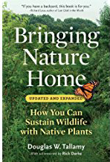

Provide a Healthy Habitat
Shelter
Perching sites to
defend territory
watch for females
Layers of trees and shrubs for windbreaks and shade
Think 4-D
Notes:
Plant in Layers
canopy, understory, shrubs, herbaceous plants, groundcovers
“THINK 3-D,” says Doug Tallamy, co-author of The Living Landscape, “and in fact, maybe think 4-D, since by designing your landscape in all three dimensions, layering plants into complex communities, you’ll add the ‘D’ of diversity, too.”
“4 D” The fourth dimension is diversity
multiples of height, width, breadth, = DIVERSITY

Slide 13
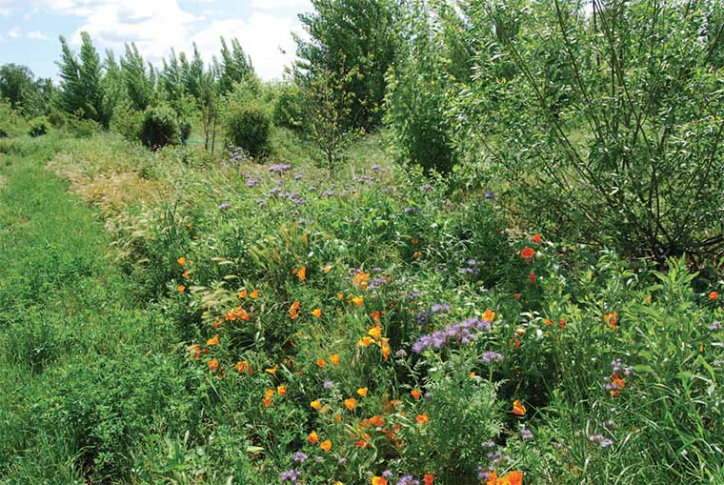
Provide a Healthy Habitat
Space
Leave a portion
of your yard
or property
“wild.”
Notes:
Provide nesting sites:
A New Vision Consider leaving a portion of your yard or property “wild”
“It’s important to not be too neat. Garden visitors will see that we leave some weed growth on the garden edges to provide this type of habitat.”
Wild areas—NOT weeds
Disney quote:
'What do you mean we can't get rid of those weeds in time? Then go over there and put some fancy signs with Latin names in front of them’—Walt Disney.

Slide 14
How Can I Attract Pollinators?
A wide selection of plants
Year-round food source
Many sources of food
Long bloom season
“Drone view.”
Large masses of
a single color/plant.
Notes:
A wide selection of plants provides
many sources of food
Long bloom season to provide a year-round food source
“Drone view.” Large masses of a single color/plant.

Slide 15
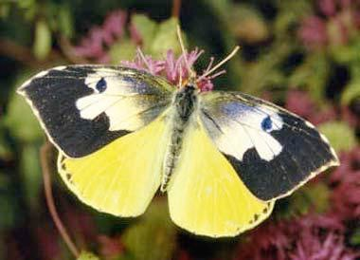
First, Butterflies…

Slide 16
Attracting Butterflies to your Garden
California State Insect
Do you know this butterfly?

Slide 17
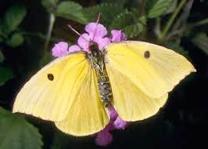
Attracting Butterflies to your Garden
California State Insect
Male
Female
California Dogface butterfly
Zerene Euridice
photo © Peter J. Bryant (used by permission).
Notes:
🦋State insect
CA dogface butterfly endemic (biologically unique) to California
1929 entomologists selected; used over 40 yrs.
In 972 4th graders got legislation passed to make it official!
host plant Amorpha californica false indigo, co-evolved

Slide 18
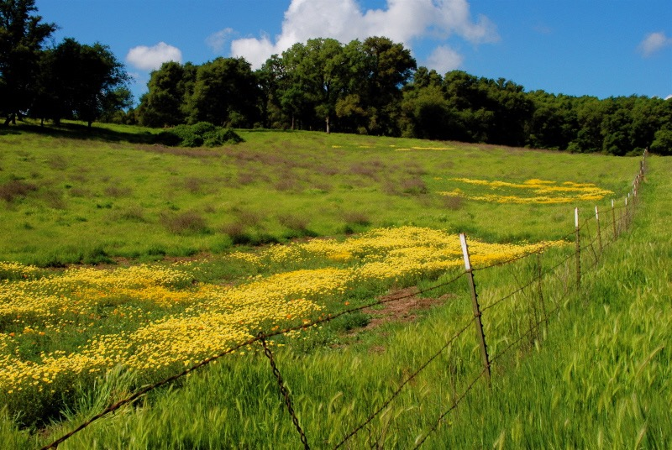
Small, fenced yards are unappealing to species that live in wide-open fields and meadows.
Photo by Rick Krach
Notes:
Most butterflies are either migratory or require a larger resource base than our typical residential lots can provide. They like to roam over a large area. The best someone in a densely developed region like the Sacramento valley can hope for is to intercept and lure in randomly flying individuals for a temporary visit. Butterflies are most numerous in the valley from August through late October.
Even those in relatively rural areas like the foothills have to work to attract the native species to their cultivated gardens because the butterflies will prefer the open, undeveloped areas away from humans. They will even be drawn to the non-native Yellow Star Thistle because it is a rich nectar source. Those homes surrounded by more-or-less intact wild areas will have the most luck attracting wandering native species.
The best butterfly habitat in the foothills is in east-west flowing river canyons, because there is great climatic and vegetative diversity. These areas can be home to as many as 70 different species. Areas of special soils (serpentine, gabbro, limestone) will have fewer species, but those that do exist will be special—in some instances living nowhere else in the world.

Slide 19
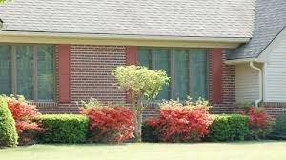
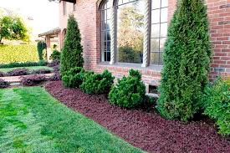
No food or shelter here.
Notes:
The tight, dense growth encouraged by frequent hedging does not allow access to the interior of the shrub where birds and butterflies, nests and cocoons, are protected from predators.
Turf grass offers no nectar for food and the fertilizers and pesticides used on lawns is toxic to birds, butterflies, caterpillars and insects that hummers eat.

Slide 20
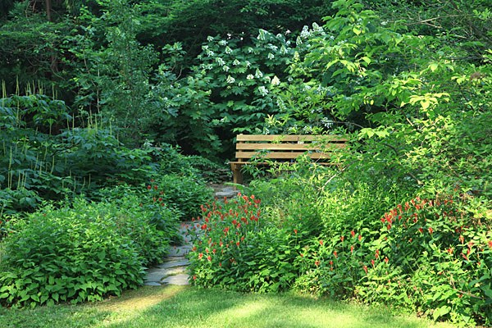
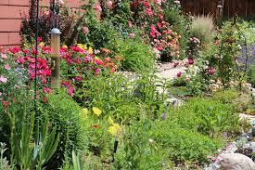
But you CAN
Create a garden
attractive to humans
and
Provide habitat to attract pollinators
Notes:
Careful planning can produce a yard that is both beautiful to our eyes and welcoming to hummingbirds and butterflies.
The diversity of plant forms and sizes needed for proper shelter for our guests will create an attractive framework for our landscapes.
The water features critical to providing proper habitat will be equally pleasing to us.
We may have to get creative in order to “hide” the weedy species and those that will be eaten by caterpillars, but we will benefit in choosing plants that will provide year-round bloom.

Slide 21
Planting to Intercept Butterflies
Intercept individual butterflies
Detain them where they can be observed and enjoyed
Few butterflies can maintain a population on a residential lot – even a big one
Work with your neighbors
to create a larger butterfly habitat.
Notes:
Intercept
Intercept singles, detain, not a population, work with neighbors to enlarge footprint of habitat

Slide 22
Habitat Components
Butterflies Require:
Mating territory
Pupation sites
Adult food supply
Larval host plants

Slide 23
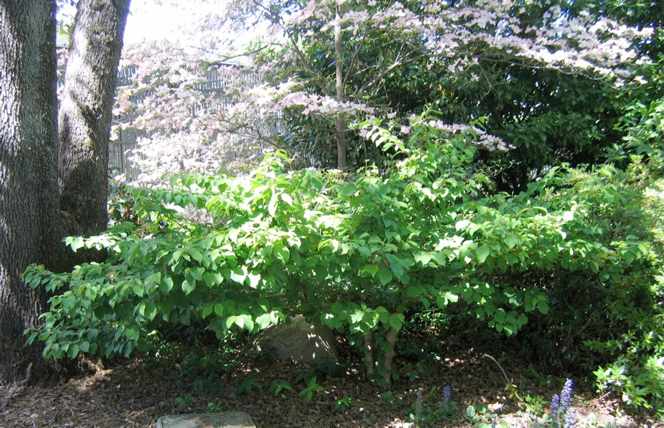
Mating Territory
Perching sites to defend territory and watch for females
Different height trees and shrubs for windbreaks and shade

Slide 24
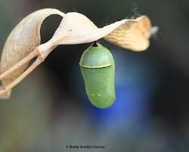
Pupation Sites
Host plants for larvae
A variety of cover for protection/pupation
Caterpillars may travel
up to 50 feet to pupate
Monarch chrysalis

Slide 25
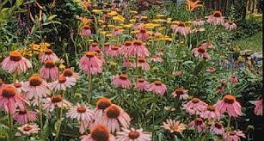
Adult Food Supply
Nectar is the lure for butterflies.
Prefer pink, red, purple, yellow and orange flowers.
Attracted to large masses of a single color
At least 3’ x 3’
Notes:
Here starts a series of slides of plant attributes that are clues to flowers with nectar that will attract butterflies.

Slide 26
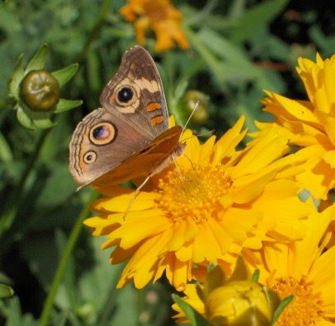
Adult Food Supply
Butterflies land on a flower to drink nectar.
Prefer
flat daisy-type flowers
or
clusters of small flowers
in umbels or spikes
Photo: Pauline Sakai
Coreopsis
Notes:
land to drink; flat daisy, umbel or spike

Slide 27
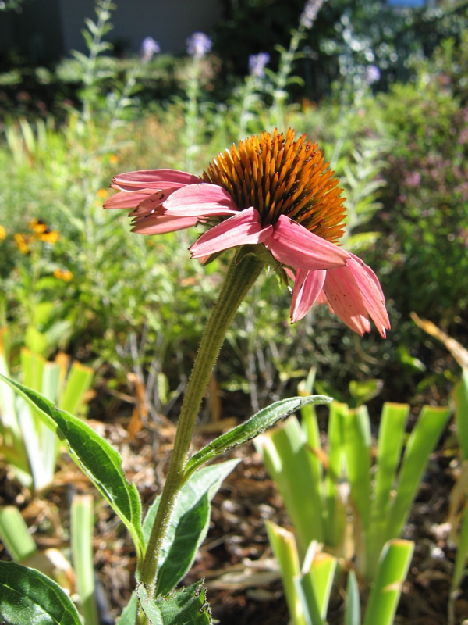
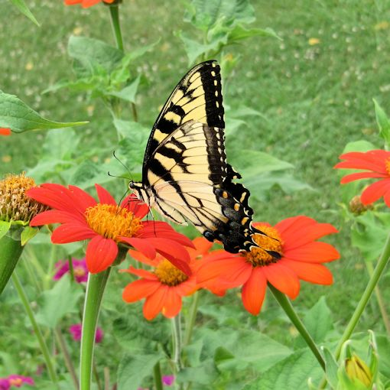
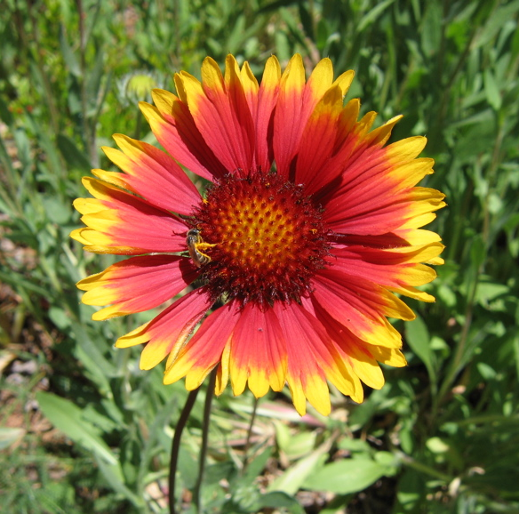
Adult Food Supply
Daisy-type flowers
Coneflower
Echinacea
Mexican Sunflower
Tithonia rotundifolia
Blanketflower
Gaillardia
Notes:
What we think of as one flower is actually a collection of many. Daisy-type flowers, those in the family Asteraceae, are composite flowers, meaning they have 2 sets of many flowers in each inflorescense: those at the base of each petal (ray flowers) and those in the center (disk flowers). This is the largest plant family, including sunflowers, asters, dandelions, thistles, cosmos, senecio, daisies, many wildflowers and many more.

Slide 28
Adult Food Supply
This is your seed packet
Mexican Sunflower
Tithonia rotundifolia
Notes:
Tithonia seeds as a handout

Slide 29
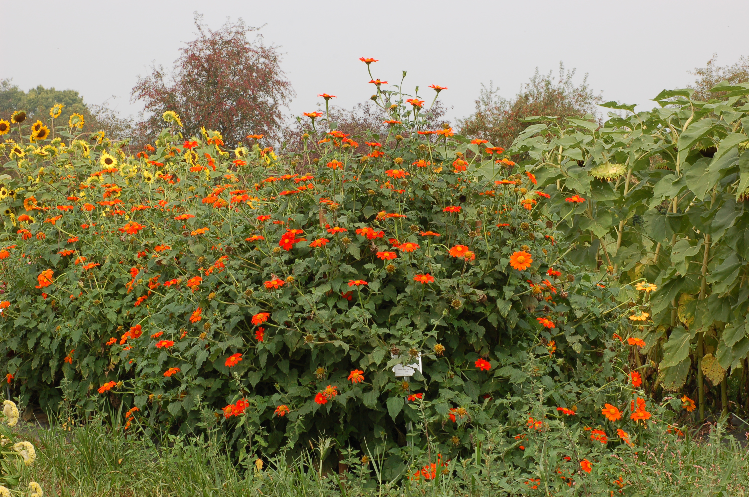
It gets BIG!
Mexican Sunflower
Tithonia rotundifolia
Notes:
Size:

Slide 30
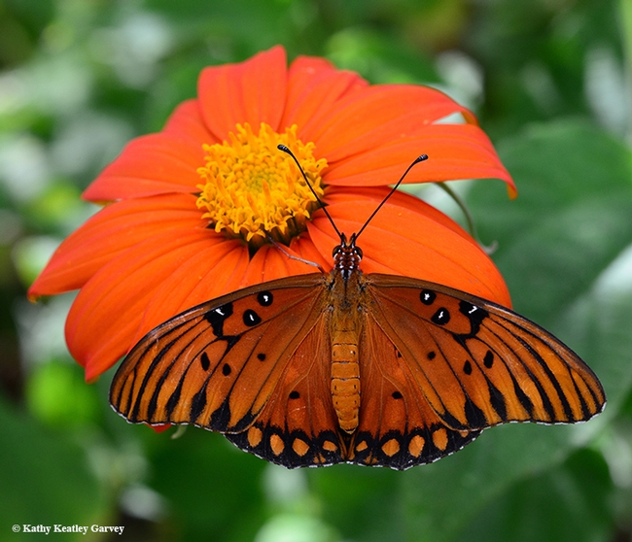
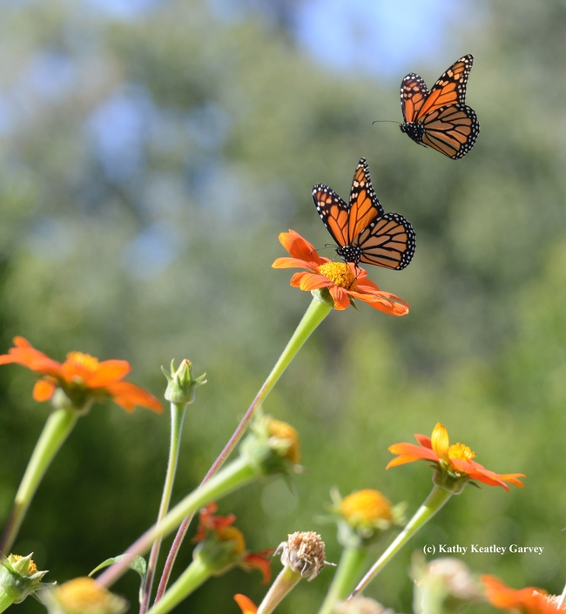

PLANTS! PLANTS! PLANTS!
#TithoniaInEveryGarden
Mexican Sunflower
Tithonia rotundifolia
Best pollinator plant
Nonnatives
are important,
too
Annual flower
Notes:
"Tithonia in every garden" or hashtag it: #TithoniaInEveryGarden.
Meanwhile, you can't go wrong with Mexican sunflower or Tithonia, which anchors many pollinator gardens in California from early spring through fall. In addition to monarchs, we've seen Gulf Fritillaries, Western tiger swallowtails, mourning cloaks, pipevine swallowtails, skippers, buckeyes, acmon blues, painted ladies and other butterflies sipping nectar from Tithonia. That's not to mention the other pollinators drawn to the colorful orange flower. Among them: bumble bees, carpenter bees, sunflower bees, leafcutter bees, blue orchard bees, sweat bees, syrphid flies or hover flies, and hummingbirds
http://www.ucanr.org/blogs/blogcore/postdetail.cfm?postnum=22079

Slide 31
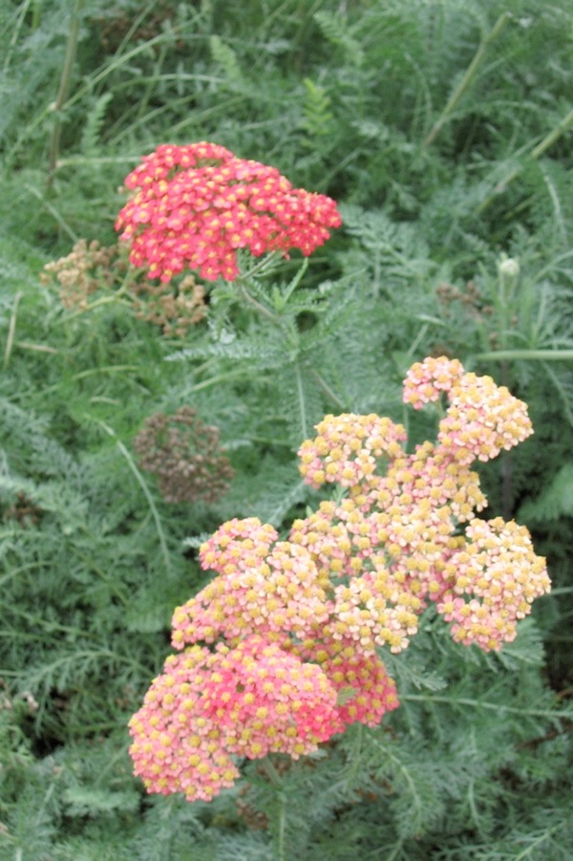
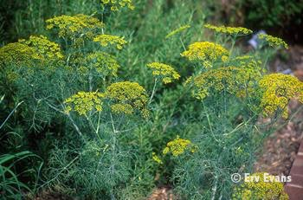

Adult Food Supply
Flat clusters (umbels) of small flowers
Sulphur Buckwheat
Eriogonum umbellatum
Dill
Anthemis graveolens
Yarrow
Achillea millefolium

Slide 32
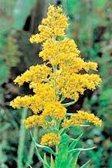
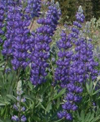
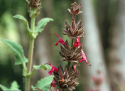
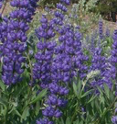
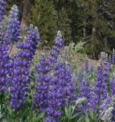
Adult Food Supply
Spikes of closely spaced small flowers
© 2002 Lynn Watson
Goldenrod
Solidago
Lupine
Lupinus
Hummingbird Sage
Salvia spathacea
Notes:
Again, these are plants where the butterfly can land once and access multiple flowers.

Slide 33
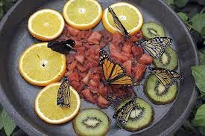
Additional Food Supply
Not all butterflies eat nectar.
Other favorite foods include:
Overripe/rotting fruit
Tree Sap
Manure
Bird Droppings
Notes:
Set out overripe fruit on a plate or on top of a fence post. Be aware that it will also attract ants, wasps and other insects, so put out of the way.

Slide 34
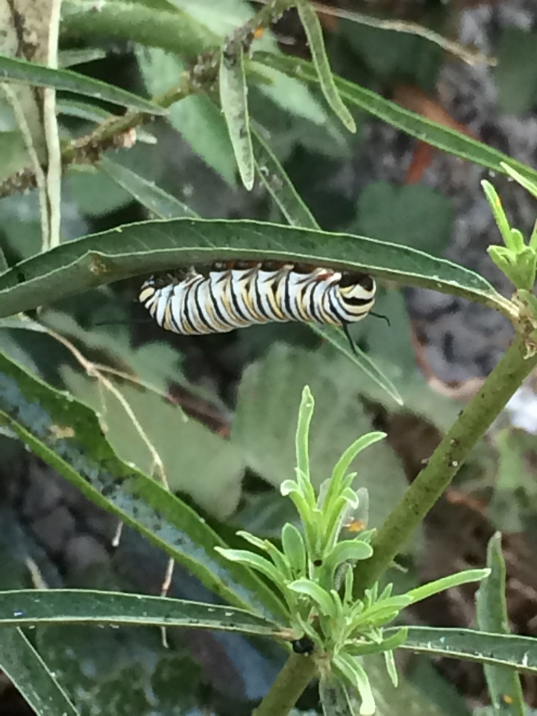
Larval Host Plants
‘Host’ plants
Where adults lay eggs
Food for caterpillars
Monarch caterpillar
on milkweed
Notes:
Many butterfly larvae (caterpillars) are specialists and rely on the presence of one particular plant species in order to survive. Others are less picky and will eat multiple plants,

Slide 35
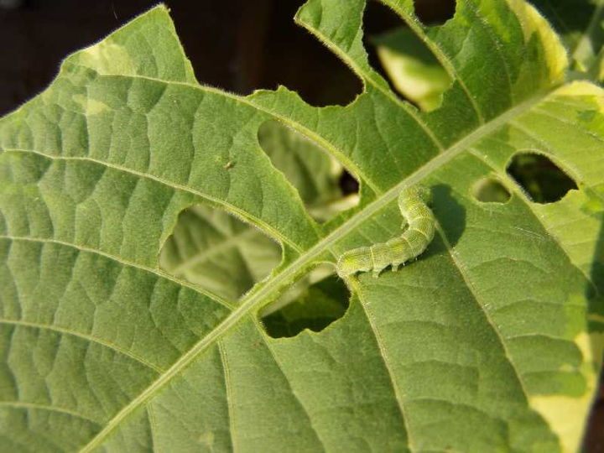
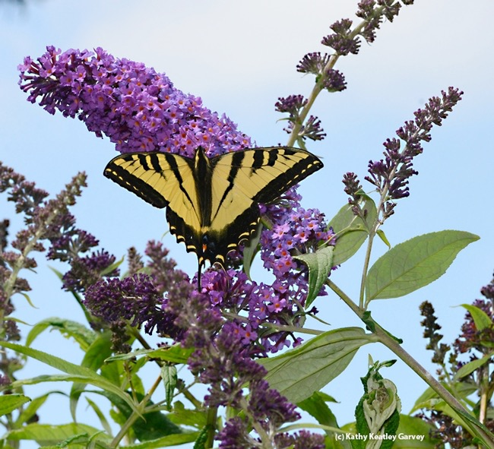
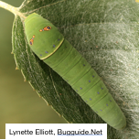
Larval Host Plants
Caterpillars cause damage to host plants
Be willing to put up with holes in leaves
Plant may disappear for the season
Western Tiger Swallowtail
Notes:
lay eggs, “cat” food
damage to plants—holes or GONE!//

Slide 36
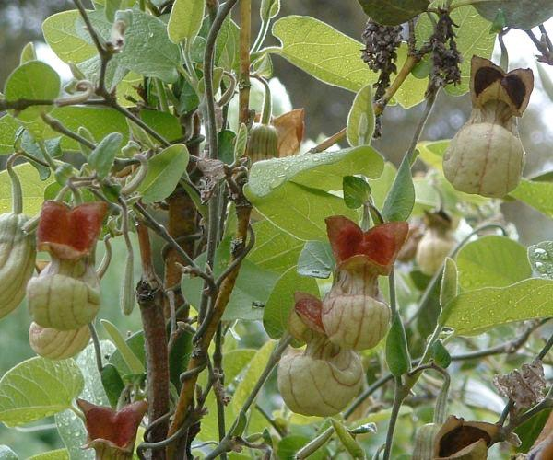
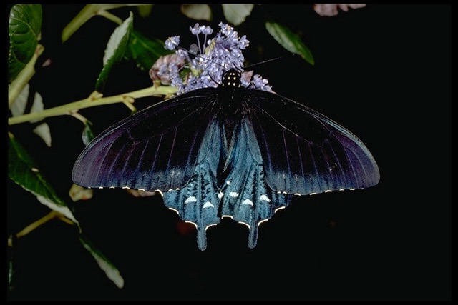
Larval Host Plants
Caterpillars can be very picky
Some will eat only one species of plant.
Dutchman’s Pipevine
Aristolochia californica
Pipevine Swallowtail
Photos: Las Pilitas Nursery
Notes:
The Pipevine Swallowtail (pictured) is a local species whose only host plant is the Dutchman’s Pipevine Aristolochia californica (also pictured). If its eggs are laid on any other vine or shrub, the hatching caterpillars will not eat it and will starve to death.

Slide 37
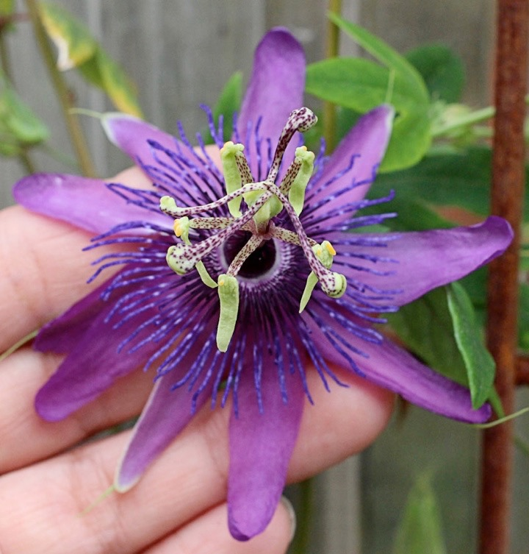
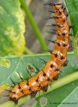
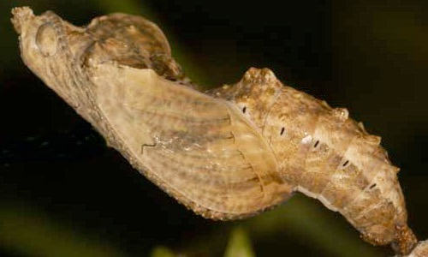
Larval Host Plants
The Gulf Fritillary butterfly is back!
After a 40 year absence, this non-native returned to the Sacramento area in 2009. Its host plant is the passion vine (Passiflora ssp.)
Photo: Peggy Beltramo
Photos by Kathy Keatley Garvey

Slide 38
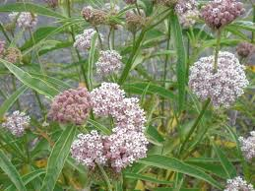
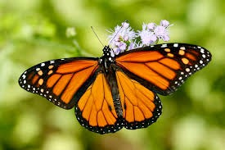
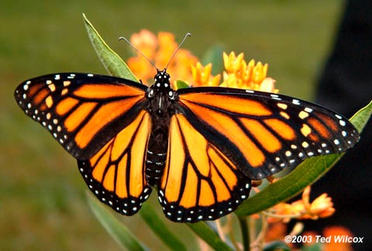
Larval Host Plants
Monarch “cats” will eat only milkweed,
but there are lots of kinds of milkweed.
Narrow Leaf Milkweed
Asclepias fascicularis
Notes:
Monarchs will eat multiple species of Milkweed, but no other Genera of plant.
Left=female (wider black lines) Right=male (note pheromone dots)

Slide 39
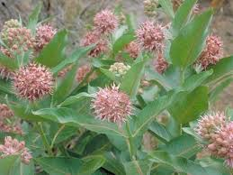
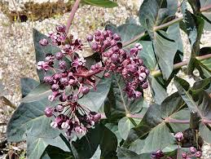
Larval Host Plants
Milkweeds native to Placer County:
Narrowleaf Milkweed
aka: Mexican Whorled
Asclepias fascicularis
Showy Milkweed
Asclepias speciosa
Purple or Heartleaf Milkweed
Asclepias cordifolia

Slide 40
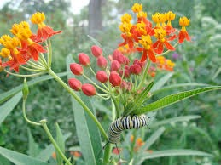
Is Tropical Milkweed
Bad for Monarchs?
Blooms earlier in spring
Later in fall/winter—longer season food source
OE, a parasite, can invade,
build up and infect larvae
and nectaring butterflies
Good
Bad
Cut plants to the ground
3 or 4 times a year,
to refresh
Cold weather will remedy the problem for us--frozen plants
Fix
It
Tropical Milkweed
Asclepias curassavica
Notes:
Blooms earlier in spring
Later in fall/winter—longer season food source
OE, a parasite, can invade,
build up and infect larvae
and nectaring butterflies
Cut plants to the ground
3 or 4 times a year,
to refresh
Cold weather will remedy the problem for us--frozen plants

Slide 41
Larval Host Plants
For host plants,
go to Art Shapiro’s Butterfly Site:
http://butterfly.ucdavis.edu/doc/garden/foothills
This is your handout.
Notes:
http://butterfly.ucdavis.edu/doc/garden/foothills

Slide 42

Think about it!
Avoid Pesticides
Insecticides kill all stages of butterflies
Toxins in herbicides & insecticides can move through the food chain and even through the soil to adjacent plants
Neonicotinoids kill butterflies. Check that purchased plants are untreated!
Bt kills ALL caterpillars
Bt Container Label:
• Controls worms and caterpillars on fruits, vegetables, ornamentals and shade trees
• Kills tomato hornworms, tent caterpillars, gypsy moths and others listed PS: Bt kills all caterpillars, not just the ones on the label!
Notes:
Insecticides are poisons. They kill insects! Butterflies are insects.
Hummingbirds eat insects in addition to nectar, so are affected when those insects are killed. Less food for hummers!
Additionally, herbicides can be ingested by insects feeding on leaves and can be passed on to the hummingbirds who eat the insects.
Bt is a soil bacteria whose proteins are toxic to some insects. Those proteins are not toxic to humans because, like all mammals, we cannot activate them. Bt is not toxic to non-target wildlife.
HOWEVER—— Bt Container Label:
Controls worms and caterpillars on fruits, vegetables, ornamentals and shade trees
Kills tomato hornworms, tent caterpillars, gypsy moths and others listed
Bt kills all caterpillars, not just the ones on the label!
In 1999, researchers at Cornell University did a preliminary lab study on the effects of Bt corn pollen on monarch caterpillars. The lead researcher, Dr. John Losey, sent a description of the study to the editors of the science journal Nature (Volume 399, 20 May 1999, page 214).
" … larvae of the monarch butterfly on milkweed leaves dusted with transgenic Bt-corn pollen ate less, grew more slowly, and suffered higher mortality than those fed leaves dusted with untransformed corn pollen or leaves without pollen."

Slide 43
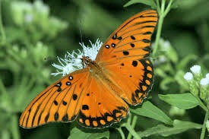



A Final Quiz
Can you name these butterflies?

Slide 44
A Final Quiz
Can you name these butterflies?
California Dog Face

Slide 45
A Final Quiz
Can you name these butterflies?
Monarch (Male)

Slide 46
A Final Quiz
Can you name these butterflies?
Western TigerSwallowtail

Slide 47
A Final Quiz
Can you name these butterflies?
California Pipevine Swallowtail

Slide 48
A Final Quiz
Can you name these butterflies?
Gulf Fritillary

Slide 49



A few last comments…
Flight wings
Tagged monarch
Nonmigrant wings

Slide 50


Monarch Sanctuary,
Michoacán, Mexico

Slide 51




Book Resources
Notes:
Attracting Native Pollinators. 2011 by The Xerces Society and Dr. Marla Spivak
The California Wildlife Habitat Garden. Aug 8, 2012 by Nancy Bauer
California Native Plants for the Garden. Dec 1, 2005 by Carol Bornstein and David Fross

Slide 52

Show and Tell Plants

Slide 53
Next Up,
Hummingbirds…

Slide 54


Thank You!
Any Questions?
Evaluations, please!
Master Gardener Hotline: (530) 889-7388
Master Gardener Website: pcmg.ucanr.org
Evaluations, please!

