Slide 1
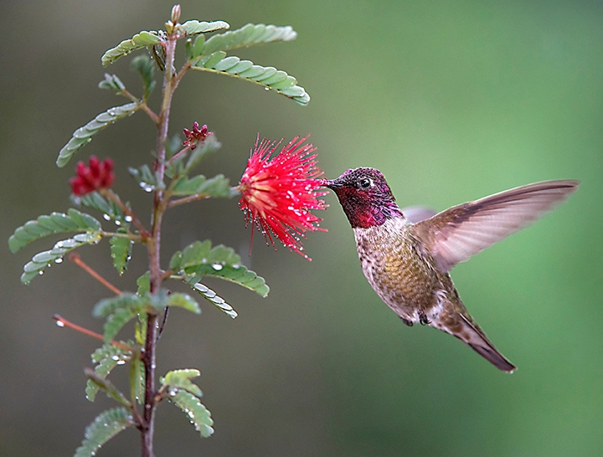
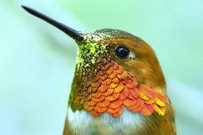
And now, Hummingbirds…
See the pollen?

Slide 2
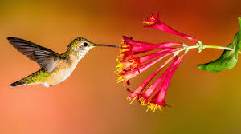
Hummingbird Facts
Hover to feed
Tubular flower shape
Flower stamens protrude
Attracted to red and other bright colors
Eat every 10 to 15 minutes
Visit between 1,000 and 2,000 flowers per day
Notes:
Hummingbirds drink from forked tongues that open up in the flower, trap the nectar, then pump it into their mouths through two grooves. While they frequently visit red flowers, hummingbirds will visit all sizes, colors and shapes of flowers — wherever they can get nectar, but hummingbirds do not survive on nectar alone. They’ll pick small insects from flowers, from the air, off leaves, or even off spider webs, sometimes along with the spiders themselves.
https://arboretum.ucdavis.edu/blog/hummingbirds-your-garden

Slide 3
Hummingbird Facts
Eat several times their weight in nectar daily
For protein, they supplement their sugary diet
with small insects.
Slow their heartbeat at night
Body temperature drops to as low as 68 degrees;
need fewer calories to keep warm
In the morning, it takes up to an hour to warm up
Notes:
Native only to North America
330+ species
Unique flying patterns
Unique feeding behavior
Poor sense of smell
Attracted to nectars of 10% or more sugar
Attracted to red and pink, but to any high-nectar flower, especially tubular
Can feed on drooping flowers

Slide 4
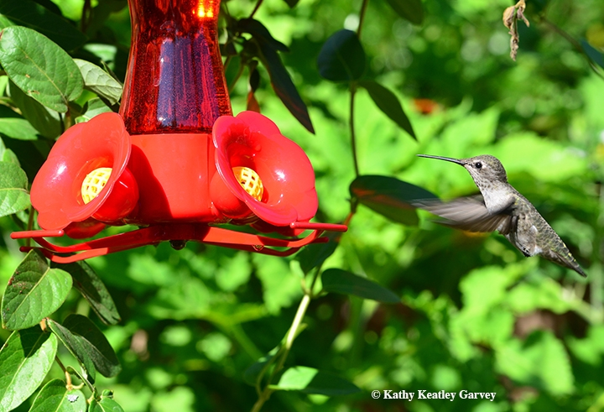
Hummingbird Feeders
1 part sugar to 4 parts water
Boil 1 minute
No honey, no red dye
Clean weekly
Refill often in heat
Discard old solution
Notes:
Providing hummingbird feeders is an easy technique to lure hummingbirds to your garden. However, supplying them with a clean, nutritious food source requires weekly maintenance. Begin with a clean feeder and add a sugary solution that is one part sugar to four parts water. Using honey or a stronger sugar concentration could be harmful or even fatal. Adding red dye to the solution is discouraged; most hummingbird feeders have red parts that will catch the hummingbird’s eye. Feeders need to be taken down to be cleaned and refilled weekly. Wash the feeder with hot, soapy water, and rinse with hot, boiling water. Refill it with a fresh supply of solution, which can be made ahead and stored in the refrigerator. It is important to discard the old solution, as it can ferment into alcohol. If you live in a very hot area, the feeder should be cleaned and solution replaced every 2 to 3 days.
MORE SUGAR RESEARCH https://ucanr.edu/blogs/blogcore/postdetail.cfm?postnum=29560

Slide 5
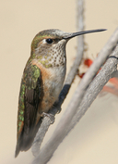
Anatomy of a Hummingbird
Selasphorus Rufus
Rufous Hummingbird
Crown
Beak
Gorget
Shoulders
Breast
Flight Feathers
Tail Feathers Ron Wolf 2008
Notes:
Color differentiation males vs. females vs. species. Iridescence requires light to spot.

Slide 6
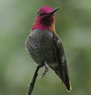
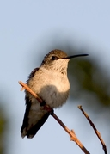
Local Hummingbirds
Calypte anna
Anna’s Hummingbird
Male crown & gorget: red
Stays in short range year-round;
usually lowlands
Early breeder: December or earlier
Nests 4-25 ft. high
Heather Lannie 2007
Tom Greer 2004
Notes:
The Anna’s hummer has extended its range due to the wider availability of nectar plants. Anna’s is the first to lay eggs: December. Incubation 14-19 days. First flight in 18-23 days.

Slide 7
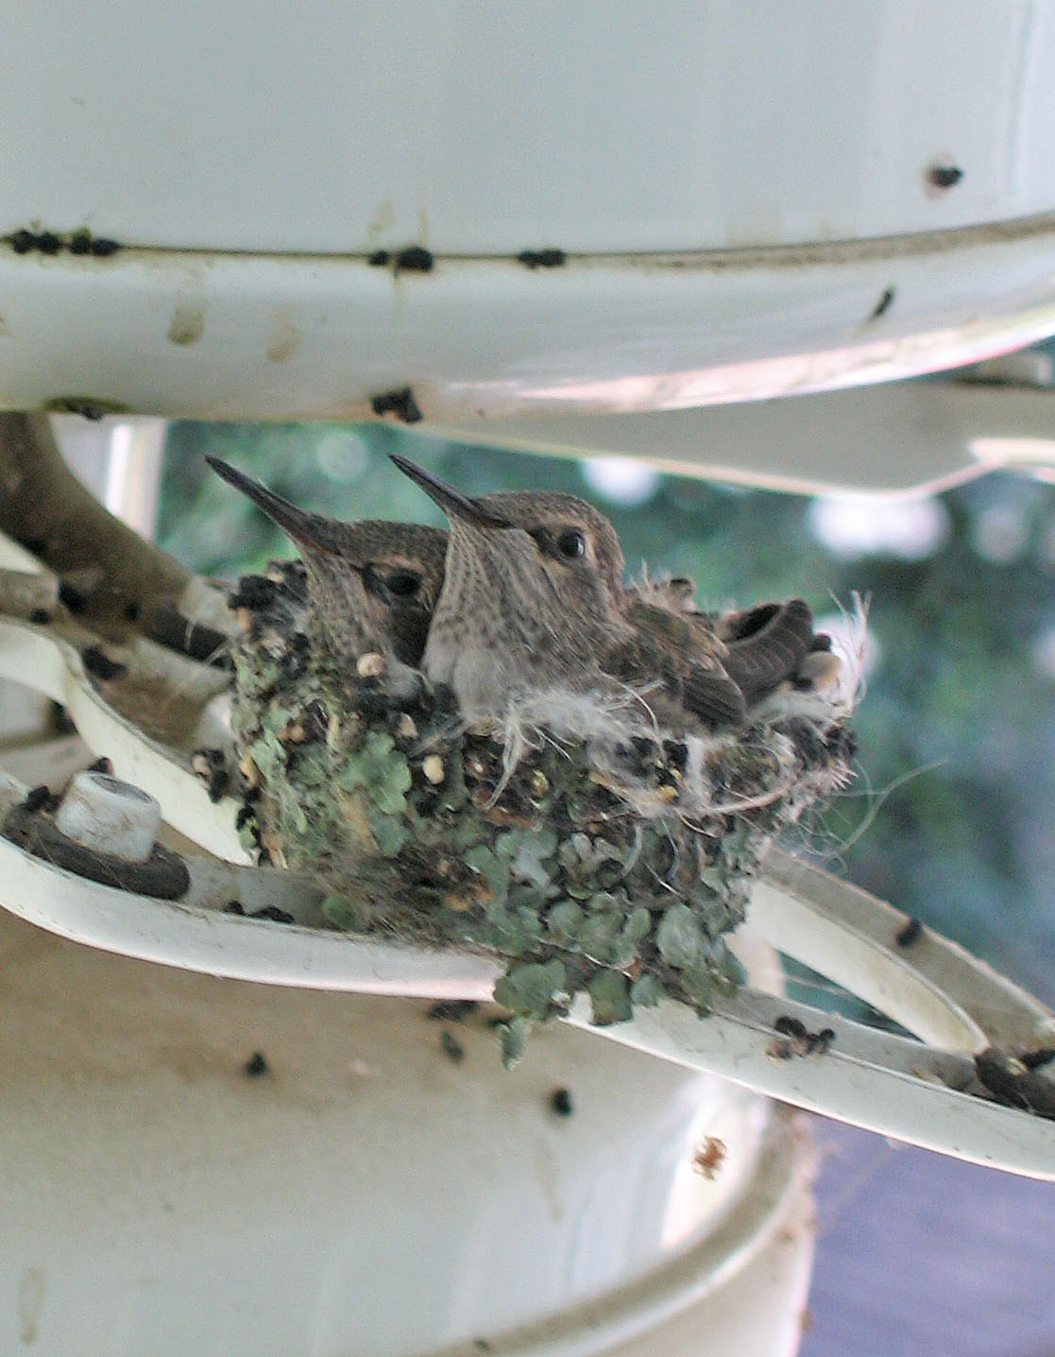
Anna’s Hummingbird nest!
Notes:
A friend’s outdoor fan. Note the intricate , decorative nest.

Slide 8
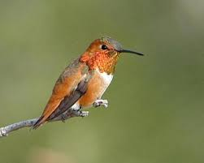
Local Hummingbirds Selasphorus rufus
Rufous Hummingbird
Male crown & gorget: red-orange
Back: brownish-red flecked in green
Very defensive of feeding territory
Nests in conifers in spring,
in deciduous trees in fall
Notes:
Rufous spends the winter in southern U.S. Or Mexico. Likes mountain meadows in summer & fall.

Slide 9
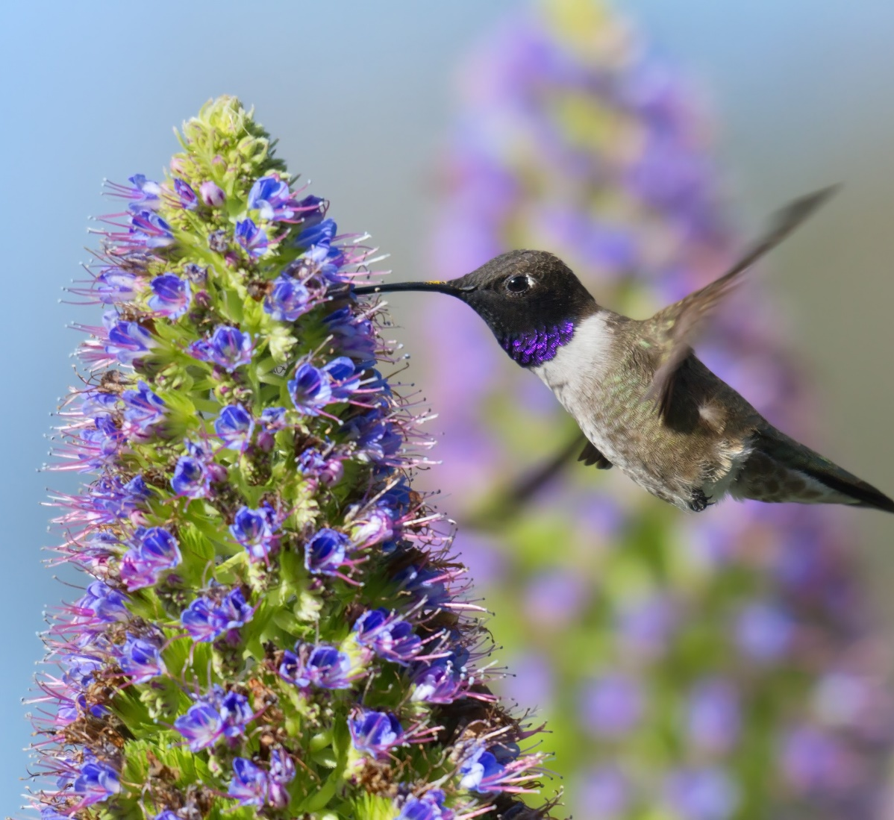
Local Hummingbirds Archilochus alexandri
Black-chinned Hummingbird
Male with deep purple throat
White spot behind eye
Female has whitish throat
Female speckled green crown
Attracted to tall trees & flowering shrubs
Nests are 4-8 ft. high.
Notes:
Female may have dusky or greenish streaks on gorget. Widespread habitat, arid to river groves. Moves to mountains after breeding, winters in Mexico.

Slide 10
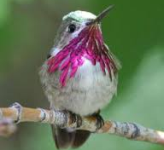
Local Hummingbirds Selasphorus calliope
Calliope Hummingbird
Smallest bird in North America
3 inches long, 1/10 ounce in weight
Green back, white throat
Male has red gorget
with purple ”whiskers”
Feeds on low growing flowers
Some migrate from Canada to Mexico
Notes:
Adult male: Metallic green back and crown, white gorget with purple rays that may be erected to show a "whiskered" effect. Adult female: Green back and crown, white throat with dark streaks, buff sides, white-tipped tail corners.
http://www.hummingbirds.net/calliope.html

Slide 11
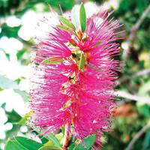
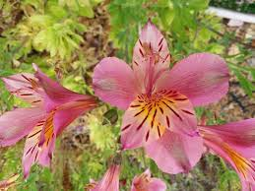
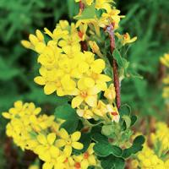
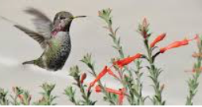
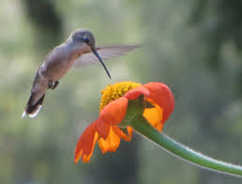
Hummingbird Flowers

