Slide 1
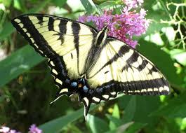
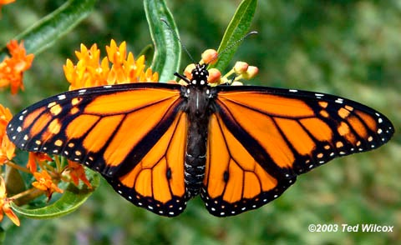

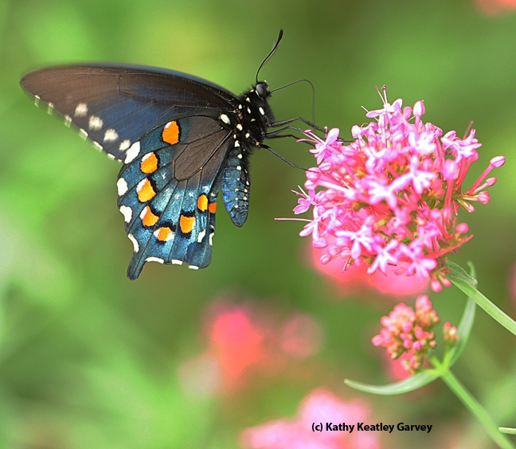
Now, on to Butterflies…

Slide 2
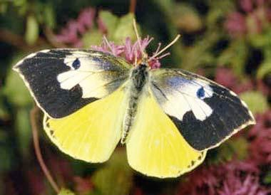
Do You Know This Butterfly?
California State Insect

Slide 3
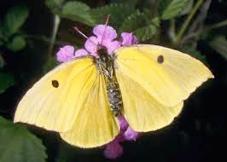
Do You Know This Butterfly?
California State Insect
Male
Female
California Dogface butterfly
Zerene Euridice

Slide 4
Attracting Butterflies
Intercept individual butterflies
Detain them where they can be observed and enjoyed
Few butterflies can maintain a population on a residential lot – even a big one
Work with your neighbors
to create a larger butterfly habitat.
Notes:
Intercept
Intercept singles, detain, not a population, work with neighbors to enlarge footprint of habitat

Slide 5
Habitat Components
Butterflies Require:
Mating territory
Pupation sites
Adult food supply
Larval host plants

Slide 6
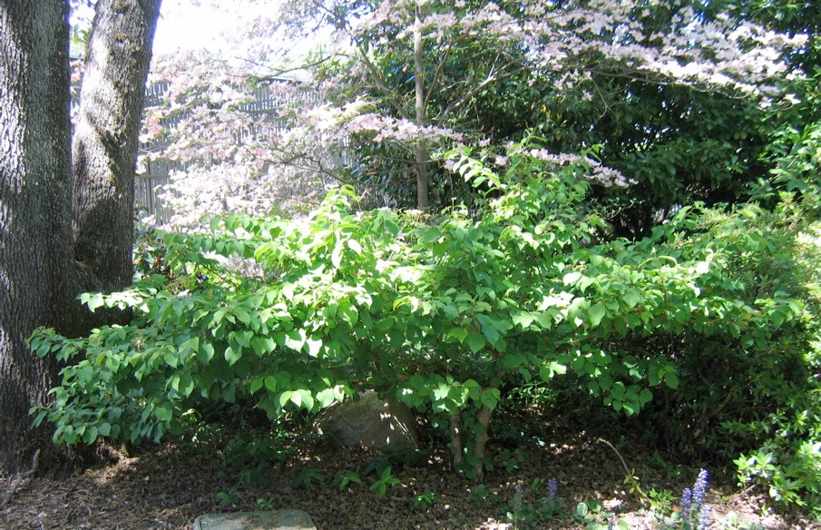
Mating Territory
Perching sites to defend territory and watch for females
Different heights of trees and shrubs for windbreaks and shade

Slide 7
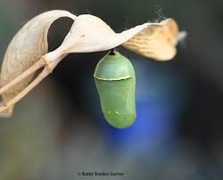
Pupation Sites
Host plants for larvae
A variety of cover for protection/pupation
Caterpillars may travel
up to 50 feet to pupate
Monarch chrysalis

Slide 8
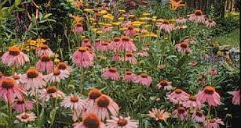
Adult Food Supply
Nectar is the lure for butterflies.
Prefer pink, red, purple, yellow and orange flowers.
Attracted to large masses of a single color
At least 3’ x 3’

Slide 9
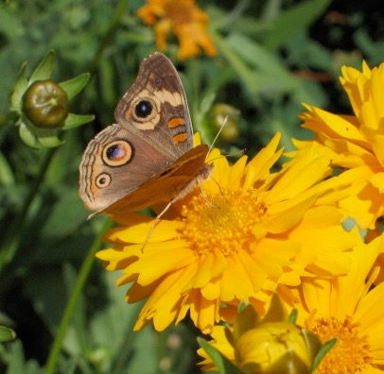
Adult Food Supply
Butterflies land on a flower to drink nectar.
Prefer
flat daisy-type flowers
or
clusters of small flowers
in umbels or spikes
Pauline Sakai
Buckeye butterfly on Coreopsis
Notes:
land to drink; flat daisy, umbel or spike

Slide 10
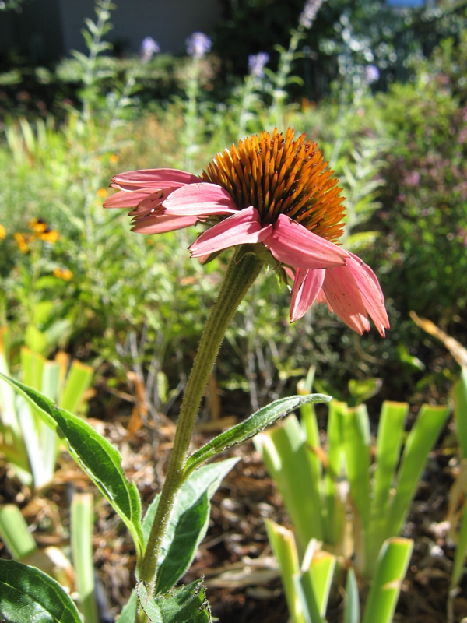
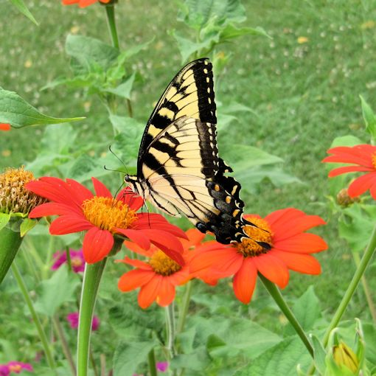
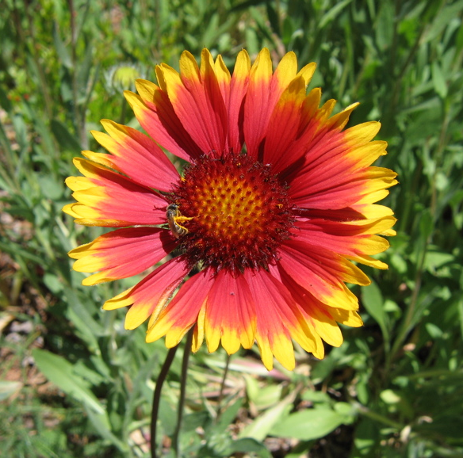
Adult Food Supply
Daisy-type flowers
Coneflower
Echinacea
Mexican Sunflower
Tithonia rotundifolia
Blanketflower
Gaillardia
Notes:
What we think of as one flower is actually a collection of many. Daisy-type flowers, those in the family Asteraceae, are composite flowers, meaning they have 2 sets of many flowers in each inflorescense: those at the base of each petal (ray flowers) and those in the center (disk flowers). This is the largest plant family, including sunflowers, asters, dandelions, thistles, cosmos, senecio, daisies, many wildflowers and many more.

Slide 11
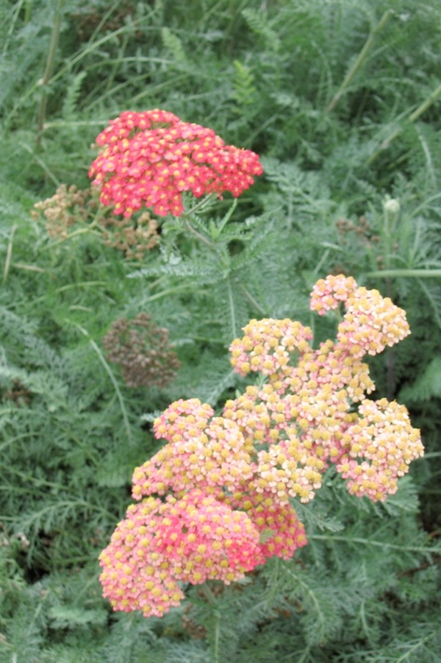
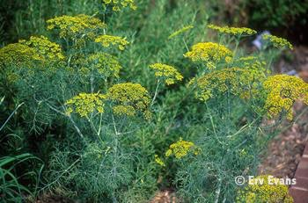

Adult Food Supply
Flat clusters (umbels) of small flowers
Sulphur Buckwheat
Eriogonum umbellatum
Dill
Anthemis graveolens
Yarrow
Achillea millefolium

Slide 12
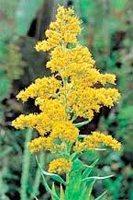
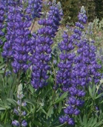
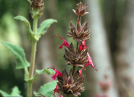
Adult Food Supply
Spikes of closely spaced small flowers
Goldenrod
Solidago
Lupine
Lupinus
Hummingbird Sage
Salvia spathacea

Slide 13
Adult Food Supply
This is your seed packet
Mexican Sunflower
Tithonia rotundifolia
Notes:
Tithonia seeds as a handout

Slide 14
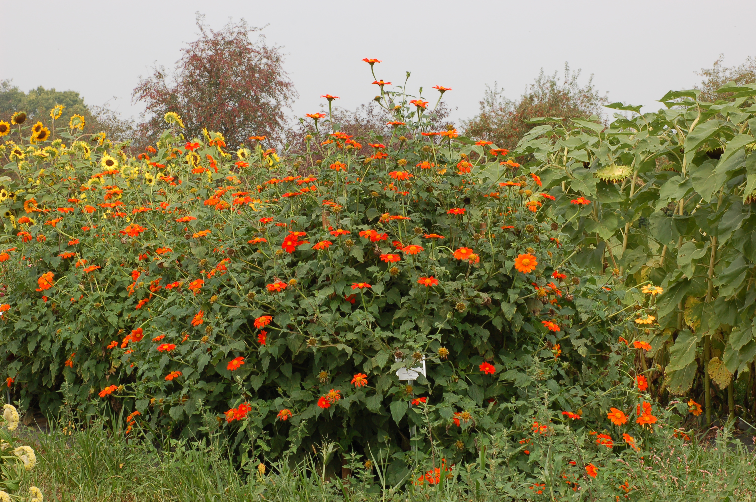
It gets BIG!
Mexican Sunflower
Tithonia rotundifolia
Notes:
Size:

Slide 15
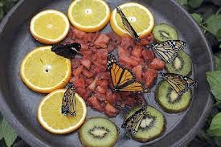
Additional Food Supply
Not all butterflies eat nectar.
Other favorite foods include:
Overripe/rotting fruit
Tree Sap
Manure
Bird Droppings
Notes:
Set out overripe fruit on a plate or on top of a fence post. Be aware that it will also attract ants, wasps and other insects, so put out of the way.

Slide 16
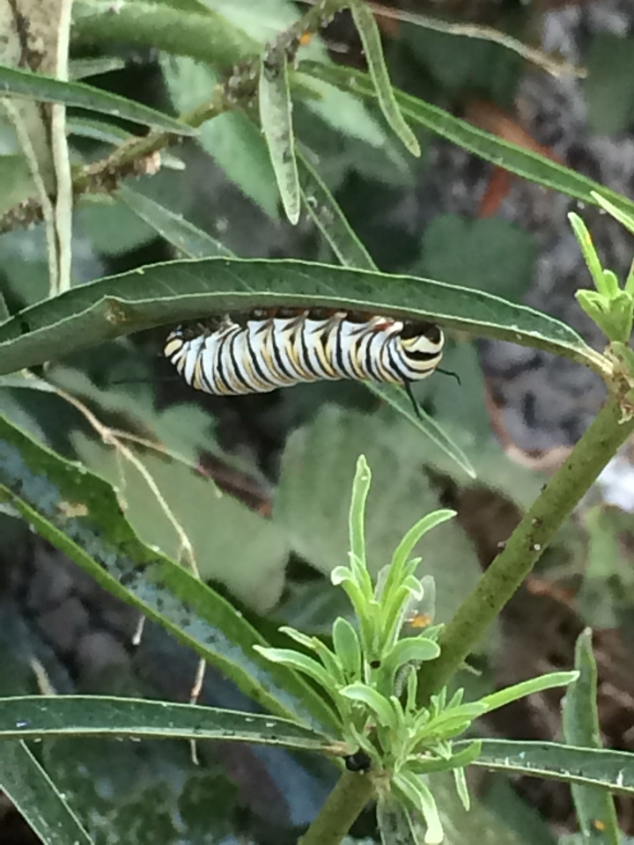
Larval Host Plants
‘Host’ plants
Where adults lay eggs
Food for caterpillars
Monarch caterpillar
on milkweed
Notes:
Many butterfly larvae (caterpillars) are specialists and rely on the presence of one particular plant species in order to survive. Others are less picky and will eat multiple plants,

Slide 17
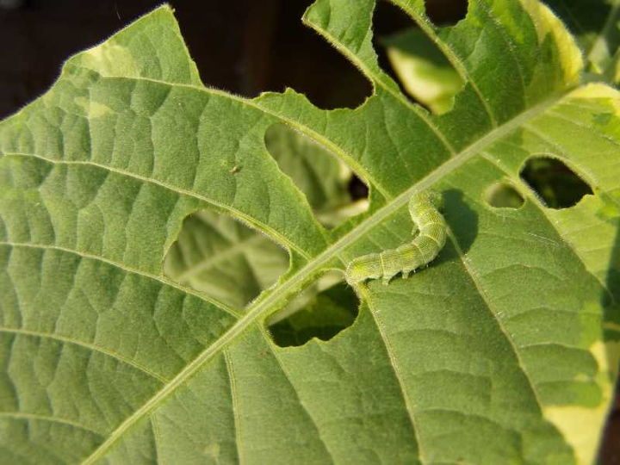
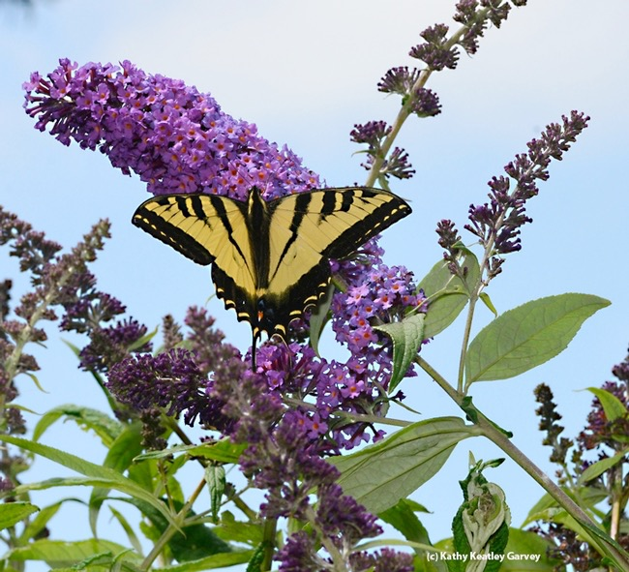
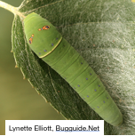
Larval Host Plants
Caterpillars cause damage to host plants
Be willing to put up with holes in leaves
Plant may disappear for the season
Western Tiger Swallowtail
Notes:
lay eggs, “cat” food
damage to plants—holes or GONE!//

Slide 18
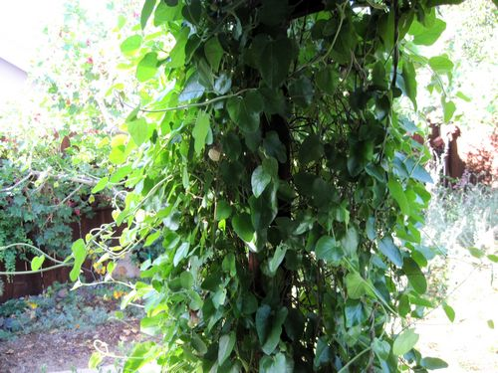
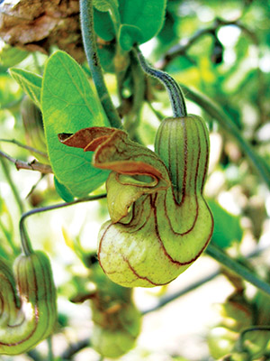

Larval Host Plants
Larval Food = Plant
Adult Food = Nectar
Dutchman’s Pipevine
Aristolochia californica
Pipevine Swallowtail
Caterpillars can be very picky.
Some will only eat one species of plant.
Notes:
The Pipevine Swallowtail (pictured) is a local species who’s only host plant is the Dutchman’s Pipevine (also pictured). If it’s eggs are laid on any other vine or shrub, the hatching caterpillars will not eat and starve to death.
Monarchs will eat multiple species of Milkweed, but no other Genera of plant.
Some butterfly larvae are less picky and will eat multiple plants, but many are specialists and rely on the presence of one particular species in order to survive.

Slide 19
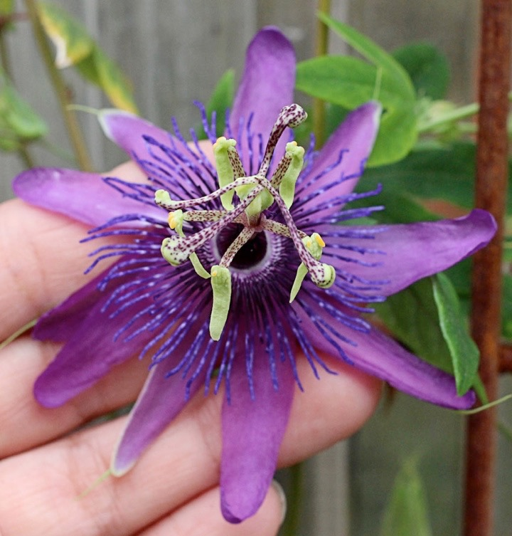
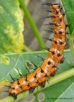
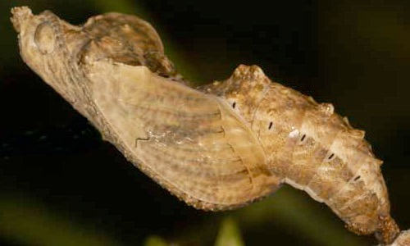
Larval Host Plants
The Gulf Fritillary butterfly is back!
After a 40 year absence, this non-native returned to the Sacramento area in 2009. Its host plant is the passion vine (Passiflora ssp.)
Photos by Kathy Keatley Garvey

Slide 20
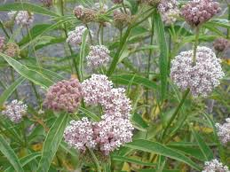
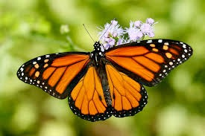
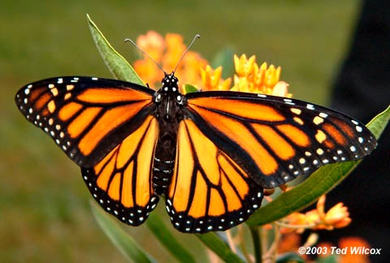
Larval Host Plants
Monarch “cats” will eat only milkweed,
but there are lots of kinds of milkweed.
Narrow Leaf Milkweed
Asclepias fascicularis

Slide 21
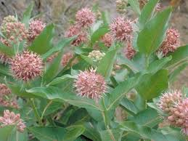
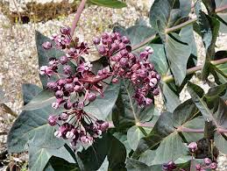
Larval Host Plants
Milkweeds native to Placer County:
Narrowleaf Milkweed
aka: Mexican Whorled
Asclepias fascicularis
Showy Milkweed
Asclepias speciosa
Purple or Heartleaf Milkweed
Asclepias cordifolia

Slide 22
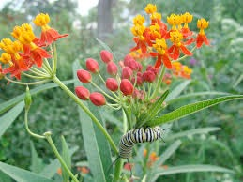
Is Tropical Milkweed
Bad for Monarchs?
Blooms earlier in spring
Later in fall/winter—longer season food source
OE, a parasite, can invade,
build up and infect larvae
and nectaring butterflies
Good
Bad
  Cut plants to the ground
  3 or 4 times a year,
  to refresh
  Cold weather will remedy the problem for us--frozen plants
Fix
It
Tropical Milkweed
Asclepias curassavica

Slide 23
Larval Host Plants
2019 Mass Migration in California
“One of the reasons they can build up their numbers so quickly is that, unlike monarchs, they can breed opportunistically on you-name-it,” Shapiro said.
Painted Lady Butterfly
When I'm not near the plant I eat, I eat the plant I'm near!’

Slide 24
Larval Host Plants
For host plants,
go to Art Shapiro’s Butterfly Site:
http://butterfly.ucdavis.edu/doc/garden/foothills
This is #5 on your handout.

Slide 25
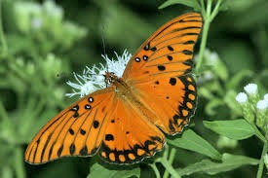
A Final Quiz
Can you name these butterflies?

Slide 26
A Final Quiz
Can you name these butterflies?
California Dog Face

Slide 27
A Final Quiz
Can you name these butterflies?
Monarch (Male)

Slide 28
A Final Quiz
Can you name these butterflies?
Western Tiger Swallowtail

Slide 29
A Final Quiz
Can you name these butterflies?
California Pipevine Swallowtail

Slide 30
A Final Quiz
Can you name these butterflies?
Gulf Fritillary

Slide 31
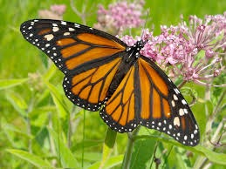
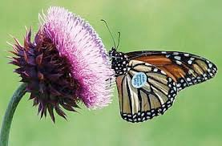
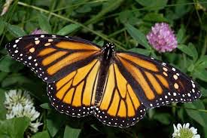
A few last comments…
Flight wings
Tagged monarch
Nonmigrant wings

Slide 32
A few last comments…
Flight wings
Tagged monarch
Nonmigrant wings

Slide 33
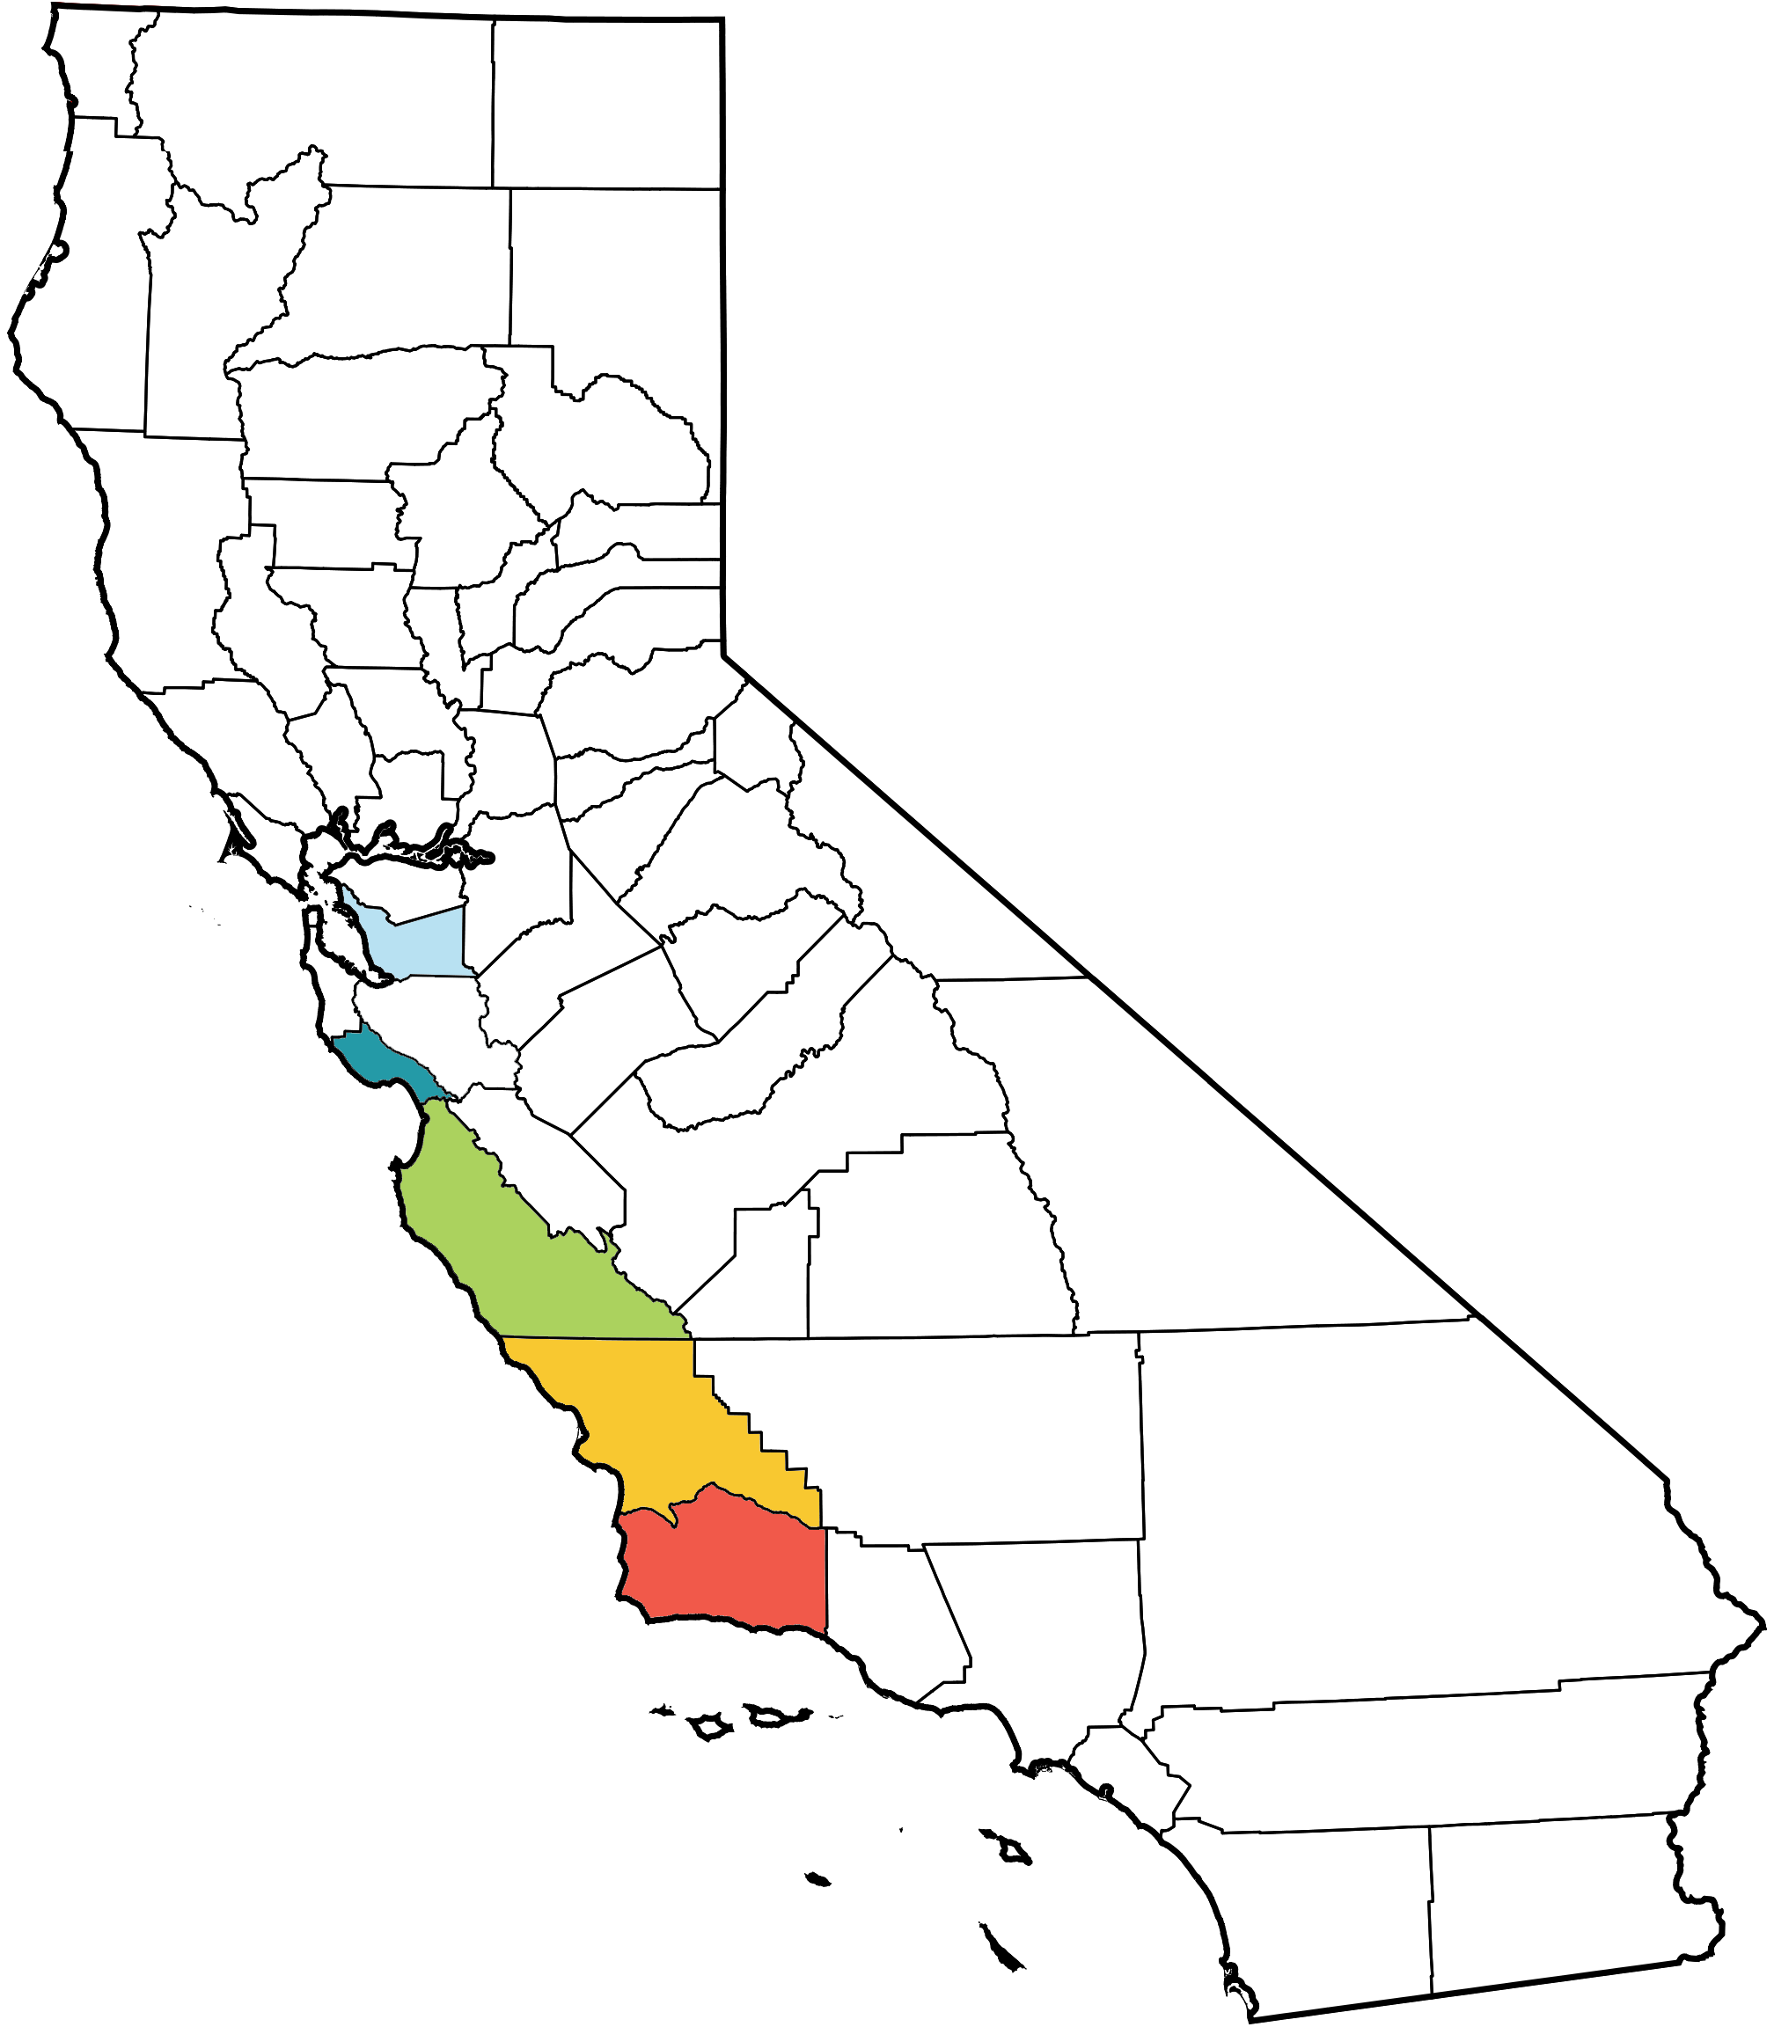
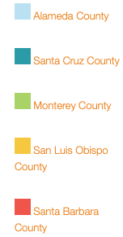
Overwintering Sites in California
Notes:
https://xerces.org/where-to-see-monarchs-in-california/
Overwintering monarchs cluster for warmth and wind protection in eucalyptus trees on the west coast of California in a number of places from Pleasanton to SoCal.

Slide 34

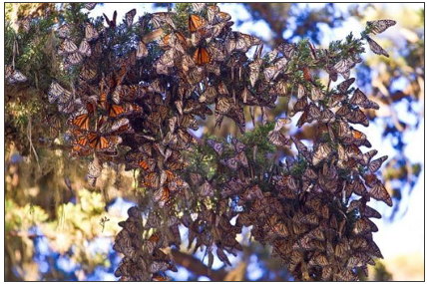
Monarch Sanctuary,
Pacific Grove, California

