Slide 1
Who Are the Pollinators?
🐝Bees, wasps, beetles, flies

Slide 2
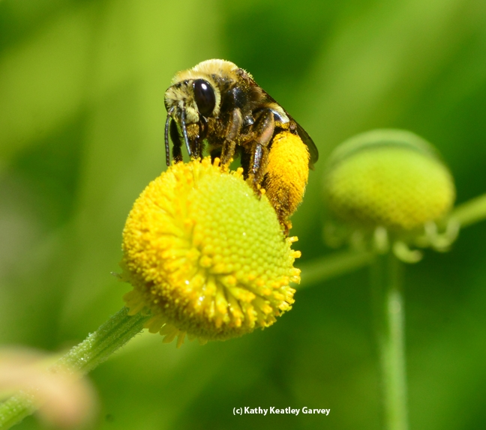
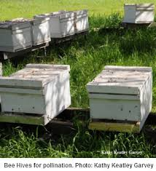
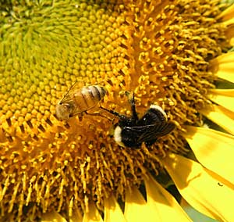
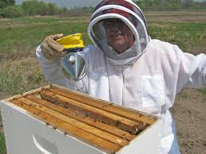
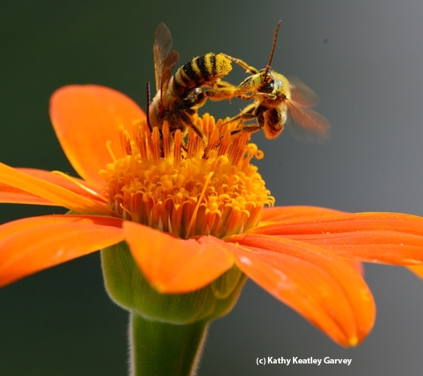
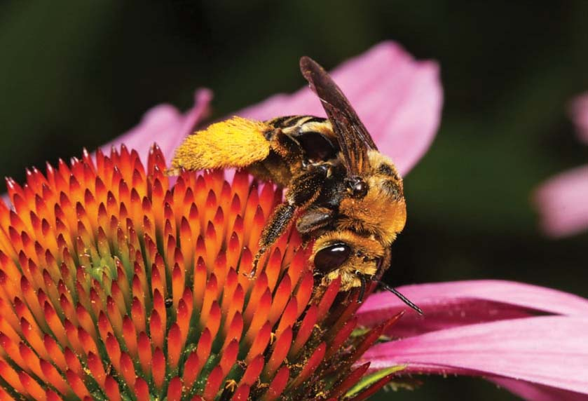
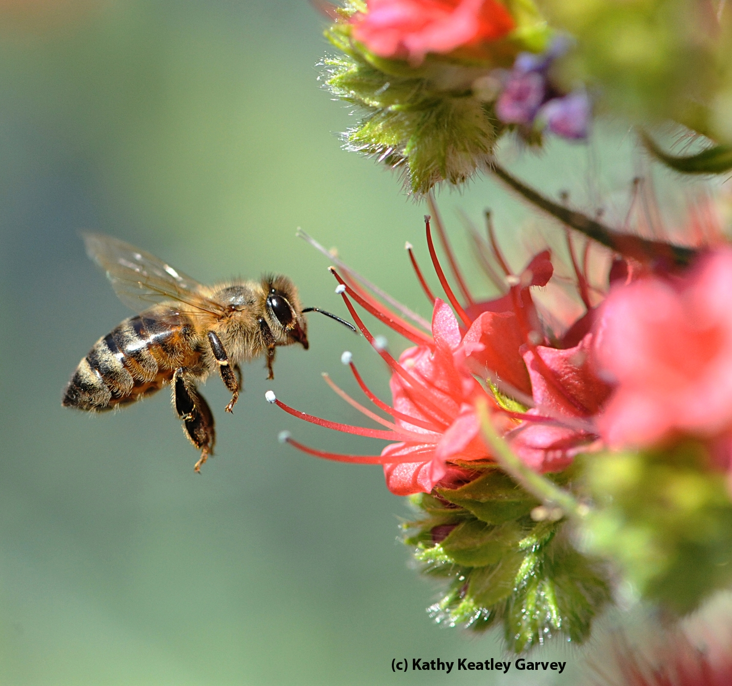
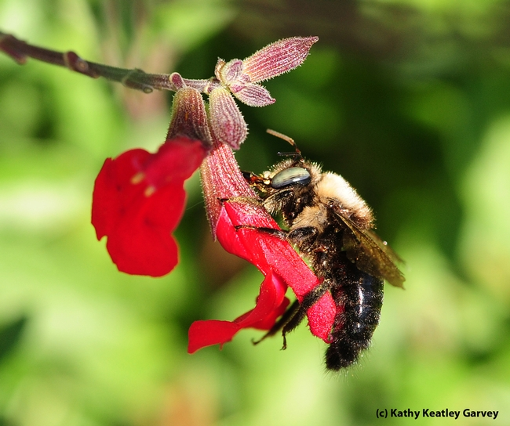
Honeybees and All the Other Guys!
The Other Guys
Honey Bees
Notes:
Bee hives; bee keeper; honey bee on Echium wildpretti (Tower of Jewels)
1 Honeybee and bumblebee on sunflower;
2 longhorn bee on Helenium (sneezeweed)
3 female solitary bee on purple coneflower
4 bee fight on Tithonia (Mexican sunflower)
5 bumblebee on Salvia (sage);

Slide 3
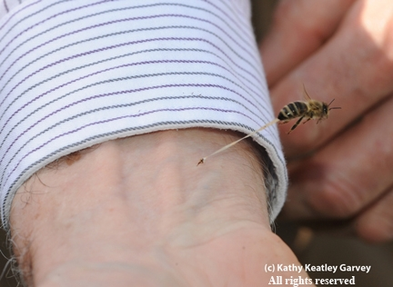
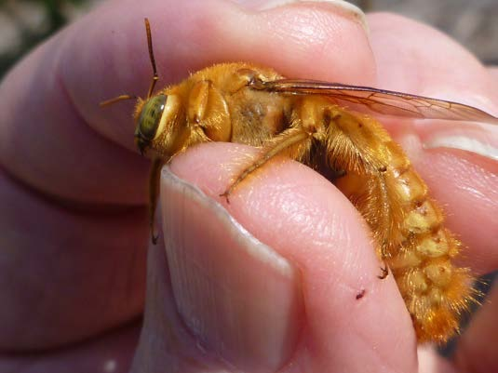
What About Stings?
Kathy Keatley Garvey
Ouch!
Males don’t sting.

Slide 4
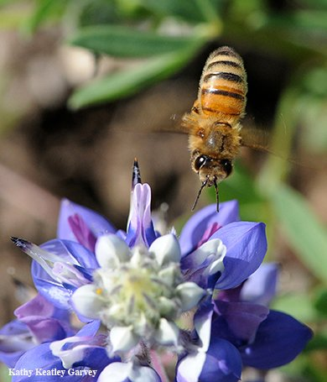
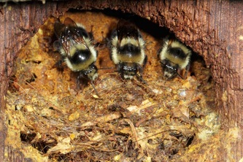
Social Bees
Honey bee
Bumble bee
Honey bees and bumble bees
live together in groups.
They defend their nests
by stinging.

Slide 5

Other guys—not honeybees
1600 native bee species in California
75% solitary—
70% ground nesters; 30% cavity nesters
10 % social—bumblebees
15% cuckoo bees—lay eggs in other bees’ chambers

Slide 6
Who Are the Pollinators?
5 Common Bee Groups of California
APIDAE (Cuckoo, Digger, Carpenter, Bumble
and Honey Bees)
COLLETIDAE (Membrane Bees)
ANDRENIDAE (Mining Bees)
HALICTIDAE (Sweat Bees)
MEGACHILIDAE (Leafcutting, Mason, Polyester,
and Wool Carder Bees)

Slide 7
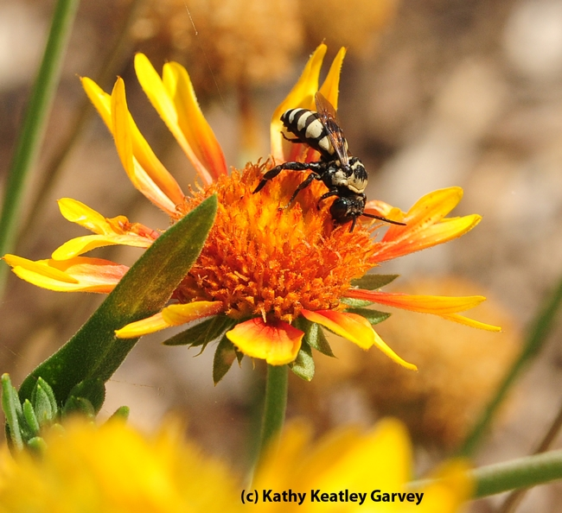
Cuckoo Bees
Cuckoo bees lay their eggs in ground nests of other bees. When the cuckoo bees hatch, they eat the pollen and egg of the other bee.
Notes:
The female cuckoo bee lays her eggs in the ground nests of other bees, including the sunflower bee, Svastra. Cuckoo bees are kleptoparasites, meaning that they steal the food stores provisioned by the host bee. Cuckoos lack pollen-collecting structures (scopa). So when the cuckoo bee eggs hatch, the larva will consume the pollen ball collected by the hosts, and kill and eat the host larvae.
https://ucanr.edu/blogs/blogcore/postdetail.cfm?postnum=10800

Slide 8
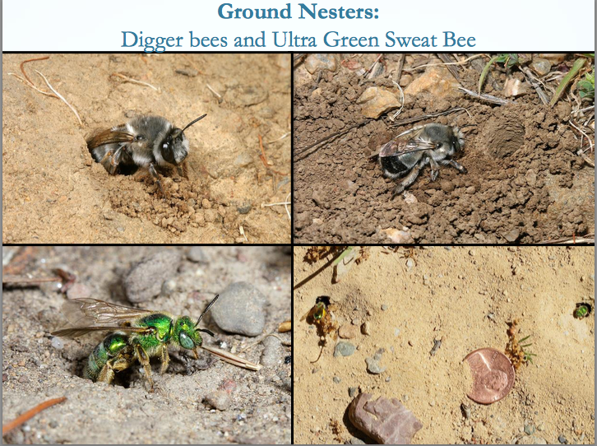
Ground Nesting Bees
Gordon Frankie
Notes:
bee groups ppt http://ucanr.edu/sites/2017MGConference/files/271017.pdf
Ground nesters
Leave some bare soil, not all mulched.
Sweat bees will land on you and drink your sweat for the salt content.

Slide 9
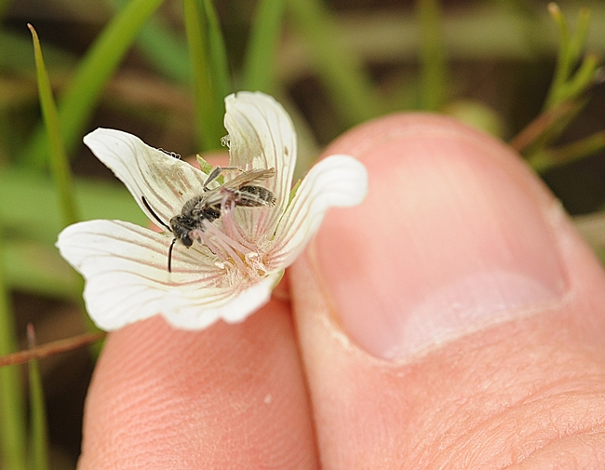
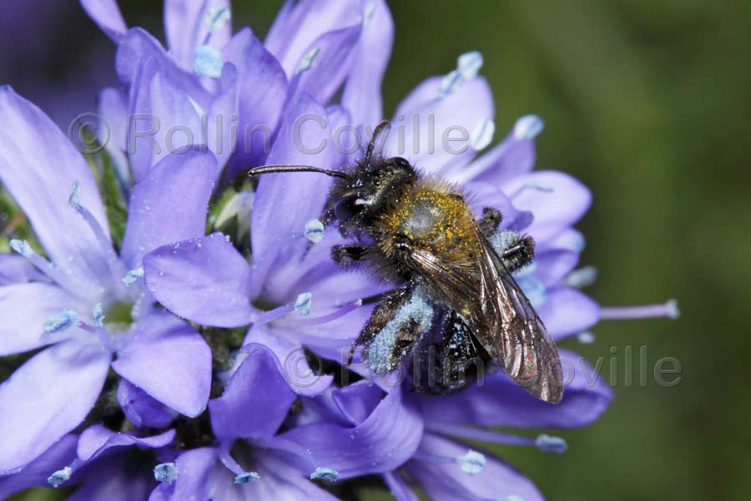
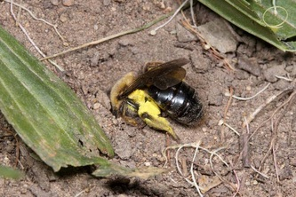
Some Bees are Gentle
“Tickle Bees”
Notes:
Andrenidae Mining Bees
Nest on the play fields
tickle bees: Sabin Elementary, Portland, Oregon
http://www.sabinpta.com/tickle-bee
mining bees in schoolyard. Students observe and protect their friends.

Slide 10
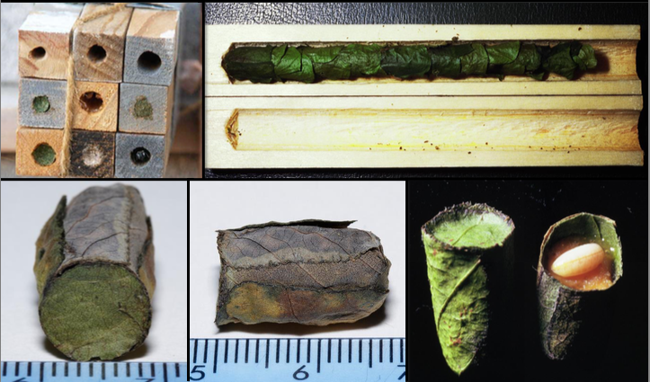
Cavity Nesters
Gordon Frankie
Leaf-cutter bees
Notes:
Leaf-cutter bees
They use redbud leaves, rose leaves, and petals
Cause scalloped edges, no danger to plants.

Slide 11
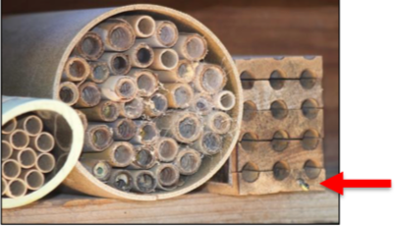
Cavity Nesters
Install a Bee Condo

Slide 12
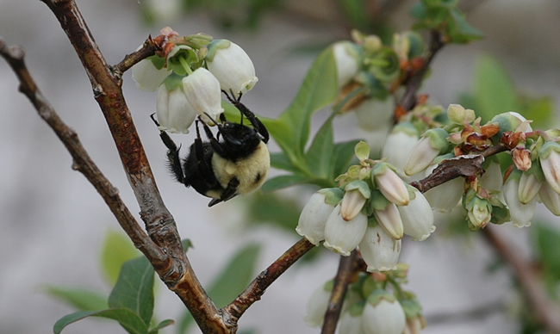
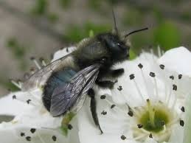
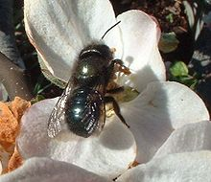
Cavity Nesters
Meet BOB
Mrs. BOB!
Notes:
BOB = blue orchard be (Mason bee) Osmia lignaria
pollinating apple blossoms
Actually females, Mrs. BOBs, do all the work. They are busy collecting pollen to provision their nests, thus pollinating crops.
This species of native bee works very early in the spring (57 °F) when fruit trees are blooming.
Also other fruit and nut tree blossoms. These bees can be “kept”, like honeybees for orchard pollination.
https://www.fs.fed.us/wildflowers/pollinators/pollinator-of-the-month/mason_bees.shtml
More:
https://www.kqed.org/science/1928378/watch-this-bee-build-her-bee-jeweled-nest

Slide 13
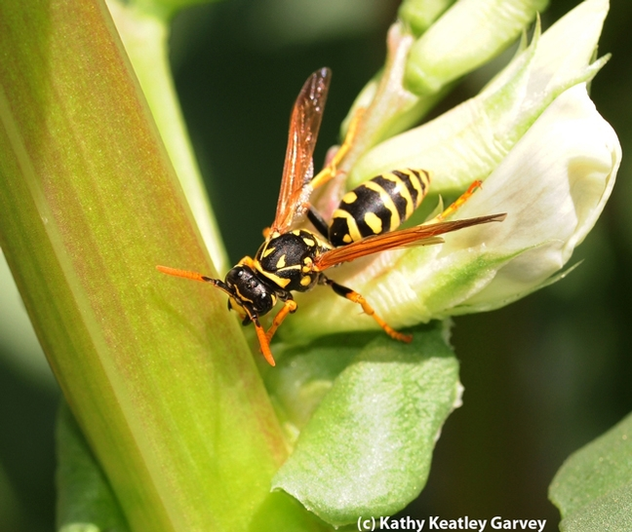
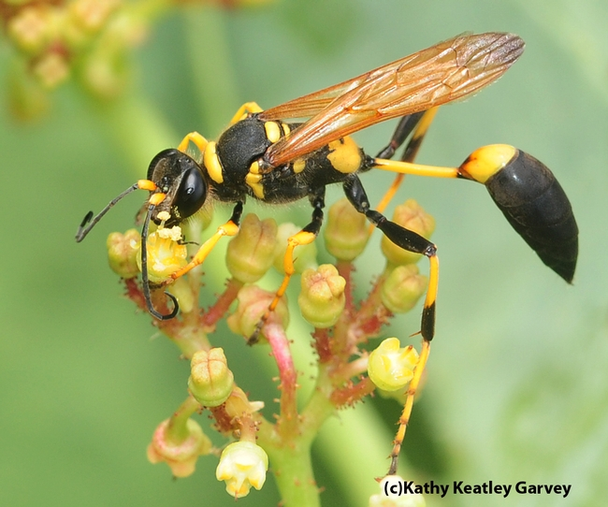
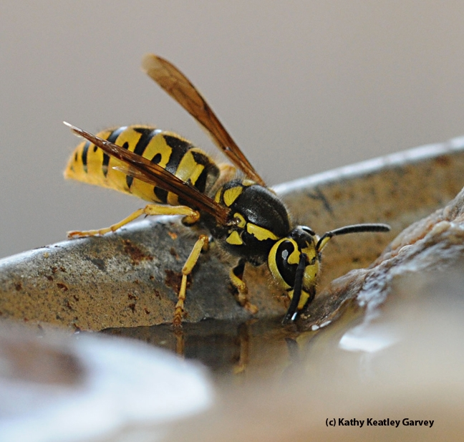
Wasps
Wasps can sting AND bite
Notes:
Western yellowjacket wasp
European paper wasp
mud dauber wasp
Wasps have a waist.
http://ipm.ucanr.edu/PMG/PESTNOTES/pn7450.html
Most social wasps provide an extremely beneficial service by eliminating large numbers of other pest insects through predation and should be protected and encouraged to nest in areas of little human or animal activity.The best way to prevent unpleasant encounters with social wasps is to avoid them.
If you know where they are, try not to go near their nesting places. Wasps can become very defensive when their nest is disturbed.
Concern about yellowjackets is based on their persistent, pugnacious behavior around food sources and their aggressive defense of their colony. Usually stinging behavior is encountered at nesting sites, but sometimes scavenging yellowjackets will sting if someone tries to swat them away from a potential food source.

Slide 14
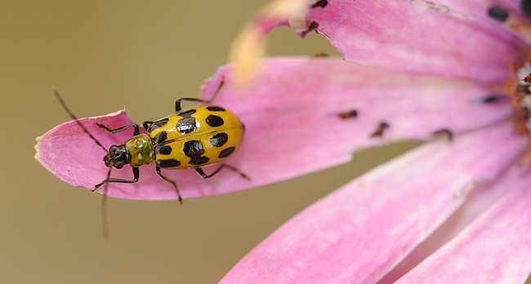
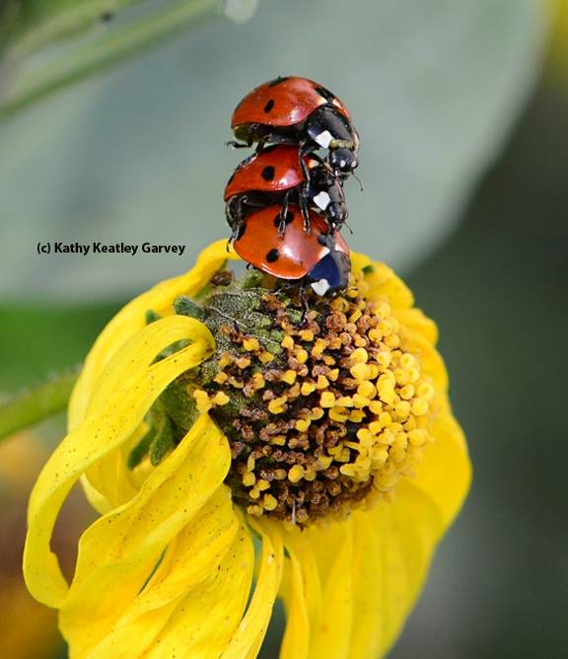
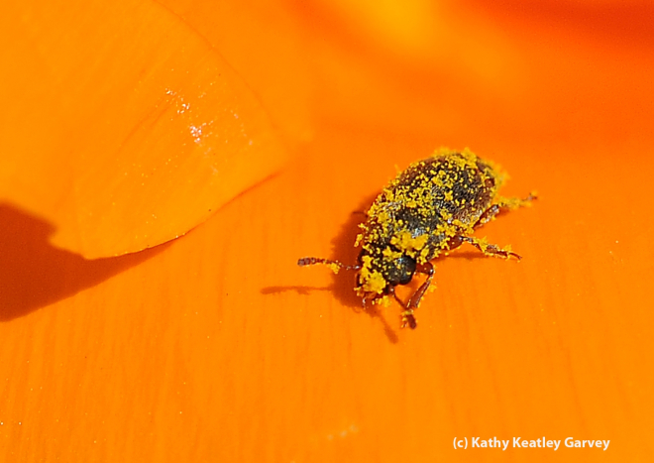
Beetles
Notes:
ladybugs=ladybird beetles
spotted cucumber beetle
POLLEN covered beetle!!!

Slide 15
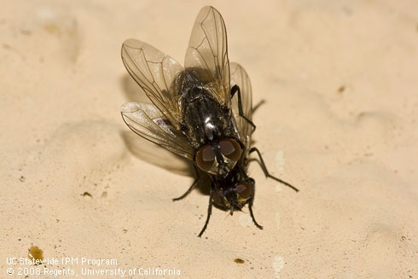
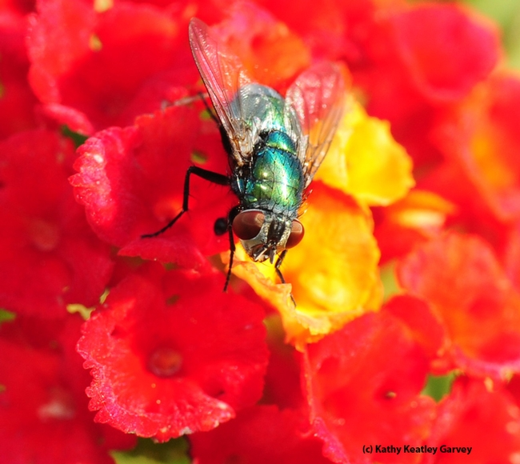
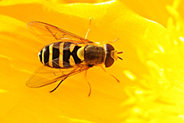
Flies
Notes:
adult house fly
green bottle fly
syrphid fly—wasp mimic Makes her look scary and dangerous!

Slide 16
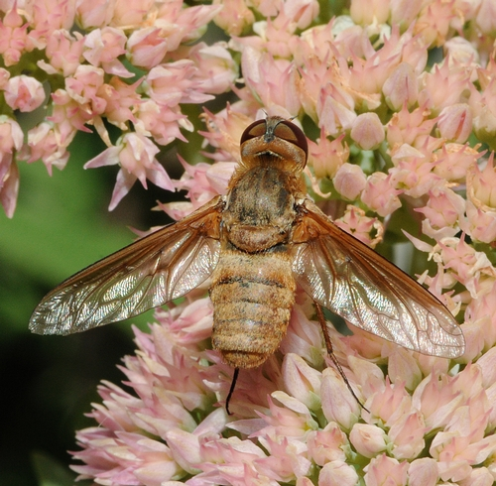
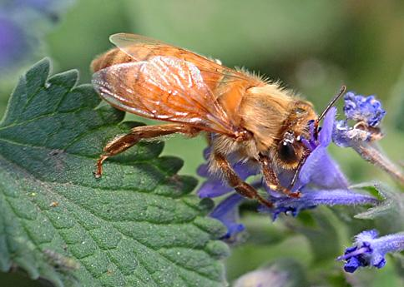
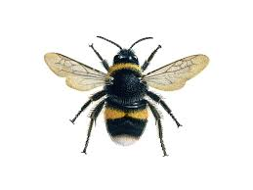

Is it a Bee or a Fly?
Bee
Fly
Two pairs of wings
Wings closed
One pair of wings
Wings widespread
Notes:
Bees = big eyes; long antennae; 2 pairs of wings; rest with wings closed
Flies = Large eyes; short antennae; one pair of open wings
https://ucanr.edu/blogs/blogcore/postdetail.cfm?postnum=19180

Slide 17
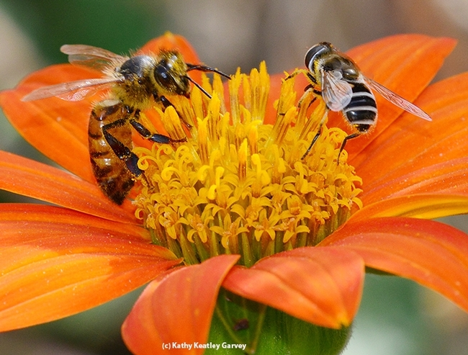
Is it a Bee or a Fly?
Notes:
Honeybee on left,syrphid fly on right
https://ucanr.edu/blogs/blogcore/postdetail.cfm?postnum=19180

Slide 18
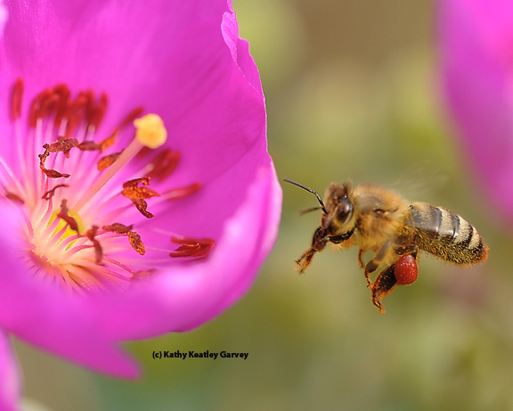
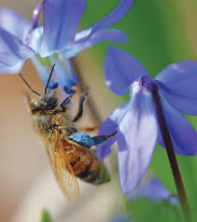
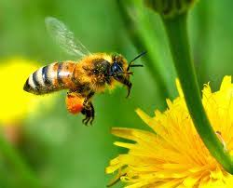
What color is pollen?
Notes:
Yellow pollen—Mexican Hat-- Ratibida columnnifera
Red pollen— rock purslane--Calandrinia grandiflora
Orange pollen—dandelion—Taraxacum officinale
Blue pollen—Siberian squill – Scilla siberica

Slide 19
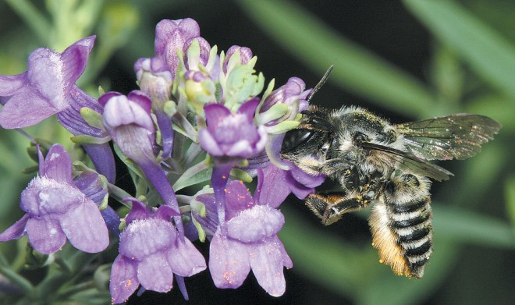
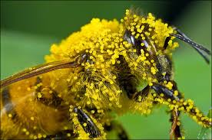
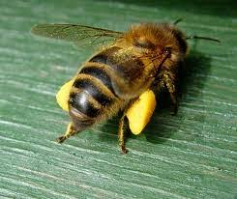
Pollen collection
Notes:
https://thehoneybeeconservancy.org/2011/04/02/pollen-basket/
Scopa—hairs on abdomen
Hairy head and body
Pollen baskets on hind legs
light electrostatic charge -= “Used” bloom vs. full store

Slide 20
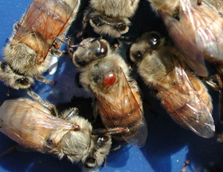
Colony Collapse Disorder
Honey Bee Stressors
Parasites (varroa mite)
Viruses
Bacterial Diseases
Pesticides
Nutrition
Genetics
Queen Quality
Management
https://www.pollinator.org/learning-center/bee-issues
Notes:
There are many factors that have contributed to Colony Collapse Disorder, including parasites, viruses, bacterial diseases, increased use of pesticides on pollinated crops, bee nutrition, genetics and queen quality. For more information, go to pollinator.org website.
CCD https://www.pollinator.org/learning-center/bee-issues

Slide 21
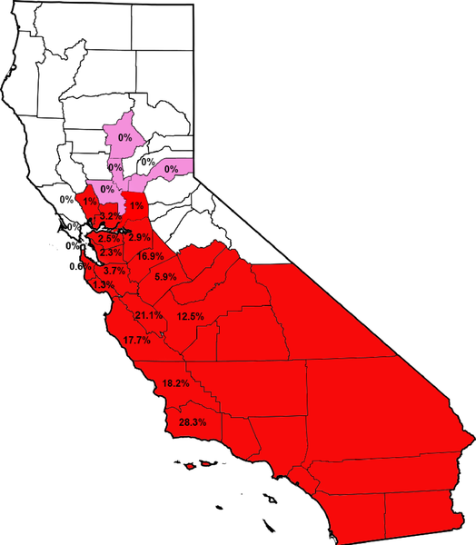

Distribution of Africanized Honey Bees
Africanized bees are hybrids of African honey bees and European/Western honey bees.
Africanized bees expanded into
southern California in 1994.
Map shows 2018 extent of Africanized bees.
RED = AHB present
PINK = tested for, not determined
Lin W, McBroome J, Rehman M, Johnson BR (2018)
Africanized bees extend their distribution in California.
PLOS ONE 13(1): e0190604. https://doi.org/10.1371/journal.pone.0190604
https://journals.plos.org/plosone/article?id=10.1371/journal.pone.0190604
Notes:
africanized honeybees https://anrcatalog.ucanr.edu/pdf/8068.pdf
update 2016 https://ucanr.edu/blogs/blogcore/postdetail.cfm?postnum=21091
In the 1950s, Brazilian scientists exported bees
from South Africa to improve breeding stock and increase honey production; however the bees escaped quarantine
and began mating with European honey bees. Since they they have spread throughout
South and Central America and arrived
in North America in 1985.
Current thinking is that Placer climate is a limiting factor---too cold for Africanized bees to establish.
https://journals.plos.org/plosone/article?id=10.1371/journal.pone.0190604

