Slide 1
What’s the Buzz about Pollinators?
Notes:
Compiled 5/19 by Peggy Beltramo For RUEC Workshop presented by Candee Kenny, Jennifer Downey, and Judith Myrick
Built from Attracting Pollinators, Butterflies, and Hummingbird modules
Advertising
What's the Buzz about Pollinators? Saturday, June 8, 2019 • 10 am - 12 pm Bees? Please! Pollinators like bees, butterflies, hummingbirds and bats are an integral part of our ecosystem and are beneficial in the garden. Learn about the different pollinators and their life cycles, what plants attract these hard workers and how to provide for their habitat. Before you know it, your garden will be fluttering with life.

Slide 2
Who Are Master Gardeners?
Master Gardeners of Placer County
Extend research-based, sustainable gardening and composting information
Present accurate, impartial information to home gardeners
Encourage public to make informed gardening decisions

Slide 3
Who Are Master Gardeners?
Where to find us…
Online, in the Media, and Special Publications
Hotline: Call (530) 889-7388 or submit your questions online
Website: pcmg.ucanr.org
Facebook, Twitter, Instagram
Gold Country Media monthly column
Curious Gardener quarterly newsletter; subscribe on website
Calendar and Gardening Guide

Slide 4
Who Are Master Gardeners?
Where to find us…
Workshops, Fairs and Festivals and Special Events
Speakers by Request
Workshops (various venues, check website)
Farmers’ Markets (seasonal: Auburn, Roseville)
Fairs and Festivals Booths (varies)
Garden Faire (April)
Mother’s Day Garden Tour (May)

Slide 5
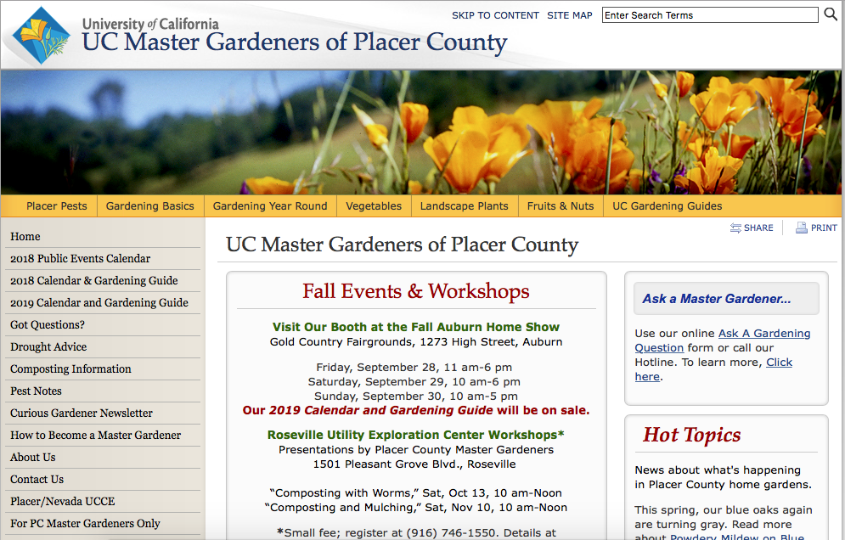


Slide 6
Your Handouts
Let’s take a quick look…

Slide 7

Your Handouts
Resources/Pleasing Pollinators
Attracting Beneficials
Bookmark
Tithonia seeds (if available)

Slide 8
How Many Types of Pollinators Can You Think of?
Who Are the Pollinators?
?

Slide 9
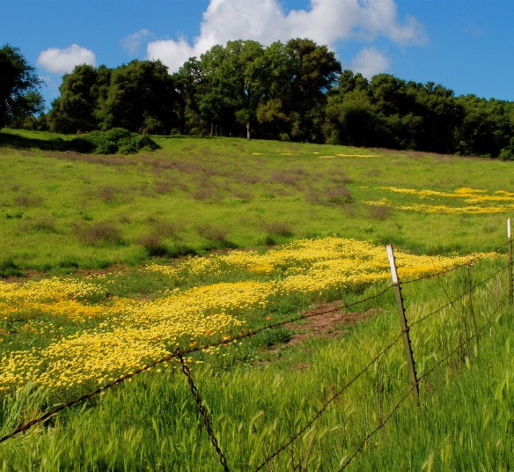
Small Fenced yards are unappealing to species
that live in wide-open fields and meadows.

Slide 10
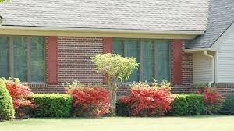
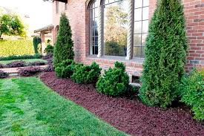
No food
or shelter here.

Slide 11
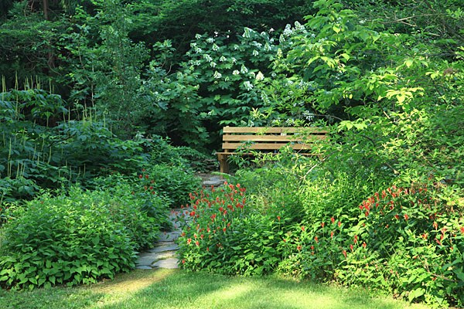
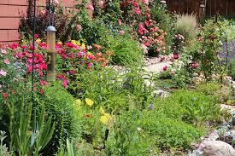
But you CAN
Create a garden
attractive to humans
AND
Provide habitat to attract pollinators

Slide 12

Agenda
Why do we need Pollinators?
What is Pollinator Habitat?
Who are Pollinators?
INSERT pollinator MODULE TITLES HERE
How Can I Attract Pollinators?
PLANTS! PLANTS! PLANTS!
12￼
Notes:
Insert module titles here: Bees, Butterflies, Hummingbirds, Beneficial Insects,

Slide 13
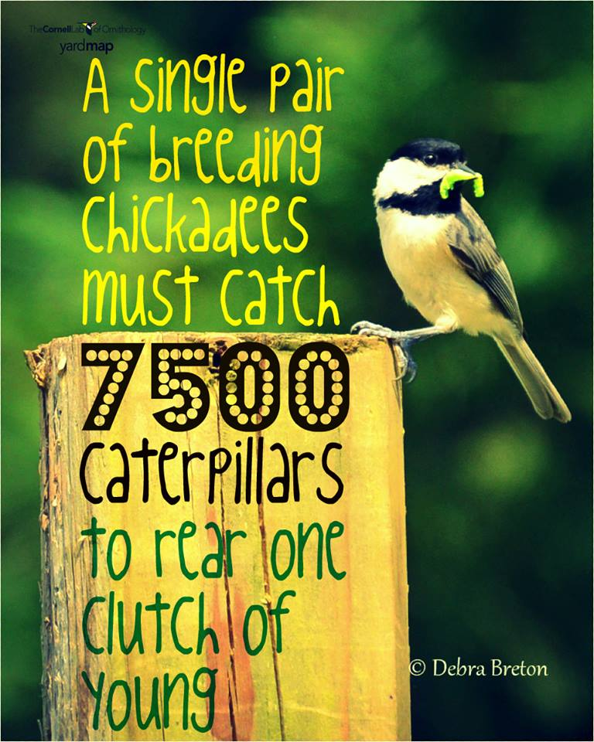
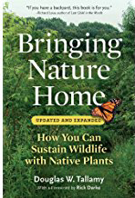
Why Do We Need Pollinators?
Notes:
A single pair of breeding chickadees must find 6,000 to 9,000 caterpillars to rear one clutch of young, according to Doug Tallamy, a professor of entomology and wildlife ecology at the University of Delaware.
https://nestwatch.org/connect/news/caterpillar-its-whats-for-dinner/

Slide 14
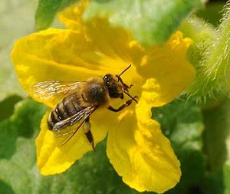
Why Do We Need Pollinators?
Pollinate 75% to 90%
of all flowering plants
180,000 plant species
1,200 crops
Squash bee Kathy Keatley Garvey
Notes:
75% crops, 90% perennials.

Slide 15
Why Do We Need Pollinators?
Responsible for 1 of every 3
bites of food
A tiny fly is responsible
for all of the world’s chocolate!
Chocolate midge
Notes:
Every bite of chocolate we eat starts off as seeds in pods that grow on Theobroma cacao, a tree whose name translates to "cacao, food of the gods." Enter chocolate midges—without the midges, there would be no chocolate! (Seen in US? Yes—National Park in American Samoa)
https://www.nps.gov/articles/chocolate-midge.htm

Slide 16
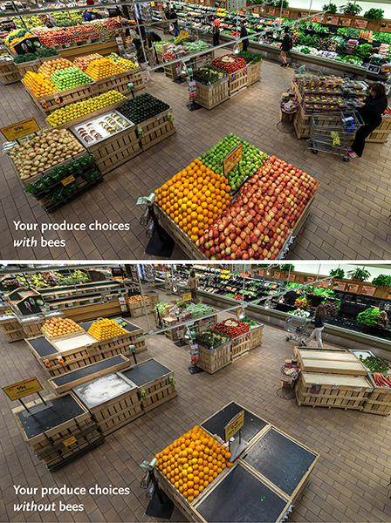
Why Do We Need Pollinators?
Notes:
https://media.wholefoodsmarket.com/news/bees
June 14, 2013
The before-and-after photo (above) is shocking – as are the statistics. Whole Foods Market’s produce team pulled from shelves 237 of 453 products – 52 percent of the normal product mix in the department. Among the removed products were some of the most popular produce items:
Apples, Onions, Avocados, Carrots, Mangos, Lemons, Limes, Honeydew, Cantaloupe, Zucchini, Summer squash, Eggplant, Cucumbers, Celery, Green onions, Cauliflower, Leeks, Bok choy, Kale, Broccoli, Broccoli rabe, Mustard greens

Slide 17
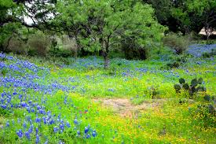
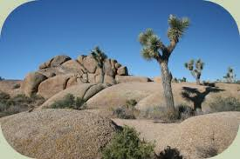
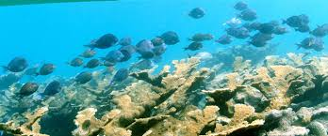
What is a Habitat?

Slide 18
What is a Habitat?
Habitat is the place
where a plant
or animal lives.
There are 4 components

Slide 19
What is a Habitat?
Food
Water
Shelter
Space

Slide 20
Provide a Healthy Habitat
Food
Adult food
Food for Young
Notes:
varies by type of pollinator
nectar for adults (flight fuel)
nectar/pollen to feed offspring
OR
“host” plant

Slide 21
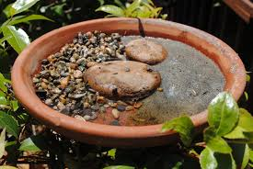
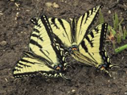
Provide a Healthy Habitat
Water
Shallow
or with
landing spots
Not clean water?
Notes:
Shallow, safe landing, corks, saucer w/ stones, “noodles” in pool
for butterflies dirty water resources
Also wet sand, and wet mud
http://ucanr.edu/blogs/blogcore/postdetail.cfm?postnum=26345

Slide 22
Provide a Healthy Habitat
Shelter
Perching sites to
defend territory
watch for females
Layers of trees and shrubs
for windbreaks and shade
Think 4-D
Notes:
Plant in Layers
canopy, understory, shrubs, herbaceous plants, groundcovers
“THINK 3-D,” says Doug Tallamy, co-author of The Living Landscape, “and in fact, maybe think 4-D, since by designing your landscape in all three dimensions, layering plants into complex communities, you’ll add the ‘D’ of diversity, too.”
“4 D” The fourth dimension is diversity
multiples of height, width, breadth, = DIVERSITY

Slide 23
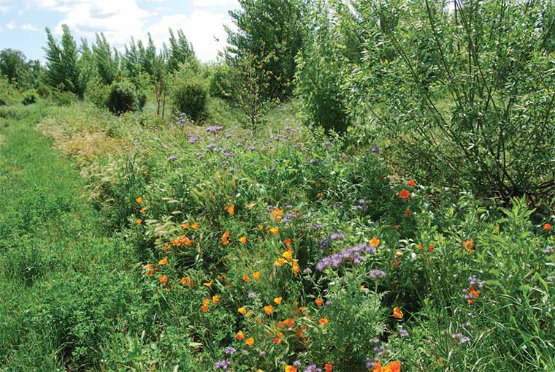
Provide a Healthy Habitat
Space
Leave a portion
of your yard
or property
“wild.”
Notes:
Provide nesting sites:
pupation sites (shrubs)
hollow stems, bare soil, 70% bees are ground nesters, leaf litter, brush piles, hotels
A New Vision Consider leaving a portion of your yard or property “wild”
“It’s important to not be too neat. Small clumps of grass or weeds or debris left under shrubs can protect the bumble bee queen as she overwinters in her nest below. Garden visitors will see that we leave some weed growth on the garden edges to provide this type of habitat.”
Wild areas—NOT weeds
Walt Disney quote:
'What do you mean we can't get rid of those weeds in time? Then go over there and put some fancy signs with Latin names in front of them’—Walt Disney.

Slide 24
How Many Types of Pollinators Did You Think Of?
Who Are the Pollinators?
?

Slide 25
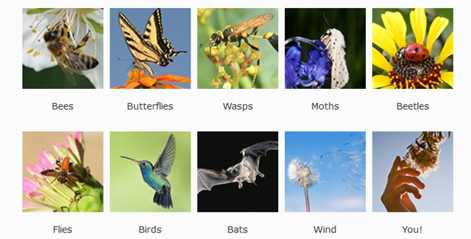
Who Are the Pollinators?
Notes:
POLLINAOTRS:
bees; butterflies; wasps; moths; beetles; flies; birds; bats; wind; humans
To get animals to help, plants provide:
• food (pollen, nectar) • scents/perfume • oils
• nest materials

Slide 26
Who Are the Pollinators?
🐝Bees, wasps, beetles, flies
🥀Hummingbirds
🦋Butterflies, (and moths)
🦇Bats in Placer County are insectivores
and do not pollinate,
but they DO eat mosquitoes!
Notes:
Animal pollinators are
• Most effective agents for plants • Take pollen directly to right kind of flower • Flower determines how pollen collected • Flower determines how pollen is deposited
The most effective pollinators are bees, wasps, beetles and flies; hummingbird, butterflies and moths, are considered “incidental” pollinators, as they are only drinking nectar, and any pollen transfer is accidental.

Slide 27
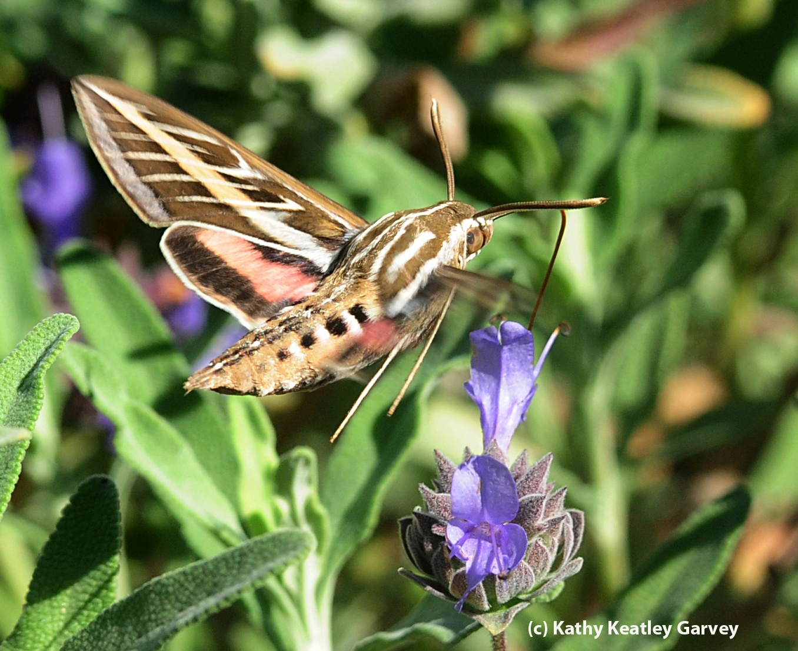
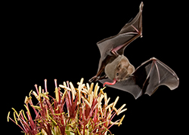
Who are Pollinators?
Who Are the Pollinators?
Moths and Bats
Notes:
Moths mostly fly at night—they like white or light colored flowers.
Local bats are insectivores and are not pollinators, but they do pollinate cactus in the southwest US and Mexico.

Slide 28
Add Selected Modules here
Possible Modules to choose:
🐝Bees, wasps, beetles, flies
🥀Hummingbirds (and moths)
🦋Butterflies, moths

Slide 29
To follow the chosen module(s),
The next pages discuss
Planting for pollinators
Notes:
POLLINAOTRS:
bees; butterflies; wasps; moths; beetles; flies; birds; bats; wind; humans
To get animals to help, plants provide:
• food (pollen, nectar) • scents/perfume • oils
• nest materials

Slide 30
How Can I Attract Pollinators?
A wide selection of plants
Many sources of food
Long bloom season
Year-round food source
“Drone view.”
Large masses of
a single color/plant.
Notes:
A wide selection of plants provides
many sources of food
Long bloom season to provide a year-round food source
“Drone view.” Large masses of a single color/plant.
Some moths are night flyers
Local bats—not pollinators; insectivores

Slide 31
Plants! Plants! Plants!
Plant for year-round bloom
Plant in the sun.
Patchwork Quilt

Slide 32
Plants! Plants! Plants!
Photo PlantRight
Ploto: UC Davis
Sage
Salvia ‘Bee’s Bliss’
Goldenrod
Solidago ‘Cascade Creek’
California Natives

Slide 33
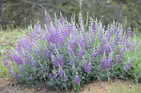
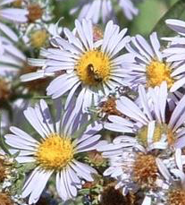
Plants! Plants! Plants!
Spring Bloom
Summer Bloom
Fall Bloom
© 2013 John Doyen
Las Pilitas Nursery
Las Pilitas Nursery
Lupine
Lupinus albifrons
Penstemon
Penstemon palmeri
California Aster
Symphiotrichum Chilense
California Natives
Winter Bloom
Photo credit:CountryMouse13
Coyote Bush
Baccharus pilularis ‘Pigeon Point’

Slide 34




Plants! Plants! Plants!
ANNUALS ARE IMPORTANT!
+60 species
Common tidy tips
Layia plattyglossa
Lacy Tansy
Phacelia tanacetifolia
California poppy
Eschscholzia californica
Bug Squad Blog
Photos by
Kathy Keatley Garvey
Notes:
Lacy Tansy Phacelia tanacetifolia,
California poppy Eschscholzia californica
Common tidytips Layia platyglossa

Slide 35
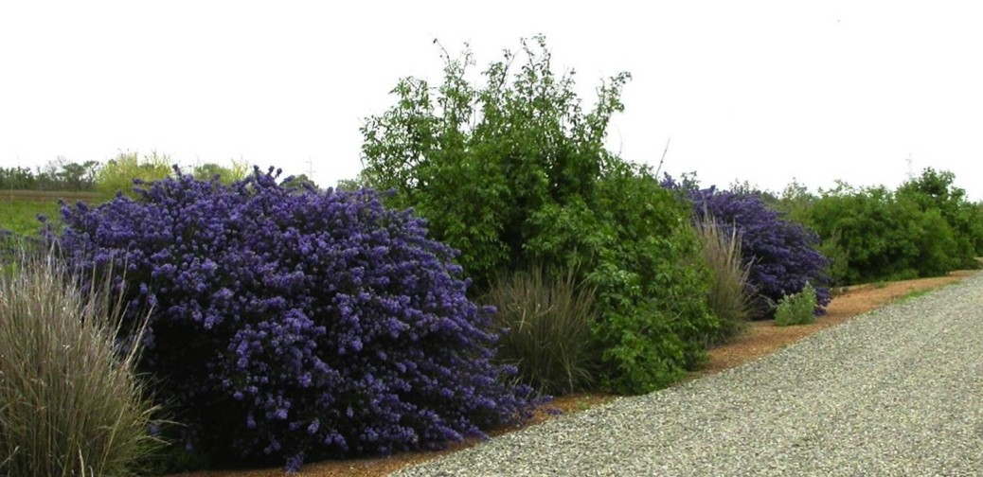
Plants! Plants! Plants!
Hedgerows provide shelter and food.
Notes:
Hedgerows can benefit pollinators in cropland, as well as large properties with space for large plantings.

Slide 36


Avoid Pesticides
ASK AT THE NURSERY!
ASK AT THE NURSERY!
Neonicotinoids are Insecticides
Are absorbed into plant tissues
including pollen and nectar.
May remain in plant up to 2 years!
Insects are killed or disrupted
when they eat those plants.
Neonicotinoids kill pollinators.
Ask at your nursery!

Slide 37
Avoid Pesticides
Bt
Bt is a bacterium
Infects the gut of caterpillars
Does not affect humans or beneficial insects.
Bt container label
Controls worms and caterpillars on fruits, vegetables, ornamentals and shade trees. Kills tomato hornworms, tent caterpillars, gypsy moths and others listed.
PS: Bt kills all caterpillars NOT just the ones on the label!!!
Bt is nonsystemic.
It can be washed off. Length of efficacy is 1 to 4 days.
Notes:
LBAM Light brown apple moth is treated for in 13 counties.
https://www.cdfa.ca.gov/plant/PDEP/target_pest_disease_profiles/LBAM_PestProfile.html
bT http://pmep.cce.cornell.edu/profiles/extoxnet/24d-captan/bt-ext.html

Slide 38
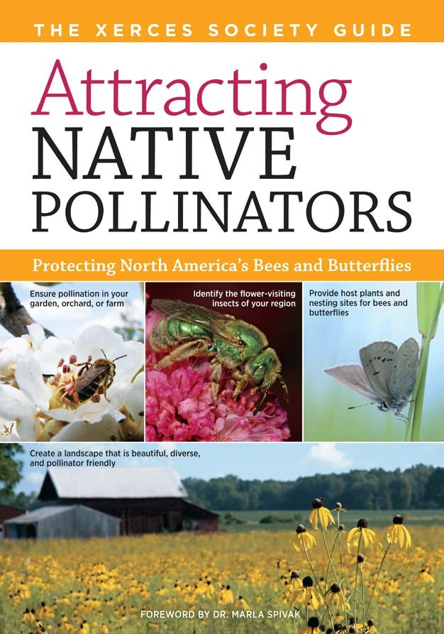
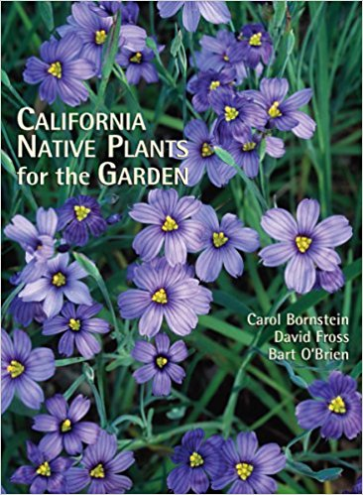
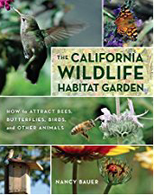
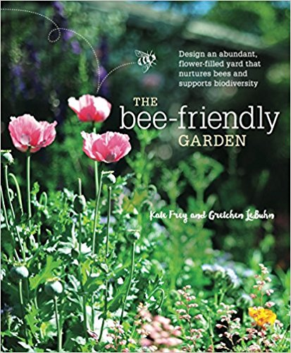
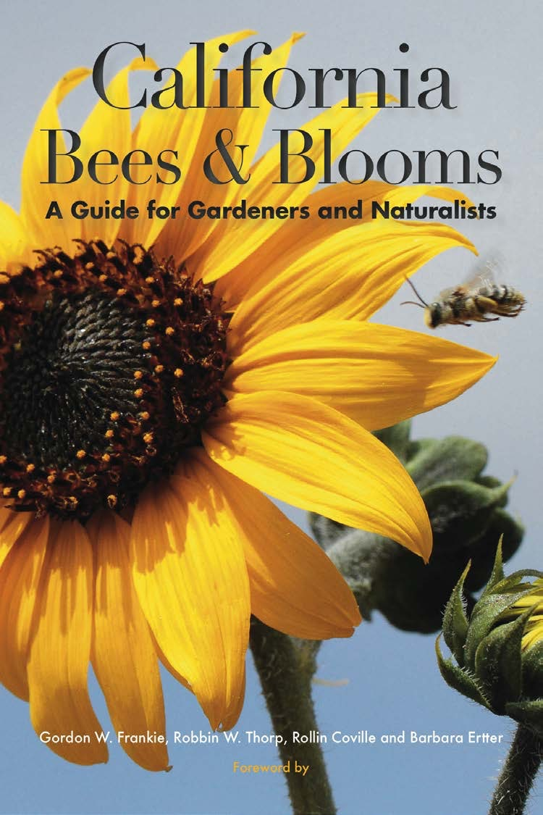
Book Resources
Notes:
Attracting Native Pollinators. 2011 by The Xerces Society and Dr. Marla Spivak
The Bee Friendly Garden. 2016 by Kate Frey and Gretchen LeBuhn
California Bees and Blooms. 2014 by Gordon Frankie, et al.
The California Wildlife Habitat Garden. Aug 8, 2012 by Nancy Bauer
California Native Plants for the Garden. Dec 1, 2005 by Carol Bornstein and David Fross

Slide 39
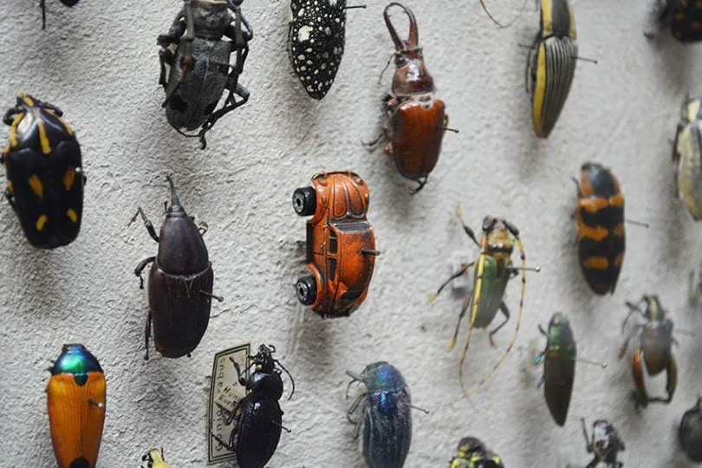
Benefits of
Gardening for Pollinators
Beautiful & interesting to watch
May help to preserve a species
Motion adds interest to your garden
Plants also attract
beneficial insects
(predators and parasites)

Slide 40
Benefits of
Gardening for Pollinators
Beautiful & interesting to watch
May help to preserve a species
Motion adds interest to your garden
Plants also attract
beneficial insects
(predators and parasites)
Look! It’s a Beetle!

Slide 41
To Recap
Pollinators are necessary for our own survival…
They pollinate crops for our food
Ensure survival of all plants
Are part of the food web, sustaining all life
They add interest and motion to our gardens!

Slide 42
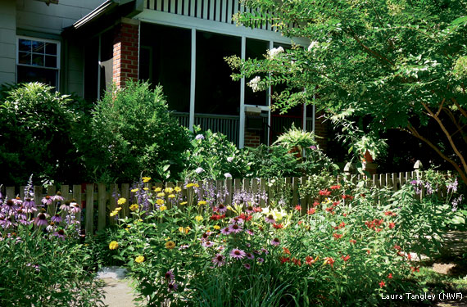
Plants! Plants! Plants!
Show and Tell
Notes:
Plants from home
INSERT SLIDE INTO STACK WHERE APPROPRIATE, IF YOU BROUGHT IN REAL SAMPLES…

Slide 43
Notes:
calscape.org find out which CA native plants grow in your zip code.
Can demonstrate and/or use phones to play with zip code. Gardeners are excited to discover lists of native plants and Advanced Search lets you select for pollinators, season of bloom, color of bloom, etc.

Slide 44
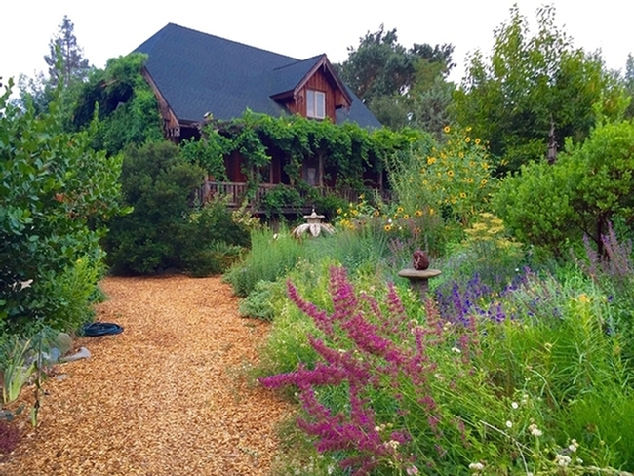
That’s All Folks!

Slide 45
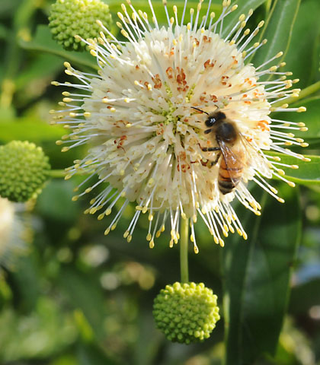
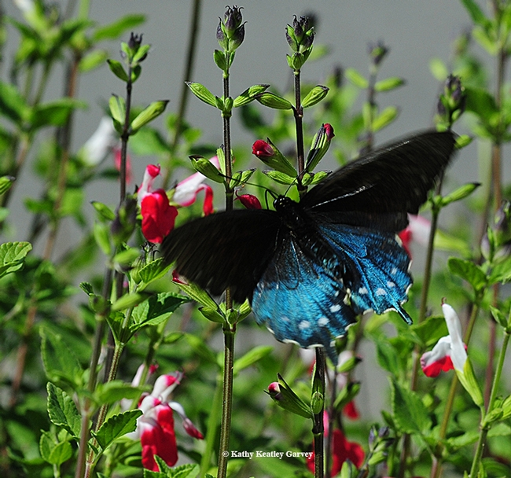
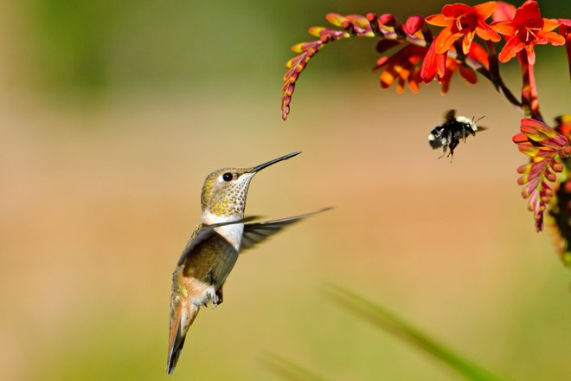
Thank You!
Any Questions?
Master Gardener Hotline: (530) 889-7388
Master Gardener Website: pcmg.ucanr.org
Evaluations, please!
Button willow
Cephalanthus occidentalis

Slide 46
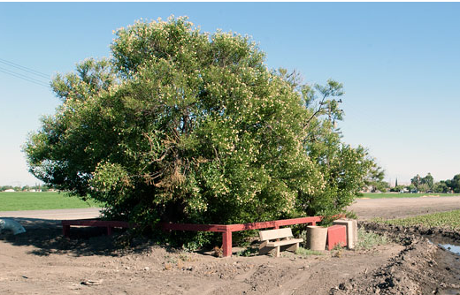
Buttonwillow in
Buttonwillow, CA
California Historical Landmark 492
Notes:
https://noehill.com/kern/cal0492.asp
California Historical Landmark 492
1952

