Slide 1
Attracting Pollinators
to Your Garden
Notes:
Created: May 2018
Created by: Peggy Beltramo
Audience: Roseville Better Gardeners Club,
10/18 Loomis Seed Library series
Publicity: Topic: Attracting and protecting our winged visitors. Come and learn what hummingbirds, butterflies, native bees and other garden visitors need in our gardens. See the plants!
Update History: N/A
*Note: Remember to resubmit any new information to SIM for approval

Slide 2
Who Are Master Gardeners?
Master Gardeners of Placer County
Extend research-based, sustainable gardening and composting information
Present accurate, impartial information to home gardeners
Encourage public to make informed gardening decisions

Slide 3
Who Are Master Gardeners?
Where to find us…
Online, in the Media, and Special Publications
Hotline: Call (530) 889-7388 or submit your questions online
Website: pcmg.ucanr.org
Facebook, Twitter, Instagram
Gold Country Media monthly column
Curious Gardener quarterly newsletter; email and on website
Calendar and Gardening Guide

Slide 4
Who Are Master Gardeners?
Where to find us…
Workshops, Fairs and Festivals and Special Events
Speakers by Request
Workshops (various venues, check website)
Farmers’ Markets (seasonal: Auburn, Roseville)
Fairs and Festivals Booths (varies)
Garden Faire (April)
Mother’s Day Garden Tour (May)

Slide 5
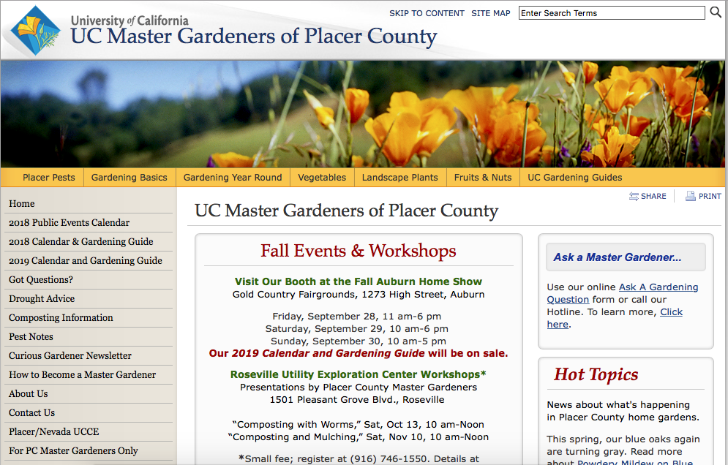


Slide 6
Your Handouts
Let’s take a quick look…
Notes:
At numerous talks to Master Gardeners and Garden Clubs we are asked many of the same questions. One of the main questions is “What are your top 5 or 6 pollinator plants that I should plant in my garden?” We hesitate to answer this question directly because we feel that it takes more than just a few key plants to really attract bees and other pollinators. We can offer suggestions on these few plants but prefer to provide information on a more complete program to those who would like to become habitat gardeners- by telling them how to provide food, water, and cover/places to raise young through sustainable gardening practices.

Slide 7

Your Handouts
Resources
Pleasing Pollinators
Plants for Beneficials by Season
Bookmark
(Tithonia seeds) if available
Notes:
At numerous talks to Master Gardeners and Garden Clubs we are asked many of the same questions. One of the main questions is “What are your top 5 or 6 pollinator plants that I should plant in my garden?” We hesitate to answer this question directly because we feel that it takes more than just a few key plants to really attract bees and other pollinators. We can offer suggestions on these few plants but prefer to provide information on a more complete program to those who would like to become habitat gardeners- by telling them how to provide food, water, and cover/places to raise young through sustainable gardening practices.

Slide 8
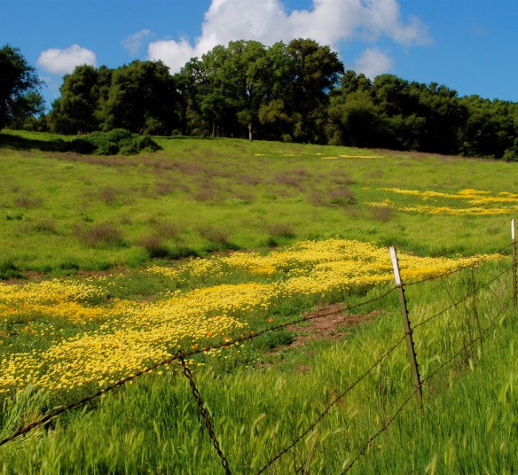
Small Fenced yards are unappealing to species
that live in wide-open fields and meadows.

Slide 9
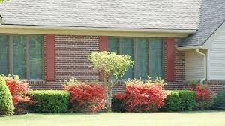
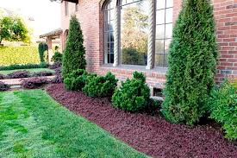
No food
or shelter here.

Slide 10
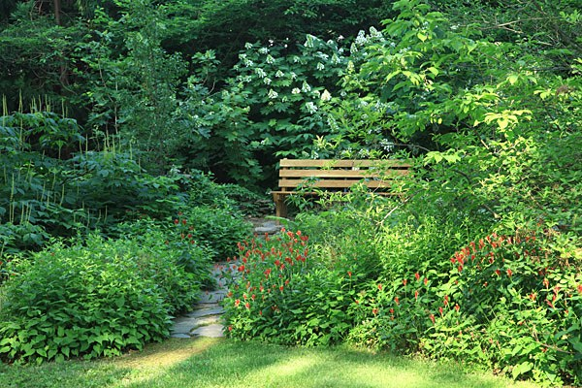
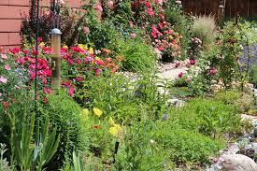
But you CAN
Create a garden
attractive to humans
AND
Provide habitat to attract pollinators

Slide 11

Agenda
Who are Pollinators?
Why do we need Pollinators?
What is Pollinator Habitat?
How Can I Attract Pollinators?
PLANTS! PLANTS! PLANTS!
11￼

Slide 12
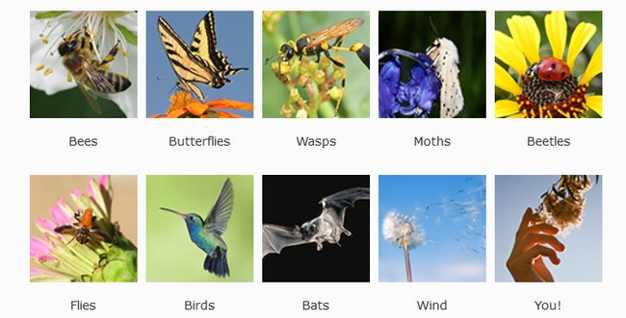
Who Are the Pollinators?
Notes:
POLLINAOTRS:
bees; butterflies; wasps; moths; beetles; flies; birds; bats; wind; humans
To get animals to help, plants provide:
• food (pollen, nectar) • scents/perfume • oils
• nest materials

Slide 13
Who Are the Pollinators?
🐝Bees, wasps, beetles, flies
🕊Hummingbirds
🦋Butterflies
We are skipping moths and bats.
Notes:
Moths mostly fly at night—they like white or light colored flowers. Local bats are insectivores and are not pollinators.
They do pollinate cactus in the southwest/Mexico.
Animal pollinators are
• Most effective agents for plants • Take pollen directly to right kind of flower • Flower determines how pollen collected • Flower determines how pollen is deposited

Slide 14
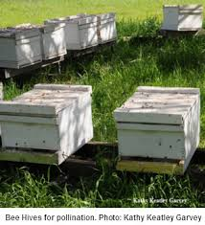
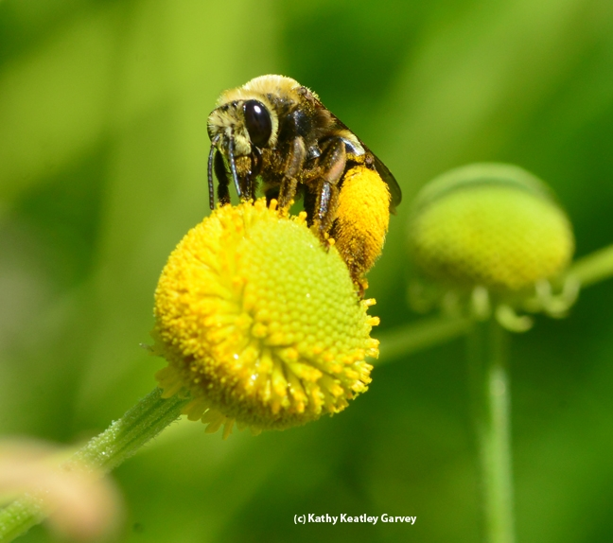
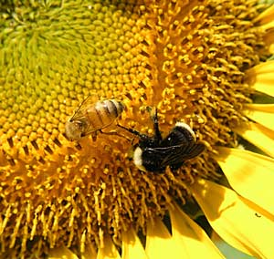
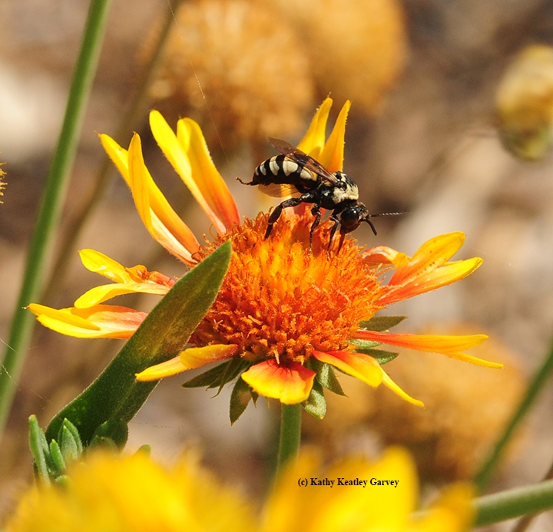
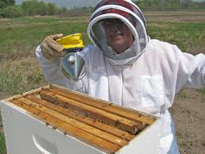
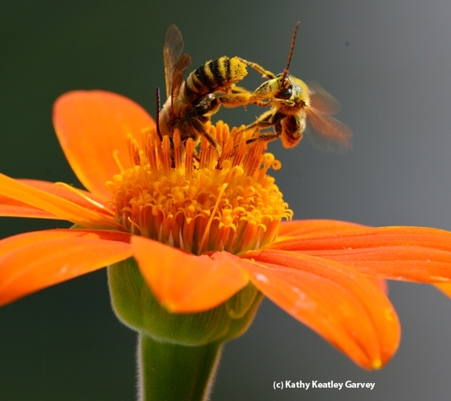
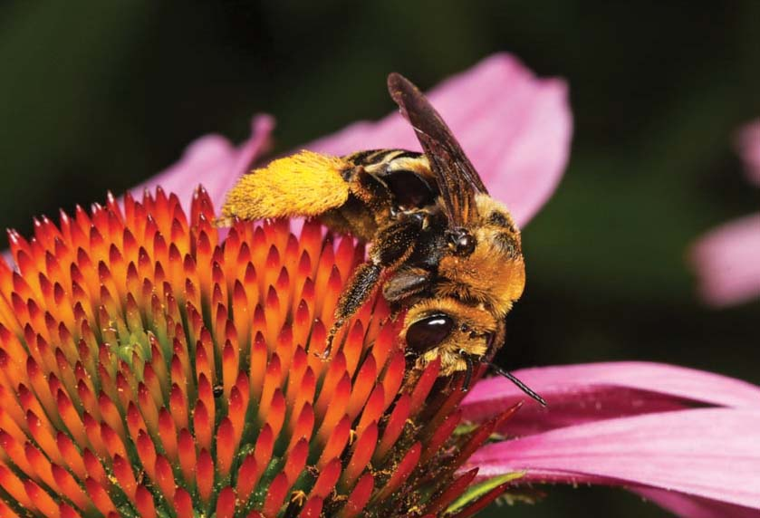
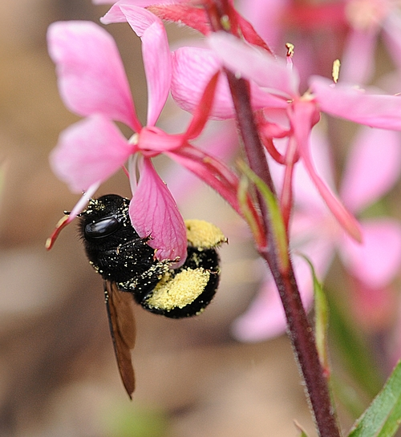
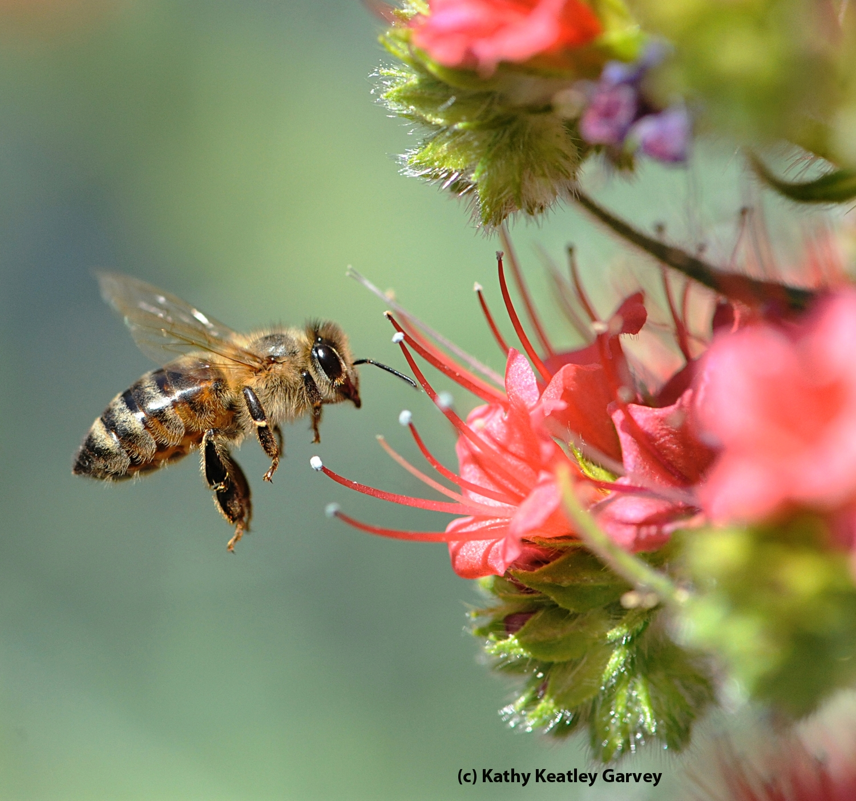
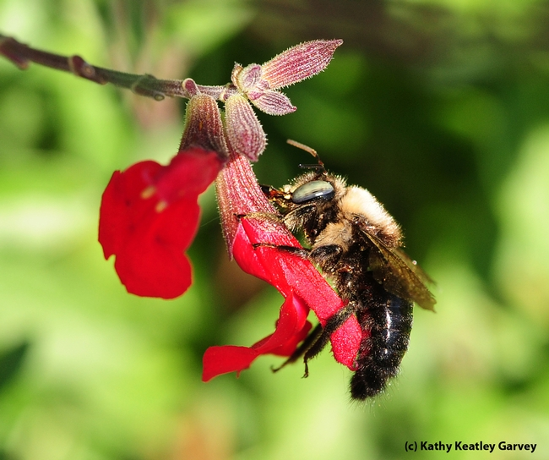
Honeybees and All the Other Guys!
The Other Guys
Honey Bees
Notes:
Bee hives; bee keeper; honey bee on Echium wildpretti (Tower of Jewels)
1 Honeybee and bumblebee on sunflower;
2 longhorn bee on Helenium (sneezeweed)
4 bumblebee on Salvia (sage);
5 female solitary bee (Svasta obliqua expurgata) on purple coneflower (Echinacea pupurea)
6 bee fight on Tithonia (Mexican sunflower)

Slide 15
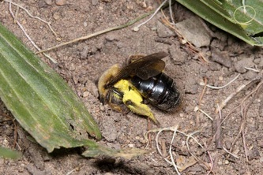
Who Are the Pollinators?
1600 native bee species in California
75% solitary—ground/cavity nesters
10 % social—bumblebees
15% cuckoo—lay eggs in other bees’ chambers
“Tickle Bees”
Notes:
Andrenidae Mining Bees tickle bees: Sabin Elementary, Portland, Oregon http://www.sabinpta.com/tickle-bee
mining bees in schoolyard. Students observe and protect their friends.

Slide 16
Who Are the Pollinators?
Common Bee Groups of California
APIDAE (Cuckoo, Digger, Carpenter, Bumble, and Honey Bees)
COLLETIDAE (Membrane Bees)
ANDRENIDAE (Mining Bees)
HALICTIDAE (Sweat Bees)
MEGACHILIDAE (Leafcutting, Mason, Polyester, Wool Carder)
Notes:
http://www.helpabee.org/common-bee-groups-of-ca.html
APIDAE (Cuckoo, Digger, Carpenter, Bumble, and Honey Bees)
COLLETIDAE (Membrane Bees)
ANDRENIDAE (Mining Bees)
HALICTIDAE (Sweat Bees)
MEGACHILIDAE (Leafcutting, Mason, Polyester, Wool Carder)

Slide 17
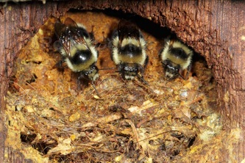
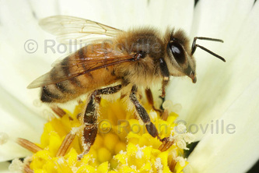
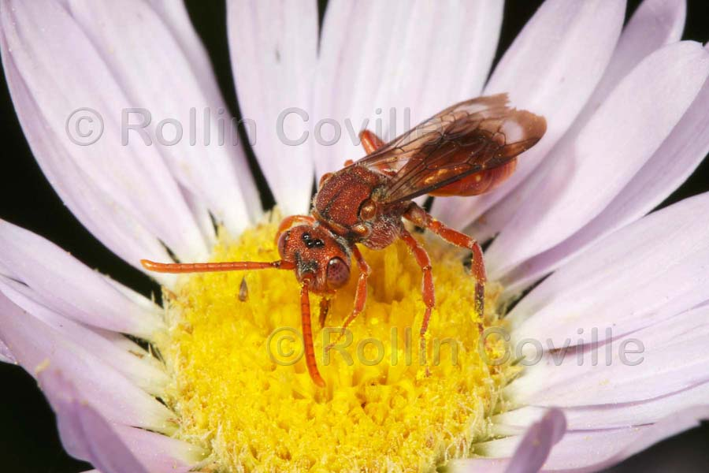
Who Are the Pollinators?
Bumblebees
Carpenter Bee
Honeybee
Digger Bee
Cuckoo Bee

Slide 18
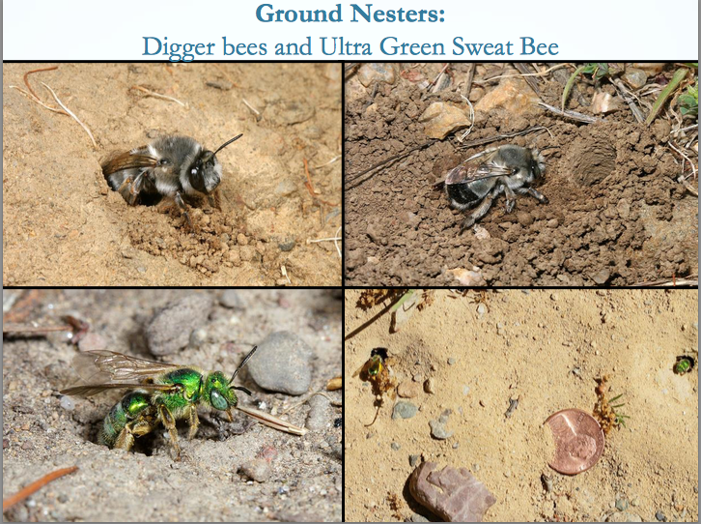
Who Are the Pollinators?
Gordon Frankie
Notes:
bee groups ppt http://ucanr.edu/sites/2017MGConference/files/271017.pdf
Ground nesters
Leave some bare soil, not all mulched.
Sweat bees will land on you and drink your sweat for the salt content.

Slide 19
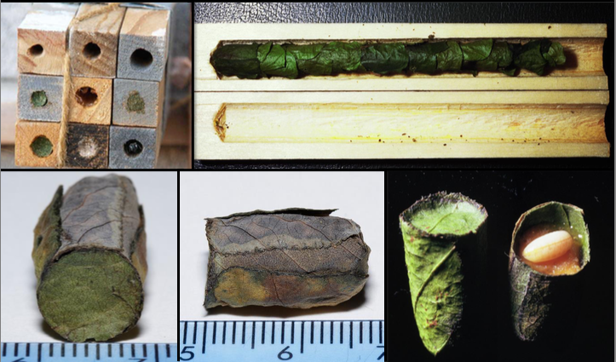
Who Are the Pollinators?
Gordon Frankie
Leaf-cutter bees
Notes:
Leaf-cutter bees
Use redbud leaves, rose leaves, petals
Cause scalloped edges, no danger to plants.

Slide 20
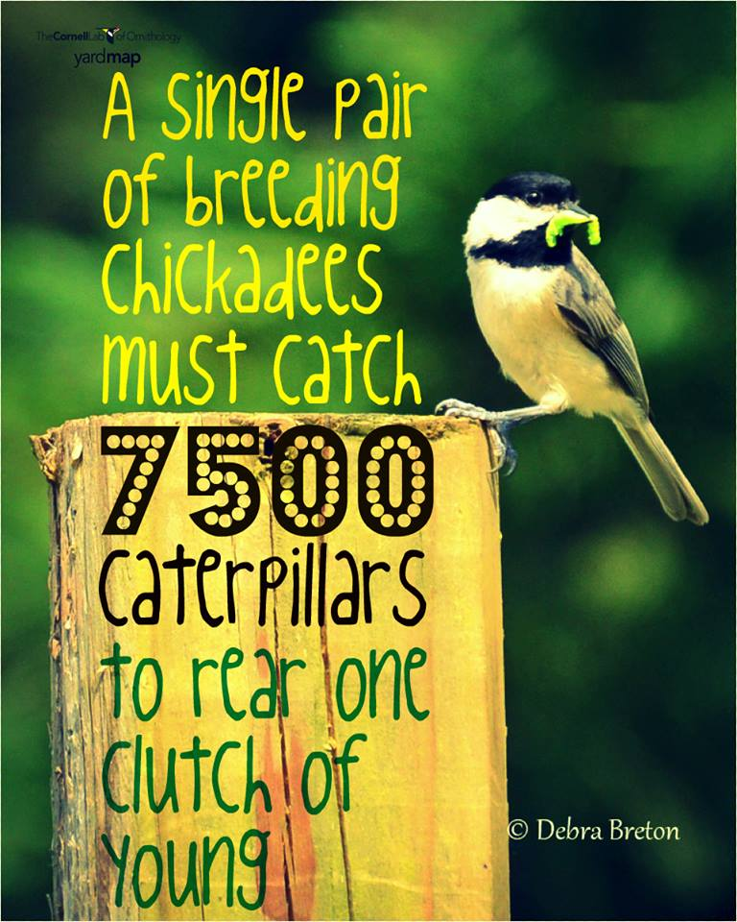
Why Do We Need Pollinators?
Notes:
A single pair of breeding chickadees must find 6,000 to 9,000 caterpillars to rear one clutch of young, according to Doug Tallamy, a professor of entomology and wildlife ecology at the University of Delaware.
https://nestwatch.org/connect/news/caterpillar-its-whats-for-dinner/

Slide 21
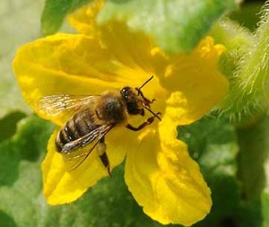
Why Do We Need Pollinators?
Pollinate 75% to 90%
of all flowering plants
180,000 plant species
1,200 crops
Responsible for 1 of every 3
bites of food
A tiny fly is responsible
for all of the world’s chocolate!
Squash bee Kathy Keatley Garvey
Chocolate midge
Notes:
75% crops, 90% perennials.
Every bite of chocolate we eat starts off as seeds in pods that grow on Theobroma cacao, a tree whose name translates to "cacao, food of the gods." Enter chocolate midges—without the midges, there would be no chocolate! (Seen in US? Yes—National Park in American Samoa)
https://www.nps.gov/articles/chocolate-midge.htm

Slide 22
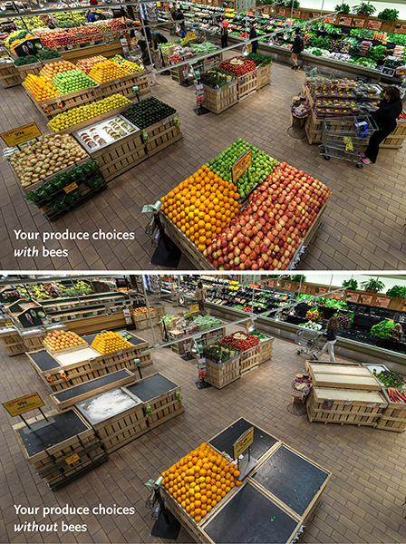
Why Do We Need Pollinators?
Notes:
https://media.wholefoodsmarket.com/news/bees
June 14, 2013
The before-and-after photo (above) is shocking – as are the statistics. Whole Foods Market’s produce team pulled from shelves 237 of 453 products – 52 percent of the normal product mix in the department. Among the removed products were some of the most popular produce items:
Apples, Onions, Avocados, Carrots, Mangos, Lemons, Limes, Honeydew, Cantaloupe, Zucchini, Summer squash, Eggplant, Cucumbers, Celery, Green onions, Cauliflower, Leeks, Bok choy, Kale, Broccoli, Broccoli rabe, Mustard greens

Slide 23
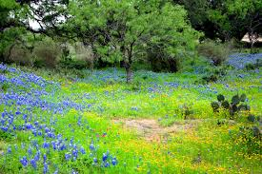
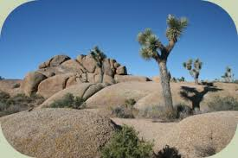
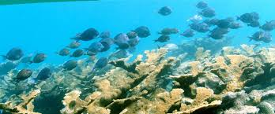
What is a Habitat?

Slide 24
What is a Habitat?
Habitat is the place
where a plant
or animal lives.
There are 4 components

Slide 25
What is a Habitat?
Food
Water
Shelter
Space

Slide 26
Provide a Healthy Habitat
Food
Adult food
Food for Young
Notes:
varies by type of pollinator
nectar for adults (flight fuel)
nectar/pollen to feed offspring
OR
“host” plant

Slide 27
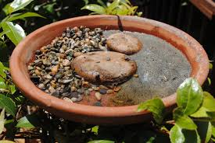
Provide a Healthy Habitat
Water
Shallow
or with
landing spots
Not clean water!
Notes:
http://ucanr.edu/blogs/blogcore/postdetail.cfm?postnum=26345
dirty water resources
shallow, safe landing, corks, saucer w/ stones, “noodles” in pool
Also wet sand, and wet mud

Slide 28
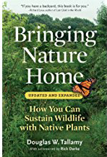
Provide a Healthy Habitat
Shelter
Perching sites to
defend territory
watch for females
Layers of trees and shrubs for windbreaks and shade
Think 4-D
Notes:
Plant in Layers
canopy, understory, shrubs, herbaceous plants, groundcovers
“THINK 3-D,” says Doug Tallamy, co-author of The Living Landscape, “and in fact, maybe think 4-D, since by designing your landscape in all three dimensions, layering plants into complex communities, you’ll add the ‘D’ of diversity, too.”
“4 D” The fourth dimension is diversity
multiples of height, width, breadth, = DIVERSITY

Slide 29
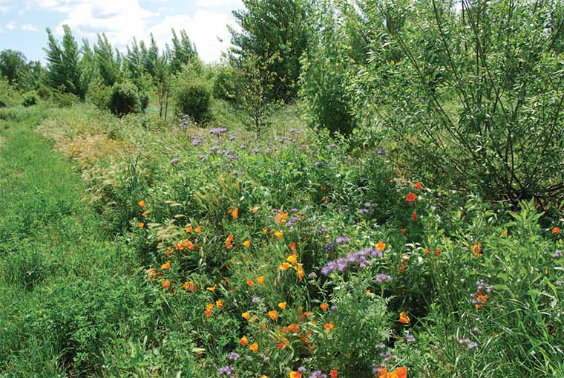
Provide a Healthy Habitat
Space
Leave a portion
of your yard
or property
“wild.”
Notes:
Provide nesting sites:
pupation sites (shrubs)
hollow stems, bare soil, 70% bees are ground nesters, leaf litter, brush piles, hotels
A New Vision Consider leaving a portion of your yard or property “wild”
“It’s important to not be too neat. Small clumps of grass or weeds or debris left under shrubs can protect the bumble bee queen as she overwinters in her nest below. Garden visitors will see that we leave some weed growth on the garden edges to provide this type of habitat.”
Wild areas—NOT weeds
Walt Disney quote:
'What do you mean we can't get rid of those weeds in time? Then go over there and put some fancy signs with Latin names in front of them’—Walt Disney.

Slide 30
How Can I Attract Pollinators?
A wide selection of plants
Many sources of food
Long bloom season
Year-round food source
“Drone view.”
Large masses of
a single color/plant.
Notes:
A wide selection of plants provides
many sources of food
Long bloom season to provide a year-round food source
“Drone view.” Large masses of a single color/plant.
Some moths are night flyers
Local bats—not pollinators; insectivores

Slide 31
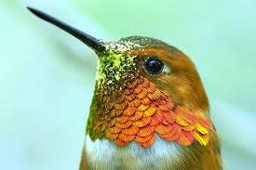
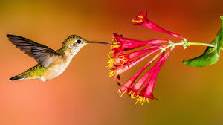
How Can I Attract Pollinators?
Hummingbirds
Attracted by bright colors
Red, yellow, orange, blue
Tubular flower shape
Hover to drink nectar

Slide 32
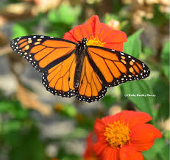

How Can I Attract Pollinators?
Mexican Sunflower
Tithonia rotunfifolia
Blooms spring to fall
Attracts many pollinators
Also butterflies
Even hummingbirds
#TithoniaInEveryGarden
Best pollinator plant
Notes:
"Tithonia in every garden" or hashtag it: #TithoniaInEveryGarden.
Meanwhile, you can't go wrong with Mexican sunflower or Tithonia, which anchors many pollinator gardens in California from early spring through fall. In addition to monarchs, we've seen Gulf Fritillaries, Western tiger swallowtails, mourning cloaks, pipevine swallowtails, skippers, buckeyes, acmon blues, painted ladies and other butterflies sipping nectar from Tithonia. That's not to mention the other pollinators drawn to the colorful orange flower. Among them: bumble bees, carpenter bees, sunflower bees, leafcutter bees, blue orchard bees, sweat bees, syrphid flies or hover flies, and hummingbirds
http://www.ucanr.org/blogs/blogcore/postdetail.cfm?postnum=22079

Slide 33
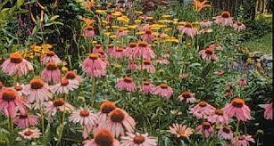
How Can I Attract Pollinators?
Butterflies and Other Insects
Must land to feed
Pink, red, purple
yellow, orange
Butterflies = nectar
Insects = Nectar and pollen

Slide 34
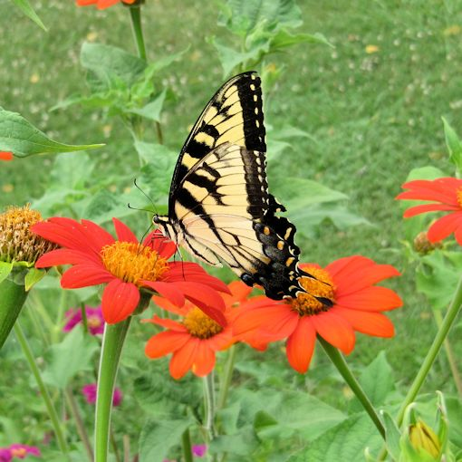
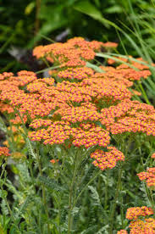
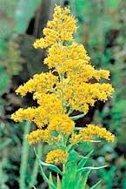
How Can I Attract Pollinators?
Daisy Type
Flat Clusters
Spikes
Mexican Sunflower
Tithonia rotundifolia
Yarrow
Achillea millefolium
Goldenrod
Solidago californica
Yarrow
Achillea millefolium
Goldenrod
Solidago

Slide 35
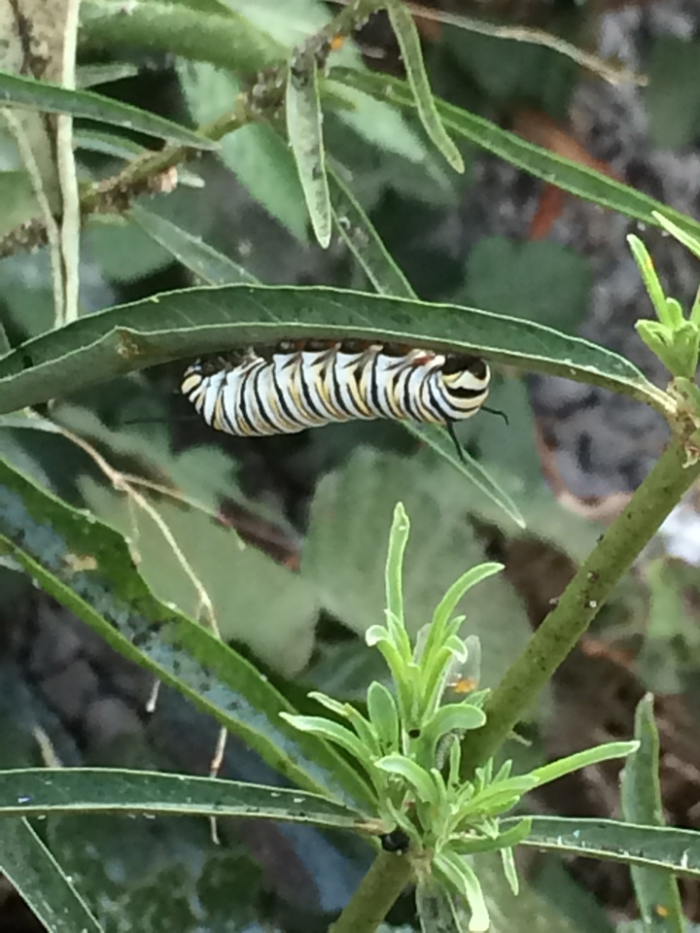
Larval Host Plants
Where adults lay eggs
Food for caterpillars
Caterpillars cause damage
Holes in leaves
Plant may disappear for the season

Slide 36
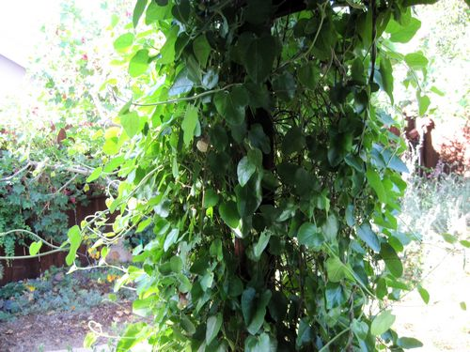
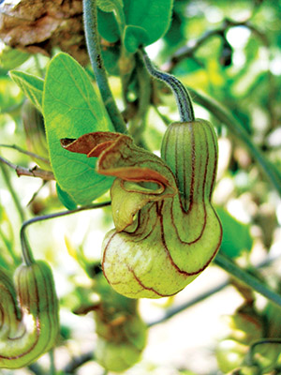
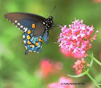
Larval Host Plants
Larval Food = Plant
Adult Food = Nectar
Dutchman’s Pipevine
Aristolochia californica
Pipevine Swallowtail
Caterpillars can be very picky.
Some will only eat one species of plant.
Notes:
The Pipevine Swallowtail (pictured) is a local species who’s only host plant is the Dutchman’s Pipevine (also pictured). If it’s eggs are laid on any other vine or shrub, the hatching caterpillars will not eat and starve to death.
Monarchs will eat multiple species of Milkweed, but no other Genera of plant.
Some butterfly larvae are less picky and will eat multiple plants, but many are specialists and rely on the presence of one particular species in order to survive.

Slide 37
Plants! Plants! Plants!
Plant for year-round bloom
Plant in the sun.
Patchwork Quilt
Patchwork Quilt

Slide 38
Plants! Plants! Plants!
Photo PlantRight
Ploto: UC Davis
Sage
Salvia ‘Bee’s Bliss’
Goldenrod
Solidago ‘Cascade Creek’
California Natives
Patchwork Quilt

Slide 39
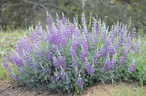
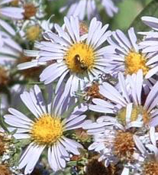
Plants! Plants! Plants!
Spring Bloom
Summer Bloom
Fall Bloom
© 2013 John Doyen
Las Pilitas Nursery
Las Pilitas Nursery
Lupine
Lupinus albifrons
Penstemon
Penstemon palmeri
California Aster
Symphiotrichum Chilense
California Natives
Winter Bloom
Photo credit:CountryMouse13
Coyote Bush
Baccharus pilularis ‘Pigeon Point’
Patchwork Quilt
Photo credit:CountryMouse13
Coyote Bush
Baccharus pilularis ‘Pigeon Point’

Slide 40




Plants! Plants! Plants!
ANNUALS ARE IMPORTANT!
+60 species
Common tidy tips
Layia plattyglossa
Lacy Tansy
Phacelia tanacetifolia
California poppy
Eschscholzia californica
Bug Squad Blog
Photos by
Kathy Keatley Garvey
Patchwork Quilt
Notes:
Lacy Tansy Phacelia tanacetifolia,
California poppy Eschscholzia californica
Common tidytips Layia platyglossa

Slide 41
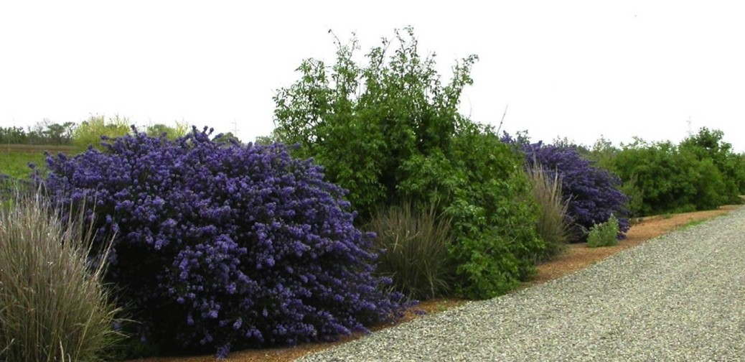
Plants! Plants! Plants!
Hedgerows provide shelter and food.
Patchwork Quilt
Notes:
Hedgerows can benefit pollinators in cropland, as well as large properties with space for large plantings.

Slide 42


Avoid Pesticides
Neonicotinoids are Insecticides
Are absorbed into plant tissues
including the pollen and nectar.
May remain in plant up to 2 years!
Insects are killed or disrupted
when they eat those plants.
Neonicotinoids kill pollinators.
Ask at your nursery!
Patchwork Quilt

Slide 43
Avoid Pesticides
Bt
Bt is a bacterium
Infects the gut of caterpillars
Does not affect humans or beneficial insects.
Bt container label
Controls worms and caterpillars on fruits,
vegetables, ornamentals and shade trees.
Kills tomato hornworms, tent caterpillars, gypsy moths
and others listed.
PS: Bt kills all caterpillars NOT just the ones on the label!!!
Bt is nonsystemic. It can be washed off.
Length of efficacy is 1 to 4 days.
Patchwork Quilt
Notes:
LBAM Light brown apple moth is treated for in 13 counties.
https://www.cdfa.ca.gov/plant/PDEP/target_pest_disease_profiles/LBAM_PestProfile.html
bT http://pmep.cce.cornell.edu/profiles/extoxnet/24d-captan/bt-ext.html

Slide 44
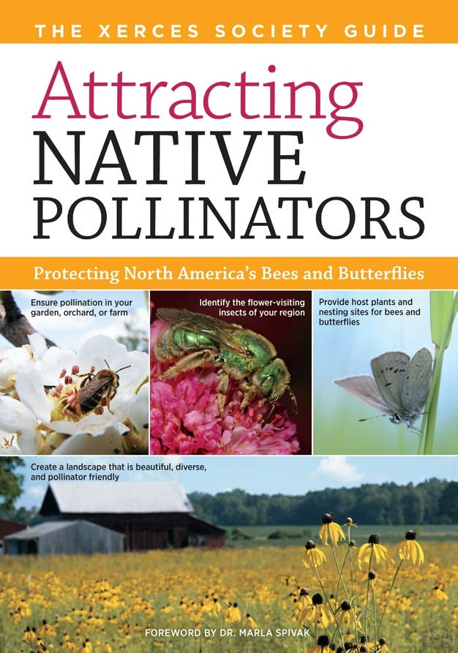
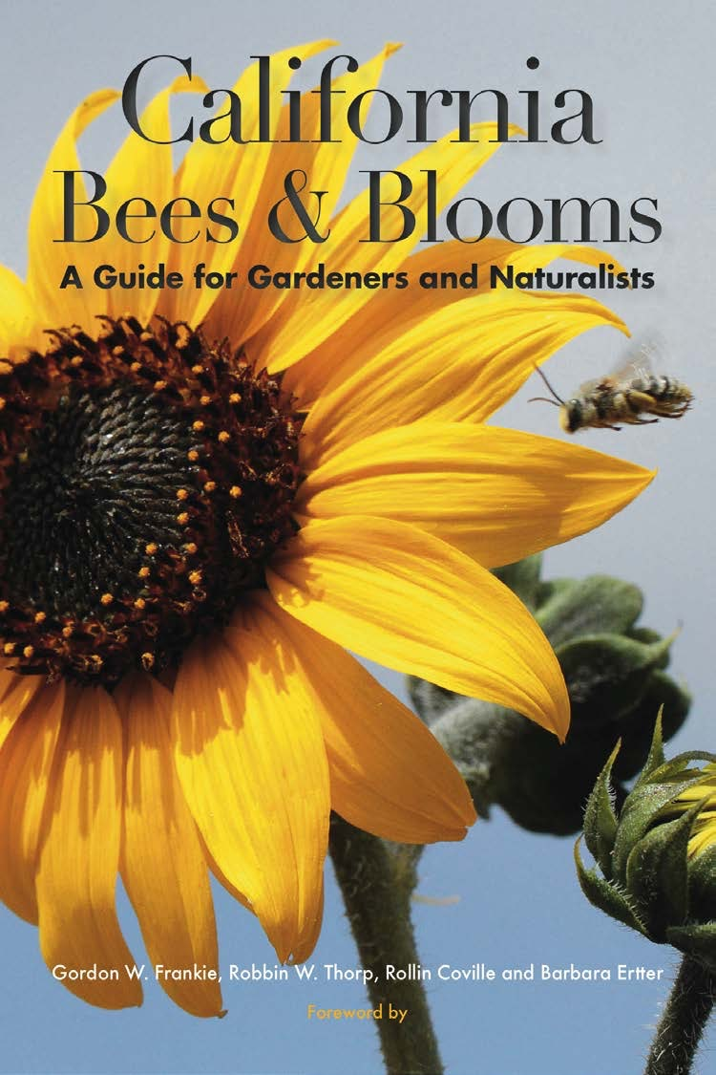
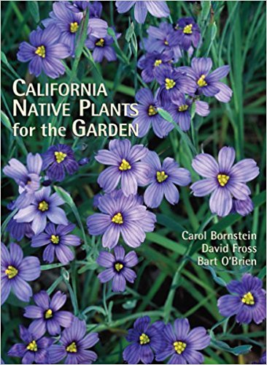
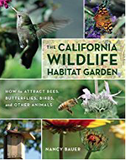

Book Resources
Patchwork Quilt
Notes:
Attracting Native Pollinators. 2011 by The Xerces Society and Dr. Marla Spivak
The Bee Friendly Garden. 2016 by Kate Frey and Gretchen LeBuhn
California Bees and Blooms. 2014 by Gordon Frankie, et al.
The California Wildlife Habitat Garden. Aug 8, 2012 by Nancy Bauer
California Native Plants for the Garden. Dec 1, 2005 by Carol Bornstein and David Fross

Slide 45

Benefits of
Gardening for Pollinators
Beautiful & interesting to watch
May help to preserve a species
Motion adds interest to your garden
Plants also attract
beneficial insects
(predators and parasites)
Patchwork Quilt

Slide 46
Benefits of
Gardening for Pollinators
Beautiful & interesting to watch
May help to preserve a species
Motion adds interest to your garden
Plants also attract
beneficial insects
(predators and parasites)
Look! It’s a Beetle!
Patchwork Quilt

Slide 47

That’s All Folks!

Slide 48


Thank You!
Any Questions?
Master Gardener Hotline: (530) 889-7388
Master Gardener Website: pcmg.ucanr.org
Evaluations, please!
Button willow
Cephalanthus occidentalis

Slide 49

Buttonwillow in
Buttonwillow, CA
California Historical Landmark 492
Notes:
https://noehill.com/kern/cal0492.asp
California Historical Landmark 492
1952

Slide 50
Notes:
calscape.org find out what CA native plants grow in your zip code.
Can demonstrate and/or use phones to play with zip code. Gardeners are excited to discover lists of native plants and Advanced Search lets you select for pollinators, season of bloom, color of bloom, etc.

Slide 51

Plants! Plants! Plants!
Show and Tell
Notes:
Plants from home
INSERT SLIDE INTO STACK WHERE APPROPRIATE, IF YOU BROUGHT IN REAL SAMPLES…

Slide 52

Who are Pollinators?
Male carpenter bee
Called a
“teddy bear bee”
Only
female bees sting!
Notes:
One more cutie!

Slide 53


How Can I
Attract Pollinators?
Bumblebee
robbing nectar
Honeybee—
Copycat!

