Slide 1
4H SUMMER STEM CAMP 2020
July 20-23rd
Noon to 2PM
ARDUINO RUBE-GOLDBERG SESSSIONS
Innovative Project involving Electrical Hardware,
Software, and Mechanical Apparatus.
Make a system that performs a fun but
not particularly useful task.

Slide 2
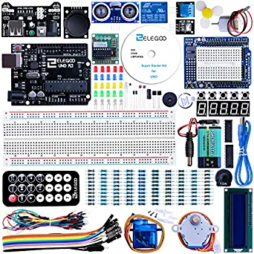
What do You need?: Arduino Rube-Goldberg Sessions
1. ELEGOO UNO Project Super Starter Kit with
Tutorial and UNO R3 Compatible with Arduino IDE
$40 on Amazon
2. Computer to Run ZOOM
and Arduino Kit:
Windows PC
Mac
Linux
3. Home Materials:
Use materials that
are commonly found around a
household to complete
a Rube-Gold berg Design
to share with the group.

Slide 3
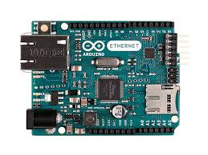
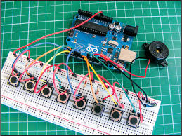
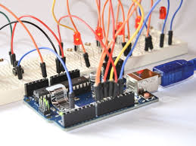
What is an Arduino?
An Arduino is a small computer that can be
connected to other electronic components
receive inputs, make decisions, and control
xxternal devices.

Slide 4
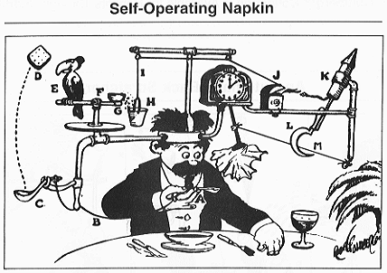
What is a Rube-Goldberg Machine?
From Wikipedia:
A Rube Goldberg machine, named after American cartoonist Rube Goldberg, is a machine intentionally designed to perform a simple task in an indirect and overly complicated way. Usually, these machines consist of a series of simple unrelated devices; the action of each triggers the initiation of the next, eventually resulting in achieving a stated goal.
Professor Butts and the Self-Operating Napkin (1931). Soup spoon (A) is raised to mouth, pulling string (B) and thereby jerking ladle (C), which throws cracker (D) past toucan (E). Toucan jumps after cracker and perch (F) tilts, upsetting seeds (G) into pail (H). Extra weight in pail pulls cord (I), which opens and ignites lighter (J), setting off skyrocket (K), which causes sickle (L) to cut string (M), allowing pendulum with attached napkin to swing back and forth, thereby wiping chin.

Slide 5
Pre-work before camp starts
Order Amazon Elegoo Super – Starter kit $40
Download the Arduino software
Watch a video on how to run the “Blink”
program to verify that everything works
Check in with instructor a week before camp
starts to make sure everything is ready to go.

Slide 6
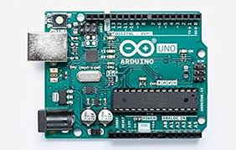
Laboratory Session #1
Students will get to know each other before first lab session starts
Lesson one: Control a servo to move a marble on to a track and load into a sail boat.
Computer tells
servo to move
causing marble
to roll down hill
into the sailboat
servo
marble
track
Students will need to create their sail boat
And track from household materials outside of
ZOOM class time as an assignment

Slide 7

Laboratory Session #2
Students will have constructed the boat, track and perfected having the marble land inside the sailboat
Outside the first session meeting time slot.
During the lab session, students will then turn on the fan to move the boat across the water.
After the marble is loaded
In the sailboat the fan
Turns on and starts the
Sailboat across the water
Tub.
Motor
And fan
Students will then turn on the fan
Automatically to start the sail boat
Moving.
Water in tub

Slide 8
Laboratory Session #3
Students will have constructed the boat, track and perfected having the marble land inside the sailboat
outside the first session meeting time slot.
During the lab session, students will then turn on the fan to move the boat across the water.
After the marble is loaded
In the sailboat the fan
Turns on and starts the
Sailboat across the water
Tub.
Motor
And fan
Students will then turn on the fan
Automatically to start the sail boat
Moving.
Water in tub

Slide 9
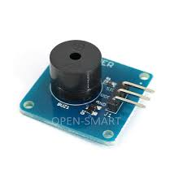
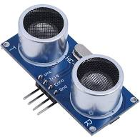
Laboratory Session #4
Students will have constructed the boat, track and and water tub with the goal of the sailboat making at
Completely across the tub.
During the lab session, students will use an ultrasonic sensor to detect when the sailboat made it across the water tub and then turn on a siren.
The ultrasonic sensor
then detects when the
dailboat makes it
Completely across the water
Tub and sounds an alarm
speaker
servo
Motor
And fan
Ultrasonic
sensor
Students will then turn on the fan
Automatically to start the sail boat
Moving.
Water in tub

Slide 10
Laboratory Session #5
Students will complete the story of their Rube Goldberg Machine using their own creativity and demonstrate their project completion story to the rest of the group.
?
How do you
Want your
Rube-Goldberg
Story to End? Add
Your creativity Here
speaker
servo
Motor
And fan
Ultrasonic
sensor
Water in tub

Slide 11
Arduino Rube-Goldberg Session at 4H Summer Camp
Learn microcontrollers
Design an Arduino Rube Goldberg Machine
Write software
Read sensors and Control hardware
Construct mechanical apparatus
MEET NEW PEOPLE, CREATIVITY, FUN, INNOVATION, SHARE YOUR SOLUTIONS

