Slide 1
Burn Unit Preparation and
Ignition Patterns
Prescribed Fire on Private Lands Workshop
October 18&19, 2019
Ryan Bauer
USDA – Forest Service

Slide 2
Burn Unit Preparation:
Fireline Location & Construction
  Avoid over-slung and under-slung line
  Existing and natural barriers
  Think about contingency
Mitigate Safety and Holding Hazards
  Snags, stovepipes, stumps, & jackpots
  Visually mark hazards
  Dog-legs, mid-slope lines, complex topography
  Point protection
Consult the Rx Fire Plan:
  Element 4: Description of Prescribed Fire Area
  Element 9: Pre-Burn Considerations and Weather
  Element 16: Holding Plan

Slide 3
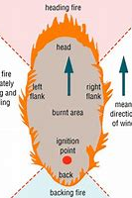
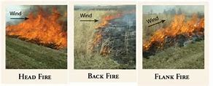
Ignition Patterns

Slide 4
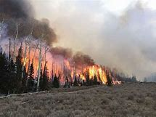
Ignition Patterns
Head Fire
  Highest intensity
  Lowest control

Slide 5
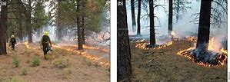
Ignition Patterns
Strip head firing
  Varying the distance between strips controls intensity

Slide 6
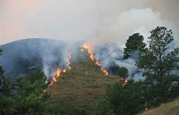
Ignition Patterns
Flank Firing
  Go faster

Slide 7
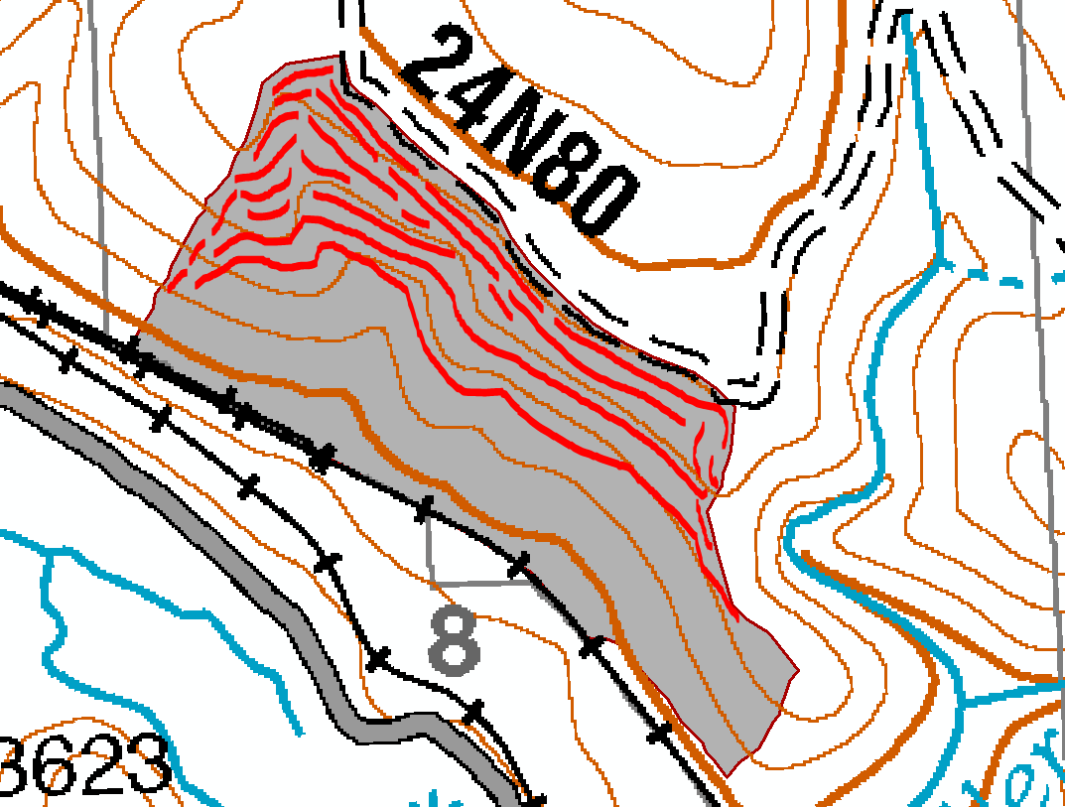
Ignition Patterns

