Slide 1
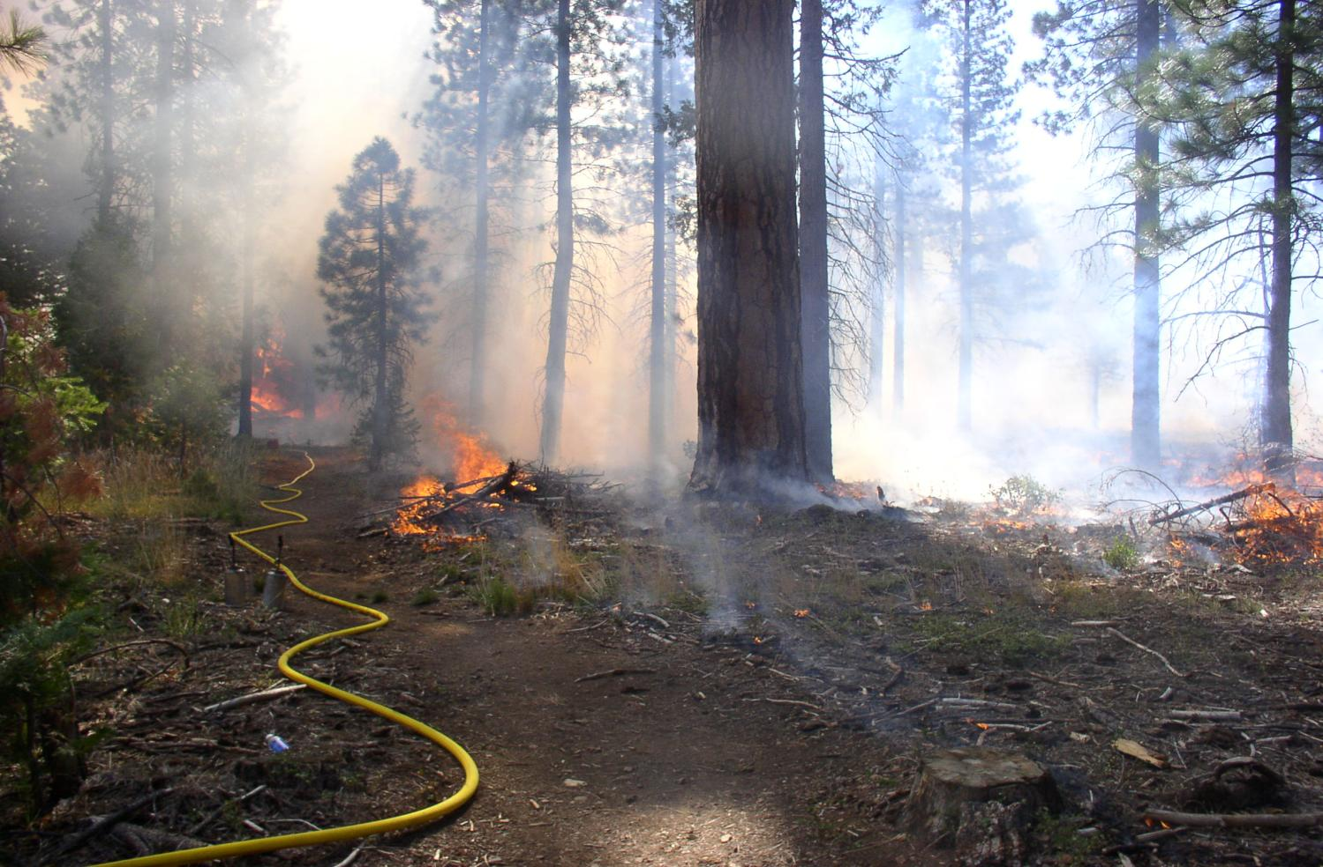
Fire Ecology and Behavior
Susie Kocher, Registered Professional Forester #2874
University of California Cooperative Extension
May 17th, 2019

Slide 2
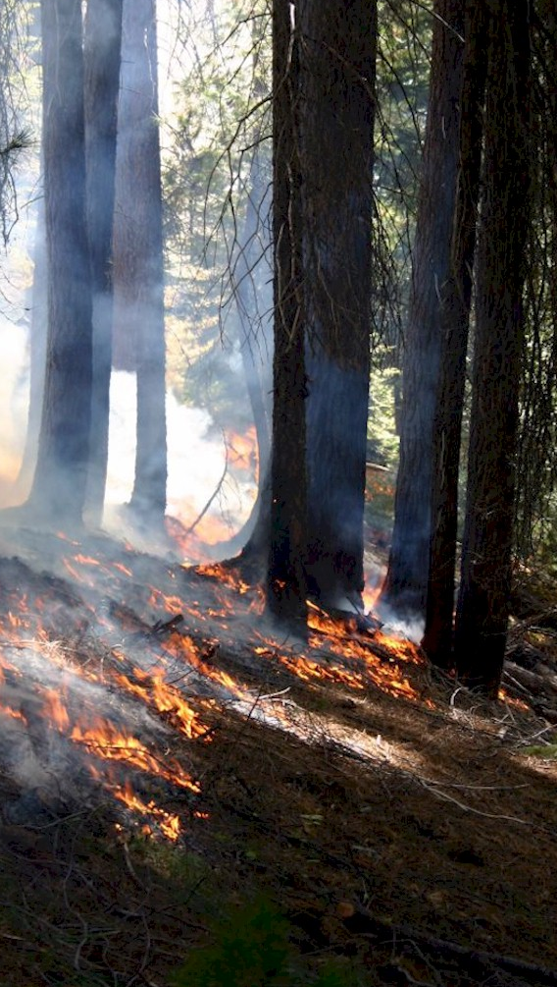
Current fire management has unintended effects
Sierra forests are adapted to frequent low intensity from native starts and lightning
Fire suppression and halt in prescribed fire have led to increased fuels, poor forest health and more destructive wildfires
Reintroducing ‘good fire’ in forests is needed as part of the solution
Private landowners have a large role to play in Rx fire solution

Slide 3
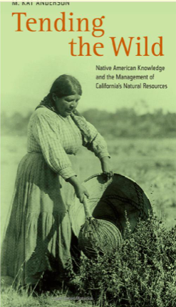
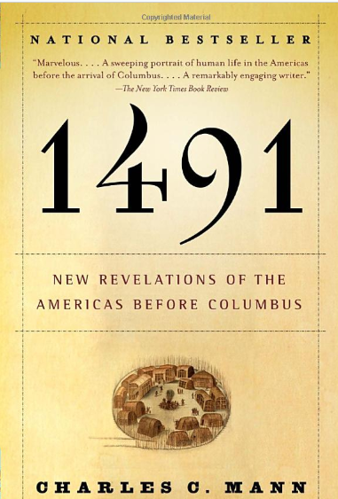
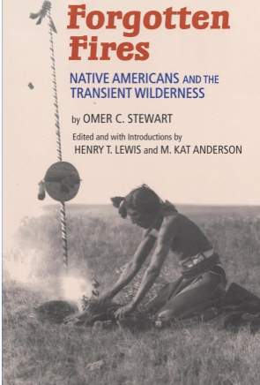
Native burning in California
Ethnographic interviews with native American tribes

Slide 4
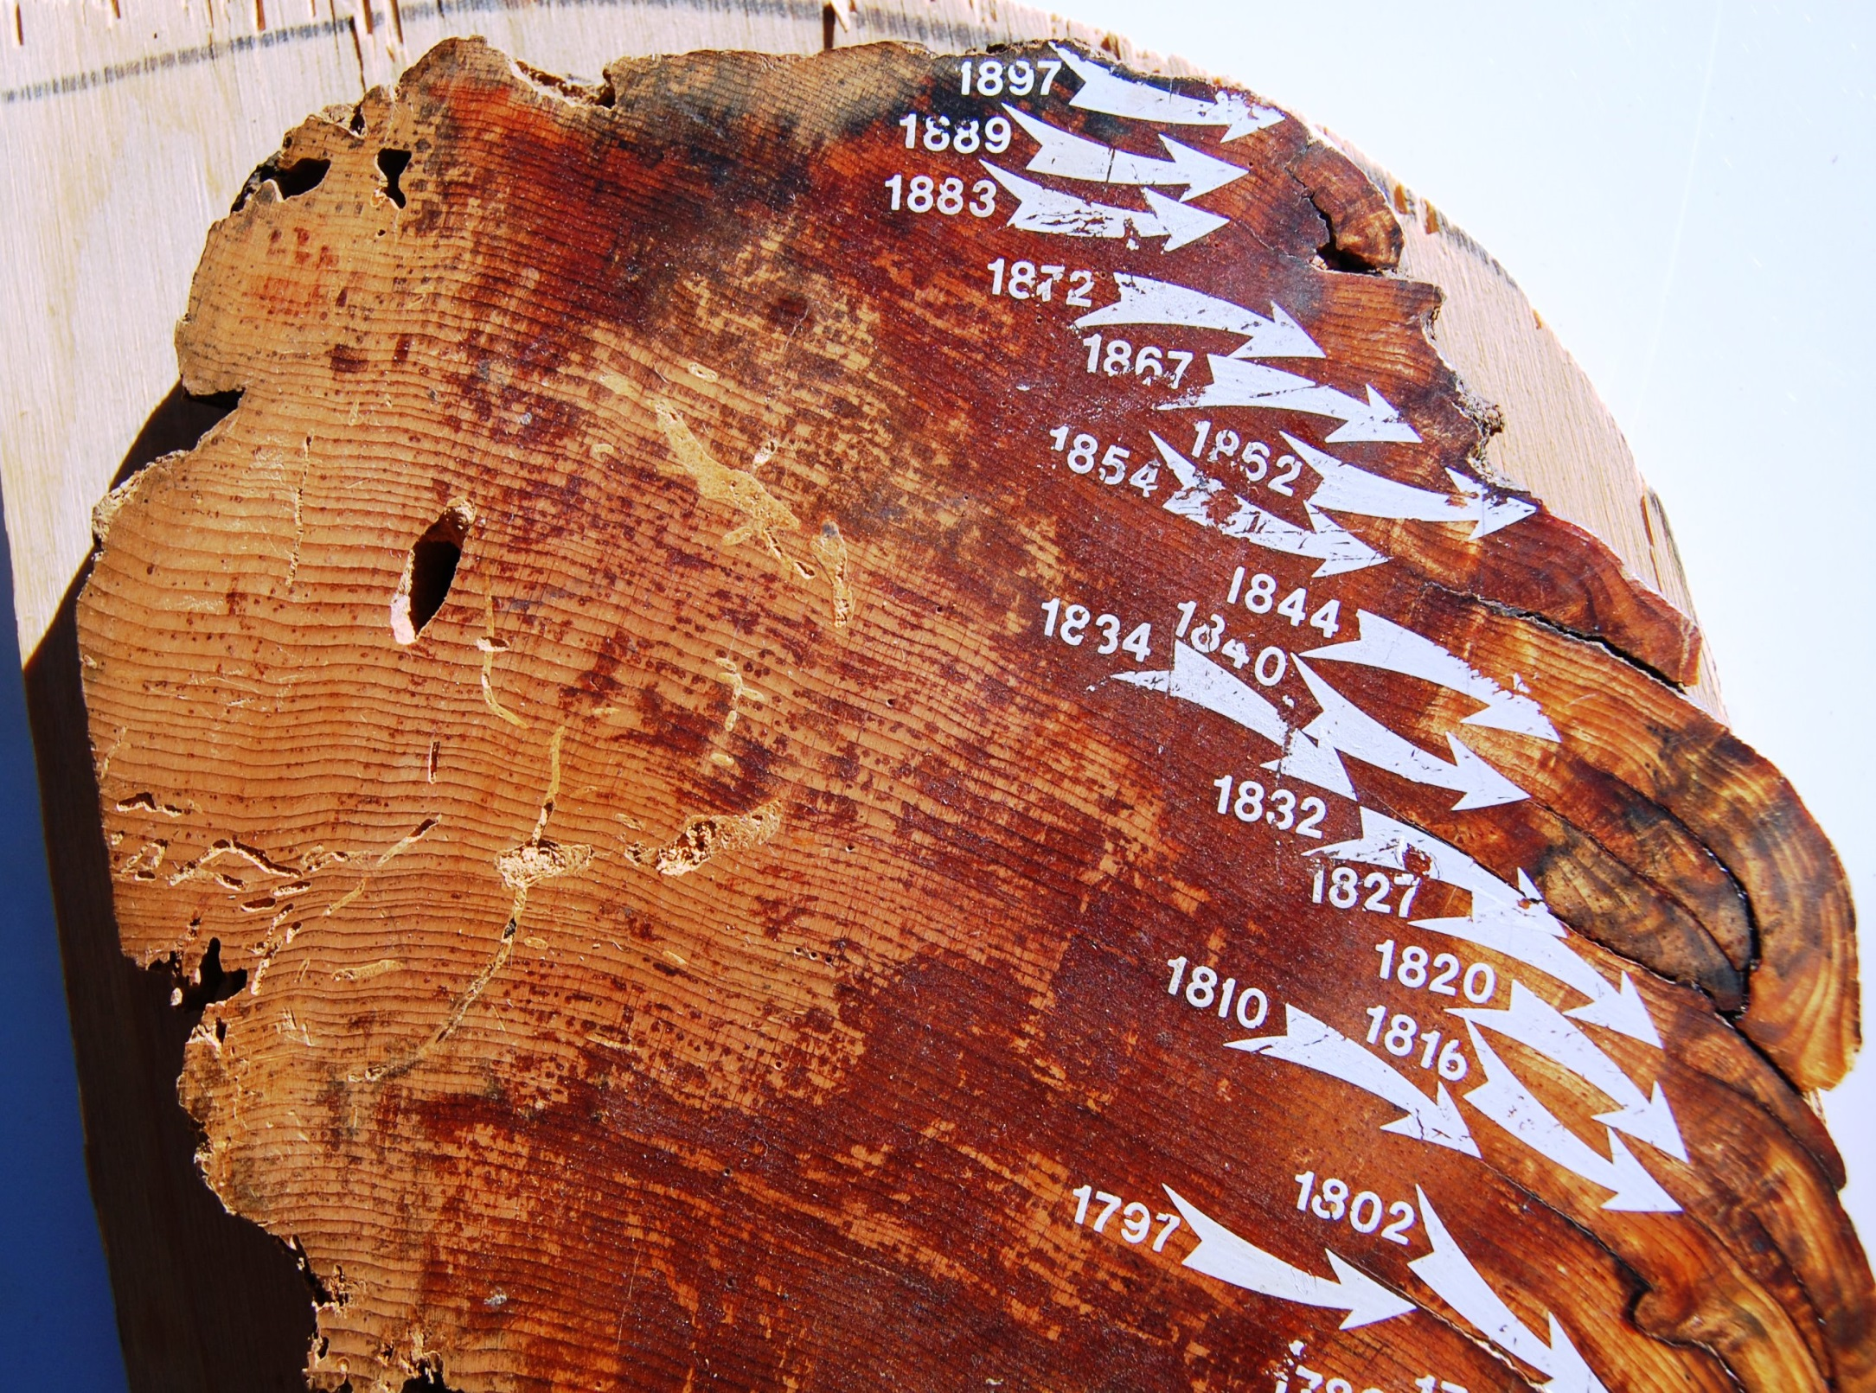
Dendrochronology (tree ring) studies - Past fire frequency can be determined from the years between fire scars on a single tree or on several trees in an area

Slide 5
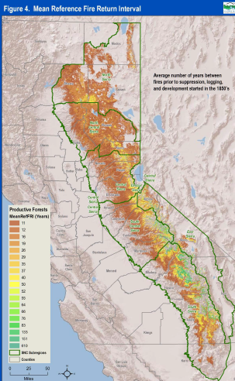
Fire Return Interval
Ponderosa 5 – 12 years
Mixed conifer 8 - 20 years
4.4 -11.9 million acres/ yr -5% - 12% of California’s lands burned annually before settlement
‘‘Of the hundreds of persons who visit the Pacific slope in California every summer to see the mountains, few see more than the immediate foreground and a haze of smoke which even the strongest glass is unable to penetrate.’’ -- C.H. Merriam 1898, Chief, US. Biological Survey

Slide 6
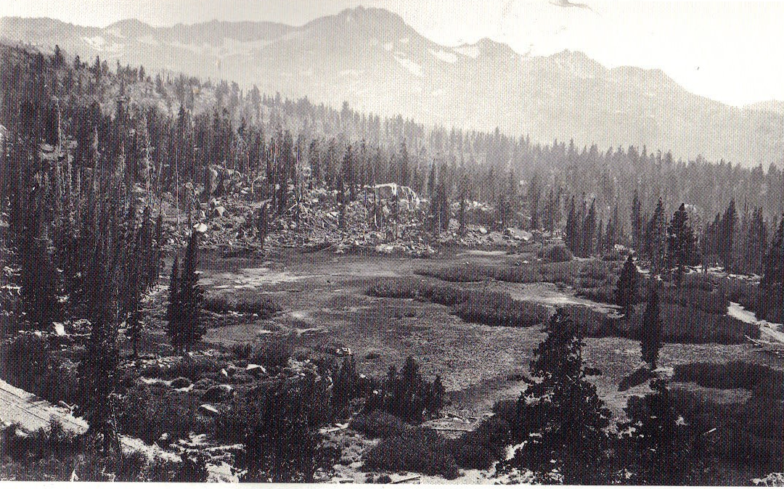
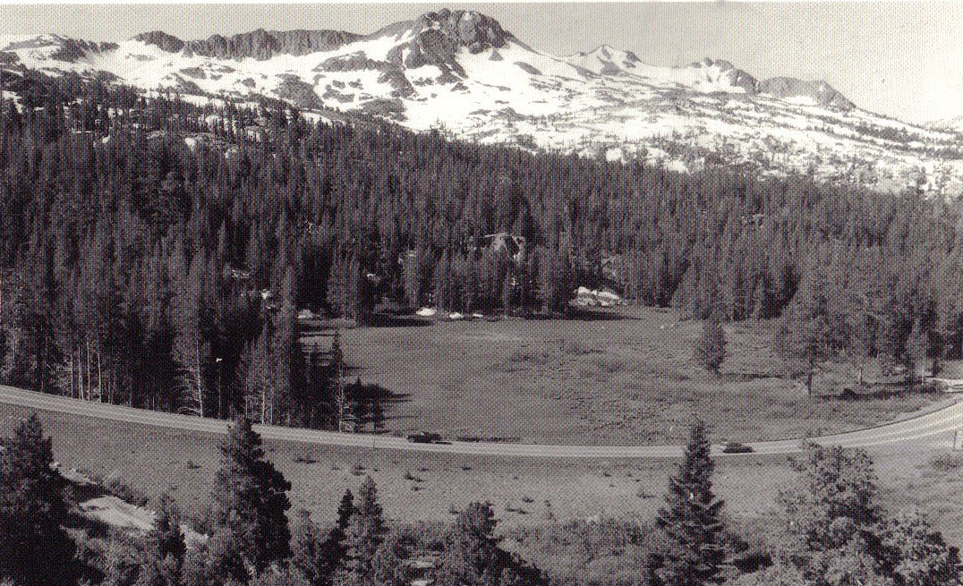
Consequences of Fire Suppression
Carson Pass, Alpine County in 1879 (top) and 1993 (bottom).
Source: Gruel 2001

Slide 7
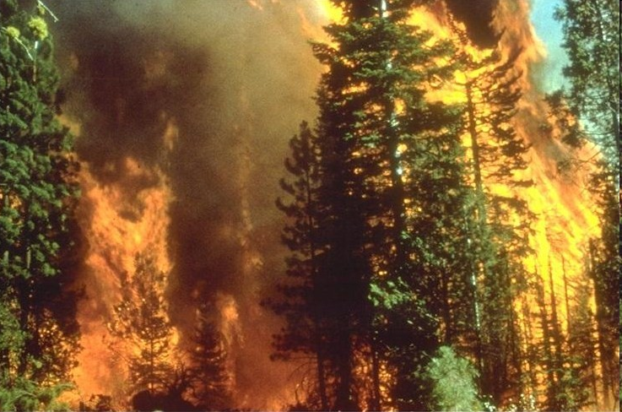
Increase in high severity fires
Forests crowded and unhealthy
Huge build up of fuels
Fires now more likely to be high severity meaning most or all trees are killed

Slide 8
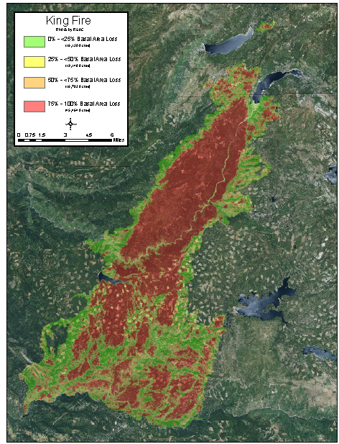
Size of high severity patches unprecedented
35,000 acre patch in 2014 King Fire

Slide 9
Short history on fire suppression
Begins 1905 with formation of the US Forest Service
Big Blow Up of 1910 burned 5 million acres (Montana & Idaho), killed 79 firefighters - USFS decides to stress fire prevention and control fires as quickly as possible.
Light burning controversy in CA – some continued to burn
  Red River Lumber company near Lake Almanor used fire on 750,000 acres Walker family property
1924 USFS researchers concluded light burning was ineffective, impractical, and economically indefensible
1924 California State Board of Forestry adopted the policy of fire exclusion USFS adopted "no burn" policy.
1943, USFS allows exception in southeast for longleaf pine

Slide 10
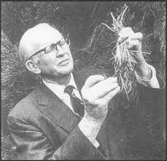
Dr. Harold Biswell
Arrived in California 1947 from Southeast
Professor of forestry UC Berkeley - experience with Rx in long leaf pine
Worked with CA ranchers to develop techniques for Rx fire to kill woody vegetation and promote grasses to increase grazing capacity

Slide 11
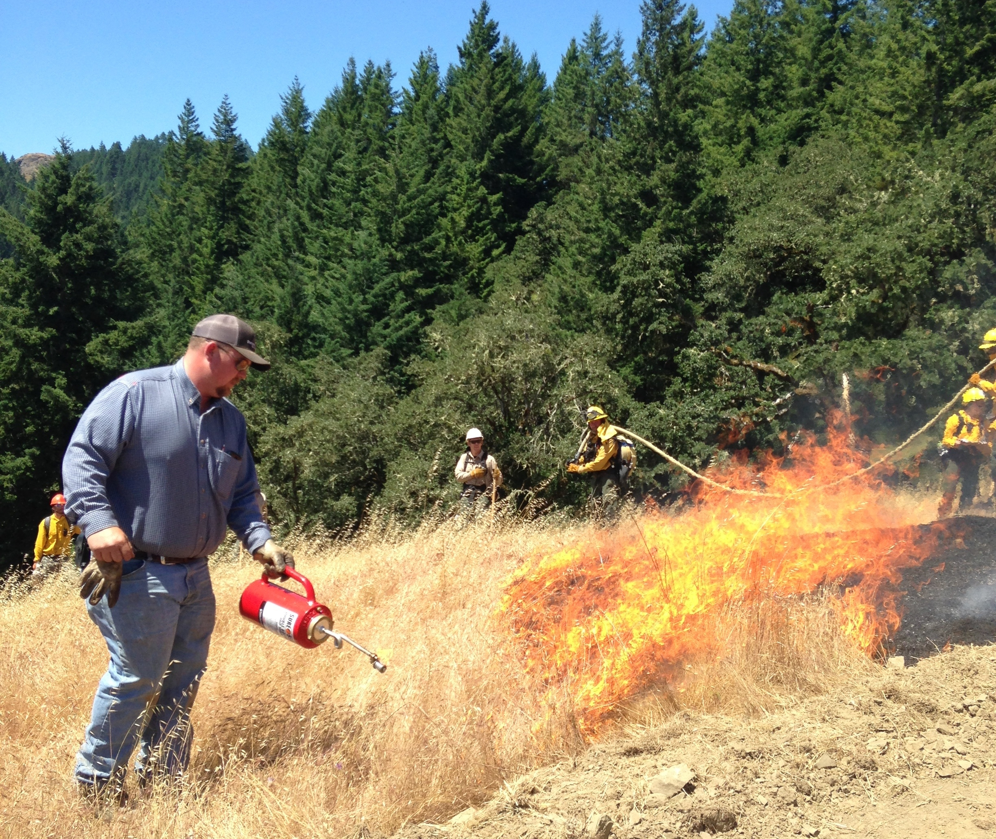
Range improvement burning
1945 first burning permits (CalFire) to conduct Rx fire
Range burning reached peak in 1955 > 200,000 acres burned
Then declined
  more homes were built on adjacent wildlands and
  ranchers were held liable for escape damage
  Still going strong in SE
van Wagtendonk, J. 1995. Dr. Biswell’s Influence on the Development of Prescribed Burning in California. USDA Forest Service Gen. Tech. Rep. PSW-GTR-158.

Slide 12
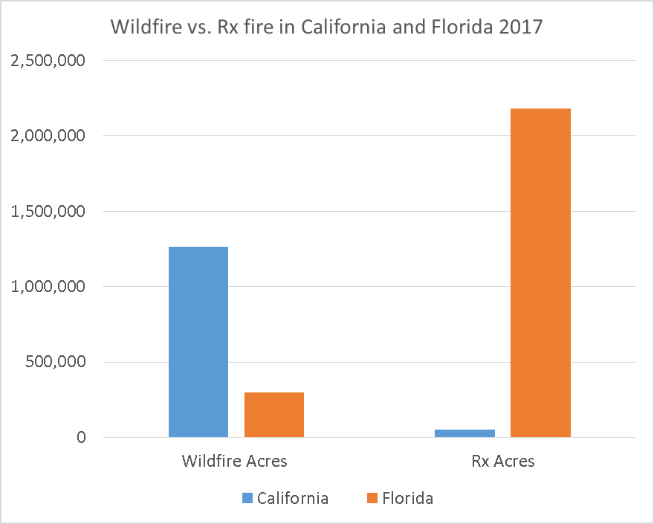
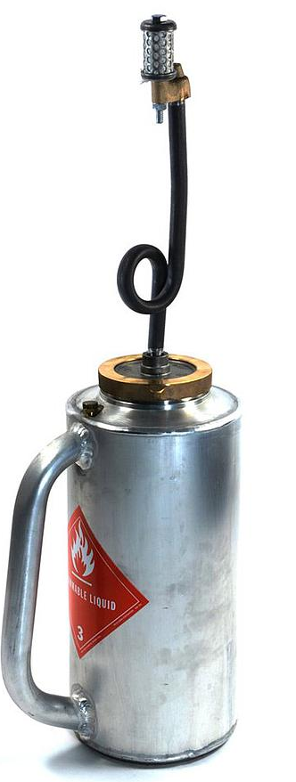

Slide 14
Private lands burning common elsewhere, why not here?
Prescribed fire councils
  Northern Ca
  Southern Sierra
  Central California
  Bay area
Prescribed fire Training Exchanges (TREXs)
  Throughout state
UC Rx fire outreach
Legislative initiatives on Rx fire liability, certification, collaboration

Slide 15
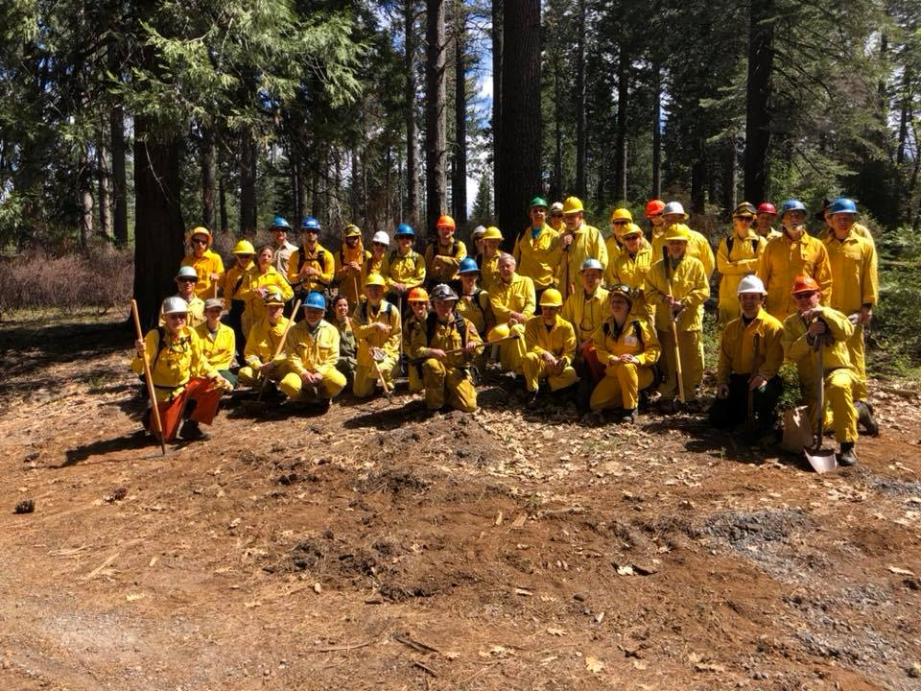
October 2018 burn crew of landowners in October 2018 at Blodgett

Slide 16
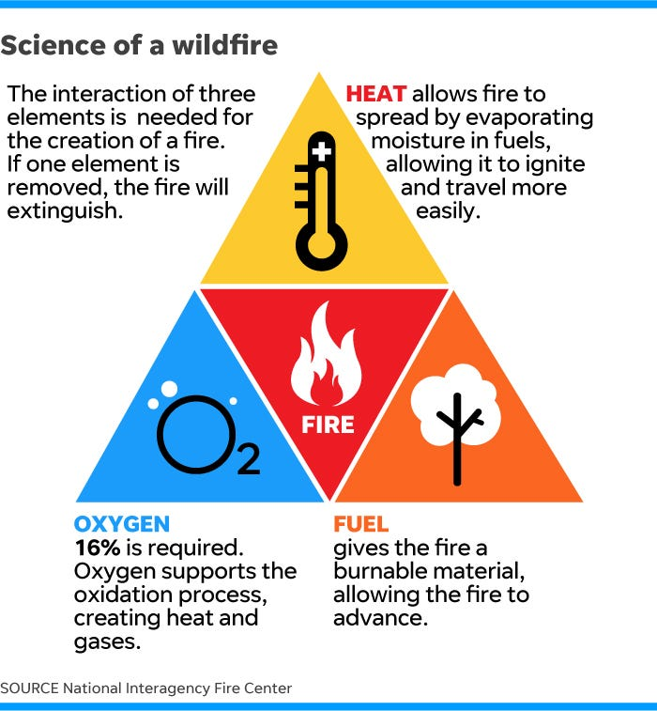
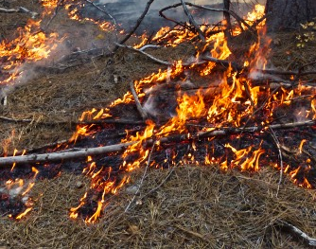
What is fire?
Fire is a chemical reaction that occurs when fuel, oxygen, and heat interact.

Slide 17
What is a fire regime?
How frequently fires burns
  Fire Return Interval – 15–30 years in much of Sierra
  Sierra forests were frequent fire forest before suppression
Fire size
  Getting larger since fire suppression effective in mildest fire weather
Energy release of the fire
  Fire intensity
How it alters vegetation
  Fire severity – low medium, high.

Slide 18
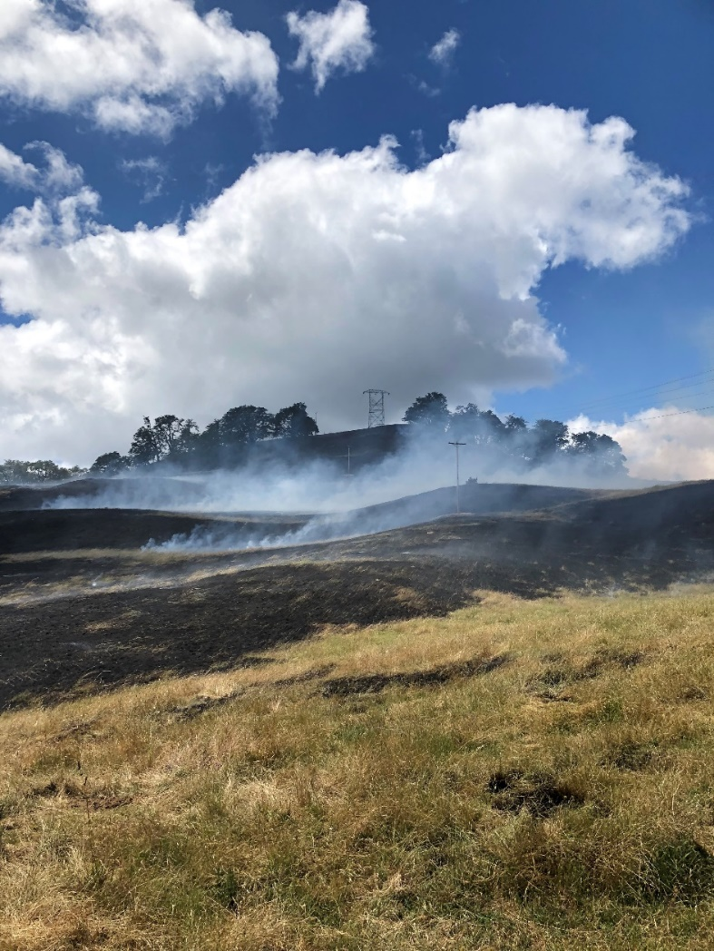
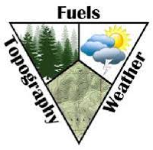
What affects fire behavior?
Fine or heavy
Continuous/ heterogenous
Fuel moisture
Ladder fuel
Canopy cover / base height
Flat or sloped
Aspect
Chutes/ canyons
Wind
Temperature
Relative humidity
Precipitation
Figure: USDA-NRCS, February 2016. Plant Materials Technical Note Report No. 66. Boise, ID

Slide 19
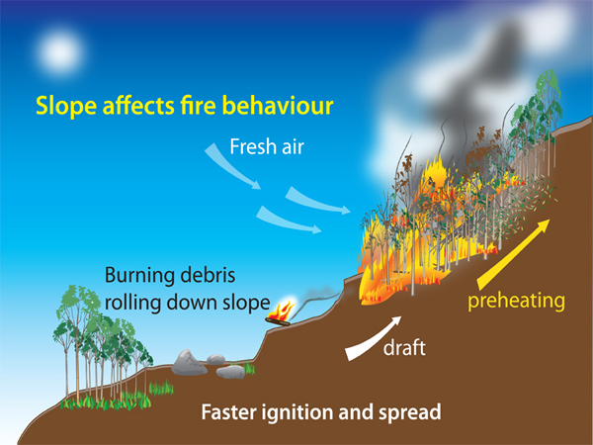
Topography
Flat or sloped
Aspect
Chutes/ canyons

Slide 20
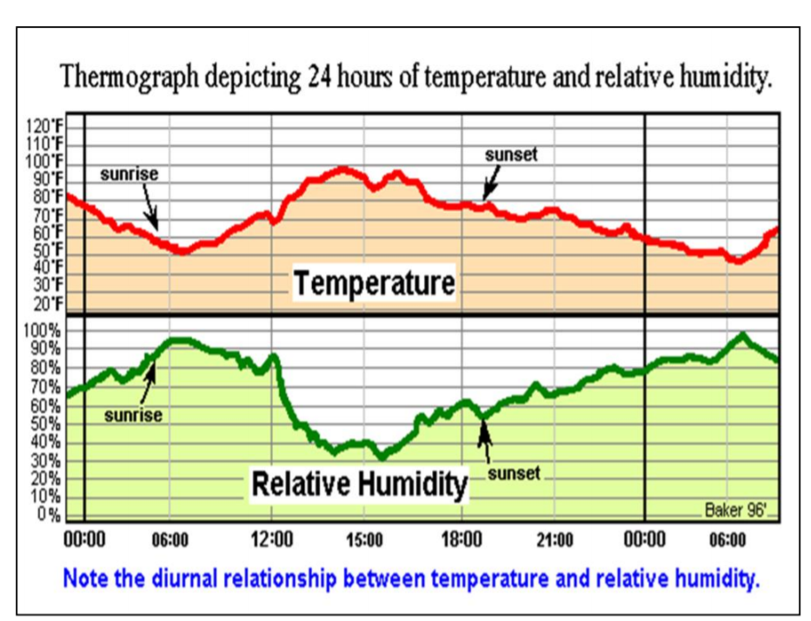
Weather
Wind – Direction of fire spread and smoke transport mostly affected by wind
  Hastens fuel drying, can send spots farther
Temperature – Varies thru day
  Warmer temp speeds burning
Relative humidity – affects fuel moisture
  Less RH increases burning – varies thru day
Precipitation – increases fuel moisture and RH
  Slows down burning

Slide 21
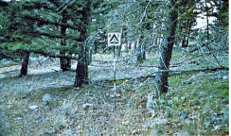
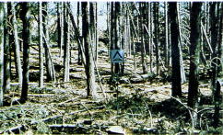
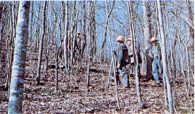
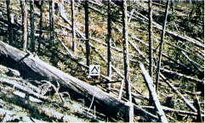
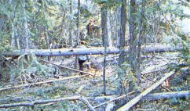
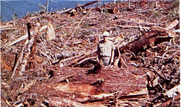
Fuel Characteristics
Loading –More fuel leads to more heat
Fuel size – smaller fuel burns faster/ dries faster
Compactedness – compacted burns slower
Continuity – fuels closer together spread faster
  Ladder fuel carry fire from surface into tree crowns
Fuel moisture – drier fuel burns faster
  Temperature, rain, humidity and shade affect it
  Size of fuel also affects fuel moisture
    1-hour fuels: <1/4 inch in diameter. - twigs, leaves, mulch and litter
    10-hour fuels: 1/4 inch to 1 inch - twigs
    100-hour fuels: 1 inch to 3 inches – twigs/ branches
    1000-hour fuels: 3 inches to 8 inches in diameter – branches/ logs
13 Anderson Fuel Models
Timber
Logging
Slash
8
9
10
11
12
13
Anderson, H. E. 1982. Aids to determining fuel models for estimating fire behavior. Gen. Tech. Rep. INT- 122. Ogden, UT: U.S. Department of Agriculture, Forest Service, Intermountain Forest and Range Experiment Station. 22 p.

Slide 22
Fires can be described in terms of:
flame height
flame length
rate of spread
spotting distance
fire intensity
OR
By descriptions of behavior

Slide 23
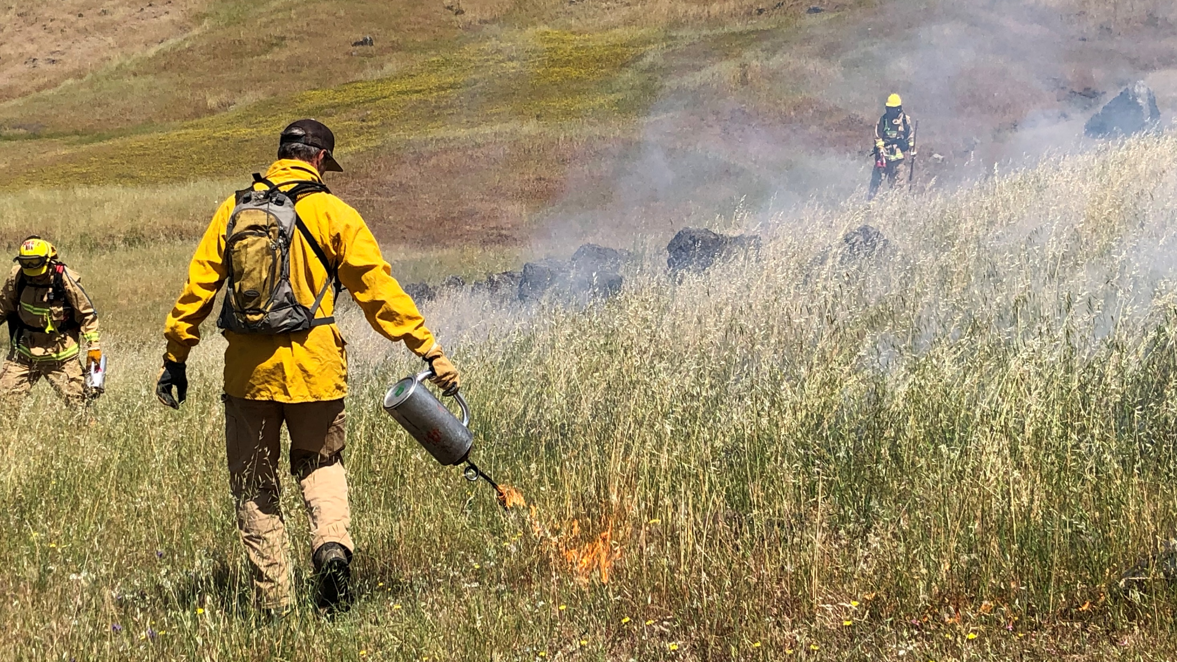
SMOLDERING – Burning without blame and barely spreading

Slide 24
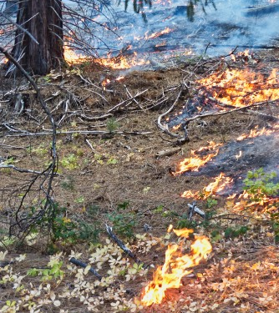
CREEPING
Burning with low flames and spreading slowly

Slide 25
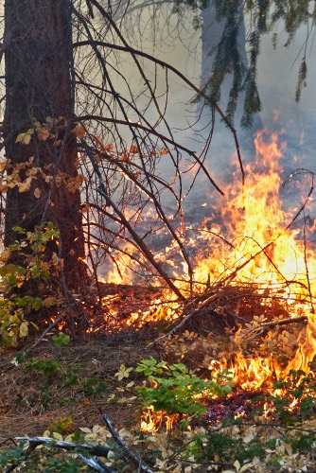
SURFACE FIRE
Low intensity fires that burn on the surface of the ground. The tree canopy may be scorched but does not burn to the extent that it will carry a fire

Slide 26
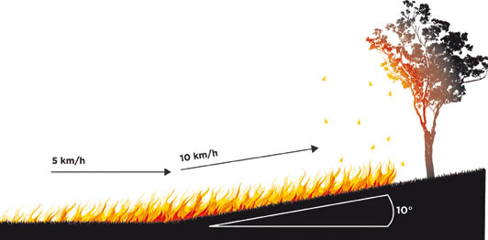
RUNNING
Rapid spread with a well defined head

Slide 27
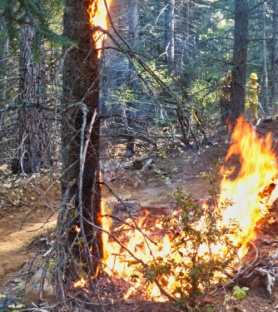
Surface fire transitioning to single tree torching

Slide 28
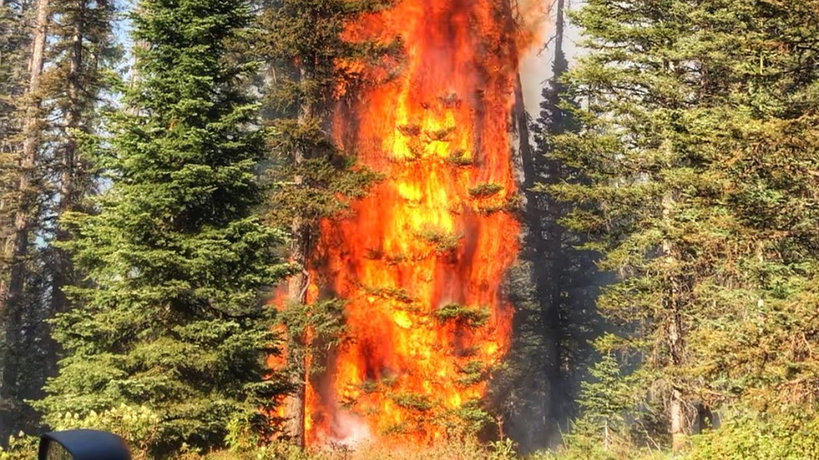
SINGLE TREE TORCHING
Literally one tree burning up – not crowning

Slide 29
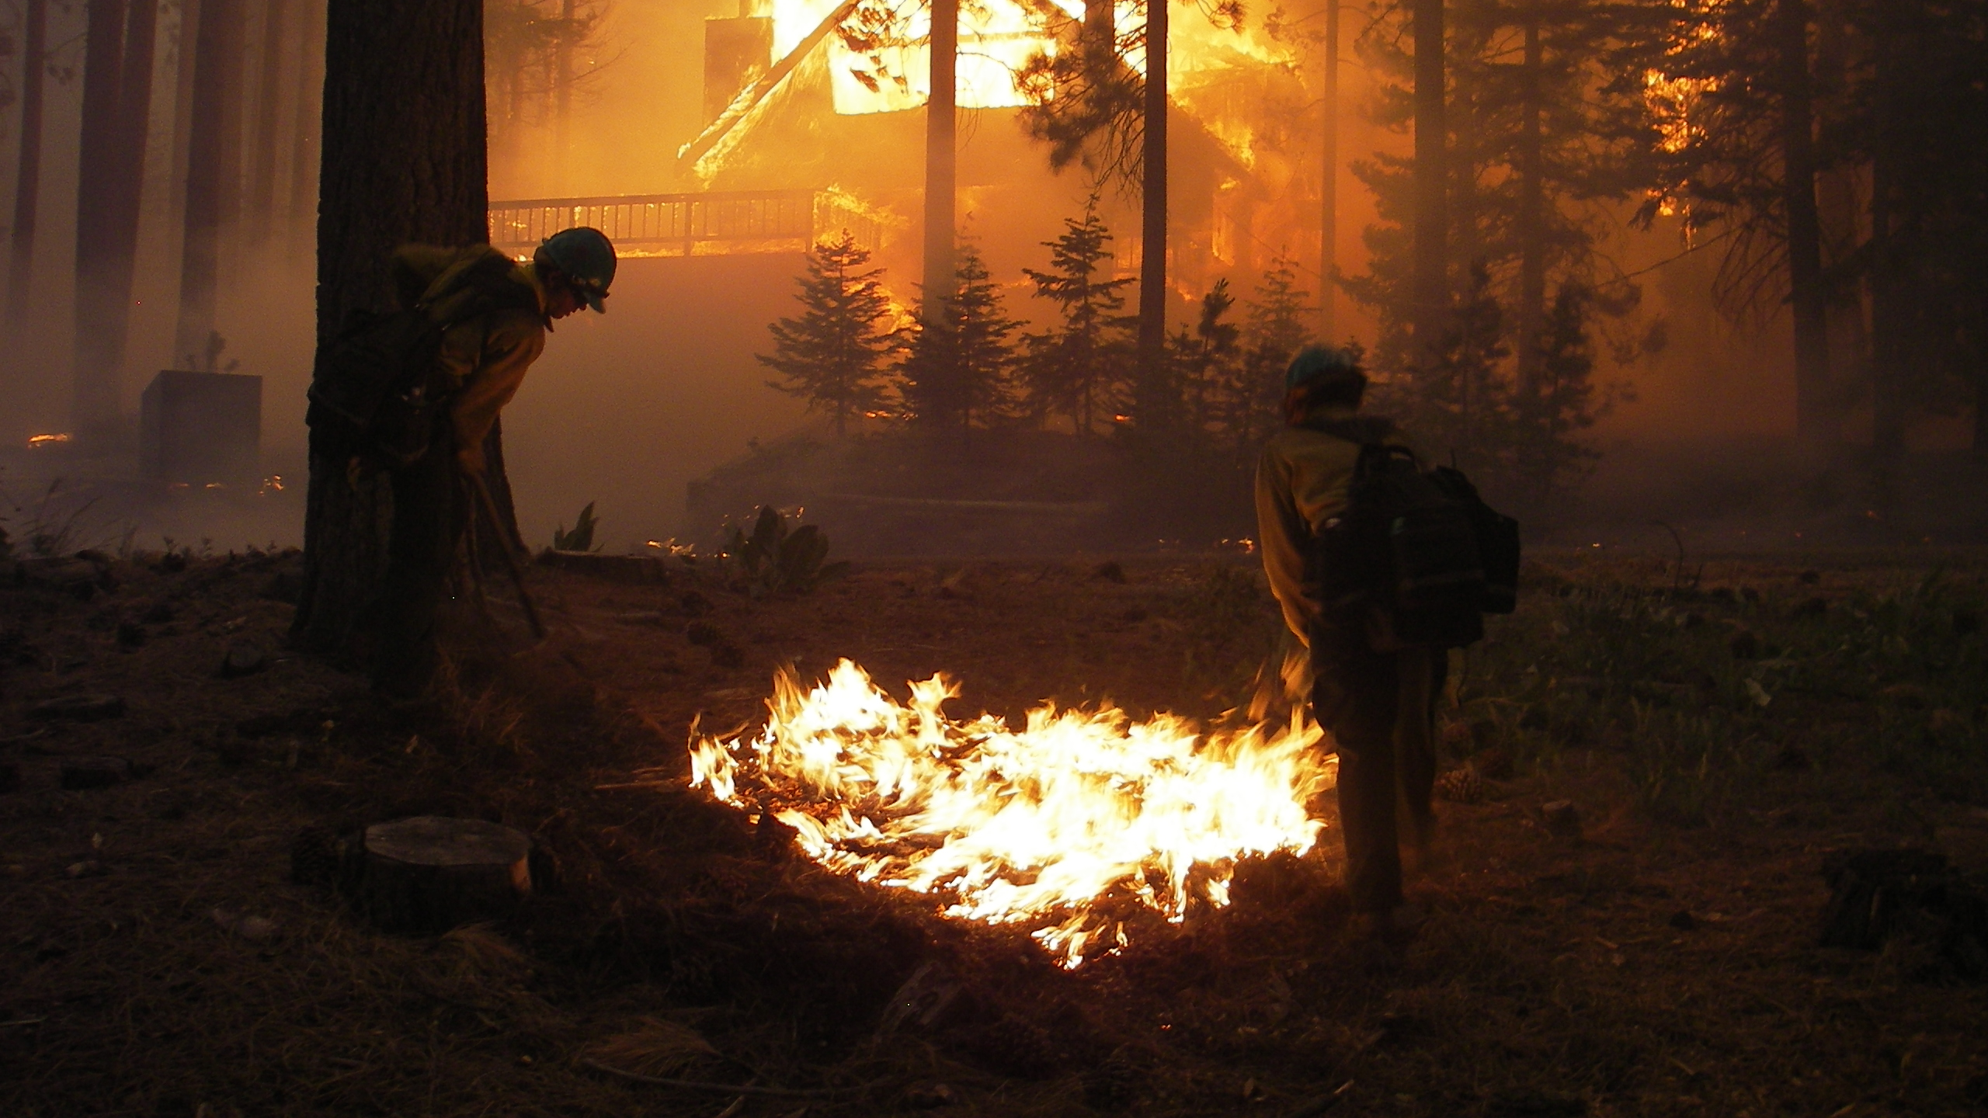
SPOT FIRE
A fire ignited outside the perimeter of the main fire by flying sparks or embers.

Slide 30
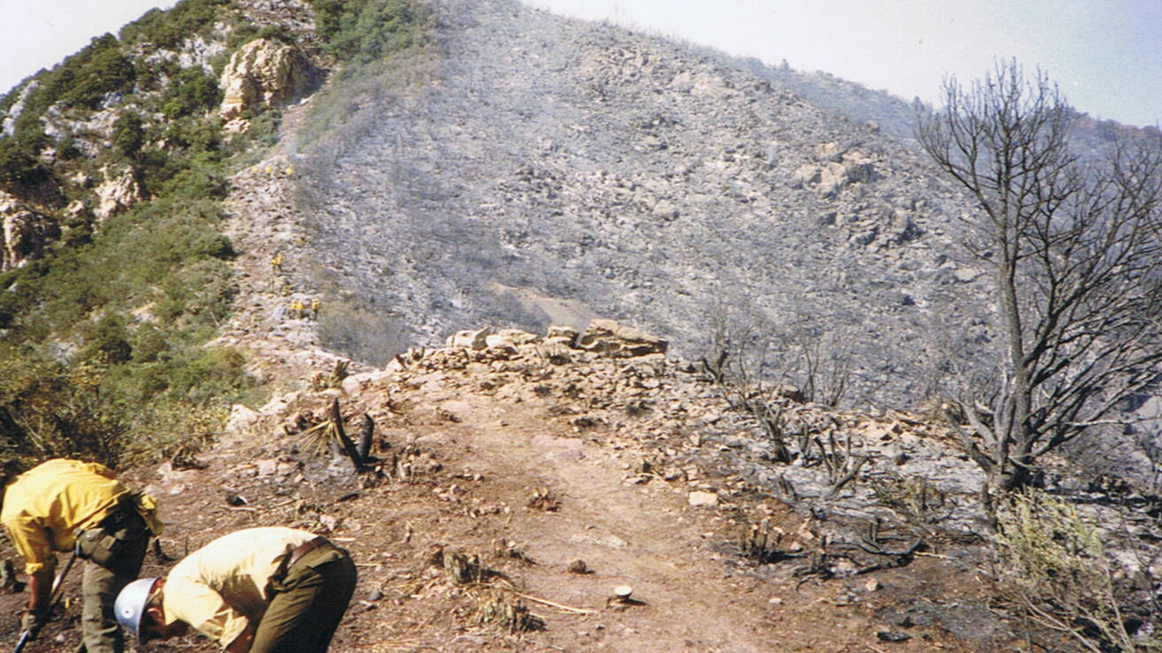
SLOP OVER:
A fire edge that crosses a control line or natural barrier intended to contain the fire.
Photo from Ben Jacobs.

Slide 31
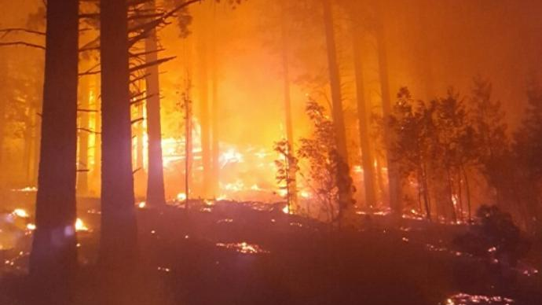
ESCAPE:
A fire which has exceeded or is expected to exceed initial attack capabilities or prescription.

Slide 32
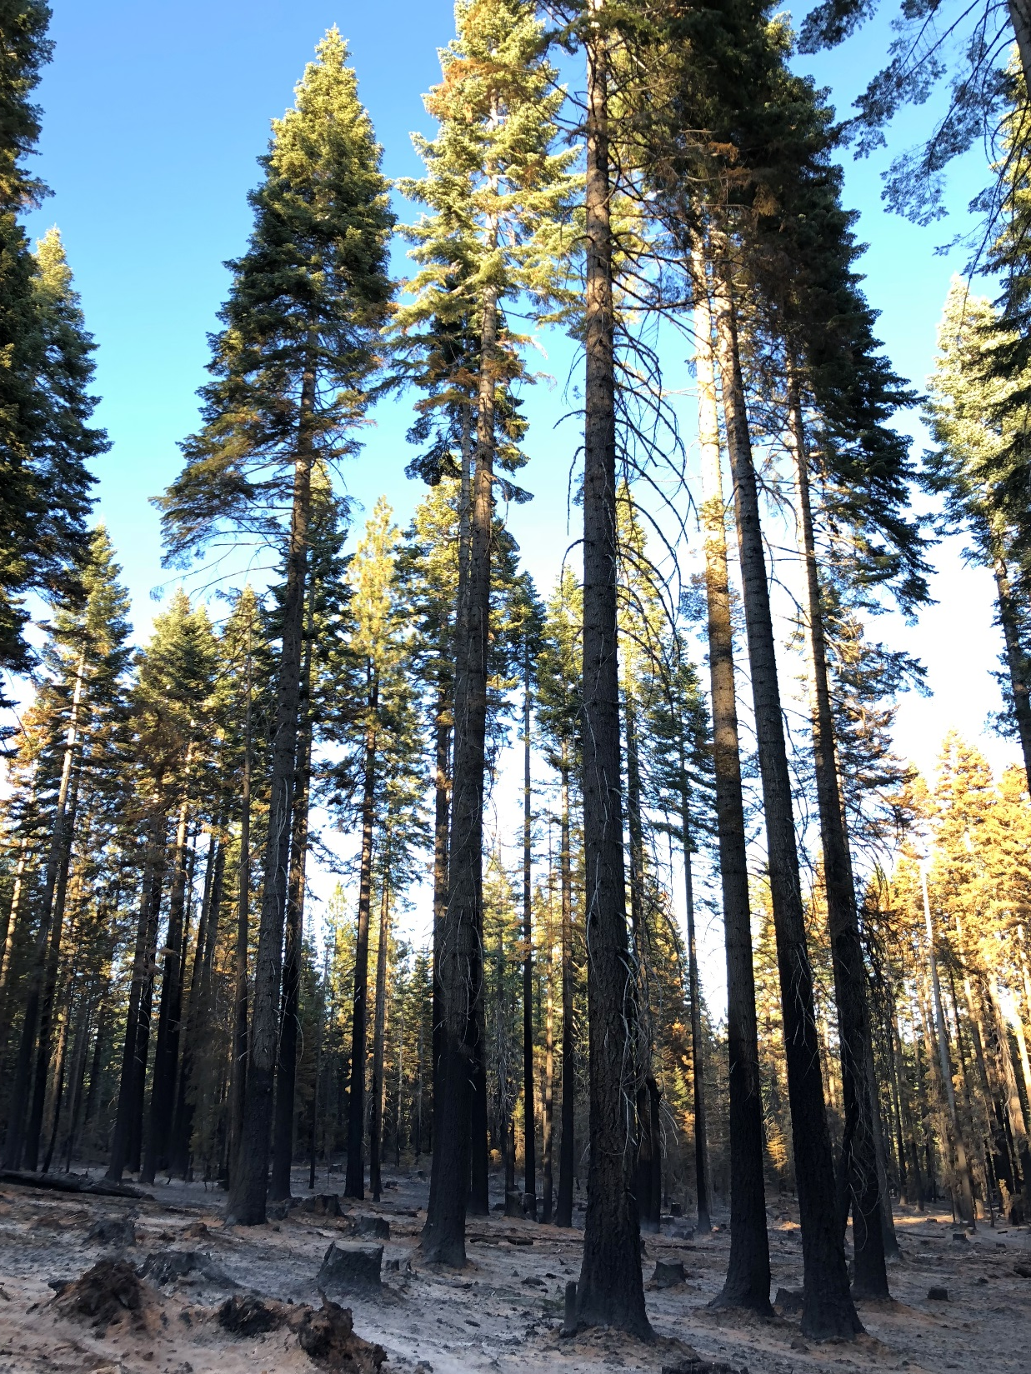
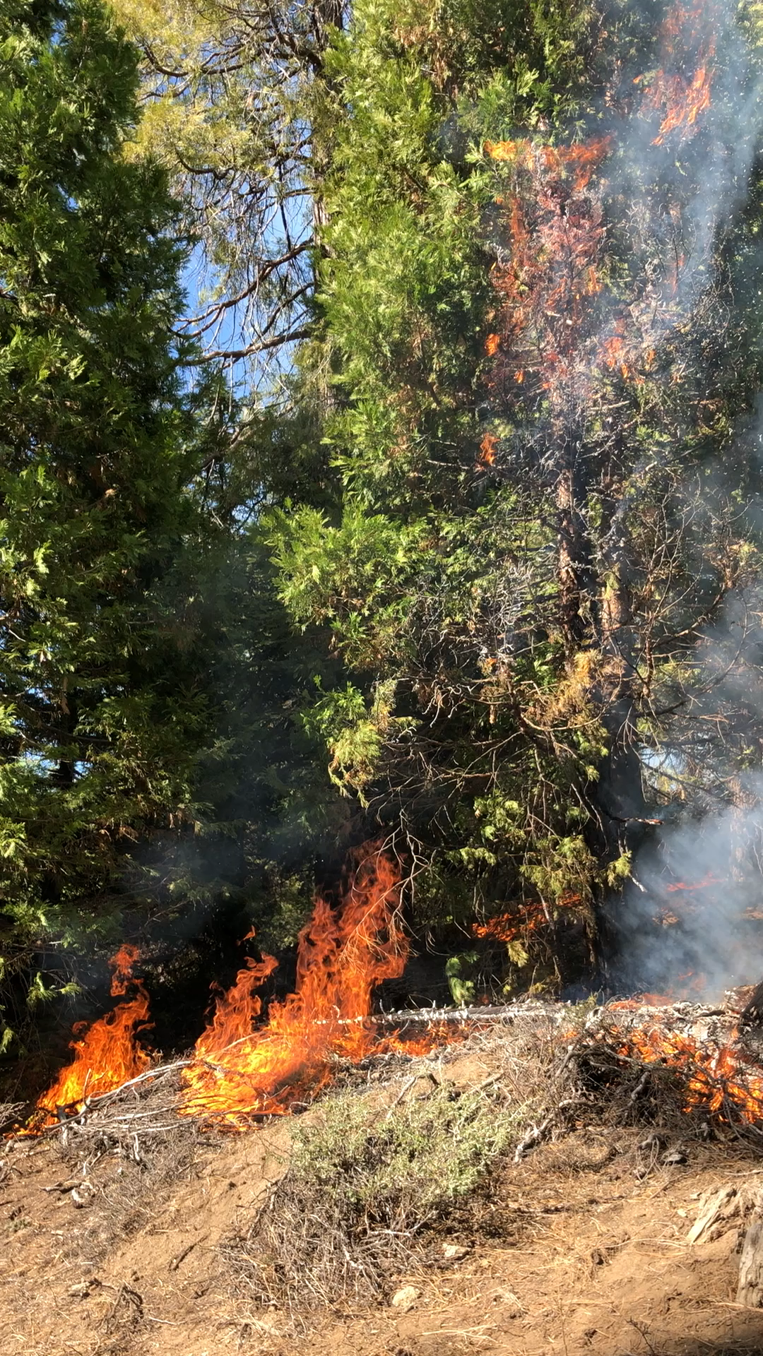
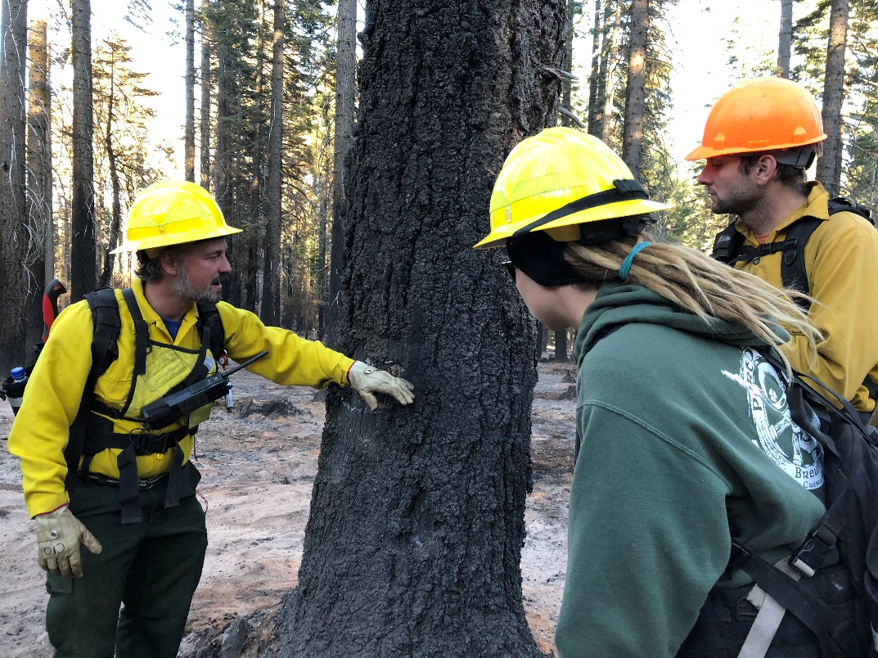
What are a fire’s effects?
Fuel consumption – how much is left
Char height – how high stems are blackened
Crown scorch - percentage of needs scorched
Soil burn severity – areas made hydrophobic
Vegetation burn severity – percentage of trees killed

