Slide 1
Seed Saving and the Cutting Garden
Notes:
Created by Judith Myrick and Ann Beinhorn. Adapted from the Seed Saving PPT created by Judith Myrick and Peggy Beltramo in June, 2018. The first showing of this presentation was January, 2019 for the Roseville Better Gardens Club, announced in club newsletter. Could use the agenda topics for future publicity.

Slide 2
Who Are Master Gardeners?
Master Gardeners of Placer County
Extend research-based, sustainable gardening and composting information
Present accurate, impartial information to home gardeners
Encourage public to make informed gardening decisions

Slide 3
Who Are Master Gardeners?
Where to find us…
Online, in the Media, and Special Publications
Hotline: Call (530) 889-7388 or submit your questions online
Website: pcmg.ucanr.org
Facebook, Twitter, Instagram
Gold Country Media monthly column
Curious Gardener quarterly newsletter; email and on website
Calendar and Gardening Guide
Notes:
Point out hotline number and website. ON HANDOUT!

Slide 4
Who Are Master Gardeners?
Where to find us…
Workshops, Fairs and Festivals and Special Events
Speakers by Request
Workshops (various venues, check website)
Farmers’ Markets (seasonal: Auburn, Roseville)
Fairs and Festivals Booths (varies)
Garden Faire (April)
Mother’s Day Garden Tour (May)

Slide 5
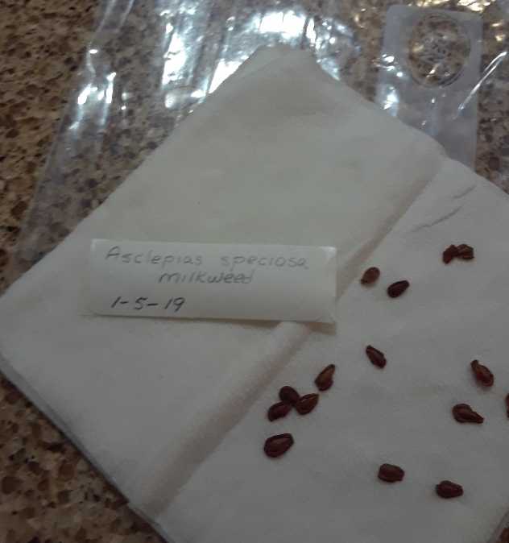

Let’s Look at Your Handouts
Flowering Plants-Germination Requirements
Resources

Slide 6
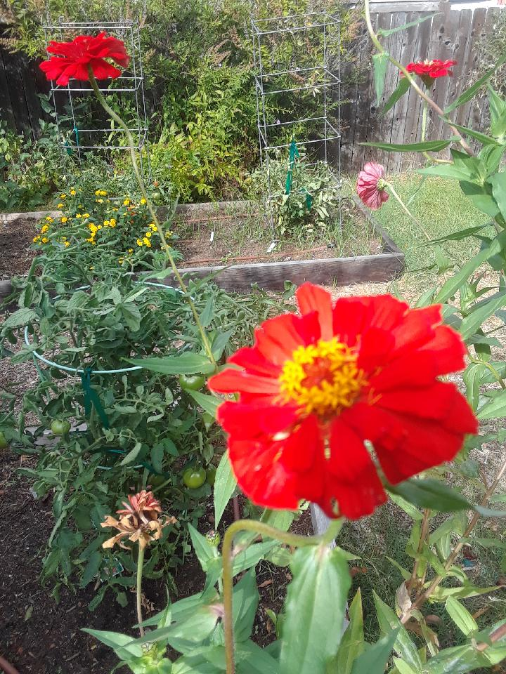
Agenda
Why Save Seeds?
Know your Parent Plant
Basic rules for Seed Saving
Germination Requirements by Species
Notes:
Agenda
Why Save Seeds?
What to save?
Where/When?
How to Save?
How to Grow?

Slide 7
Why Save Seeds?
Pros:
to grow plants identical to the parent plant
to grow locally adapted plants
to preserve heirlooms
to get free seed!
Notes:
Seed saving is the process of saving seeds from open-pollinated fruit, vegetables, grains, flowers, and herbs.
Traditional agriculture relied on saved seed for next year’s crops.
Recent influx of large seed companies
Grow plants identical to the parent plants (which are genetically identical) Hybrid varieties are cross pollinated between two species of a particular genus of plant. The next generation will not come true to those parent plants.Seed library
Plusses
Free seeds
Chosen varieties
Local adaptation
Minuses
Seed crossing—isolation distances
Seed care—Viability

Slide 8
Why Save Seeds?
Cons:
Seed crossing
Isolation distances
Seed care
Seed viability

Slide 9
Know Your Parent Plant
Is it a hybrid or open-pollinated variety?
Saving seeds from open-pollinated plants
will produce plants identical to the parents.
Heirloom seeds are an example.
What happens with a hybrid?
Notes:
Open Pollinated Seeds not hybrids
• Many traditional varieties are open-pollinated. This term is commonly used for what is really controlled pollination, where plants have been in-bred for several generations and have a stable genetic make-up, and out-crossing from different varieties is prevented.
• Seed saved from such “open-pollinated” crops will breed true to type.
Hybrid Seeds
• Many varieties of vegetables and fruits are “hybrids”. This is often designated by a F1 appearing after the variety name. Hybrid varieties tend to have favorable characteristics like high yield, good color, disease, or fruit uniformity.
Hybrids are produced from crosses between two distinct, inbred parent lines. The seed from hybrid plants is not usually saved for future plantings, because it does not produce plants that are true to the original hybrid variety you planted
annual vs. biennial
* Many vegetables are annuals, which produce their seed in one year. Annuals, such as tomatoes, lettuce, beans and peas are good candidates for your first seed-saving project. They are generally self- pollinating, and their seeds will produce plants like the parent plant.
Source: http://extension.umass.edu

Slide 10
Basic Rules for Seed Saving

Slide 11
Plan Ahead
Determine how much seed you want to save
Plant extra plants
Allow wider spacing than normal so there is good air circulation, which helps retard disease
Strategies to prevent cross-pollination

Slide 12
Plan Ahead
Prevent cross-pollination
One variety of a species
Only one plant to go to seed
Maintain distance between varieties

Slide 13
3 Basic Rules
Let seeds ripen on the plant as long as possible
Dry seeds well
Store seeds in a cool, dark place in sealed containers at 34-41 degrees F

Slide 14
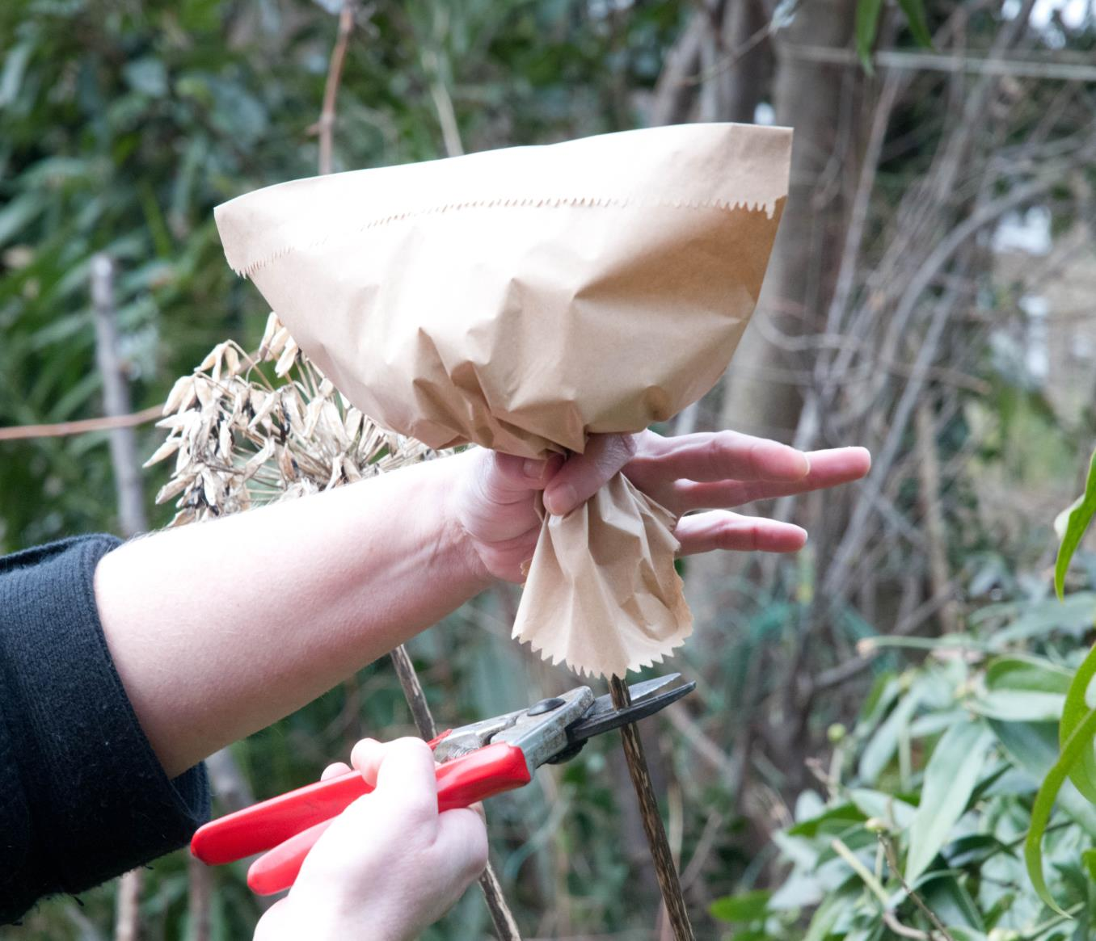
Bag Fragile Seeds

Slide 15
Seed collection
Prevent inbreeding: Try to collect flower seeds from at least 6 plants.
Hand pick delicate seeds with caution and dry on screens.
ex: columbine, delphinium, salvia, pansy, petunia, zinnia
Extract seeds by drying, threshing, rubbing or flailing & store in sealed containers, 34-41 degrees F.

Slide 16
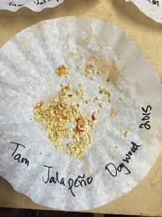
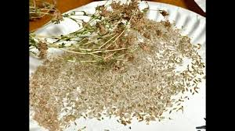
Seed preparation
Notes:
drying your seeds
Moisture is a seed savings worst enemy. Be sure to finish drying them completely. Drying the seeds thoroughly is extremely important and if it isn’t done well then your seeds are much less likely to germinate next year and are susceptible to mold, fungus and bacteria.
Here are the steps for drying seeds:
1. Spread seeds out on a screen or tray in a warm (not above 95°F), dry place that has good air flow.
2. If there isn’t a lot of air flow, set up a gentle fan near the seeds. 3. Stir the seeds occasionally so that they dry on all sides.

Slide 17
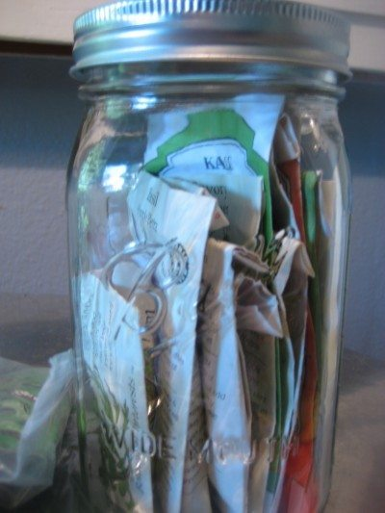
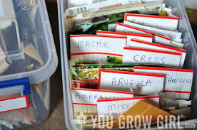
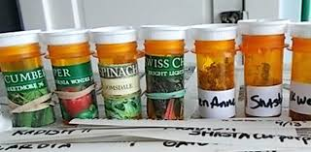
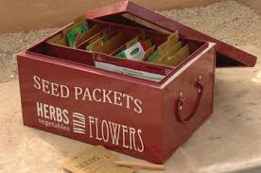
Store Seeds Safely
Cool, dry, dark
Notes:
Recycled containers Fancy collections
label and store your seeds
§ After allowing the seed to dry, funnel the seeds into small paper bags, small glass jars, sealable bags, or other moisture-proof containers.
§ Clearly label with the date, species and the variety.
§ Store your seed packets in a cool, dry, dark location until
you are ready to plant.
§ If stored seed becomes moist and warm, some may begin to germinate or become moldy and contaminated with pathogens. A kitchen freezer is an ideal location for storing seed.

Slide 18
Breaking dormancy

Slide 19
Requirements for Seed Germination
Moisture
Temperature
Oxygen
Light or darkness

Slide 20
Methods to Break Seed Dormancy
Stratification by pre-chilling
Plant outdoors
Keep cool and moist in refrigerator
Imbibition
Soak in running water for 30 minutes
Scarification: Breech the seed coat to let in
water & oxygen
Abrasion
Scratching

Slide 21
Stratification: pre-chilling
-simulates winter
-needs moisture
Plant outdoors in autumn
Notes:
Dry Seed Saving Method
Beans, peas, onions, carrots, corn, most flowers and herb seeds are prepared by a dry method.
•Allow the seed to mature and dry as long as possible on the plant.
•Complete the drying process by spreading on a screen in a single layer in a well-ventilated dry location.
*As the seed dries the chaff or pods can be removed or blown gently away. An alternative method for extremely small or lightweight seed is putting the dry seed heads into paper bags that will catch the seed as it falls out.
*Decant seeds to remove chaff and separate viable seeds
Decanting Seeds
Decanting separates viable (living seeds) from unviable (dead) seeds; often seed savers decant after also soaking or rinsing seeds.
Put the seeds and pulp in a big container and cover with about four times as much clean water.
Put your hand in and rub the pulp and seeds around a bit to loosen things up. Wait a few minutes and you will see that good seeds sink to the bottom and dead, lightweight seeds float to the top.
Skim off the dead seeds and any pulp from the top.
Pour the water and good seeds through a screen or strainer and then start over with new water, following the process another 3-6 times until the seeds are clean.

Slide 22
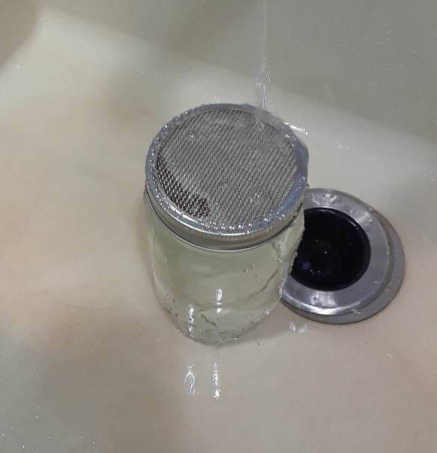
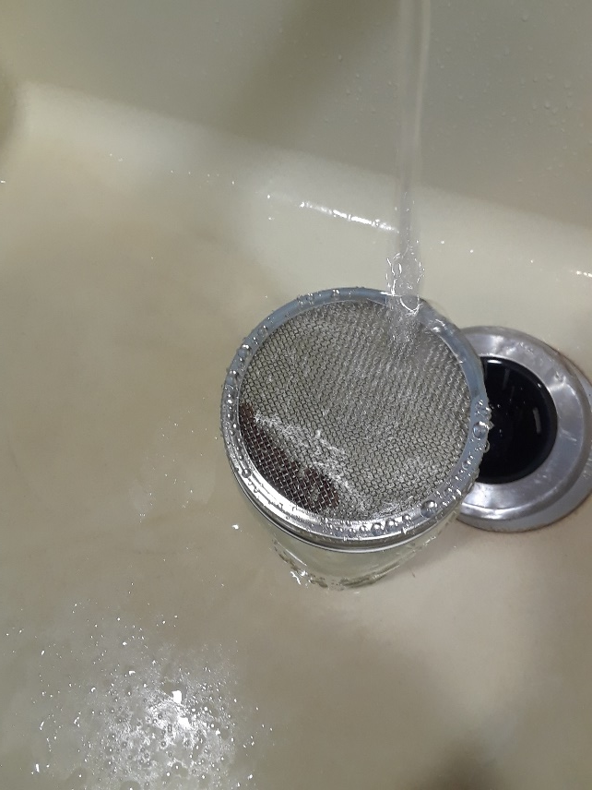
Imbibition

Slide 23
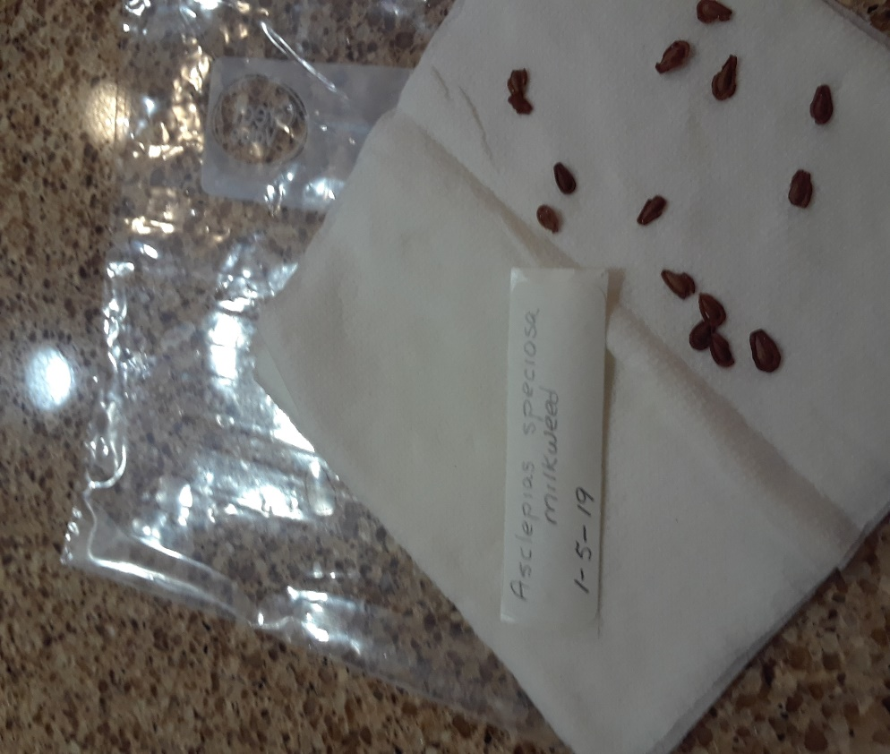
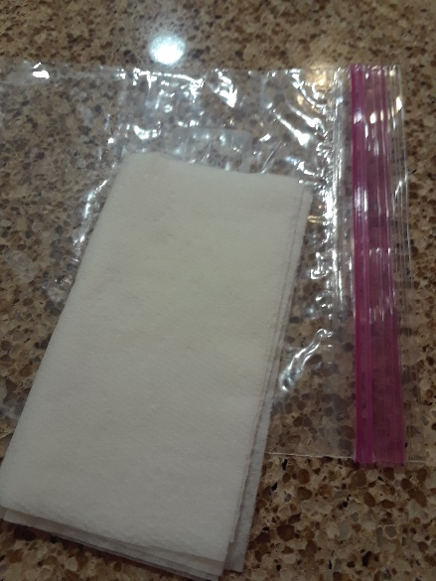
Stratification Cover & Store at 33-41 degrees

Slide 24
Scarification
Breach the seedcoat
Mimic nature

Slide 25
Germination Requirements by Species
Notes:
drying your seeds
Moisture is a seed savings worst enemy. Be sure to finish drying them completely. Drying the seeds thoroughly is extremely important and if it isn’t done well then your seeds are much less likely to germinate next year and are susceptible to mold, fungus and bacteria.
Here are the steps for drying seeds:
1. Spread seeds out on a screen or tray in a warm (not above 95°F), dry place that has good air flow.
2. If there isn’t a lot of air flow, set up a gentle fan near the seeds. 3. Stir the seeds occasionally so that they dry on all sides.

Slide 26
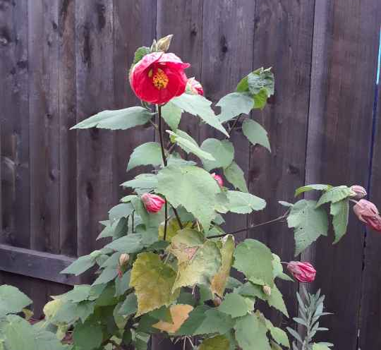
Germination Requirements
Abutilon
Germinate
75 degr., 14-21 days
Seed viability duration
unknown

Slide 27
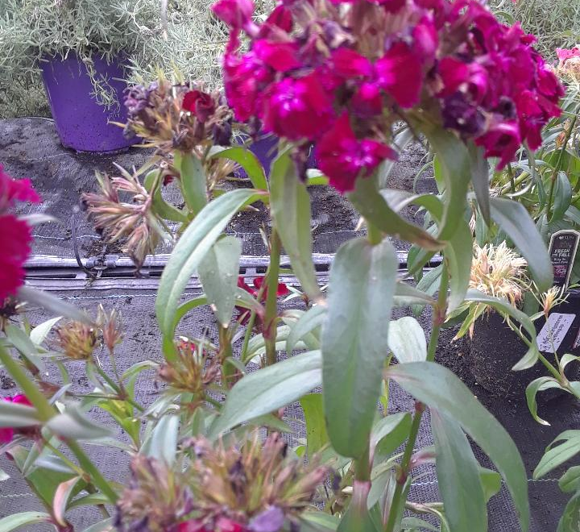
Germination Requirements
Carnation (Dianthus)
Germinate 14-21 days,
60-70 degr.
8-10 yr. seed viability

Slide 28
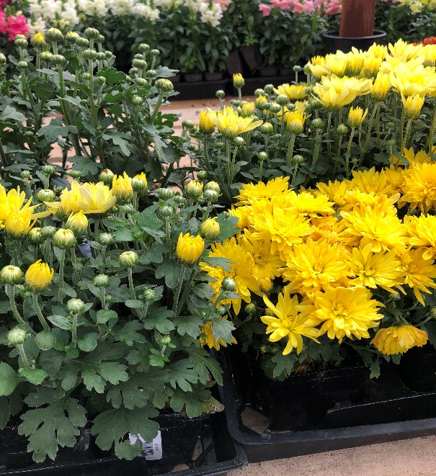
Germination Requirements
Chrysanthemum
May need 1 mo. stratification
Germinates in 14-35 days,
65 degr.
9-10 yr. seed viability

Slide 29
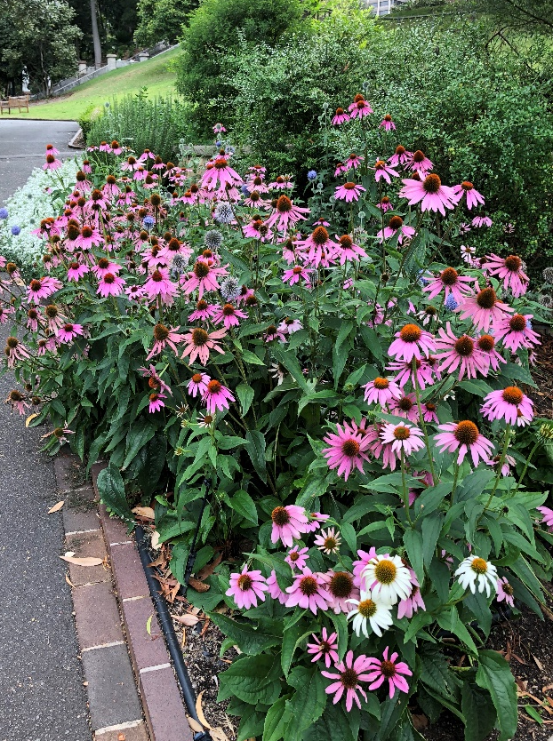
Germination Requirements
Coneflower
20-30 days
in the dark 60-65 degr.
Seed viability duration unknown

Slide 30
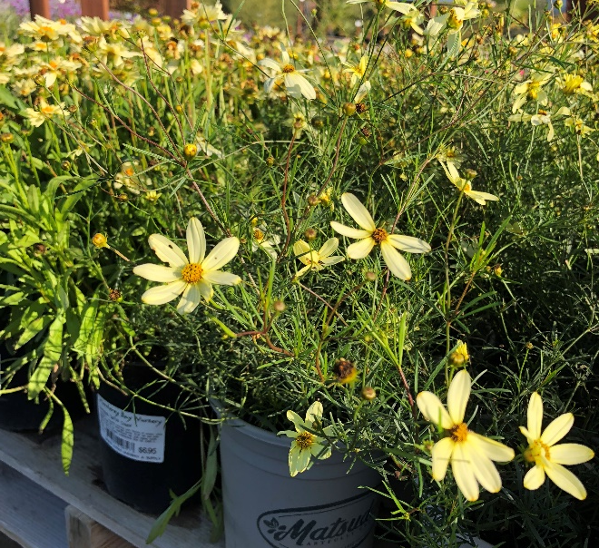
Germination Requirements
Coreopsis
Stratify 3-4 wks;
germinates in 14-28 days
in the light at 68 degr.
6 yrs. seed viability

Slide 31
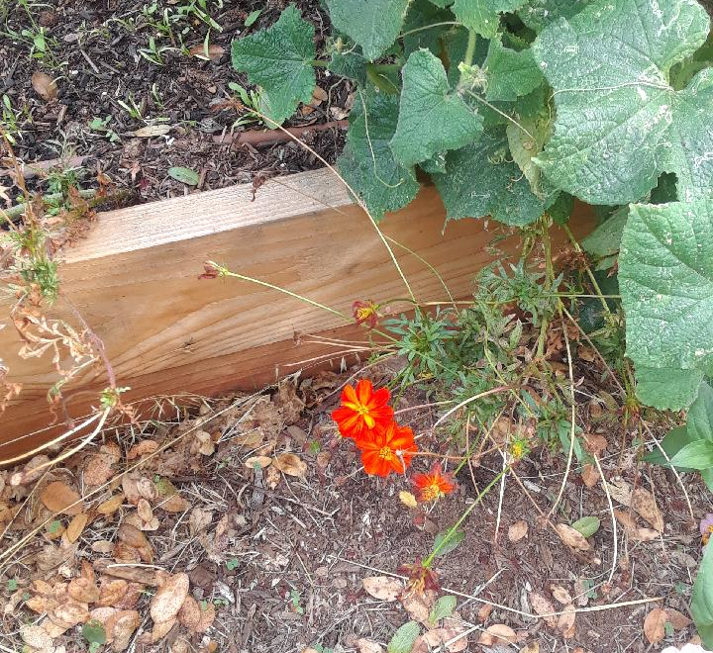
Germination Requirements
Cosmos
Stratify 14-28 days
in light, 70 degr.
5 yrs. Seed viability

Slide 32
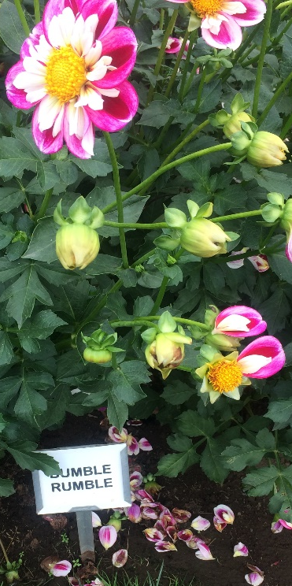
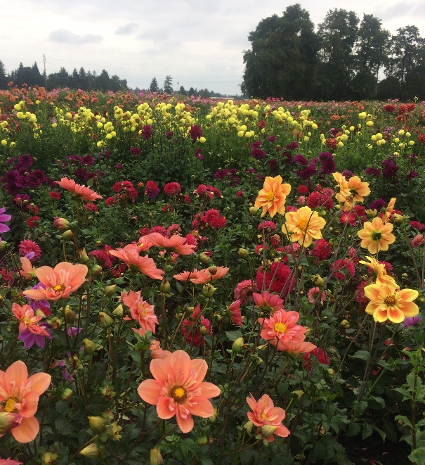
Germination Requirements
Dahlia
Geriminate 10-14 days
at 63 degr.
2-3 yrs. seed viability

Slide 33
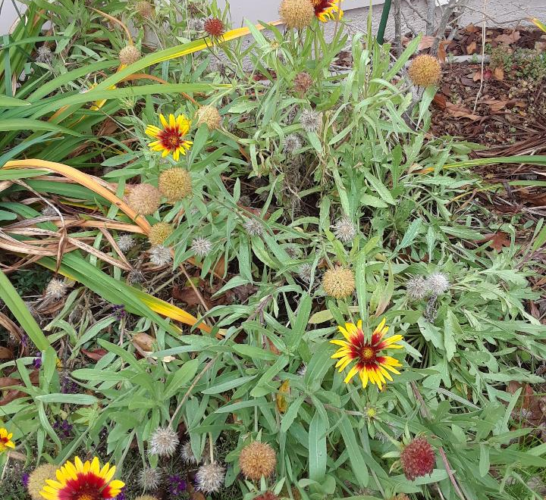
Germination Requirements
Gaillardia
Germinates 14-21 days,
in light,
70-75 degr.
Seed viability 2-4 yrs.

Slide 34
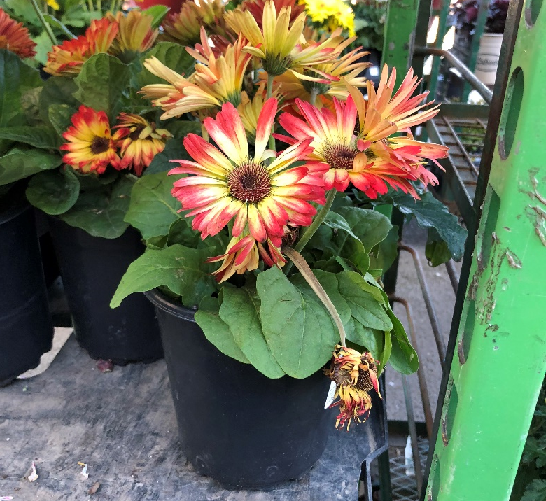
Germination Requirements
Gerbera Daisy
4-6 wks. In sandy, peaty soil,
70 degr.
Seed viability duration unknown

Slide 35
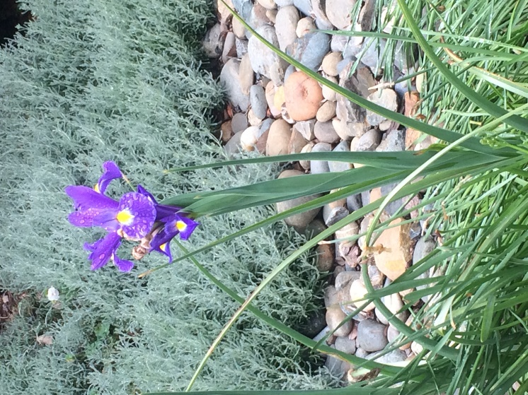
Germination Requirements
Japanese Iris
Scarify w/sandpaper, then
let germinate 1 mo., 68 degr.
then stratify 50 degr.
Seed viability unknown

Slide 36
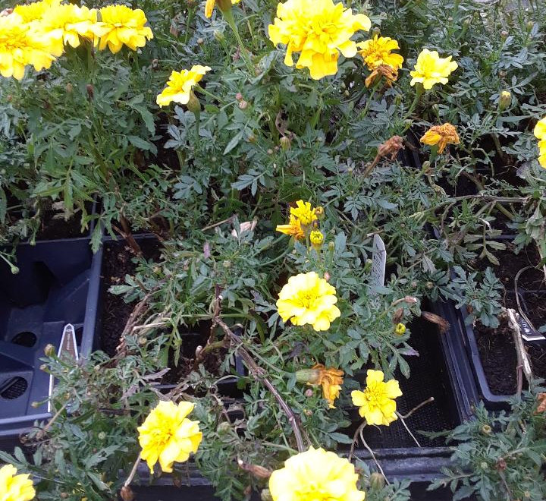
Germination Requirements
Marigold
Requires light,
3-14 days, 74 degr.,
seeds vertical, shallow
5 yr. seed viability

Slide 37
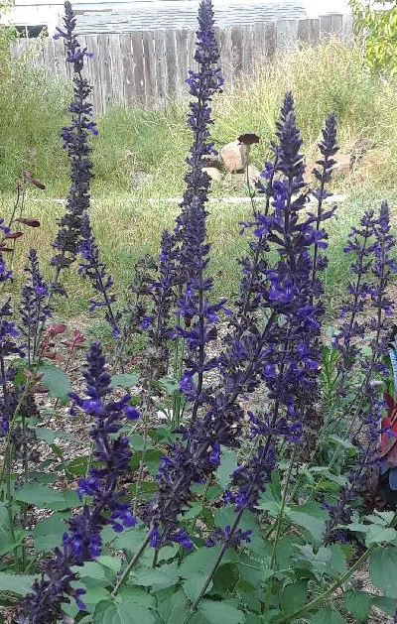
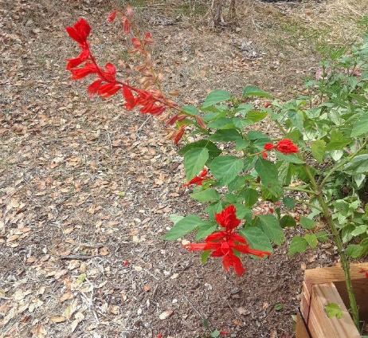
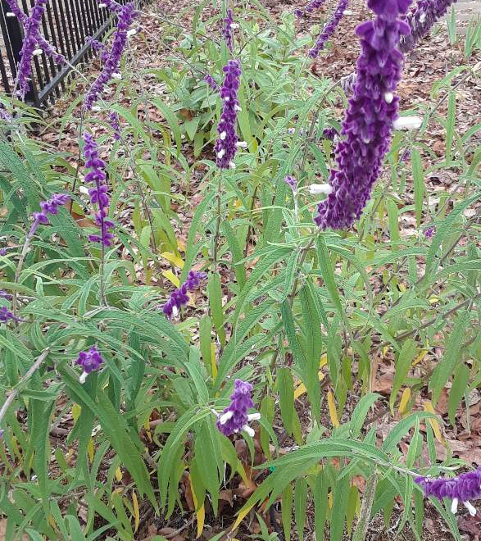
Germination Requirements
Salvia (Sage)
Requires light
3 wks. Stratification
Germinates in
7-21 days,
68 degr.
Seed viability 1 yr.

Slide 38
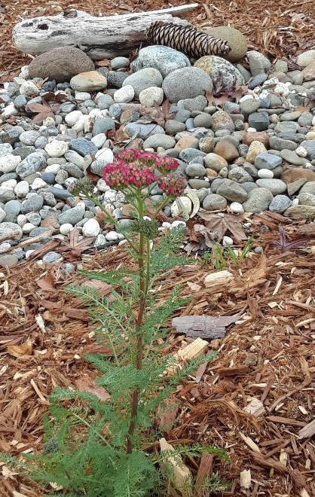
Germination Requirements
Yarrow
Germinates in light,
10-14 days, 68 degr.
4 yr. seed viability

Slide 39
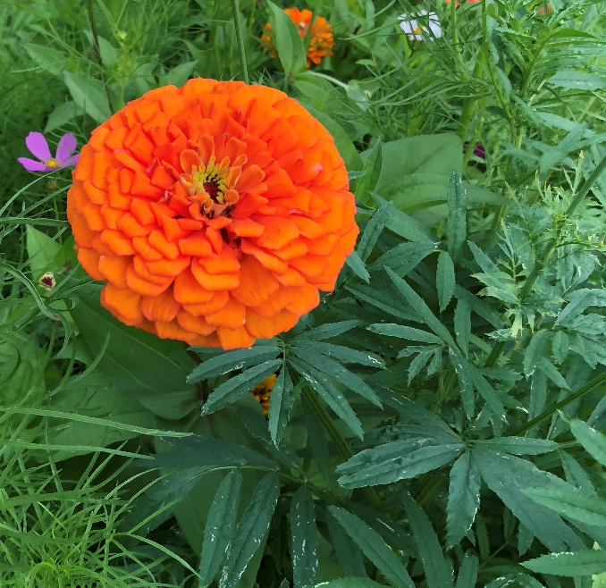
Germination Requirements
Zinnia
Imbibition
30 mins. @125 degr.
Germinates 7-21 days,
70 degr.
2-3 yr. seed viability

Slide 40
Helpful Resources
Books-
Master Gardener Handbook University of California ANR pub 3382
Complete Guide to Saving Seeds, Robert & Cheryl-Moore Gough
Online-
UC Agricultural and Natural Resources:
http://anrcatalog.ucdavis.edu: free publications
http://cagardenweb.ucanr.edu/
Other edu:
https://www.purdue.edu/hla/sites/yardandgarden
http://www.ext.colostate.edu/pubs/garden
http://www.msue.msu.edu

Slide 41
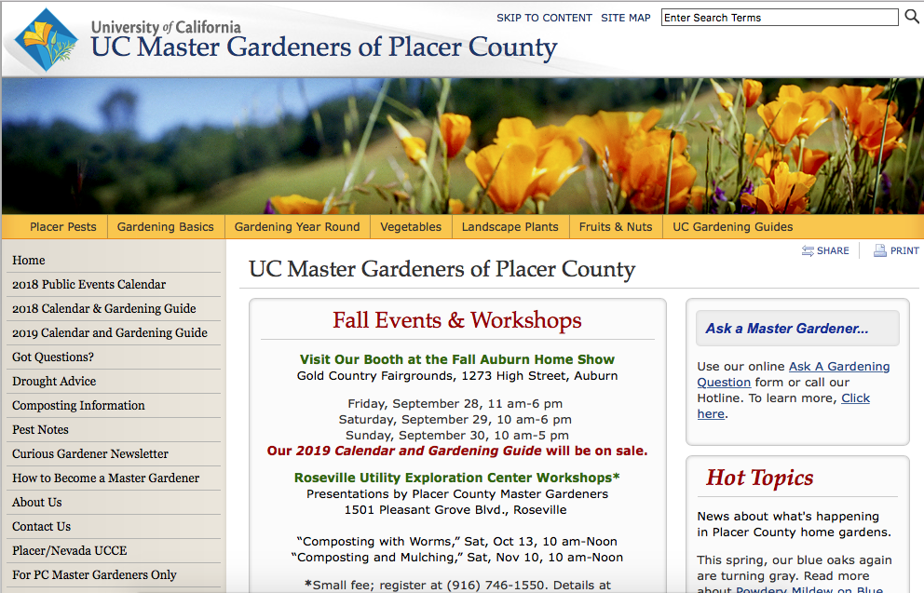

Slide 42
Thank You!
Any Questions?
Master Gardener Hotline: (530) 889-7388
Rot Line: (530) 889-7399
Master Gardener Website: pcmg.ucanr.org
Evaluations, please!

