Slide 1

UCPath
Funding Entry
Notes:
As a division, we are working toward being more intentional about our brand identity >
To help our customers understand who we are and what we do in memorable and easy-to-understand ways; and
To build a more positive reputation for our units and our major initiatives with our customers and stakeholders.
We are in the process of completing brand identity toolkits for all of our units and major initiatives – your units are in the queue as well.

Slide 2
Key Changes:
Position vs. Job, New Codes and Terminology

Slide 3
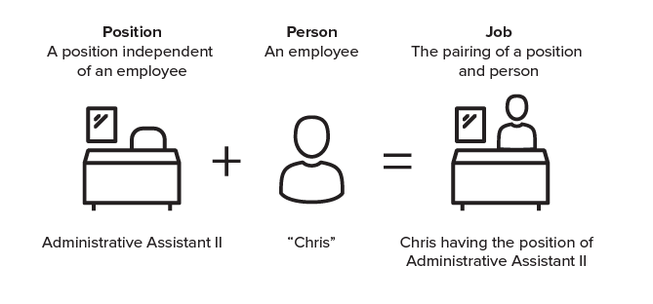
Fundamental Concept: Position
A Position can be either filled or vacant. Vacant positions formerly documented in the Open Provision System will now be documented in UCPath.
A position’s FTE can be different than that of the Job. For example, the position is being held at 100%, however, Chris is a 75% employee.

Slide 4



Approval Today
Today preparers enter transactions into PPS
PAN Reviewers verify transactions after the system is updated.
Transaction
Entry
The system is updated.
Post Authorization Notification
(PAN)

Slide 5
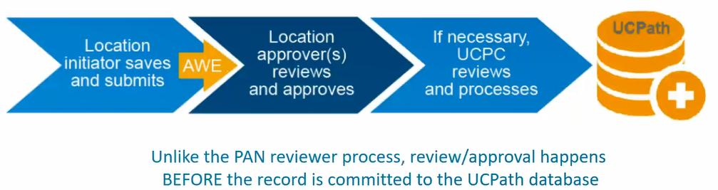
Approval in UCPath:
The Approval Workflow Engine (AWE)
AWE systematically routes UCPath transactions for review and approval at UC ANR before they are sent to UCPath Center for commitment to the system.
UCPath system roles determine user access for initiating and approving transactions.
Initiators cannot initiate or approve their own transactions.
AWE doesn’t replace current pre-approvals of transactions. It is designed to complement the existing Local approval structures and procedures in UC Davis Org/Depts.
Notes:
In UCPath, Approval Workflow will route our UCPath transactions to require and record approvals within the UCPath system. In the current state, PAN Reviewers verify transactions after the system is updated. In the future state, with UCPath, approvers must verify the transactions before the system is updated.
It’s really a validation tool, since the real “approval” from managers and directors happens before the transaction gets to UCPath.

Slide 6
Key Changes - New Codes
Future Code | Description | Current Code | Example
Set ID | DVCMP = UC Davis & UC Davis Health UCANR = Agriculture & Natural Resources | N/A
Business Unit | DVCMP = UC Davis Campus DVMED = UC Davis Health UCANR = Agriculture & Natural Resources | Chart | 3, S, H, L
Employee ID | 12345678 (8) | Employee ID | 219000000 (9)
Position | 40012345 (8) | N/A
HR Department | 040250 Philosophy | Home Department | 040250 Philosophy
Earnings Code | REG, SPD: Some codes change, some stay the same | DOS Code | REG, PDD
Job Code | 007372 | Title Code | 7372
Notes:
There are some fundamental changes coming with the new system. First, with separate security roles, finance users can have direct access to enter and approve funding entry and cost transfer transactions. Managers should consider who in their groups will be granted these roles (users with current access to the KFS SET is a good start).

Slide 7
Funding Entry

Slide 8
Key Changes – Funding Entry & Salary Cost Transfers
Funding Entry and Salary Cost Transfers have separate, unique security roles to enable access for departmental finance staff.
Salary Cost Transfers will be processed in UCPath instead of in KFS
  Fiscal Officers will be responsible for transacting in UCPath for Funding Entry.
Funding Entry on
New Positions
Service Channels
Funding Updates to
Existing Positions
*Fiscal Officers
Salary Cost Transfers
Fiscal Officers
*Service Channels will also make funding updates when needed – such as when the funding change is related to HR actions such as promotions, change to appointment percentage, etc.
Notes:
There are some fundamental changes coming with the new system. First, with separate security roles, finance users can have direct access to enter and approve funding entry and cost transfer transactions. Managers should consider who in their groups will be granted these roles (users with current access to the KFS SET is a good start).

Slide 9
Funding Entry
UC ANR and UCPath team is developing specific training
Funding Entry (used for funding distributions) does not determine if an employee is paid.
Exception employees will be paid as long as there is an active Job record even if the Funding Entry Page is blank or has expired funding. Bi-weekly employees will continue to be paid based on the hours submitted.
Payroll expenses that aren’t associated with funding entry lines will be charged to a default account in the department and expense transfers will need to be made to correct the account.
Funding Entry transactions have approval workflow.
    Transactions require approval prior to being committed.
    There will be one or more people in each department who will be responsible for approving Funding Entries & Cost Transfers.

Slide 10
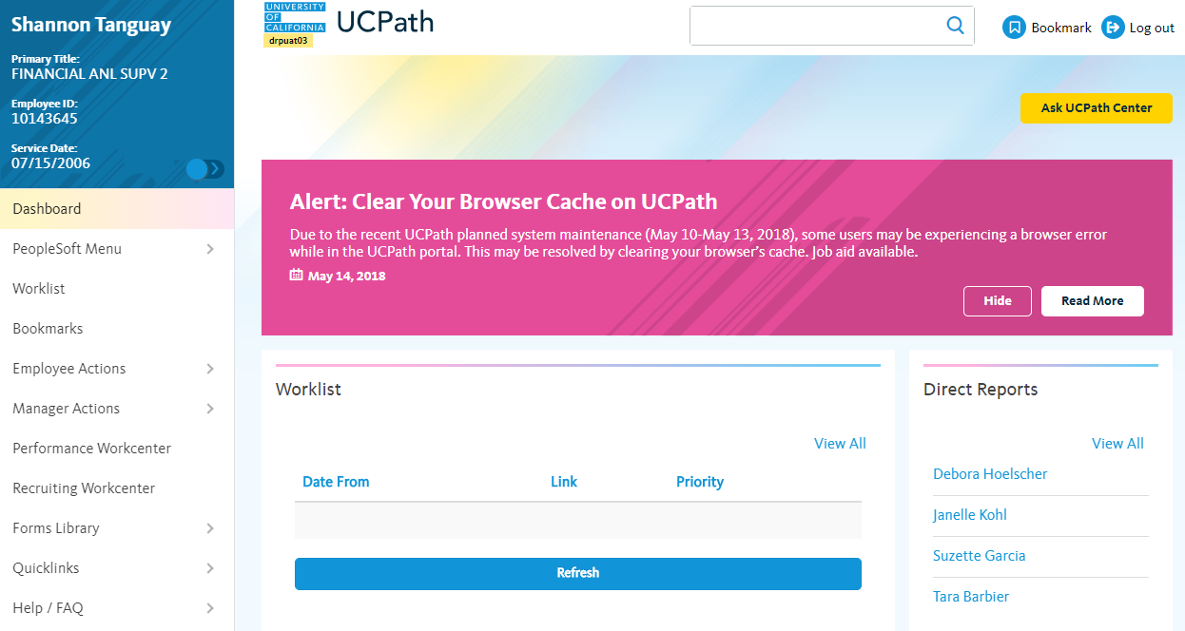
Topics Covered

Slide 11
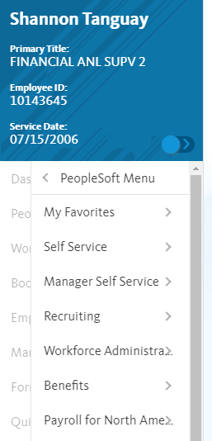
Menu Structure
Drill down to the transaction you need
Expand the menu
Where Do I? Navigation Guide https://ucdavis.box.com/s/sj2w9qlb1lo2cqr2lzb54x731nf0pq82
Set up Bookmarks and/or My Favorites to quickly access the transaction you need

Slide 12
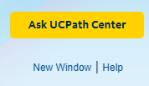
Navigate to a new window
By opening a new window, you can eliminate the left-side navigation and free up more real estate.
Also shows a bread crumb of where you are in the site.
Be mindful that the original tab with the UCPath navigation menus will time out after 30 minutes even if you are actively using the tab that opened when you opened the new window.

Slide 13
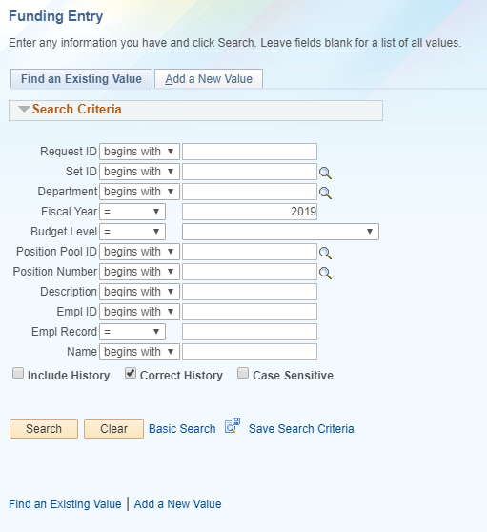
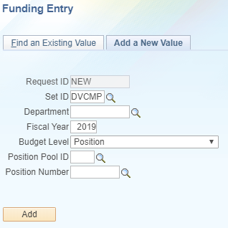
Funding Entry
Default view
PeopleSoft Menu > Set up HCM > Product Related > Commitment Accounting > UC Customizations > Funding Entry
Click Add a New Value
Select default DVCMP for Chart 3 employees
Select UCANR for Chart L employees

Slide 14
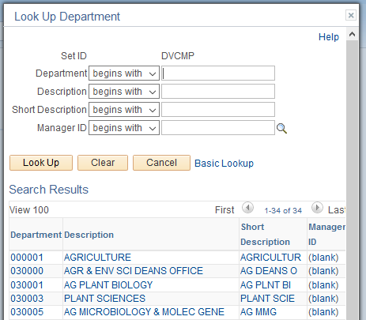
Funding Entry
Certain fields are required.
Within this funding entry lookup, the required fields are:
  Set ID (either DVCMP or UCANR)
  Department
  Fiscal Year
  Budget Level
  Position Number
The department look up allows you to type a portion of the department name to search on or sort by any of the fields such as department description
You will only see departments to which you have been given access

Slide 15
Funding Entry
Fiscal Year: Enter the year based on the period of time you want to change
  2019 = the 2018-19 fiscal year
  2020 = the 2019-20 fiscal year
Budget Level:
  Department – will likely not be used in CA&ES
  Position Pool – will likely not be used in CA&ES
  Position – will be used in CA&ES
Position Pool ID: Only needs to be completed if Budget Level
is set to Position Pool
Position Number is a new field that is equivalent to
Appointment within PPS.

Slide 16
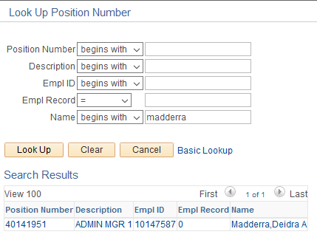
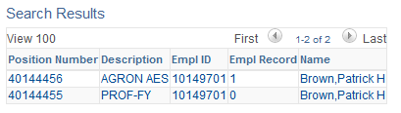
Funding Entry
Look Up Position Number
If you don’t know the position number or the employee ID, you can enter the first part of the person’s last name and select Look Up.
If someone formerly had 2 appointments in PPS, they will have 2 positions in UCPath.
You will need to select the position to which you want to make changes.
Then click Add
xxxxxxxxxxxx
xxxxxxxxxxxx
xxxxxxxxxxxx

Slide 17
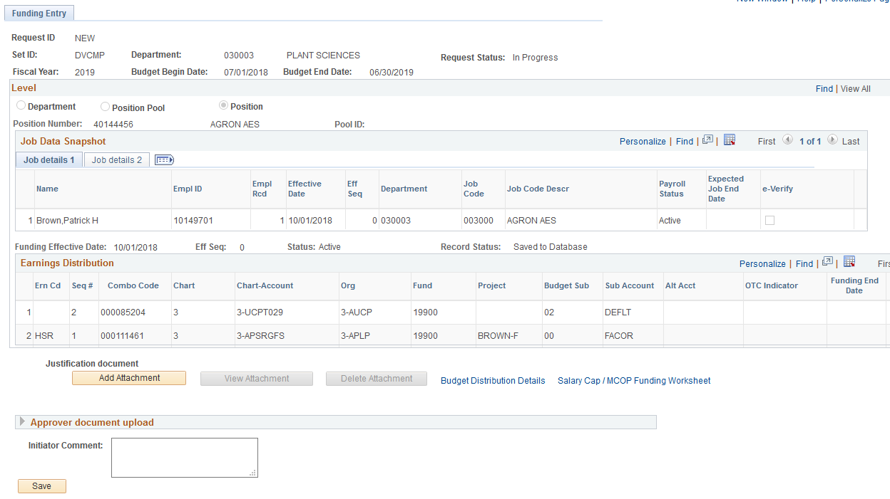
Enter the fiscal year in which you based on the period of time to which you want to make changes.
  2019 = the 2018-19 fiscal year
  2020 = the 2019-20 fiscal year
Budget Level: we use the Position Level in CA&ES.
We do not use Position Pool ID.
Position Number is a new field that is equivalent to
Appointment within PPS.
xxxxxxxxxxxx

Slide 18
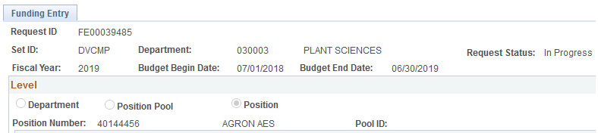
Funding Entry
Request ID = Doc # and will be created once the document is saved
Fiscal Year = the year in which the funding change will occur. 2019 = 2018-19
Budget Begin Date = start of the fiscal year in which the funding change will occur
Budget End Date = end of the fiscal year in which the funding change will occur
Request Status = In Progress since it hasn’t been submitted
Level will be set to position for all CA&ES employees

Slide 19
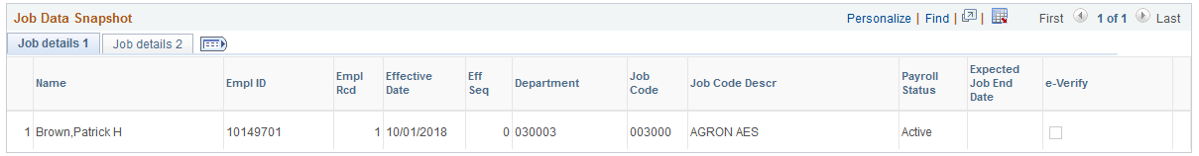
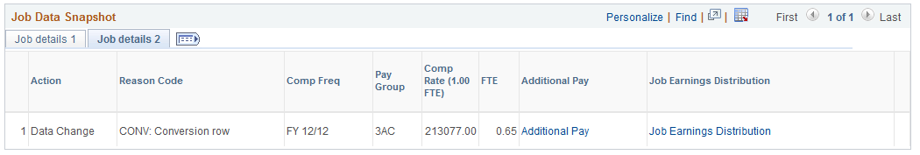
Funding Entry
Job Details 1 shows basic person and job information
Job Details 2 shows FTE and the annual pay rate
To view both at once, select
xxxxxxxxxxxx

Slide 20
FAU Differences in UCPath
Object
Chart
Chart-Account
Org
Fund
Project
Budget Sub *
Sub Account
  Auto derived in UCPath (Hidden)
  User Entered (Required)
  User Entered (Required)
  Auto Populated based on KFS Account
  Auto Populated based on KFS Account
  User Entered (Optional)
  User Entered (Required)
  User Entered (Optional)
*Budget Sub is used to derive Object Consolidations:
  00 – Used to derive Objects SB01-SB07 (Budgeted Academics)
  01 – Used to derive Object SUBS (Budgeted Staff)
  02 – Used to derive Objects SUBG, SUBA, SUBX (Non-budgeted Academics & Staff)
  03 – Used to derive 777P (Postdoc FEN & FEL only)
Notes:
The FAU in UCPath is different than what appears in PPS. A key change is that the Object Code will no longer be entered by the user, but rather derived by the system based on rules programmed by UCD. I does not appear on screen, but will appear in reporting. Org and Fund will be displayed (not displayed in PPS today), and a new FAU field is being introduced: the Budget Sub. This field is used in the derivation of the Object Code and is selected by the user.

Slide 21
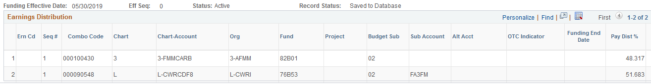
Earnings Distribution
Earn Code (Ern Cd) = DOS Code in PPS. A blank Earn Code is equal to REG pay.
Combo Code = auto derived by the system and can be ignored.
OTC Indicator = indicates if this distribution involves an account that is subject to a salary cap.
Funding End Date = is not needed in most circumstances. Current funding distributions will be replaced by new distributions on the effective date of the new distributions.
Pay Dist % must total 100.000 for each earn code. This is true even when the position is one of two or more positions that total a person’s total employment amount.
  For example, Sally holds two 50% positions: 50% PROF-FY and 50% AGRON AES
  Within her AGRON AES position, she is funded on two 50% earnings distributions with a blank Ern Cd.
  Each of the two 50% earnings distributions represents 25% of her total employment.
CA&ES is developing a calculator to help fiscal officers in determining what percentage to use on earnings distributions for people with more than one position.
Notes:
The FAU in UCPath is different than what appears in PPS. A key change is that the Object Code will no longer be entered by the user, but rather derived by the system based on rules programmed by UCD. I does not appear on screen, but will appear in reporting. Org and Fund will be displayed (not displayed in PPS today), and a new FAU field is being introduced: the Budget Sub. This field is used in the derivation of the Object Code and is selected by the user.

Slide 22
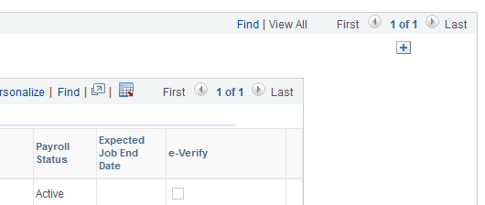
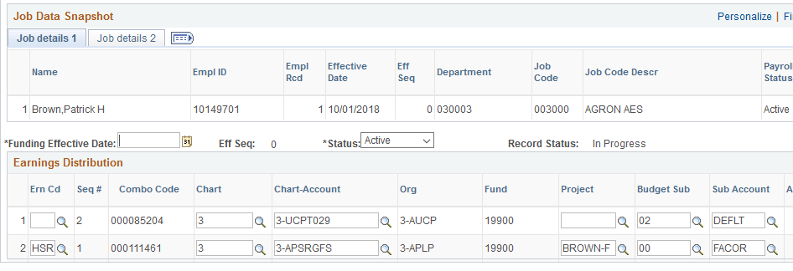
Funding Entry
Change a person’s funding
Scroll to the right and select the to add new rows
that can be edited.
Enter the date when
you want the new
split to take place
After you enter the
Funding Effective Date
you can save the
document and a
document number
will be assigned
This Request ID document number can be used to search for the document after it is submitted for approval.
xxxxxxxxxxxx

Slide 23
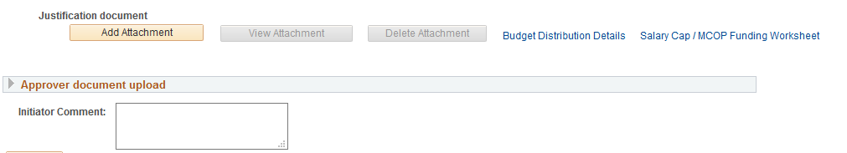
Funding Entry
Supporting documents can be attached and viewed as needed.
There is a field for initiators to enter comments

Slide 24
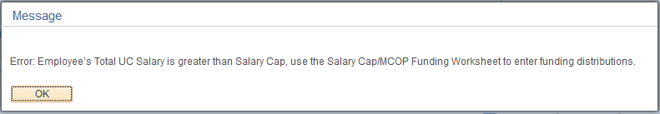
Funding Entry -
If an account is added to the Earnings Distribution section that is subject to a salary cap, the following error message will appear.
The Salary Cap / MCOP Funding Worksheet must be used.
Additional training will be provided about the use of this function.

Slide 25
Training Update & Coursework
Curricula and training:
  Library of content will continue to expand over coming months
  Web trainings and Job Aids for Finance are being created for UCD
  Lead trainers for campus are Kristen Pereira – finance business analyst and Theresa Schumacher – A&FS payroll services
  Trainer for CA&ES is Shannon Tanguay; Analyst Alley members available to answer questions
  Learning labs and refresher training will be available
All Fiscal Officers will be required to complete certain training classes. A preliminary curriculum can be found at https://ucpath.ucdavis.edu/training
Classes you can be taking now through https://lms.ucdavis.edu
(Chrome is recommended browser)
  UCPath: PeopleSoft Overview
  UCPath: Basics and Navigation
  UCPath: AWE Overview and Approvals
  UCPath: Funding Entry Inquiry
  UCPath: Direct Retro Inquiry

Slide 26
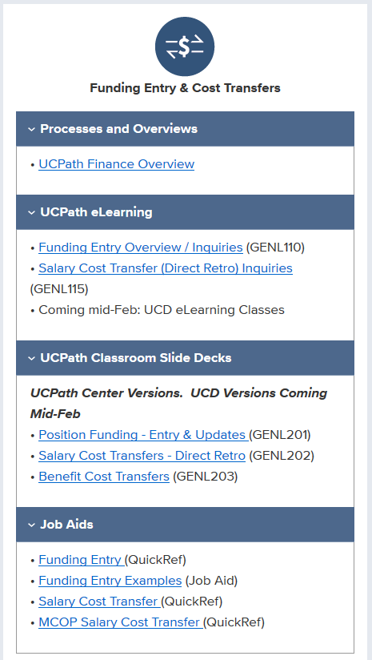
Additional Resources
UC ANR UC PATH WEB PAGE
http://ucpath.ucanr.edu/
Training home page for guidance on which courses are right for you: https://ucpath.ucdavis.edu/training-resources
Fact Sheet page with link to the Finance and Reports presentation (there is a PowerPoint version and a recorded version of the same presentation with audio from the January Finance Change Network Meeting). https://ucpath.ucdavis.edu/fact-sheets

