Slide 1

Project Board Training
Part One – What is Project Board?
Training Recording: https://bit.ly/2rhx1Ms
Kit Alviz and Chris Hanson, Program Planning and Evaluation
Kim Ingram, Academic Human Resources
David White, Affirmative Action
Welcome by Chris Greer, Vice Provost

Slide 2
Desired Outcomes
Participants will have:
Understanding of Project Board’s purpose and why it was built
Awareness of the roles of Academic Human Resources, Affirmative Action, and Program Planning and Evaluation in the development and management of Project Board
Understanding of the structure of Project Board in preparation for the Part Two hands-on training
Experience with Project Board Help webpage

Slide 3
Agenda
Welcome, overview, purpose (10 min)
Academic Human Resources (10 min)
Affirmative Action overview and Civil Rights Compliance changes (40 min)
Program Planning and Evaluation (10 min)
Project Board structure, definitions , integration of multiple reporting requirements (20 min)
Notes:
Polls during #3 and #5

Slide 4
Project Board Purpose
New system that aims to reduce duplicative data entry efforts and make data accessible for multiple purposes. Replaces DANRIS-X, CASA, and Academic Online Program Review. Designed to manage information for the following purposes:
Academic Merit and Promotion
Accountability
Advocacy Efforts
Notes:
Replaces DANRIS-X and integrates affirmative action reporting systems (CASA), Academic Human Resources (AHR) systems, and ANR profiles
-Academic Merit and Promotion:
The data fields are designed to capture the information that is reported in annual evaluation, merit, and promotion packages.
Informed by E-Book policy and lessons learned from Peer Review Committee (PRC); designing the data fields and instructions and dossier export that will hopefully make for more consistent development (and thus review) of dossiers.
Sensitive information, such as merit/promotion decisions and comments, will remain confidential.
CE Specialists with campus merit/promotion already have to do intensive data entry for their packages, so they will have a simpler user experience; we’ve tried to reduced duplicative data entry where possible.
-Accountability: includes federal reporting, UC accountability & budget reports, county reports to Board of Supervisors, ad hoc reports such as audit materials, etc.
-Advocacy Efforts: Information is used for talking points and marketing materials for ANR leaders when talking to
legislators, partners, and others. Creating a “What’s Happening in Cooperative Extension” reporting tool that will allow all users to search and find projects and people.
-Condition change FTE survey – Did anyone in room complete it? The survey captured baseline and Project Board is designed to capture it for the future, along with county FTE and multistate FTE.

Slide 5
System Highlights
Designed with academic and administrative input
Modern user experience
Collaborative reporting
“What’s Happening in Cooperative Extension” reporting tool
Civil rights compliance reporting is integrated with Extension Activity reporting
Notes:
Biweekly meetings with project team including two academics, Academic Human Resources, Program Planning & Evaluation, IT web applications team. Training group meets regularly, involves Affirmative Action.
Quarterly meetings with Academic Advisory Committee, including 5 CE Advisors, 4 CE Specialists
2016: Input sessions with administrative and academics groups. Campus input sessions with 37 CE Specialists.
2017-2018: 4 user testing sessions, attended by 21 CE advisors, 14 CE Specialists, three Dean's office staff, and seven other academic titles.
Had academic input in various stages; iterative project; made that priority.
Modern user experience = intuitive. Hover overs, instructions, multiple entry points, dynamic, open year round.

Slide 6
Academic HR
Role in Project Board Development & Management
Development Team participation
Projects, themes and activities: How they populate your dossier
ByCommittee
E-Book and Peer Review Committee (PRC)
Civil Rights Compliance for non-advisor academic titles
System administrator
Notes:
Kim

Slide 7
Timeline
Academics with ANR merit/promotion processes:
May 3, 2018: Project Board opens (ANR Portal)
October: Begin compiling AE/M/P packages
February 1, 2019: Due date in Project Board
Academics with campus merit/promotion have a different timeline
Notes:
Three basic user groups: Academics with ANR merit/promotion; CE Advisors with campus merit/promotion; administration (supervisors/monitors, SLT, admin units)
Timelines align with other processes. For campuses, other federal reporting such as those doing REEport. For ANR, aligns with AE/M/P due date.

Slide 8
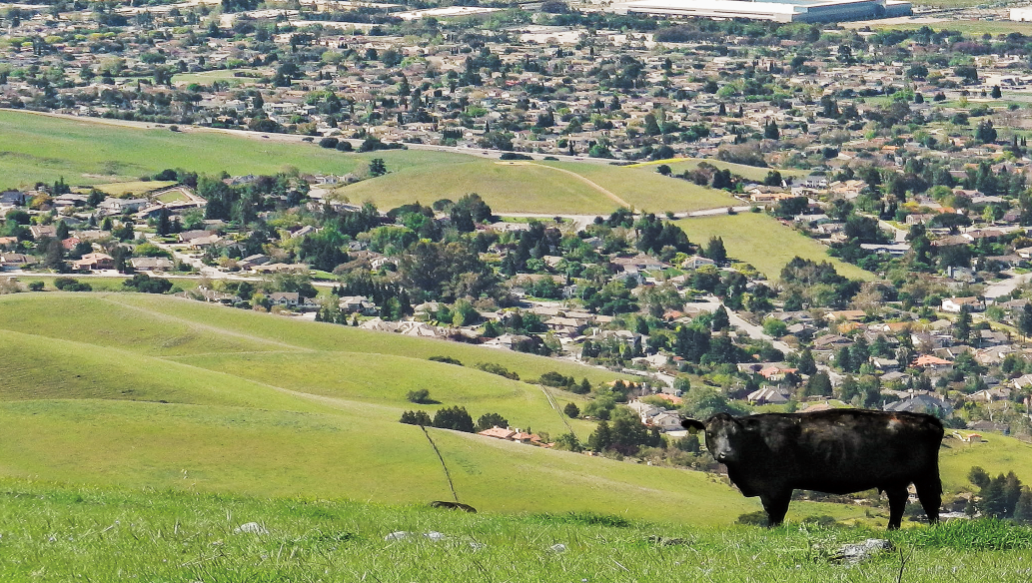
(Partial) Introduction to Project Board
UC ANR Affirmative Action Office
Notes:
Hello, everyone and welcome to this not quite full introduction to Project Board.
This presentation will be dealing mainly with the Affirmative Action or Civil Rights reporting requirements of Project Board, and the components of program compliance.

Slide 9

Topics & Outcomes
Participants will have an understanding of . . .
What is Affirmative Action?
  → Goals of Affirmative Action
Civil Rights: Why & Wherefore
What is Program Compliance?
→ What is Project Board Civil Rights reporting?
→ Why do we collect racial data?
→ What is All Reasonable Effort?
→ What is parity of participation?
Notes:
Here are our goals for today’s presentation. At the end you should have a clear idea of what Affirmative Action is and what the goals of Affirmative Action are here in ANR.
We will discuss why there is a civil rights reporting component within Project Board and the requirements of it. We will also touch on the components that make up program compliance.

Slide 10
Overview of Affirmative Action
Established by the federal government in 1965 through an executive order signed by President Lyndon Johnson
Designed to eliminate the present effects of past discrimination, such as the underrepresentation of minorities and women; and, in addition, to encourage the employment of veterans and persons with disabilities.
Valuing inclusion and diversity to guide educational programming for our clientele.
Implement the ANR Core Values as an expression
of support for the goals of Affirmative Action.
Notes:
Let’s start with a quick overview of Affirmative Action.
Affirmative Action is an outgrowth of the Civil Rights Act of 1964. It was established in 1965 by an executive order signed by President Lyndon Johnson.
It was designed to eliminate the present effects of past discrimination against minorities and women. Later, it was expanded to encourage the employment of both veterans and persons with disabilities.
Today we look at Affirmative Action as the valuing of inclusion and diversity – and using these values as a guide to our educational programming for our clientele.
We will see in a later slide how the goals of Affirmative Action have informed even our UC ANR Core Values as well as the ANR Strategic Plan. You should see this as indicative of the high status with which UC and UC ANR holds non-discrimination, the prevention of all forms of harassment (including sexual harassment) and the ideals of affirmative action – both in our CE programs and in the workplace.

Slide 11

National Institute of Food and Agriculture (NIFA)
The Food, Conservation, and Energy Act of 2008 (the 2008 Farm Bill) authorized the creation of NIFA.
NIFA provides leadership and funding for programs that advance agriculture-related sciences through partnerships with the Land-Grant University System and their extension programs.
NIFA is a federal agency within the United States Department of Agriculture (USDA) — is part of USDA’s Research, Education, and Economics (REE) mission area. The agency administers federal funding to address the agricultural issues impacting people’s daily lives and the nation’s future.
Notes:
When we’re talking about Project Board, we are talking, in part, about the UC ANR’s web-based contact reporting system. We have a contact reporting system because the USDA a long while ago had requested each land grant university create such a system.
Now which agency is really monitoring our contact reporting? It’s NIFA. The National Institute of Food and Agriculture. Here are some bullet points that explain what NIFA is and what it does.
[ Pause to let folks read the bullets. ]

Slide 12
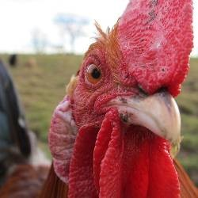
Program Access (Barriers)
NIFA CIVIL RIGHTS REVIEW AREAS OF CONCERN/INTERESTS
Quantity and quality in the collection and reporting of Extension and Research program and workforce race/ethnicity and gender data.
Racial/ethnic and gender composition of academic workforce, staff workforce: any employees, volunteers that support Extension and Research.
Identifying potential workforce and program audiences.
Racial/ethnic and gender composition of committees and councils.
National Origin discrimination and Limited English Proficiency
Accessibility to the disabled and public notification for accommodation.
Notes:
What is NIFA interested in when they come here to give UC ANR a civil rights audit?
Here are some bullet points of their areas of interest. You see in the first bullet that they are not interested ONLY in the actual Cooperative Extension (CE) programs . . . they are ALSO interested in the diversity of the ANR workforce – both academic AND staff.
In short, they are interested in Equal Opportunity both in program access and in the area of employment. Note the bullet points that touch on not only race but national origin, and the disabled, as well.

Slide 13
CODE OF FEDERAL REGULATIONS (CFR)
7 CFR part 15 —Nondiscrimination on the basis of race, color, or national origin.
CFR part 5, Subpart A “Nondiscrimination in Federally-Assisted Programs of the USDA—Effectuation of Title VI of the Civil Rights Act of 1964”
7 CFR part 15a.1 —“The purpose of this part is to effectuate Title IX of the Education Amendments of 1972, Discrimination on the basis of Sex in any education program or activity receiving federal financial assistance…”
7 CFR part 15b—Nondiscrimination on the basis of HANDICAP in program or activities receiving federal financial assistance 7 CFR 15B.1 “The purpose of this part is to implement section 504 of the Rehabilitation Act of 1973 …{Also ADA Amendments Act of 2008}
45 CFR PART 90– Nondiscrimination on the basis of AGE in programs or activities receiving federal financial assistance (Health and Human Services)
28 CFR §42.104 (b)- A recipient may not on the ground of race, color or national origin.. “deny a person the opportunity to participate as a member of a planning or advisory body which is an integral part of the program.”
Notes:
Here is a list of the CFRs, the Codes of Federal Regulations, that outlaw particular discriminatory practices within any agency receiving federal money. There is one more CFR for us to look at on the next slide.
[ Pause to let folks read the bullets. ]

Slide 14
CODE OF FEDERAL REGULATIONS (CFR)
(cont.)
7 CFR, Subpart A § 15.5, (b) “Each recipient (primary and other recipients) shall keep such records and submit to the Agency timely, complete, and accurate compliance reports at such times, and in such form and containing such information, as the Agency may determine to be necessary to ascertain whether the recipient has complied or is complying …”
“…have available for the Agency racial and ethnic data showing the extent to which members of minority groups are beneficiaries of federally assisted programs.” (Also reference USDA DR-4300-005)
Notes:
This CFR is of particular interest. It outlines why we collect clientele contact data. We do so in order to document “the extent to which members of minority groups are beneficiaries of federally assisted programs.”

Slide 15
Goals of Affirmative Action
To assure nondiscrimination and equal opportunity in hiring practices and in the workplace
To expand access to people from traditionally underrepresented groups with outreach activities
Promote nondiscrimination and valuing of differences among staff and clientele
Value inclusiveness and diversity
Notes:
Let’s look at the Goals of Affirmative Action in your academic role.
As an academic you will assure nondiscrimination and equal opportunity in your program outreach and activities.
You will expand access to people from underrepresented groups with your outreach activities. Suggested methods of outreach will be reviewed in upcoming slides.
As an academic you will promote nondiscrimination in your program planning, outreach and program activities in ways that will be inclusive, and that will value differences among your clientele.
Your commitment to nondiscrimination and inclusion will allow you to reflect the ANR Core Values in your work with clientele as well as your interactions with the staff in your workplace. We’ll take a look at the ANR Core Values in our next slide.

Slide 16
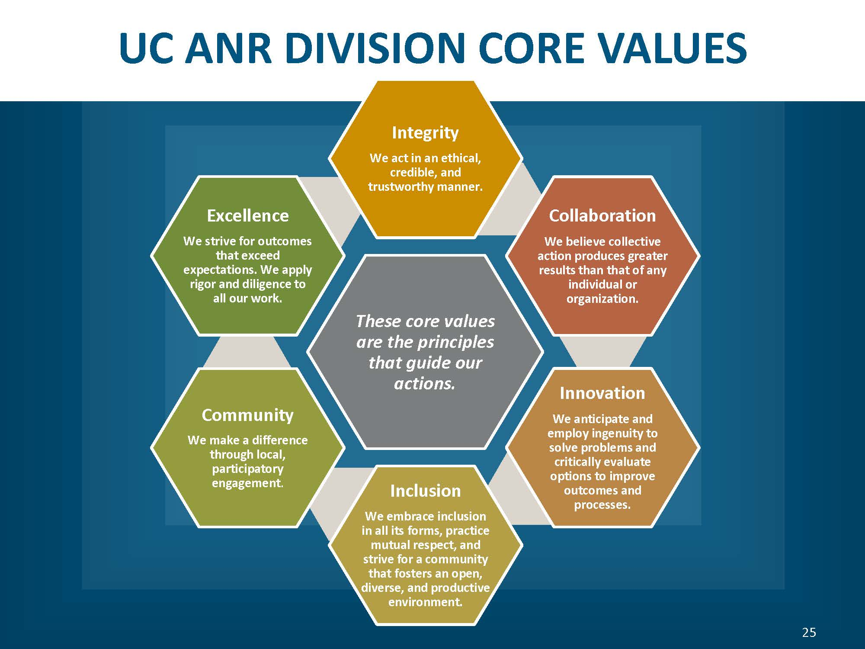

Goals of Affirmative Action
To assure nondiscrimination and equal opportunity
To expand access to people from traditionally underrepresented groups with outreach activities
Promote nondiscrimination and valuing of differences among staff and clientele
Value inclusiveness and diversity.
Notes:
Here’s the graphic representation of the ANR Core Values.
The ANR Core Values embrace not only inclusion but also integrity, collaboration, excellence, innovation and community development.

Slide 17

ANR’s Strategic Plan –
Public Value Statements
UC ANR: Promoting economic prosperity in California
UC ANR: Developing a qualified workforce for California
UC ANR: Safeguarding abundant and healthy food for all Californians
UC ANR: Protecting California’s natural resources
UC ANR: Building climate-resilient communities and ecosystems
UC ANR: Promoting healthy people and communities
7. UC ANR: Developing an inclusive and equitable society
Notes:
The ANR Public Value Statements derive from the ANR Strategic Plan and are short statements that articulate both the value and the goals of our work in Cooperative Extension. Number 7, in particular, addresses indirectly the intent behind the Civil Rights Act of 1964 . . . to have an equitable and inclusive society is to eliminate the present effects of past discrimination against minorities and women. The Civil Rights Reporting component in Project Board, by our embracing of non-discrimination and inclusion, is one small step that UCANR takes toward that goal.

Slide 18
Assure Nondiscrimination with
Federal and/or California Laws
—discrimination prohibited on the basis of:
Race/Ethnicity
Color
Gender (sex/gender identity)
Medical Condition
Disability (physical or mental)
Religion
National Origin
Ancestry
Age
Sexual Orientation
Pregnancy
Marital or Parental Status
Veterans
Genetic Information
Notes:
What overview of Affirmative Action or Civil Rights compliance is complete without a list of the protected categories? This slide presents the protected categories.
The Federal and California laws prohibit discrimination in extending your program and in hiring practices on the basis of any of these categories . . .
[ Pause to let folks read the bullets. ]

Slide 19

Project Board’s Civil Rights Reporting Why & Wherefore
Notes:
Now we will look at why we do civil rights reporting.

Slide 20
Why do Civil Rights Reporting?
The following USDA requirement receives its scope, in part, from Code of Federal Regulations, Title 7: Agriculture, Subtitle A: Office of the Secretary of Agriculture, Part 15A
“Each agency that administers programs . . . will develop a system for establishing base data that identifies eligible populations and measures delivery of program benefits in order that the quantity and quality of benefits and services delivered to minority individuals can be documented and compared to benefits delivered to nonminority individuals . . .”
Ultimately, Project Board’s Civil Rights component is the documentation that ANR executes its CE mission with equality. . .that the “quantity and quality of benefits and services” is the same for both people of color and whites.
Notes:
We touched on this topic in an earlier slide. We do civil rights reporting in order to document “the extent to which members of minority groups are beneficiaries of federally assisted programs.”
The language in this slide is from an earlier reg and succinctly re-states this requirement. We identify a clientele, we establish a baseline for that clientele group, then we report the contacts made against that baseline because attendance/contacts allows – maybe not a perfect – but at least some sort of measure that the delivery of program benefits and services to minorities is equal to the benefits being delivered to nonminority individuals.
Then in the red font there at the bottom of the slide, I restate this requirement once again . . . because it’s important.

Slide 21
What is Parity?
Parity or ‘parity of participation’ is defined by the USDA as when the percentage of each minority group making up your actual contacts comes to within 80% of their percentage in the baseline. For example, if Hispanics make up 10% of your potential or baseline, then Hispanics should make up at least 8% of your actual contacts in order for your program to be in parity for Hispanics.
What is All Reasonable Effort?
All Reasonable Effort (ARE) is the utilization of at least three of four specific outreach methods (i.e. 1-Mass Media; 2-Newsletter/flyers; 3-Personal letters/emails; 4-Personal invitations) in order to expand access and move toward or maintain parity of participation.
Notes:
Here’s the definition of Parity. If your actual contacts come to within 80% of their percentage in the baseline, then your program is in parity. It has achieved parity of participation. We see an hypothetical example for Hispanics in this slide illustrating this point.
[ Pause here. ]
You establish All Reasonable Effort (ARE) by utilizing (at least one time) at least three of four specific outreach methods. (And there is no substitution allowed, you must use at least three of these four specific methods. You are free to use other methods not listed but in order to establish compliance by ARE you must use at least three of these four outreach methods.) Mass Media / Newsletter or flyers / personal letters or personal emails to specific individuals / personal invitations – either face-to-face or by phone.

Slide 22
Who is Your Potential Clientele?
Your PVA & PD should provide key information on who your position is intended to serve. Then work with your county director and program colleagues to fine tune this and discover additional groups who may also become potential clientele
Learn about the demographics of your clientele group(s) by viewing US Census, Ag Census, Ag Commissioner’s Report, local data and local knowledge
  Ask who would be interested in or benefit from your educational program
  Consider the geographic area of your potential audience/clientele
Work with collaborators, agencies and stakeholders who represent and serve those protected classes/groups
Notes:
How do you identify your potential clientele?
Your PVA & PD should state who your position is intended to serve. That’s your starting point. Then, working with colleagues in the similar program areas and/or your County Director, you can fine-tune that to discover additional groups who could also benefit from your program. Once you define you clientele group or groups, then the fun begins.
As an academic it is important that you find the demographic breakdown of your clientele groups in your county or geographical area. Some programs can use the US Census. If you are in an agricultural program area you may want to check the Ag Census and Ag Commissioner’s Report. Feel free to use local data and local knowledge from individuals who have lived or worked in the area for a period of time – but remember to document whatever sources you use.
As an academic you should ask yourself who are those individuals who would be interested in or benefit from my educational program.
Another great source is the collaborators, stakeholders or even individuals from other agencies who serve or represent the protected or underrepresented groups you are trying to reach.
If you are unfamiliar with them, learn about the diverse cultures within the geographical area where you work.

Slide 23
Your AA Responsibilities…
Establishing Your Baseline
Define potential audience for each program
  Ask who are those individuals who would be interested in or benefit from your educational program
Learn about the demographics of your county by viewing US Census, Ag Census, Ag Commissioners Report, local data, and local knowledge
Work with partners and stakeholders who represent and serve those protected classes
  Where they live and work
  Their values and beliefs
  Their cultures.
Notes:
As an ANR Cooperative Extension Advisor, probably your chief – or at least pretty high up there – Affirmative Action responsibility is finding your baseline data.
We cannot determine if you’ve achieved parity if we cannot compare your actual contacts to a baseline. As important as establishing a baseline is, it is also important to get a good demographic breakdown of audience participants in any events you may hold. These make up your actual contacts and it’s vital to get a breakdown of race, gender and ethnicity of your audiences. If you have a formal sit-down event, you can have sign-in sheets that offer people an opportunity to self-identify their race, ethnicity and gender. If you’re having an open-house sort of thing with people flowing in and out throughout the day this is far more challenging. Even with a sit-down event people are free to decline to state but in both instances, (sit-down, formal or in-and-out open house-style) the USDA has stated that visual identification of audience make-up is fine. If you have any questions about this, contact me at the Affirmative Action Office.

Slide 24
Your AA Responsibilities cont.
All reasonable efforts to reach individuals who are representative of the cultures and ethnicities, genders and ages of your county/area
Move from ARE toward parity in program participation
Partner with groups, agencies and organizations to reach protected audiences you want to reach
Include people from protected groups on program planning committees, on survey lists and on research projects
Keep mailing and e-mail lists
Make personal contacts within protected or under-represented groups
Conduct meetings/trainings in facilities welcoming and accessible.
Notes:
Take a minute to read over these additional bullet points concerning your Affirmative Action responsibilities.
[ Pause so they can read the bullets. ]

Slide 25
What is ARE Activity?
ARE is the things you do to encourage people to participate in your program. It is not synonymous with program delivery methods.
ARE can be targeted to reach underserved clientele in order to expand access.
ARE Efforts Compliment Good Extension Programs
Consider . . .
Press releases in local publications
Holding meetings in places people are comfortable going to
Identifying possible barriers to participation and seeking ways
to remove them
Find groups to co-sponsor meetings
Notes:
So to be clear that we’re all on the same page, let’s review, “What is ARE Activity?”
It’s what you do to encourage people to participate in your program. It is NOT synonymous with program delivery. You can also target your ARE to reach specific segments of your clientele baseline in order to expand access.
Good ARE efforts could or should include sending press releases to local publications, holding meetings in place were all people can feel comfortable; if you can identify barriers to participation, try and find ways to remove them; seek out other groups to co-sponsor meetings with as an aid to reaching wider segments of your clientele.

Slide 26

Evaluation
County Director/MCP Director annually communicate with their advisors about their contact reporting in Project Board.
Measurable Goals: establish measurable goals such as moving toward full parity in your program.
AA Office annually reviews Project Board reports and monitors progress toward compliance/parity. Also, supplies compliance status of programs of advisors up for Merit/ Promotion to ANR Administrators.
Advisors should be comfortable defending their choice of clientele group(s) and the source of their baseline data should there be a federal audit.
Notes:
O.K., we’re almost at the end!
What’s measured gets done. (Or so it is said.) As part of the ANR evaluation process, your supervisor should meet with you annually and go over your contact reporting. A goal that any advisor can have is to either move their program into full parity or to maintain parity.
The ANR AA Office annually reviews contact and ARE activity and compiles a compliance history for each advisor. Are you in compliance by ARE or by parity? Or are you out of compliance? This information is supplied to ANR administration for all advisors going forward for Merit/ Promotion.
As a side note: Any advisor should be comfortable defending their choice of clientele group(s) and the source of their baseline.

Slide 27
Questions? Contact . . .
David White
dewhite@ucanr.edu
530-750-1286
CASA Affirmative Action policies and requirements
Notes:
If you have any questions concerning your Affirmative Action or Civil Rights obligations, feel free to contact me, David White, the ANR Affirmative Action Analyst and Title IX Investigator
Thank you again for taking this training.

Slide 28
Civil Rights Compliance
Clientele groups imported from CASA
Supervisor instructions
Statewide Program instructions (important: Project Board system and self-identify templates do not replace any existing Statewide Program reporting systems, procedures, and forms!)
Screenshare /Polls: Project Board Civil Rights Compliance instructions and new demographic categories
Notes:
Kit slides

Slide 29
Program Planning & Evaluation (PPE)
Development Team Participation
  Represent federal/UC reporting needs and compliance
  Represent needs of ANR senior leaders
  Management
  Technical/content assistance and system administrators
  Request/manage budget
  Convene “owners” and users
Notes:
Convener: Convene project team, convene users for input, etc.
Director of PPE manages/requests budget

Slide 30
PPE Uses of Project Board information
UC ANR's federal plan and report of work (almost $8.5 million)
UC ANR's contributions to the UC annual accountability report, sustainability report, Office of the President budget reports, ad hoc requests
Program planning & resource allocation (e.g., academic programmatic footprint report for Call for Positions)
Legislative/External/Internal Requests
Compliance with federal requirements to maintain funding levels (multistate!)
Notes:
Legislative/external/internal requests: (often in partnership with Strategic Communications)
Compliance with federal requirements: (e.g., meeting 25% targets of multistate and integrated work)

Slide 31

How NIFA Uses Reporting Data
Annual budget requests and Office of Management & Budget inquiries
NIFA budget explanatory notes/USDA Annual Performance Report
Congressional inquiries
Secretary’s travel and speaking engagements
Audits and oversight inquiries
Other USDA departmental inquiries
Scientific emphasis area evaluations
Notes:
Kit
NIFA recently provided this information at a national extension administrator’s conference. I can’t speak to the specifics but in general, NIFA uses the information ANR provides them for demonstrating accountability, securing funding, generating public support, and advocating with congress.

Slide 32
Structure
Activity
Activity
Theme
Project
Project
Project
Activity
Activity
Activity
Activity
Activity
Activity
Activity
Activity
Activity
Activity
Activity
Notes:
Earlier Kim mentioned that the E-Book was used to inform the design of Project Board. Definitions and instructions from the E-Book are used in the help website and in the actual system hover-over’s. But also, the system’s key elements and workflows are also based on the E-Book. There are three primary elements in Project Board: Themes, Projects, and Activities.
Theme – Based on the idea of organizing ANR program summary narratives into themes that include both extending knowledge and information and research and creativity. Summarize the background, clientele, goals, inputs, outputs or methods, outcomes, and impacts.
Only tagging condition change to theme and FTE.
Project – Think of the ANR dossier project summary table. This often includes a collection of activities.
Activity – Think of the ANR dossier Extension activities, university/public service tables, etc. Note: If you are a CE Specialist with campus-based merit/promotion process, you will not have to enter detailed activities as you already do this in your campus systems. We will ask for counts instead!
Projects get tagged directly to a theme.
Extension activities can be tagged to a project (and thus inherit the project theme tag), or they can be tagged directly to a theme.
All projects and Extension/Research/Creative activities must be linked to a theme in order for the dossier to work properly.
Note: University/Public Service and Professional Competence activities are not tagged to projects/themes. Again, this is all based on E-Book guidance: “Organize extension activities by the themes where possible as outlined in your narrative…”

Slide 33
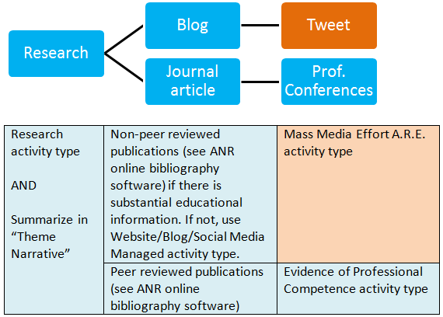
Notes:
Let’s talk about an oversimplified real life example of an academic’s work (one RESEARCH and one EXTENSION) and how each item would be reported in Project Board and if applicable your dossier.
Research – conduct a trial on an integrated pest management strategy for organic celery
Write up the findings in blog and journal article
Disseminate research findings via tweeting and presenting at professional conferences.

Slide 34
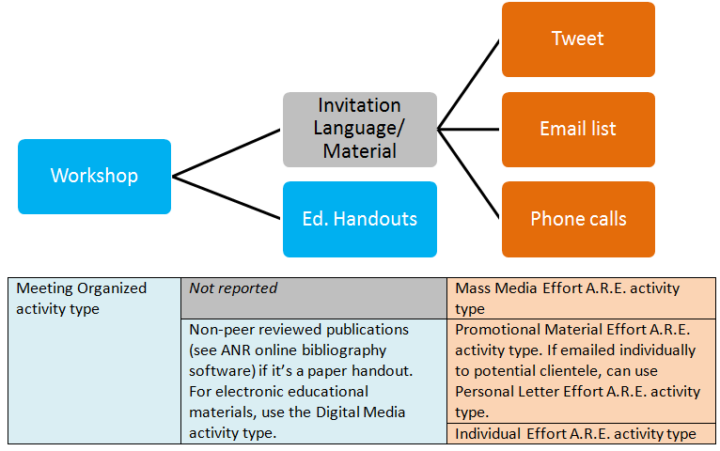
Notes:
4-H/YFC advisor delivers a workshop to after school care providers
Decide with partners that you want to deliver a workshop.
Prepare for the workshop by preparing some invitations and educational handouts.
Invite people to attend those workshops. Especially want to make sure individuals from populations that are historically underserved by your program.

Slide 35
Help page screenshare/polls: http://ucanr.edu/sites/ProjectBoardHelp/

Slide 36
Recap – System built for multiple purposes
Themes | Academics: Dossier export Administration: Outcomes reporting, advocacy
Projects | Academics: Dossier export Everyone: Collaboration, advocacy
Extension/ Research/ Creative Activities | Academics: Dossier export Affirmative Action: Civil Rights Compliance analysis Administration: Outputs and contacts reporting Everyone: Collaboration, advocacy
Notes:
To recap, the system was built to serve several needs. I’m not going to discuss this table but it’s meant to visualize how there are 2 or more uses for each of the key elements in Project Board.
Academics in their program review process
System administrators in accountability processes
Everyone in advocacy and collaboration – reporting tool
Affirmative Action for CRC
Also dossier export intends to help both academics in preparing dossier to meet E-Book requirements, as well as provide consistency for reviewers.

Slide 37
Addressing Concerns
1. Privacy
2. Different ”voice” for reporting vs. dossier
3. Better than DANRIS-X?
4. This change will take time!
How can we help with the transition?
Notes:
Kit
1. Privacy: Don’t want private personnel or intellectual property to be available to anyone → Worked with academics to determine what is sensitive (narratives, outcomes, decisions) and what is less sensitive (activity and project tables), and designed system around it. For example, merit/promotion decisions will remain confidential!
2. Organizational reporting and dossier should be separated; the intent is different → We learned from academics that some dossier items are more straightforward to write up (tables!) and what requires more flexibility and caution with interpretation (program summary narrative). Designed system to allow for varying levels of flexibility and privacy given these concerns.
3. Will it be as laborious as DANRIS-X? → Engaged contractors to ensure a modern and intuitive user experience. Several issues with DANRIS-X have been addressed, including copy/paste features, submit and save buttons, ability to delete, accessible with keyboard, etc. We also integrated data entry rather than multiple systems/modules. There will be no open and close of systems and no separate annual report/plan modules and related issues. The new system will better reflects the complex nature of responsibilities, such as dynamic tagging to counties for clientele groups; but will still be able to transfer clientele groups between retired and newer advisors.
4. Lots of changes → We recognize there are a lot of changes happening in ANR, such as the new condition changes, website redesign, new leadership positions and members, etc. We’re doing our best to make this a collaborative effort and welcome ideas on how we can help with the transition to Project Board.
Already have good tools and processes for preparing my dossier → We recognize this is a tough one. Please know that you still have full control via the dossier editing screen to edit, include, and exclude information. We also know that CE specialists on campus had to do this transition; they now all have to do similar management of dossier information in online systems with discreet data fields. All 100+ except a handful at Berkeley have stopped using paper/MS word dossier to manage activities, publications, etc. Via input sessions, we’ve learned from their experiences and how important it is to streamline where we can, and don’t ask for anything that isn’t needed.

Slide 38
Contact Information
Help site: http://ucanr.edu/sites/ProjectBoardHelp/
General Project Board and Program Planning and Evaluation questions: Kit Alviz (kit.alviz@ucop.edu) or Chris Hanson (christopher.hanson@ucop.edu)
Annual Evaluation, Merit, or Promotion Dossier/Academic Human Resource questions: Kim Ingram (kcingram@ucanr.edu)
Civil Rights Compliance/Affirmative Action questions: David White (dewhite@ucanr.edu)

