Slide 1
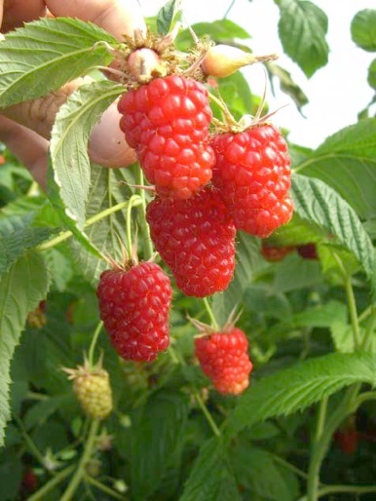
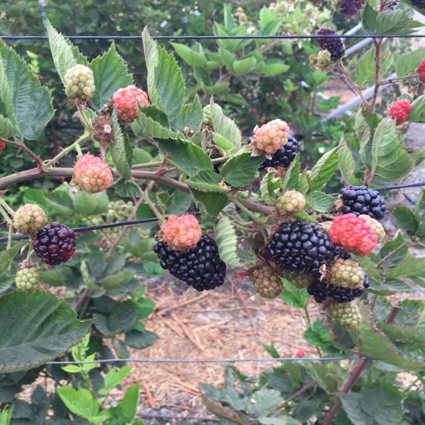
Primocane Blackberry and Raspberry Evaluations at Santa Paula and Oceano, CA.
Mark Gaskell, Farm Advisor (Emeritus)
UCCE - SLO
Oleg Daugovish, Farm Advisor
UCCE Ventura

Slide 2
Overview - caneberry public varieties
New plant material from public patent-protected varieties and proprietary
Public breeding programs in US limited
  U Ark, NCSU, Cornell, USDA Corvalis, OR; also Canada
  Then Netherlands, UK, Scotland, Italy, Spain, etc
  - also, Australia, N. Zealand ?
All new cultivars entering US have to pass through a two-year plant quarantine process, so lag between release in country of origin and US availability

Slide 3
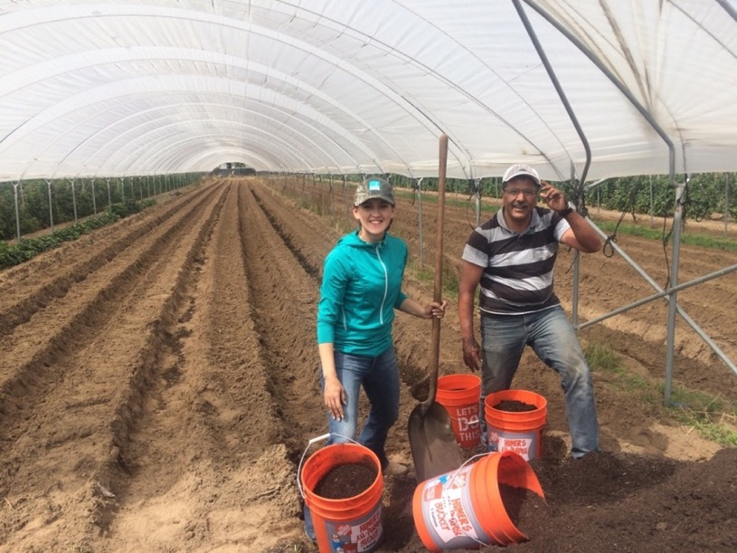
Primocane Blackberry and Raspberry Evaluations at Oceano, CA.
Prepped and planted Sept / Oct - 2016
Kwanza, Kweli, Imara raspberry
Prime Ark 45, Traveler blackberries
Vintage and Kokanee added April 2017 along with APF 268 and ORUS 4545-1
No data collected in 2017 allowing plots to establish and develop uniformity.

Slide 4
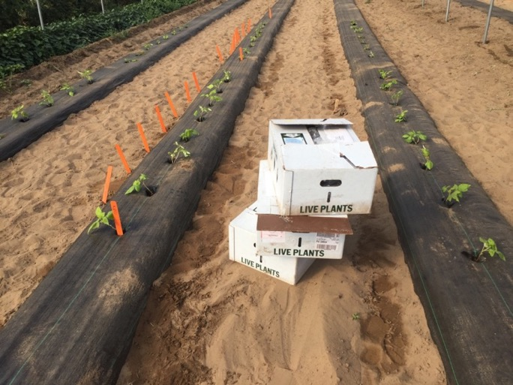
Raspberry - 18” between plants X 8 plants (3 beds)
= 12 ft. plots; replicated 4 times
Blackberry 30” between plants X 4 plants per plot = 10 ft long plots; replicated 4 times
Planted Oct 2016 and April 2017
All plots received ½ lb compost / sq. ft preplant incorporated;
in-season injection of 5 lb N per acre per week equivalent (N Force 8-0-0)
All plots in tunnels with weed fabric over the row; fabric opened during establishment season to allow normal primocane development

Slide 5
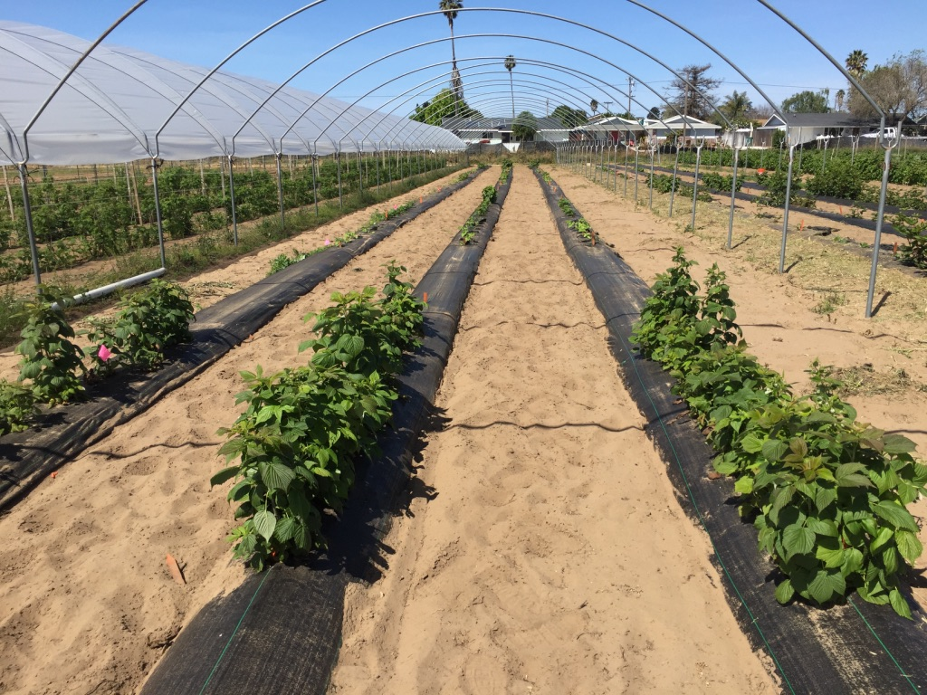
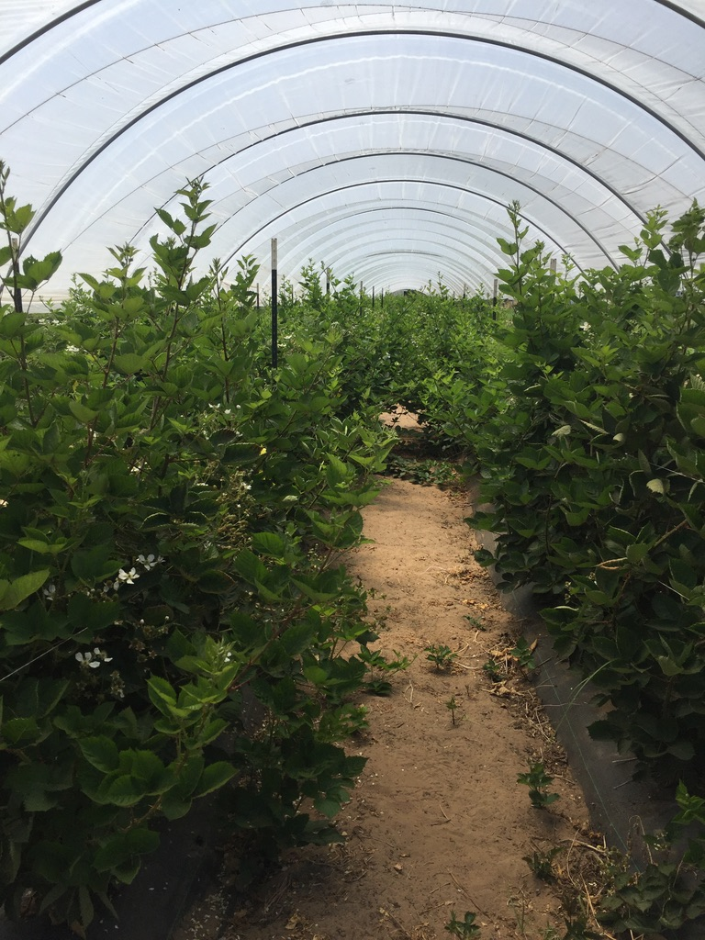
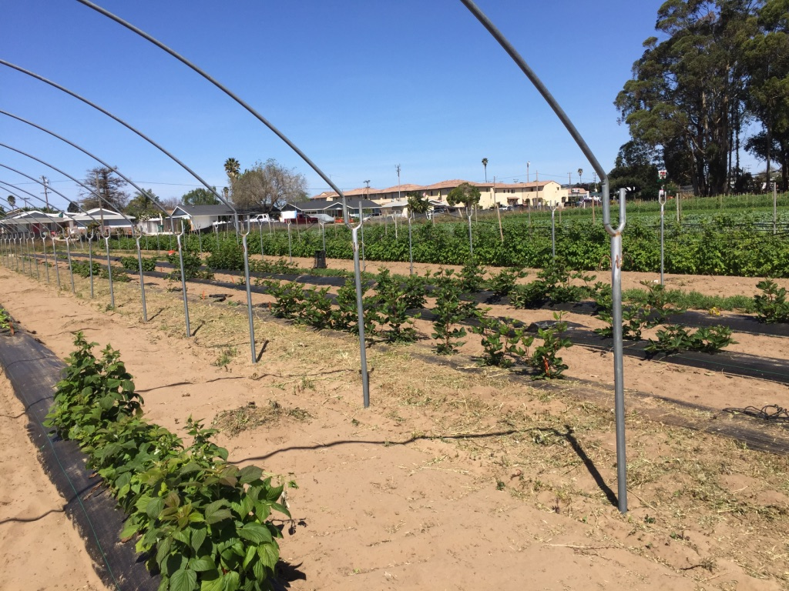

Slide 10
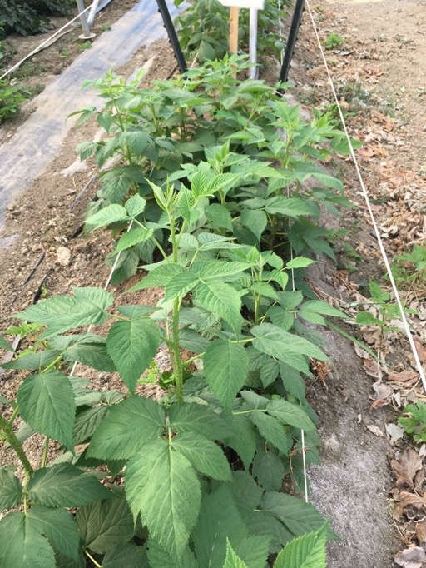
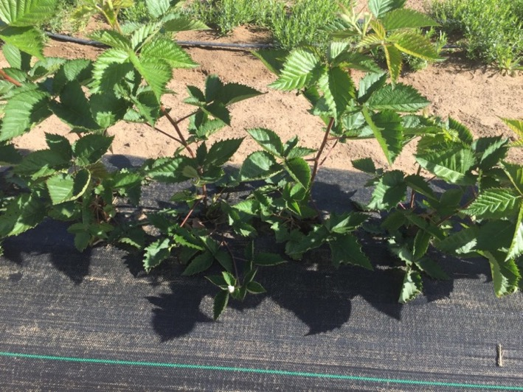
Raspberry Yields
~ lb/ A (kg/sq. m)
Imara 6,381 0.73 1.5*
Kokanee 7,765 0.89
Kwanza 4,699 0.54 1.5*
Kweli 5,085 0.58 1.5*
Vintage 6,333 0.73
*License holder ests.
Blackberry Yields
~ lb/ A
APF 268 6,968
ORUS 4545 6,653
PrimeArk 45 11,526
Traveler 3,049
Low plant density 18” spacing?

Slide 11
Kokanee raspberry
USDA Corvalis, OR (C. Finn)
US Distribution – North American Plants
others?

Slide 12
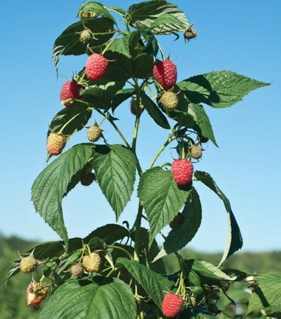
Imara raspberry
Advanced Berry Breeding – Netherlands
US Distribution – Nourse Farms
Special licensing:
• All commercial fruit producers must complete and sign a Fruit Producers License.
• Annual royalty payments collected on linear meters of row under production.
• Less than 5000 plants can be planted without an Annual License Fee and Annual Royalty payments, but carry a plant royalty of $1.00 per plant. must also be signed.

Slide 13
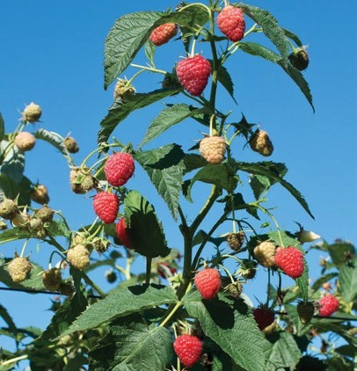
Kweli raspberry
Advanced Berry Breeding – Netherlands
US Distribution – Nourse Farms
Special licensing:

Slide 14
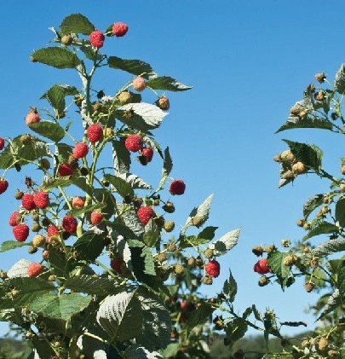
Kwanza raspberry
Advanced Berry Breeding – Netherlands
US Distribution – Nourse Farms
Special licensing:

Slide 15
Primocane Blackberry and Raspberry Evaluations at Santa Paula and Oceano, CA.
Mark Gaskell, Farm Advisor (Emeritus)
UCCE - SLO
Oleg Daugovish, Farm Advisor
UCCE Ventura

