Slide 1
Nutritional Issues in Caneberries
February 21, 2019
Annual Caneberry Meeting

Slide 2
Mineral Template
Caneberries
Nutrient | Range of Sufficiency
Nitrogen | 2.0-3.0%
Phosphorous | 0.25-0.40%
Potassium | 1.50-2.50%
Magnesium | 0.3-0.9%
Calcium | 1.5-2.50%
Manganese | 50-200 ppm
Iron | 50-200 ppm
Copper | 7-50 ppm
Boron | 30-50 ppm
Zinc | 20-50 ppm

Slide 3
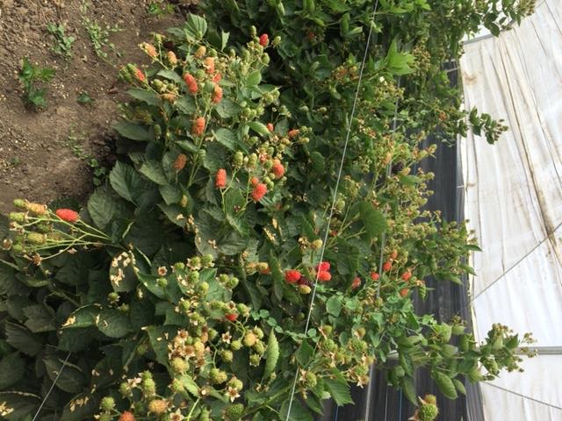

Slide 4
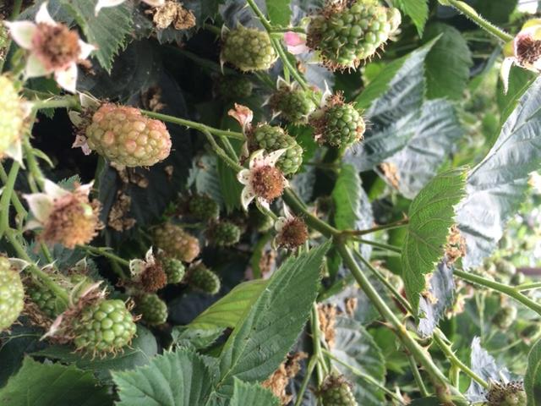

Slide 5
Case Study – Primocane Blackberry
Nutrient | Out put
Nitrogen | 2.7%
Phosphorous | 0.25%
Potassium | 0.9 %
Magnesium | 0.46 %
Calcium | 1.6 %
Manganese | 156 ppm
Iron | 158 ppm
Copper | 8 ppm
Boron | 48 ppm
Zinc | 40 ppm

Slide 6
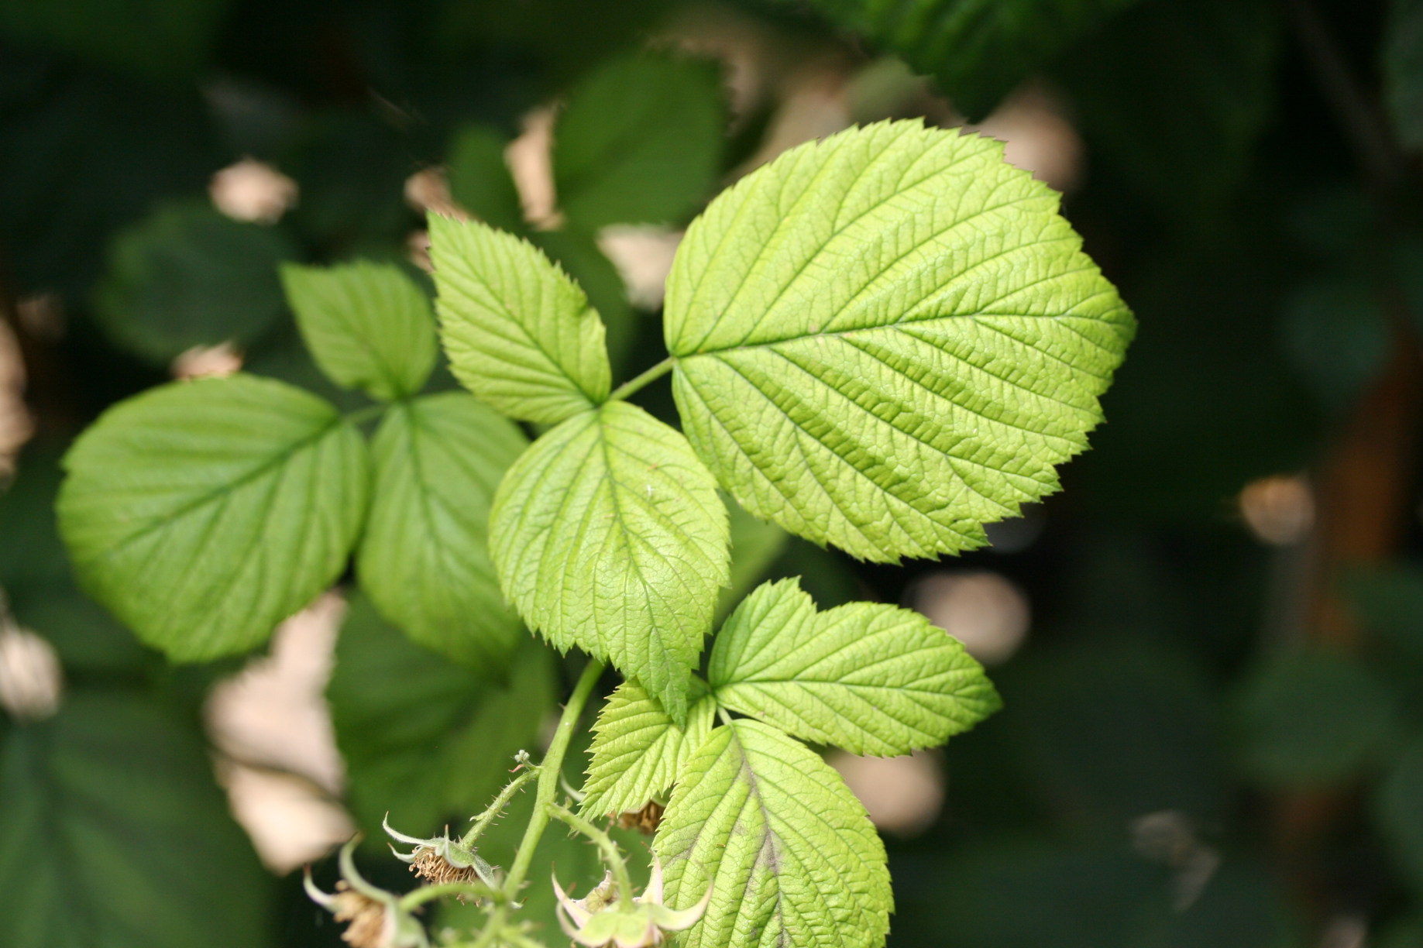

Case Study #1

Slide 7
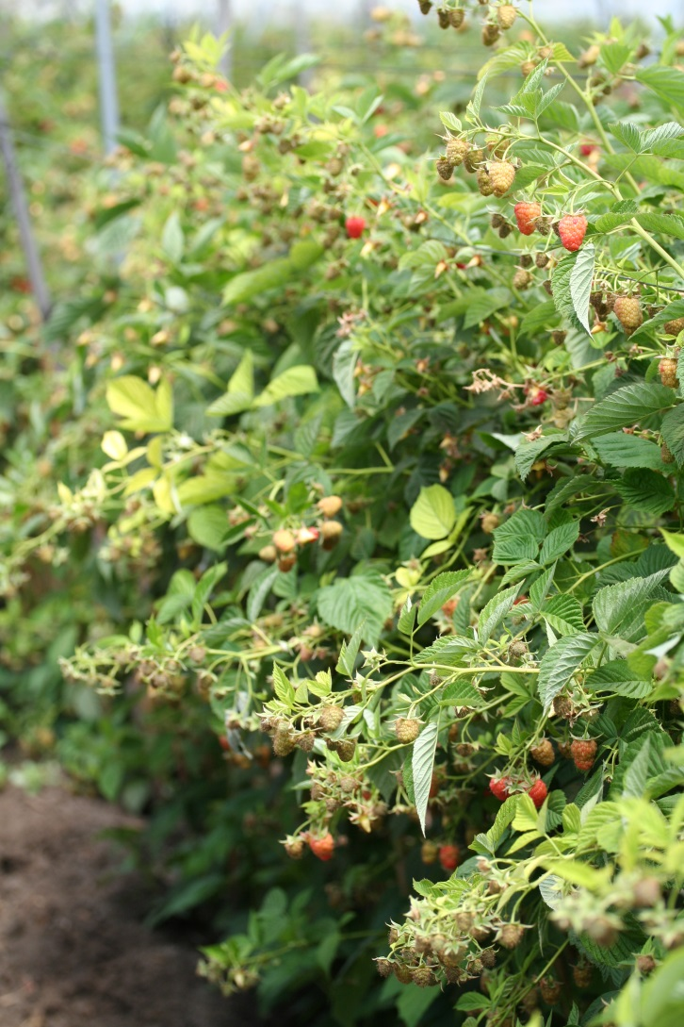
Ends of canes all the same

Slide 8
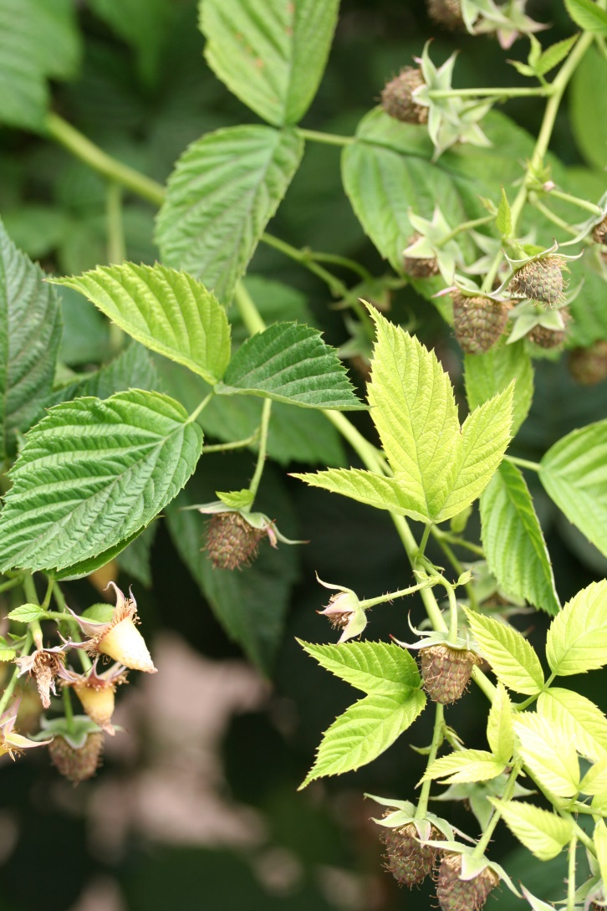
Contrast with older leaves

Slide 9
Average Mineral Concentrations of the Soil
Mineral | Soil Concentration
NO3-N (ppm) | 10.83
NH3- N (ppm) | 5.70
Phosphorous (ppm) | 102.00
SP (%) | 59.33
pH | 7.63
ECe (dS/m) | 0.91
Calcium (meq/L) | 4.73
Magnesium (meq/L) | 2.37
Sodium (meq/L) | 1.63
Potassium (meq/L) | 0.49
Chloride (meq/L) | 1.83
SO4-S (meq/L) | 2.40
SAR | 0.87
Boron (ppm) | 0.65
Copper (ppm) | 1.53
Zinc (ppm) | 4.77
Iron (ppm) | 27.67
Manganese (ppm) | 3.90

Slide 10
Mineral Concentrations of the Leaves
Mineral | Green Leaves | Yellow Leaves | T-test p value
Total Nitrogen (%) | 2.825 | 2.875 | 0.4950
Total Phosphorous (%) | 0.19 | 0.2025 | 0.2394
Potassium (%) | 1.425 | 1.925 | 0.0088
Calcium (%) | 1.675 | 1.375 | 0.0462
Magnesium (%) | 0.4525 | 0.375 | 0.0139
Sulfur (%) | 0.165 | 0.15 | 0.1817
Copper (ppm) | 4.725 | 4.625 | 0.7629
Zinc (ppm) | 14.25 | 14 | 0.3910
Iron (ppm) | 530 | 380 | 0.0270
Manganese (ppm) | 42.75 | 21.25 | 0.0016
Boron (ppm) | 73.25 | 68.5 | 0.2777
Molybdemum (ppm) | 1.625 | 1.55 | 0.7680
Sodium (ppm) | 172.5 | 167.5 | 0.1817
Chloride (ppm) | 5250 | 3125 | 0.0520
Nitrate (ppm) | 1115 | 1800 | 0.3185

Slide 11
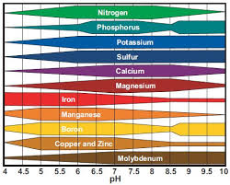
pH Nutrient Uptake Chart

Slide 12
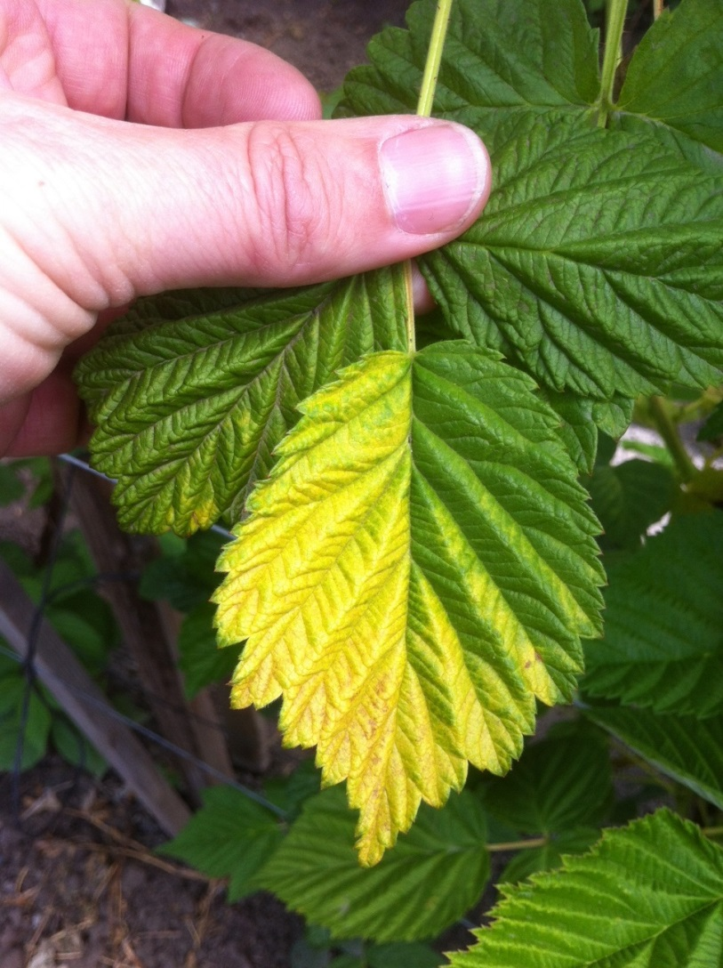
Case Study #2

Slide 13
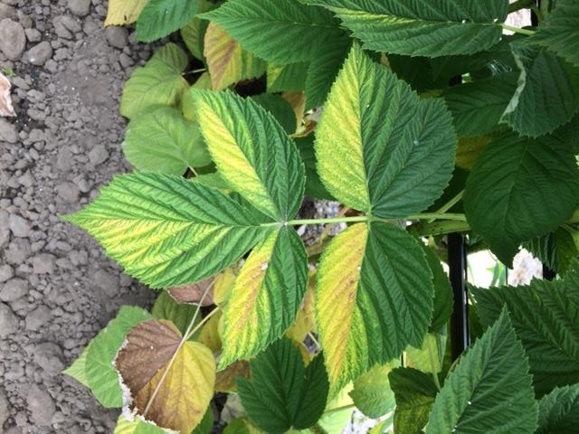
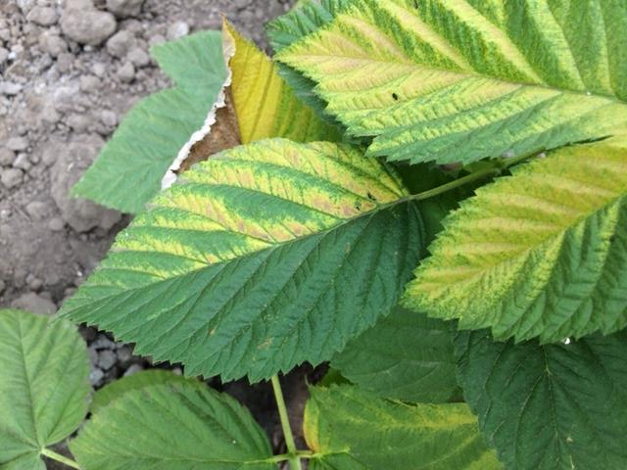
Leaf yellowing at the bottom of the plant

Slide 14
Remobilization of nutrients from dying leaves
Element | Green Leaves | Yellow Leaves
Nitrogen (%) | 3.30 | 2.34
Phosphorous (%) | 0.23 | 0.10
Potassium (%) | 2.06 | 1.25
Calcium (%) | 0.65 | 1.02
Magnesium (%) | 0.29 | 0.46
Sodium (%) | 0.03 | 0.05
Iron (ppm) | 83 | 165
Boron (ppm) | 95 | 167
Zinc (ppm) | 15 | 24
Copper (ppm) | 7.4 | 8.7
Manganese (ppm) | 89 | 123

Slide 15
Soil Samples
Sample Description
Data | Healthy Green | Yellow 1 | Yellow A | Yellow 2 | Yellow 3
NO₃-N (ppm) | 33 | 4.2 | 16 | 4.7 | <2
P (ppm) | 120 | 98 | 130 | 100 | 130
K (ppm) | 240 | 580 | 340 | 210 | 260
Ca (ppm) | 3300 | 3000 | 2700 | 2000 | 2300
Mg (ppm) | 840 | 550 | 400 | 340 | 400
SO₄-S (meq/L) | 8.6 | 1.3 | 7.5 | 4.3 | 4.2
Na (ppm) | 100 | 74 | 53 | 40 | 50
Cl (ppm) | 110.1 | 22.0 | 23.8 | 22.7 | 34.8
CEC (meq/100 g) | 24 | 21 | 19 | 13 | 16
pH | 7.1 | 6.9 | 5.5 | 6.8 | 7.2

Slide 16
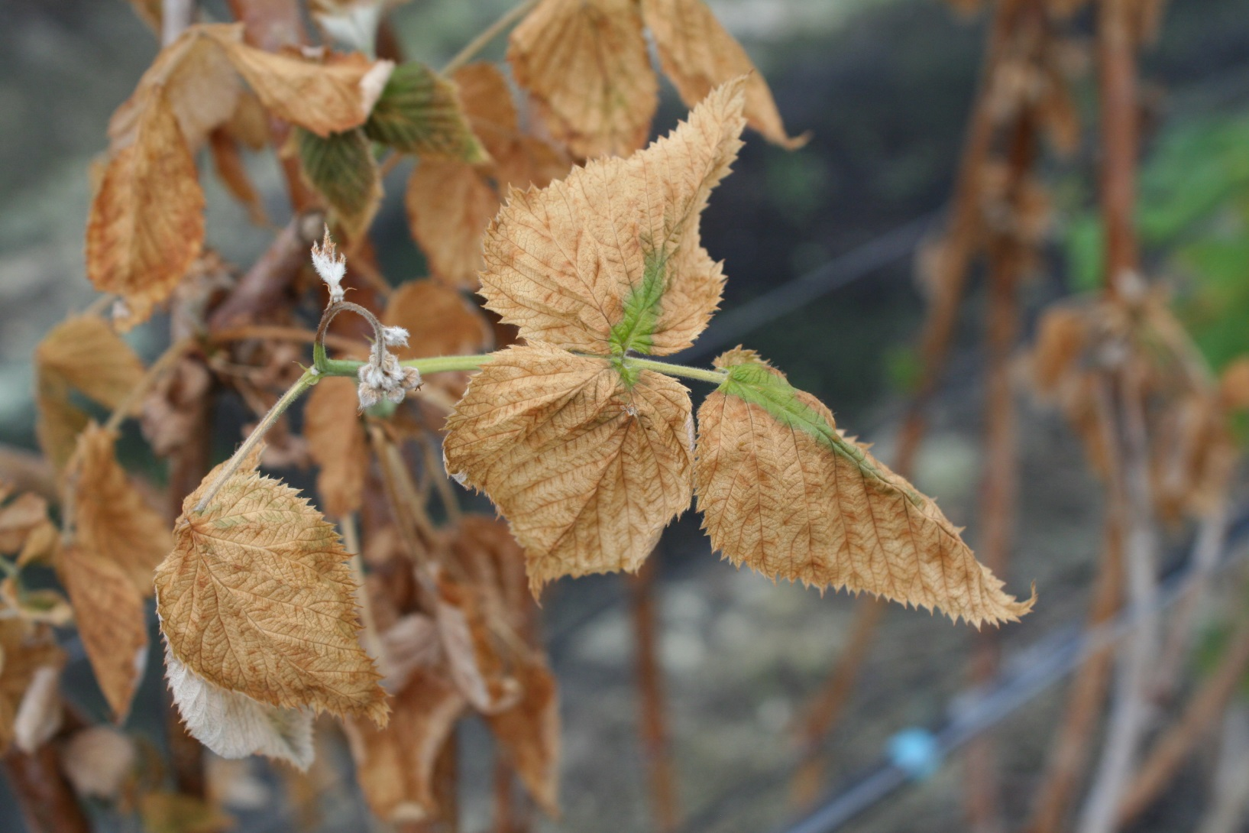
Sodium – 250 ppm
Chloride – 20,000 ppm
Too salty!

Slide 17
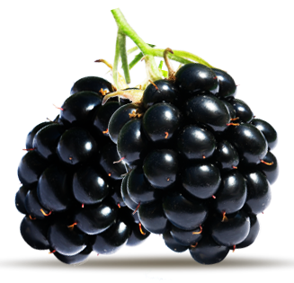
Thank you!

