Slide 1
Optimization of Strawberry Production in Fusarium Infested Soil
Part 1
Mark Bolda, Monise Sheehan, Luis Rodriguez and Joji Muramoto
February 14, 2019

Slide 2
Introduction
Discussion of study and design
Evaluation parameters

Slide 3
Goal
To optimize fumigation and fumigation alternative results by modification of plastic color (i.e. soil temperature) and nitrogen fertilizer use.
Sixteen total treatments.

Slide 5
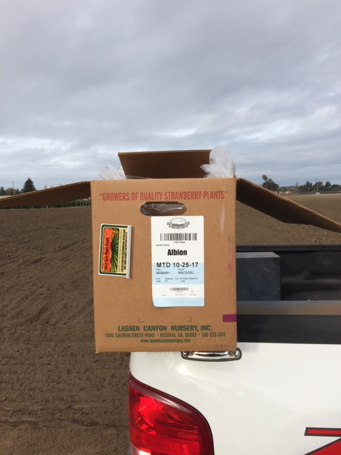
Plant Variety Albion

Slide 6
Evaluation Parameters
Plant vigor measured in plant diameter
Yield per acre and fruit size
Stand loss

Slide 7
Trial Description

Slide 8
Parameters
Grower standard nitrogen use = 97 # per acre preplant
2x grower standard nitrogen use = 194 # per acre
In season nitrogen 75# for grower standard, and 150# for 2x N treatments. Applied as CN9.

Slide 9
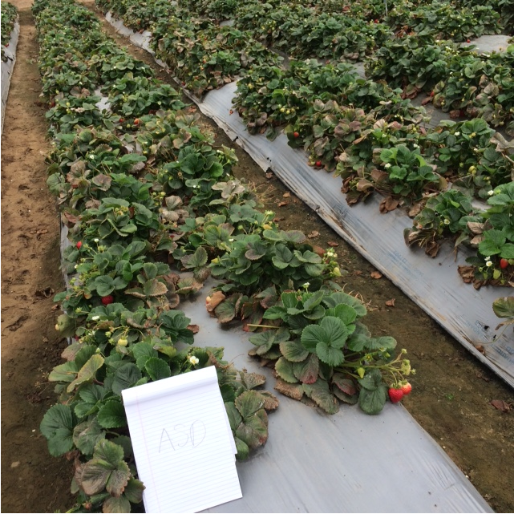
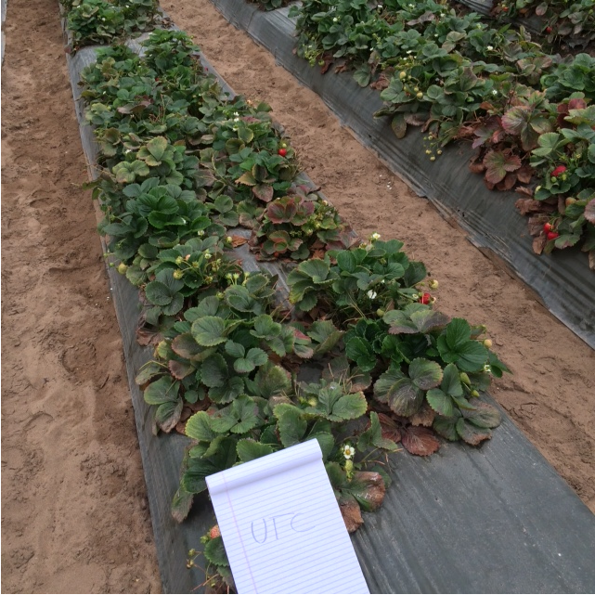
Plastic colors
Silver Green

Slide 10
Fumigation treatments
350 # /acre Triform 80 (chloropicrin)
340 # /acre Dominus (AITC)
8000 # /acre Verdesol
6 tonnes rice bran /acre for ASD

Slide 11
Treatment List
Untreated control, green and silver plastic
Triform 80 (chloropicrin), green and silver plastic
Triform 80 (chloropicrin), green plastic & double grower standard N
Dominus (AITC), green and silver plastic
Dominus (AITC), green plastic & double grower standard N

Slide 12
Treatment List
Verdesol, green plastic only, grower standard rate nitrogen
Verdesol, green plastic only, half grower standard nitrogen
ASD, green and silver plastic (no pre-plant fertilizer)

Slide 13
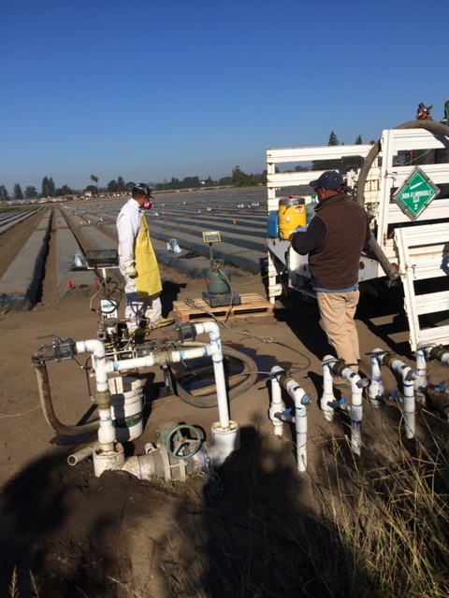

Slide 14
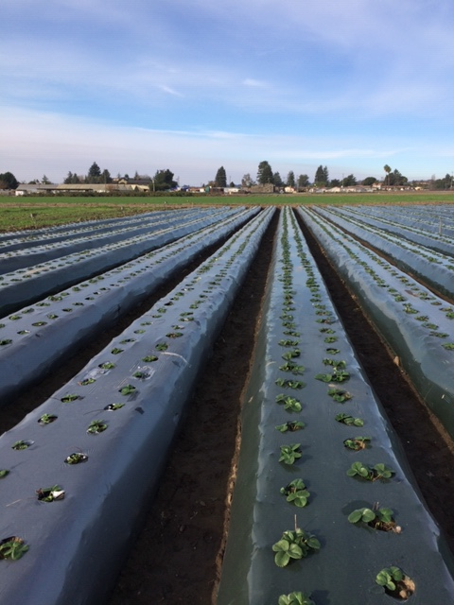
Plant Diameters

Slide 15
Plant Diameters
f ab a bcde def cdef f abc abcd ef bcdef f

Slide 16
Fruit Yields

Slide 17
April Total Yields
de cd de ab de de bcd abc a cde bcd e

Slide 18
May Total Yields
c a a a c c bc bc b c c c

Slide 19
June Total Yields
b a a a bc b b c bc b b b

Slide 20
July Total Yields

Slide 21
August Total Yields
cd ab ab a cd abc bc d cd abc bc d

Slide 22
Season Total Yields
* * *

Slide 23
By plastic color – April Yield Only
c c cb c c c a ab

Slide 24
By Plastic Color – Total Yield

Slide 25
Effect of Higher Nitrogen x Fumigant Season Total
a a
b b

Slide 26
Higher Nitrogen x Fumigant - April
a b

Slide 27
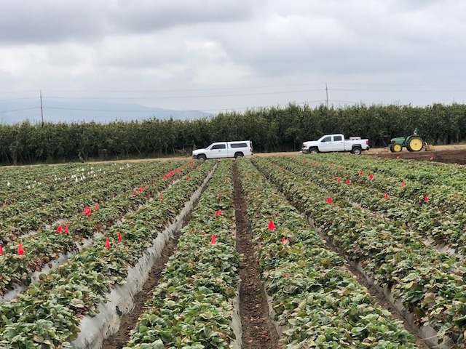
Emergence of Fusarium wilt disease

Slide 28
July 18 % - mortality
cd bc bc bcd b d b a a b b bc

Slide 29
August 25 - % mortality
ab bc bc c ab abc bc a ab abc bc ab

Slide 30
Conclusions
ASD using rice bran fall is not a good choice for Fusarium infested soils, especially under green plastic.
Higher rates of nitrogen result in significantly higher fruit yield early in the season in chloropicrin treated soils.
Chloropicrin gives significantly higher yields of fruit than other alternatives.

Slide 31
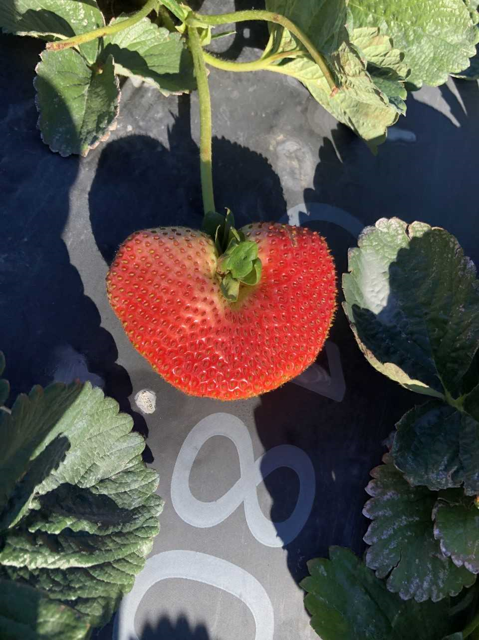
Thanks for coming!

