Slide 1


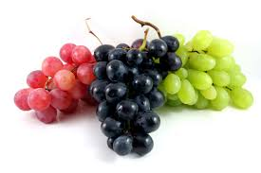
The Home Vineyard
Art Nathan, Enologist/Viticulturist
UC Master Gardener 2011

Slide 2

The Home Vineyard
I. BRIEF HISTORY OF GRAPE GROWING
  Early grape culture
  Grape growing in California
  Effects of 18th Amendment (Prohibition!)
  Post Prohibition
Notes:
V. vinifera
V. labrusca
V. californica

Slide 3
The Home Vineyard
II. HOME VINEYARD CULTURAL PRACTICES
  A. Site selection
  B. Plant selection – Rootstock and cultivars for home vineyard
  C. Planting and early care during First Leaf
  D. Second Leaf care
  Third leaf and beyond
  Pruning principles
  Irrigation
  Pest Control
  Diseases

Slide 4
The Home Vineyard
Brief History….
Family “Vitaceae”; Genus “Vitis”;
  Mostly species “vinifera”. V. labrusca is eastern NA species; V. rotundafolia is found in southern states. French hybrids – inter-species crosses.
Seeds in refuse piles of pile dwellers.
Biblical mentions
Culture began in Asia Minor
Phoenicians moved grapes into Europe
California – Mission grape
  Southern California
  Northern California

Slide 5
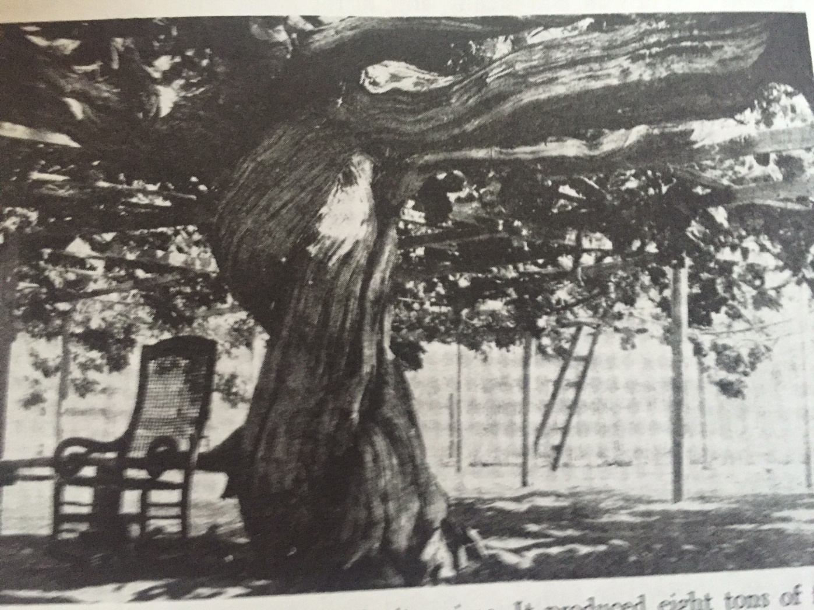
The Home Vineyard
Notes:
Carpenteria vine in1893. Produced 8 tons at 51 years old. *8’ circumference

Slide 6
The Home Vineyard
Site selection:
  Soil types – can be varied between sandy and clay – slightly acid
  pH 5.5 to 6.5
  Grapes do reasonably well in poor, shallow soils
  Vine spacing – depends on soil types and vigor of vines being planted.
Selecting plants
  Rootstocks – may not need if soil free of phyloxera and nematodes.
  Cultivars – dependent on climate for proper ripening.
    Table Grapes
    Wine Grapes
    Raisin Grapes

Slide 7


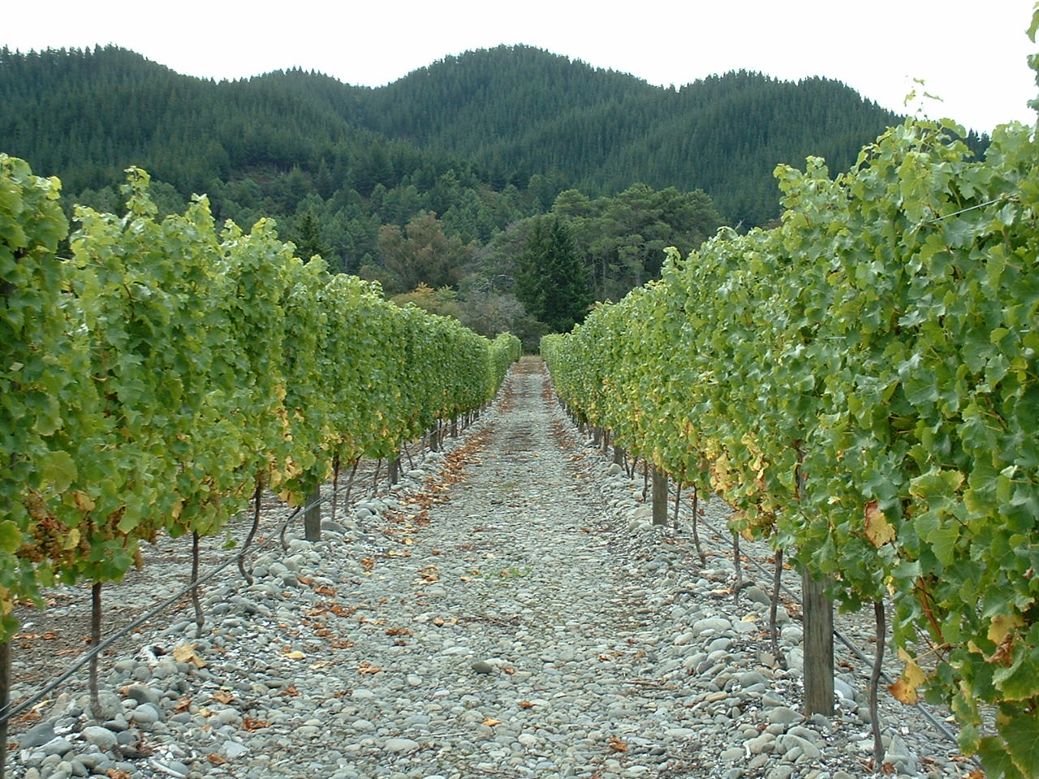
Sauvignon Blanc
Northbank Vineyard, Marlborough, NZ
The Home Vineyard

Slide 8
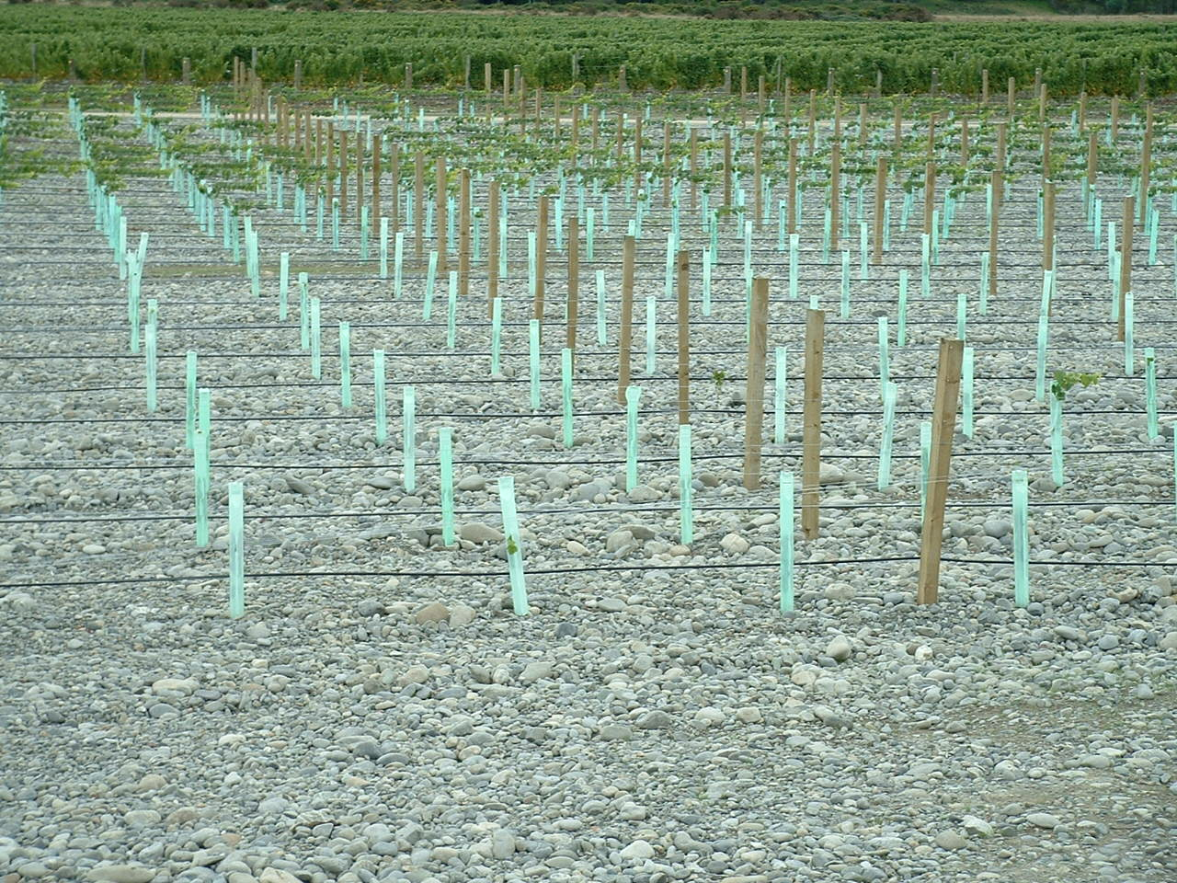
Pinot Grigio (Gris)
Northbank Vineyard, Marlborough, NZ
The Home Vineyard

Slide 9
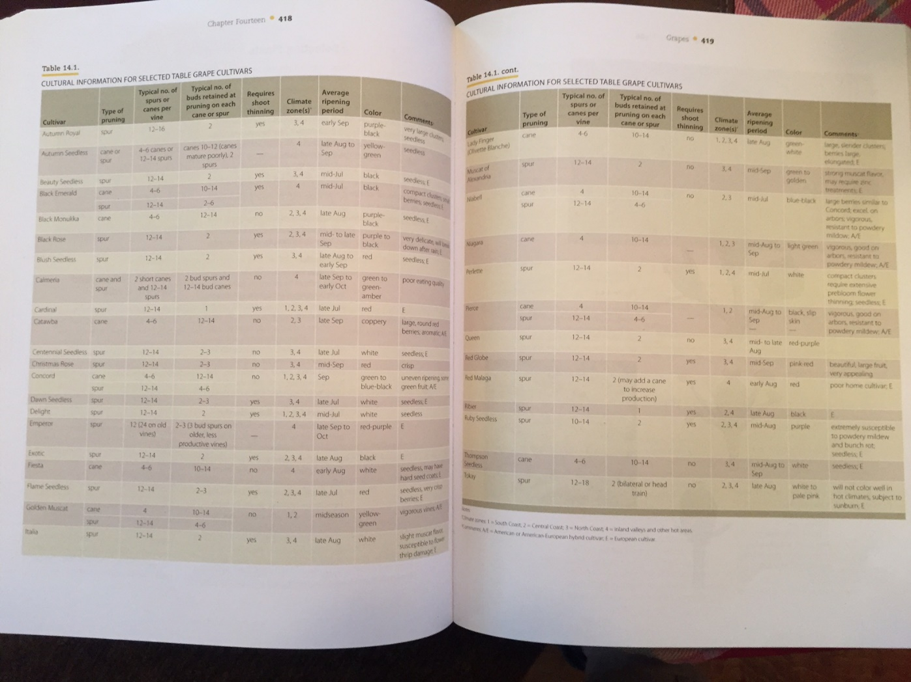
The Home Vineyard

Slide 10
The Home Vineyard
Planting and care during First Leaf
  Planting –
  Soil should be well drained and weed free
  Add “French Drain” if necessary to provide drainage.
  Eliminate rodent pests (squirrels, gophers, moles) if possible
  Plant rooted vines for easier vine establishment
  Trim vine prior to planting.
  Can put cuttings in the ground – will root in ground.
  *Nursery Rows for multiple vine planting*
  Stake vines before or after planting if not growing at fencing.

Slide 11
The Home Vineyard
Planting and care during First Leaf (continued)
  Weed control – mechanical vs. chemical
  NO CHEMICAL weeding the first year!
  Keep soil clean, using care not to damage young grapevine
  Cluster thin – eliminate any potential fruit the first two years.
  Prune after all leaves drop in fall
  Prune to single spur of two buds.
  Maintain vigilance against ground pests like slugs, snails & rodents.

Slide 12
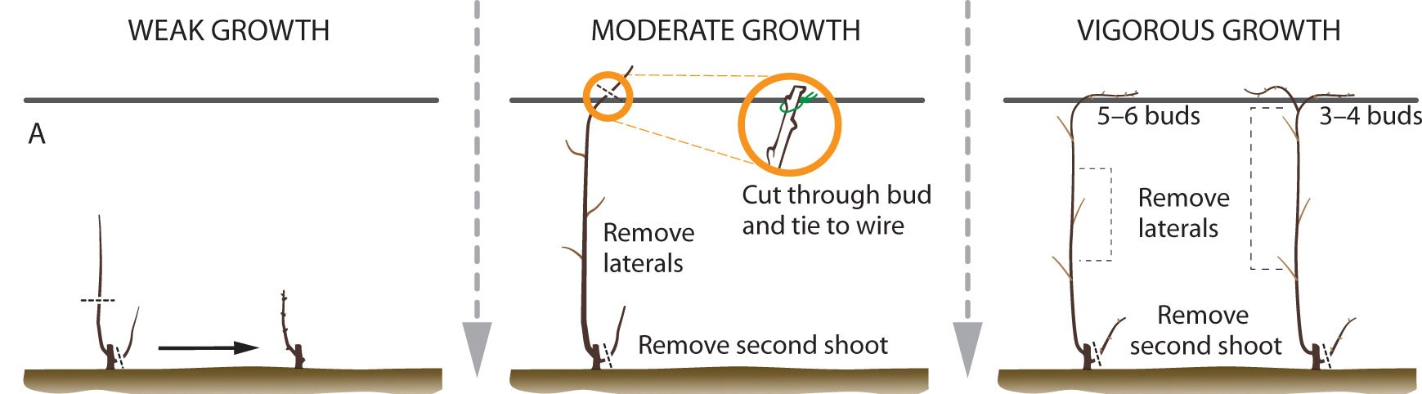
The Home Vineyard

Slide 13
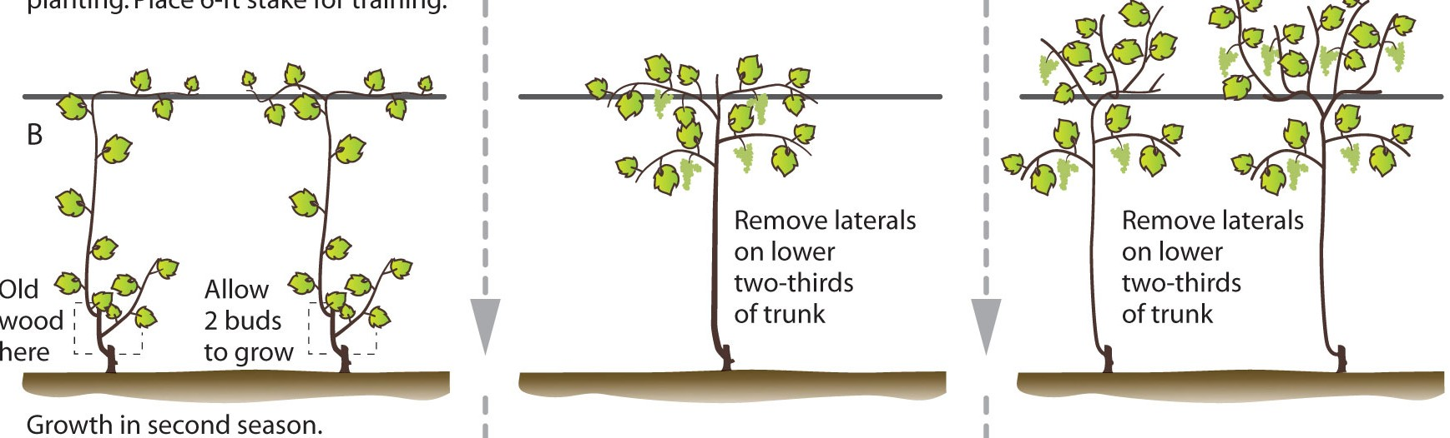
The Home Vineyard
Care During Second Leaf:
  Most care is in training the vine up the stake
    Pick a single shoot
    Leave spur – just in case

Slide 14
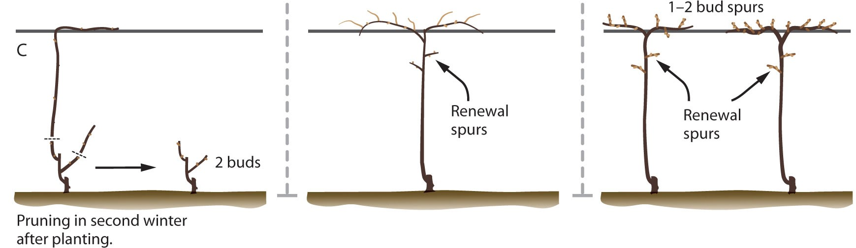
The Home Vineyard
Dormant pruning after end of 2nd Leaf

Slide 15
The Home Vineyard
  Trellising and Training
  Multitude of trellis types and methods for training grapes.
    Easiest and oldest method is a single grape stake, with no wires.
    Wine grapes usually grown on wire from 40 to 42 inches above ground.
    Table grapes generally grown higher, with 5 feet between vine and ground.
    Arbors and other patio structures are quite suitable for training and growing table grapes.
      Allow 50-100 Square feet per grapevine

Slide 16
The Home Vineyard
  Training Systems: 2 Basic Systems
  Cordon Trained
  Head Trained
    Spur pruned
    Cane pruned

Slide 17
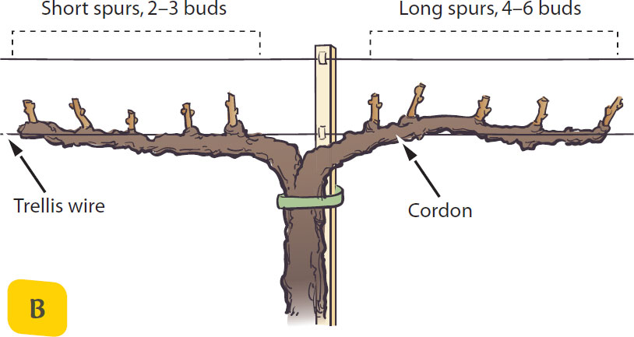
The Home Vineyard
  Cordon Trained

Slide 18
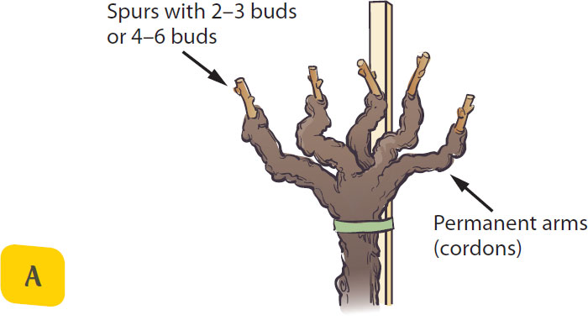
The Home Vineyard
  Head trained, spur pruned

Slide 19
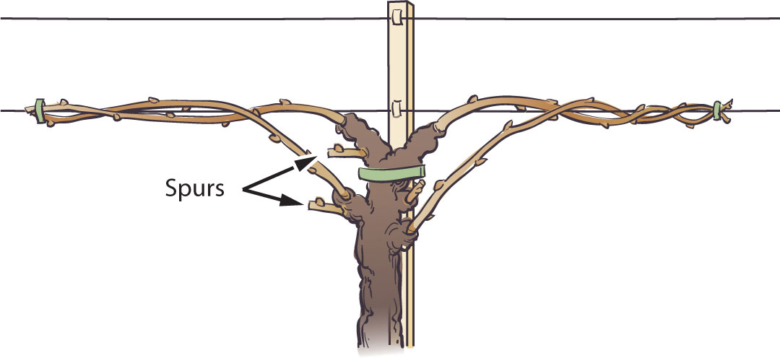
The Home Vineyard
  Head trained, cane pruned

Slide 20
The Home Vineyard
  Principles of Pruning
  1. Pruning has a depressing or stunting effect on the vine; the removal of living vegetative parts at any time decreases the capacity or total productive ability of the vine.
  -Leaf area, number and size determines capacity.

Slide 21
The Home Vineyard
  Principles of Pruning
  2. The production of crop depresses the capacity of the vine for the following year or years.
  - Over cropping when very young can depress vine growth & production for many years, especially large cluster varieties.

Slide 22
The Home Vineyard
  Principles of Pruning
  3. The capacity of the vine varies directly with the number of shoots that develop.
  - Capacity of vine determined by leaf area, NOT how fast the shoots grow.

Slide 23
The Home Vineyard
  Principles of Pruning
  4. The vigor of the shoots of a vine varies inversely with the number of shoots and with the amount of crop.
  - Few shoots with reduced crop will have greater growth than many shoots with crop.

Slide 24
The Home Vineyard
  Principles of Pruning
  5. The fruitfulness of a vine, within limits, varies inversely with the vigor of the shoots.
  - VINE BALANCE IS THE KEY.

Slide 25
The Home Vineyard
  Principles of Pruning
  6. A large cane, arm, or vine can produce more than a small one and therefore should carry more fruit buds.

Slide 26
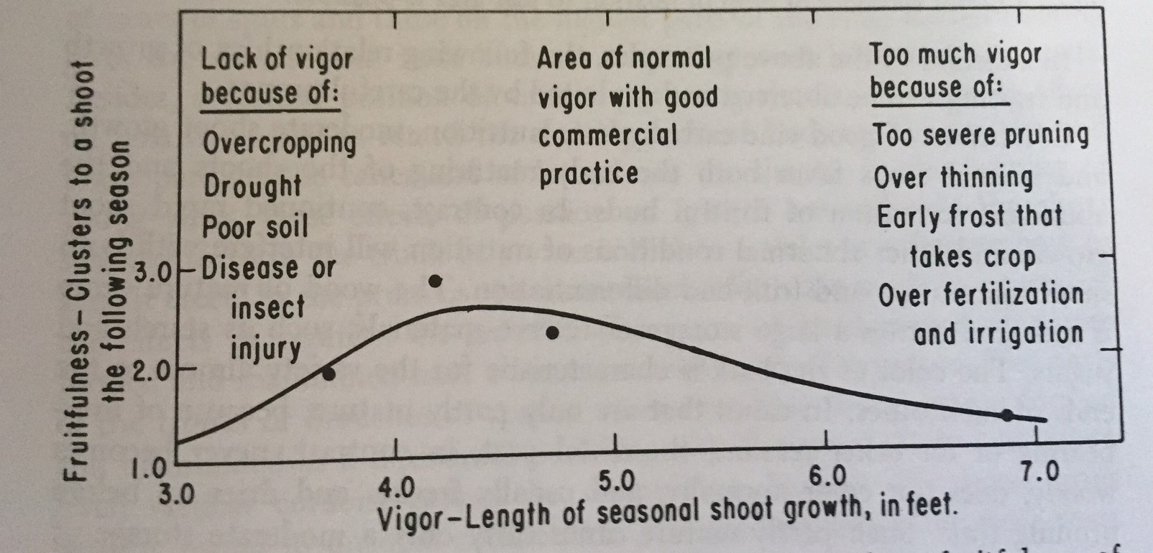
The Home Vineyard

Slide 27
The Home Vineyard
  7. A given vine in a given season can properly nourish and ripen only a certain quantity of fruit; its capacity is limited by its previous history and its environment.
  - Bearing capacity without delaying ripening is IDEAL.

Slide 28
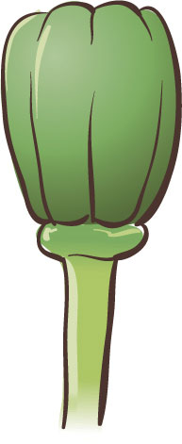
The Home Vineyard
Inconspicuous flowers
  Don’t confuse with developing berries

Slide 29
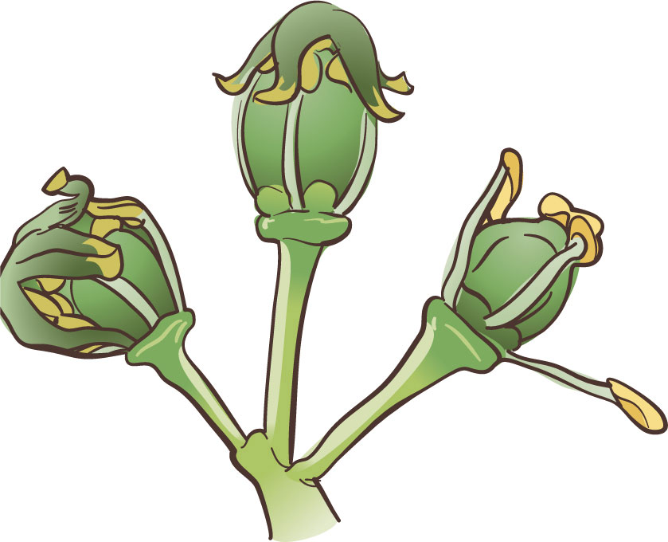
The Home Vineyard
  Bloom Evolves quite rapidly in warm, sunny weather

Slide 30
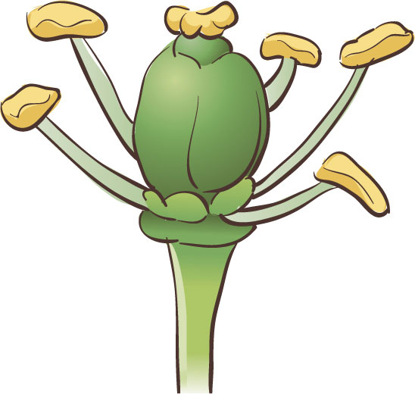
The Home Vineyard
  Flower reaches “full bloom” when calyptra falls off

Slide 31
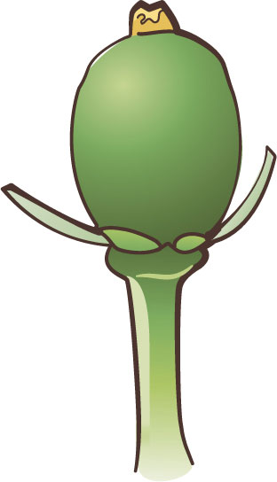
The Home Vineyard
  Stamen fall off and
  berry begins to develop

Slide 32
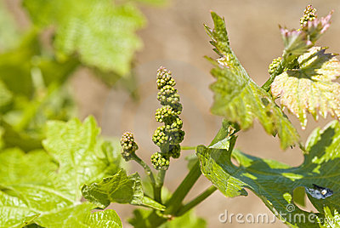
The Home Vineyard
  Grape flowers
before bloom

Slide 33
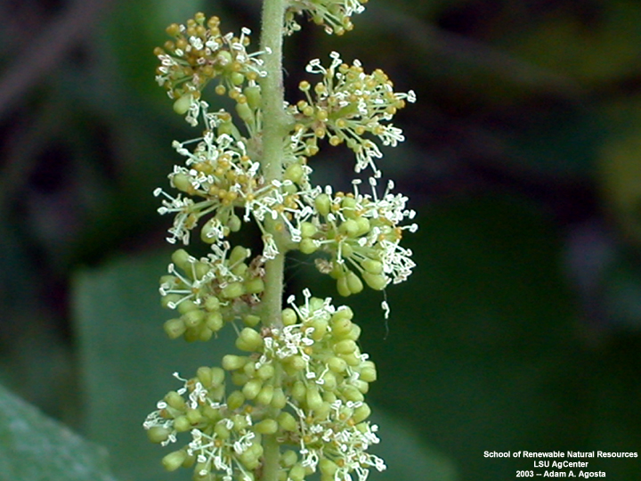
The Home Vineyard
  Grape flowers
mid-bloom

Slide 34
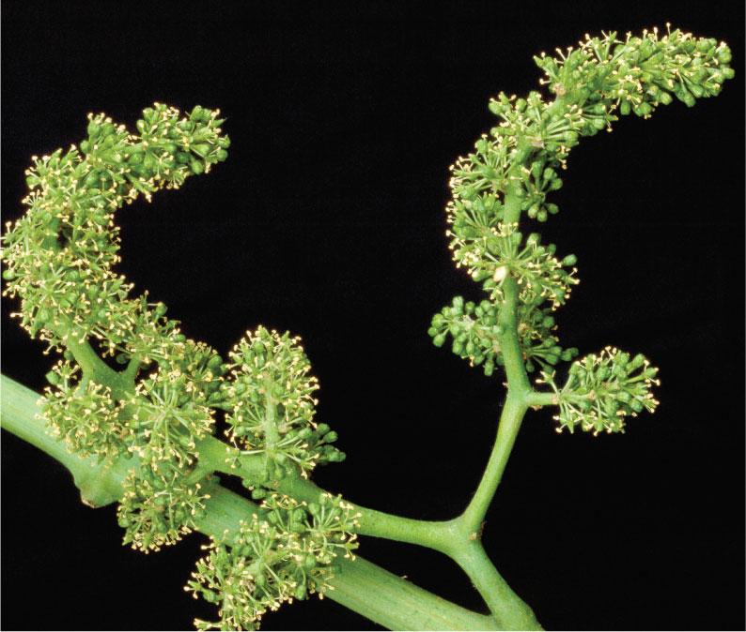
The Home Vineyard
  Grape flowers
full bloom
(85%)

Slide 35
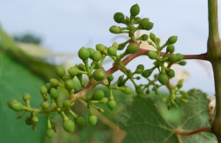
The Home Vineyard
  Grape fruit set
  after shatter

Slide 36
The Home Vineyard
  Producing quality wine grapes:
  Get light on the fruit
  -Crop thinning
  -Leaf thinning
  -Improves fruit color
  -Pest reduction
  -Reduced disease pressure

Slide 37
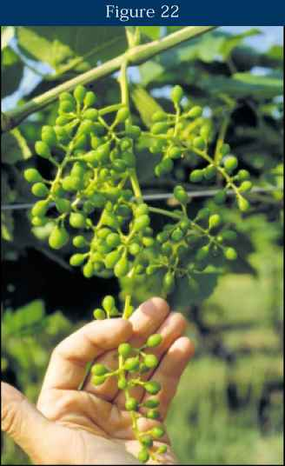
The Home Vineyard
  Producing quality table grapes:
  Thin, thin, thin
    Flower cluster thin – too many blooms
    Cluster thin – vine set too many clusters
    Berry thin – improves berry size.
  Girdling & growth regulators
    Not common in home vineyards

Slide 38
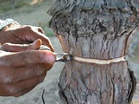


Girdling Procedure

Slide 39
The Home Vineyard
  Irrigation for Grapevines
  Grapes need moderate irrigation – can require up to 10 gallons/day/vine in very warm climates like Monterey south county (Soledad to Bradley.)
    Flood around one or two vines works. Depending on soil, every 2-3 weeks is sufficient.
    Drip irrigation works great but must be done more frequently.
    Avoid stress between bloom and veraison.

Slide 40
The Home Vineyard
  Grape Nutrition
  Grapes have pretty low nutritional needs compared to most crops
  Nitrogen – don’t over fertilize…will lead to extreme vigor, reducing fruitfulness.
  Zinc – can be dabbed on pruning wounds in winter or foliar spray 1-2 weeks prior to bloom
  Potassium – apply to soil 6” deep and 18” from trunk of vine.

Slide 41
The Home Vineyard
  Pest Management
  Invertebrates
  - Leafhoppers, thrips, western grapeleaf skeletonizer, leaf folders, leaf rollers, blue-green & glassy winged sharpshooter (GWSS), light brown apple moth (LBAM), cutworms
  - See UC IPM Guidelines for treatments
  Diseases
    Powdery mildew, Botrytis cinerea, Eutypa sp.

Slide 42
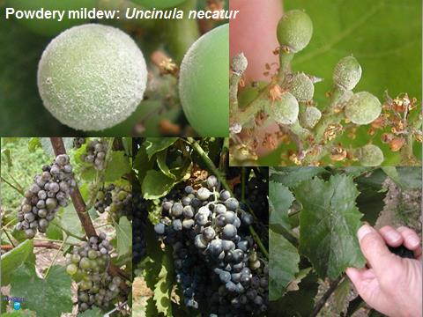
The Home Vineyard
  Pest Management
  Diseases
    Powdery mildew, easily
    Controlled with dusting sulfur
    at 6”, then every 6” until
    veraison

Slide 43
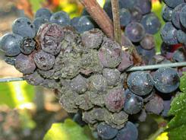
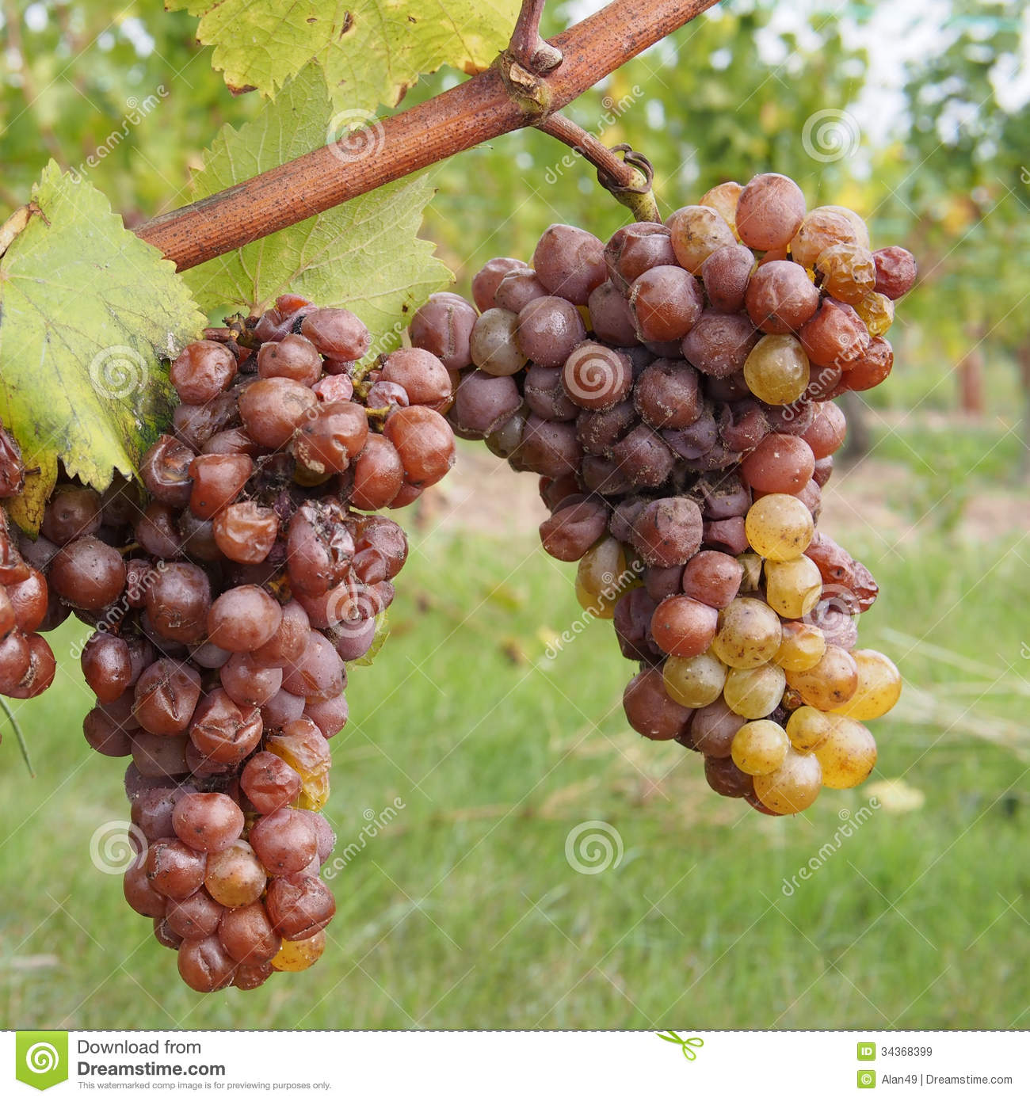
The Home Vineyard
  Pest Management
  Diseases
    Botrytis cinerea (gray
    mold) AKA “Noble Rot”

Slide 44
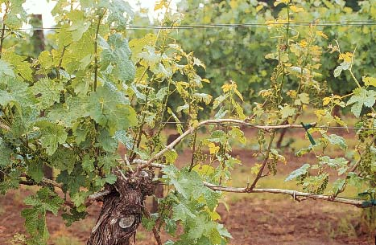
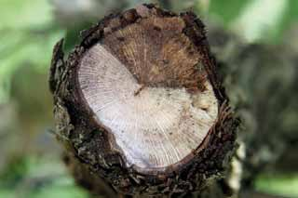
The Home Vineyard
  Pest Management
  Diseases
    Eutypa dieback

Slide 45
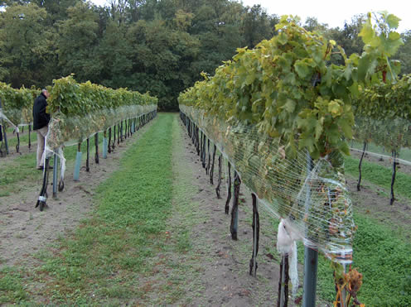
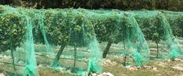
The Home Vineyard
  Birds can be devastating to ripening grapes
  - Apply netting after veraison.

Slide 46
The Home Vineyard
  References:
  California Master Gardener Handbook 2nd edition, UC Press
  General Viticulture 2nd edition, Winkler et. al., UC Press, 1974
  http://cagardenweb.ucanr.edu/Growing_Grapes_in_the_California_Garden/
  Winemaking in California, Ruth Teiser & Catherine Harroun, McGraw-Hill Book Company, 1983

