Slide 1

Sonoma County 4-H
Presentation Day

Slide 2
Purpose
Public speaking skills are ranked #1 among the desired skill sets of professionals.
4-H Presentations help youth develop many life skills including the ability to speak in front of a group, organize ideas, and create and use graphics to support the spoken word.
  Discovering an important component of leadership development
  Increasing self-esteem, self-confidence, and the ability to accept feedback
  Expanding skills for planning, preparation and performance

Slide 3

You can get ideas for presentations from many different sources. A great place to start is with your projects or developing a presentation around your spark.
Other sources for ideas: books, magazines, project manuals, websites

Slide 4
Planning Steps
Choose Topic
Determine Audience
Determine Purpose
Research
Outline
Title
Materials
Practice
Prepare For Questions

Slide 5
Types of Presentations

Slide 6
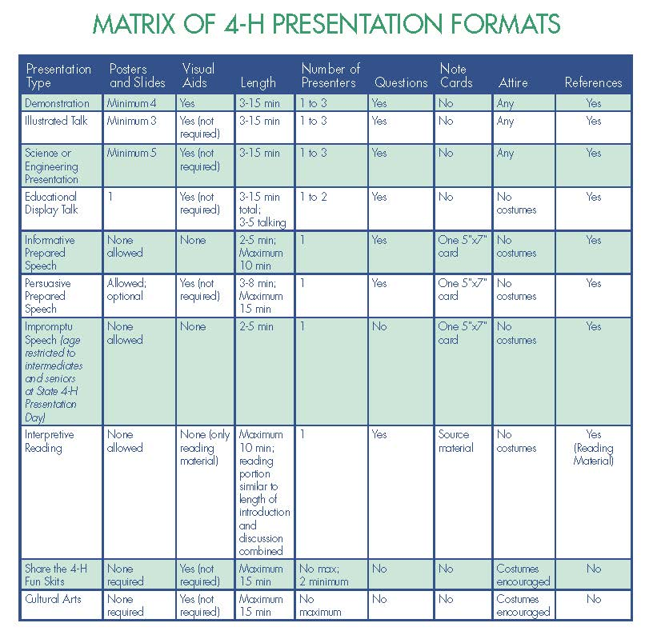

Slide 7
Demonstration
Doing, showing, making
Minimum of 4 posters/ slides
Visual Aides encouraged
Length: 3-15 minutes
Individual or Team
No notes
Costume Acceptable
Example: How to show your rabbit

Slide 8
Illustrated Talk
Talking, telling with the aid of visuals
Minimum of 3 posters/ slides
Visual Aides encouraged
Length: 3-15 minutes
Individual or Team
No notes
Costume Acceptable
Example: The Periodic Table (watch ex. here)

Slide 9
Science or Engineering Pres.
A science presentation emphasizes the core process of inquiry to describe, explain, and predict through observation, experimentation, modeling, and other scientific techniques.
An engineering presentation uses the process of design to plan, build, and test a process, system, or device.
Minimum of 5 posters/ slides
Allowed, not required
Length: 3-15 minutes
Individual or Team
No notes
Costume Acceptable
Example: Gene Matrix in Rabbits (watch ex. here)

Slide 10
Educational Display Talk
Organized visual presentation of a concept
Card Table or Panel Display option
Visual Aides allowed
Length: 3-5 minutes
Individual or Team
No notes
Costume NOT Acceptable
Example: Sheep Pedicures (watch ex. here)

Slide 11
Informative Prepared Speech
Write and deliver speech
No poster or slides allowed
Visual Aides not allowed
Length: 2-10 minutes
Individual only
Notes allowed
Costume not acceptable
Example: Inspiration(watch ex. here)

Slide 12
Persuasive Prepared Speech
The purpose of a persuasive prepared speech is to sway, convince, and influence.
Poster or slides allowed
Visual Aides allowed
Length: 3-15 minutes
Individual only
Notes allowed
Costume not acceptable
Example: Conservation Education (watch ex. here)

Slide 13
Impromptu Speech
Speaker develops a speech themselves at the Presentation Day within three minutes
Topics are randomly drawn the day of
Topics are announced annually early winter & are posted http://4h.ucanr.edu/4-H_Events/SFD/PD/
Length: 3-5 minutes
Individual or Team
No notes
Costume NOT Acceptable
Example: Sheep Pedicures (watch ex. here)

Slide 14
Interpretive Reading
Speakers may read any published written work that is age appropriate and acceptable for use in a public school classroom. Political and religious advocacy is not appropriate
Posters/slides not allowed
No visual aides other than the reading material allowed
Length: no more than 10 minutes
Individual only
Costumes not acceptable
Example: Reflect, React, Respond(watch ex. here)

Slide 15
Share The 4-H Fun Skits
Groups perform acts such as skits and other presentations that focus on health, safety, community pride, citizenship, science, engineering, or technology, or other 4-H projects. The presentation must include a topic surrounding 4-H
Poster/slides: none required
Visual aides encouraged
Length: no more than 15 minutes
Team only
Note cards not allowed
Costumes encouraged
Example: Reflect, React, Respond(watch ex. here)

Slide 16
Cultural Arts
Individual participants or groups, projects and clubs, perform a costumed dramatic reading, musical, dance, or other such performing art
Posters/slides not required
Visual Aides encouraged
Length: no more than 15 minutes
Note cards not allowed
Costumes encouraged

Slide 17
Mechanics of Presenting
Be Conscious Of:
Body Position
Standing & Posture
Speaking Voice (volume, pitch, dynamics)
Eye Contact
Gestures & Movements

Slide 18
Visual Aids
Posters & Slides

Slide 19
Lettering
Use bold letters for headings where you want to make a point.
The use of plain lowercase letters makes charts easier to read. They should also be used for sub- items in a list and additional information.
Use a font and large size letters that are easy to read from the back of the room.
Use capital letters, italics, and/or color to provide emphasis. Use strong and forceful headlines.

Slide 20
Posters
When visual aids are the same size, they are easier to handle, and you appear more organized and professional.
Make sure you have adequate color contrast.
Avoid using pastel colors.
Lettering should be 1 ½ inches in height and/or 125 point text or larger

Slide 21
Digital Slides
Lettering should be at least 24 size font.
Keep text to a minimum.
Text should be used as an outline.
Use photographs and graphics that support the message of each slide.
Use bullet points.
Avoid using pictures as backgrounds for slides

Slide 22
Visual Aid Checklist
Visibility
Simple
Interest
Useful
Structure
Information
Spelling

Slide 23
Responding to Questions
Listen to the entire question before you begin to answer any questions.
Repeat the question out loud so the entire audience can hear it.
Respond to the question honestly and the best you can. If you do NOT know an answer to a question, tell them you do not know the answer.

Slide 24
Evaluation
Each presentation type has its own evaluation form, which can be found in the Manual.
Two evaluators will be present for each presentation. Their job is to assess how well a presentation is performed and how requirements are met. Helping youth improve their public speaking abilities is the #1 goal of an evaluator.
Placing is determined by predetermined scoring key based on event location and type of presentation

Slide 25
Steps to Success
Prior to:
  pre-register through the county process
  review the requirements for your chosen type of presentation
  review the evaluation form for your type of presentation
  practice multiple times
Day of:
  arrive to the venue dressed appropriately, on time, and with all your needed equipment
    A room host is assigned to each room, they will introduce you to the evaluators once you are ready to begin

Slide 26
Resources
Sonoma County 4-H Website
  http://cesonoma.ucanr.edu/4H/
  County Event information
  This presentation
CA 4-H Website
  http://4h.ucanr.edu
  Presentation Manual, Video Examples, Area & State Event information

Slide 27
Time to get started!
Choose your topic- pick something that you are passionate about!
Look at the different format options (10) & decide what fits with your vision
Start to prepare- research, create an outline, choose a title
Materials- props, posters, slides…
Practice, practice, practice! Prepare for questions.

Slide 28
Questions?
Tessa Matuszak, 4-H Program Lead
707-565-3443
tessa@ucanr.edu
Jesenia M., 4-H Admin.
707-565-2681
jesenia.mendoza@Sonoma-county.org
Sara Glashan, Event Coordinator
707-480-1446
skglashan@sbcglobal.net

