Slide 1
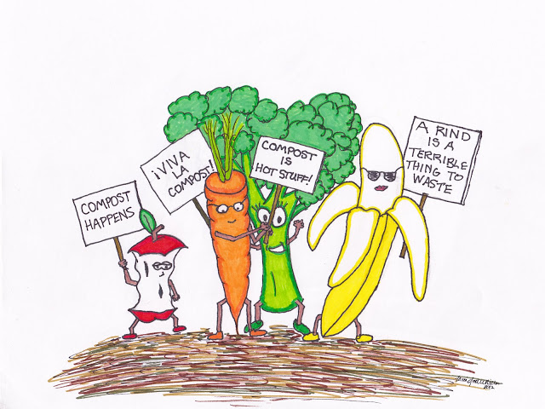
Composting at Home:
Turning Waste into Treasure
Presented by:
Melanie Burgess
Bridgette Ballatore
UCCE Composting Education Program

Slide 2
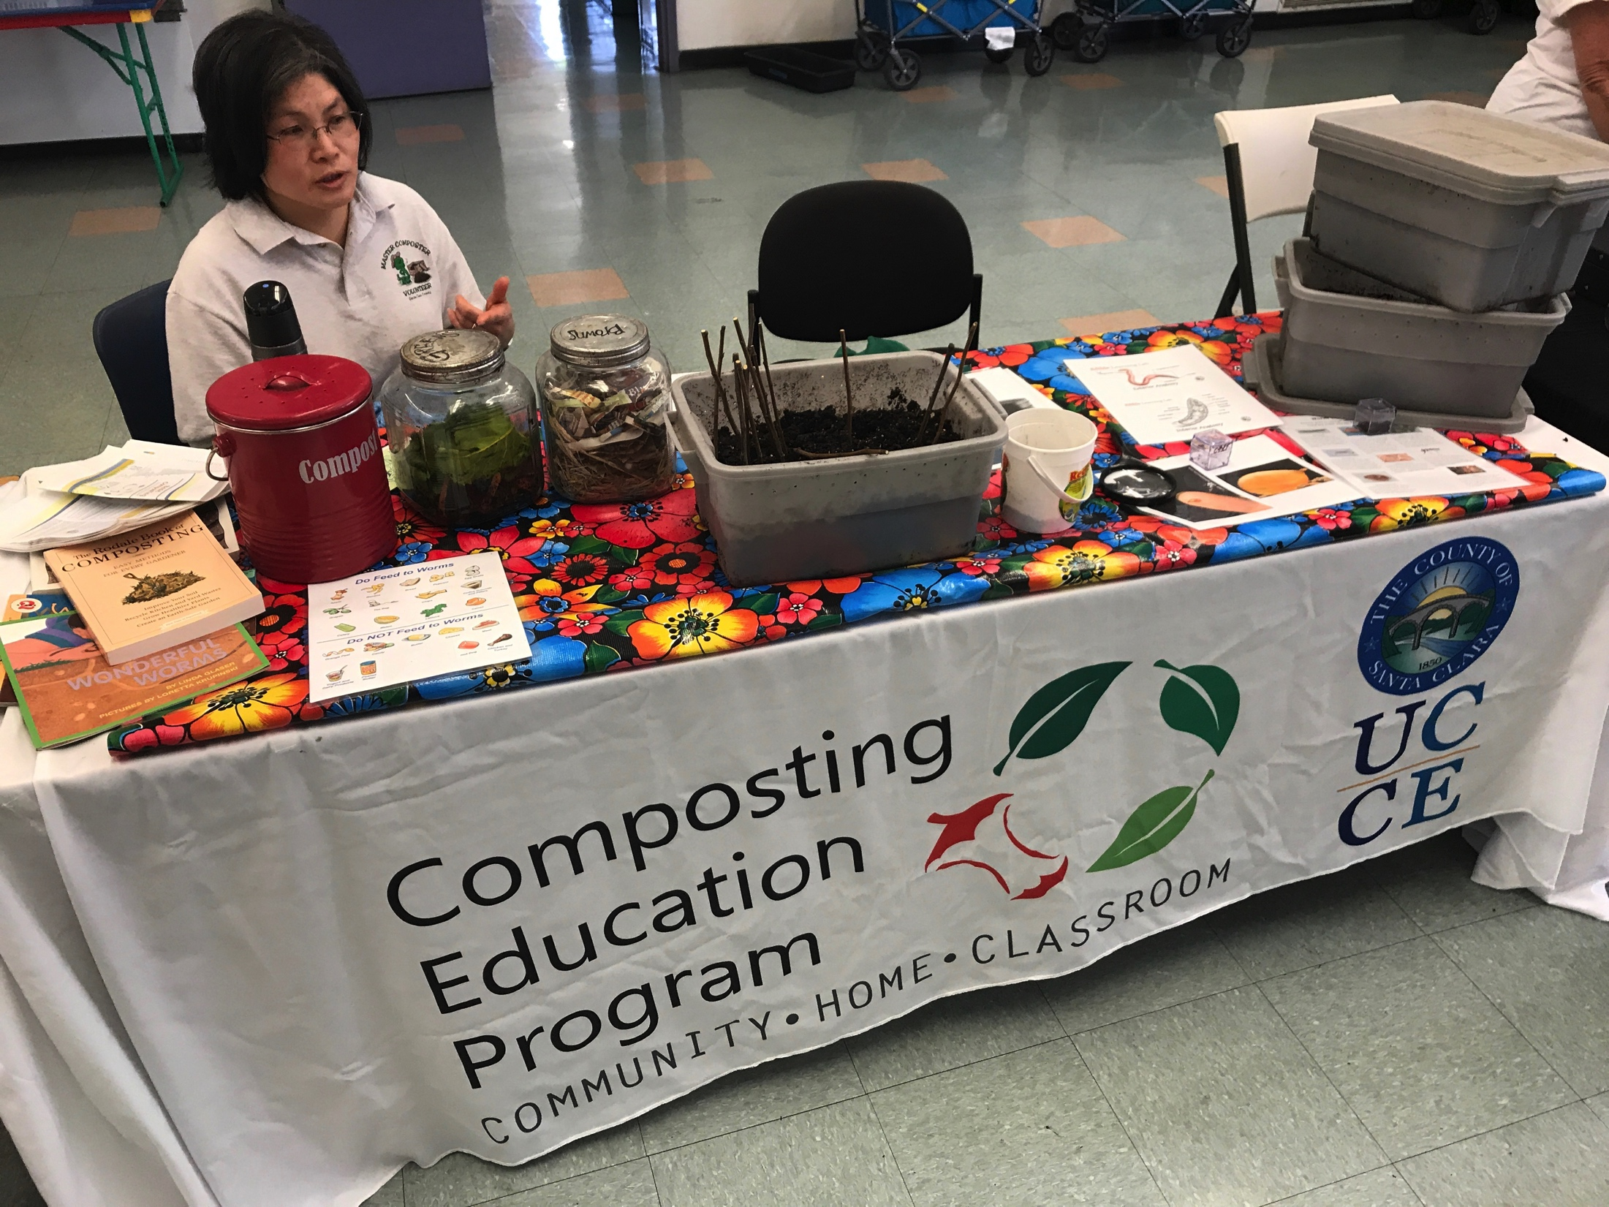
University of California Cooperative Extension
Master Composter Program of Santa Clara County
WHAT WE PROVIDE
  Master Composter Trainings on even years (Next 2020)
Composting education to Santa Clara County residents
Monthly composting workshops at various locations
Sell discounted compost and worm bins
School composting education
CONTACT US
Rotline (408) 918-4640
http://cesantaclara.ucanr.edu/Home_Composting_Education/

Slide 3
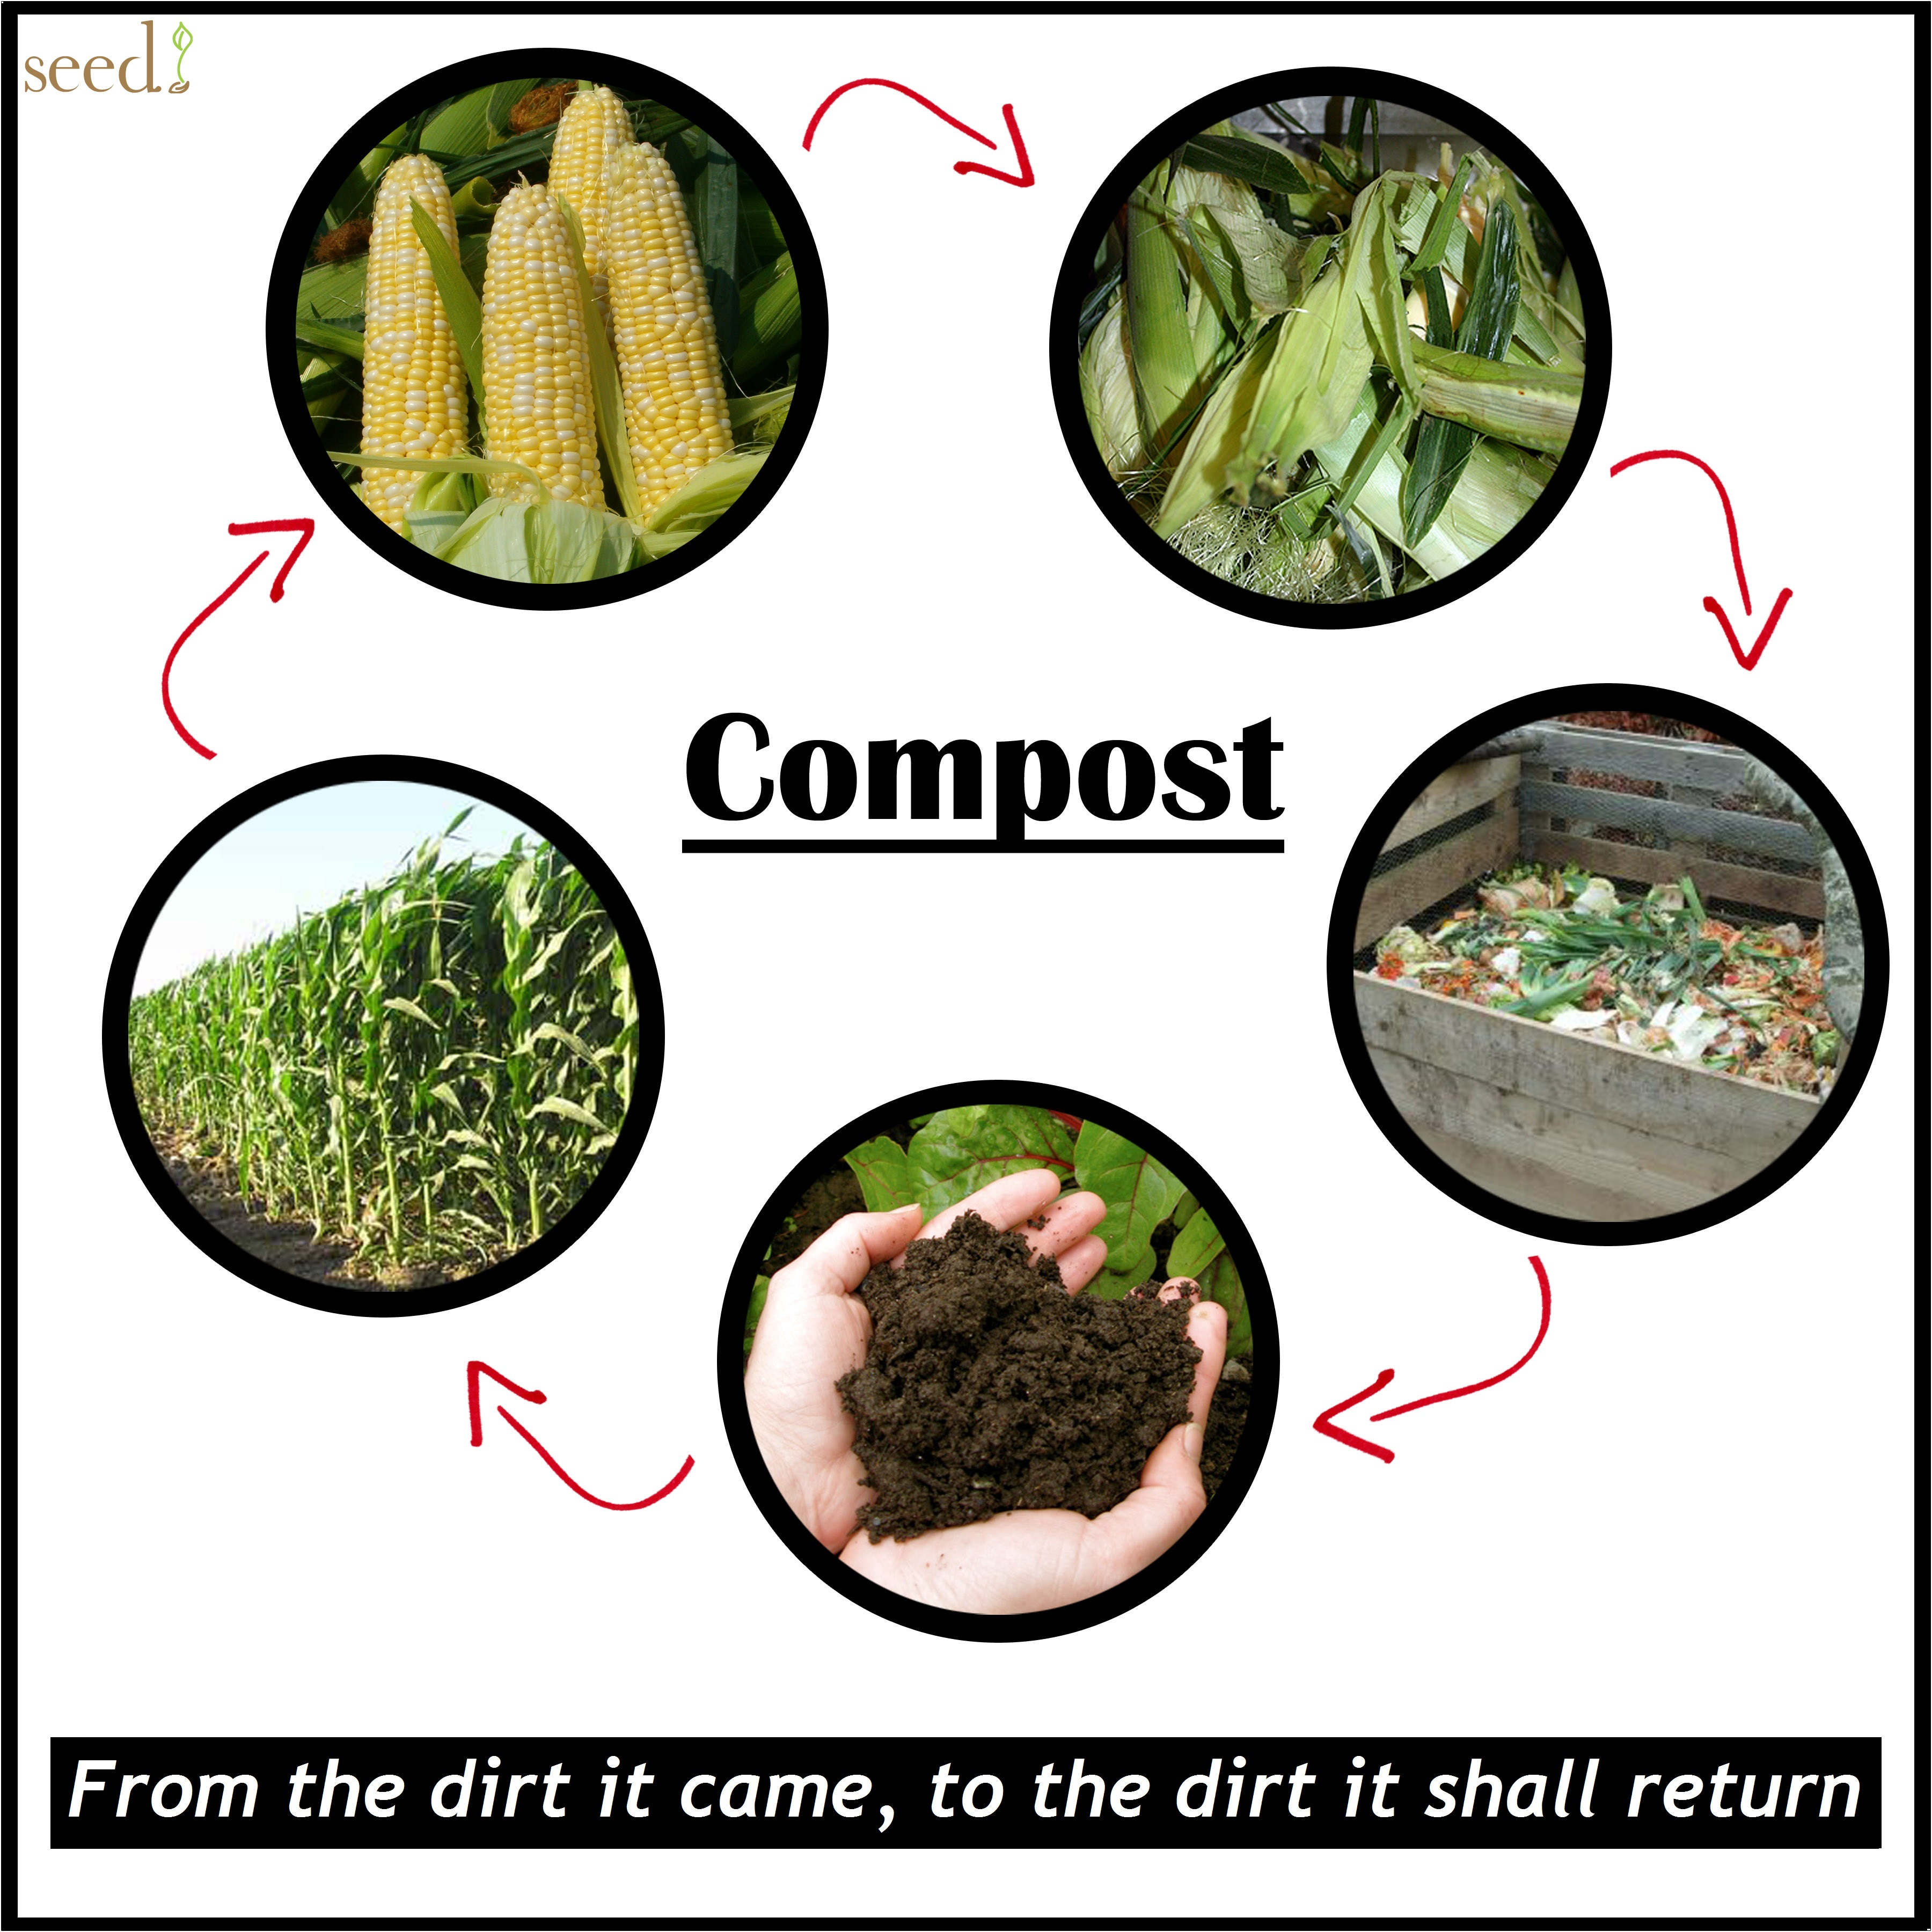
WHAT IS COMPOST?
DECAYED ORGANIC MATERIAL
A mixture that consists of decayed organic matter and is used for fertilizing and conditioning land
BIOLOGICALLY ACTIVE
High concetrations of beneficial microbes
FREE
Other than time you don’t need $

Slide 4
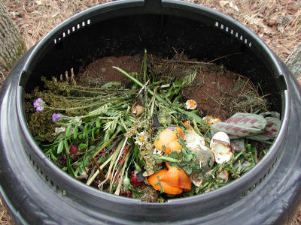
WHY COMPOST?
DIVERTS WASTE
  Reduces methane emissions
  Increases water retention
  Reduces irrigation requirements
IMPROVES SOIL
  Increases nutrient-holding capacity
  Reduces need for chemical fertilizer
SEQUESTERS CARBON
  Creates stable forms of carbon
SUPPRESSES PATHOGENS
  Provides bio-filtration
  Supports beneficial microbes

Slide 5
COMPOSTING DIVERTS WASTE
Notes:
Municipal Solid Waste
ADD FOOD + PAPER + YARD TRIMMINGS = 54.2% OF ALL WASTE THAT CAN BE DIVERTED INTO SOMETHING USEFUL
2012 = 55.4%

Slide 6
COMPOSTING DIVERTS WASTE
Notes:
Largest inputs are Yard Trimmings, Food and Paper Products.

Slide 7
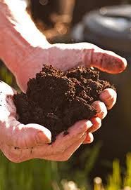

COMPOSTING IMPROVES SOIL
Lightens clay soils
Helps sandy soils retain water
Aeration
Reduces runoff and soil erosion
Adds beneficial microbes
Slow release nutrients
  (N-P-K = 1-1-1)
Adds organic matter
Encourages healthy root stucture
Balances PH
Moderates soil temps
Attracts and feeds FBI’s

Slide 8
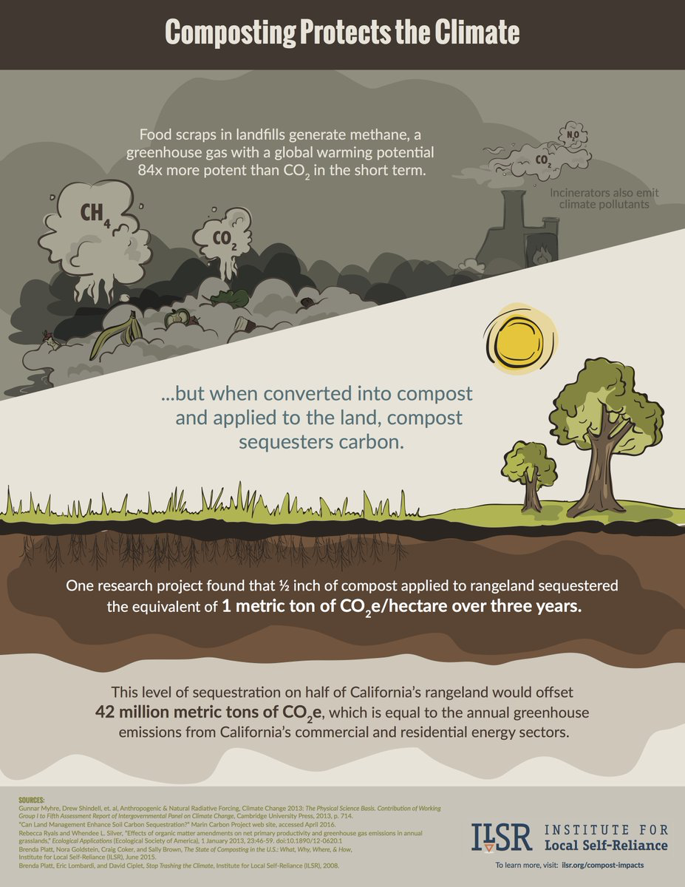
COMPOSTING SEQUESTERS CARBON
Soil carbon sequestration is the process of capuring Carbon from the air mostly through plant photosynethsis. This process provides nutrients for the soil while reducing the amount of carbon dioxide in the atmosphere.
Notes:
Through Photosynthesis a plant draws carbon out of the air to form Carbon compounds. What the plant doesn’t need for growth is exuded throught the roots to feed soil organisms whereby carbon is rendered stable.
https://www.marincarbonproject.org
Increased soil water holding capacity by 17-25%
Increased forage production by 40-70%
Increase soil organic matter from 1% to 2% it would mitigate all CA’s residential, commercial, and livestock emission and increase water holding capacity by over 1 million acre feet

Slide 9
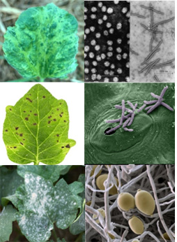
COMPOSTING SUPPRESSES PATHOGENS
IMPROVED SOIL
Improves physical and chemical properties of soil
ADDED DIVERSITY
Increases the number and diversity of bacteria and fungi
OUT NUMBERED
Soil diveristy out numbers soil pathogens.
REDUCED
Some Diseases have been reduced by 80% in areas with high compost rates

Slide 10
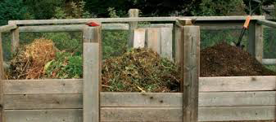
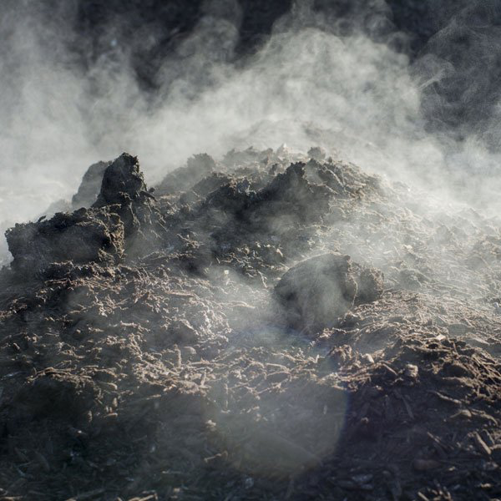
COLD COMPOSTING
HOT COMPOSTING
vs.
COOL TEMPS
70-110F
PROS
Less labor intensive
More worm friendly
Can add material slowly
CONS
Slower (6 months to a year)
Does not Kill Pathogens or weeds
HIGH TEMPS
110-165F
PROS
Faster (weeks-months)
Kill pathogens and weeds
CONS
Very labor intensive
Need all materials ready to go
Notes:
Mesophilic
Thermophilic
FOCUS ON COLD COMPOSTING FOR HOME OWNERS

Slide 11
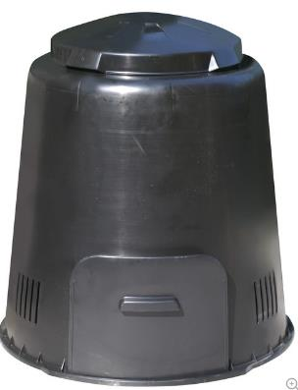
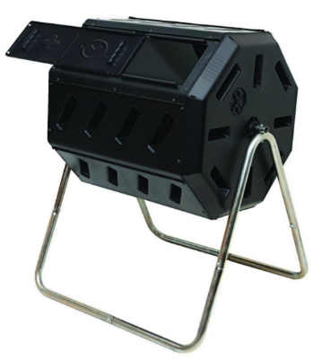
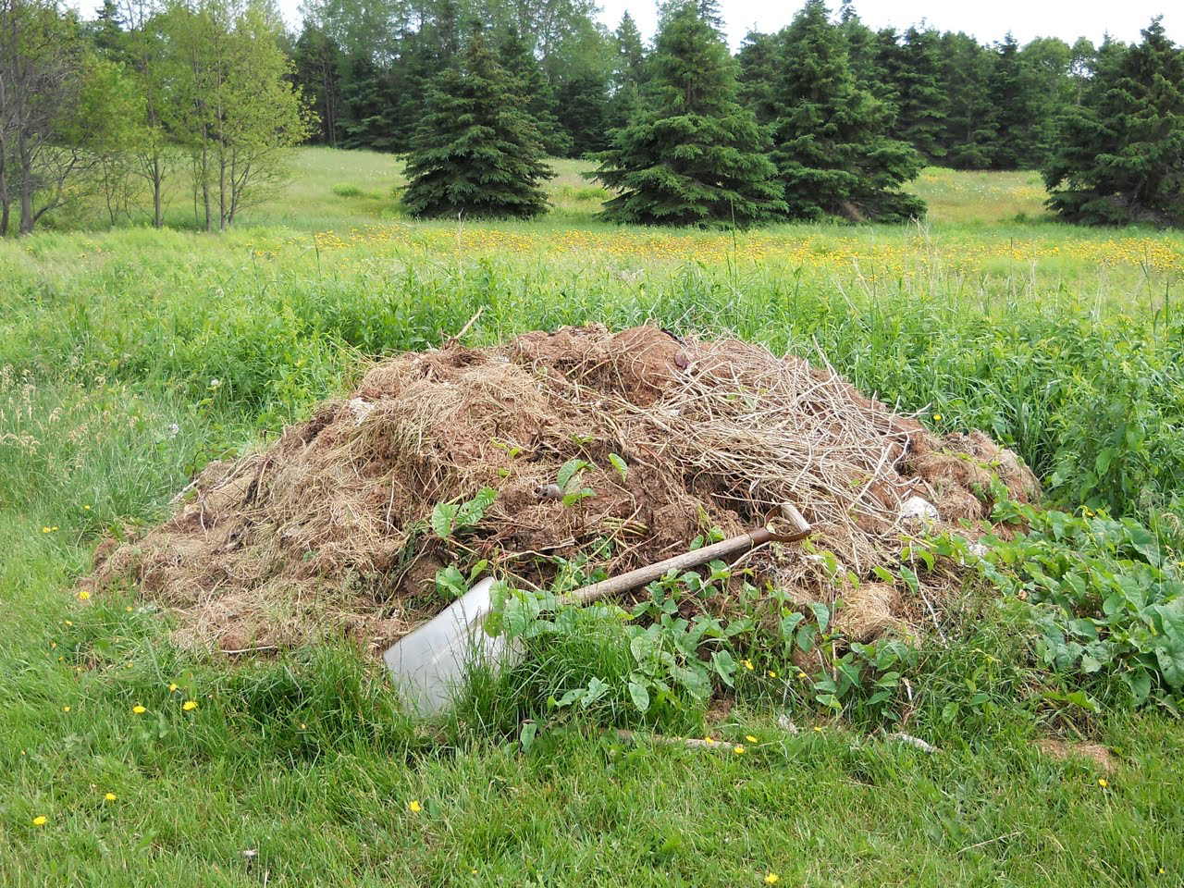
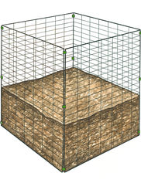
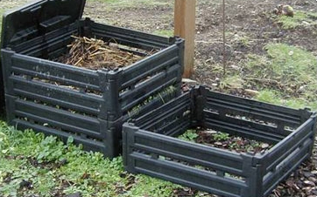
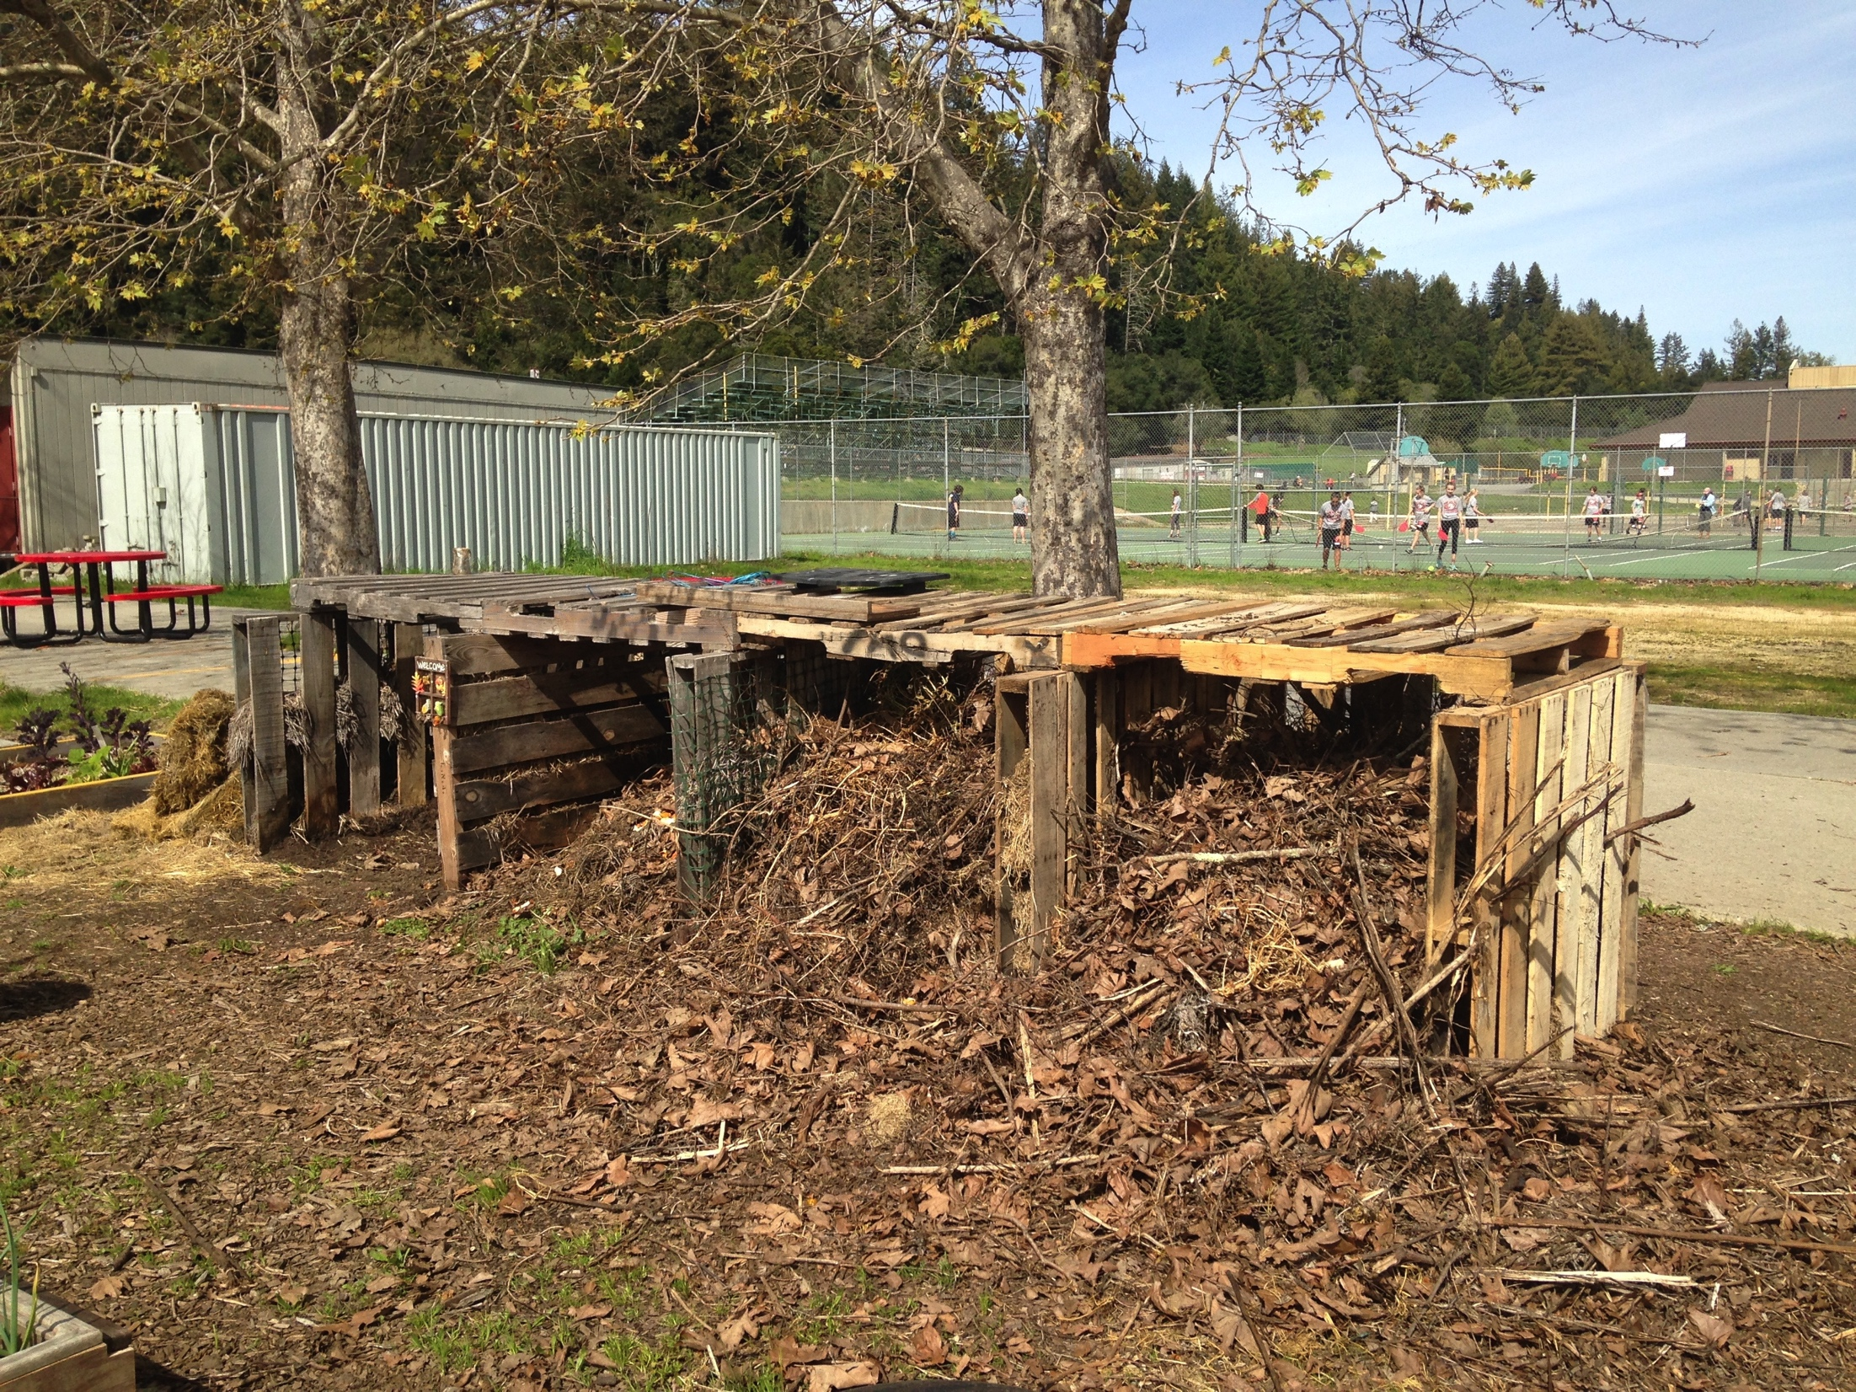
INFRASTRUCTURE
Cost
Size (3’ x 3’ x 3’)
Ability to turn the pile
Pest resistance
Notes:
Here are some samples of shelters or bins.
3 Bin Style Tumbler
Homemade types Open Pile
Mesh or metal wire fencing
Bins need holes for plenty of air.

Slide 12
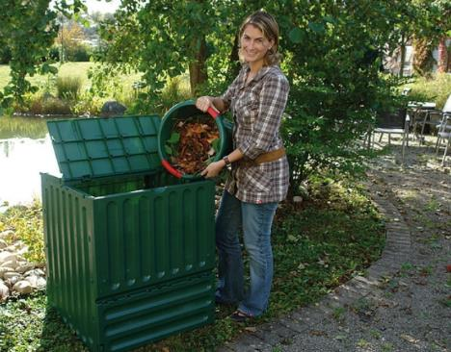
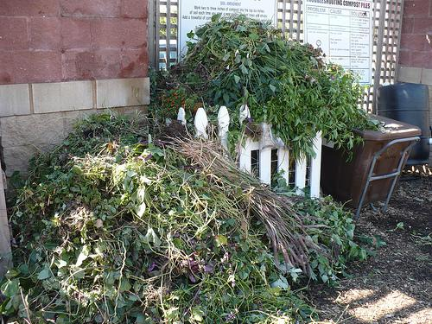
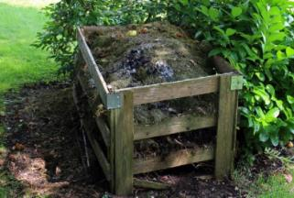
SITE ASSESSMENT
CONVENIENT
  Access to material
  Maintain the pile
MOISTURE
  Not too wet or dry
  Sunny or shady
  Near water source
PROTECTION
  From Pests

Slide 13
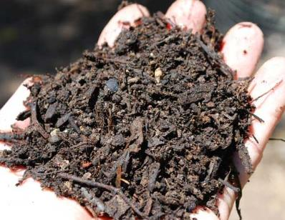

COMPOST RECIPE
+
FBI’s
Fungi
Bacteria
Invertebrates
+
Browns
Greens
Air
Moisture
Time
=
Notes:
Invertebrates
are living things that do not have backbones like we do.

Slide 14
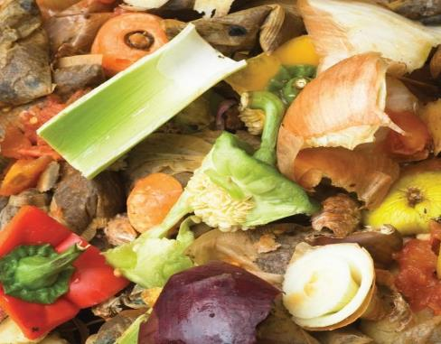
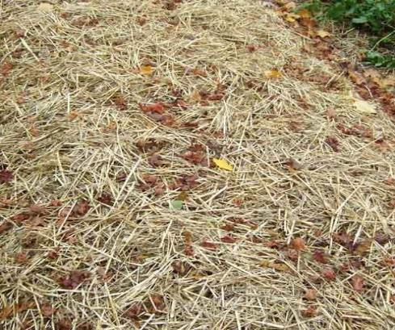
MATERIALS
50% GREENS (Nitrogen)
  Manure from plant eating animals
  Grass clippings
  Food scraps
  Green plant cuttings
  Coffee grounds or tea bags
  Eggshells
50% BROWNS (Carbon)
  Cardboard and Newspaper
  Straw
  Dry leaves
  Sawdust (not treated)
  Woody cuttings
50%
50%
Notes:
Eggshells are a mineral additive Calcium Carbonate. They reduce acidity and help to aerate

Slide 15
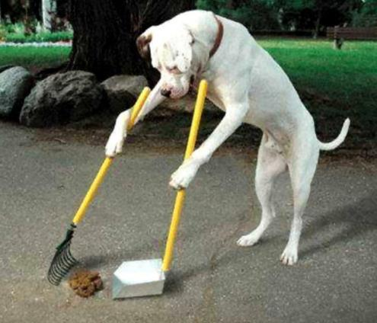
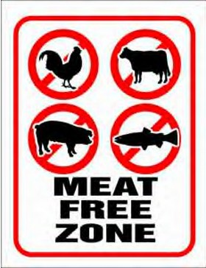
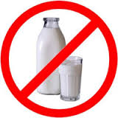
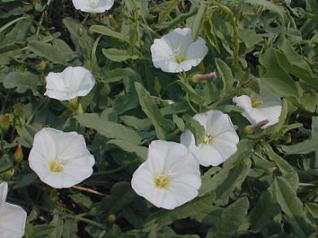

WHAT TO AVOID
Meat and Bones
Oily or Buttery foods
Eggs
Dairy Products
Human and Pet Feces
Weeds
Treated Wood
http://discountdogpoopbags.com/
https://ripenraworganics.com.au/
http://www.illinoiswildflowers.info/

Slide 16
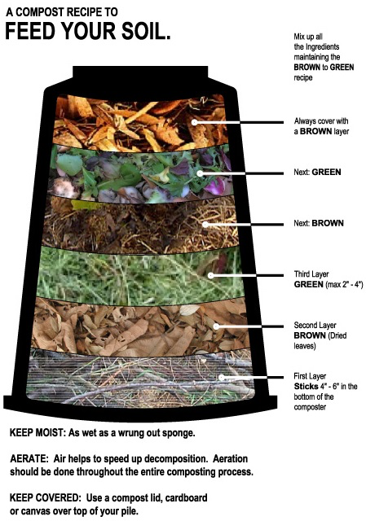
MAKING COMPOST
CHOP materials
  The smaller the pieces the faster the process
LAYER equal amounts of browns and greens. Start and end with brown layers
ADJUST moisture content. Texture s/b like a wrung-out sponge
Notes:
Chop materials: Smaller pieces decay faster
Layer browns and greens (1:1)
Layer larger brown stalks and branches to create good aeration on the bottom.
Always bury greens and top off with browns.
Maintain Moisture: By adding water or allowing it to dry out (want wrung out sponge)
Maintain Air: By turning pile

Slide 17
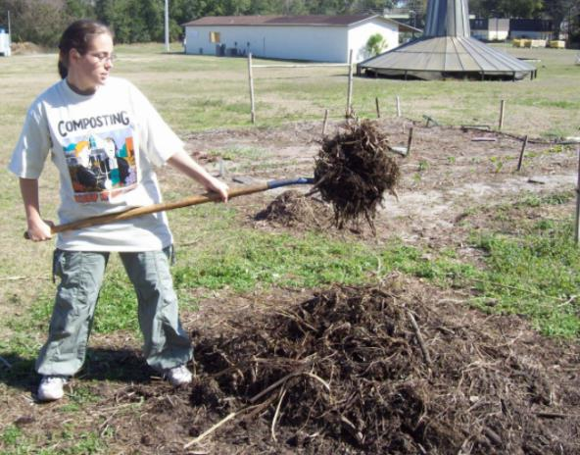
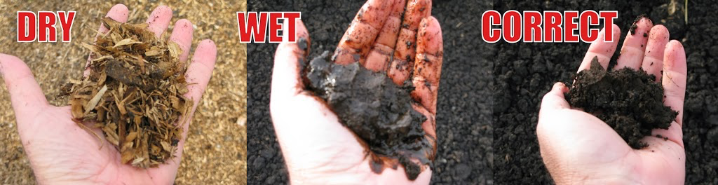
COMPOST MAINTANENCE
MOISTURE
  Texture like a wrung-out sponge
AIR
  Turn more = faster decomposition
  Less often for lower maintenance
TIME
  Maintain until “finished”
  No recognizable materials
  Pile is completely cold
OPTIONS
  Monitor temperature
  Monitor moisture

Slide 18
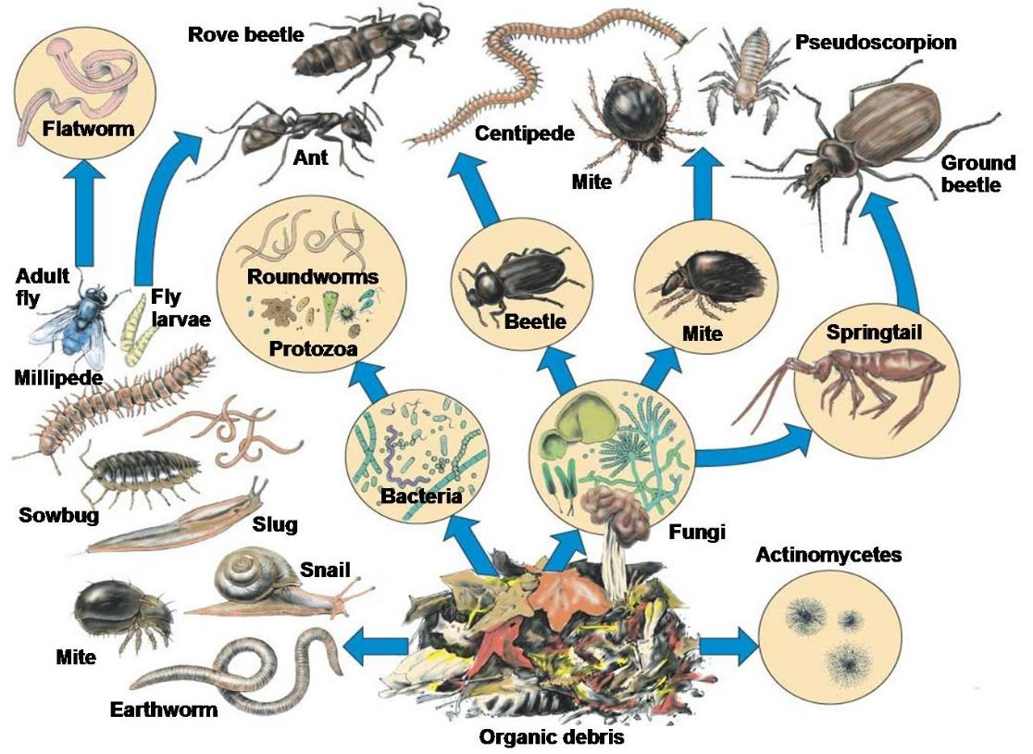
FBI’s = Fungi, Bacteria, and Inverebrates

Slide 19
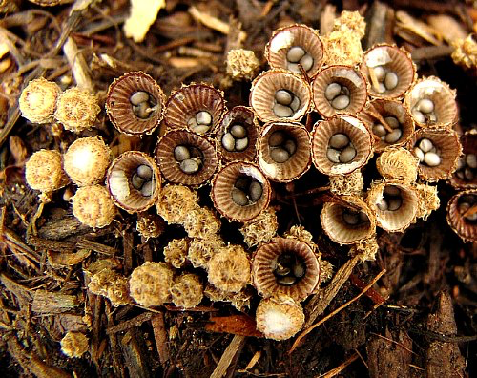
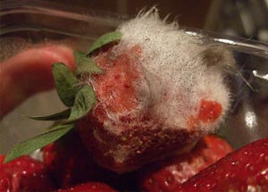
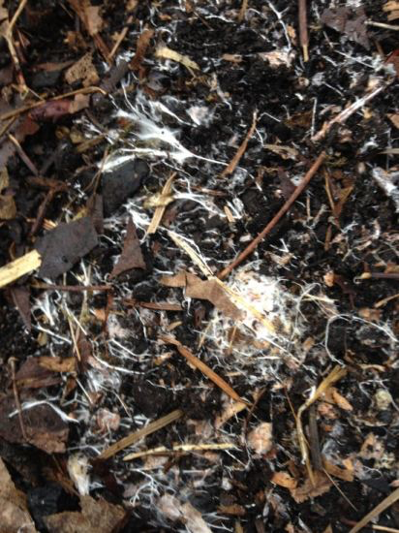
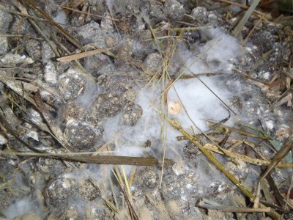
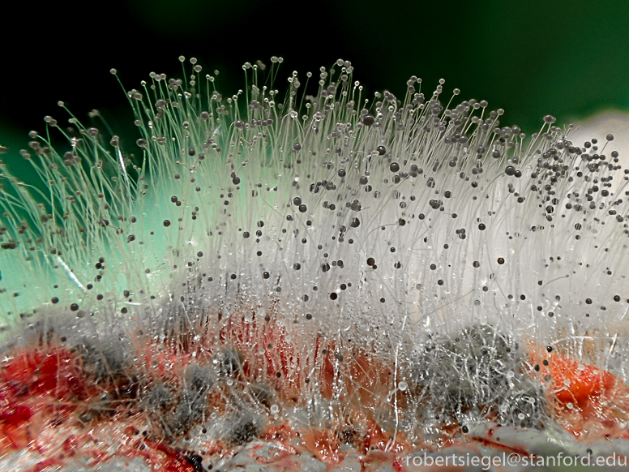
FUNGI
Notes:
Fungi are responsible for organic matter decay in compost.
Their main contribution is to breakdown plants.

Slide 20
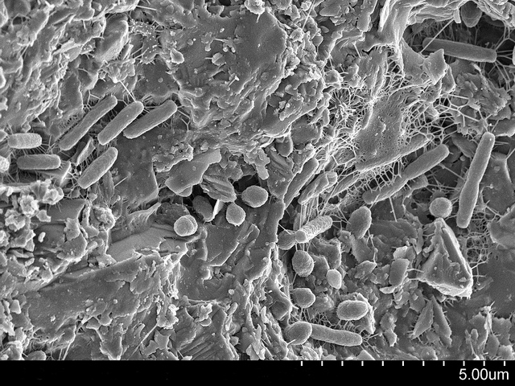
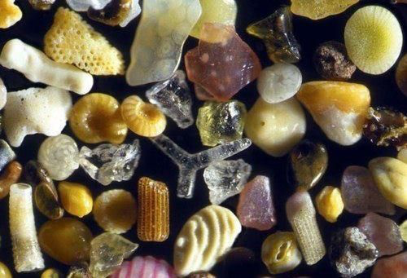
BACTERIA
Notes:
This is a community of Bacteria on a single grain of sand.
The Earth would have no soil without Bacteria and they are responsible for breaking down carbon inputs and converting them to Nitrogen sources.
Estimated number of bacteria is more than 100 million per gram of soil and there are 6,000 to 8,000 different types of bacteria on a gram of soil. There are more bacteria in two teaspoons of soil than there are humans on the earth.
Water and Temperature conditions have a major impact on the actions of the bacteria
Mesophillic Bacteria and Thermophilic Bacteria. Meso Bac die off or move to outter areas of the compost as tempuatures rise.

Slide 21
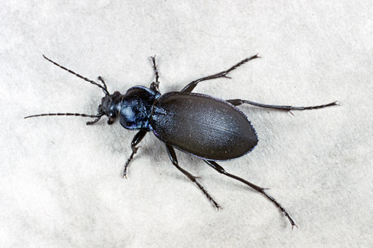
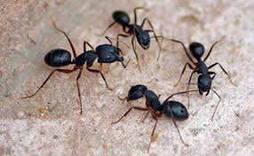
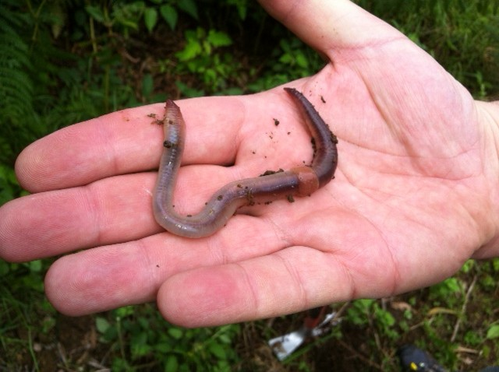
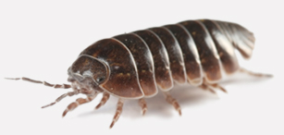
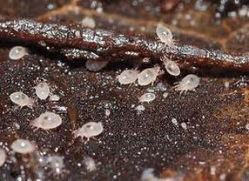
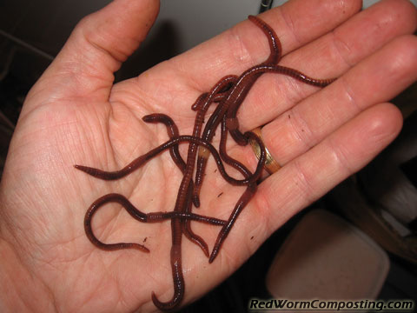
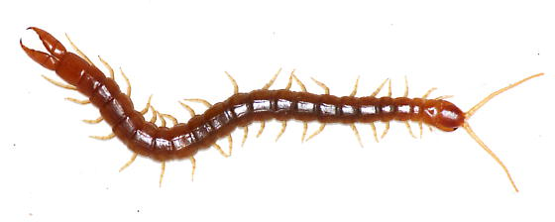
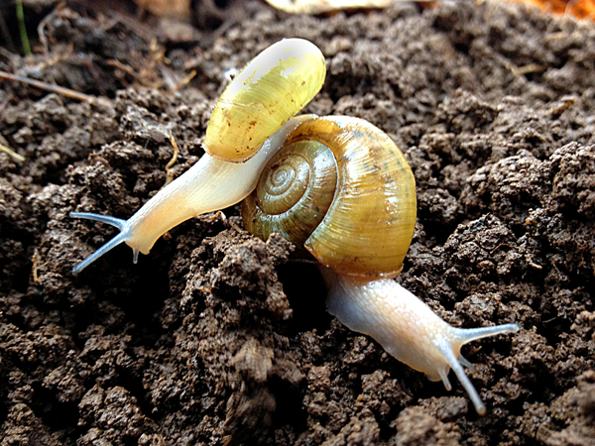
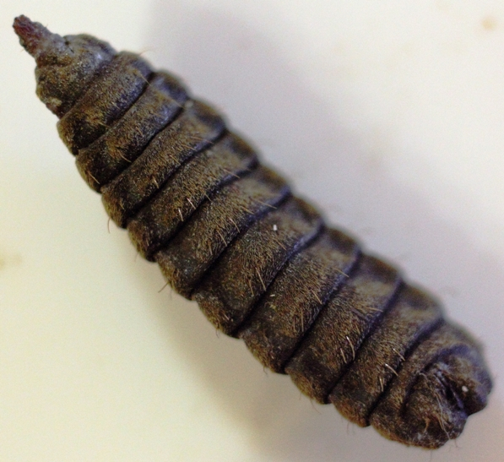
INVERTEBRATES
Notes:
Invertebrates - are living things that do not have backbones like we do.
Sow Bug Soldier Fly Larve
Snails or slugs Centepedes
Beetles Mites
Ants

Slide 22
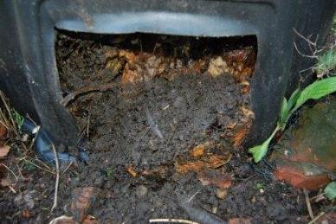
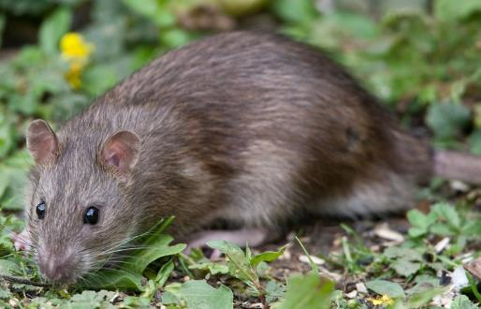
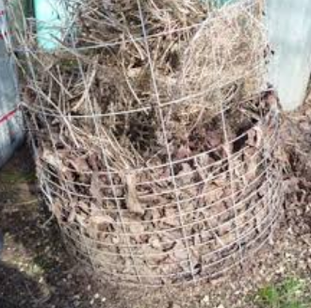
TROUBLESHOOTING
Rodents | No Decoposition | A smelly pile
Food Access | Too dry C:N imbalance Pile not turned | Too many greens (N) Too much water/rain
Notes:
Fruit Flies, White Flies – Too mush moisture or fruit/food waste. Always cover greens with thick layer of browns.
Pot Worms – PH too Low and too much moisture. Add more browns and do not add any food waste for two weeks.
Rodents – meat or greasy foods or bins is accessible. Need to prevent access.
Smelly – Too many greens and/or moisture. Add more browns.
Material composting slowly – Too dry. Check moisture, turn pile, add manure to speed things up.

Slide 23
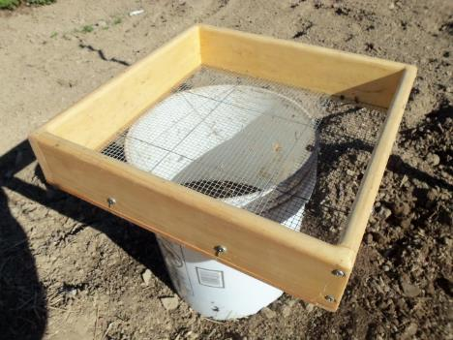
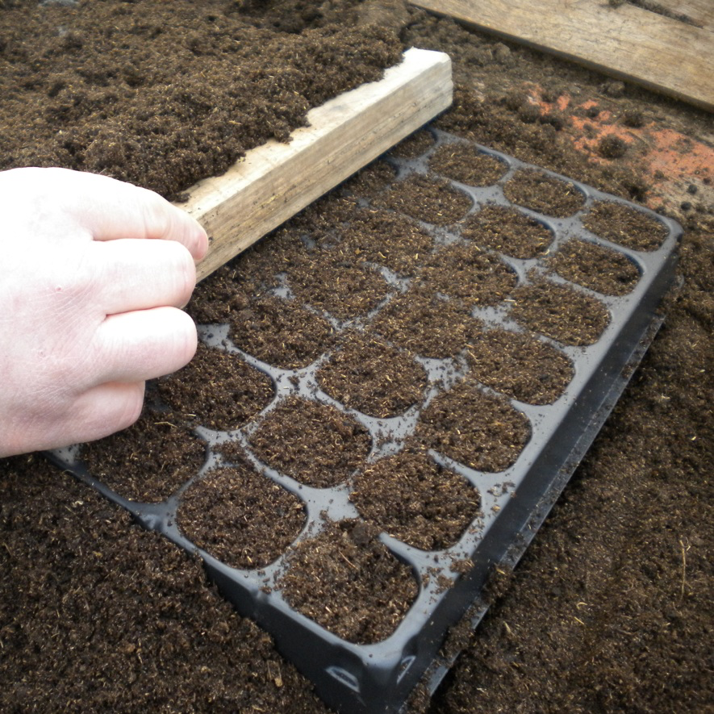


SIFTING AND APPLYING COMPOST
SIFTING
¼” hardware cloth
APPLICATION
  Topdressing
  Transplanting
  Mulch

Slide 24

Vermicomposting
Composting with worms

Slide 25

WHY WORM COMPOSTING?
FUN
It’s fun to have 1000+ pets
DIVERTS WASTE
From landfills
IMPROVES
Soil fertility
RREDUCES
Need for chemical fertilizer
SEQUESTERS
Sequesters carbon
SUPPRESSES
Pathogens
COMPACT
Can be done in small spaces and indoors

Slide 26

TYPE OF WORMS
RED WIGGLER (Eisenia fetida)
Feeds from the duff layer
Non borrowing
Often referred to as Manure Worms Temperature range 55 – 77
RED WORM (Lumbricus rubellus)
Soil dwelling
Requires more soil medium
Prefers broken down material

Slide 27



WORM HABITAT
Parameter | Range
Temperature | 40F to 95F The ideal range is 55F to 77F
Moisture | 40% to 60% Like a wrung-out sponge
Bedding | Safe and digestible
Food | Worm friendly
Light | None
https://www.armaghbanbridgecraigavon.gov.uk/dont-bin-itrecycle-your-food-waste/
https://unsplash.com/search/photos/darkness

Slide 28



SETTING UP A WORM BIN
ACQUIRE BIN
  Recycle bin
  Dresser drawer
  Commercial bin
PREPARE BIN
  Provide air holes
  Provide drainage
PREPARE BEDDING
  Newspaper
  Cardboard
  Paper

Slide 29



SETTING UP A WORM BIN (continued)
MOISTEN
  Bedding with a spray bottle
ADD WORMS
  Get ‘em from a friend
  Buy them locally
  Buy them online
ADD FOOD
  Select suitable worm food
ADD CARBON
Cover the bin

Slide 30

FEEDING WORMS
Vegetables
Fruit and juicer pulp
Grains
Tea bags
Coffee & filters
Eggshells (ground)
Lawn clippings (if not sprayed)
Pasta
Newspaper
Cardboard
Sawdust (from untreated wood)

Slide 31

WHAT TO AVOID
Meat, bones, and fat
Dairy products (except egg shells)
Canned processed food
Citrus
Onions and garlic
Spicy foods
Yard trimmings that have been treated
Glossy paper
Toxic plants
Anything that is not biodegradable

Slide 32





BIN TYPES
https://www.etsy.com/

Slide 33


HARVESTING
  TRAY OR BIN
  Dump contents out onto a tarp
  Allow the worms to move down and away from the light
  Scrape a layer off the top
  Repeat and then recover worms
LONG BIN
  Feed on alternate sides of the bin
  Harvest from the other side
FLOW THROUGH SYSTEM
  Take vermicompost from the bottom of the bin

Slide 34

WORM TUNNELS

Slide 35



TROUBLESHOOTING
FLIES
Don’t overfeed
Keep food covered
Limit fruit
Smells bad
Provide more air
Control moisture
Add carbons
Drain leachate
My worms have died
Too hot
Too wet or dry
Insufficient air
No food

Slide 36


APPLYING
APPLYING
Top-dress indoor, outdoor, vegetable, and landscaping plants
Spread it on a lawn
Add it to the soil between seasonal plantings
Add it to seed starting and up-potting mixes

Slide 37




Thank You!
UCCE Composting Education Program
www.ucanr.edu/compost

