Slide 1
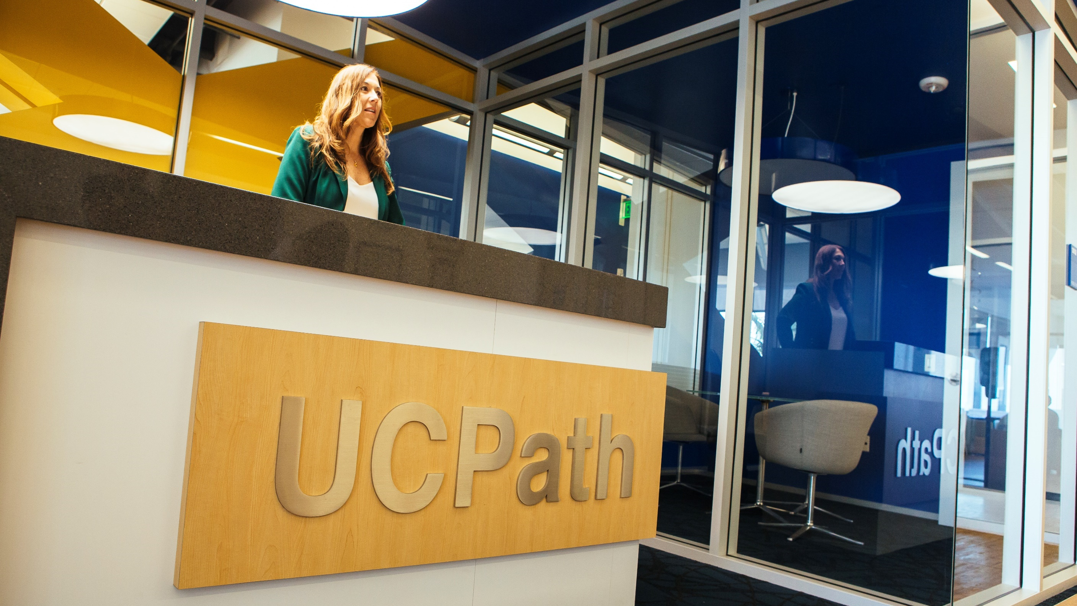
UC ANR UCPath Network
Kick-Off Meeting
August 22 and 24, 2018
NR UCPath Implementation Plan
August 2017

Slide 2
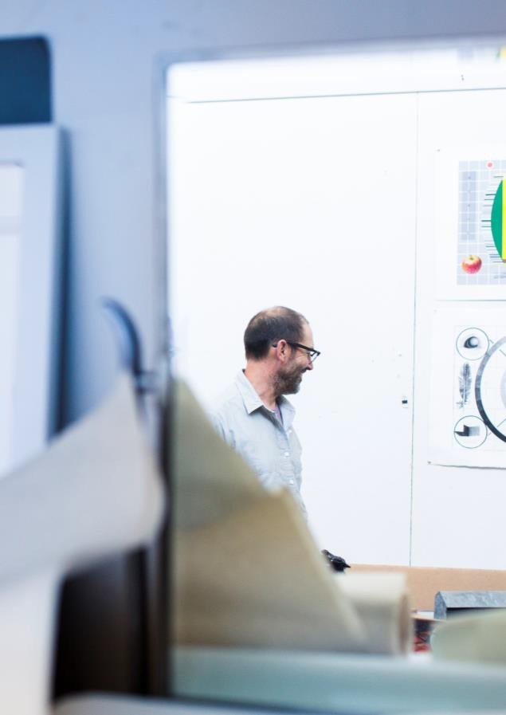
Agenda
Agenda
Introduction
Why are we meeting?
What is UC Path?
Project timeline
UC Path Network: goals, expectations, resources
Questions and discussion
Future meeting dates
2
Notes:
Scott - 1/3 team, 2/3 discussion

Slide 3

Introductions

Slide 4
Why are we meeting?
To share information about UCPath with key people across ANR to help ensure a successful transition to new systems and new processes
You are the people who know how to get things done at ANR today. You help your colleagues navigate systems and processes
  Business officers and administrative staff in UCCE, REC offices, and Administrative Units
You will become UCPath experts in the future, and we want to work with you to get you and your colleagues the information you need to be successful.
  Change Network
Notes:
Tu

Slide 5
What is UCPath?
UCPath is a systemwide initiative launched by the University of California to modernize its current payroll system, which is nearly 40 years old.
This provides the opportunity to improve efficiency and strengthen compliance and accountability
  A single, new payroll & human resources technology system
  Standardized and streamlined UC-wide processes
  New shared services center in Riverside: UCPath Center
  Formation of UC ANR as a distinct business unit within UC

Slide 6
UC ANR Business Unit
UCPath implementation will create our business unit, similar to an individual campus (Examples: UCLA or Lawrence Berkeley National Laboratory)
The formation of a single, unified business unit is one of the strategic initiatives for ANR; supported by Office of the President.
Provides the opportunity for UC ANR to improve efficiency and strengthen compliance and accountability.
Our fiscal “silos” will be unified, hugely improving the accuracy of our fiscal data and the speed with which we can access it.
ANR VP has direct oversight, authority and fiscal responsibility for all aspects of the ANR business unit, including the CE Specialist and CE Advisor academic titles. In this capacity, the ANR VP reports to the UC President, just as the Chancellors and Laboratory Directors.

Slide 7
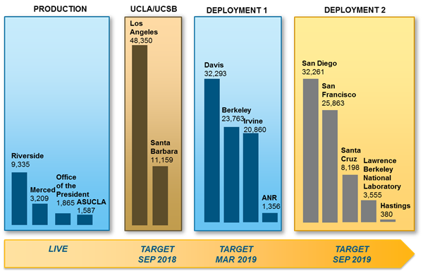
Deployment Timeline

Slide 8
Deployment 1: High Level
Data Gathering & Conversion Testing
Integration Testing
Test functions within end-to-end processes
Payroll Parallel Testing
(PPS / UCPath)
User Acceptance Testing
Dress Rehearsal & Cutover
Feb - Mar
April
2019
Jan - Feb
Aug - Nov
UCPath Launch!
The intensive support period – “hypercare” – will continue for up to 6 months.
Aug - Dec
May - Aug

Slide 9
UC Path Network
We want to work with you to get you and your colleagues the information you need to be successful.
  Supported by the UCPath OCM/COMM Committee
  Project updates through regular meetings and email
  Information about training and job aids
  “Office hours” to address questions and concerns
Notes:
Tu

Slide 10
What can you do to support UC Path?
Help us spread the word
Share communications with colleagues
  Communication packets, newsletters
Discuss in local staff meetings
  Talking points
Refer colleagues to project resources
  UCPath Portal/ANR Portal for timely updates
Provide input on our UC Path Communication Plan
  What’s the best way to reach ANR people?

Slide 11
Questions and Discussion
What do you need to support the UC Path Network? How do you like to receive information?
What questions do you have about UC Path?
UC Path info for ANR employees
http://ucanr.edu/ucpath

Slide 12
UC Path Network – Future Meeting Dates
Fourth Wednesday of each month, 11am – Noon
Sept 26, 2018
Oct 24, 2018
Nov 28, 2018
No meeting planned for Dec 2018
Jan 23, 2019
Feb 27, 2019
Mar 27, 2019
Apr 24, 2019
May 22, 2019

