Slide 1

Wood Energy Policy in the Northeastern US
West SWET 2017
Fresno, California
November 14th, 2017
Adam Sherman

Slide 2
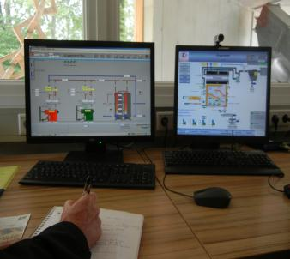
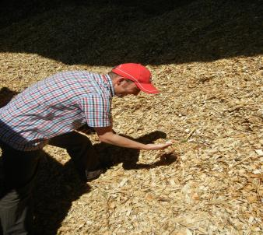
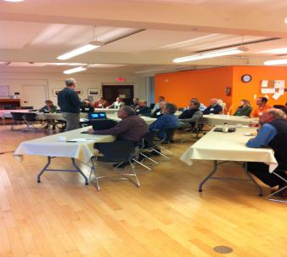

Biomass Energy Resource Center (BERC)
Advancing the use of Modern Wood Heat and CHP in North America
Technical Consulting
Project feasibility studies
Fuel supply assessments and procurement
Third-party expert review
Develop and review of standards
Market Assessments
Program Design & Implementation
Wood heat market expansion potential assessments
Program design and implementation support
Training, and advisory support services
Advocacy
Showcasing “best practices” and case studies of successful projects
Tracking market growth and impacts
BERC is a program of the Vermont Energy Investment Corporation
A mission-driven non-for-profit whose mission is to reduce the economic and environmental impacts of energy production and consumption

Slide 3
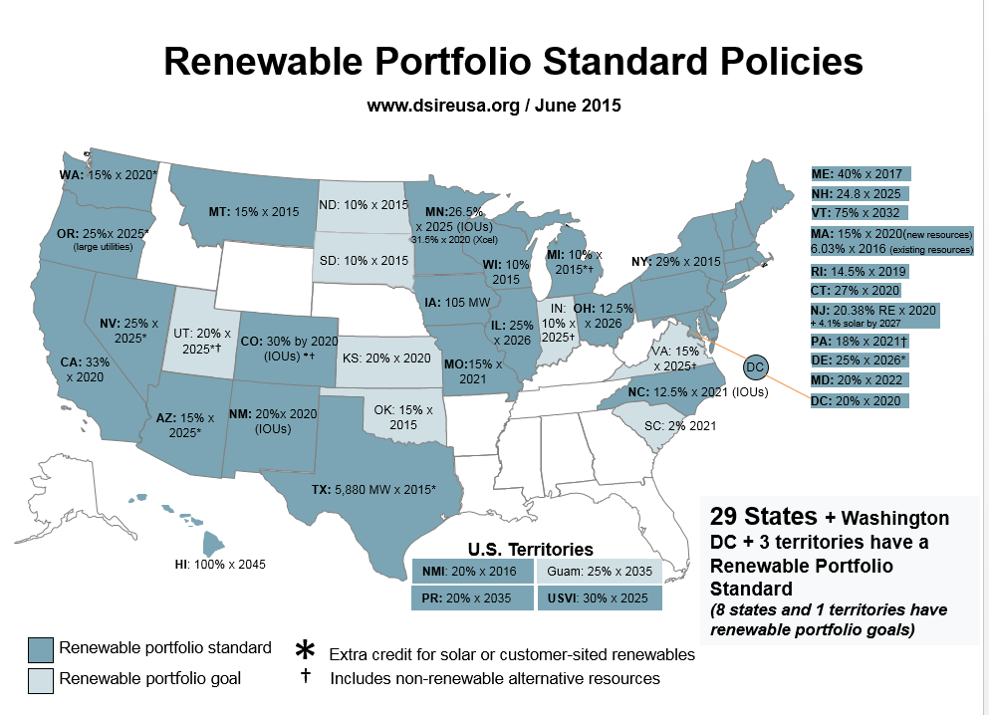

Slide 4
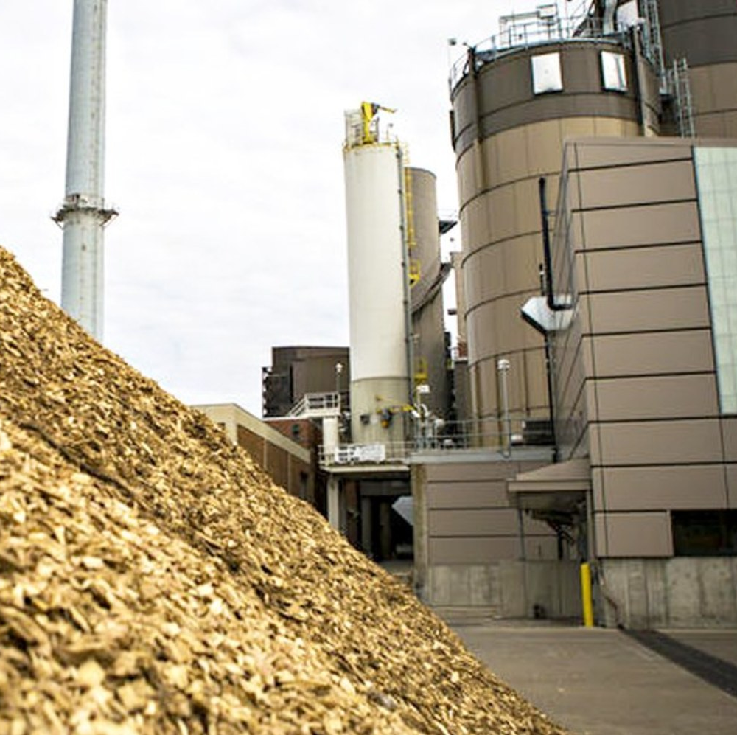
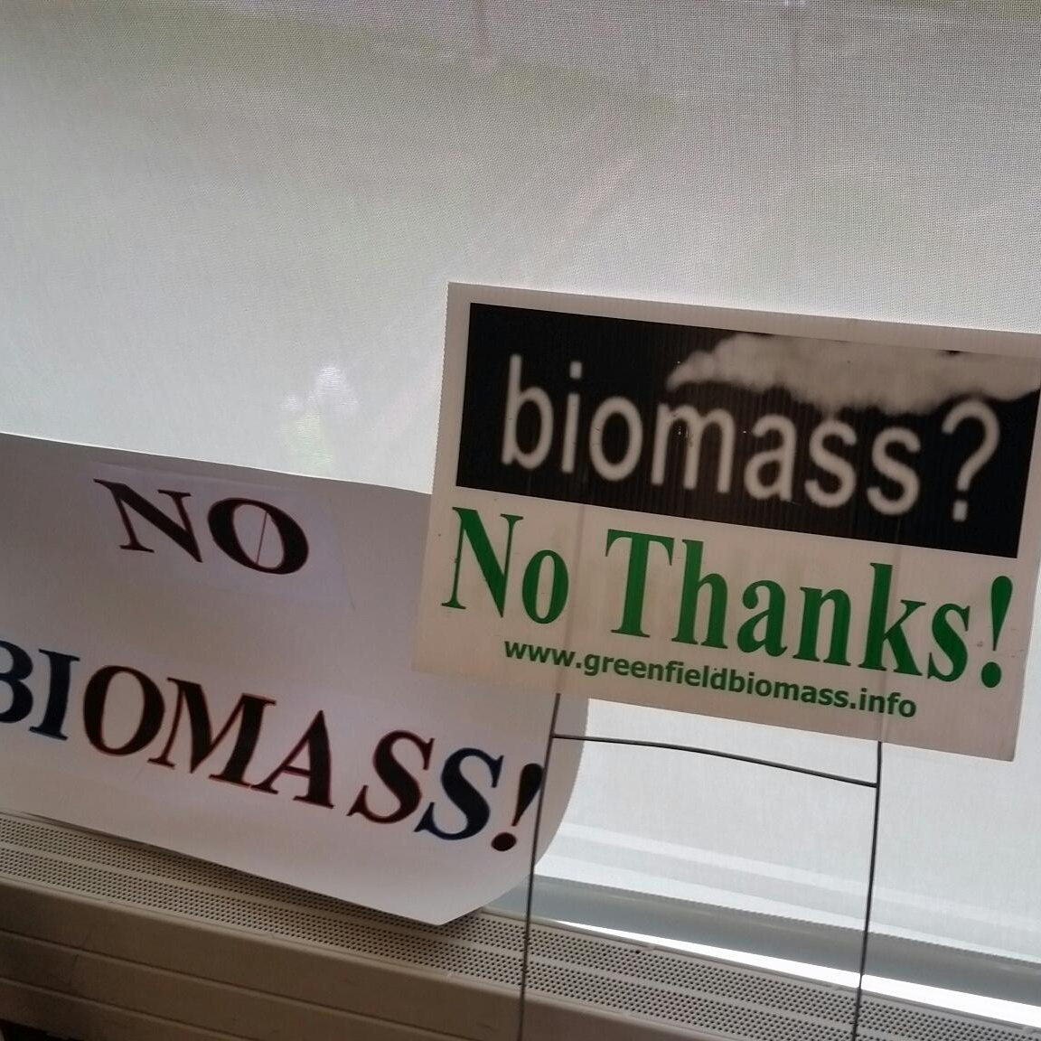
Biomass Power

Slide 5
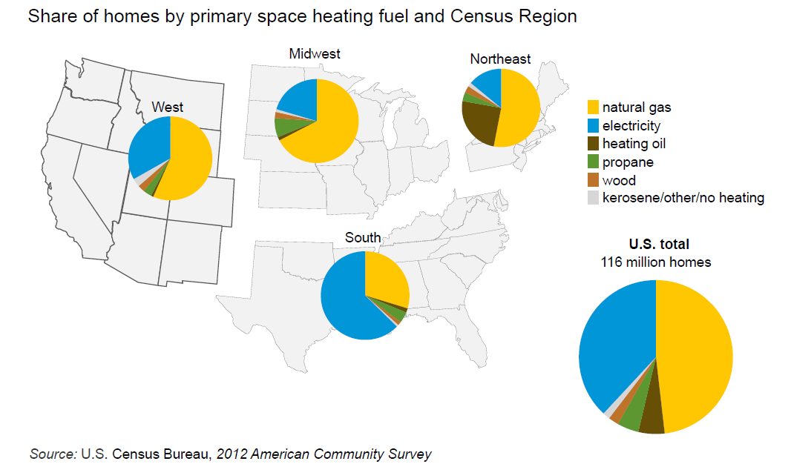
Heating Fuel Mix by Region
Notes:
Thermal is 1/3 of energy consumption
Heating fuels like oil and propane are unregulated unlike electricity and natural gas.

Slide 6
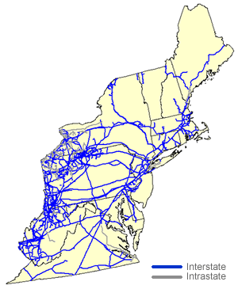
Natural Gas Pipelines Service
Notes:
These states have been the front runners – in wood heating policy adoption.
They have colder winters. More forests and less natural gas pipeline.

Slide 7

Regional Dependence on Oil for Heating
 | Annual Gallons of Heating Oil | Population | Gallons Oil/ Capita
Connecticut | 473,000,000 | 3,500,000 | 135
Maine | 263,000,000 | 1,300,000 | 202
Massachusetts | 596,000,000 | 6,646,000 | 90
New Hampshire | 137,000,000 | 1,320,000 | 104
New York | 1,308,000,000 | 19,570,000 | 67
Pennsylvania | 757,000,000 | 12,763,000 | 59
Rhode Island | 131,000,000 | 1,050,000 | 125
Vermont | 89,000,000 | 626,000 | 142
Total/Average | 3,753,000,000 | 46,775,000 | 80
Source: Energy Information Administration (EIA) and 2010 US Census Data

Slide 8
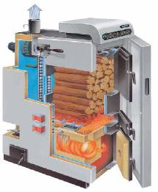
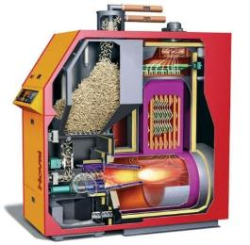
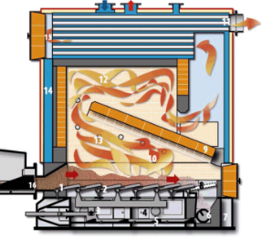

Modern Wood Boiler Technology
Cordwood system
Pellet system
Woodchip system

Slide 9

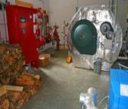
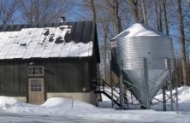
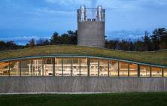
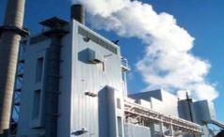
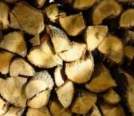
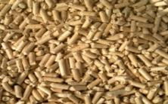
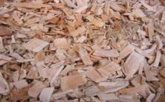
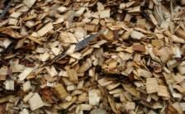


Technology | Cordwood Boilers | Pellet Boilers | Single Facility Woodchip Heating | District Heating w/Woodchip Boilers | Industrial CHP
Typical heat output capacity | 20kW – 100kW | 20kW - 1MW | 500kW – 9MW | 1.5MW – 15MW | 8MW - 150MW
Applications | Home heating and farm buildings | Home heating & small commercial buildings | Schools, hospitals, office buildings, etc. | College campuses and downtown communities | Merchant Power Plants
Fuel Type
Annual Fuel Use | 2-15 cords | 2-20 tons | 100 – 10,000 tons | 500- 50,000 tons | 1,000 – 500,000 tons
Installed Systems in VT | >300 | > 400 | > 200 | 6 | 2
Average Efficiency | 70% | 80% | 75% | 75% | 28% - 40%

Slide 10
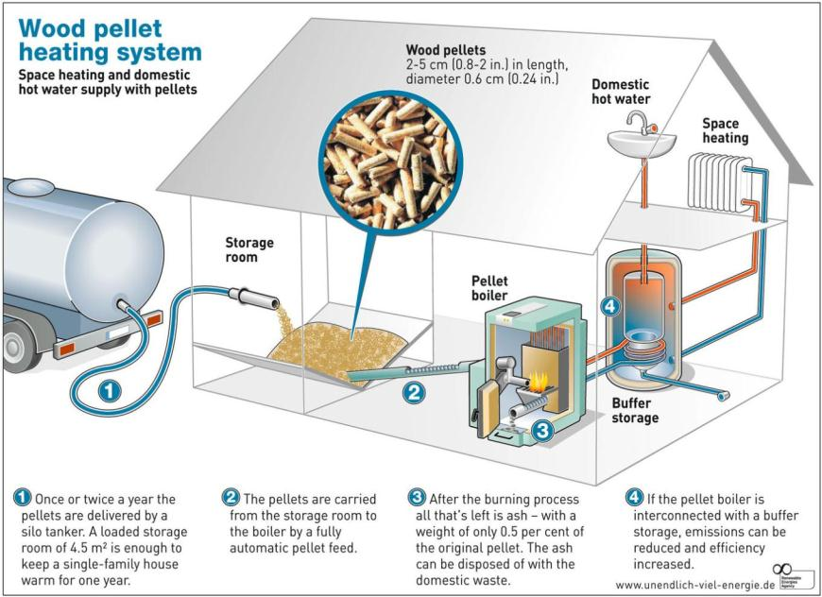
Bulk Pellet Fueled Central Heating

Slide 11
Policy Options for Overcoming Market Barriers
Barrier | Potential Policy Solution
High capital costs | Federal 30% tax credit State income tax credits State funded rebate programs Thermal inclusion in RPS in a way that creates “credit worthy” thermal RECs used toward capital costs
Public awareness | Adopt policies such as “lead by example” programs by state and local government Provide program support services to show case “best in class” projects using modern, efficient biomass thermal technologies Support education, outreach, and training for architectural, building construction, insurance, real estate, and engineering professions
Lack of regulatory framework for thermal sector | Develop comprehensive “total energy” approach including electrical, thermal, and transportation energy Expand RPS to include thermal energy Apply SBC to heating fuels
Expanded natural gas service into new jurisdictions | Apply a SBC to natural gas to further fund thermal efficiency and renewables such as biomass

Slide 12
Spectrum of Policies and Incentives Offered in NE
 | NY | VT | NH | ME | MA
Flexible Boiler Regulations |  | √ | √
Sales Tax Exemption on Wood Heating Appliances |  |  | √ | Partial | Partial
Sales Tax Exemption on Wood Fuel |  | √ | √ | Residential only | Residential only
State Income Tax Credit on Installed systems |  |  | N/A
Pellet Boiler Incentives | √ | √ | √ | √ | √
Property Assessment Financing |  | √
Thermal Renewable Portfolio Standards |  | √ | √ |  | √
State Grants for Wood Heat Projects | √ | √ | √ | √ | √
Government “Lead by Example” for Biomass Thermal |  | √ |  |  | √
System Benefits Charge on Heating Fuel |  | Weatherization only
Mandatory Renewable Energy Targets Applied to Building Codes
Source: http://www.veic.org/Media/berc/Summary-BT-Policy-Report10.30.13.pdf

Slide 13
Advanced Wood Heating State Incentives
State | Residential offers | Commercial offers
New York | Boiler Type: Wood Pellet Boiler with Thermal Storage Incentive Type: Rebate Program Incentive Amount: 25% Maximum Incentive: $20,000 (additional $2,000-$4000 possible for recycling old outdoor or indoor wood boiler. | Renewable Heat New York Boiler Type: Large Pellet Boiler with Thermal Storage (More than 300Mm Btu/hr) Incentive Type: Rebate Program Incentive Amount: 20% Maximum Incentive: $100,000
Vermont | Boiler Type: Automatic Pellet Boiler Incentive Type: Rebate Program Incentive Amount: $5,000 (flat fee) | Boiler Type: Automatic pellet boiler and wood chip systems. Also includes multiple boilers/furnaces. Type: Rebate Program Amount: $3,000 or $1.25/sq-ft heated space Maximum Incentive: $3,000 - $80,000
New Hampshire | Boiler Type: Automatic Pellet Boiler Incentive Type: Rebate Program Incentive Amount: 40% Maximum Incentive: $10,000 | Boiler Type: Pellet Boiler up to 2.5MM Btu/hr Incentive Type: Rebate Program Incentive Amount: 40% Maximum Incentive: $65,000
Maine | Boiler Type: Automatic Pellet Boiler Incentive Type: Rebate Program Incentive Amount: 33% Maximum Incentive: $5,000 | Not available
Massachusetts | Boiler Type: Automatic Pellet Boiler Incentive Type: Rebate Program Incentive Amount: Boiler 45%, Thermal Storage 100% Maximum Incentive: $12,000 (Income-Based Rebate Adder can qualify for a total award of up to $16,500) | TBD

Slide 14
Renewable Thermal Energy Policy Options
Adapted from MA DOER Thermal APS Study Report, January 2013
 | Precedent | Opportunity | Concerns
Fees on unregulated heating fuels | “System Benefit Charges” in many states, but electricity/NG only | Revenues could fund incentives for RE, also help oil/propane dealers | Tax on heating oil and propane – tough to sell politically
Tax incentives | State and federal (SHW, Geo, but NOT biomass) | Ease capital costs | New tax incentives hard to pass; reduce revenues
Rebates and competitive grants | MA, NH have rebates and grants, from ACP/RGGI $ | Ease capital costs | Electric and gas ratepayers asked to finance thermal
Renewable energy mandates | Some EU countries – new building mandates | Mandated market share (Fed. Exec. Order?) | Tough to implement in U.S.
Renewable Energy Standards | 12 states and DC recognize thermal, mostly SHW. NH full thermal provision. | Performance-based incentive | Ratepayers bear costs; impact on other RPS technologies
Table source: INRS

Slide 16

Vermont Energy Goal –
35% of Thermal Energy from Wood Heat by 2030
Preliminary numbers – please do not cite or circulate!
Notes:
Sometimes setting a target helps lay out a path…

Slide 17
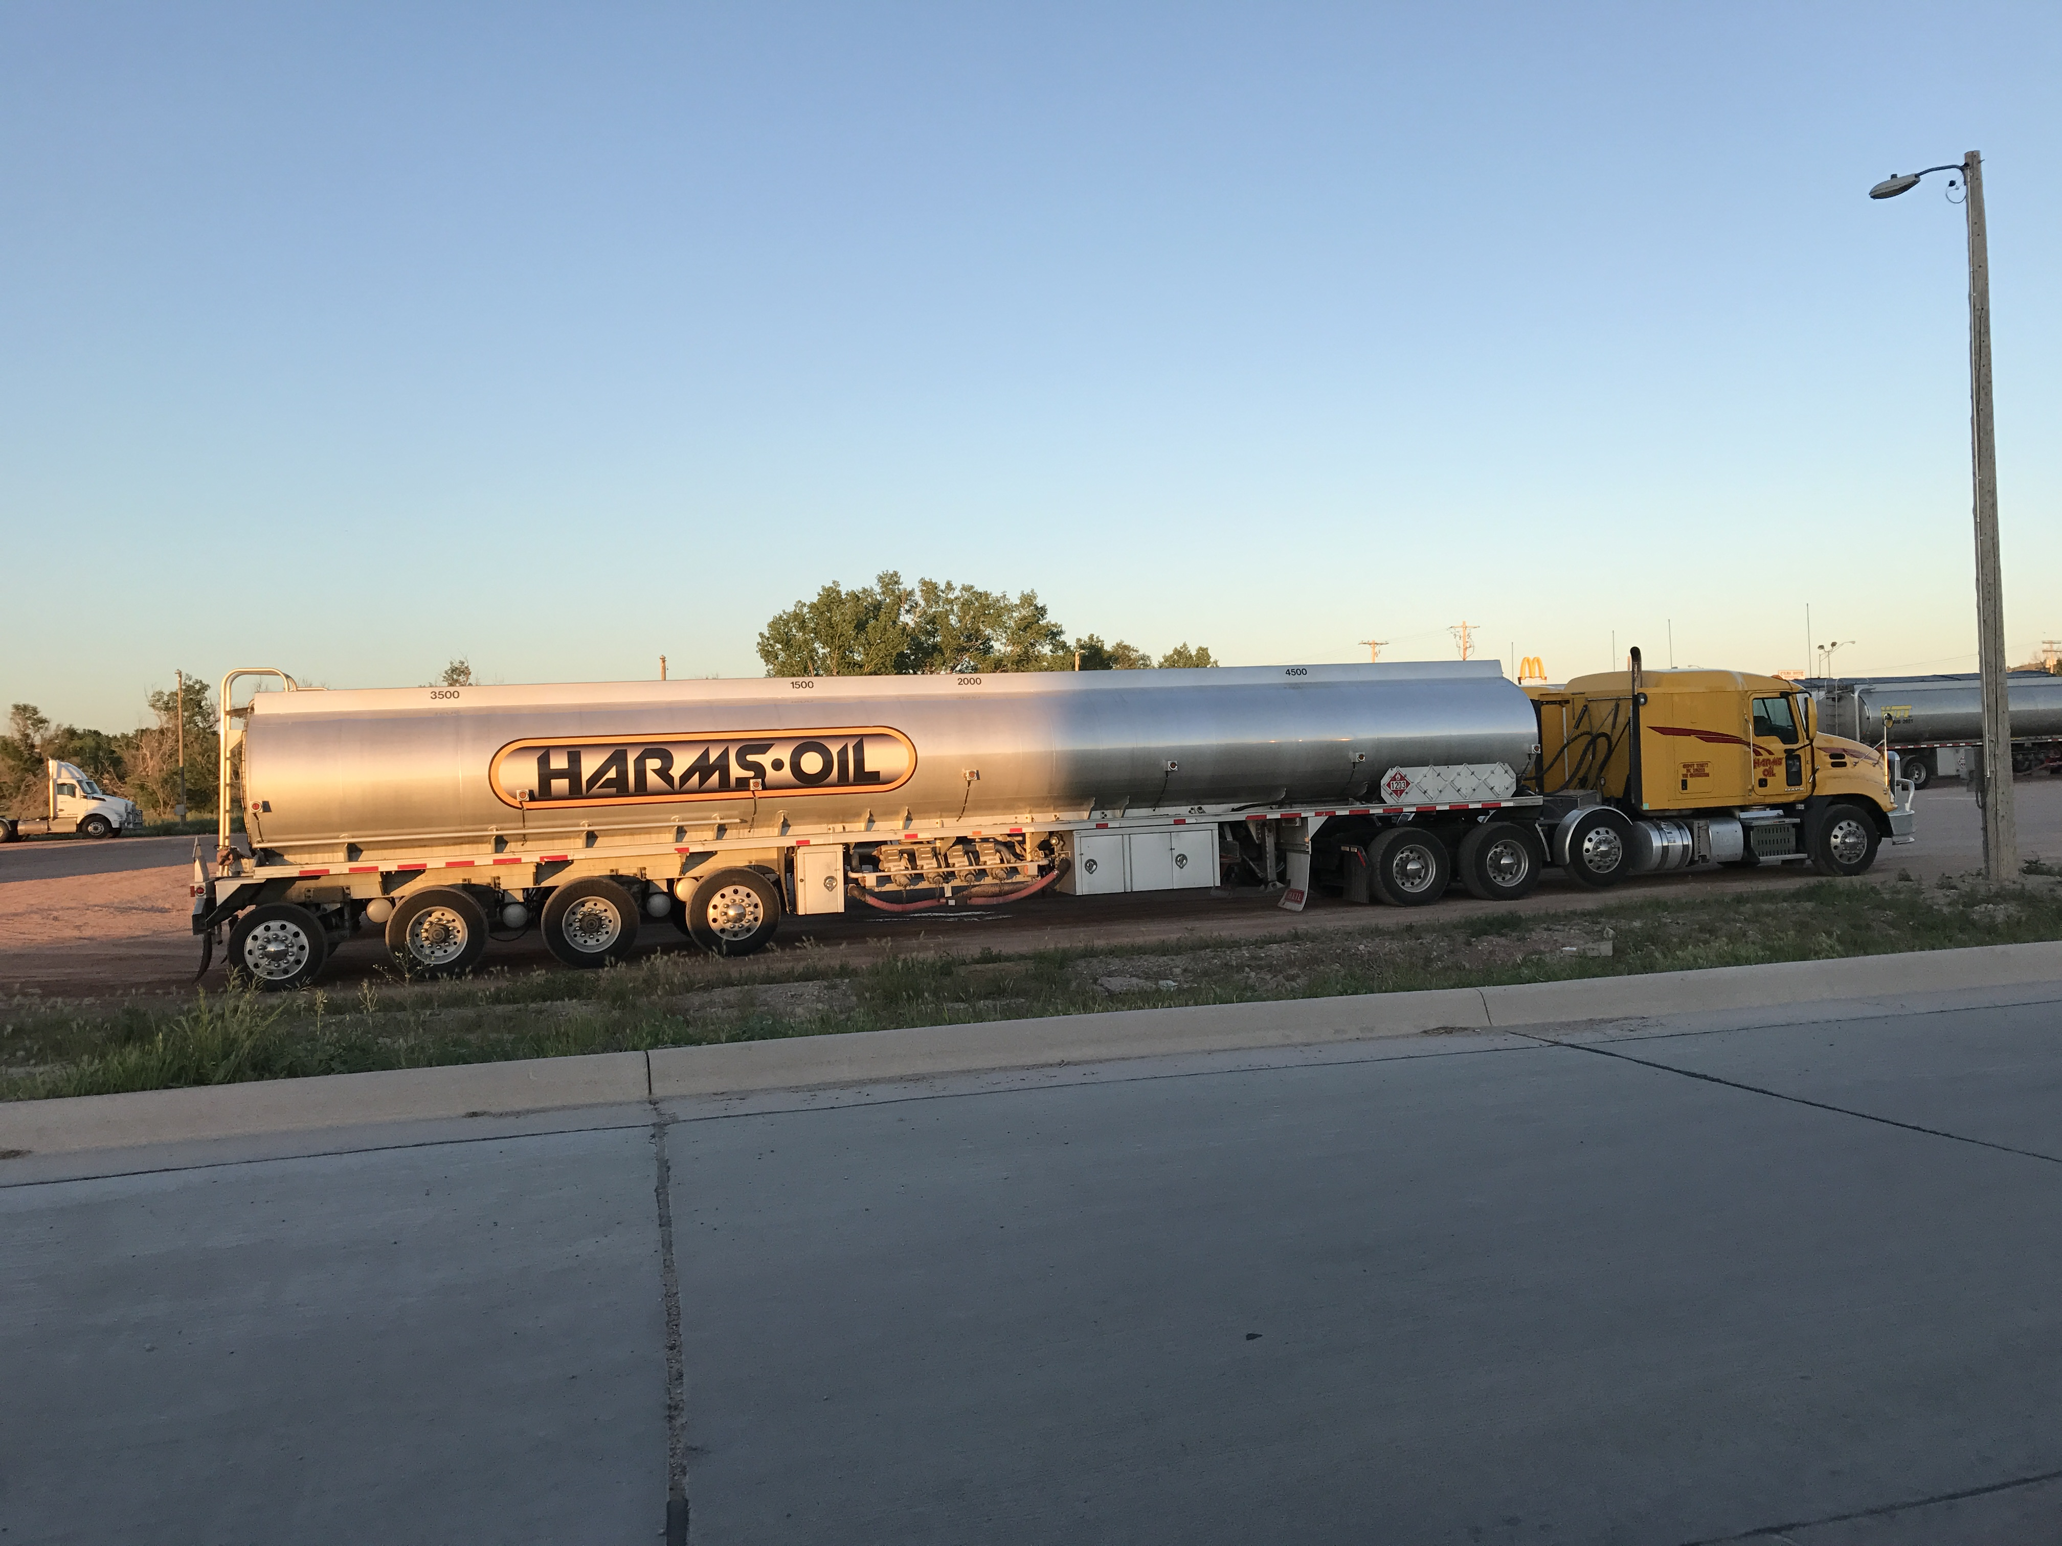
Notes:
Policy makers have in the past looked at wood heat as a way to develop markets for low-grade wood to replace pulpwood markets. More recently as policy makers realized that thermal energy is important wood heat has been recognized as a effective strategy for meeting our carbon and energy targets, and lastly we have seen our policy makers finally recognized the importance of the economic benefits and how this can help support vibrant rural communities.
So this has worked very well for us in Vermont – I suspect this has tremendous opportunity in Ontario to provide the same benefits and impacts.

Slide 18
CONTACT INFORMATION:
Adam Sherman, Manager
Biomass Energy Resource Center at VEIC
802 540 7863 asherman@biomasscenter.org
www.biomasscenter.org

Slide 19
Extra Slides
For Q&A

Slide 20
An Integrated Policy Approach for Developing Wood Heat Markets
Legislative
Action
Program Support
Financial Support
Regulatory Framework

Slide 21
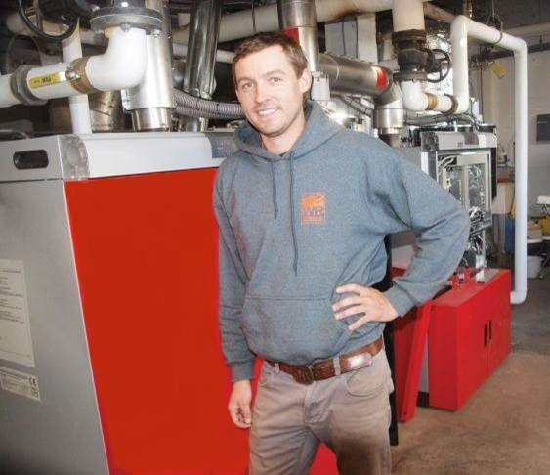
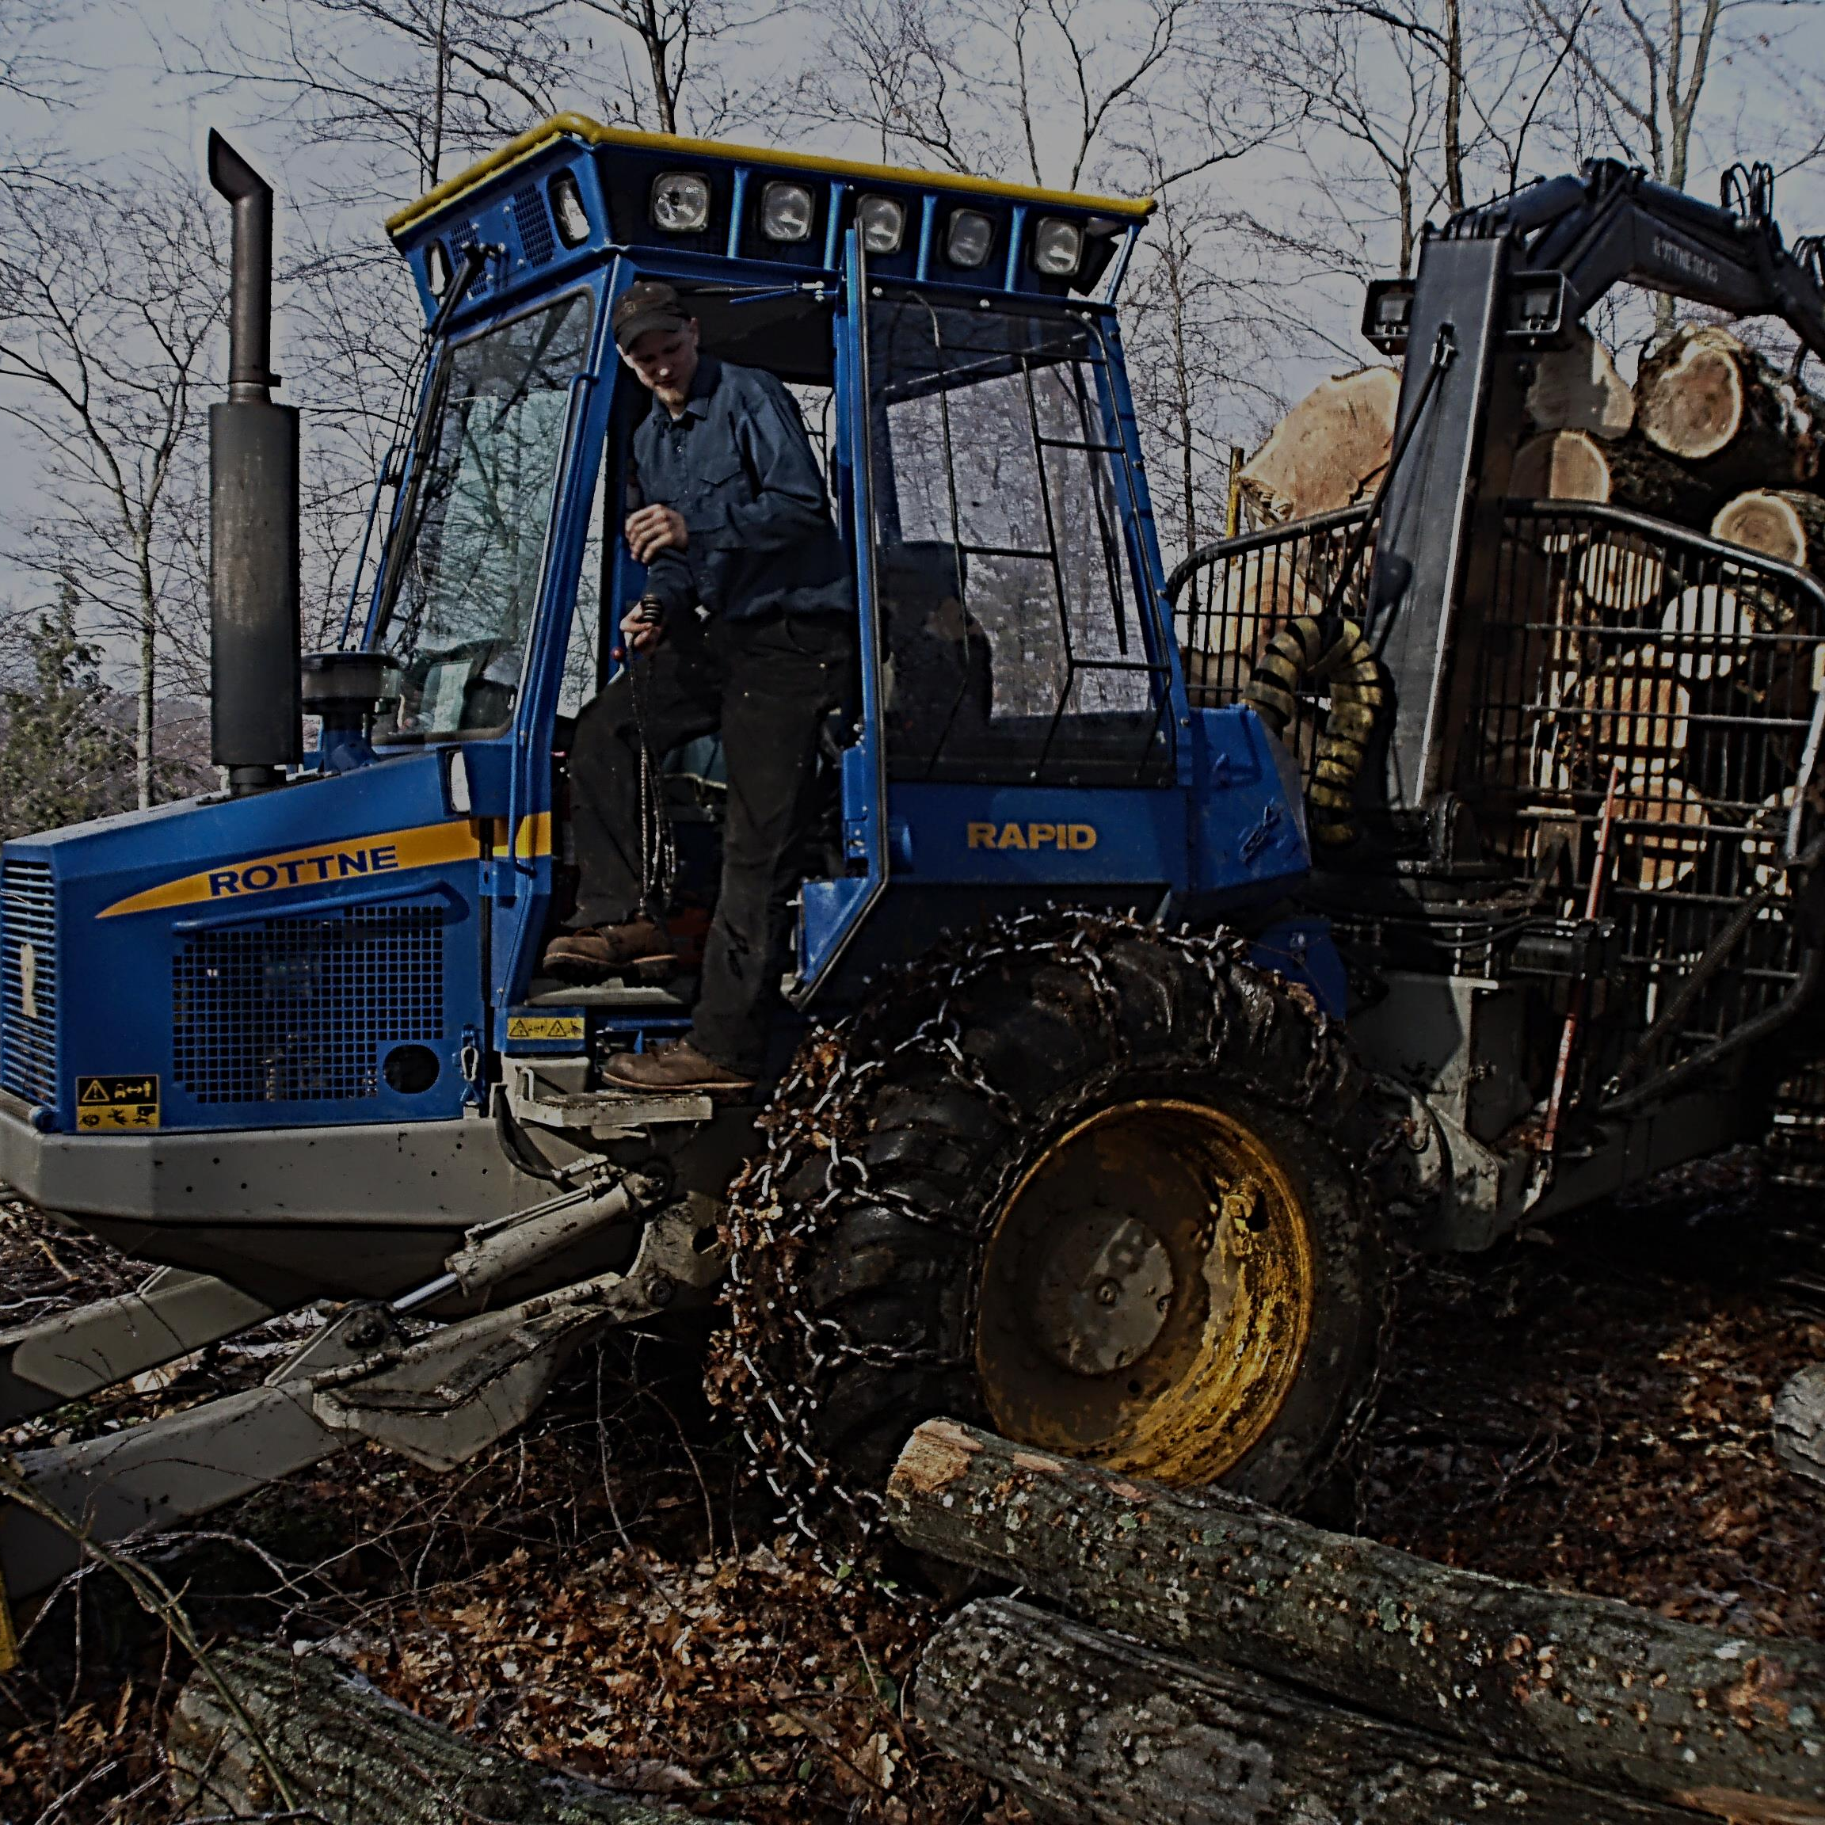
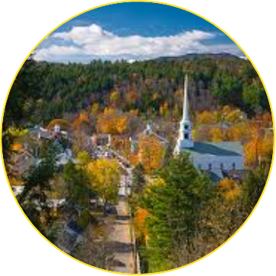
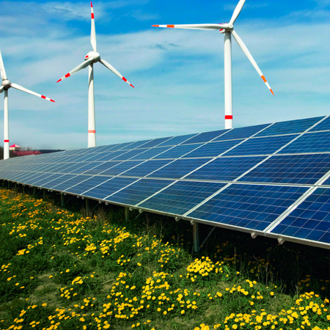
Modern Wood Heating –
An Effective Strategy for Vermont & Ontario
Healthy Forested Working Landscape
Vibrant Communities & Economic Development
Expanded Use of Renewable Energy
Notes:
Policy makers have in the past looked at wood heat as a way to develop markets for low-grade wood to replace pulpwood markets. More recently as policy makers realized that thermal energy is important wood heat has been recognized as a effective strategy for meeting our carbon and energy targets, and lastly we have seen our policy makers finally recognized the importance of the economic benefits and how this can help support vibrant rural communities.
So this has worked very well for us in Vermont – I suspect this has tremendous opportunity in Ontario to provide the same benefits and impacts.

Slide 22
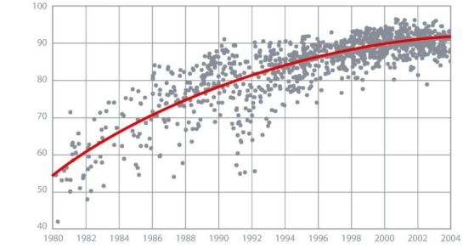
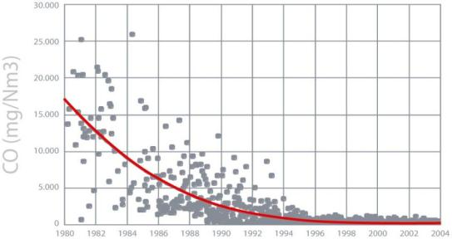
Advancements in Modern Combustion
Peak Efficiency (%)
Source: Ober Oesterreich Energiesparverband

Slide 23
Source: EPA Burnwise program and BERC Analysis
Notes:
PM emissions are important!
PM emissions from modern wood chip and pellet boilers is nearly on par with oil. Without and ESP. Larger boilers with ESPs are equal to natural gas.
Over 40 times more PM emitted by a woodstove than a pellet boiler.

Slide 25
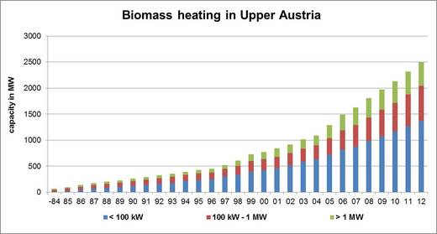
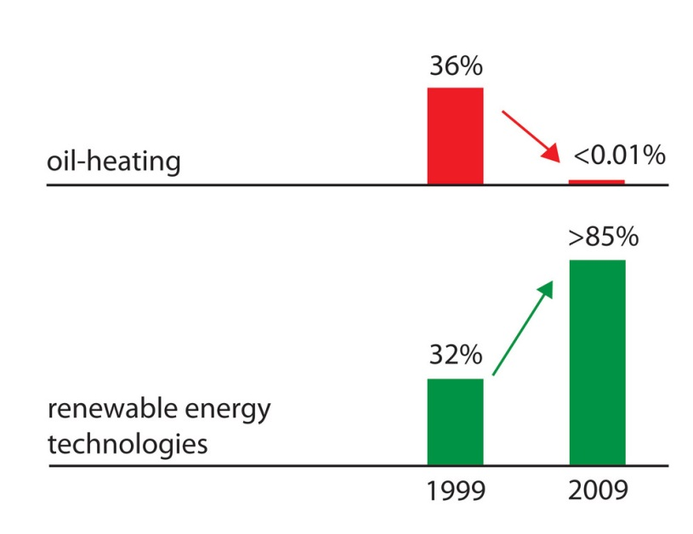
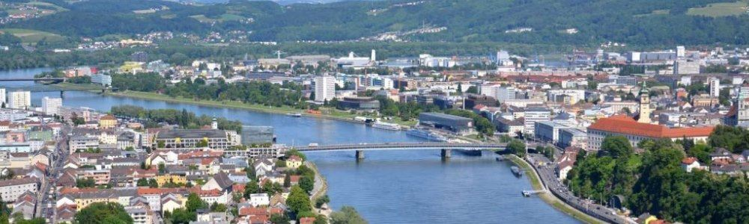
Upper Austria: “Carrots, sticks & tambourines” result in wood for 15% of energy consumption, over 40,000 installations, 300 district heating systems, over 40% municipalities heating with biomass.
Notes:
Automatic feeding versus bag feeding

Slide 26
Cost of Heating Fuels in Vermont
$3.57/gallon
$2.99/gallon
$280/ton
$250/cord
$1.52/therm
$65/GT
Data sources: January, 2015 VT Fuel Report and BERC

Slide 27
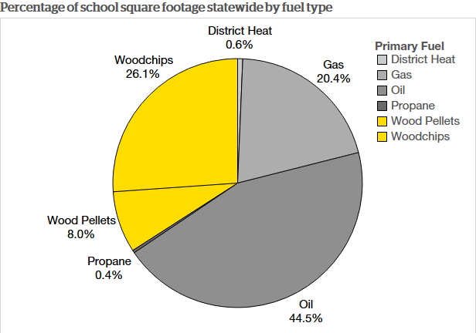
Vermont Public School Sector
Notes:
70 schools displacing over 2 million gallons of heating oil each year.

Slide 28
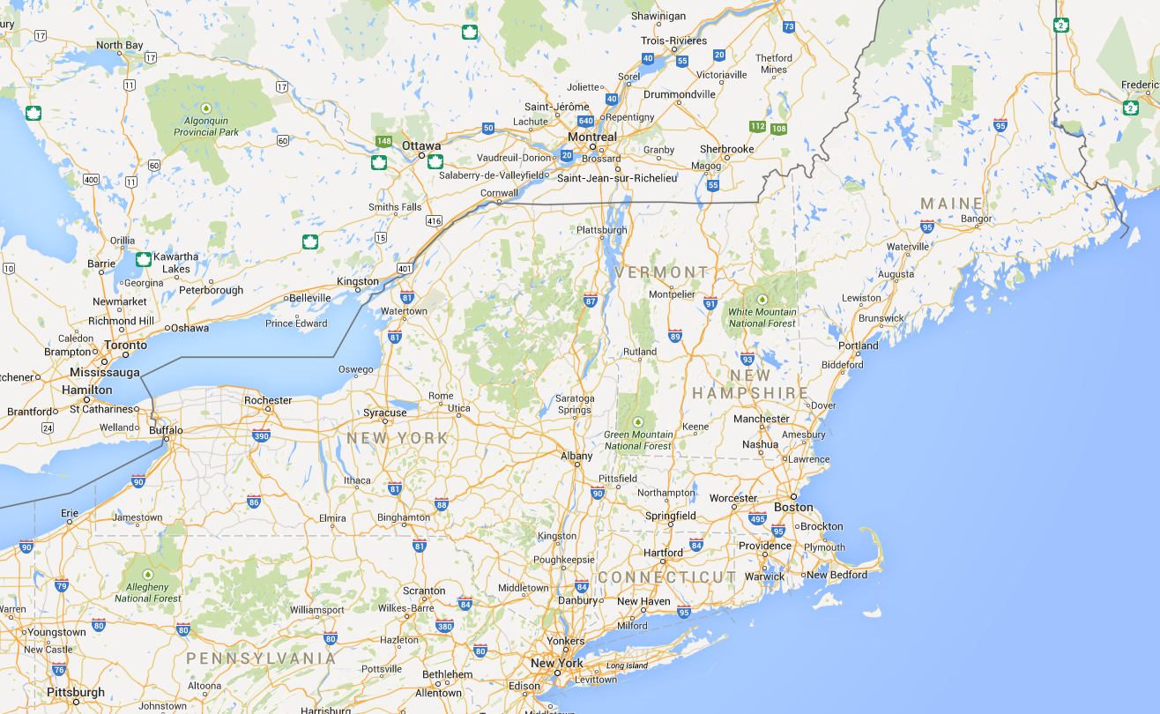
Northeastern US Pellet Production
Lauzon
Ashland
Lauzon
Energex
Corinth
Curran
Strong
Athens
VWP
Over 1.4 Million Tons of Annual Production Capacity
NEWP
Queston
NEWP
Dry Creek Creek
Addison
NEWP

Slide 29
The Carbon Cycle
Wood Heated Buildings vs. Fossil Fuel Heated Buildings
CO₂
CO₂
CO₂
CO₂
CO₂
CO₂
CO₂
CO₂
CO₂
CO₂
Natural Carbon Cycle
CO₂
Natural Carbon Cycle
Fossil Fuel Heated Building
CO₂
Wood Heated Building
CO₂
Wood Heated Building
CO₂
CO₂
CO₂
CO₂
CO₂
Oil (fossil carbon)
Woodchips
(forest carbon)
Woodchips
(forest carbon)
Underground Fossil Fuel

Slide 30
Cumulative Debts and Dividends Over Time – Thermal Applications
BAU Scenario – Oil heating
Atmospheric carbon levels
Big Dividend
Wood heat from well managed forests
Small Debt
0 1 5 10 20 30 40 50 60 70 80 90 100
Years

