Slide 1
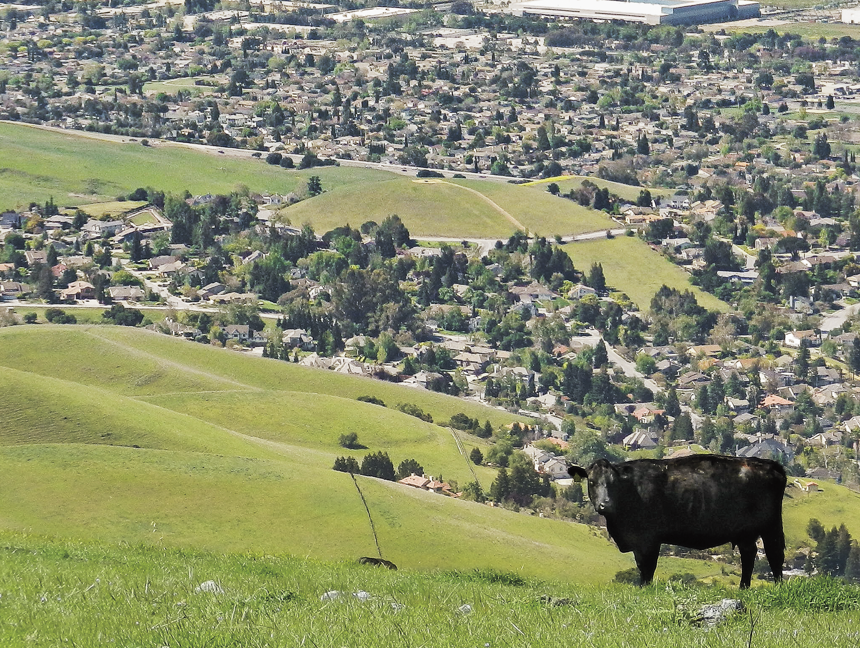
Affirmative Action &
Project Board
UC ANR Affirmative Action Office
Notes:
Good morning everyone and welcome to this introduction to Affirmative Action, Civil Rights Compliance and Project Board reporting.
This presentation will be dealing mainly with the Affirmative Action or Civil Rights reporting requirements of Project Board, although we will also cover many other aspects of your contact reporting responsibilities.

Slide 2


Topics & Outcomes
Participants will have an understanding of . . .
What is Affirmative Action?
→ Goals of Affirmative Action
Civil Rights: Why & Wherefore
What is Program Compliance?
Who is Your Potential Clientele?
→ What is Project Board Civil Rights reporting?
→ Why do we collect racial data?
→ What is All Reasonable Effort?
→ What is parity of participation?
Notes:
At the end you should have a clear idea of what Affirmative Action is and what the goals of Affirmative Action are here in ANR.
We will discuss why there is a civil rights reporting component within Project Board and the requirements of it. We will touch on the components of program compliance and briefly look at determining who your potential clientele should be.
Please feel free to type your questions or comments into the chat box.

Slide 3
Overview of Affirmative Action
Signed into law in 1965 by President Lyndon Johnson
Designed to eliminate the present effects of past discrimination, such as the underrepresentation of minorities and women; and to encourage the employment of veterans and persons with disabilities.
ANR Core Values support the goals of Affirmative Action, including inclusion and diversity in our programs.
Notes:
Let’s start with a quick overview of Affirmative Action.
Affirmative Action is an outgrowth of the Civil Rights Act of 1964. It was established in 1965 by an executive order signed by President Lyndon Johnson.
It was designed to eliminate the present effects of past discrimination against minorities and women. Later, it was expanded to encourage the employment of both veterans and persons with disabilities.
Today we look at Affirmative Action as the valuing of inclusion and diversity – and using these values as a guide to our educational programming for our clientele.
The goals of Affirmative Action have informed even our UC ANR Core Values as well as the ANR Strategic Plan.
We will see in a later slide how the goals of Affirmative Action have informed even our UC ANR Core Values as well as the ANR Strategic Plan. You should see this as indicative of the high status with which UC and UC ANR holds the principles of non-discrimination, the prevention of all forms of harassment (including sexual harassment) and the ideals of affirmative action – both in our CE programs and in the workplace.

Slide 4
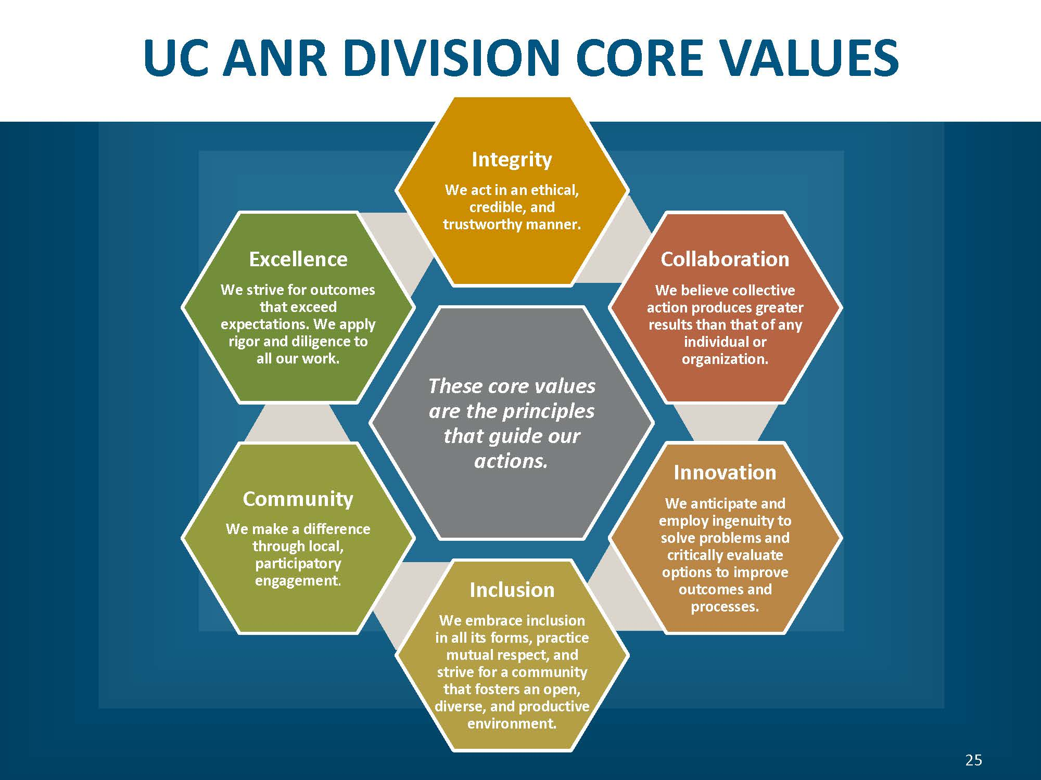

Goals of Affirmative Action
To assure nondiscrimination and equal opportunity
To expand access to people from traditionally underrepresented groups with outreach activities
Promote nondiscrimination and valuing of differences among staff and clientele
Value inclusiveness and diversity.
Notes:
As mentioned, ANR Core Values are the principles that guide our actions. You should see this as indicative of the high status with which UC and UC ANR holds the principles of non-discrimination, the prevention of all forms of harassment (including sexual harassment) and the ideals of affirmative action – both in our CE programs and in the workplace.
The ANR Core Values embrace not only inclusion but also integrity, collaboration, excellence, innovation and community development.

Slide 5

National Institute of Food and Agriculture (NIFA)
The Food, Conservation, and Energy Act of 2008 (the 2008 Farm Bill) authorized the creation of NIFA.
NIFA provides leadership and funding for programs that advance agriculture-related sciences through partnerships with the Land-Grant University System and their extension programs.
Notes:
NIFA, The National Institute of Food and Agriculture is the federal agency that administers federal funding to advance agriculture-related sciences through partnerships with the Land-Grant University System and their extension programs. Because of this funding, NIFA also monitors our contact reporting.

Slide 6
NIFA CIVIL RIGHTS REVIEW AREAS OF CONCERN/INTERESTS
Including:
Reporting data on clientele race/ethnicity and gender,
Racial/ethnic and gender composition of academics, staff, volunteers, committees and councils,
Potential workforce and program audiences.
National Origin discrimination and Limited English Proficiency
Accessibility to the disabled and public notification for accommodation.
Notes:
NIFA is not interested ONLY in the actual Cooperative Extension (CE) programs . . . they are ALSO interested in the diversity and Equal Opportunity of the ANR academic and staff workforce.
As such, NIFA reviews reporting data on
1) Extension and Research program and workforce race/ethnicity and gender data.
2) Racial/ethnic and gender composition of academic workforce, staff, volunteers, committees and councils.
3) potential workforce and program audiences.
4) National Origin discrimination and Limited English Proficiency
5) Accessibility to the disabled and public notification for accommodation.

Slide 7
CODE OF FEDERAL REGULATIONS (CFR)
Various CFRs and subparts prohibit discrimination from participation in programs receiving federal funding based on:
Race, color, or national origin,
Sex
Handicap
Age
Additionally, the opportunity to participate as a member of a planning or advisory body which is an integral part of the program cannot be denied based on race, color or national origin.
Organizations receiving federal funds must keep detailed records, including racial and ethnic data, and submit to the Agency upon request.
For more information on University policy and federal and state laws, including ALL protected categories, please visit:https://ucanr.edu/sites/DiscriminationSexual_Violence/Policies_and_Laws/
Notes:
Codes of Federal Regulations outlaw particular discriminatory practices related to race, national origin, sex, and age for example, within any agency receiving federal money. Not only is discrimination prohibited against those wishing to participate, but also to those wishing to advise or plan programs.
For more specifics on the CFR’s please visit the AA website.

Slide 8
Goals of Affirmative Action
To assure nondiscrimination and equal opportunity in hiring practices and in the workplace
To expand access to people from traditionally underrepresented groups with outreach activities
Promote nondiscrimination and valuing of differences among staff and clientele
Value inclusiveness and diversity
Notes:
When thinking of your AA goals, consider:
How you will assure nondiscrimination and equal opportunity in your program outreach and activities.
How you will expand access to people from underrepresented groups with your outreach activities.
Your commitment to nondiscrimination and inclusion will allow you to reflect the ANR Core Values in your work

Slide 9

Project Board’s Civil Rights Reporting
Notes:
Now we will look at why we do civil rights reporting.

Slide 10

Civil Rights Reporting and
Data Collection
Project Board’s Civil Rights component is the documentation that ANR executes its CE mission with equality. . .that the “quantity and quality of benefits and services” is the same for both people of color and whites.
California courts have held that the collection of racial data to monitor for non-discrimination does NOT violate state law prohibiting the consideration of race, sex, or ethnicity in areas of public employment, public contracting, and public education.
Notes:
We do civil rights reporting because the USDA wants to see documentation about “the extent to which members of minority groups are beneficiaries of federally assisted programs.”
How do we provide that documentation? We identify a clientele, we establish a baseline for that clientele group, then we report the contacts made against that baseline because attendance/contacts allows – maybe not a perfect – but at least some sort of measure that the delivery of program benefits and services to minorities is equal to the benefits being delivered to nonminority individuals. (Hence the importance of sign-in sheets – which we will talk about in a future slide.)
Ultimately, Project Board’s Civil Rights component is the documentation that ANR executes its CE mission with equality. . .that the “quantity and quality of benefits and services” is the same for both people of color and whites.

Slide 11
Who is Your Potential Clientele?
Your PVA & PD should provide key clientele information. Work with your county director and program colleagues to discover additional groups who may also become potential clientele
Learn about the demographics of your clientele group(s) by viewing US Census, Ag Census, Ag Commissioner’s Report, local data and local knowledge
Ask who would be interested in or benefit from your educational program
Consider the geographic area of your potential audience/clientele
Work with collaborators, agencies and stakeholders who represent and serve protected classes/groups
Notes:
How do you identify your potential clientele?
Your PVA & PD (Position Description) should state who your position is intended to serve. That’s your starting point. Then, working with colleagues in the similar program areas and/or your County Director, you can fine-tune that to discover additional groups who could also benefit from your program. Once you define you clientele group or groups, then the fun begins.
As an academic it is important that you find the demographic breakdown of your clientele groups in your county or geographical area. Some programs can use the US Census. If you are in an agricultural program area you may want to check the Ag Census and Ag Commissioner’s Report. Feel free to use local data and local knowledge from individuals who have lived or worked in the area for a period of time – but remember to document any sources you use.
As an academic you should ask yourself who are those individuals who would be interested in or benefit from my educational program.
Another great source is the collaborators, stakeholders or even individuals from other agencies who serve or represent the protected or underrepresented groups you are trying to reach.
If you are unfamiliar with them, learn about the diverse cultures within the geographical area where you work.

Slide 12
Am I Limited to One Clientele Group?
No, you are not limited to one clientele group, but you have to have at least one clientele group. However, if your clientele group is predominantly white and/or male, ANR strongly encourages you to identify an additional clientele group that may capture underrepresented peoples who are involved in some way with your program area but whom you may not have thought of as a distinct clientele group before.
Examples of Clientele Groups:
Example: All owners, operators, managers of __ commodity
Example: All PCAs
Example: Agencies and organizations that work in__ commodity arena
Example: Farm labors
Notes:
Am I Limited to One Clientele Group?
No, you are not limited to one clientele group.
You are required to have at least one clientele group. However, keep in mind that if your primary clientele group is predominantly white and/or male, ANR strongly encourages you to identify an additional clientele group that may capture underrepresented peoples who are involved in some way with your program area, perhaps in some niche industry, but whom you may not have thought of as a distinct clientele group before. Assuming such a group of people exists, capturing them in another clientele group will help you more accurately reflect the demographics of your geographic area and increase the reach of your programmatic efforts and potentially help more people.
Examples of Clientele Groups:
1) Example: All owners, operators, managers of __ commodity
2) Example: All PCAs
3) Example: Agencies and organizations that work in__ commodity arena
4) Example: Farm labors

Slide 13
Compliance and Parity
Program Compliance with federal requirements is achieved when:
1) clientele contacts are in “Parity”; or
2) through establishing All Reasonable Effort (A.R.E.).
Parity is defined by the USDA as when the percentage of each minority group making up your actual contacts comes to within 80% of their percentage in the baseline. For example, if Hispanics make up 10% of your potential or baseline, then Hispanics should make up at least 8% of your actual contacts in order for your program to be in parity for Hispanics.
Notes:
As you know, we report contacts to comply with federal and state laws, to promote nondiscrimination and the valuing of differences among clientele and to measure our progress toward achieving full parity of participation.
Now let’s look at how program compliance is achieved.
A program can be in compliance in two ways. 1) your clientele contacts are in full parity (more on that later); OR, 2) you establish All Reasonable Effort (ARE) if you are not in parity (we’ll discuss this later, as well).
Let’s take a look at parity, first. The definition of Parity: If your actual contacts come to within 80% of their percentage in the baseline, then your program is in parity. It has achieved parity of participation. Here’s an example for Hispanics :
Let’s say Hispanics make up 10% of your potential or baseline, then Hispanics should make up at least 8% of your actual contacts in order for your program to be in parity for Hispanics. That’s parity.

Slide 14

What is All Reasonable Effort?
All Reasonable Effort (ARE) is the utilization of at least three of four specific outreach methods (i.e. 1-Mass Media; 2-Newsletter/flyers; 3-Personal letters/emails; 4-Personal invitations) in order to expand access and move toward or maintain parity of participation.
We care about AA and A.R.E. in order to promote the widest adoption of best practices to the widest possible audience.
Notes:
You establish All Reasonable Effort (ARE) by utilizing (at least one time) at least three of four specific outreach methods. (And there is no substitution allowed, you must use at least three of these four specific methods. You are free to use other methods not listed but in order to establish compliance by ARE you must use at least three of these four specific outreach methods.) Mass Media / Newsletter or flyers / personal letters or personal emails to specific individuals / personal invitations – either face-to-face or by phone.

Slide 15
What is A.R.E. Activity?
ARE is the things you do to encourage people to participate in your program. It is not synonymous with program delivery methods.
ARE can be targeted to reach underserved clientele in order to expand access.
ARE Efforts Compliment Good Extension Programs
Consider . . .
Press releases in local publications
Holding meetings in places people are comfortable going to
Identifying possible barriers to participation and seeking ways
to remove them
Find groups to co-sponsor meetings
Notes:
So to be clear that we’re all on the same page, let’s review, “What is ARE Activity?”
It’s what you do to encourage people to participate in your program. It is NOT synonymous with program delivery. You can also target your ARE to reach specific segments of your clientele baseline in order to expand access.
Good ARE efforts could or should include sending press releases to local publications, holding meetings in place were all people can feel comfortable; if you can identify barriers to participation, try and find ways to remove them; seek out other groups to co-sponsor meetings with as an aid to reaching wider segments of your clientele.
A R E Efforts Compliment Good Extension Programs
Consider . . .
Press releases in local publications
Holding meetings in places people are comfortable going to
Identifying possible barriers to participation and seeking ways to remove them
Find groups to co-sponsor meetings

Slide 16
Why Report A.R.E. Activity &
a Note on How
Always report A.R.E. (Extension Activity type) in Project Board for civil rights compliance; this is not captured anywhere else
Report and qualitatively describe A.R.E. conducted by you and staff/volunteers
Important - Establish A.R.E. for each clientele group that is out of parity by reporting at least 3 of the 4 A.R.E. activity types in Project Board. Tag each A.R.E. activity to a clientele group.
Notes:
Now we’re going to look at why we report ARE activities and briefly touch on aspects of how to do that.
First, Why? [read first bullet]

Slide 17
AA Documentation
Promotional material and program outreach
News releases, radio spots, newsletters, flyers, other mass media
Nondiscrimination statement on promotional materials
Accommodation statement or icon
Keep notes that demonstrate your outreach to underrepresented individuals/groups
Mailing lists
Keep mailing and e-mail lists up to date
Notation about race, ethnicity, gender
Update frequently (12-18 months)
Assurance of Nondiscrimination Forms
Meeting sign-in sheets/documentation.
Notes:
O.K., we’re getting close to the end now. This next series of slides have to do with Frequently Asked Questions. For instance: the ANR AA Office is often asked what Affirmative Action Documentation should I keep?
You should keep for a period of three years, any documentation regarding any outreach or promotional activity that you did. Such as any PSAs or news releases sent to mass media outlets such as radio or television stations or newspapers. If you program cooperates with any non-governmental agency , for instance, if you use meeting space at, say, the Elks’ Club, you should have on file a signed Assurance of Nondiscrimination form from the Elks’ Club which states that they do not discriminate in their membership practices. These Assurance of Nondiscrimination letters should be updated every two years. (If you have any questions concerning the Assurance of Nondiscrimination letter, please contact the ANR Affirmative Action Office.)
Any outreach activities toward underrepresented groups that you do that is not related to mass media, keep some kind of documentation of such activity on file for three years. Keep snail mail and/ or email lists on file. Keep any Sign-in Sheets or other documentation you may have regarding audience attendance, also for three years. All this documentation can be kept in hard copy and filed in your office or as electronic copies and kept on your office computer.
Let’s talk a little more about Promotional activities in mass media:
On a case-by-case basis, other media including certain social media outlets such as blogs and Facebook posts may be considered as “mass media” and documentation about these should also be kept for three years.
Keep samples of any newsletters and flyers you send out for three years.
While we’re speaking of promotional and outreach materials -- you should include the nondiscrimination statement on any newsletters or flyers. The appropriate statement can be found on the ANR Affirmative Action website under the resource sidebar, or call the AA Office.
You should also include in these materials a solicitation for accommodation statement asking participants to contact you or your County Office if they need special accommodations. You can also use the wheelchair icon shown in an earlier slide. This icon indicates that your program or activity is accessible to individuals with disabilities – assuming your facilities actually are accessible, of course.
Your snail mail mailing list and/or your email mailing list should be updated regularly and as outlined in the third bullet under mailing lists it should be done every 12-18 months. It is important that you discuss with your county director the mailing or email list updating process used in your county or MCP unit.
Your mailing lists (snail or email) need to note the individuals’ race, ethnicity and gender, if possible. Your meeting sign-in sheets should offer people the opportunity to self-identify their gender, race and ethnicity. Self-identification is voluntary. No individual participating in UCCE programs is required to identify their gender, race/ethnicity in order to participate. We need the information in order to document for the federal government that ANR is supplying the benefits and services of CE to everyone who is interested without regard to their race or gender. If participants decline to self-identify, ANR still has a legal obligation to document that our CE programs are not discriminating. The USDA has o.k.’d the use of visual identification of audience make-up with regard to gender, race and ethnicity if we first offer an opportunity to self-identify and audience members subsequently decline to state. Take a head count of the audience. If fewer people self-identify than you have in your headcount, the USDA asks you to visually identify the race, gender and ethnic makeup of the rest of the audience. If half your audience declines to self-identify, you are asked to visually identify – yes, to guess – the makeup of the other half of the audience to the best of your ability. Why? I’m sure they’d love to take our word

Slide 18
Youth Development & NFCS Programs
& Project Board Entry
4-H Advisors:
NOT required to enter club or group Youth enrollments as contacts,
REQUIRED to enter their outreach (A.R.E.).
NFCS Advisors in EFNEP:
NOT required to enter their adult and/or youth participants as contacts,
REQUIRED to enter their outreach (A.R.E.).
NFCS Advisors in UC CalFresh:
REQUIRED to enter their enrollees as contacts and,
REQUIRED to enter their outreach (A.R.E.) into Project Board.
All other NFCS programs ARE REQUIRED to enter their contact numbers
Notes:
O.K. if you’re not a Youth Development or an NFCS Advisor these next few slides, for you, will be in the neighborhood of “getting into the weeds” of Project Board but I am asking your forbearance – it’s only for two slides, I promise.
If you are a 4-H Advisor, you are not required to enter youth enrollments as contacts into Project Board.
If you are an NFCS advisor in UC CalFresh or EFNEP and you’ve been an advisor for awhile who has already been entering your adult and/or youth participants in as contacts and are comfortable with your baseline, you may continue to do so.
However, all other NFCS advisors with programs NOT in UC CalFresh or EFNEP are required to enter their contacts into Project Board.

Slide 19
Youth Development & NFCS Programs
and Project Board Entry
NFCS Advisors in UC CalFresh or EFNEP who are not comfortable with their baseline data, the State YFC Office and ANR AA will take your participation data, establish a standardized baseline and determine the compliance status of your program for you.
Your county will be notified concerning the compliance status of your program.
Notes:
If you are a newer NFCS advisor in UC CalFresh or EFNEP who is not comfortable with your baseline data, the Statewide YFC Office and the ANR AA Office will take your participation data, establish a standardized baseline and determine the compliance status of your program for you. Your county will be notified concerning the compliance status of your program.
4-H youth enrollments and UC CalFresh and EFNEP enrollments are all collected in systems outside of Project Board – and we are trying hard not to duplicate efforts.
However, these other systems are not collecting outreach data at all. Therefore, all 4-H advisors and all NFCS advisors are required to input their outreach into Project Board!

Slide 20
Project Board and
Your PR Connection
Demonstrating extension efforts and impacts to your clientele groups is a key to being successful in your merits and promotions.
PR Reviewers look to your position description, narrative, and supporting documnets to determine if your program is serving your defined clientele.
User Manual Academics with ANR Merit + Promotion:
https://ucanr.edu/sites/ProjectBoardHelp/User_Manual_-_ANR_MP_/
Project Board Help:
https://ucanr.edu/sites/ProjectBoardHelp/
Notes:
Your clientele will be the focus of your research and extension program.
1) Demonstrating extension efforts and impacts to your clientele groups is key to being successful in your merits and promotions.
2) To start, your PVA and PD should provide key information on what clientele groups your position is intended to serve – but usually only in broad, industry-wide terms. You should fine tune this information to discover additional groups (i.e. special niche or auxiliary industries) whose members could also benefit from your program.
3) PR Reviewers look to your position description, program summary narrative, and extension tables to determine if your program is serving your defined clientele.

Slide 21

Evaluation
County Director/MCP Director annually communicate with their advisors about their contact reporting in Project Board.
Measurable Goals: establish measurable goals such as moving toward full parity in your program.
AA Office annually reviews Project Board reports and monitors progress toward compliance/parity. Also, supplies compliance status of programs of advisors up for Merit/ Promotion to ANR Administrators.
Advisors should be comfortable defending their choice of clientele group(s) and the source of their baseline data should there be a federal audit.
Notes:
O.K., we’re almost at the end!
What’s measured gets done. (Or so it is said.) As part of the ANR evaluation process, your supervisor should meet with you annually and go over your contact reporting. A goal that any advisor can have is to either move their program into full parity or to maintain parity.
The ANR AA Office annually reviews contact and ARE activity and compiles a compliance history for each advisor. Are you in compliance by ARE or by parity? Or are you out of compliance? This information is supplied to ANR administration for all advisors going forward for Merit/ Promotion.
As a side note: Any advisor should be comfortable defending their choice of clientele group(s) and the source of their baseline.

Slide 22
Questions? Contact . . .
David White dewhite@ucanr.edu
530-750-1286
Project Board Affirmative Action policies and requirements and Title IX Investigator
Affirmative Action Compliance & Title IX Officer
For Project Board technical assistance, contact UC ANR Project Planning & Evaluation Analysts Kit Alviz or Chris Hanson
Kit Alviz kit.Alviz@ucop.edu
510-987-0027
Chris Hanson Christopher.hanson@ucop.edu
510-987-0628
Notes:
If you have any questions concerning your Affirmative Action or Civil Rights obligations, feel free to contact me, David White, the ANR Affirmative Action Analyst and Title IX Investigator
Thank you again for taking this training.

