Slide 1
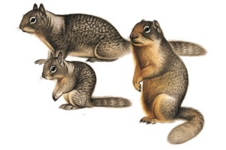
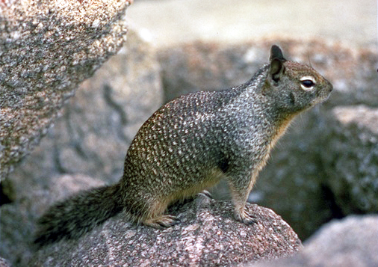
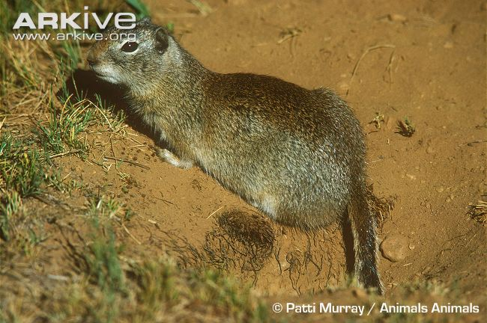
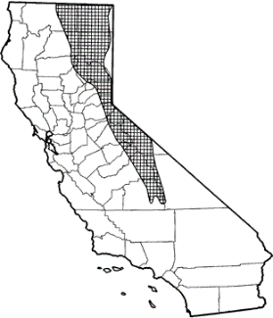
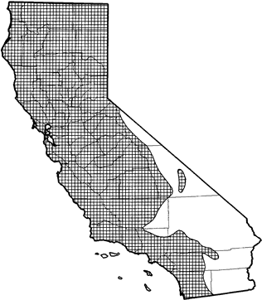


Squirrel Biology & IPM
Bill Tietje, UC Cooperative Extension
Otospermophilus beecheyi
Spermophilus beldingi
Notes:
The California Ground Squirrel is very adaptable and prefers open habitats.
They usually increase in grazed areas, as form production and visibility increase. This plus the fact that It’s favorite foods are grains, nuts, fruits, and forage makes it not the favorite animal of agriculturists.
I am going to give you a little background on the squirrel, talk about its live history and predators, and a bit about grazing and the squirrel.

Slide 2
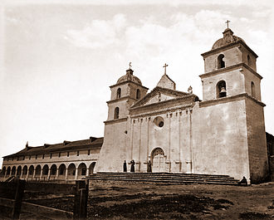
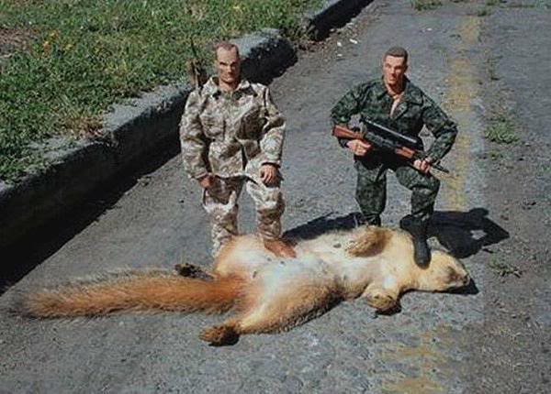
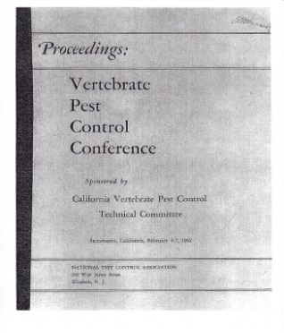
Brief History
The Bounty 3¢
(repealed 1877)
Santa Barbara Mission--1808
1st Vertebrate Pest Conference
(Sacramento, 1962)
$1.00
Notes:
The first recorded campaign for control of gd sq was at the Santa Barbara Mission, in 1808. Thousands were killed in nine days of May in that year. 1901 was cited as the beginning of statewide interest in control programs.
During most of the 1800s, there was a BOUNTY on squirrels. County coffers were strained even at 3 cents per squirrel when 100s of thousands of claims were made.
--There were many abuses. For example, different parts of the same squirrel were turned in in adjoining counties.
--Also, when sq numbers were reduced to moderate numbers, incentive to pursue them waned, and so long-term control was not attained.
--The bounty was repealed in 1877.
First Vertebrate Pest Conference was held in Sacramento in 1956. There has been one every other year since then.

Slide 3
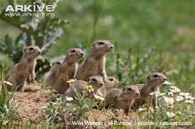
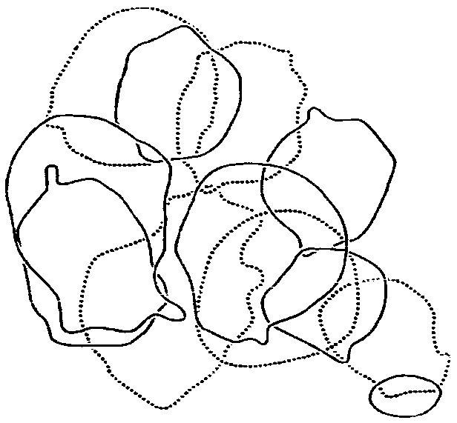
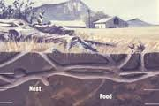
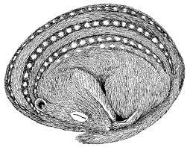
Reproduction/Annual Cycle
Hibernate (Sep-Jan) Active (Feb-Jun)_ Aestivate (Jun-Aug)
Density
30-35/acre
Ad. Males
& Females
Aestivate
1 litter/year
5-7 young nursed underground
Males disperse/Female Kin Clusters
Yearlings reproductively mature
Notes:
HIBERNATION__BURROW: Within 2-3 feet of gd surface, up to 100 feet of burrow, with many branches, several entrances.
EMERGE: Jan and all out by March. Because this is the time that the most sq are above gd, and it is the time of most competition with cattle, it is the time that control could be the most effective, but it depends on conditions.
--After emergence they feed primarily on green grass and forbs. They switch to seeds, grains, and nuts when they mature.
AESTIVATION: Depending on food availability and summer heat, males go underground in Sept and may remain thee for only a week or two or may remain underground until the following spring.
--Females enter the burrow later and young of the year may not hibernate at all. Therefore, fall and winter populations are composed almost entirely of young squirrels.
General time line (burrow, food, summer sleep) and then what will cover in the next few slides (Reproduction, HR, Predators, Cattle/Sq, and END

Slide 4
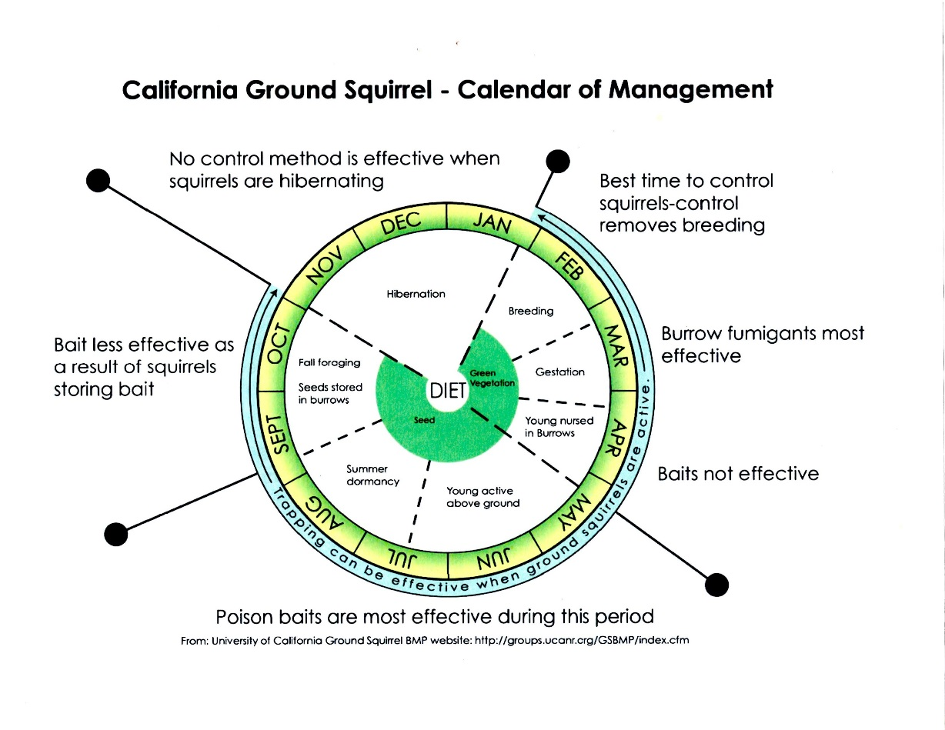
Gd. Squirrel Calendar
Hibernate
Young Weaned—All Emerge
Fall: Ad. Aestivate
Young Active
Feed on Grass & Forbs
Males Disperse
Female Kin Clusters
Summer: Feed on Seeds & Nuts

Slide 5
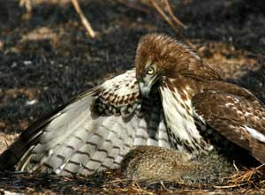
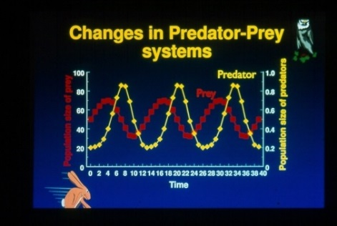
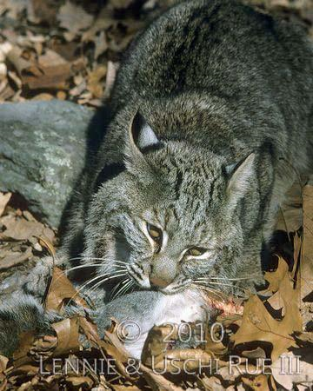
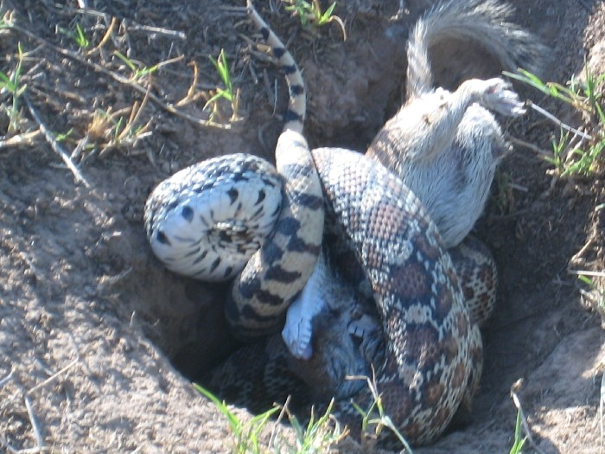
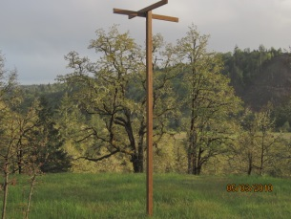
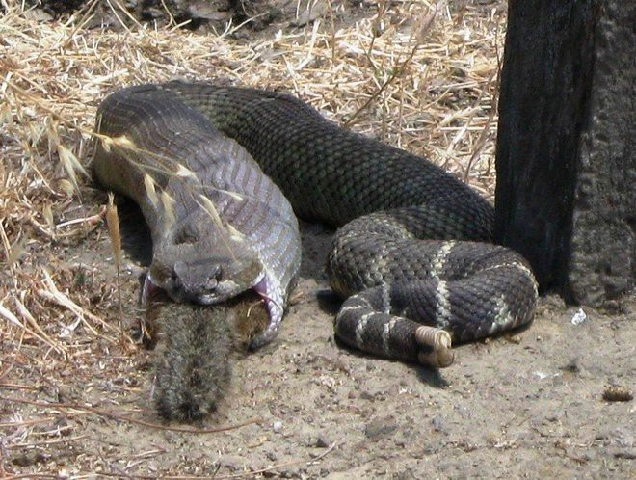
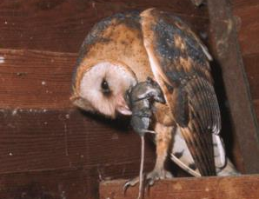
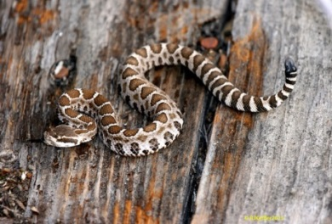
Control Options—Biocontrol
70% diet rattlesnake
Blood proteins
Hemotoxin/Neurotoxin
Notes:
PREDATORS: Many: snake, coyote, hawk, bobcat, badger. Most effective are hawk, mammal, snake
SNAKE: squirrels eat shed rattlesnake skin and then lick their fir as a method to deter predators and deter conspecifics
--Sq comprise 70% of the diet of rattlesnakes , foothills Sierra Nevada.
NOTE: Young and old sq. have evolved blood proteins that confer some immunity to rattlesnake venom. Pups succumb to rattlesnake bites because they cannot neutralize as much venom as adults can. Consequently, rattlesnakes eat almost exclusively pups.
(In defending their pups, adults are often injured, but oftentimes do not die from the bite.)
NOTE: Juvenile snakes have less venom, but there venom has more neurotoxins (as opposed to hemotoxins) than an adult snake and therefore ounce for ounce is more dangerous than that of the adult snake.
xx. Predators will help to keep an already depressed population depressed longer. Predators are not able to achieve the level of control that most landowners want. Predators surely will help with control, but it’s very difficult to measure just how much they will help. Need an IPM Program.

Slide 6
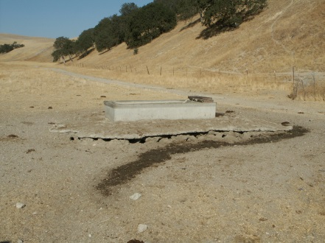
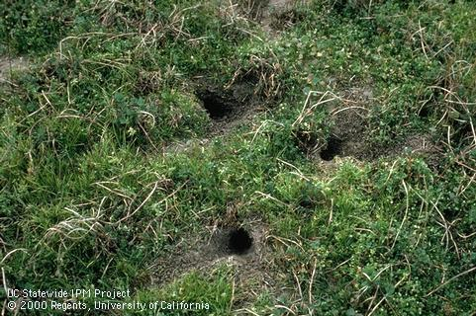
Cattle & Squirrel
Forage Competition
IMPACT―Very Site Specific.
B. Critical time:
Late winter (Low forage for cattle)
C. Study: Effects of Livestock on CA Gd. Sq.
Conclusion:
Moderate grazing
Adequate rainfall
Can have cattle, squirrels, & predators the squirrels support.
Notes:
Difficult to summarize the literature on the relationships between Cattle & Sp. I will just make several points based on the fairly numerous articles that I reviewed. You can take it for what it is worth:
A. Forage Competition
Reduce gain by 1 lb/day
200 squirrels = one 1,000 lb. steer
3% of what available (range 2-6%)
B. Most critical time: Late winter (period when forage plants are growing slowly. Time of inadequate forage growth for cattle.
--Competition also more critical at heavy grazing intensity and during drought years.
C. Study that had eye toward maintenance biodiversity and rofitable cattle enterprese: Fehmi, Russo, Bartolome. 2005. Effects of Livestock on CA Gd Sq. J. Range Ecology & Mgmt.
Conclusion: At moderate grazing intensity and during years of adequate rainfall, can have cattle, squirrels, & predators the squirrels support.

Slide 7
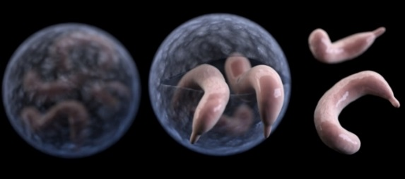
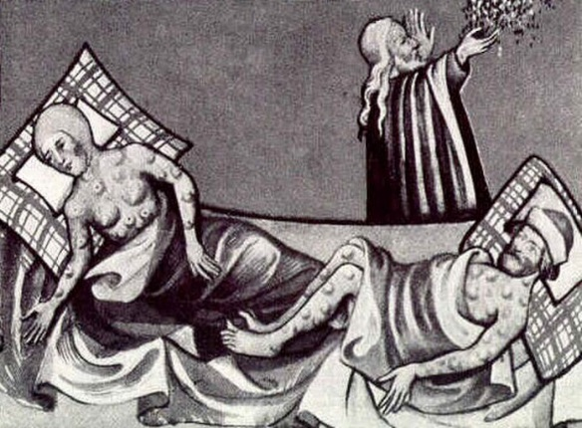
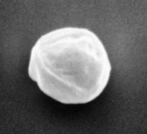
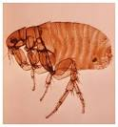
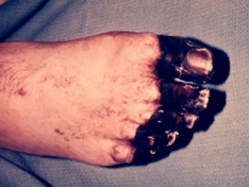
Disease & Squirrel
Cryptospordium parvum
Septicemic Plague
Oocist
Black Plague

Slide 8
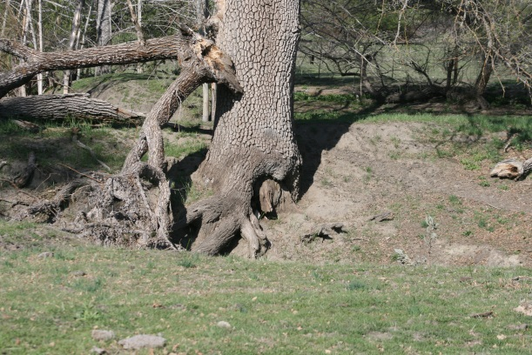
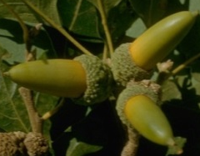
Oak Tree & Squirrel
Ideal habitat
--shelter
--food (acorns)
Burrowing dries roots
Moved soil may be contaminated w/oak root fungus
Destroys seedlings

Slide 9
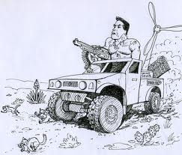
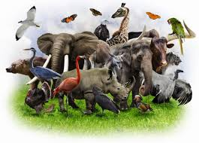
Not ALL Bad!
The Bad:
Ag pest extraordinaire!
Health hazard: Bubonic plague
Oak seedling predator
The Good:
Keystone Spp.: helps maintain
predator & grassland diversity
Challenge: Maintain the functional roles
of burrowing mammals in ways compatible
with human activities
END

