Slide 1



PRUNING AND CARE OF ROSES
Placer County Master Gardeners
Lynne Gold
Marie Salers

Slide 2

WHO ARE MASTER GARDENERS
Master Gardeners are trained volunteers, who have received up to 80 hours of horticultural instruction from the University of California Cooperative Extension and other local gardening experts. We are trained in gardening topics ranging from basic botany and plant pathology to integrated pest management and irrigation techniques.

Slide 3
WHO ARE MASTER GARDENERS CONT’D
In exchange for this training, Master Gardeners agree to complete 50 hours of apprenticeship and volunteer work to become certified.
Additional training and volunteer time are required annually to renew certification. Only persons who have successfully completed these requirements can call themselves Master Gardeners.

Slide 4

ALL ABOUT ROSES
CHOOSING THE RIGHT ROSE
VARIETIES OF ROSES
PRUNING GUIDELINES
DEADHEADING
COMMON DISEASES IN ROSES
PESTS
BENEFICIALS
GENERAL CARE

Slide 5



CHOOSING THE RIGHT ROSE
    DETERMINE YOUR PURPOSE FOR THE ROSE BEFORE PURCHASING OR PLANTING
    CHOOSE THE HEALTHIEST, BEST AVAILABLE SPECIMENS FREE OF INSECTS AND DISEASE WHETHER IN A CONTAINER OR BARE ROOT

Slide 6


VARIETIES OF ROSES
HYBRID TEA ROSES
    - large bloom at cane's end

Slide 7

VARIETIES cont’d
FLORIBUNDAS and GRANDIFLORAS
    - Clusters of smaller blooms

Slide 8
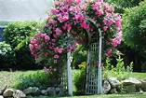
VARIETIES cont’d
CLIMBING ROSES
    - Very long, rambling canes

Slide 9
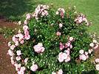
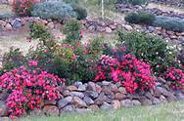
VARIETIES cont’d
SHRUB ROSES and GROUNDCOVER ROSES
    - more compact; many small blooms

Slide 10


VARIETIES cont'd
LANDSCAPE ROSES – These plants require little care and can be left unpruned; miniatures can be mowed

Slide 11
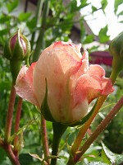
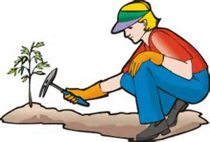
PRUNING GUIDELINES
REMOVE DEAD AND DISEASED WOOD ANYTIME OF YEAR HEAVY PRUNING BEST IN JANUARY
HYBRIDS – annually
FLORIBUNDAS AND GRANDIFLORAS – similar to Hybrids but more forgiving
CLIMBING ROSES
  wait until plant is about 2-3 years old; retain 6 well spaced canes; attach to support and remove others
PRUNE PLANT INTO A VASE SHAPE

Slide 12
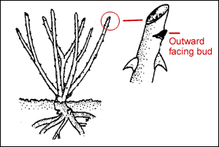
Pruning
General Guidelines
  Remove dead, damaged or diseased wood
    Keep shrub from becoming a tangled mess
  Shape the plant
    Increase air circulation
  Removal of 1/3 to 2/3 healthy wood is okay
    Encourage growth of flowering wood
    Cut ¼” above outward facing buds
Notes:
Here is the shape you will want to create. This shape provides adequate light and air within the plant. Prune to an outside branch, so that the new growth will be facing outward rather than inward. Try to remove only 1/3 of the plant when pruning. The longer you can wait to prune your new plant, the better. The new plant will have an opportunity to become well established and you should have fewer problems.

Slide 13
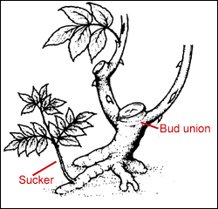
Pruning cont.
Hybrids
  Prune annually
  3-5 canes
  Vase shape
Remove growth below bud union

Slide 14
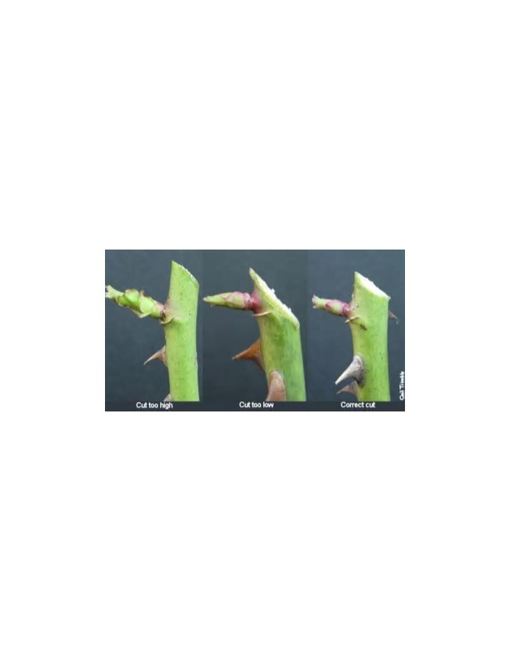
PROPER CUTS
THE FIRST CUT IS TOO LONG
THE SECOND CUT IS TOO SHORT
THE THIRD CUT IS CORRECT
Notes:
The first cut can cause dieback which can affect the branch; the second cut could injure or kill the node from which the new growth is seen; the third cut provides enough room for growth in the node. You probably wonder why the rules always say to cut at a five leaf leaflet. The five leaf leaflet cut will provide the strongest part of the branch for regrowth.

Slide 15
PRUNING PHOTOS

Slide 16
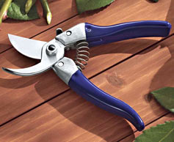
PRUNING cont’d
CLEAN, SHARP TOOLS
  use by-pass pruners; clean in alcohol after each use
DORMANT OR SULFUR SPRAY AFTER PRUNING
BY-PASS PRUNERS --

Slide 17

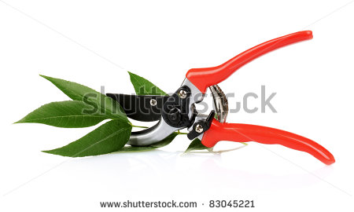
DEADHEADING
WHAT IS DEADHEADING?
WHY IS IT IMPORTANT?
WHAT DOES IT DO?
WHAT BRANCHES SHOULD BE DEADHEADED?

Slide 18
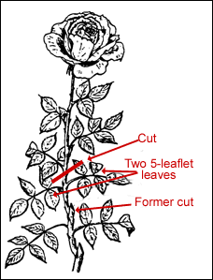
DEADHEADING cont’d
REDUCES DISEASE
IMPROVES CIRCULATION

Slide 19
DEADHEADING cont’d
DEADHEADING REMOVES SPENT FLOWERS WHILE PRUNINGREMOVES BRANCHES AND SHAPES THE PLANT
DEADHEADING CAN BE DONE AS OFTEN AS THE FLOWER IS SPENT
DEADHEADING FRESHENS THE PLANT AN ENCOURAGES NEW FLOWERS TO BLOOM
DEADHEADING IS IMPORTANT BECAUSE IT IMPROVES CIRCULATION OF THE PLANT AND REDUCES THE CHANCE OF DISEASE

Slide 20
COMMON DISEASES IN ROSES
    POWDERY MILDEW –white-grey powdery growth; spreads by airborne spores; control by spray washing foliage in the morning
    BLACK SPOT – black spots appear on leaves and quickly spread; remove all leaves and discard in trash
    Both of the above are a fungus; it is important to provide good circulation. Place plant in right location. Remember – right plant/right place; can be controlled organically with neem oil

Slide 21
BENEFICIALS
LADY BEETLE LARVAE
LADY BEETLES
LACEWINGS
PARASITIC WASPS
FLIES – SYRPHID AD TACHINID
SOLDIER BEETLES
MANY OTHERS

Slide 22
PESTS
APHIDS – most common
ANTS – provide care for aphids
THRIPS, SPIDER MITES, AND MANY OTHERS
A GOOD RESOURCE
www.ipm.ucdavis.edu/mg/pestnote/PM7466.HTM

Slide 23

Thank You And Happy Gardening!
UCCE Placer County Master Gardeners
Office Hotline 530 889-7388 or Online: http://pcmg.ucanr.org/Got_Questions
Web: pcmg.ucanr.org

