Slide 1
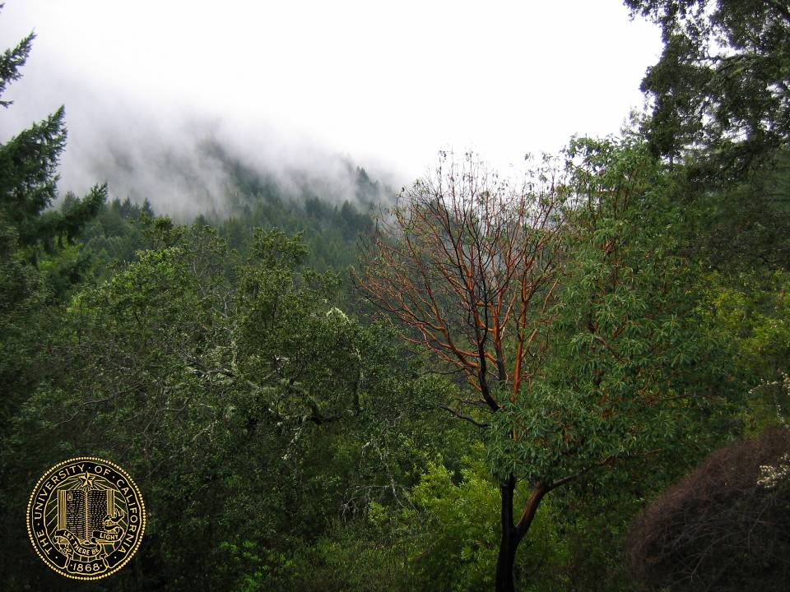
Disease suppression in the composting process
Steven Swain, UCCE Marin & Sonoma Counties
Matteo Garbelotto, UCB Forest Pathology Specialist

Slide 2
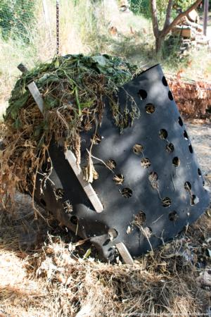
Compost
DD?
  Webster’s 2nd College Edition:
    -n A mixture of decomposing vegetable refuse, manure, etc., for fertilizing and conditioning the soil
    -vt To convert (vegetable refuse) into compost
  Mulch?
    Leaves, straw, peat moss, etc., spread on the ground around plants to prevent evaporation of water from soil, freezing of roots, etc.

Slide 3
Process variables
Main variables
  Moisture content
  C:N ratio
  Ambient temperature
    Open versus closed container
  Turning frequency
  Pile size
Secondary variables
  Feed stock
  Process type
    Turned windrow
    Forced air static pile
  Turning type
  Urban / Rural location
  Curing time
  Post process inoculation

Slide 4
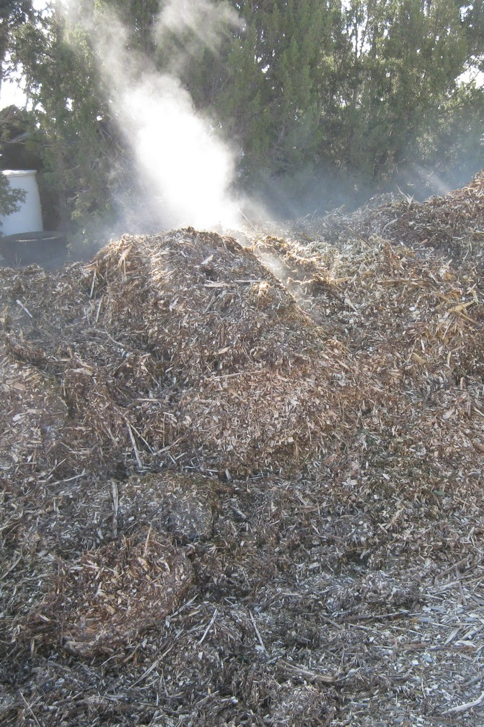
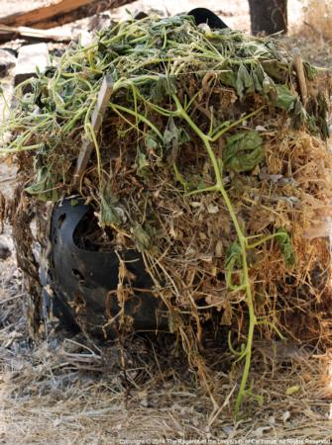
Temperature
Pile size drives this
~1m³ threshold
  If everything else is right

Slide 5
Temperature
Pile size drives this
~1m³ threshold
  Cold composting
    Small piles
      Turned by hand
    Biological / chemical pathogen destruction
    Kills some microbes
    Yuen & Raabe, Plant Disease, 1984

Slide 6
Temperature
Pile size drives this
~1m³ threshold
  Hot composting
    Big piles
    Above methods + thermal destruction
    Kills virtually all microbes
      Some viruses and prions escape
      For the most part, these exceptions are non-issues

Slide 7
Temperature
Why do we care?
  DD of compost
  Can include:
    Animal manures
    Biosolids
    Infected plant material
Pre 1940’s container media (nurseries)
  Aged peat moss
  High % organic matter loams
  1960’s, hard to find

Slide 8
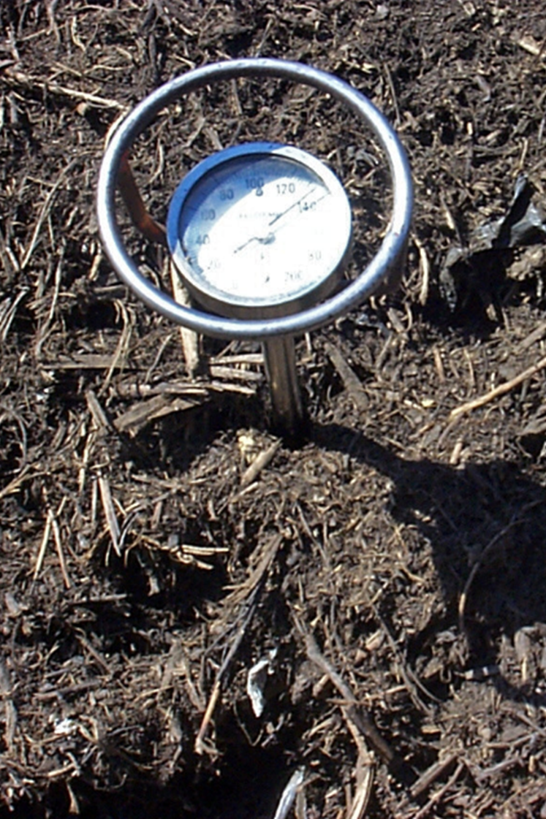
Temperature
Nursery Industry
  Tries compost
    Hoitink et al (1976) … Composted Hardwood Bark
Compost
  Noun
    Plant and human health concerns
  Verb
  US EPA regulates commercial process
  40 CFR Part 503

Slide 9
Temperature
Time requirements vary by composting process
  Always at 55°C
  131°F

Slide 10
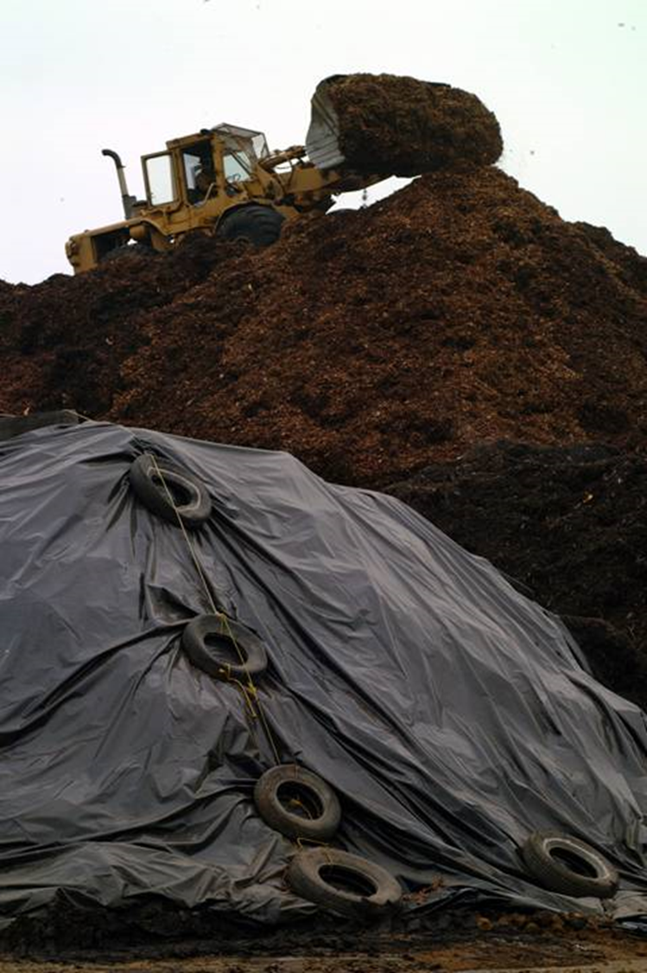
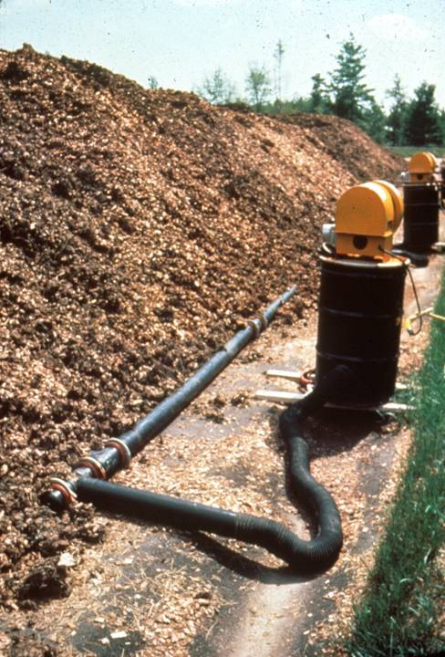
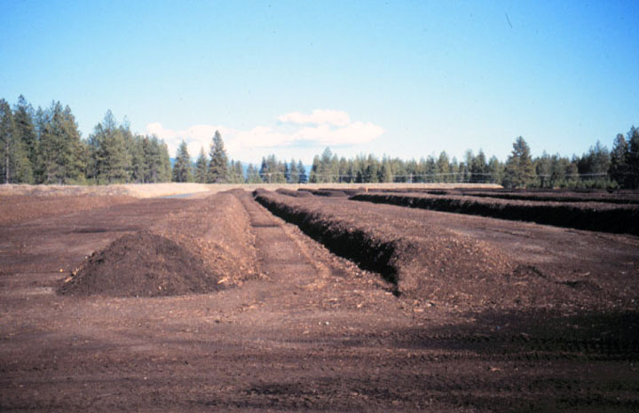
Commercial Composting Processes (bay area)
No turning
Air forced in by blowers
“Traditional” composting method
Turned by various types of machinery

Slide 13
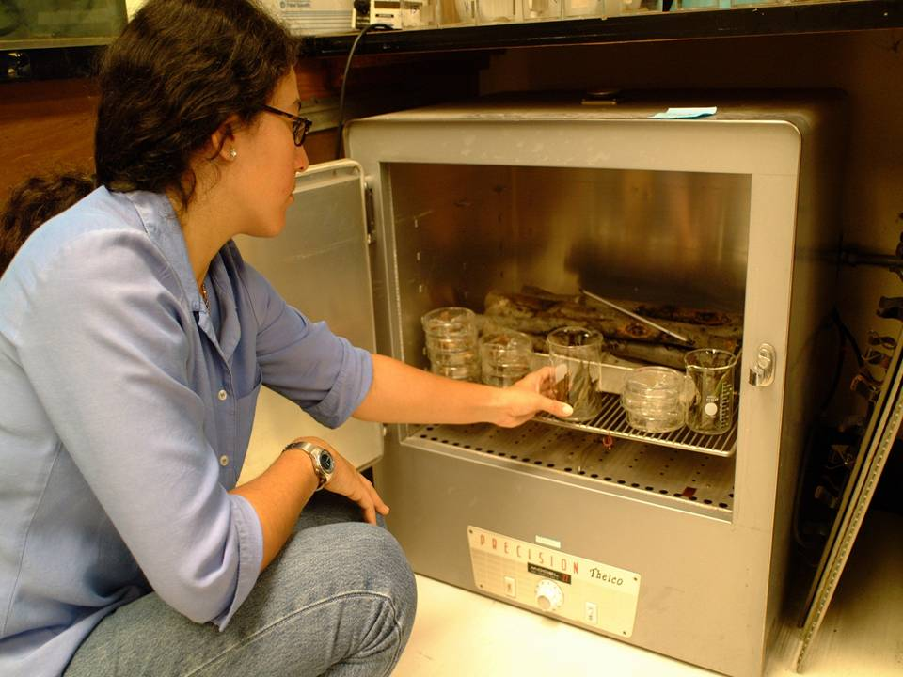
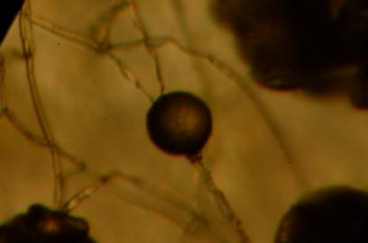
Heat Treatment of P. ramorum on Natural Substrates

Slide 14
Heat Treatment of Pure Culture
Time to Mortality
1 Hour
2 Hours
Lower tempera-
tures did not cause
mortality within the
experimental time
frame
24 Hours

Slide 15
Curing time
None technically required
Young (low curing times, typically <1 wk)
  Low biodiversity, high chemical diversity
  Recolonization easy(ish)
Mesic (1-4 weeks)
  High biodiversity, recolonization in process
  Most reactive chemicals stabilized
Mature (^ curing times, typically >4 wks)
  Moderate biodiversity, chemically homogenous and stable
  Recolonization finished
NOTE: These times vary with location & climate

Slide 16
The problem with mulch
No formal definition of product or process
  Mylar
    shredded reflective plastic for thrips control
  Sheet mulching
    Newspaper/cardboard/manure/wood chip lasagna
  Wood chips
    Straight from chipper
    Pallets
  BUT fresh wood chips can self-compost
    Especially if chipped with leaves (unregulated?)

Slide 17
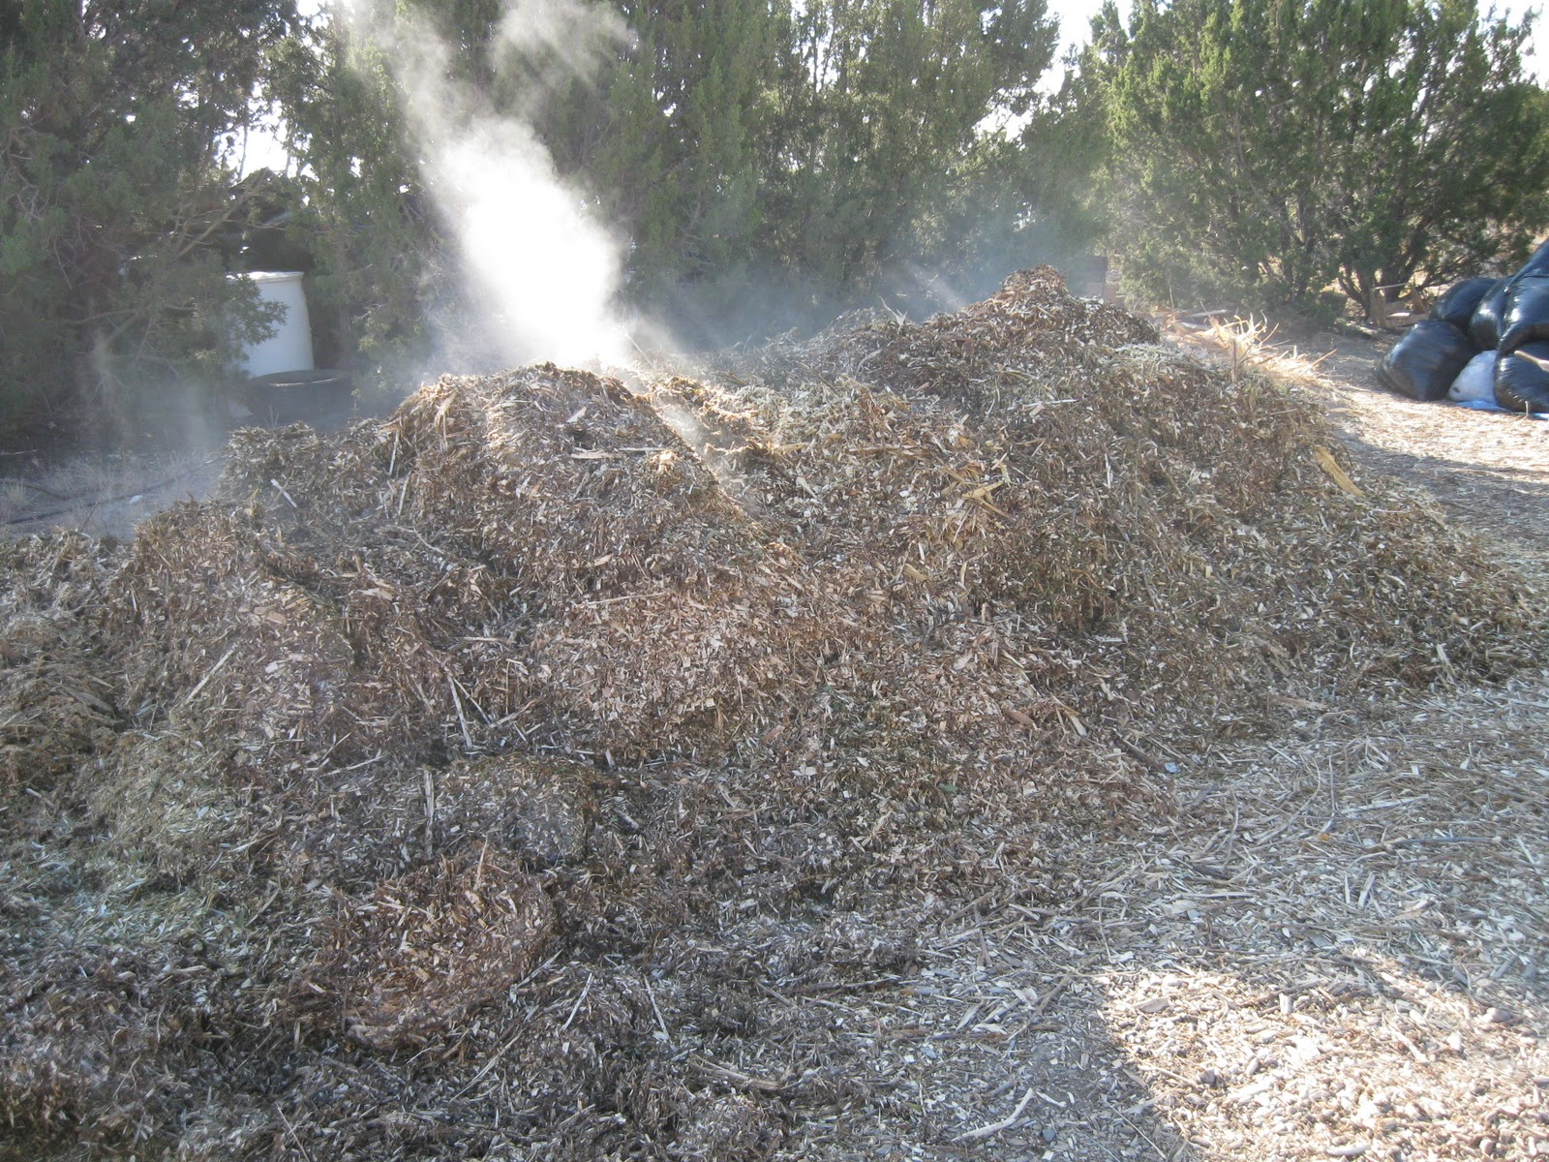
http://onelittlefarm.blogspot.com

Slide 18
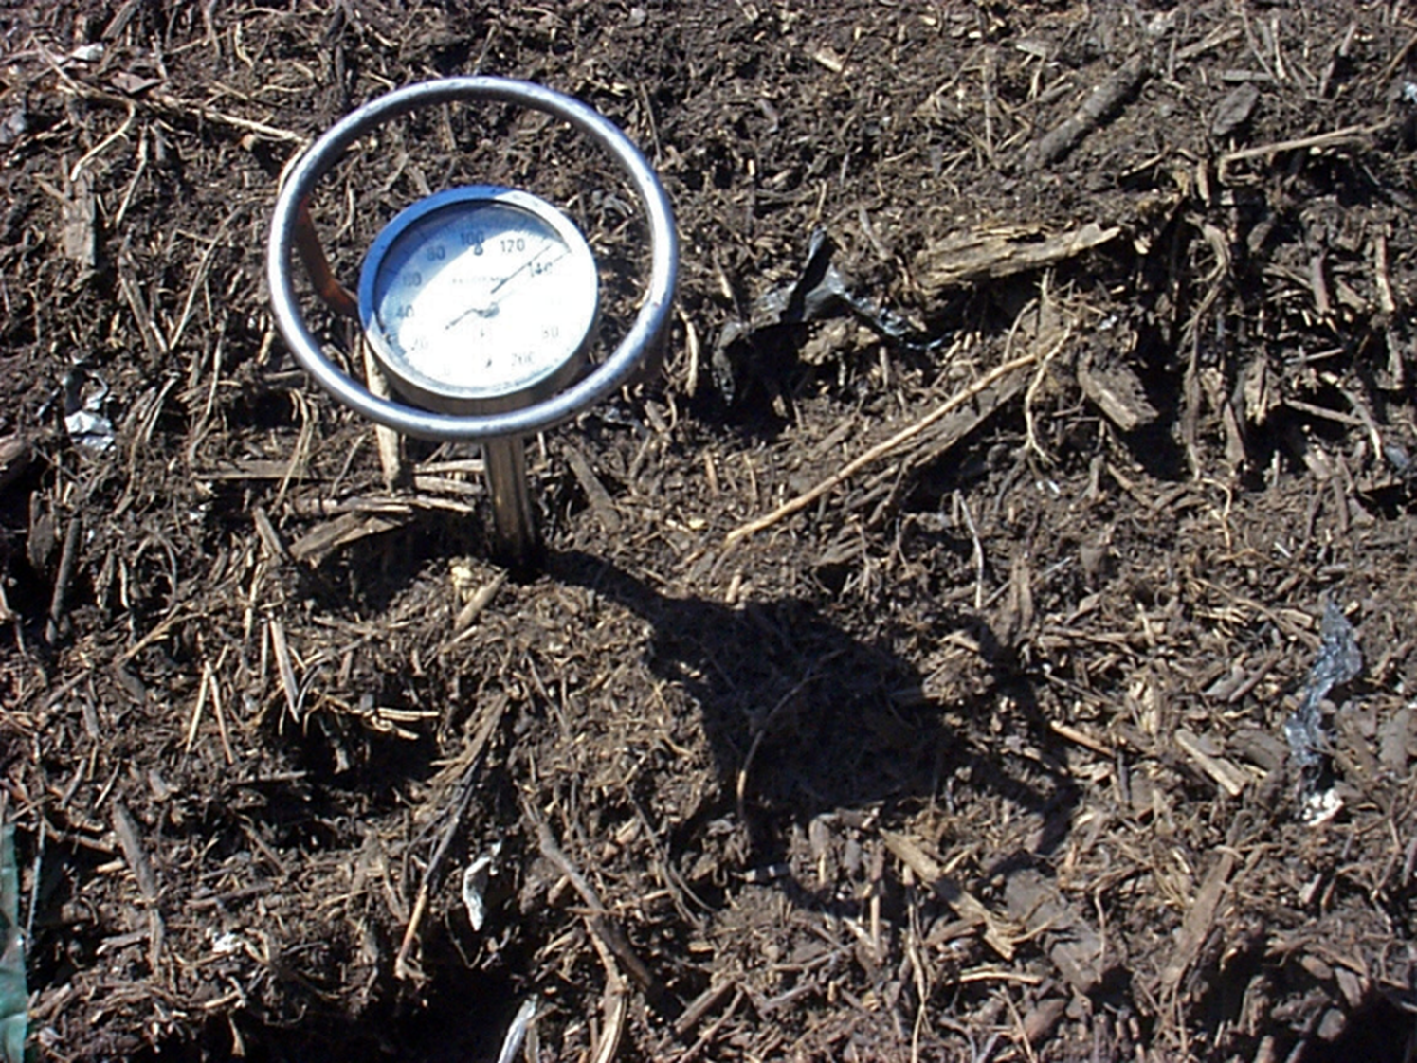

Slide 19
Compost as a cure?
Harry A.J. Hoitink at the Ohio State U.
  Composted green-waste (bark) is disease suppressive in potting mixes (1970’s – 2009+)
  Bacillus, Trichoderma, etc.
  e.g.: http://plantpath.osu.edu/sites/plantpath/files/imce/files/Hoitink/BioCycle_2009.pdf
The Ashburner system: Guy Ashburner (Australian avocado grower, 1970’s)
  cover crop / mulches, and amends soil beneath trees
  Reduces P. cinnamomi infections after several years
  Ref: Magdoff F. & Weil R.R. (2004) Soil Organic Matter in Agriculture, CRC Press, p.162
  Adopted wholesale by Australian avocado industry

Slide 20
Will compost disinfect my soil?
Field efficacy
  Results all over the board
  Product consistency
    Process is regulated (kills most pathogens)
    Product is not regulated (may not be effective vs pathogens)
  Suggestions for post-process inoculation
    Trichoderma, other bio-fungicides
    Cost is already a factor
      Full circle?
Giles Hardy and others show that some (many?) soilborne Phytophthora species can survive in finished compost

Slide 21
Can P. ramorum survive the composting process?
Federal quarantine on P. ramorum
Composting industry subject to quarantine
We prove composting eradicates
  Cultural methods to assess contagion
  DNA methods to assess survival
Properly processed compost should be exempted from quarantine

Slide 22
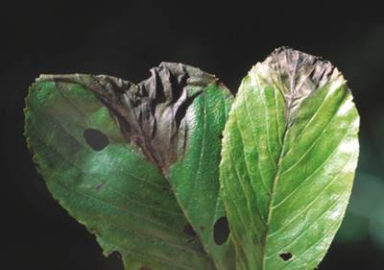
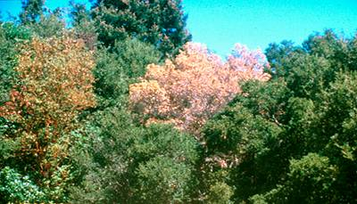
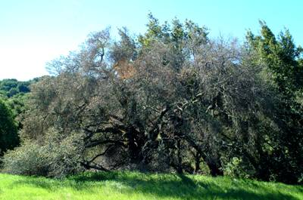
Phytophthora ramorum
Sudden Oak Death
Rain, wind, water dispersed
Devastating to oak trees and relatives
Large host list
  Many landscape species
Believed to be introduced

Slide 23
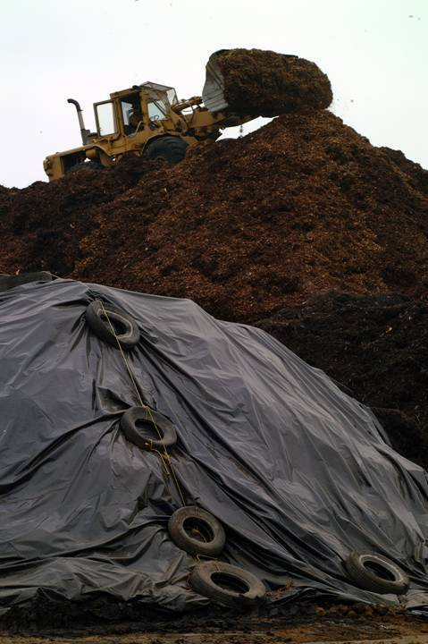
P. ramorum and composting
More than 50,000 tons composted per day in California
Composting effective against other diseases
USDA & CIWMB requested study
  Validate quarantine
  or
  Provide exemption

Slide 24
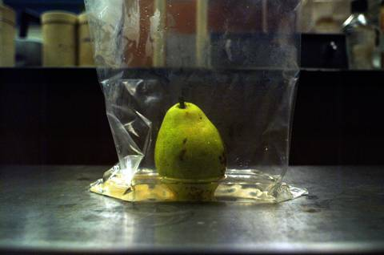
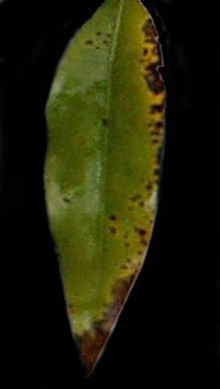
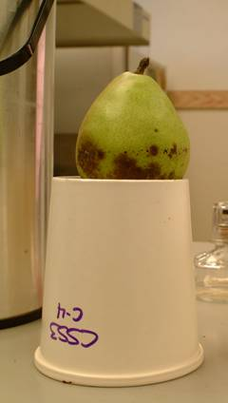
Cultural methods: Direct Plating vs. Baiting
Method depends on substrate

Slide 25
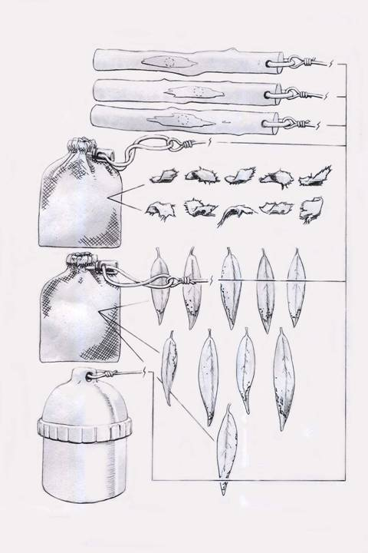
Can composting do the job?
“Direct Process Evaluation”
Test probe composition:
  3 Stems
  10 Chips (mesh bag)
  10 Laurel leaves
  (mesh bag)
Temp. Recorder
4x in each pile

Slide 26
Turned Windrow and Oven Results by Site
Site | n | Pre | % Pre | SE | Post | % Post | SE | Delta mean | SEdiff | 99% CI for 0
B | 8 | 66/180 | 37% | 3.85% | 0/180 | 0% | 0.00% | -37% | 3.85% | 0 +/- 13%
M | 8 | 61/180 | 34% | 4.49% | 0/180 | 0% | 0.00% | -34% | 4.49% | 0 +/- 16%
C | 8 | 63/180 | 35% | 3.08% | 50/180 | 28% | 1.38% | -7% | 3.38% | 0 +/- 11%
O | 8 | 52/168 | 31% | 4.03% | 0/168 | 0% | 0.00% | -31% | 4.03% | 0 +/- 14%
Forced Air Static Pile Results
Pile | n | Pre | %Pre | SE | Post | %Post | SE | delta mean | SEdiff | 99% CI for 0
1 | 8 | 125/184 | 68% | 4.45% | 0/184 | 0% | 0.00% | -68% | 4.45% | 0 +/- 16%
2 | 4 | 63/92 | 68% | 5.95% | 0/184 | 0% | 0.00% | -68% | 5.95% | 0 +/- 35%
C | 8 | 123/184 | 67% | 2.40% | 92/184 | 50% | 7.79% | -17% | 8.15% | 0 +/- 27%

Slide 27
Turned Windrow and Oven Results by Site
37% to 0
34% to 0
31% to 0
Chance
Variation
Chance
Variation
Chance
Variation
Chance
Variation
35-28%

Slide 28
Forced Air Static Pile Composting Results
68% to 0
68% to 0
Chance
Variation
Chance
Variation
Chance
Variation
67 – 50%

Slide 29
Oven and Compost Trial Conclusions
Composting is capable of eliminating P. ramorum from green-waste
  Cal. Integrated Waste Mgmt. Board guidelines
Heat alone is sufficient to kill P. ramorum
  Biotic and chemical interactions may augment the kill rate

Slide 30
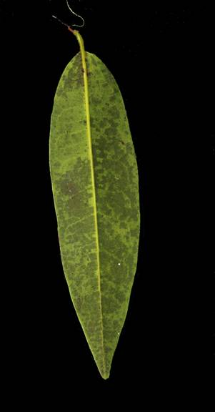
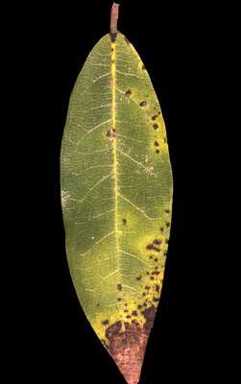
Is it effective?
“Spot Test Evaluation”
Large compost pile
  10% artificially inoculated bay leaves
  Estimated equivalent of 30% naturally infected material
Cultural tests (contagion)
  Runoff collection
  Flooding
  Sentinel plants 1-15m around compost pile
  Planting Rhodies in finished compost
DNA detection (presence)
  Comparison of DNA levels beginning and end

Slide 31
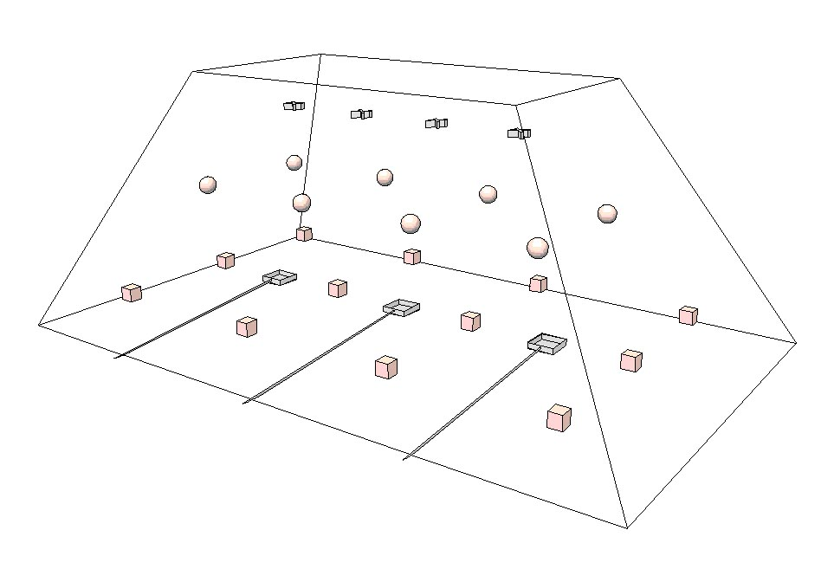
Level Three Datalogger locations: “X”’s
Level One Datalogger Locations: Cubes
Level Two Datalogger Locations: Spheres

Slide 32
Leachate Collection Boxes

Slide 33
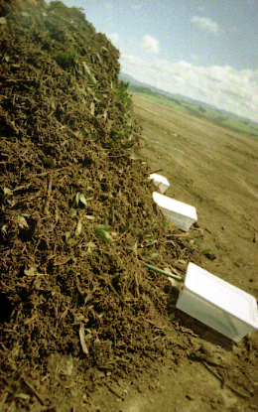
Runoff collection
Test contagion in rain
Collection after limited irrigation
Pear bait collected water
Turn pile to dry and aerate

Slide 34
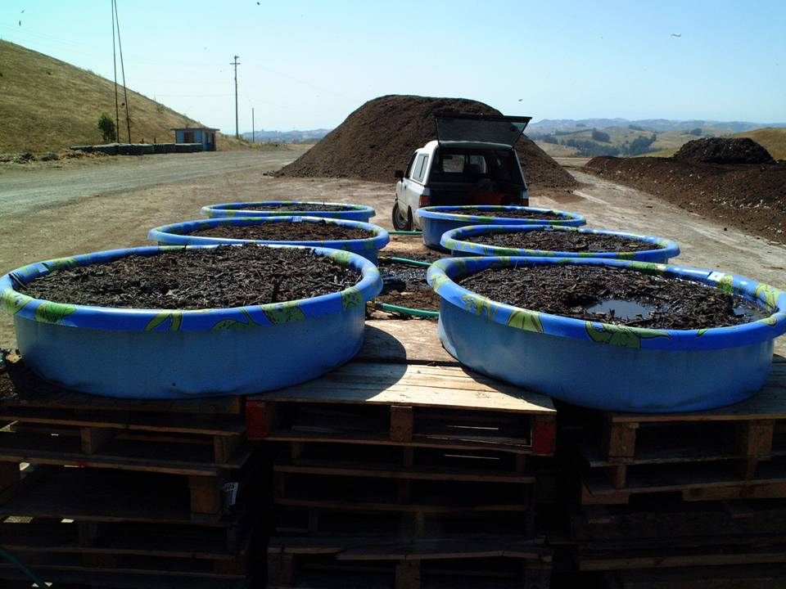
Flood sampling: tests contagion in water
  ½ of pile flooded in pools
  Drained
  Pear baited

Slide 35
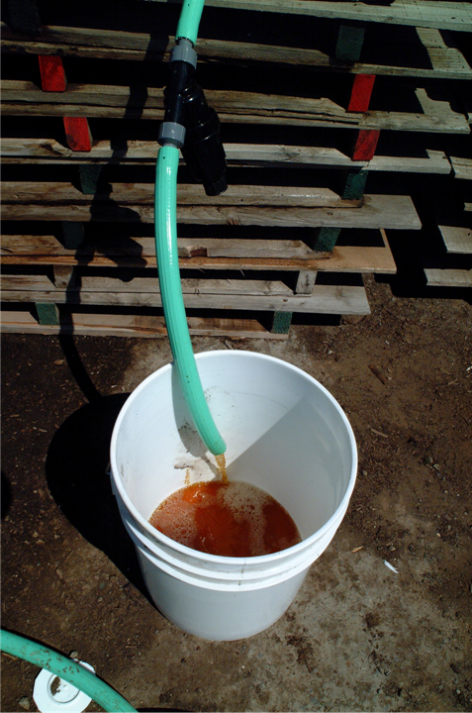
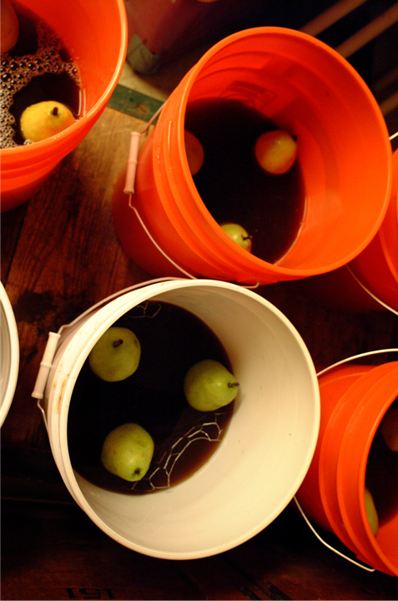

Slide 36
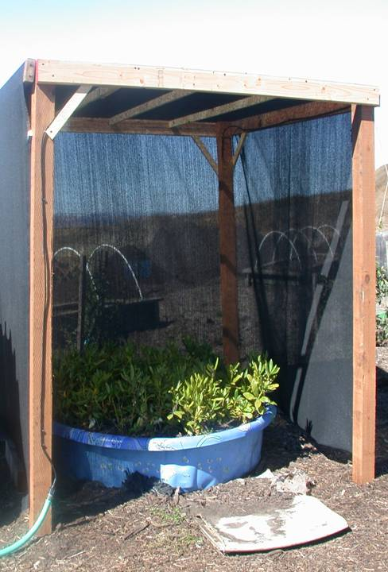
Planting tests
Tests contagion in planting material
Sentinel Rhodies planted in compost
  After pile disassembled
Leaves and stems evaluated for symptoms
Any symptoms found are plated and baited

Slide 37
Cultural test Results
All 48 direct samples from the pile were negative
All runoff tested negative
All 120 flood samples tested negative
All 248 direct plating and 36 pear baitings of sentinel plant leaves tested negative
After three months from experiment end, all planted rhododendrons tested negative

Slide 38
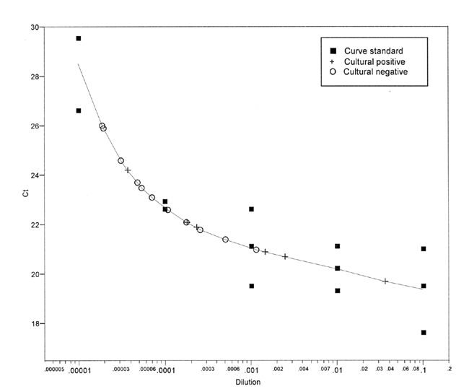
DNA detection limit
Detection region of killed cultures
(Ct = approx 24)
Detection region of positive controls
(Ct = approx 22)
Strong signal
Easy detection
430 DNA samples taken throughout pile: all negative (off the chart)
>99% probability no P. ramorum DNA remaining in pile

Slide 39
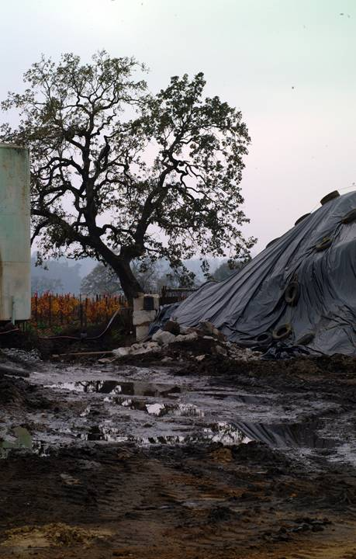
Conclusions
Contagion risk from wind, water, or finished compost undetectably low
DNA levels at end of process undetectably low
Composting effectively eliminates P. ramorum from greenwaste
Compost contagion risk negligible

Slide 40
Okay, but what if it gets infected afterwards?
Article in California Agriculture on Phytophthora ramorum infesting finished compost
  Somewhat esoteric angle on the subject
  http://californiaagriculture.ucanr.edu/landingpage.cfm?article=ca.v069n04p237&fulltext=yes
Perhaps more relevant article in the Journal of Applied Microbiology
  More comprehensive study, and sort of a basis for the newer article
  https://nature.berkeley.edu/garbelotto/downloads/Swainetal.pdf

Slide 41
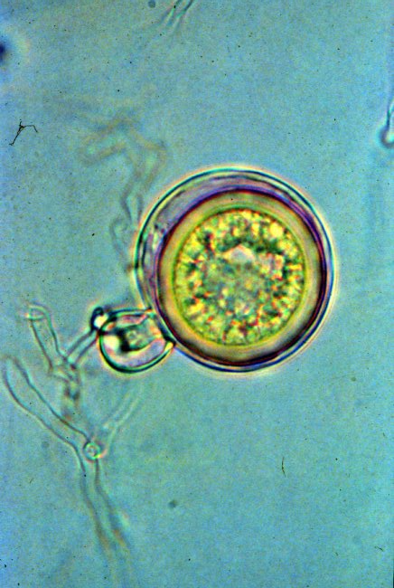
Spore types
Oospores
  Sexually produced survival structures (~seeds)
Chlamydospores
  Asexual survival structures
Sporangia
  Delicate football shaped dispersal structures
Zoospores
  Delicate hunting spores
Image: Don Barr, bsu.edu

Slide 42
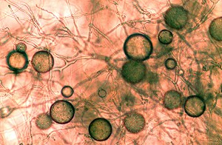
Spore types
Oospores
  Sexually produced survival structures (~seeds)
Chlamydospores
  Asexual survival structures
Sporangia
  Delicate football shaped dispersal structures
Zoospores
  Delicate hunting spores

Slide 43
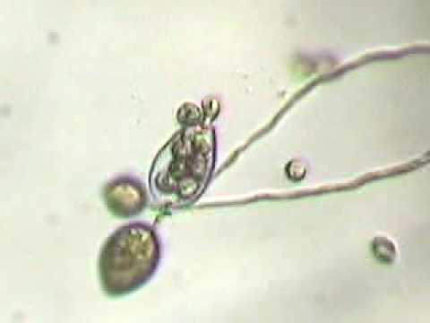
Spore types
Oospores
  Sexually produced survival structures (~seeds)
Chlamydospores
  Asexual survival structures
Sporangia
  Delicate football shaped dispersal structures
  https://www.youtube.com/watch?v=hsdYrSgR4Ag
Zoospores
  Delicate hunting spores
  Cysts
Image: Rizzo Lab, UC Davis

Slide 44
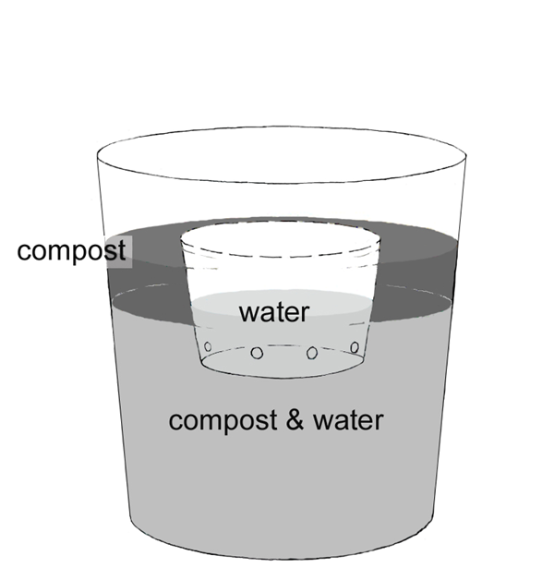

Slide 45
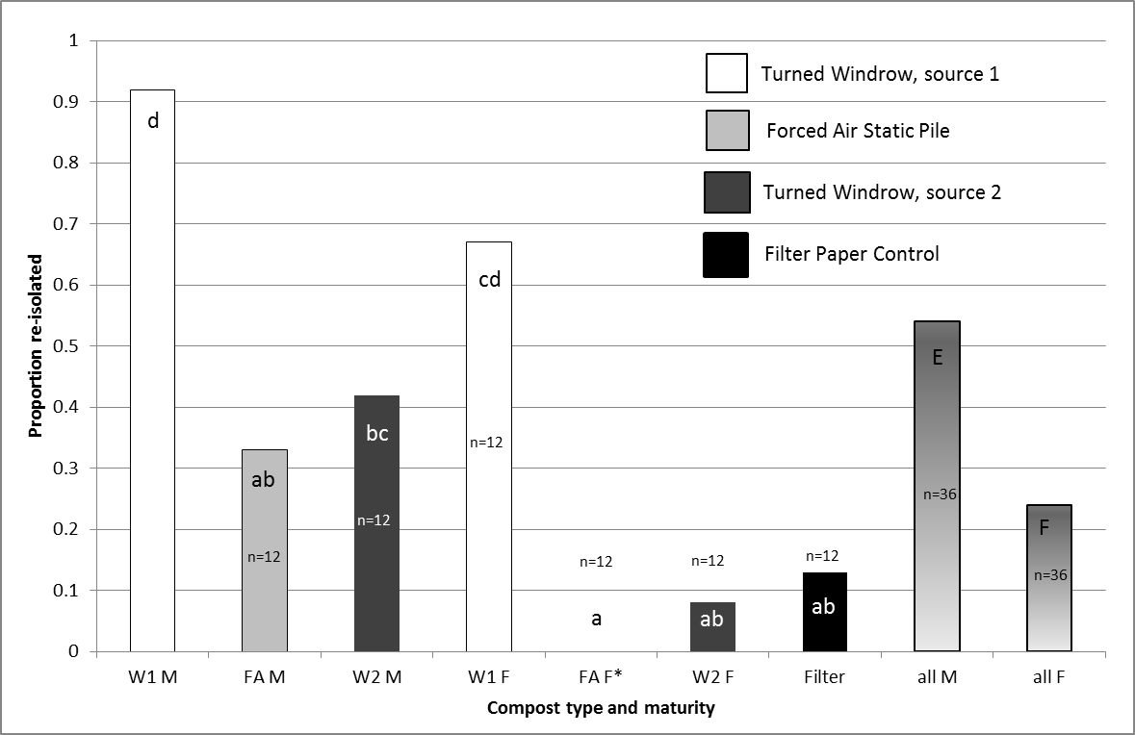

Slide 46
Conclusions
Can it survive if introduced into finished compost?
  Yes, even zoospores can survive …
  if introduced at high enough rates, and held under relatively ideal conditions (cool and moist).
  Survival is much higher in aged composts than in fresh composts
  Caveat: This was an “Is it possible?” kind of question, not necessarily “is it likely?”
    We’d also need to consider the Phytophthora species in question if extrapolating

Slide 47
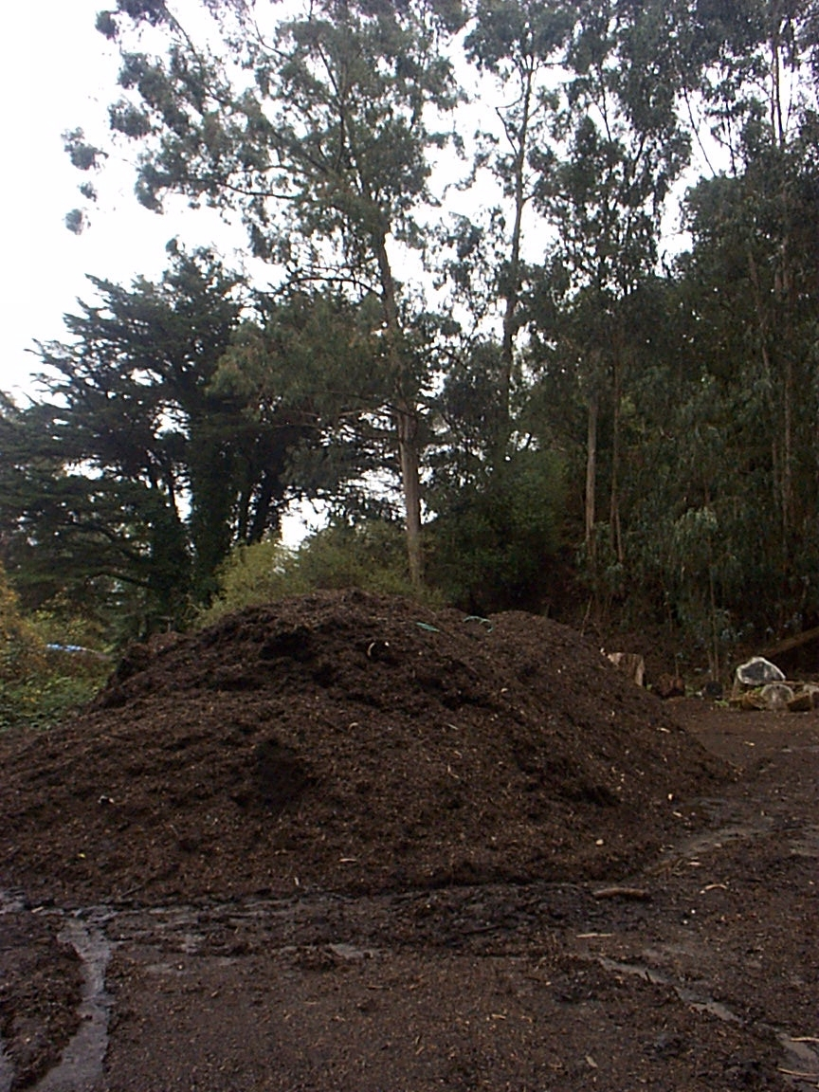
Compost production
Facilities should be distant from contamination sources
  Wind blown water
  Surface flow
  How far?
    3 miles?!
    30 feet?
Tarping?

Slide 48
Compost production
Loaders used for moving fresh material should be cleaned before moving to finished composts

Slide 49
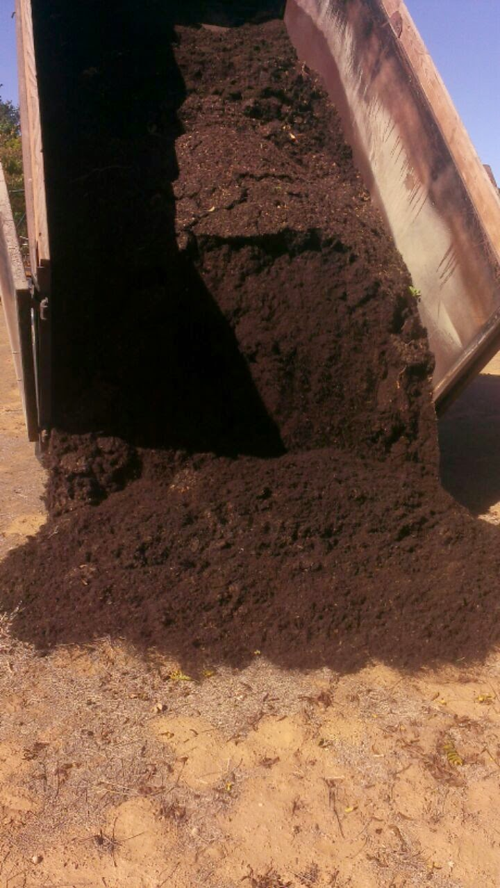
Compost consumption
Is compost safe?
  Probably
    Still hot is good
    If bagged, is it less likely to be contaminated?
  It’s hard to get aged compost
  Beneficials can infest it too
    At your site …
Image: Scott Berndt, Fox Farm

Slide 50
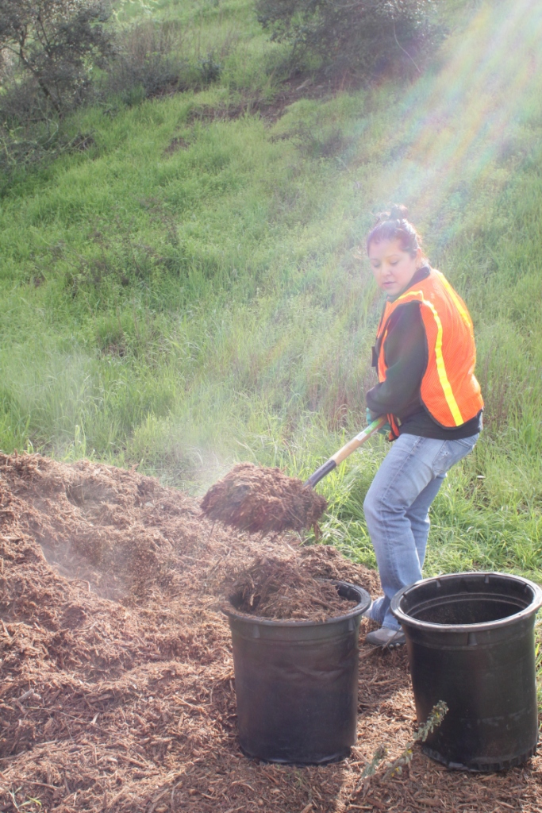
Mulch consumption
Is mulch safe?
  Probably
    Still hot is good
    Lava rock and mylar aren’t typically good growth media …
  Compost on site first?
Image: Urban Forest Collaborative

Slide 51
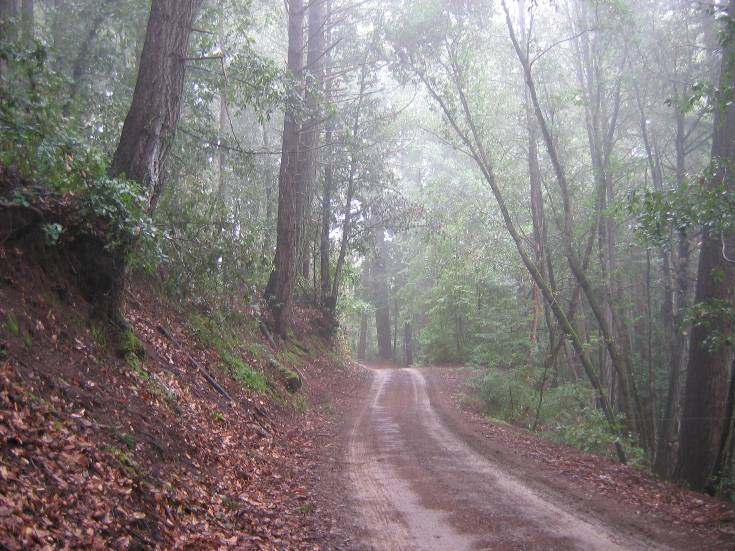

Thanks!
www.suddenoakdeath.org
This presentation is on line at: http://ucanr.edu/MarinIPM
Steven Swain: svswain@ucanr.edu
415 473 4226

Slide 52
Acknowledgements
This research was funded in part by:
  the California Integrated Waste Management Board
  http://www.ciwmb.ca.gov/
  the USDA Forest service Pacific Southwest Region
  the Gordon and Betty Moore Foundation.
Many thanks to McEvoy Ranch, Grab & Grow Soil Products, Chip Sanborne and Don Liepold for their invaluable assistance
Forced air and windrow composting images: Washington State University website,
  http://organic.tfrec.wsu.edu/compost/ImagesWeb/CompSys.html
Other images by Garbelotto or Rizzo labs, UC Berkeley and Davis respectively, except where noted

