Slide 1

IT’S MY CHOICE…
EAT RIGHT! BE ACTIVE!
A Nutrition Curriculum for Third Grade

Slide 2

IT’S MY CHOICE…EAT RIGHT! BE ACTIVE!
A Nutrition Curriculum for Third Grade
Book-based Lessons
Lesson 1 – It’s My Choice…MyPlate and Exercise for Health! Picky Peggy by Jennifer Dussling
Lesson 2 – It’s My Choice…Fruits and Vegetables Every Day! The Ugly Vegetables by Grace Lin
Lesson 3 – It’s My Choice…Whole Grains Every Day! Macaroni and Rice and Bread by the Slice by Brian P. Cleary
Lesson 4 – It’s My Choice…Vary the Protein! Scrambled Eggs Super! by Dr. Suess
Lesson 5 – It’s My Choice…Choosing Healthy Beverages Alicia’s Fruity Drinks by Lupe Ruiz-Flores
GOALS
Students will make healthy food and exercise choices by developing positive attitudes and behaviors towards food and fitness.
Objectives
Students will:
Recognize MyPlate and identify it as a guide to healthy eating.
Describe the health benefits provided by foods from each of the five food groups.
Understand the concept of essential nutrients.
Increase their consumption of fruits, vegetables, and whole grains.
Expand the variety in their diets.
Increase their physical activity.

Slide 3
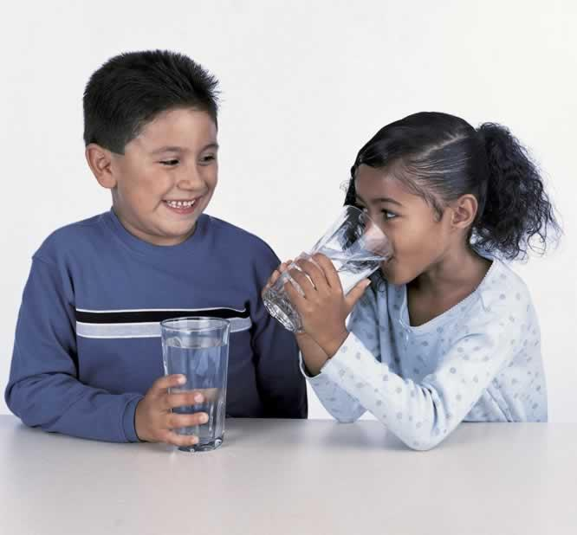
IT’S MY CHOICE…EAT RIGHT! BE ACTIVE!
A Nutrition Curriculum for Third Grade
Lesson Highlights:
Provides more than 10 hours of instruction, plus other classroom enrichment activities.
Teacher Background
Group Book Reading
Lesson Application
Classroom Enhancements
Tasting Activity
Family Flyers
Visual Support Pieces
Students will make healthy food and exercise choices by developing positive attitudes and behaviors towards food and fitness.
Meets California State Department of Education’s Grade-based Standards
Common Core Standards for English Language Arts
Health Framework and Content Standards
Nutrition Competencies

Slide 4

IT’S MY CHOICE…EAT RIGHT! BE ACTIVE!
A Nutrition Curriculum for Third Grade
2003 California Health Framework and 2008 Health Education Content Standards
Nutrition and Physical Activity emphasized in grades K, 2, 4, 5, 7, 8, 9-12
Growth and Development emphasized in grades K, 1, 3, 4, 5, 7, 8, 9-12
Content standards met are listed in each lesson.
Meets California State Department of Education’s
2010 Common Core Standards for English Language Arts.
2010 Nutrition Competencies
Guide the development of curricular materials and benchmark learning in nutrition education.
Nutrition Competencies are listed for each lesson.

Slide 5
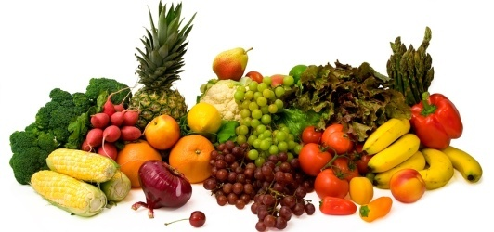
IT’S MY CHOICE…EAT RIGHT! BE ACTIVE!
A Nutrition Curriculum for Third Grade
Establishing Healthy Habits
Positive habits of healthy eating, adequate physical activity, sufficient sleep, and proper hand washing can lead to increased life expectancy, enhanced quality of life, and reduced risk of disease.
Only 2% of children daily meet the MyPlate recommendations.
Only 42% of children get 60 minutes of physical activity.
Few children get 10-12 hours of sleep.
Most children do not practice proper hand washing.
Promoting healthy eating and physical activity in childhood, when important lifestyle habits are formed, can provide lifelong health benefits for children.
Teachers and Schools are Important Players
Teachers and schools, not only play and important role in helping students acquire important knowledge and skills, but also in promoting healthy environments where these behaviors are valued, nurtured, and practiced.

Slide 6

IT’S MY CHOICE…EAT RIGHT! BE ACTIVE!
Role of Schools in Nutrition Education
School Involvement
School Administrators – can assure that School Wellness and other policies are of sufficient strength and fully implemented.
Teachers – can integrate nutrition education into daily activities and create environments that nurture and support behavior adoption.
Food Service – can provide healthy appealing food and appropriate eating environments for making healthy choices.
According to the CDC, it is unlikely the rate of childhood obesity will be significantly improved without strong contributions from schools.
Multiple Benefits
Schools have opportunities to implement a range of policies to promote student wellness, enhance health skills and knowledge, and influence positive behavior acquisition.
There are more benefits than just health…research shows that healthy children also perform better academically and socially.

Slide 7

IT’S MY CHOICE…EAT RIGHT! BE ACTIVE!
Role of Teachers in Nutrition Education
Our Amazing Classroom
Easy to implement ideas that reinforce the learning.
Ways to enhance the classroom environment to support the learning.
Offers a secondary book of the opposing genre for the lesson.
Provides family supports - Family Time Flyer – Creating Healthy Habits Together.
Teachers make the classroom a warm and supportive environment that instills the joy of learning in every student.
Enhancing the Classroom Environment
Teachers can assure that students are not just learning new knowledge, but adopting new habits that will help them maintain healthy bodies for optimal growth and development.

Slide 8

IT’S MY CHOICE…EAT RIGHT! BE ACTIVE!
Role of Families in Nutrition Education
Family Involvement
Active partners in nutrition education.
Engaged in policy development and volunteer activities.
Informed of classroom and school practices and strategies.
Communicated with through consultations, newsletters, take-home sheets, and workshops.
Parents and families have the greatest initial influence on children’s nutrition and physical activity behaviors.
Curriculum Family Supports
Family Time: Creating Healthy Habits Together Take Home Sheet – Lesson specific flyer with easy to implement strategies that reinforce the lesson’s messages.
Families Have You Tasted Take Home Sheet – One page sheet on the produce or food tasted in the classroom and an easy to prepare recipe.

Slide 9

IT’S MY CHOICE…EAT RIGHT! BE ACTIVE!
Use of Literature
Books Are Used to Teach Nutrition
Books are a natural way to reach early elementary students.
Books provide an emotional attachment to the content – important for effective learning.
Books offer a familiar and interesting way to stimulate curiosity, build background, and introduce the lesson content.
Books were selected to help tell the nutrition message, meet the SDE CCS, and be interesting and engaging for students.
Use of Book Genre
Narrative Books – Also called picture or story books, tell a story based on reality or fiction.
Information Books – Are non-fiction books and should provide reliable, documentable information.
Illustrations are an essential part of both types of books.

Slide 10

IT’S MY CHOICE…EAT RIGHT! BE ACTIVE!
Assessment of Student Learning
Assessments
Activity 1 – Book Retell and Fact Sheets.
Activity 2 – Review and Reflect questions to check understanding and ability to apply the information.
A Review the Lesson page is included at the end of each lesson.
Pre-Post Student Evaluation for the entire curriculum is available for measuring overall knowledge gains.
Students understanding of the lesson content is critical to students’ application and adoption of the nutrition and health strategies.
Educator Evaluation
To help UCCE capture valuable teacher “expert observer” input on potential changes in students’ knowledge, skill and behavioral changes, an Educator Evaluation sheet is included at the end of each lesson.

Slide 11
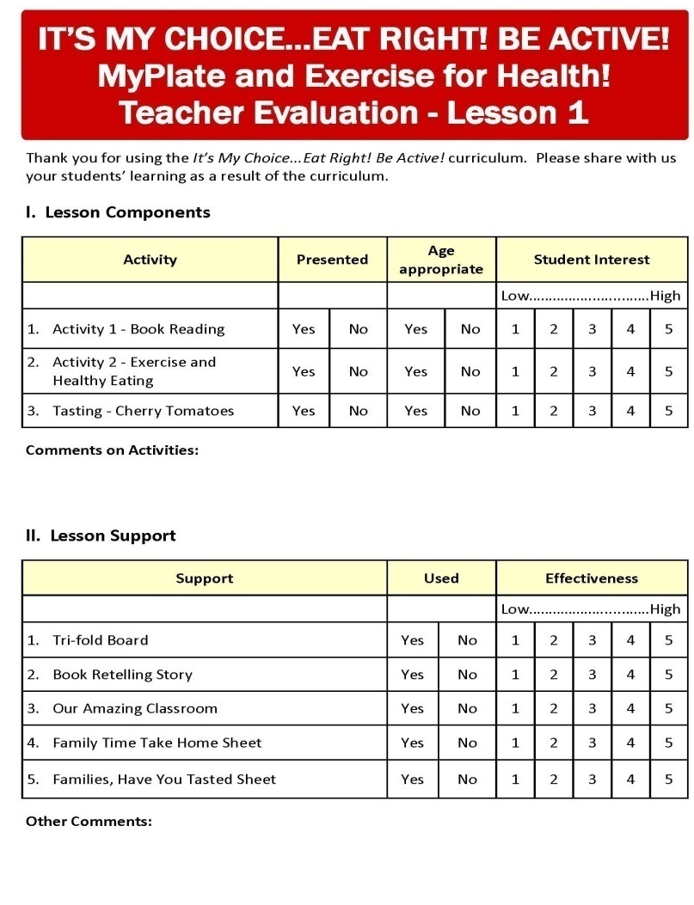
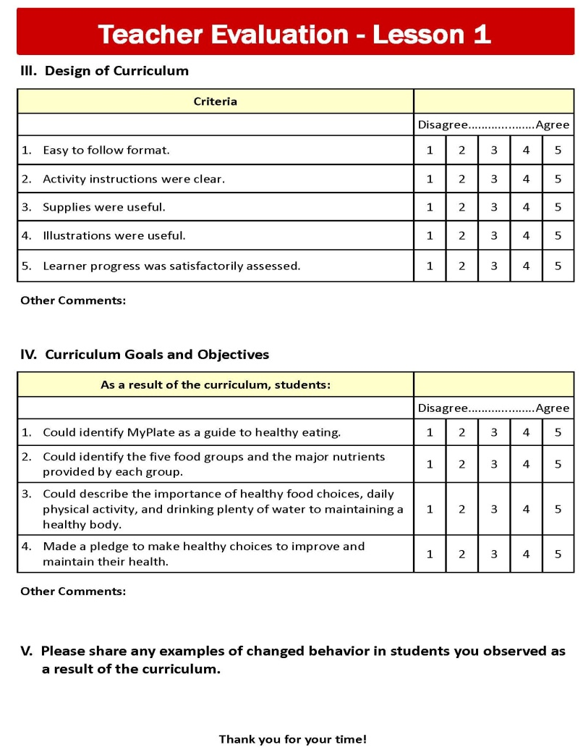
IT’S MY CHOICE…EAT RIGHT! BE ACTIVE!
Educator Evaluation

Slide 12

IT’S MY CHOICE…EAT RIGHT! BE ACTIVE!
How to Read the Books
How a Book is Read is Critical For:
Comprehension
Vocabulary development
Literacy development
Activity 1 in each lesson uses research-based strategies and CCS for presenting the book reading activity.
Narrative Books
Students listen for the sequence of the story (what happens first, next, and in the end), as well as the problem that was identified and the solution to the problem. Students are asked to make predictions.
Information Books
Students learn something new and answer questions. They are asked what they already know about the topic and what they would like to learn.
Worksheets for each type of book are included to retell the story or book content.

Slide 13
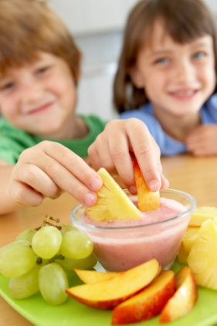
IT’S MY CHOICE…EAT RIGHT! BE ACTIVE!
Classroom Tasting
Increasing Fruit and Vegetable Consumption
Many children consume less than recommended amounts.
Taste preference is a strong predictor of children’s intake.
Access and exposure to fruits and vegetables affects children’s consumption.
Children who set goals and have positive feelings towards fruits and vegetables are more likely to consume them.
Tasting of fruits and vegetables is an effective way of introducing students to new fruits and vegetables.
Let’s Take a Taste
A fruit or vegetable is featured in each lesson.
Instruction is provided for selecting and preparing the produce and conducting the tasting.
A Family Take Home Sheet – Families Have you Tasted… is provided for each lesson.

Slide 14
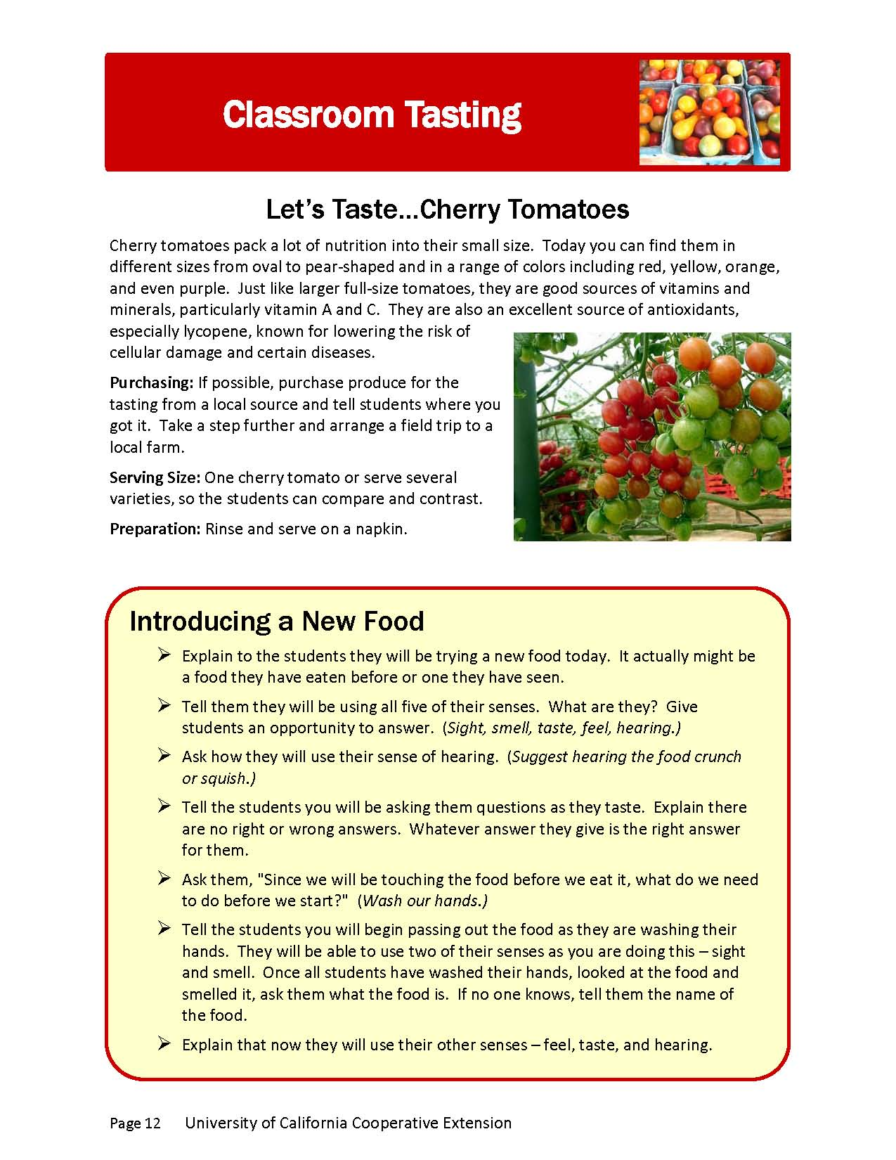
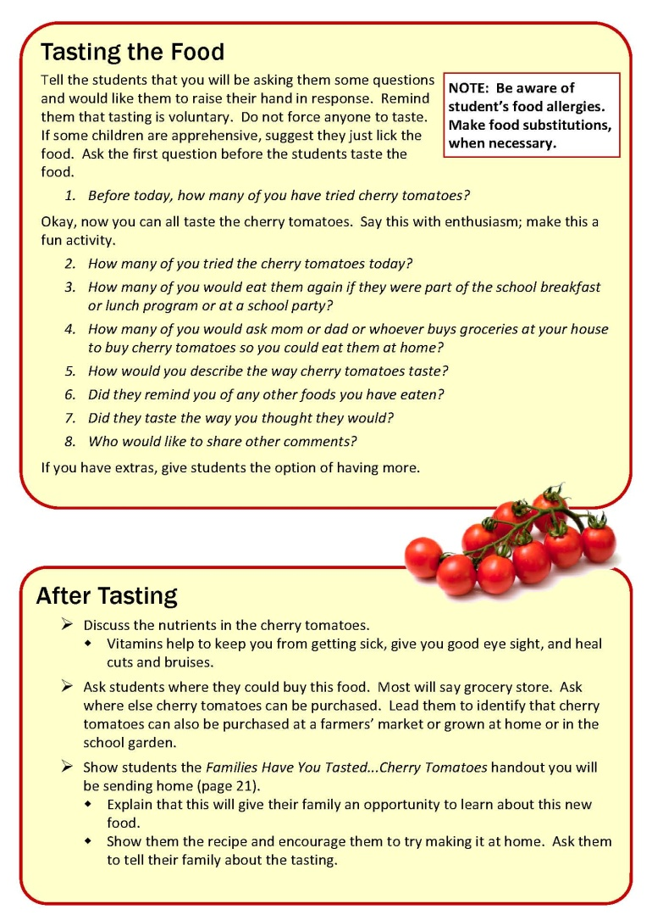
IT’S MY CHOICE…EAT RIGHT! BE ACTIVE!
Tasting Activity

Slide 15
IT’S MY CHOICE…
EAT RIGHT! BE ACTIVE!
A Nutrition Curriculum for Third Grade

Slide 16

IT’S MY CHOICE…
MyPLATE AND EXERCISE FOR HEALTH!
Lesson
1
It’s My Choice… MyPlate and Exercise for Health!
Students learn the importance of MyPlate and the benefits that each food group gives to the body and being physically active.
Objectives:
Identify MyPlate as a guide to healthy eating.
Identify the five food groups and the major nutrients provided by each group.
Describe the importance of healthy food choices, daily physical activity, and drinking plenty of water to maintaining a healthy body.
Make a pledge to make healthy choices to improve and maintain their health.
Picky Peggy
by Jennifer Dusssling
and illustrated by Lynn Adams

Slide 17
IT’S MY CHOICE…EAT RIGHT! BE ACTIVE – Lesson 1
Benefits of Healthy Choices
Making Healthy Health Choices
Positive habits of healthy eating, adequate physical activity, sufficient sleep, and proper hand washing and food handling can lead to increased life expectancy, enhanced quality of life, and reduced risk of disease. Poor health behaviors have caused childhood obesity to increase.
Obesity can lead to increased risk of heart disease, stroke, cancer, Type II diabetes, orthopedic problems, sleep disturbances, and social and psychological problems.
Making Healthy Nutrition Choices
Choosing what to eat is a learned behavior and these behaviors are progressively learned.
Elementary students are still establishing eating habits and food preferences, so it is important to provide guidance on healthy eating, expose them to new healthy foods, and create environments that support healthy choices.
Making Healthy Exercise Choices
Students are not getting their recommended 60 minutes of physical activity and are participating more in sedentary activities.
Sufficient physical activity has significant health benefits, but also is important for mental and emotional health and can improve academic performance.

Slide 18
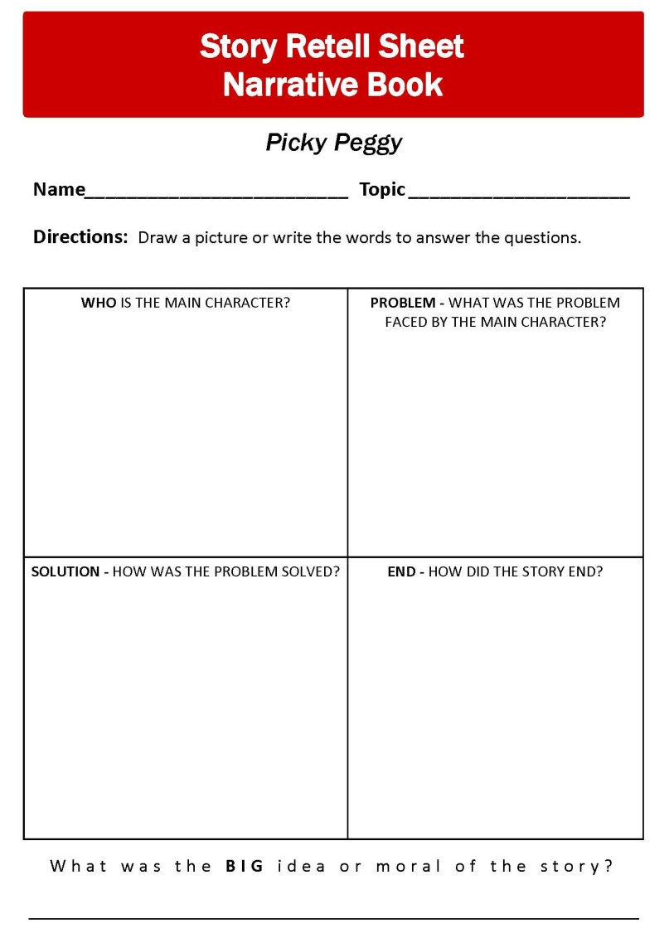

IT’S MY CHOICE…EAT RIGHT! BE ACTIVE – Lesson 1
Activity 1 Book Reading
Picky Peggy
Read the book several times, so you are familiar with the cadence of the text, the key messages, and where to pause and discuss content.

Slide 19
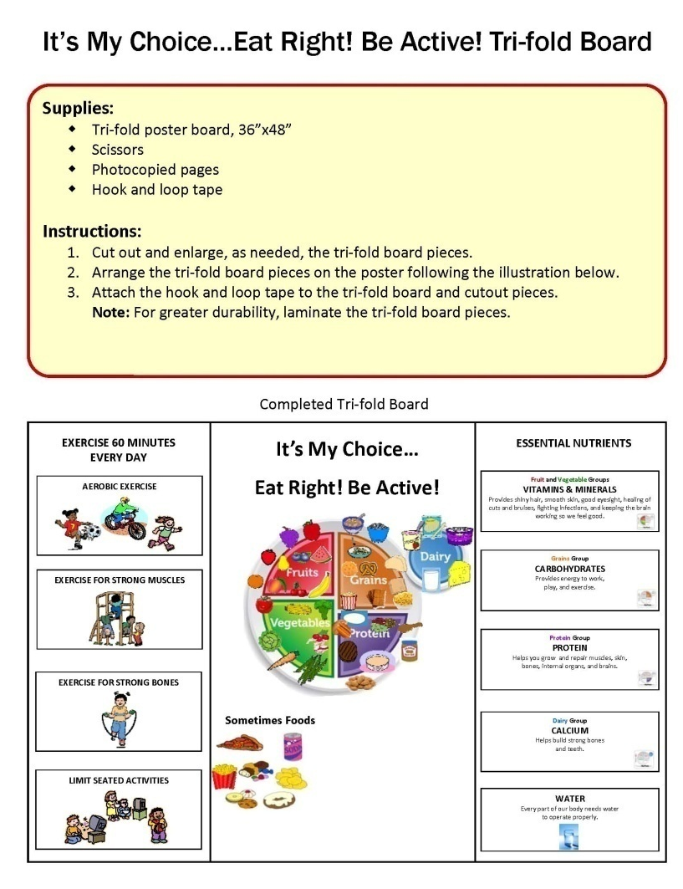
IT’S MY CHOICE…EAT RIGHT! BE ACTIVE – Lesson 1
Activity 2
Choosing Exercise and Using MyPlate to Make Healthy Choices
Students study MyPlate and how foods are grouped based on the nutrients they provide. They learn and practice three different types of physical activity.

Slide 20
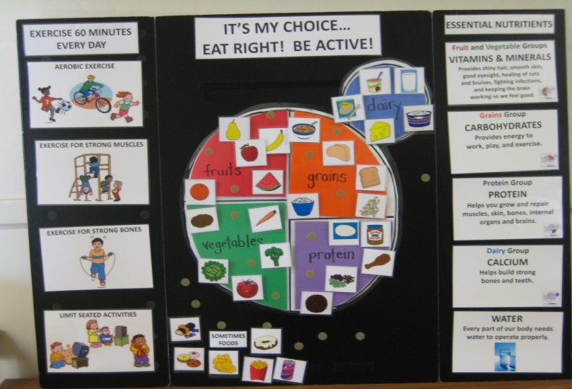
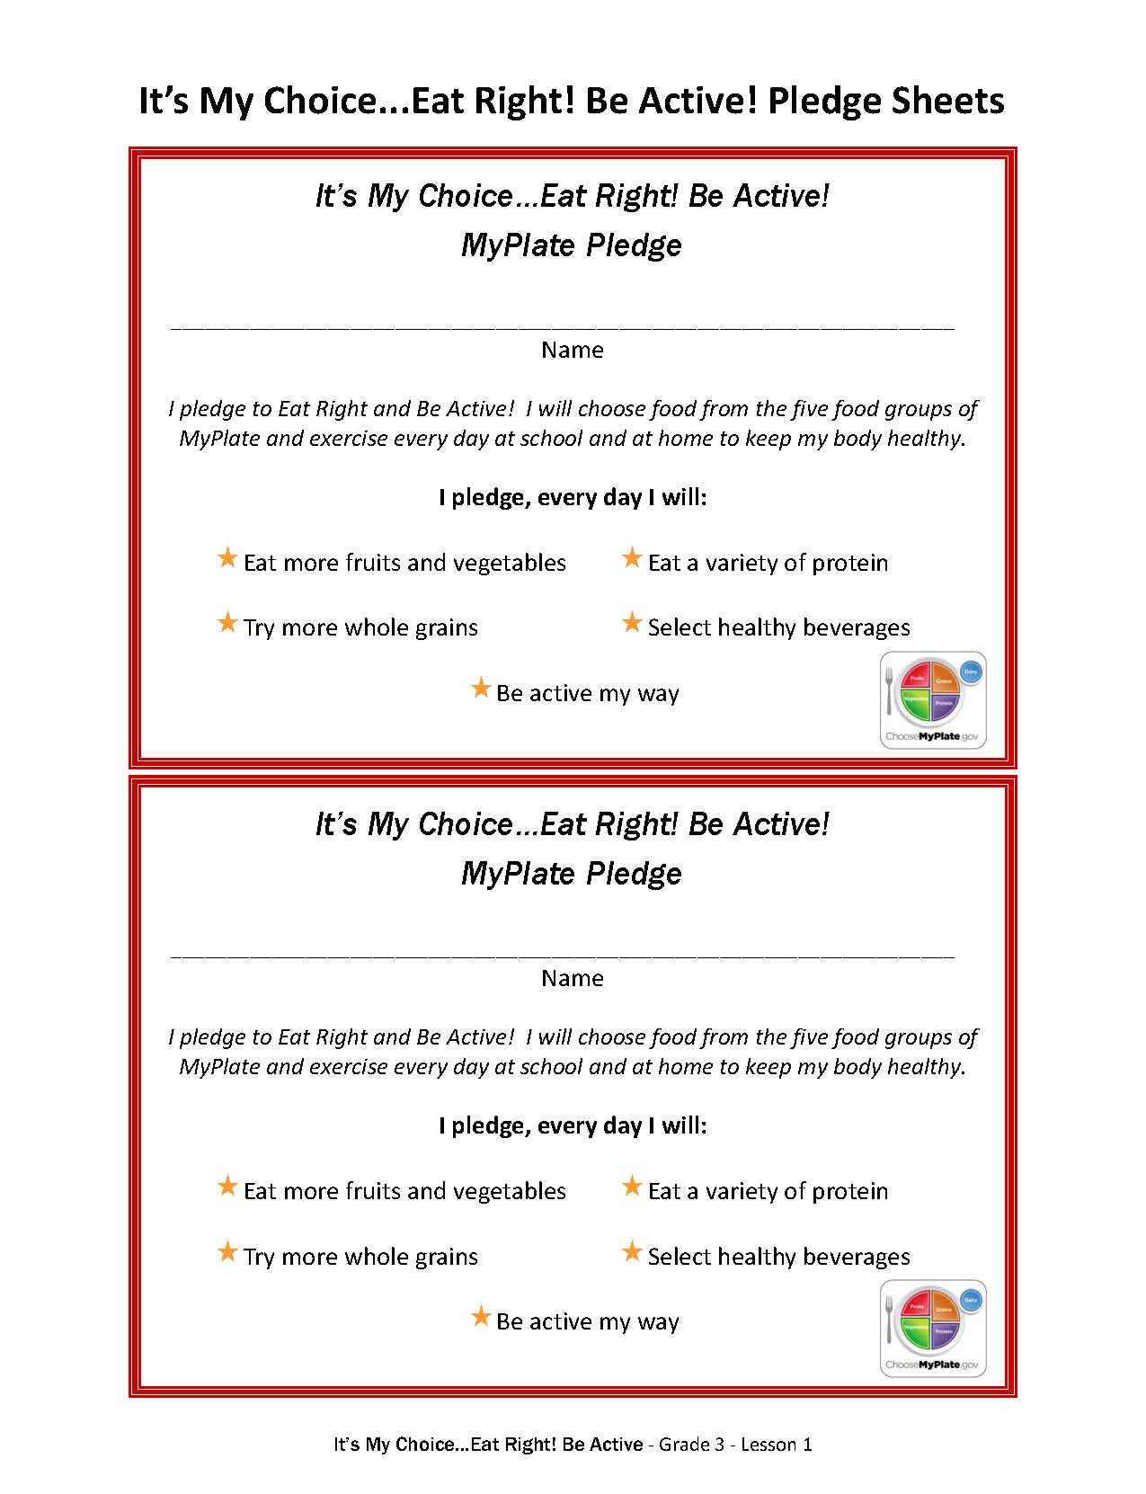
IT’S MY CHOICE…EAT RIGHT! BE ACTIVE – Lesson 1
Activity 2
Choosing Exercise and Using MyPlate to Make Healthy Choices
Review Picky Peggy’s Food Choices.
Explore MyPlate.
Explore Food Groups and Nutrients.
Study the Five Food Groups.
Water an Essential Nutrient.
Exercise for a Healthy Body.
Make a My Choice Pledge.
Photo of tri-fold board at the end of the lesson.

Slide 21
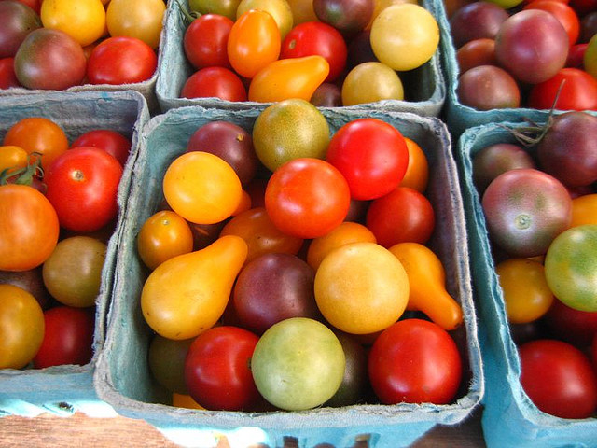
IT’S MY CHOICE…EAT RIGHT! BE ACTIVE – Lesson 1
Our Amazing Classroom Enhancing the Learning
Create healthy classroom rules.
Daily review the school lunch menu.
Integrate nutrition into other subjects.
Do classroom food tastings.
Take physical activity breaks.
Read More Books on
Healthy Eating and Exercise
Good Enough to Eat by Lizzy Rockwell
Classroom Tasting
Cherry Tomatoes…They pack a lot of nutrition into their small size. Just like larger full-size tomatoes, they are excellent sources of vitamins A and C.

Slide 22
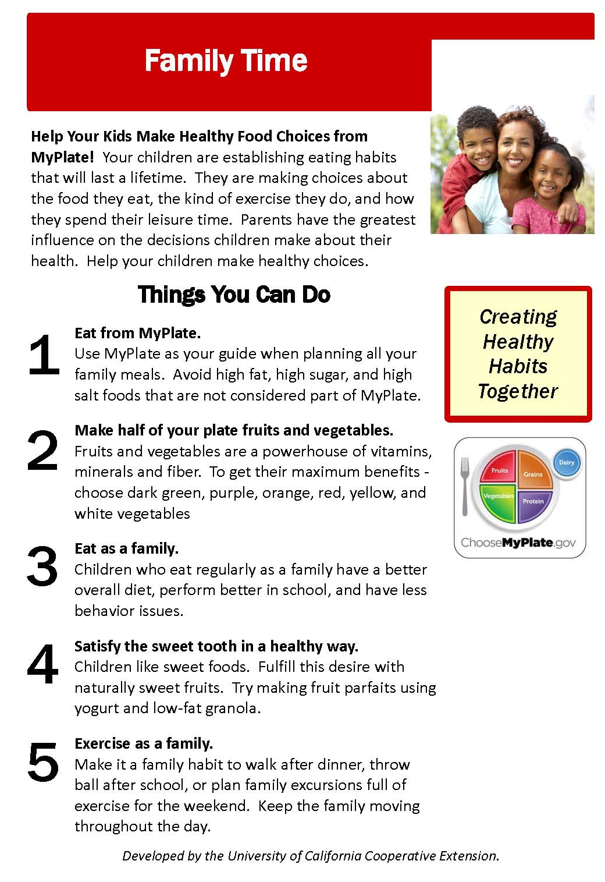
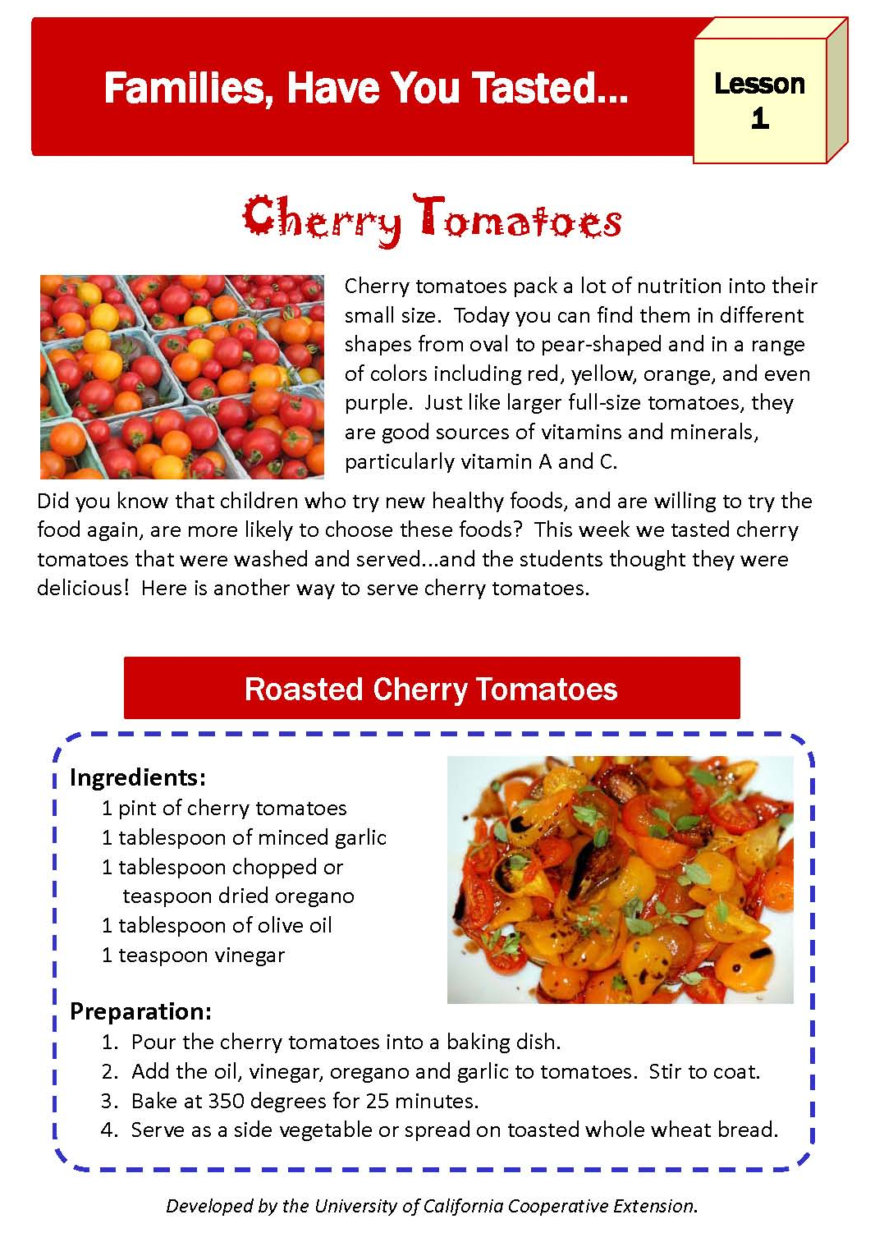
IT’S MY CHOICE…EAT RIGHT! BE ACTIVE – Lesson 1

Slide 23
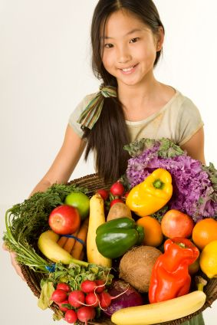
IT’S MY CHOICE…
FRUITS AND VEGETABLES EVERY DAY!
Lesson
2
It’s My Choice…
Fruits and Vegetables Every Day!
Students learn about phytonutrients and the importance of eating fruits and vegetables from all colors of the rainbow.
Objectives:
Identify they should eat a variety of fruits and vegetables every day.
Identify vitamins, minerals, and phytonutrients as the key nutrients provided in the Fruit and Vegetable Groups.
Describe how fruits and vegetables help their body.
Describe how to include fruits and vegetables in daily meals and snacks.
The Ugly Vegetables
by Grace Lin
and illustrated by Grace Lin

Slide 24
IT’S MY CHOICE…EAT RIGHT! BE ACTIVE – Lesson 2
Ways Schools Can Increase Student’s Consumption of Fruits and Vegetables
Consuming sufficient amounts of fruits and vegetables provide both health and academic performance benefits for students.
Establish School Gardens - School gardens have been shown to increase children's willingness to taste vegetables, their preference for eating vegetables and their nutrition knowledge. Students who participated in school gardening scored significantly higher on science achievement tests compared to students that did not participate in garden-based learning activities.
Start Farm to Fork and Farm to School Projects - Studies have shown that school participation in sustainable food systems such as purchasing local produce, teaching students about the local food system, and making connections with local farmers create more sustainable communities, localize the food system, and improve student health.
Enhance Cafeteria Fruit and Vegetable Offerings - The school cafeteria can become a learning laboratory for the exploration of healthy fruit and vegetable choices through salad bars featuring local produce and linking nutrition lessons to farming, gardening, and composting.

Slide 25
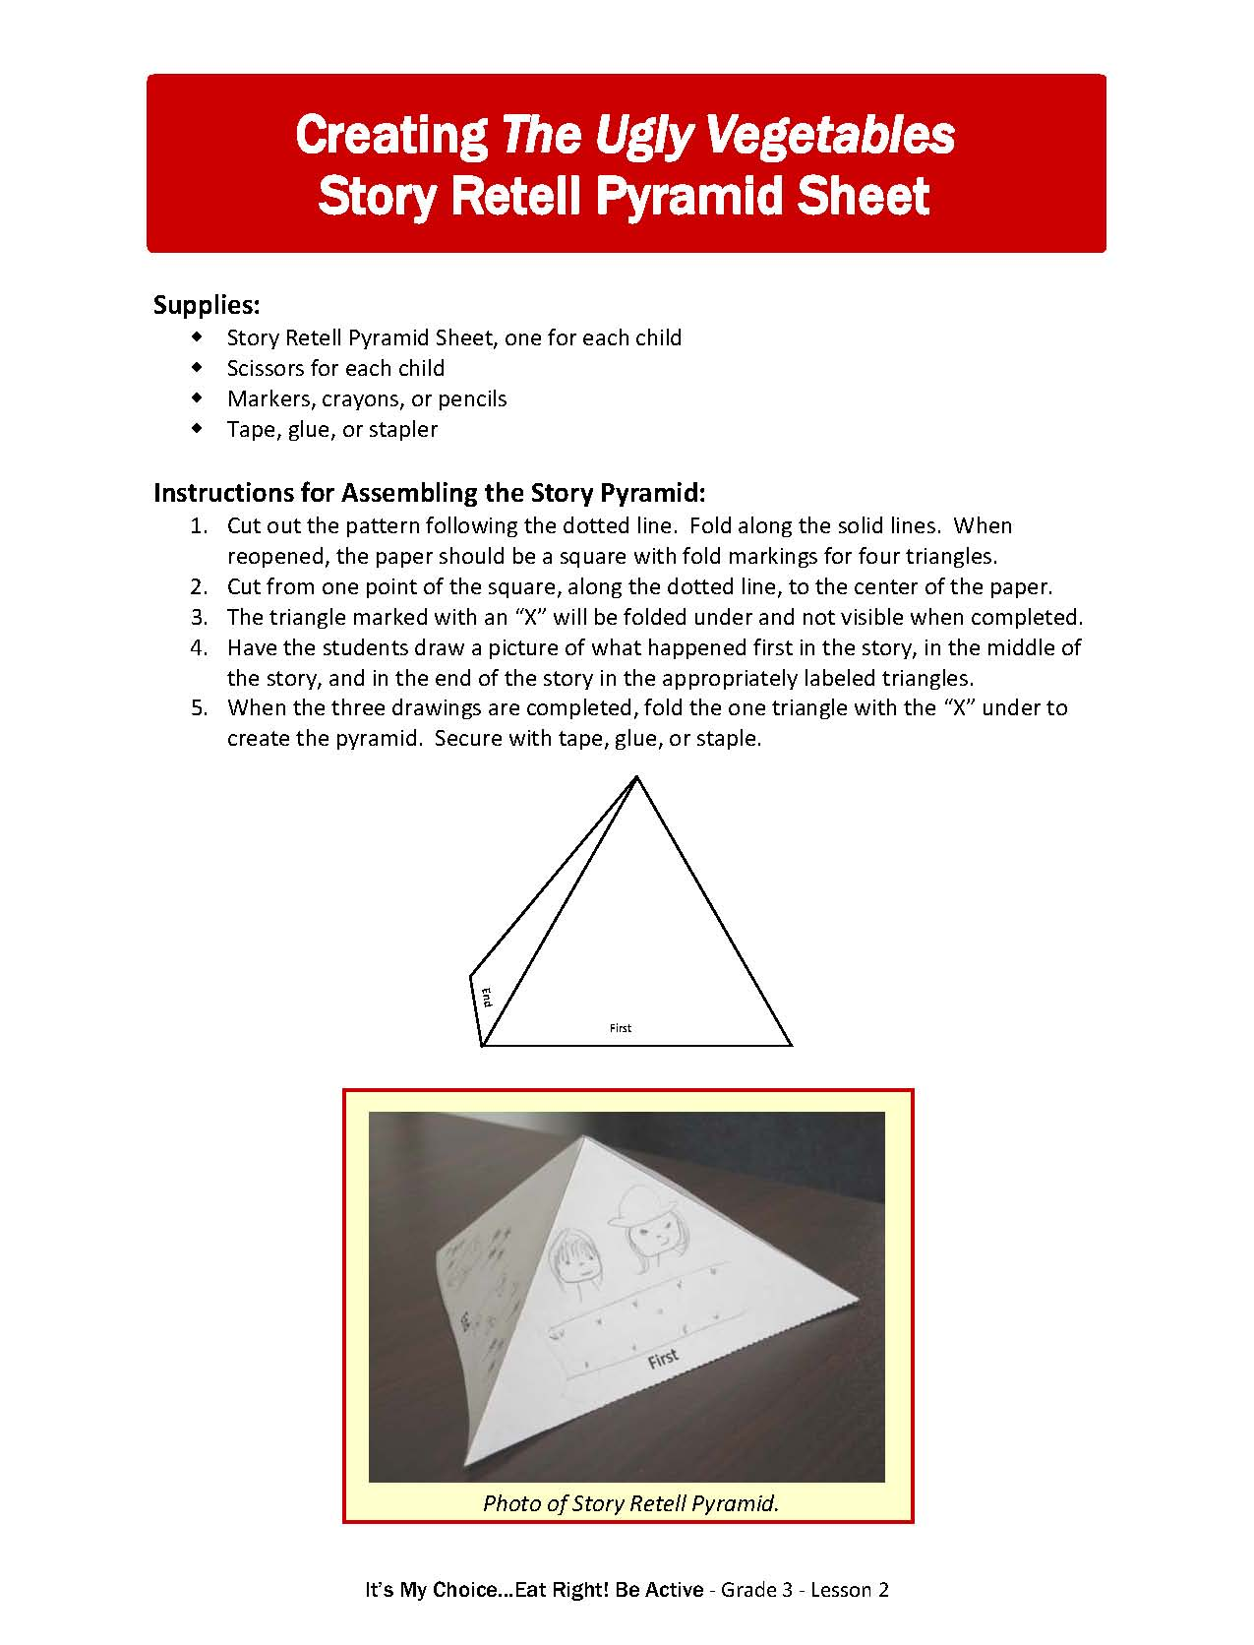

IT’S MY CHOICE…EAT RIGHT! BE ACTIVE – Lesson 2
Activity 1 Book Reading
The Ugly Vegetables
BEFORE READING introduce the book, activate prior knowledge, grab interest, and predict the content.

Slide 26
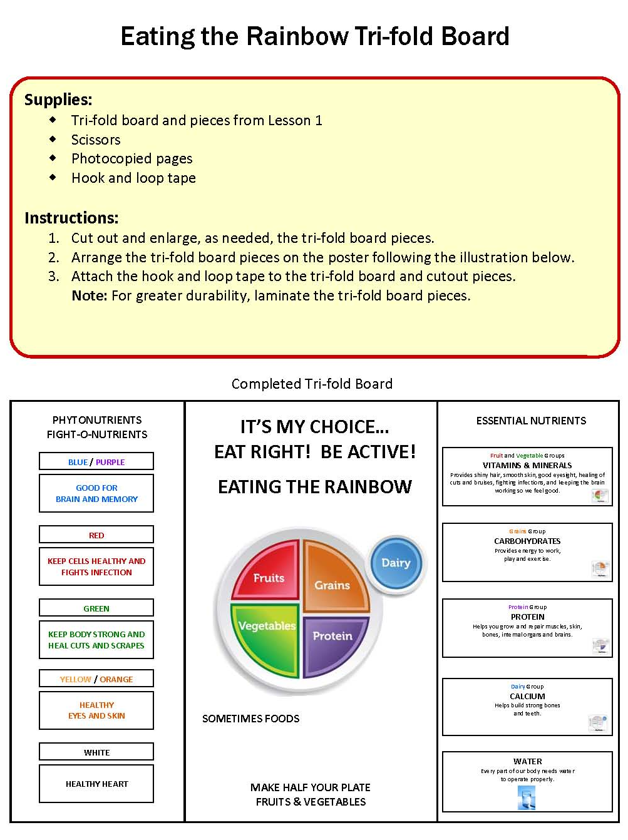
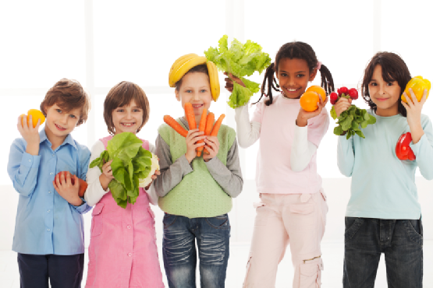
IT’S MY CHOICE…EAT RIGHT! BE ACTIVE – Lesson 2
Activity 2
Choosing a Rainbow of Colorful Fruits and Vegetables for Your Plate
Students learn about phytonutrients and the importance of eating fruits and vegetables from all colors of the rainbow to get all the benefits of eating fruits and vegetables.

Slide 27
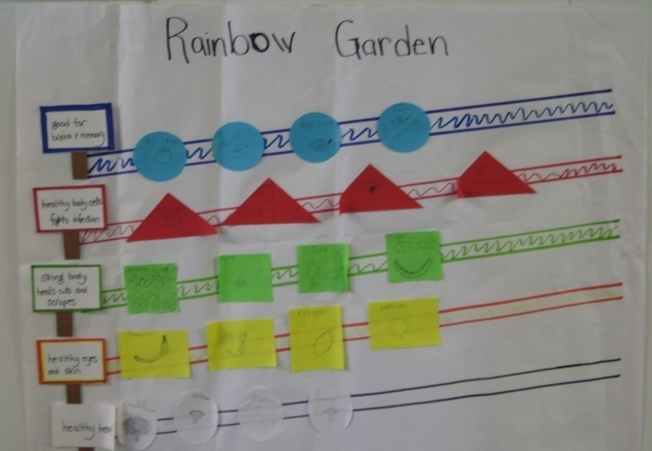
IT’S MY CHOICE…EAT RIGHT! BE ACTIVE – Lesson 2
Activity 2
It’s My Choice…
Fruits and Vegetables Every Day!
Review MyPlate Tri-fold Board.
Introduction to Phytonutrients.
Fruit and Vegetable Colors Game.
Plant a Rainbow Garden.
Review and Reflect.
Photo of completed Rainbow Garden Poster.

Slide 28
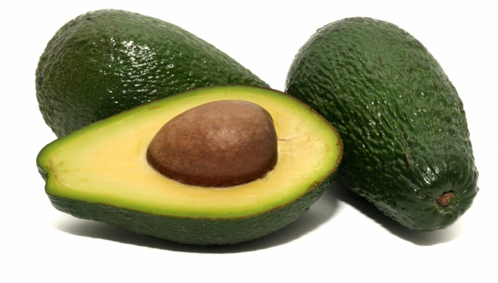
IT’S MY CHOICE…EAT RIGHT! BE ACTIVE – Lesson 2
Our Amazing Classroom Enhancing the Learning
Start a school garden.
Plan a field trip to a local farm or ranch.
Do classroom food tastings.
Create a salad bar.
Invite a farmer to share how she grows vegetables and fruits.
Read More…Information Book
The Vegetables We Eat by Gail Gibbons
Classroom Tasting
Avocados…are full of heart healthy fats that help in the absorption of many fat soluble vitamins and are a good source of antioxidants providing helpful anti-inflammatory qualities.

Slide 29
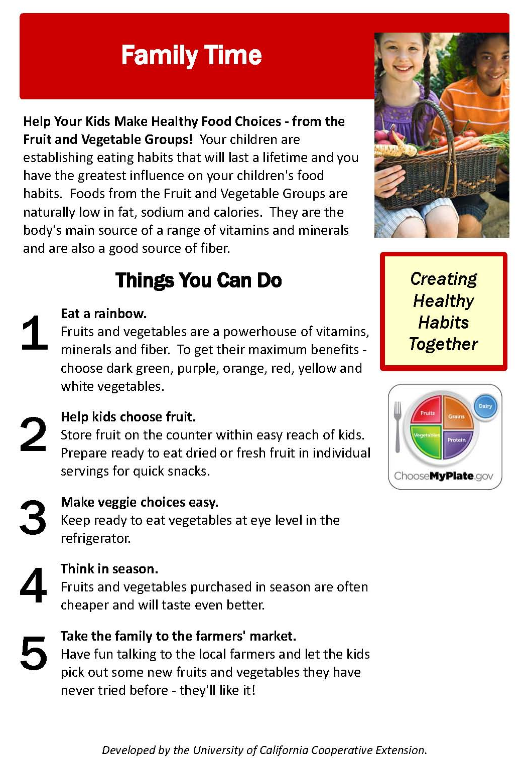
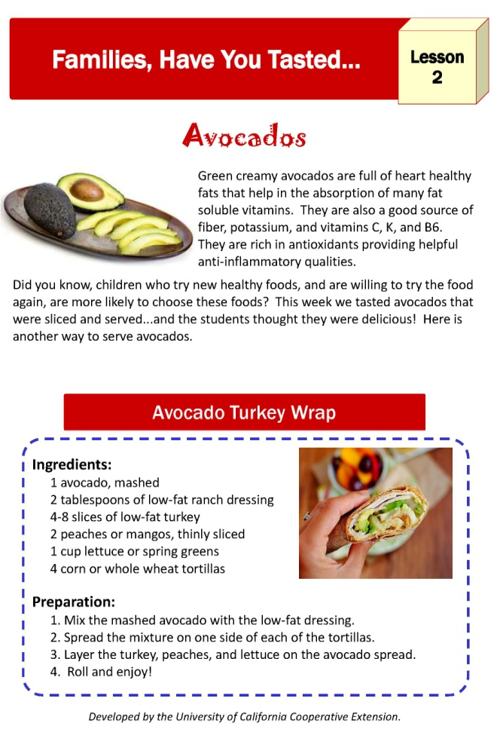
IT’S MY CHOICE…EAT RIGHT! BE ACTIVE – Lesson 2

Slide 30
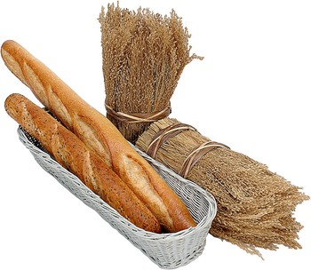
IT’S MY CHOICE…
WHOLE GRAINS EVERY DAY!
Lesson
3
It’s My Choice…
Whole Grains Every Day!
Students examine the difference between whole and refined grains.
Objectives:
Describe carbohydrates, fiber, vitamins, and minerals as the key nutrients of the Grains Group and that we should eat Grains Group foods every day.
Identify the difference between whole grains and refined grains.
Identify ways to include Grains Group foods in meals and snacks.
Macaroni and Rice and
Bread by the Slice
by Brian P. Cleary
and illustrated by Marin Goneau

Slide 31
IT’S MY CHOICE…EAT RIGHT! BE ACTIVE – Lesson 3
Benefits of the Grains Group
People who eat whole grains as part of a healthy diet have a reduced risk of some chronic diseases. Unfortunately, only 4% of U.S. adults and children over 12 are consuming sufficient whole grains. In fact, most children consume less than one serving of whole grain each day.
Grains Group foods, especially whole grains, are vital for the health and maintenance of our bodies.
  Carbohydrates – are the body’s major source of the essential nutrient carbohydrate, which provides energy to power the body.
  Fiber – provided by whole grains reduces constipation, can lower blood cholesterol, and may lower the risk of heart disease, obesity, and Type II diabetes.
  B Vitamins – including thiamin, riboflavin, and niacin play an important role in metabolism by releasing energy from protein, fat, and carbohydrates and are essential for the proper functioning of the nervous system.
  Iron – used to carry oxygen in the blood is provided by whole and enriched Grains Group foods.
  Magnesium and Selenium – provided by grains are used in building bones, releasing energy from muscles and protecting cells from oxidation.

Slide 32
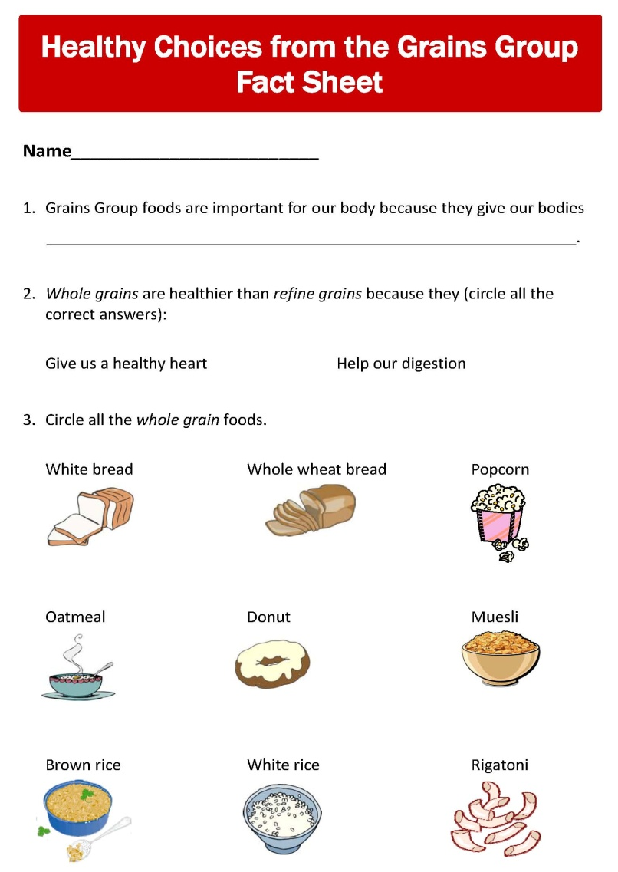

IT’S MY CHOICE…EAT RIGHT! BE ACTIVE – Lesson 3
Activity 1 Book Reading
Macaroni and Rice
and Bread by the Slice
DURING THE READING pause to emphasize text and illustrations and discuss the key points of the book.

Slide 33
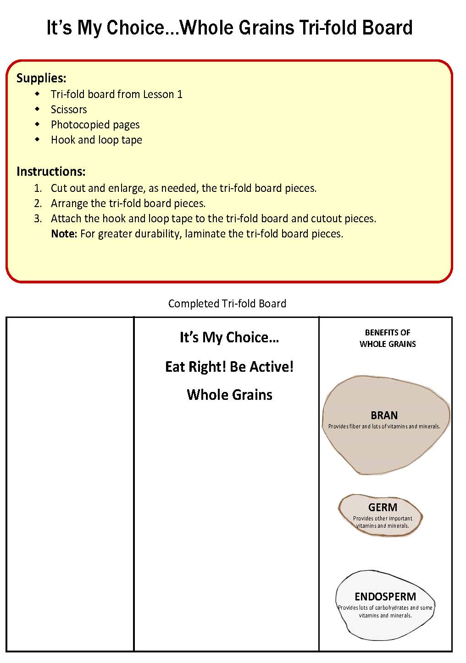
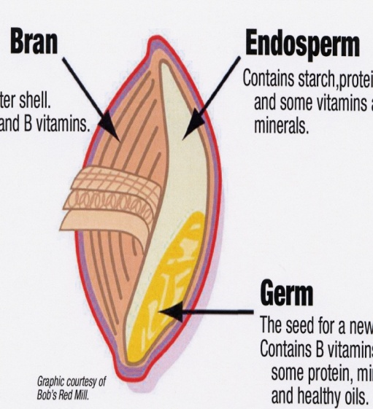
IT’S MY CHOICE…EAT RIGHT! BE ACTIVE – Lesson 3
Activity 2
It’s My Choice…Eating Whole Grains
Students learn how the bran and germ are removed from refined grains, taking away many of the their important nutrients.

Slide 34
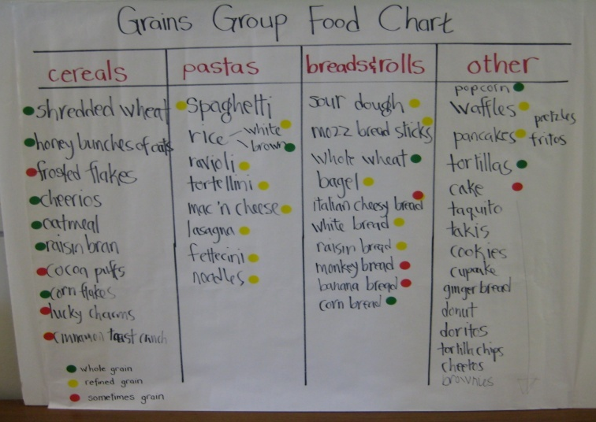
IT’S MY CHOICE…EAT RIGHT! BE ACTIVE – Lesson 3
Activity 2
It’s My Choice…
Whole Grains Every Day!
Review Macaroni and Rice and Bread by the Slice.
Grains and Seeds from the Cereal Plant.
Two Types of Grains – Whole and Refined.
Comparing Whole and Refined Grains.
Name Grains Groups Foods.
Choose to Make Half of Your Grains Whole Grains.
Plan Meals With Whole Grains.
Photo of completed Grains Group Food Chart.

Slide 35
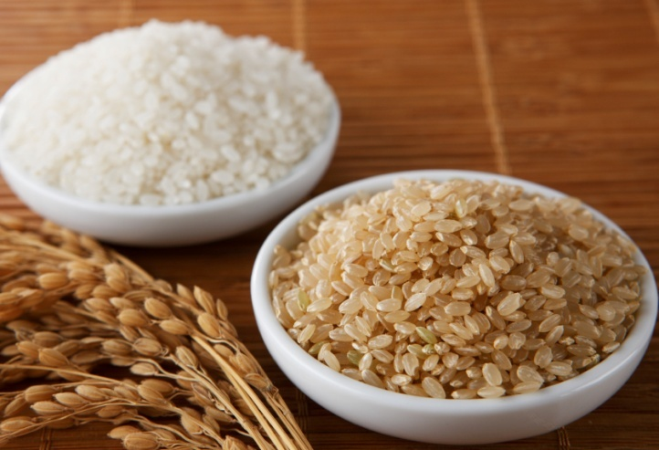
IT’S MY CHOICE…EAT RIGHT! BE ACTIVE – Lesson 3
Our Amazing Classroom
Enhancing the Learning
Take water breaks.
Inform parents of your classroom policies.
Keep yourself healthy.
Start a Squeaky Clean Friday.
Lead students in aerobic activities.
Read More Books on
the Grains Groups and Carbohydrates
Everybody Cooks Rice by Norah Dooley
Classroom Tasting
Brown Rice…is a whole grain that still has most of its natural nutrition. It is an excellent source of fiber and other vitamins and minerals important for good digestion.

Slide 36
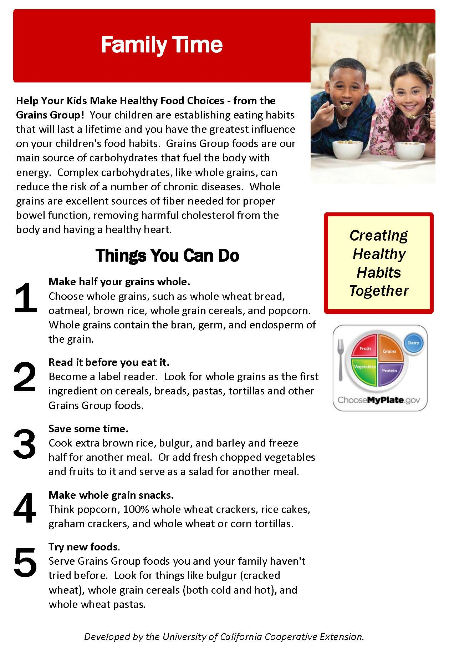
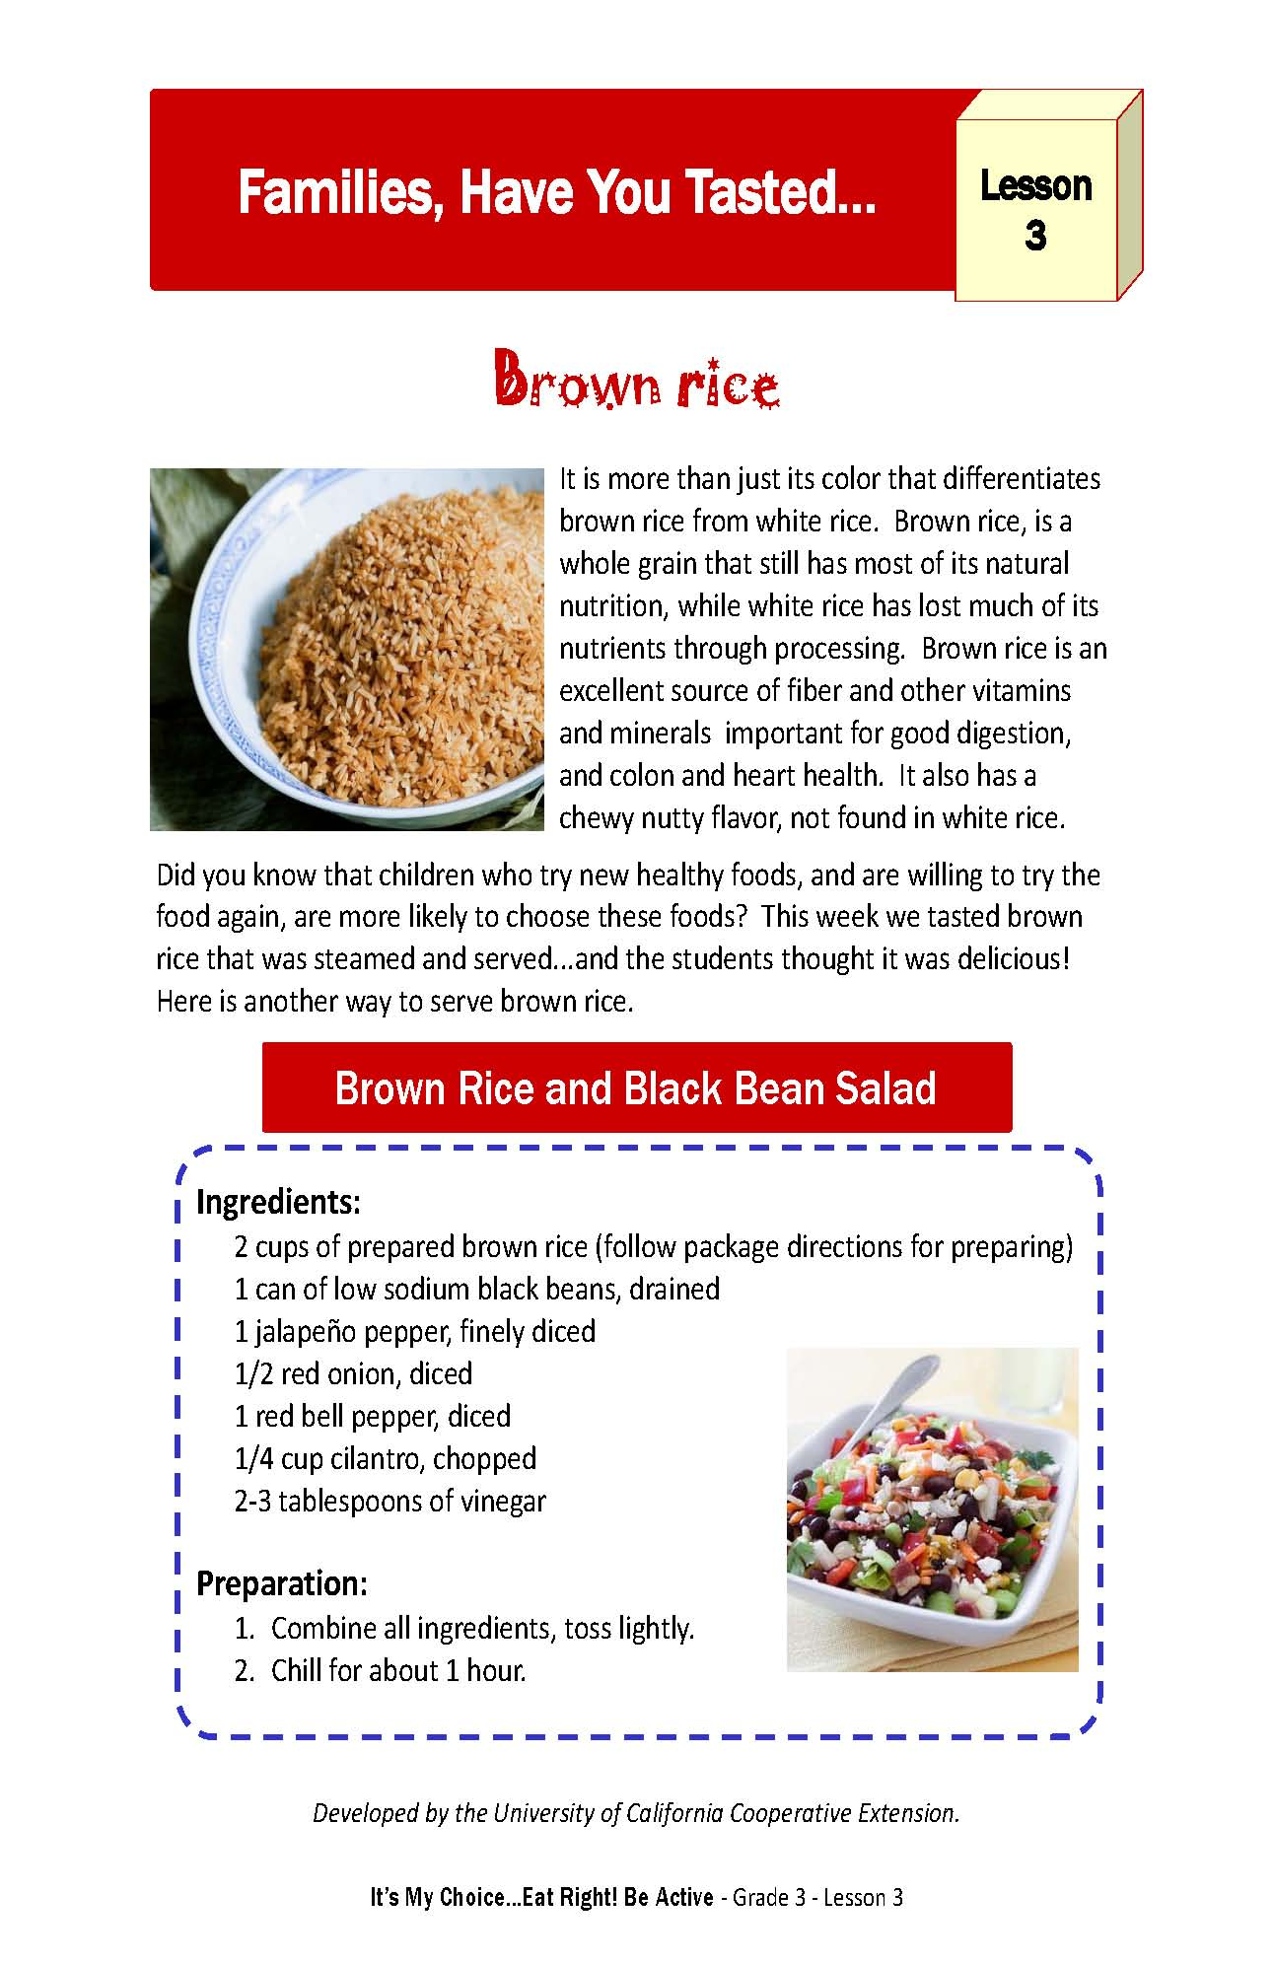
IT’S MY CHOICE…EAT RIGHT! BE ACTIVE – Lesson 3

Slide 37
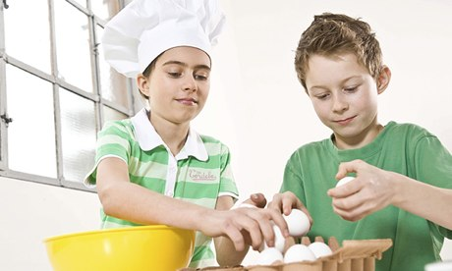
IT’S MY CHOICE…
VARY THE PROTEIN!
Lesson
4
It’s My Choice…Vary the Protein!
Students learn that protein comes from both plant and animal sources.
Objectives:
Describe protein as the key nutrient of the Protein Group and that we should eat Protein Group foods every day.
Describe that Protein Group foods are the body’s building blocks and help build strong muscles, cartilage, skin, blood, and brains.
Describe Protein Group sources as coming from both animals and plants.
Identify how to include Protein Group foods in daily meals and snacks.
Scrambled Eggs Super!
by Dr. Suess

Slide 38
IT’S MY CHOICE…EAT RIGHT! BE ACTIVE – Lesson 4
Benefits of the Protein Group
Proteins are one of the essential nutrients needed for good health. Proteins function as the body's building blocks. Because of children's higher growth rates, it is especially important for them to eat protein-rich foods every day.
Health Benefits of Protein
According to the U.S.D.A., there are many health benefits derived from the Protein Group of MyPlate:
  Proteins function as building blocks for bones, muscles, cartilage, skin, blood, and the brain. They are also building blocks for enzymes, hormones, and vitamins.
  B vitamins found in the Protein Group help the body release energy, play a vital role in the function of the nervous system, aid in the formation of red blood cells, and help build tissues.
  Protein Group Foods are a main source of iron used to carry oxygen in the blood.
  Magnesium is used in building bones and in releasing energy from muscles.
  Zinc is necessary for biochemical reactions and helps the immune system function properly.
  EPA and DHA are omega-3 fatty acids found in varying amounts in seafood. Adults eating 8 ounces per week of seafood have reduced their risk for heart disease.

Slide 39
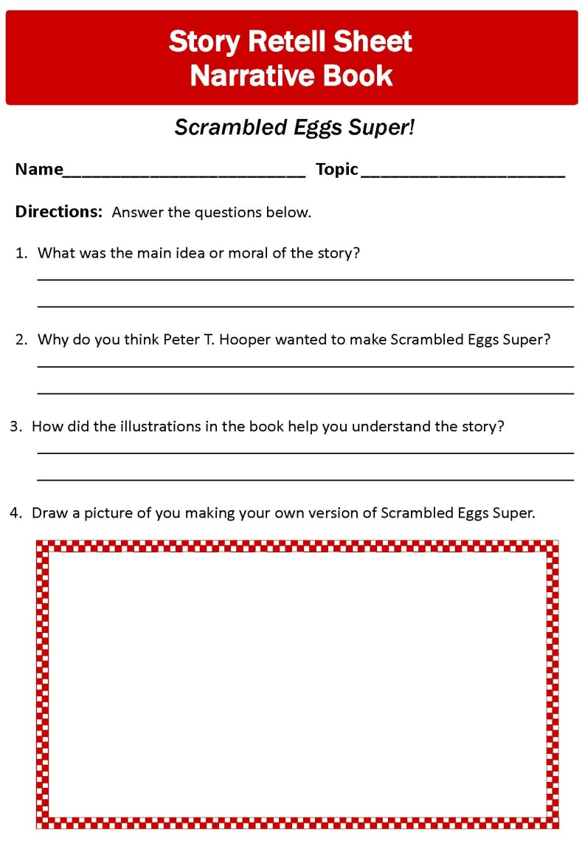

IT’S MY CHOICE…EAT RIGHT! BE ACTIVE – Lesson 4
Activity 1 Book Reading
Scrambled Eggs Super!
AFTER THE READING review the list of things students wanted to learn and ask questions to reinforce and clarify the learning.

Slide 40
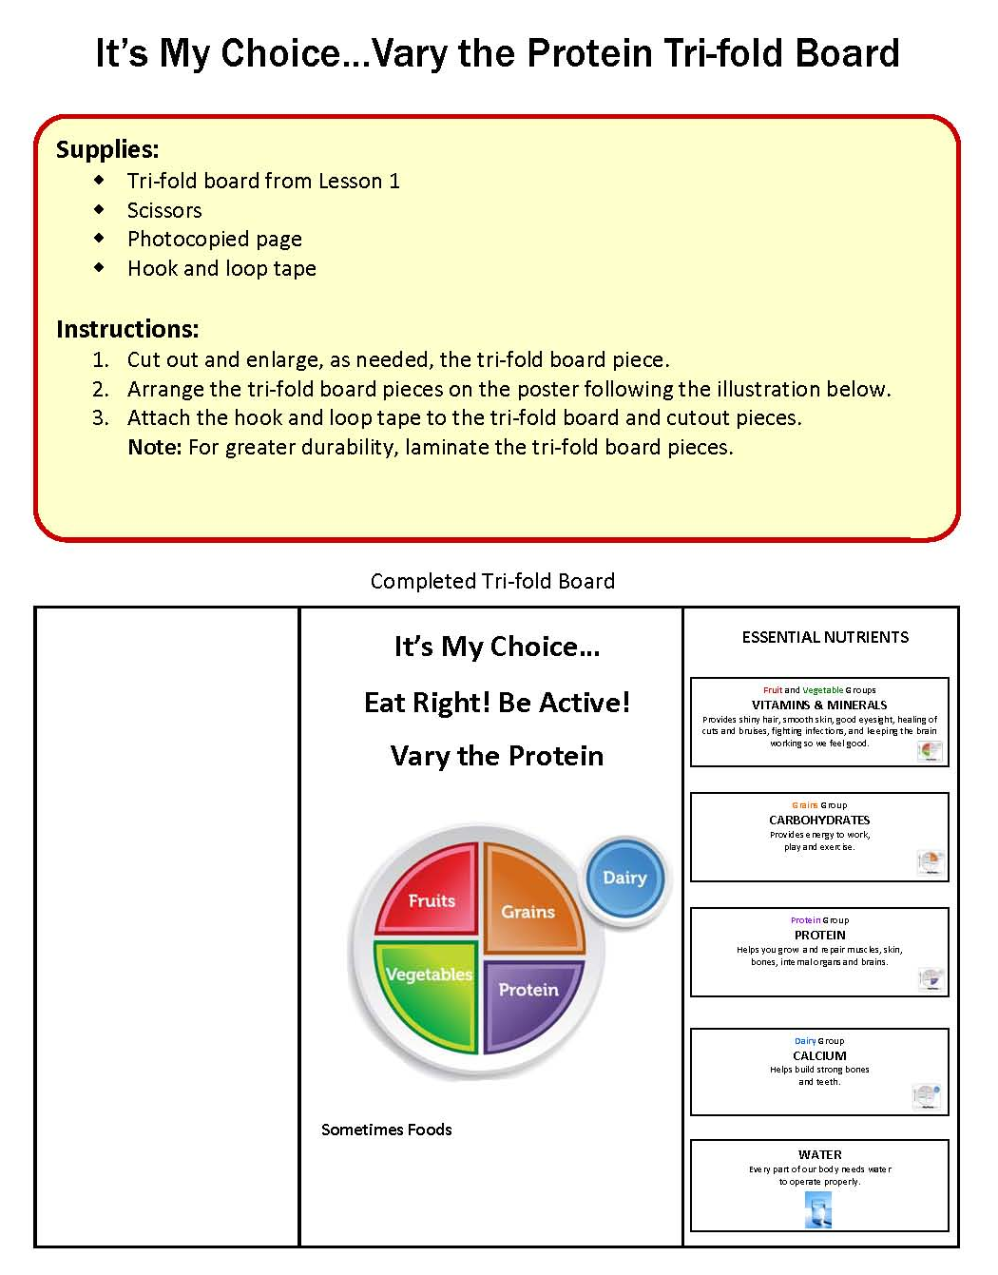
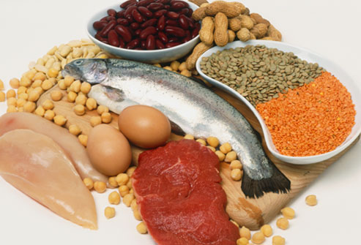
IT’S MY CHOICE…EAT RIGHT! BE ACTIVE – Lesson 4
Activity 2
Making Healthy Choices
from the Protein Group
Students learn that proteins are the building blocks of the body…helping it grow strong muscles, cartilage, skin, blood, and healthy brains.

Slide 41
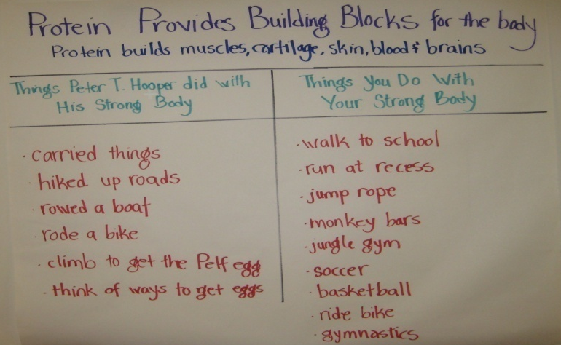
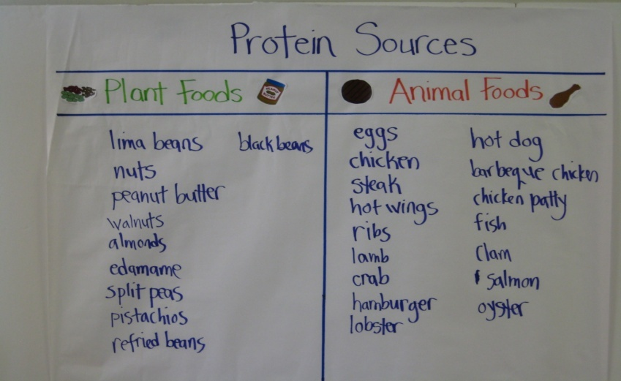
IT’S MY CHOICE…EAT RIGHT! BE ACTIVE – Lesson 4
Activity 2
Making Healthy Choices from the Protein Group
An Eggsperiment.
The Protein Group on MyPlate.
Protein Provides Building Blocks for the Body.
Animal and Plant Sources of Protein.
Vary Your Protein.
Review and Reflect.
Photo of completed Protein Provides Building Blocks for the Body chart.
Photo of completed Protein Foods chart.
Photo of completed Protein Foods chart.

Slide 42
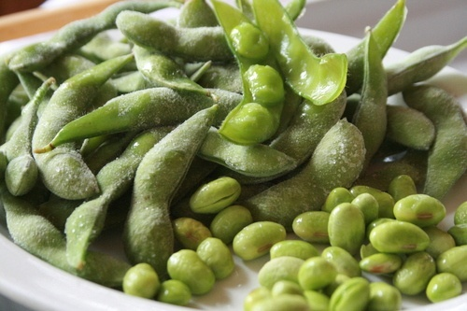
IT’S MY CHOICE…EAT RIGHT! BE ACTIVE – Lesson 4
Our Amazing Classroom
Enhancing the Learning
Write a healthy classroom snack policy.
Open the classroom windows.
Lead students in muscle strengthening activities.
Cook in the classroom.
Invite a guest speaker to talk about how they make healthy choices about eating and exercise.
Read More…Information Book
Black Beans and Lamb, Poached Eggs and Ham by Brian P. Cleary and illustrated by Martin Juneau
Classroom Tasting
Edamame…Is a fun word to say and is another name for the immature green soybean. They are an excellent source of fiber; one serving providing as much fiber as four slices of whole wheat bread.

Slide 43
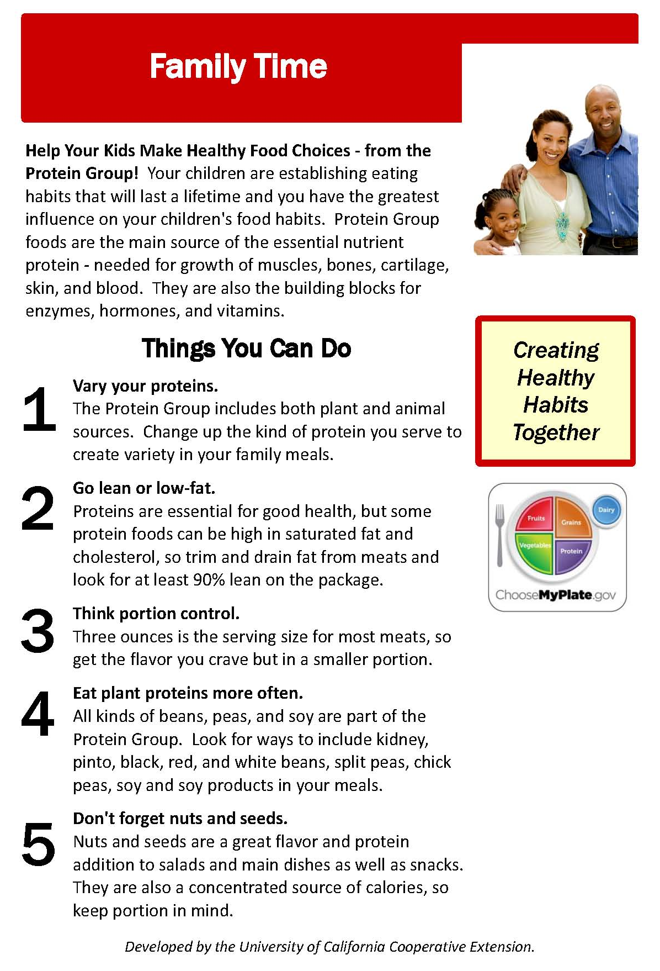
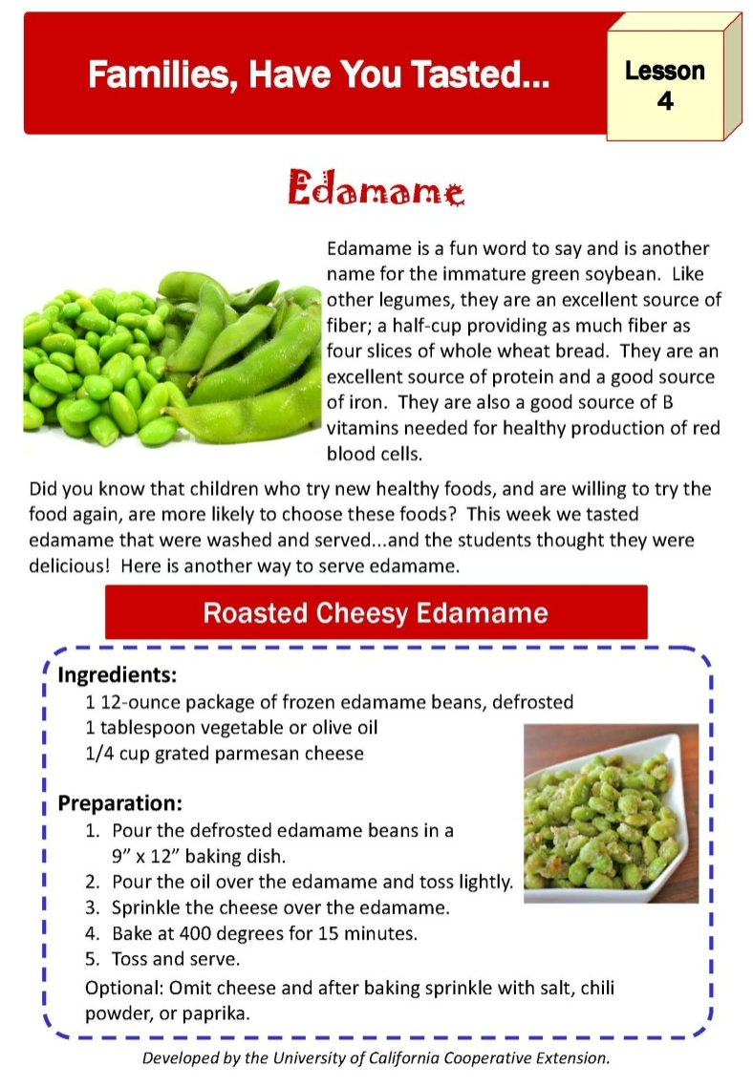
IT’S MY CHOICE…EAT RIGHT! BE ACTIVE – Lesson 4

Slide 44

IT’S MY CHOICE…
HEALHTY BEVERAGES!
Lesson
5
It’s My Choice…Choosing Healthy Beverages!
Students develop criteria to make healthy beverage choices.
Objectives:
Describe healthy beverages as ones that come from one of the food groups on MyPlate.
Identify water as an essential nutrient that should be consumed throughout the day.
Describe low-fat milk as a healthy beverage and calcium as the key nutrient of the Dairy Group.
Describe healthy alternatives to high sugar beverages including sodas, sports, and other sugary drinks.
Alicia’s Fruity Drinks
by Lupe Ruiz-Flores
and illustrated by Laura Lacomara

Slide 45
IT’S MY CHOICE…EAT RIGHT! BE ACTIVE – Lesson 5
Choosing Healthy Beverages
The Issue
Healthy beverages are an important part of children's diets. Healthy beverages can help children consume all the vitamins, minerals, and other nutrients needed for a balanced diet. Unfortunately, many of the beverages consumed by children at meals and throughout the day are high in sugar and fat and lack other essential nutrients.
  Over 40% of the added sugars consumed by children come from beverages.
  22% of the empty calories children consume are from beverages.
  One study has shown that children consuming just one 8 ounce sugary drink a day can increase their odds of becoming obese by 60%.
Healthy Beverage Choices
In addition to water, healthy beverages should come from one of the five food groups of MyPlate and be:
  Low in fat, especially trans and saturated fats
  Low in added sugar
  Low in calories
  High in vitamins, minerals, or fiber
  High in calcium or protein

Slide 46
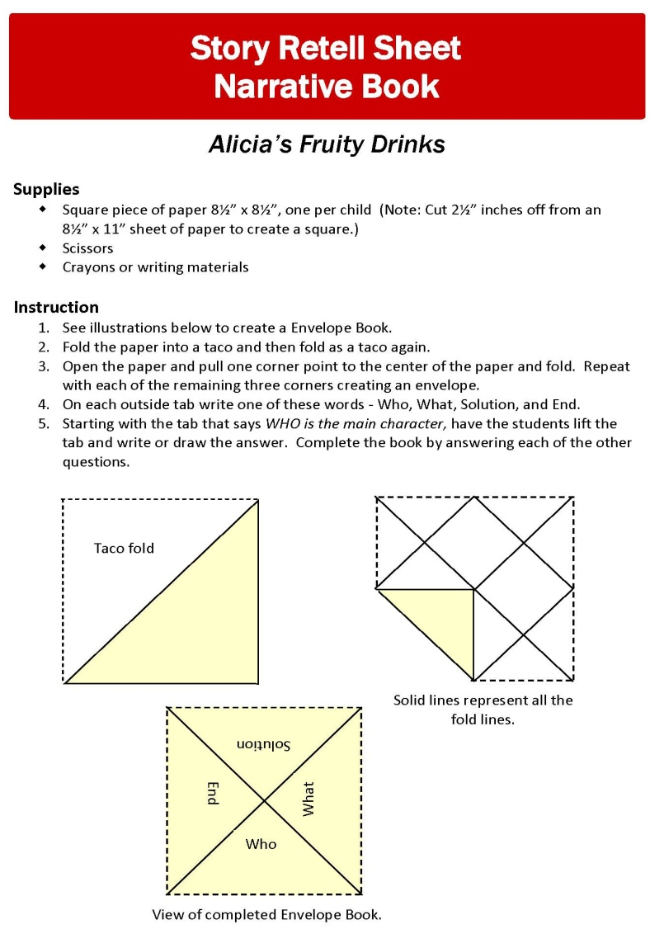

IT’S MY CHOICE…EAT RIGHT! BE ACTIVE – Lesson 5
Activity 1 Book Reading
Alicia’s Fruity Drinks
AFTER THE READING help the students “retell the story” by completing the Story Retell or Fact Sheet.

Slide 47
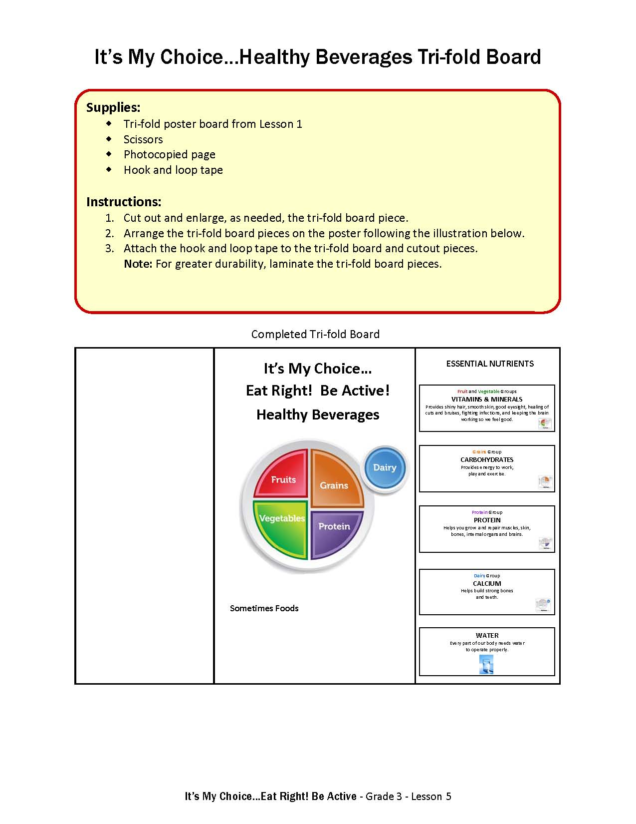

IT’S MY CHOICE…EAT RIGHT! BE ACTIVE – Lesson 5
Activity 2
Making Healthy Beverage Choices
Students review the four prior lessons and apply what they learned to making healthy beverage choices.

Slide 48
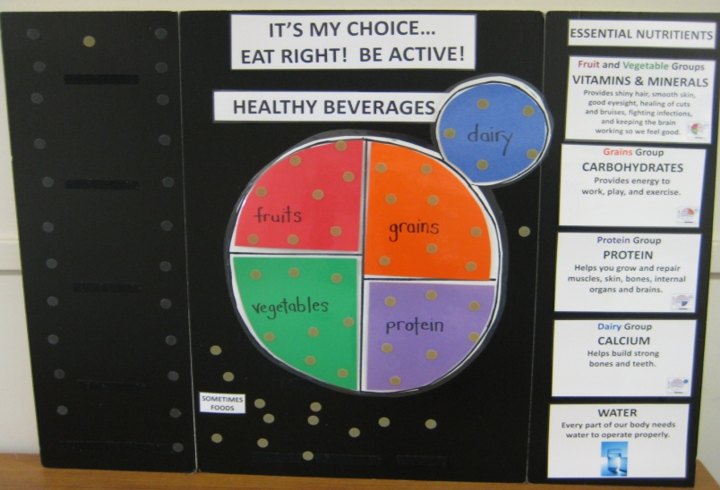
IT’S MY CHOICE…EAT RIGHT! BE ACTIVE – Lesson 5
Activity 2
Making Healthy Beverage Choices
Review MyPlate and the Essential Nutrients.
Introduction to Beverages.
Review Our Need for Water.
Healthy Guide for Making Beverage Choices.
Thumbs Up for Healthy Beverage Choices.
Review and Reflect.
Photo of tri-fold board completed from Lesson 1.

Slide 49
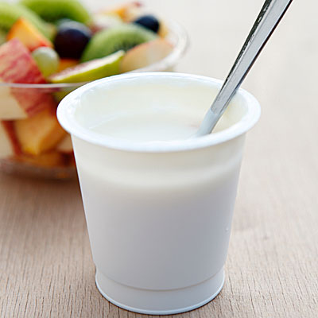
IT’S MY CHOICE…EAT RIGHT! BE ACTIVE – Lesson 5
Our Amazing Classroom
Enhancing the Learning
Set up a water station in the classroom.
Keep yourself healthy.
Hold a school health fair.
Lead students in bone building activities.
Send home messages on healthy eating and exercise.
Read More…Information Book
Drinking Water by Mari C. Schuh
Classroom Tasting
Yogurt…A fermented milk product, is an outstanding source of calcium and protein and is a good source of other vitamins and minerals.

Slide 50
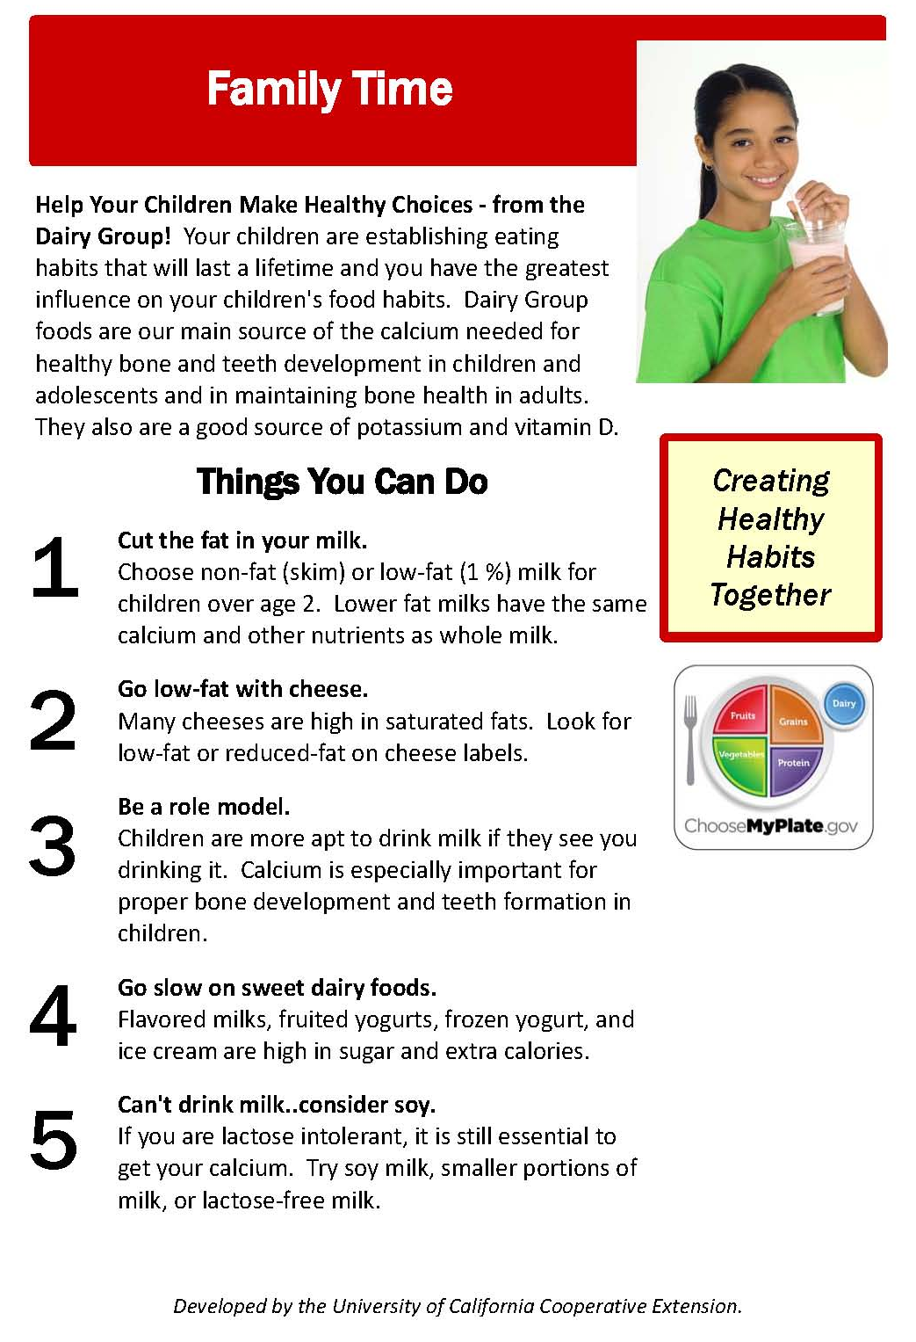
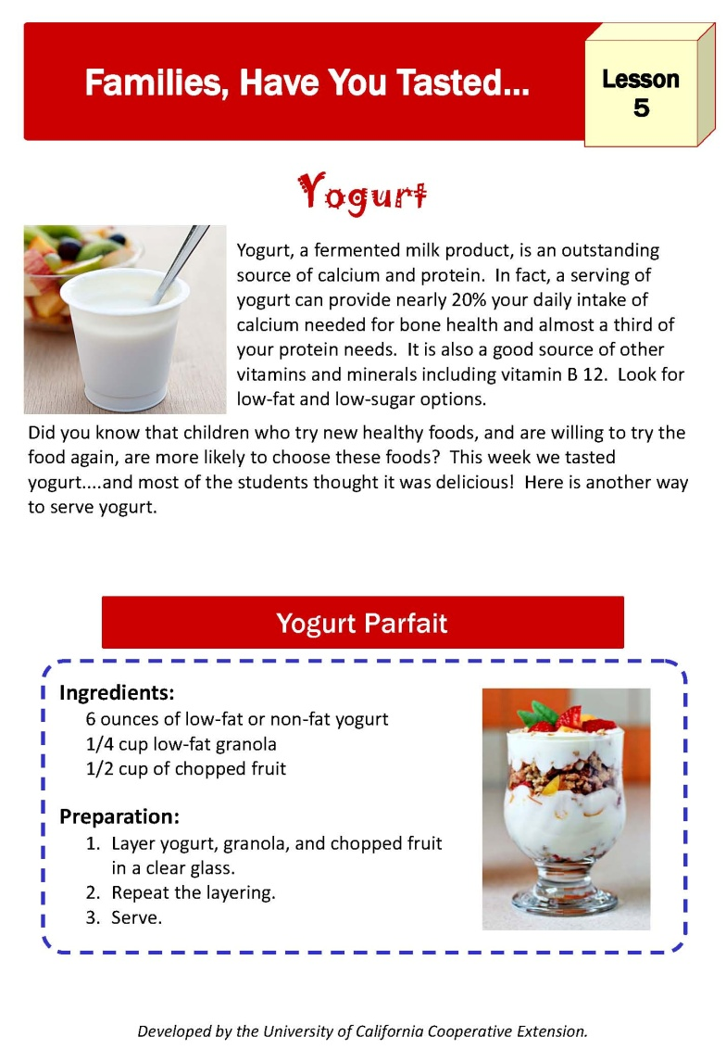
IT’S MY CHOICE…EAT RIGHT! BE ACTIVE – Lesson 5

Slide 51


IT’S MY CHOICE…EAT RIGHT! BE ACTIVE!
Credits
Developer:
Sharon K. Junge, University of California Cooperative Extension, Emeritus
Contributor:
Rosemary Carter, University of California Cooperative Extension,
Placer/Nevada Counties
Translation:
Myriam Grajales-Hall, ANR News and Outreach in Spanish
Pilot Testing:
Rosemary Carter, University of California Cooperative Extension,
Placer/Nevada Counties
Layout and Design:
Annette Cosgrove, University of California Cooperative Extension,
Placer/Nevada Counties
©2014 by the Regents of the University of California. All rights reserved. Permission is granted to reproduce the handouts and home activities for workshop sessions. No other part of this publication may be reproduced in whole or in part, or stored in a retrival system or transmitted in any form or by any means, electronic, mechanical, photocopying, recording, or otherwise, without written permission of the author.

