Slide 1
Edible Landscaping
Harvest and Storage
Pam Geisel
UC Cooperative Extension
pgeisel@ucanr.edu

Slide 2
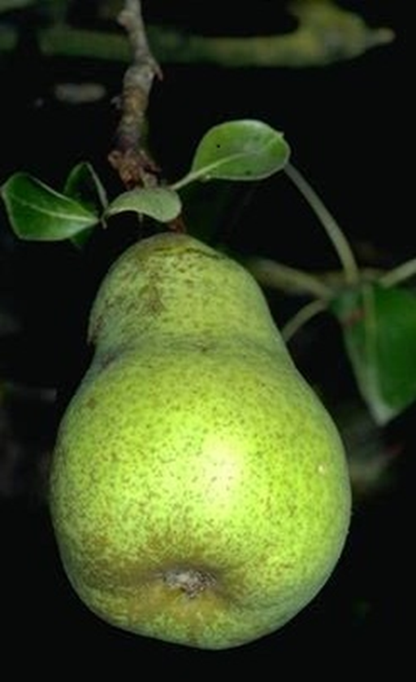
Why Pay Attention to Harvest?
Resources go into producing a crop
Allows harvest to suit personal ripeness and preferences
Plan to be available to process harvest
Notes:
A lot of effort goes into growing a crop. We plant, water, fertilize, and manage pests but often times, at the critical stage of harvest there is a lot of loss due to incorrect timing of the harvest (i.e. waiting too long), or just not doing it and then the fruit or vegetables bolt or rot. Each crop has an optimum period and method for harvest but it can vary depending upon your personal preferences, physiological characteristics of the produce and how you plan to use. However, most crops can be ripened over a range of maturities. I prefer my fruit to be firm ripe not soft ripe but others may prefer the delectible juiciness of a very ripe peach. Other factors may come into play such as size of the seeds inside the fruit. Eggplant for example, is best harvested when fully developed but before the seeds in the fruit start to enlarge. They may look similar on the outside but the larger seeds can cause some off flavors in foods. In addition, planning for harvest in terms of your planned time away is important. You can schedule your vacations at the right time so you can be home when the bulk of the fruit matures. Finally, most fruits don’t need to be picked and processed all at one time which is great for people who don’t want to spend all weekend processing peaches…

Slide 3
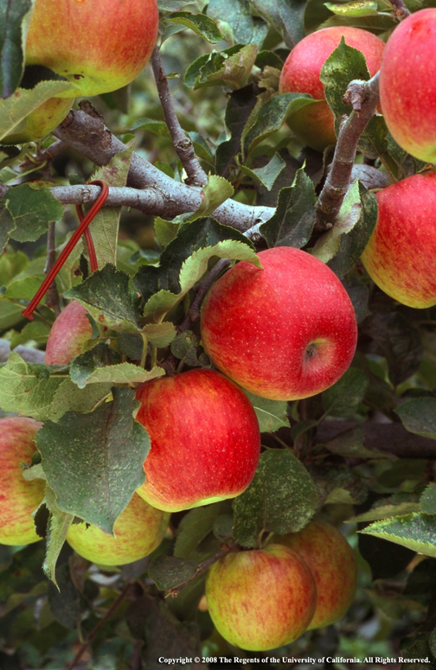
General Rules of Harvest
Each crop has an optimum harvest period and method.
Varies based on:
Individual taste preferences
Physiological characteristics of the fruit
Planned use of the crop
Notes:
Each crop has an optimum period and method for harvest but it can vary depending upon your personal preferences, physiological characteristics of the produce and the use.
Some species are harvested when fully ripe and ready to eat while others are harvested when they are physiologically mature, but that they continue to ripen after harvest. Many of the berries, for example, as the fruit matures, while the sugar content may remain the same once they reach maturity, the acidity does go down which may cause the fruit to taste sweeter., blackberries, cherries, grapes, citrus, raspberries and strawberries-which do tend to taste better when they are on the more mature side. There are several stages of ripening and I would like to discuss each of them.

Slide 4
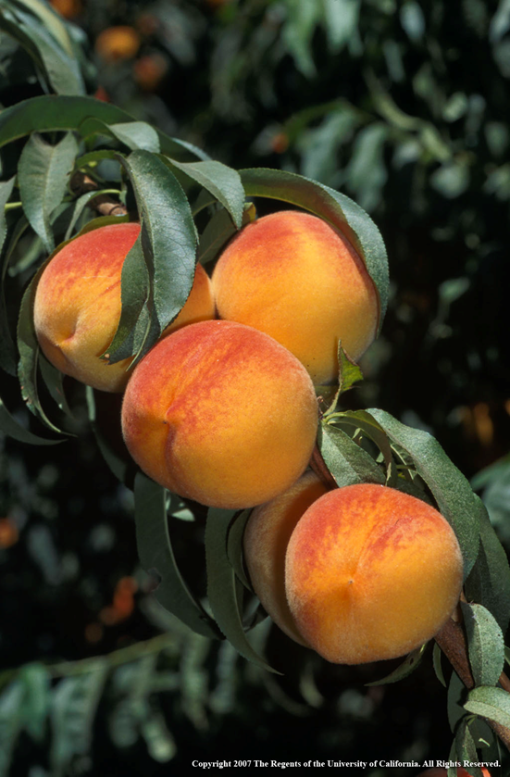
Stages of Ripening
Fully Ripe-Tree Ripe
Full maturity and ready to eat at harvest.
Best for fresh eating, drying
Firm ripe is better for canning and freezing
Notes:
The first is the Fully tree ripe fruit. These fruits are ready to eat right off the tree. Fruit of this maturity is best for fresh eating and drying. For me, this is almost too ripe (for my taste preference). I prefer what is called “Firm Ripe” which means that the sugars have already developed in the fruit but the fruit has not yet started to soften, perhaps change color and increase in juiciness.

Slide 5
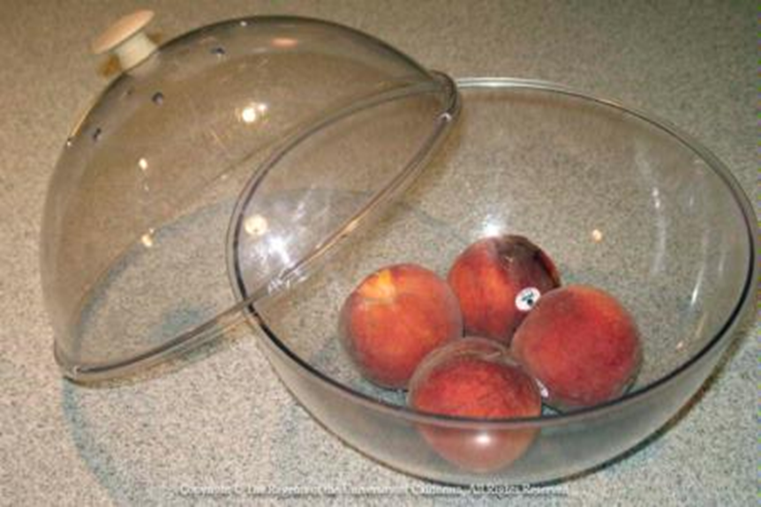
Stages of Ripening
Physiologically Mature
Fruit may or may not continue to ripen after harvest
Notes:
These are mature fruits but not really ready to eat. Some will continue to ripen after harvest and others will not but will soften….
May change color, texture and juiciness but will not improve in sweetness or flavor….peaches, pears, mango, plum,…

Slide 6
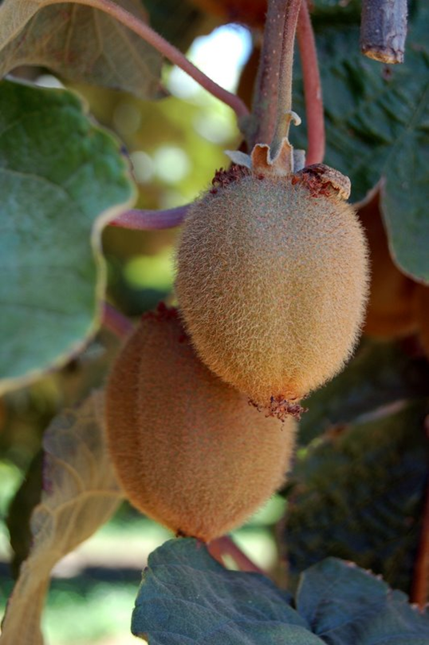
Physiologically Mature
Species that increase in sugar after ripening due to conversion of starches to sugar after harvest:
European pears
Cherimoyas
Kiwifruit
Mangos
Papayas
Notes:
3. Some do increase in sugar and sweetness after harvest. In many cases, exposing to cold storage (except for tropical fruit) helps to improve the ripening process.

Slide 7
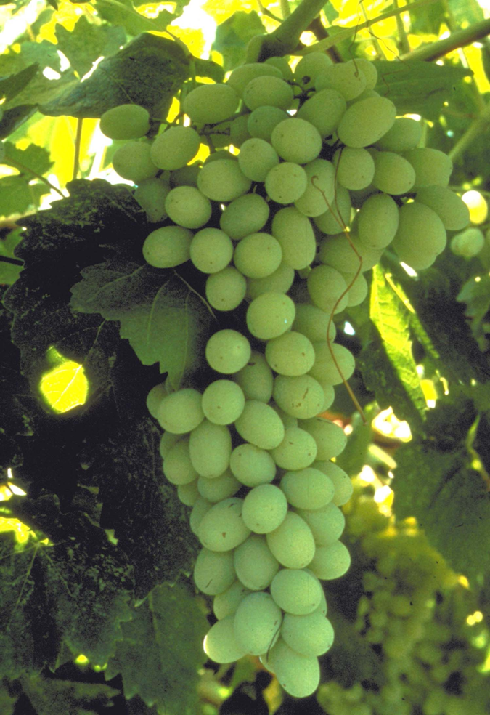
Physiologically Mature
Species that do not increase in sugar but seem to get sweeter due to decrease in acidity in the fruit:
Blackberries
Cherries
Grapes
Citrus
Raspberries
Strawberries
Notes:
Those that do not ripen further after harvest (the sugar they have is all they will ever have) berries) but do decrease in acidity which makes them taste sweeter

Slide 8
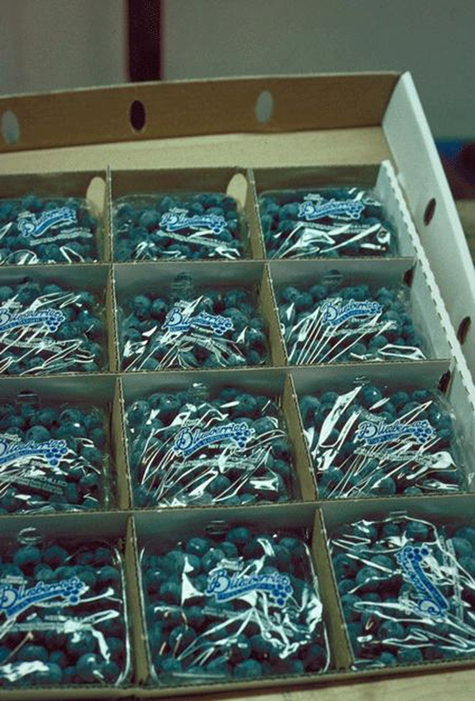
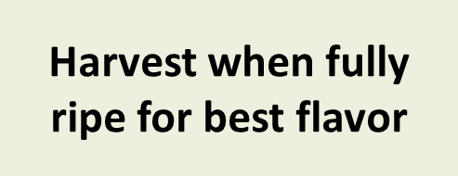
Mature with Full Sweetness
Species that may change in texture, color or juiciness but will not improve in sweetness of flavor:
Apricot
Blueberry
Fig
Nectarine
Peach
Plum

Slide 9
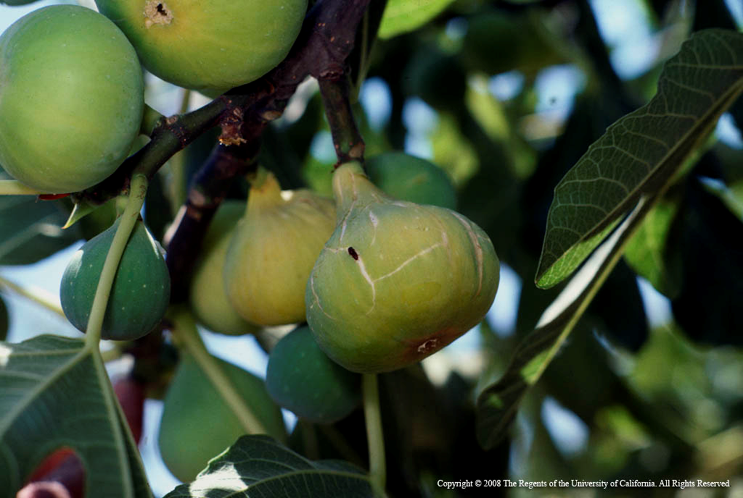
Waiting Too Long to Harvest Leads to Problems
Notes:
In all cases, waiting too long to harvest will render the fruit overripe, perhaps over tough and susceptible to birds, dried fruit beetles, fruit flies (spotted wing drosophila) and beetles or rot. Over ripe fruit does not store well.

Slide 10
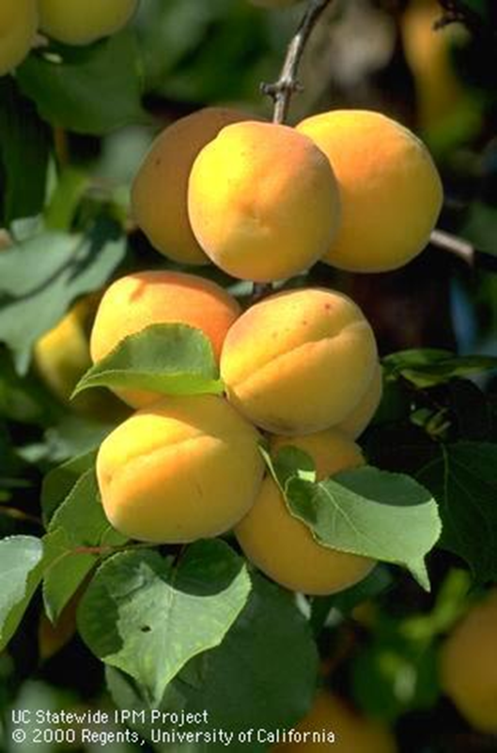
Harvest Over Time
Some crops can be harvested over a period of weeks.
Allows processing of smaller quantities
Harvest at the peak of ripeness
Reduces pest problems by promptly removing ripe fruit
Notes:
You may have to harvest every 3-5 days in order to get all of the fruit right when it is ready. While more time-consuming than one-time harvesting, this extended harvest period allows you to process a smaller quantity of fruit at one time instead of processing the whole try all at once.

Slide 11
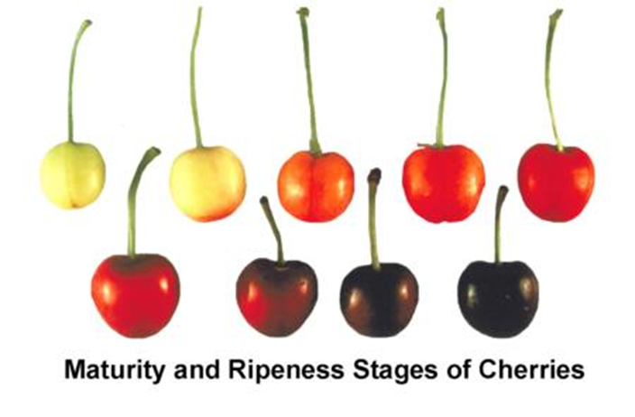
Optimum Harvest/ http://postharvest.ucdavis.edu/producefacts
Based on taste
Color of fruit (change of skin or skin ground color)
Soluble solids content/acidity ratio
Firmness
Size-(vegetables)
Free from defects
Notes:
http://postharvest.ucdavis.edu/producefacts/#fruitsmelons--fact sheets on maturity indices

Slide 12
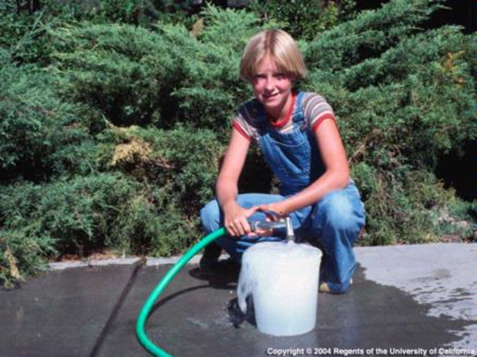
Sanitation and Harvest
Use only clean, sanitized buckets and bins
Wash hands prior to harvest
Wear clean cotton gloves to reduce contaminants on fruit
Do not stack bins/buckets
Notes:
Avoid stacking bins and buckets on top of each other to avoid introducing contaminants from the bottoms of the containers.

Slide 13
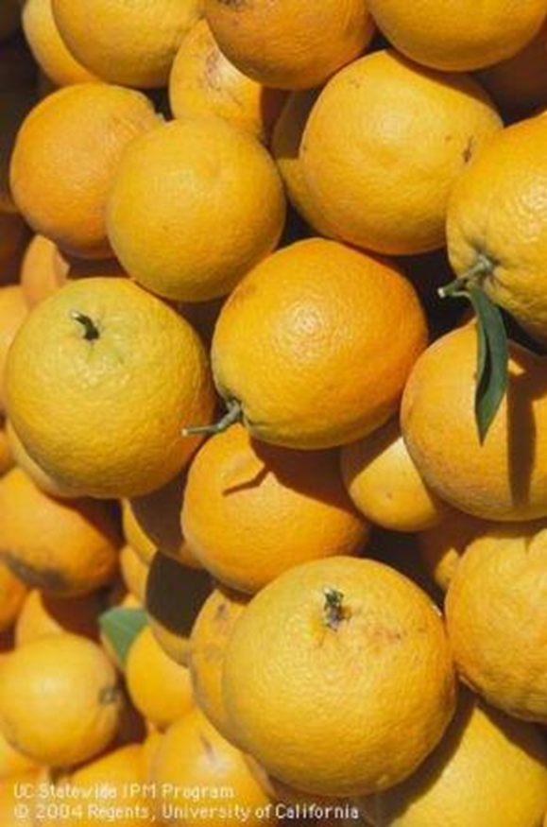
Harvest Gently
Avoid bruising and cutting
Wear clean cotton gloves to reduce damage to fruit
Place gently into buckets/bins
Preserve fruit spurs
Notes:
For county regulations contact County Department of Environmental Health.

Slide 14
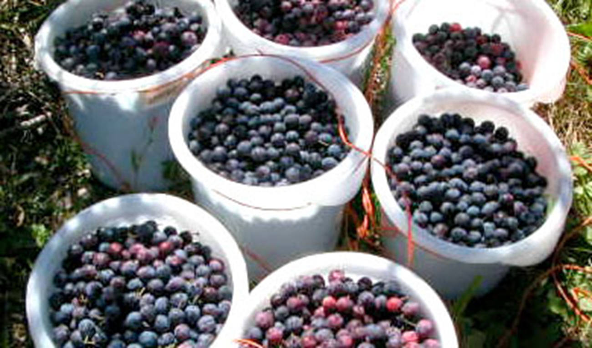
Harvest Gently
Avoid stacking fruit too high in buckets or bins. Photo courtesy of Cornell University

Slide 15
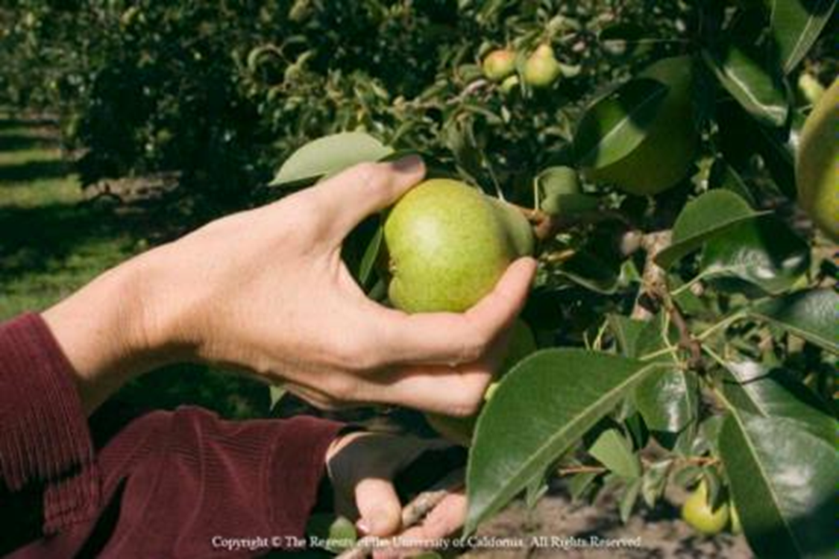
Twist Up!
Notes:
Most fruit such as peaches, nectarines, plums, cherries, apricots, pears and apples are harvest by gently twisting and pulling up on the fruit. Avoid damaging the fruit spurs. If the fruit resists separating from the spur, it is likely not quite ready to harvest.

Slide 16
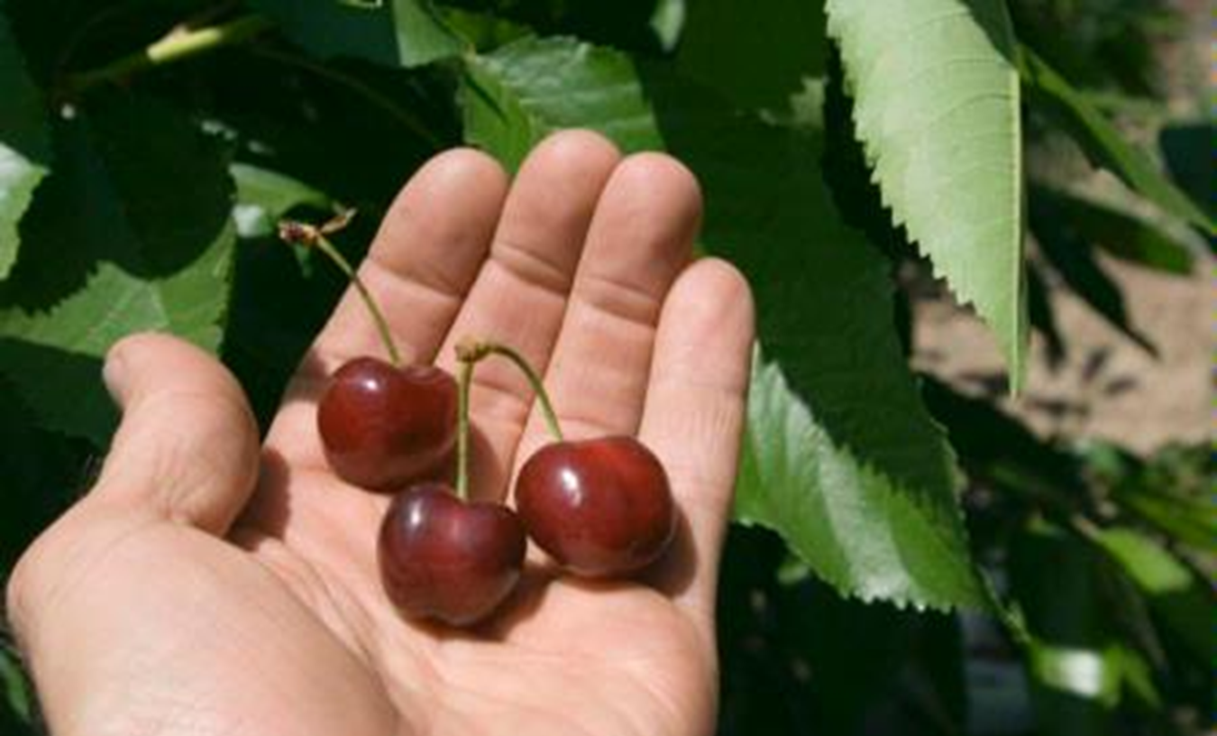
Twist Up!
Some fruits store best with stems attached.
Notes:
Grab stems and twist upward. Be careful not to break the fruit spur. If you are using the fruit for canning or further processing, you can harvest without the stems, which is much faster.

Slide 17
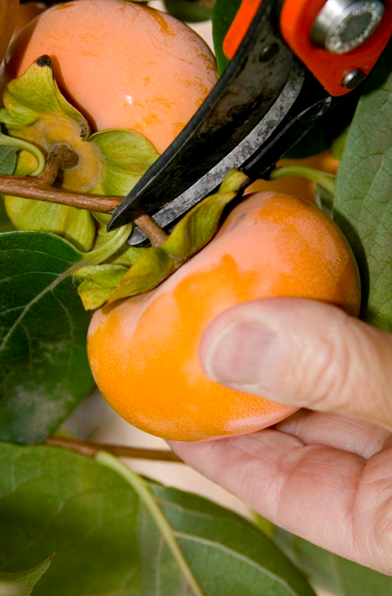
Clipping
Fruits such as persimmon, pomegranate, quince and grapes require clipping.
Avoid damaging the skin of the fruit by layering newspaper between fruit layers.

Slide 18
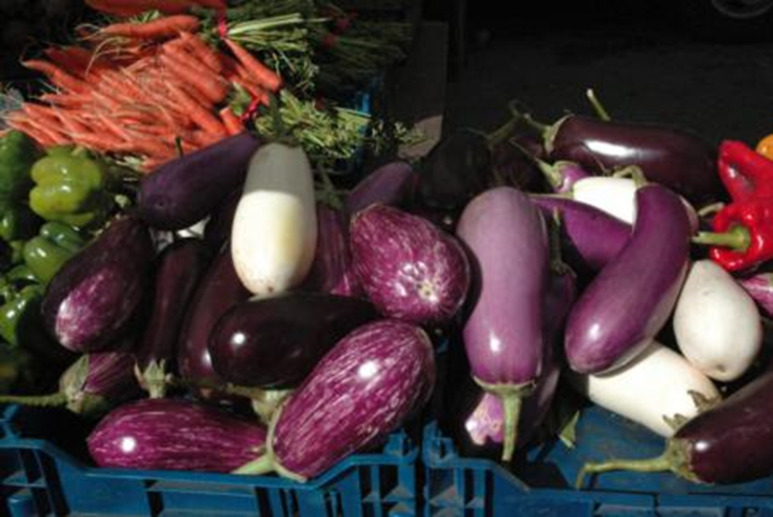
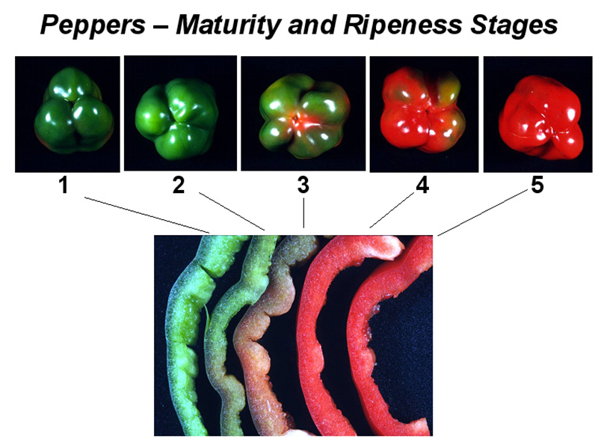
Clipping
Peppers and eggplants can be harvested by clipping.

Slide 19
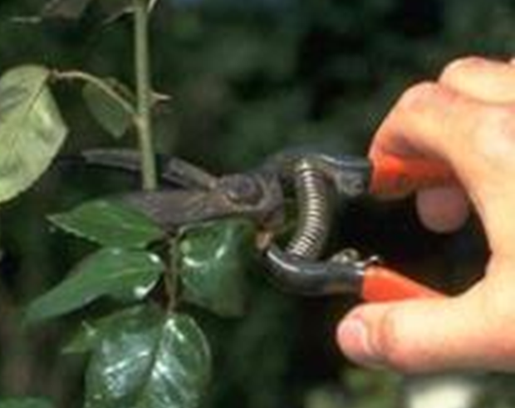
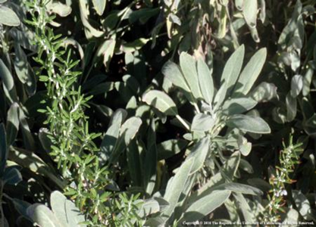
Harvesting Leafy Herbs and Veggies
Clip using clean kitchen shears or sanitized clippers
Sanitize clippers with product such as Lysol (least corrosive)
Lubricate clippers after use to avoid corrosion.
Notes:
http://www.puyallup.wsu.edu/~linda%20chalker-scott/FactSheets/Pruning.pdf
http://baker.ifas.ufl.edu/Horticulture/documents/DisinfectingPruningTools.pdf
Available Disinfecting Products*
Household bleach (ex: Clorox): 25% solution (1 part bleach + 3 parts water)
Pine oil cleaner (ex. Pine-Sol): 25% solution (1 part cleaner + 3 parts water)
Rubbing alcohol (70% isopropyl): 50% solution (1 part alcohol + 1 part water)
Denatured ethanol (95%): 50% solution (1 part alcohol + 1 part water)
Trisodium phosphate (Na3PO4): 10% solution (1 part Na3PO4 + 9 parts water)
Quaternary ammonium salts: use as directed on product label
Household Disinfectants (Lysol, etc): full strength

Slide 20
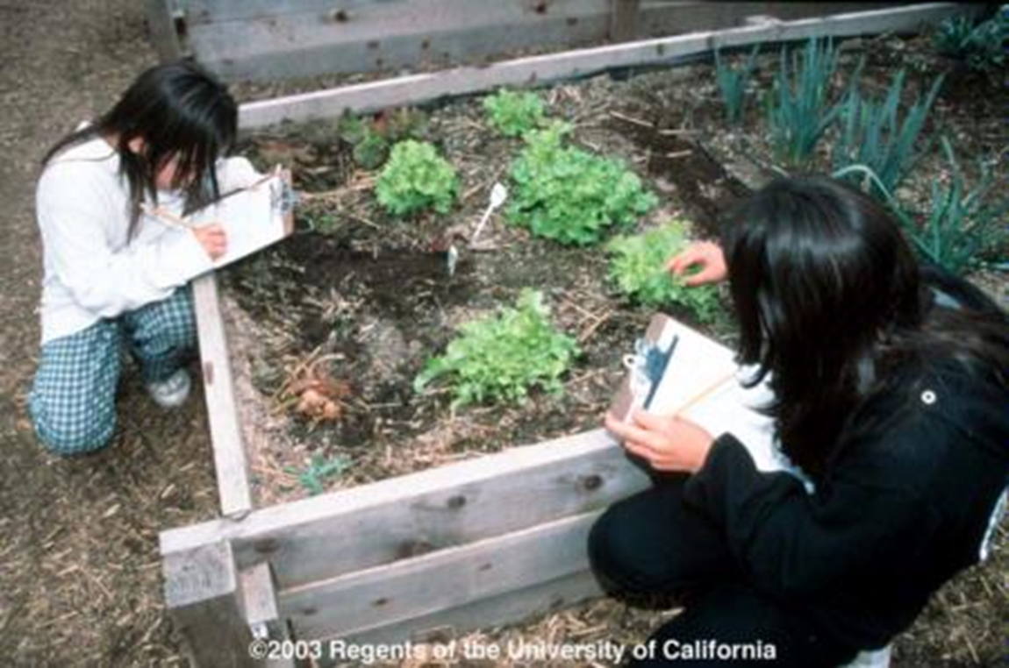
Sustained Harvest
Sustain harvest of leafy crops by harvesting outside leaves frequently.
Notes:
The same criterion for harvest of fruit often also applies to vegetables. Exceptions to this include leafy vegetables and cole crops. Leafy veggies and cole crops should be harvested with the head is fully developed but still firm and before the plants begin to flower. Size and bud maturity are the best indicators of harvest period. However, with some leafy crops such as lettuce, spinach, chard, kale etc. can be harvested over a sustained period of time by just removing the outside leaves. Others can be cut and then they grow back again for successive harvests.

Slide 21
Proper Storage Short Term and Long Term
One large tree may produce several hundred pounds of fruit…...
Do you have time to process by canning, jamming, freezing or drying?
Do you have adequate freezer space?
Do you have a food dryer or places to sun dry?
Do you have space in the refrigerator to store fruit until ready to process?

Slide 22
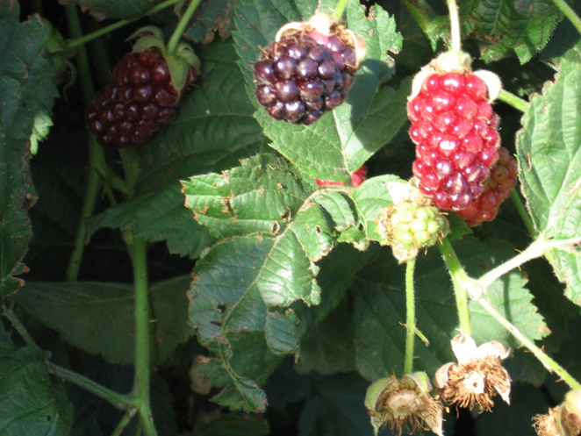
Key Storage Requirements
Depends on Product:
Most ripe fruit (apples, stone fruits, fig and berries)
Harvest in a.m.
Place in refrigerator at 32-35F ASAP
Get fruit cold after harvest and keep cold until use
Notes:
When it comes to tree fruit, temperature is the most crucial facto that determines how fast fruit will derad in storage. For every 18F above the fruits optimum temp, the rate of deterioriation increases two to three times. (deciduous fruits are not as sensitive to chilling injury). However, for ripening, the optimum temperature is 77F

Slide 23
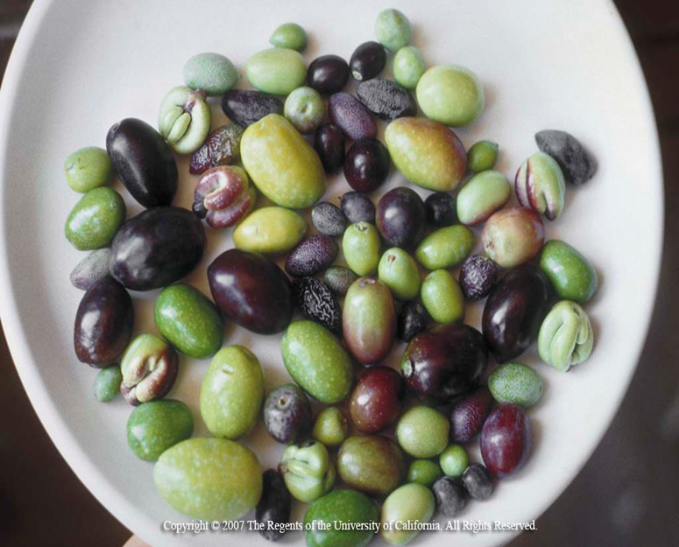
Key Storage Requirements
Tropical fruit (olive, citrus, cherimoya, mango, papaya, avocado)
Store on counter until ripe at temperatures between 68-77F
For cold storage, store between 50-59F
Notes:
Tropical fruits are prone to chilling injury so they are best stored bwetween 50-59F. Optimum ripening occurs from 68-77F

Slide 24
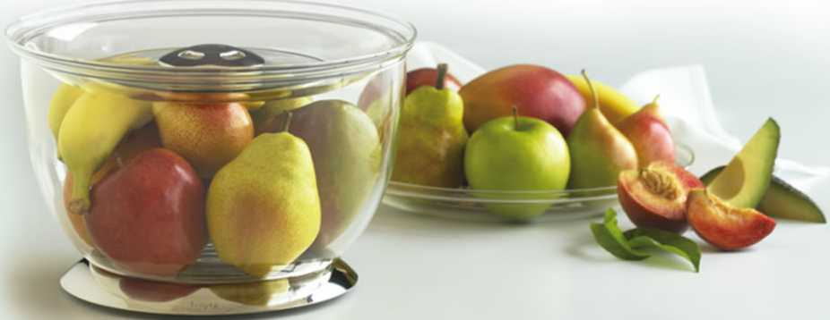
Key Storage Requirements
Fruit that must ripen further (stone fruits, pears, kiwi, avocado)
Countertop
Then cool storage
Notes:
7.5C=44.5F
20=68F

Slide 25
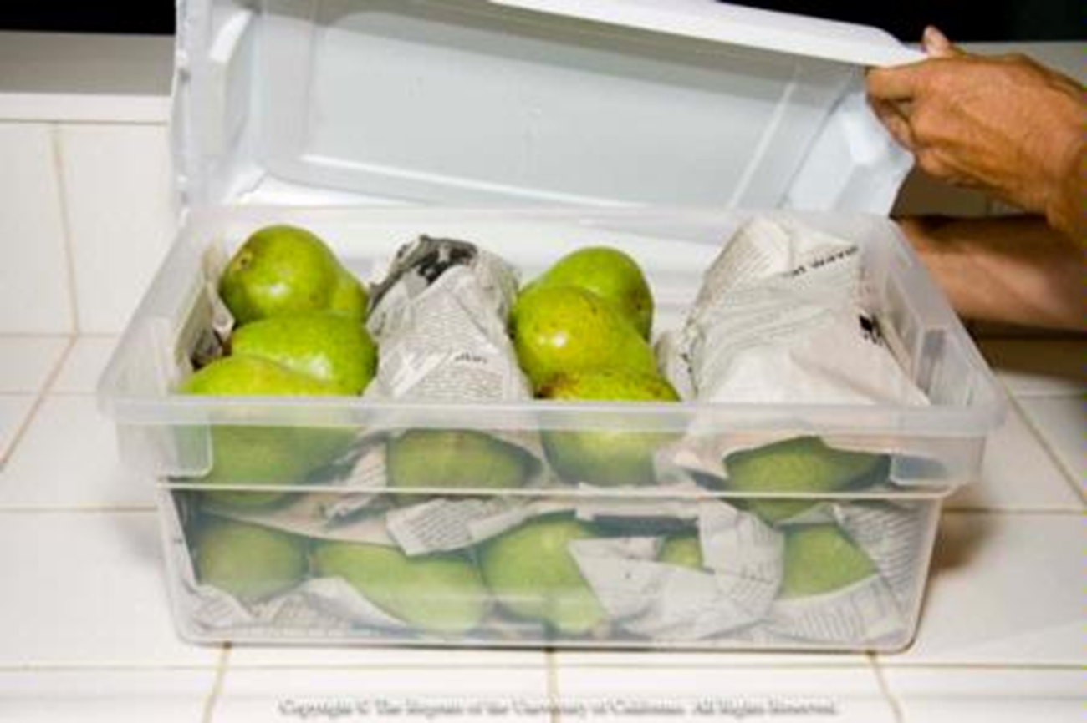
Key Storage Requirements
Storing harvested fruit in layers of paper for countertop ripening and refrigeration.
Notes:
Layering with paper helps to isolate decay and protect fruit from bruising

Slide 26
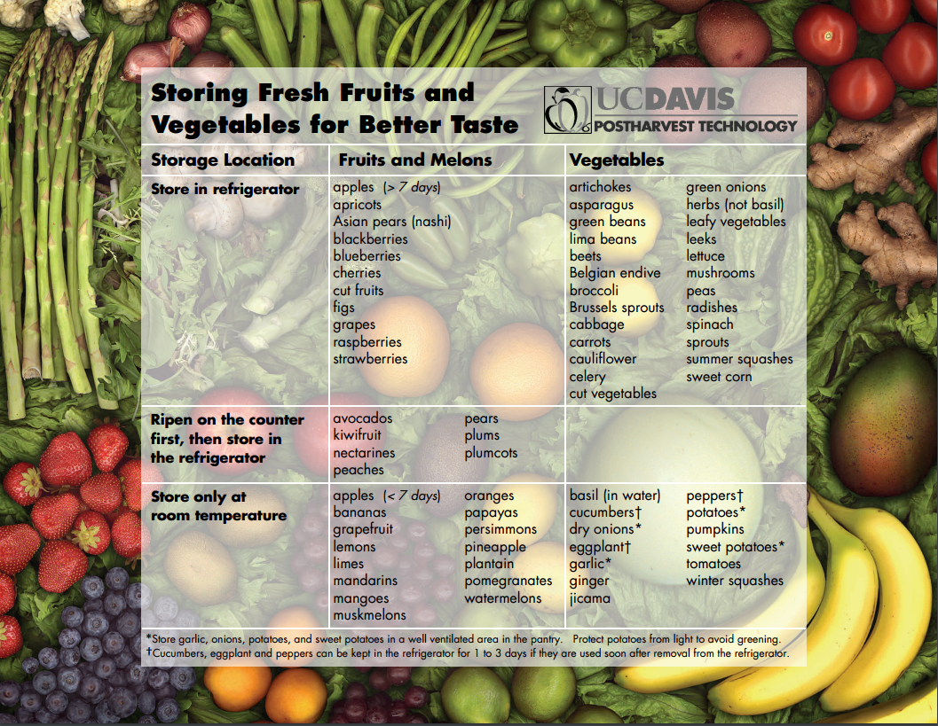
http://ucce.ucdavis.edu/files/datastore/234-1920.pdf
Notes:
This chart is a synopsis of how to store many types of fruits and vegetables. Page 37

Slide 27
Notes about Refrigeration
Plant on second refrigerator for fruit/vegetable harvest
Energy efficient model
Wide doors for loading/unloading
Uniform cold air distribution
Accurate temperature controls
Layer fruit in paper to avoid fruit to fruit disease transmission
Keep fruit away from walls with adequate air around each fruit.
Don’t put fruit in wet
Most can be maintained at only about 45F or somewhat lower. If possible, maintain at 35F for all temperature fruits and vegetables.
Notes:
Most home refrigerators will not be large enough to handle fruit harvest and the household food. A second refrigerator is a good alternative.

Slide 28
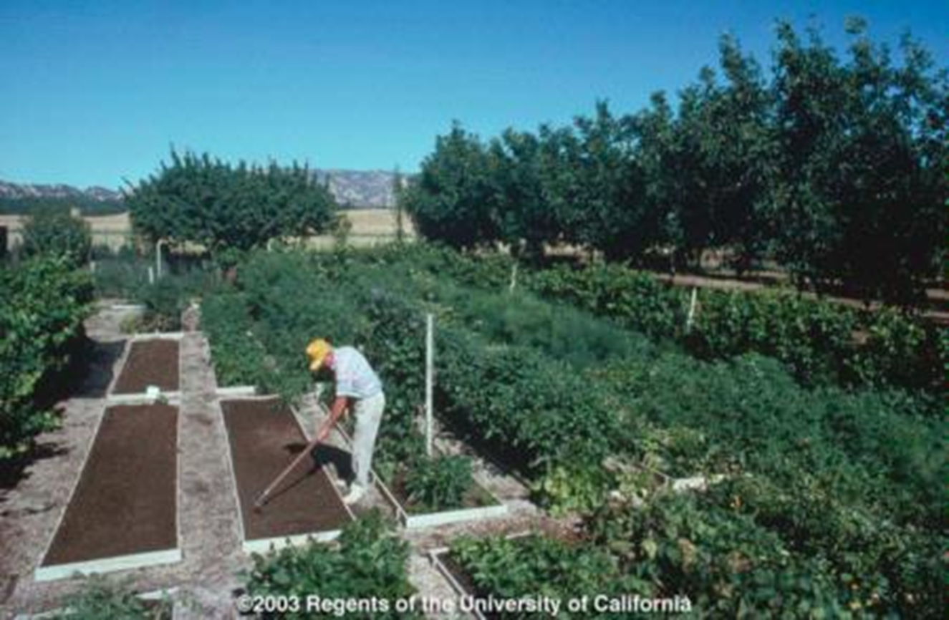
What about Storing Vegetables?
Notes:
The same criteria for harvest of fruit most often also applies to vegetables. IN all cases, you want to harvest at the peak of quality, store quickly and appropriately and then process as needed.

Slide 29
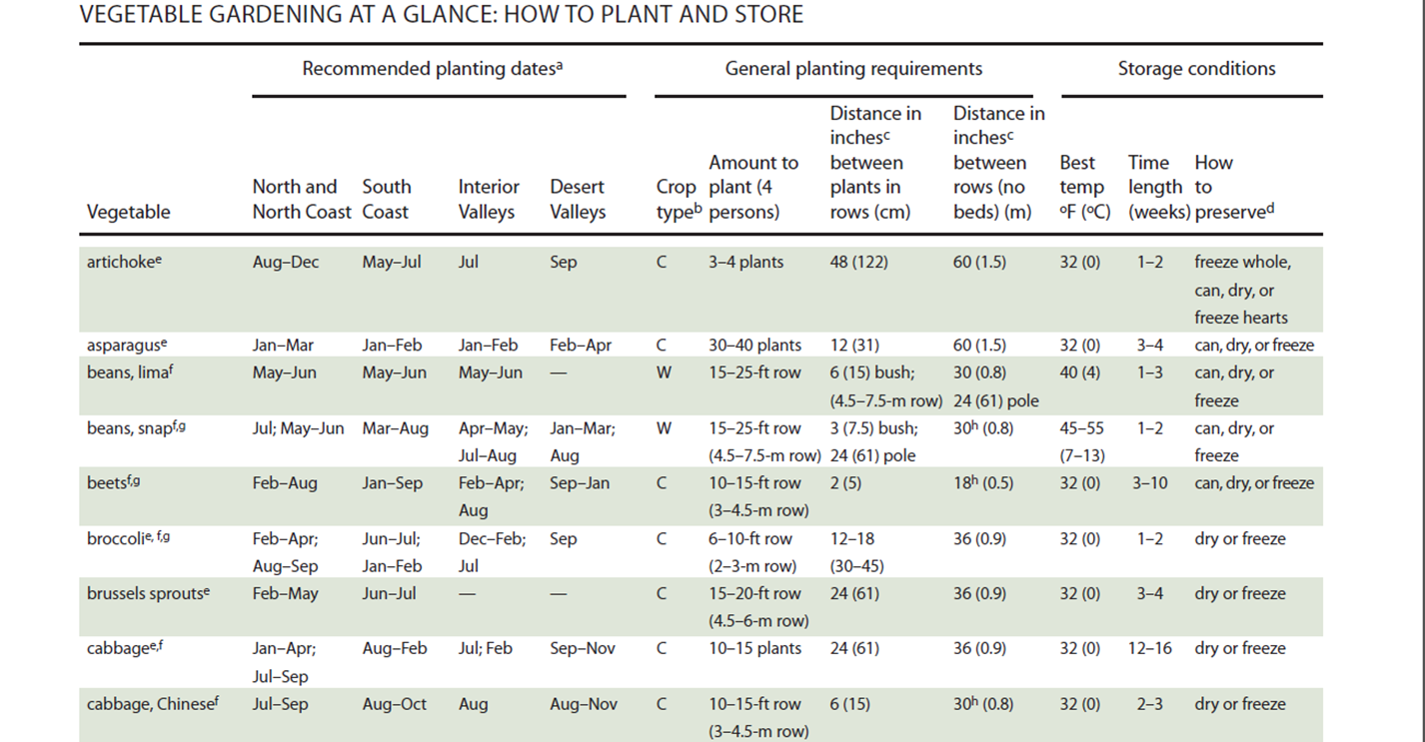

What about Storing Vegetables? http://ucanr.org/sites/gardenweb/files/29040.pdf
Notes:
This website has an excerpt from the Master Gardener Handbook, which can be a very useful guide for harvest and storage of vegetables. I have to say though, that I have never had dried broccoli or chinese cabbage…..Kale chips yes, but not dried beets either.

Slide 30
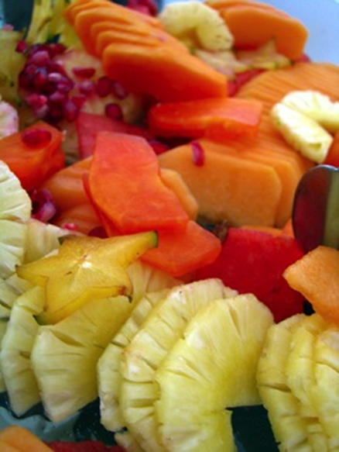
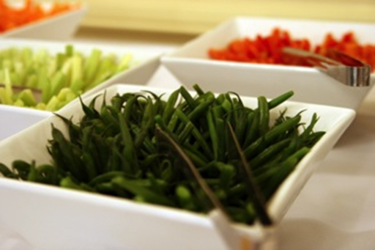
Food Storage and Preservation Cut Fruits and Vegetables
Cut produce should be consumed immediately or refrigerated within 2 hours (1 hour if >90°F)
Notes:
http://www.fda.gov/food/resourcesforyou/consumers/ucm114299

Slide 31
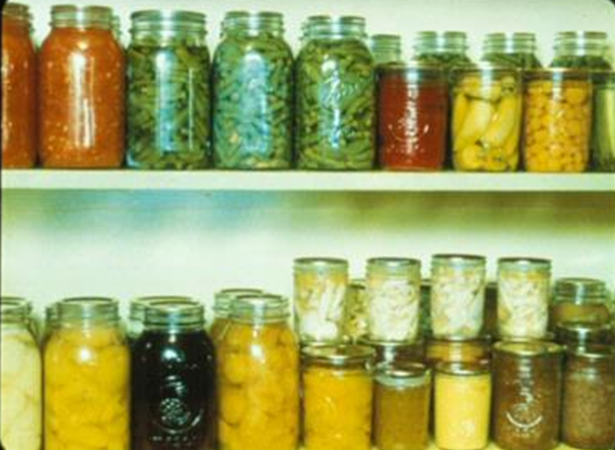
Long-Term Storage
Several methods of home preservation
Freezing
Drying
Fermentation
Pickling
Canning
Jams and Jellies
Notes:
Fruits and vegetables can be stored for long periods of time if frozen, dried, fermented, or canned. The UC Davis foodsafety website has brochures describing the post harvest handling on a variety of fruits and vegetables.
http://ucfoodsafety.ucdavis.edu/UC_Publications/UC_Home_Preservation_and_Storage_Publications/
Canning Safe Methods of Canning Vegetables (PDF 355 KB)
Fermentation http://nchfp.uga.edu/how/can6a_ferment.html

Slide 32
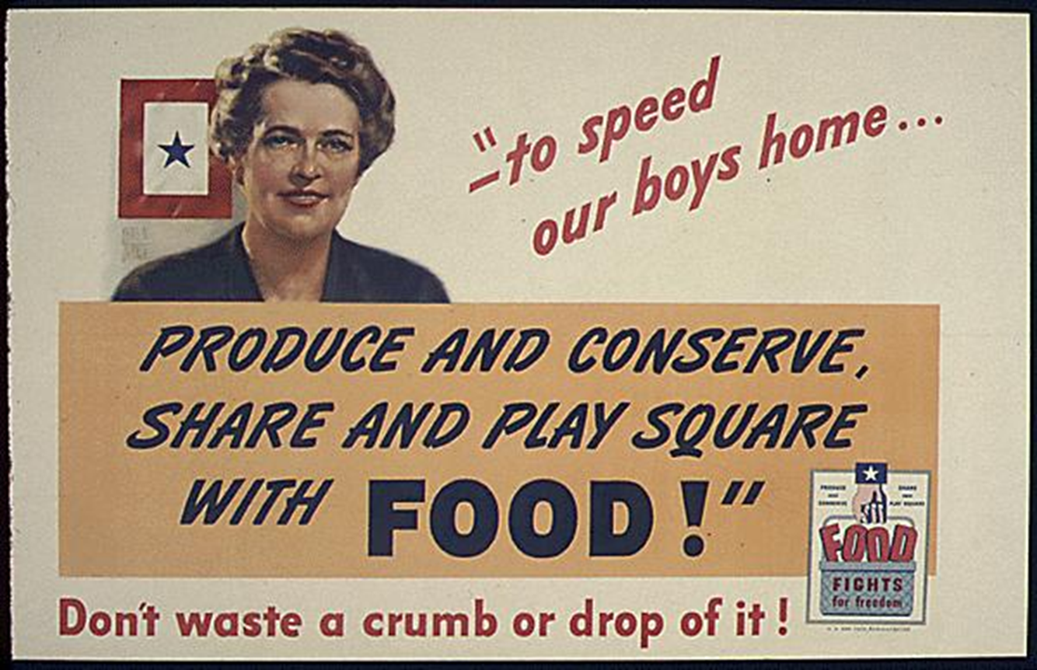

Slide 33
Thank you! Questions? Pam Geisel pgeisel@ucanr.edu

